Slide 1
Solving the Set Packing Problem via a Maximum Weighted Independent Set Heuristic
Ruizhi Li, Yupan Wang, Shuli Hu, Jianhua Jiang, Dantong Ouyang, Minghao Yin
Mathematical Problems in Engineering, Hindawi, Vol. 2020, 11 pages, December 2020.
Presenter：Yu-Cheng Chang
Date：April 13, 2021

Slide 2
Abstract
The set packing problem (SPP) is a significant NP-hard combinatorial optimization problem with extensive applications. In this paper, we encode the set packing problem as the maximum weighted independent set (MWIS) problem and solve the encoded problem with an efficient algorithm designed to the MWIS problem. We compare the independent set-based method with the state-of-the-art algorithms for the set packing problem on the 64 standard benchmark instances. The experimental results show that the independent set-based method is superior to the existing algorithms in terms of the quality of the solutions and running time obtained the solutions.

Slide 3
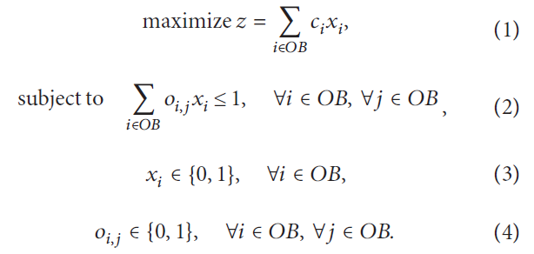
Set Packing Problem (SPP)
IS = {1, 2, 3, 4, 5, 6} Weights = {10, 8, 10, 12, 7, 9} O₁ = {1, 2} O₂ = {1, 4} O₃ = {2, 4, 6} O₄ = {3, 4, 5} SPP answer = {1, 3, 6} with maximum weight 29
Definition
M.R. Garey, D.S. Johnson, Computers and Intractability: A Guide to the Theory of NP-Completeness, V.H. Freeman and
Company, 1979.
Notes:
https://en.wikipedia.org/wiki/Computers_and_Intractability

Slide 4
Set Packing Problem (SPP) proved by Karp
Input
Output
Richard M. Karp. Reducibility Among Combinatorial Problems. Proceedings of a symposium on the Complexity of Computer Computations, held March 20-22, 1972, at the IBM Thomas J. Watson Research Center, Yorktown Heights, New York.
Notes:
https://zh.wikipedia.org/wiki/%E5%8D%A1%E6%99%AE%E7%9A%84%E4%BA%8C%E5%8D%81%E4%B8%80%E5%80%8BNP-%E5%AE%8C%E5%85%A8%E5%95%8F%E9%A1%8C

Slide 5
SPP to Maximum Weighted Independent Set (MWIS)
IS = {1, 2, 3, 4, 5, 6} Weights = {10, 8, 10, 12, 7, 9} O₁ = {1, 2} O₂ = {1, 4} O₃ = {2, 4, 6} O₄ = {3, 4, 5} ⸪ MWIS answer = {V₁, V₃, V₆} with maximum weight 29 ⸫ SPP answer = {1, 3, 6} with maximum weight 29
10
12
10
V₁
V₄
V₃
V₂
V₆
V₅
8
9
7

Slide 6
MWIS ≡ minimum weighted vertex cover (MWVC)
0
1
2
Graph(V, E)
MWIS
3
4
0
1
2
5
3
4
6
7
8
5
6
7
8
0
1
2
MWVC
3
4
5
Maximum Weighted Independent Set (MWIS) is the complement of Minimum Weighted Vertex Cover (MWVC)
6
7
8

Slide 7
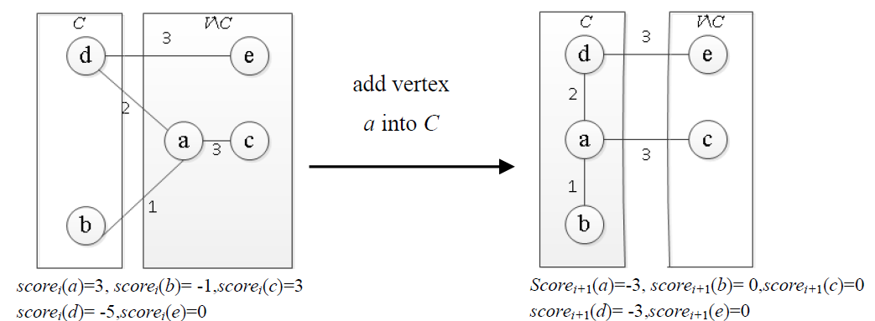
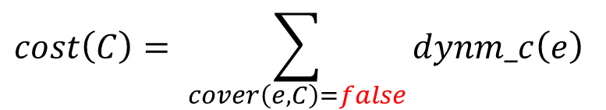
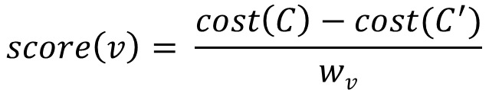
Diversion Local Search Based on Weighted Configuration Checking (DLSWCC)
Use DLSWCC to approach minimum weighted vertex cover problem (MWVC)
Dynamic Scoring Strategy： the weight of uncovered edge will be increased 1
$$cost\left(C\right)= \sum_{cover\left(e,C\right)=false}{dynm_c\left(e\right)}$$
$$score\left(v\right)= \frac{cost\left(C\right)−cost(C^{′})}{wv}$$
Notes:
加入: 可以帶越多大edge進來越好
移除: 帶走越少edge越好

Slide 8
Diversion Local Search Based on Weighted Configuration Checking (DLSWCC)
Use DLSWCC to approach vertex cover problem (MWVC)
Weighted Configuration Checking strategy： prevent cycling problem ( prevent to pick the removed element )
initialize wcnfg[v] = 1 of each vertex v
if v removed from C, then wcnfg[v] = 0 and wcnfg[v’s neighbor] = 1
if v added into C, then wcnfg[v’s neighbor] = 1
if the weight of edge(u,v) is updated, then wcnfg[u] = wcnfg[v] = 1
Vertex Selection Strategy select the one with highest score (or select the one with greatest age, which is the counter of state after changing )

Slide 9
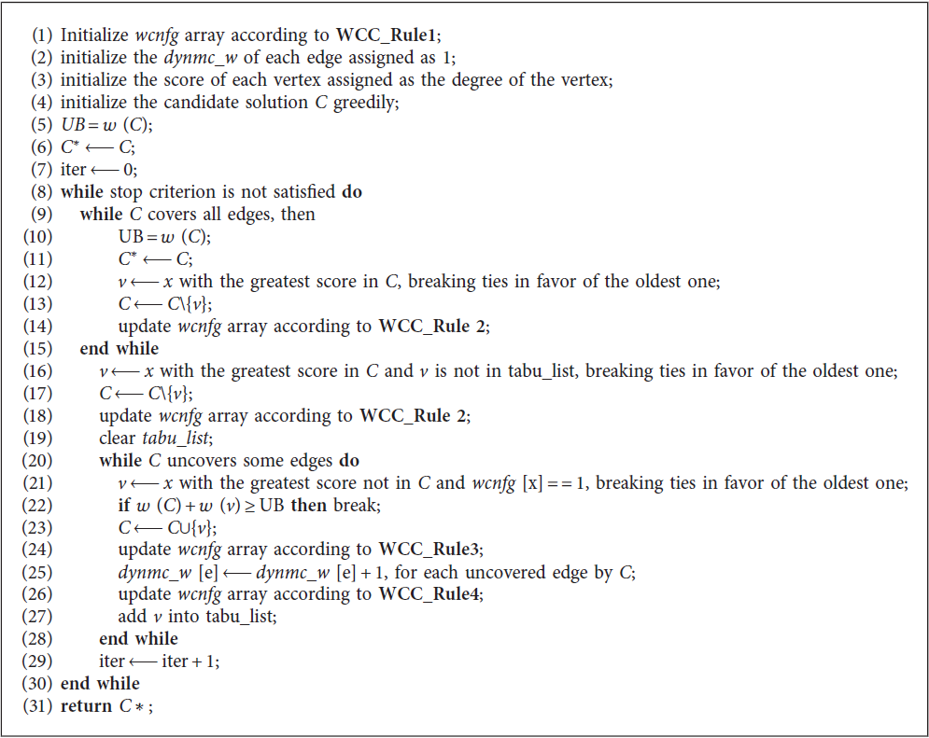
Algorithm
select the nodes with greatest score
until all edges covered
delete the nodes in candidate answer and
try to find better one
try to select nodes and
get lower weight. After
selecting successfully,
update the weight of
uncovered edges
Notes:
加入: 可以帶越多大edge進來越好
移除: 帶走越少edge越好

Slide 10
Greedy MWVC
0
1
2
0
1
2
0
1
2
0
1
2
3
4
3
4
3
4
3
4
5
5
5
5
6
7
8
6
7
8
6
7
8
6
7
8
0
1
2
0
1
2
0
1
2
3
4
3
4
3
4
5
5
5
6
7
8
6
7
8
6
7
8
greedy answer

Slide 11
Greedy MWVC
0
1
2
3
4
5
Weight = 5
0
1
2
6
7
8
3
4
5
Optimal answers
6
7
8
0
1
2
3
4
Weight = 6
UB = 6
Weight = 5
5
6
7
8

Slide 12
Algorithm － while loop (remove)
0
1
2
Score(V₀) = -2
Score(V₄) = -2
Score(V₅) = 0
Score(V₆) = -1
Score(V₇) = 0
Score(V₈) = -1
0
1
2
3
4
3
4
5
5
6
7
8
6
7
8
Weight = 6
UB = 6
Weight = 5
UB = 5

Slide 13
Algorithm － while loop (remove)
0
1
2
Score(V₀) = -3
Score(V₄) = -3
Score(V₆) = -1
Score(V₇) = -1
Score(V₈) = -2
0
1
2
3
4
3
4
5
5
6
7
8
6
7
8
Weight = 5
UB = 5
Weight = 4
UB = 5
illegal

Slide 14
Algorithm
0
1
2
Score(V₀) = -3
Score(V₄) = -3
Score(V₇) = -2
Score(V₈) = -2
0
1
2
3
4
3
4
5
5
6
7
8
6
7
8
Weight = 4
UB = 5
illegal
Weight = 3
UB = 5
illegal

Slide 15
Algorithm － while loop (select)
0
1
2
Score(V₁) = 0
Score(V₂) = 0
Score(V₃) = 1
Score(V₅) = 1
Score(V₆) = 2
0
1
2
3
4
3
4
5
5
6
7
8
6
7
8
Weight = 3
UB = 5
illegal
Weight = 3
UB = 5
illegal

Slide 16
Algorithm － while loop (select)
0
1
2
Score(V₁) = 0
Score(V₂) = 0
Score(V₃) = 0
Score(V₅) = 1
Score(V₇) = 1
0
1
2
3
4
3
4
5
5
6
7
8
6
7
8
Weight = 4
UB = 5
illegal
Weight = 5
UB = 5

Slide 17
Experiment
DLSWCC (Intel (R) Xeon (R) CPU E7-4830 with 2.13 GHz), compared with
CPLEX
Greedy Randomized Adaptative Search Procedure approach (GRASP) (Pentium III at 800 MHz)
Ant Colony Optimisation (ACO) approach (Pentium III at 800 MHz)
EA/G approach (Core 2 Duo system with 2 GB RAM running under Fedora 12 at 3.0 GHz)
Stop condition：
3600 seconds or 1,000,000 iterations
run 16 times independently on each instance
Notes:
環境不同，時間僅供參考。
主要比對其精度

Slide 18
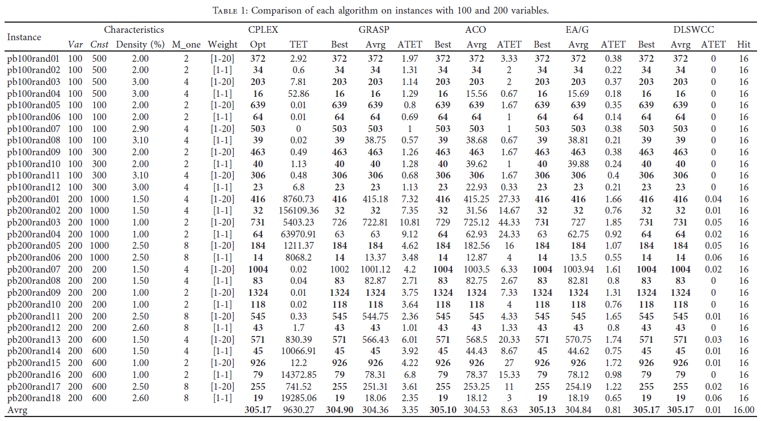
Notes:
Density: nonnull elements in constraints matrix (%)
M_one: the number of the maximum set Oj
--------------------------------------------------------------
TET: 取得最佳解所花費的時間
*: CPLEX無法取得最佳解，而是最好 best solution
avrg: average solution quality
ATET: 平均值行時間
Hit: DLSWCC 有達到 best 的次數
粗體字表示有達 best

Slide 19
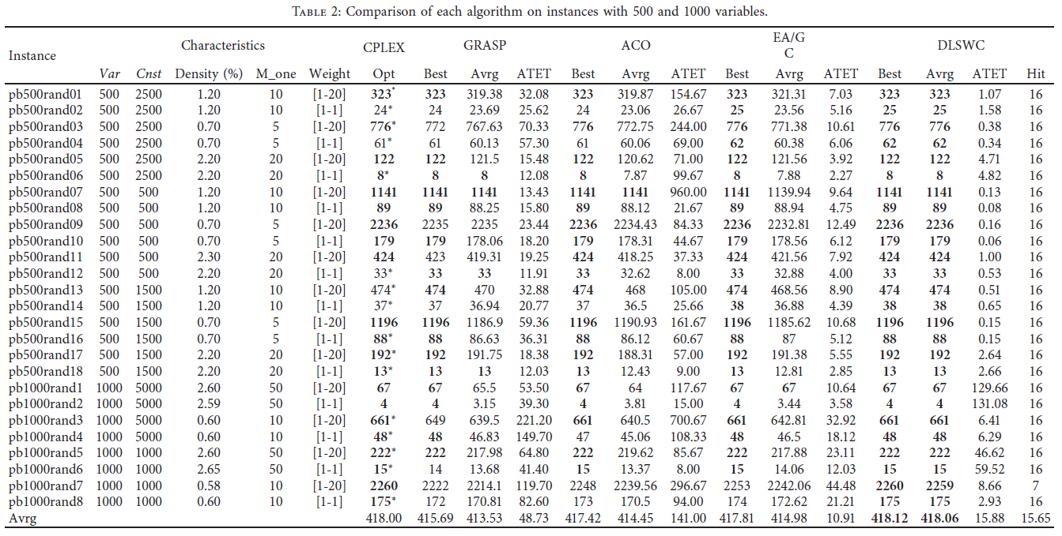

Slide 20
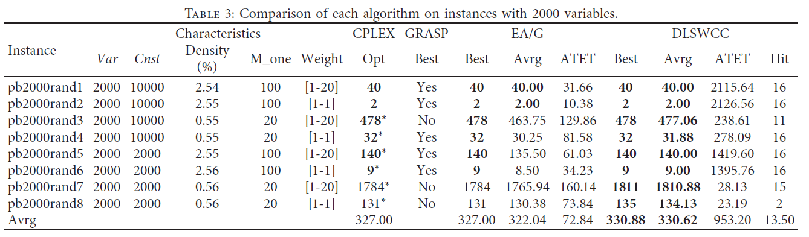
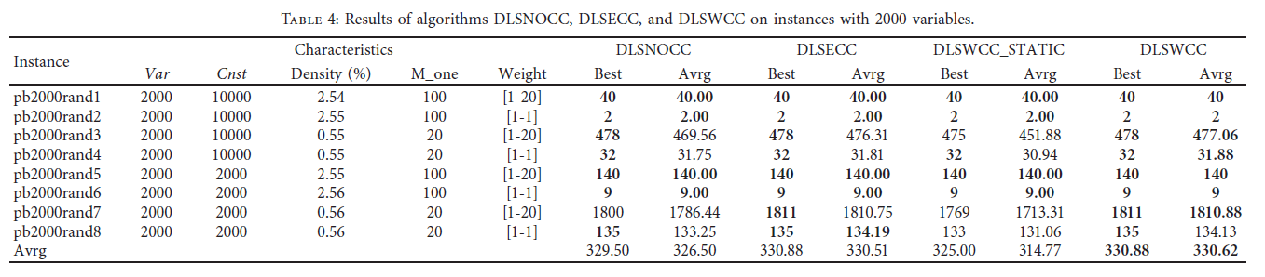
Notes:
DLSNOCC: 沒有 Weighted Configuration Checking (沒有排除 cycling)
DLSECC: straightforward extension of the configuration checking
DLSWCC_STATIC: 使用static scoring strategy (原本是動態的 dynamic scoring strategy)
--------------------------------------------------
NOCC & ECC : 比較 configuration checking
ECC & WCC: 比較 weighted configuration checking
STATIC & WCC : 比較 dynamic scoring strategy

Slide 21
Implementation
routing and scheduling trains at intersections in railway operations
selecting winning bids in combinatorial auctions
surgical operations scheduling
packets scheduling and transmission in communication networks
among many others.

