Slide 1
Comparison of Robust Regression Methods in Linear Regression
Özlem Gürünlü Alma
International Journal of Contemporary Mathematical Sciences,
Vol. 6, 2011, No. 9, p.409 - 421

Slide 2
Abstract
In classical multiple regression, the ordinary least squares estimation is the best method if assumptions are met to obtain regression weights when analyzing data. However, if the data does not satisfy some of these assumptions, then sample estimates and results can be misleading. Especially, outliers violate the assumption of normally distributed residuals in the least squares regression.

Slide 3
Abstract
The danger of outlying observations, both in the direction of the dependent and explanatory variables, to the least squares regression is that they can have a strong adverse effect on the estimate and they may remain unnoticed. Therefore, statistical techniques that are able to cope with or to detect outlying observations have been developed. Robust regression is an important method for analyzing data that are contaminated with outliers. It can be used to detect outliers and to provide resistant results in the presence of outliers. The purpose of this study is to define behavior of outliers in linear regression and to compare some of robust regression methods via simulation study. The simulation study is used in determining which methods best in all of the linear regression scenarios.

Slide 4
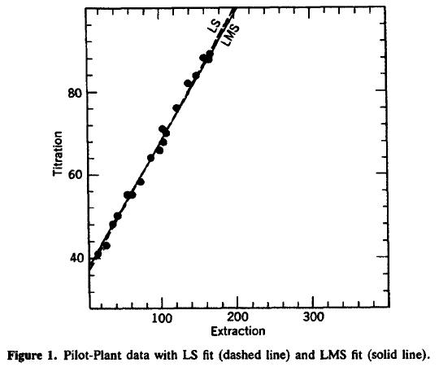



The simple regression model
For example
Least squares(LS)
Least median squares(LMS)
PETER J. ROUSSEEUW, "Robust Regression and Outlier Detection"

Slide 5
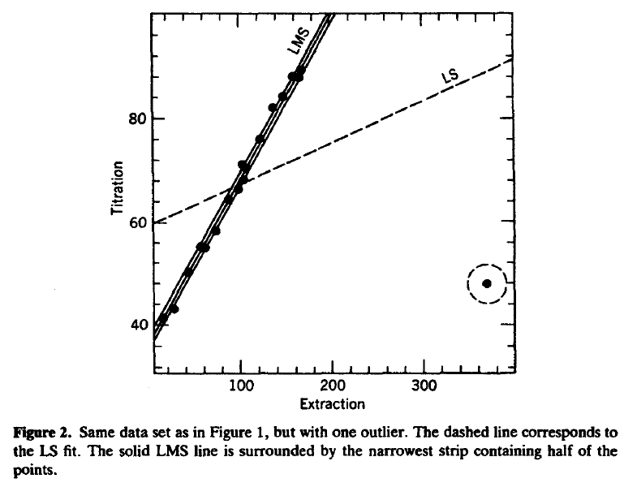
Data contaminated with an outlier
Outliers can be detected by means of large residuals obtained form the conventional LS method.
the residual
Δy=y-ŷ
PETER J. ROUSSEEUW, "Robust Regression and Outlier Detection"
PETER J. ROUSSEEUW, "Robust Regression and Outlier Detection"

Slide 6
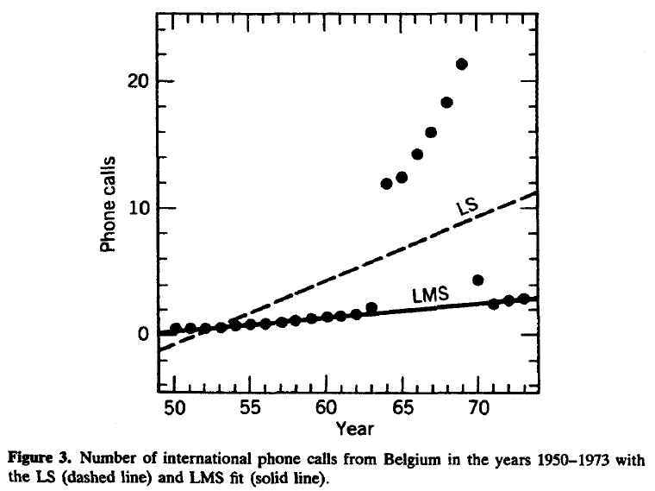
Data contaminated with outliers
Some outliers can be detected by means of large residuals obtained form the conventional LS method.
PETER J. ROUSSEEUW, "Robust Regression and Outlier Detection"
PETER J. ROUSSEEUW, "Robust Regression and Outlier Detection"

Slide 7
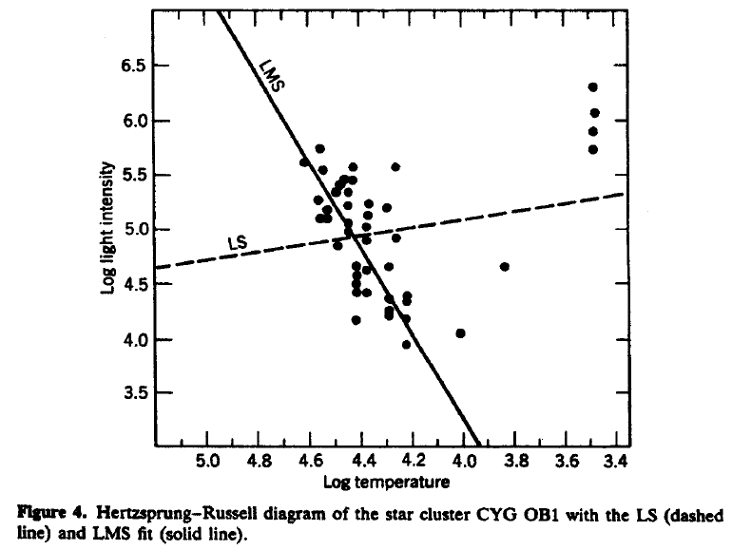
Data contaminated with outliers
Some outliers can be detected by means of large residuals obtained form the conventional LS method.
PETER J. ROUSSEEUW, "Robust Regression and Outlier Detection"
PETER J. ROUSSEEUW, "Robust Regression and Outlier Detection"

Slide 8
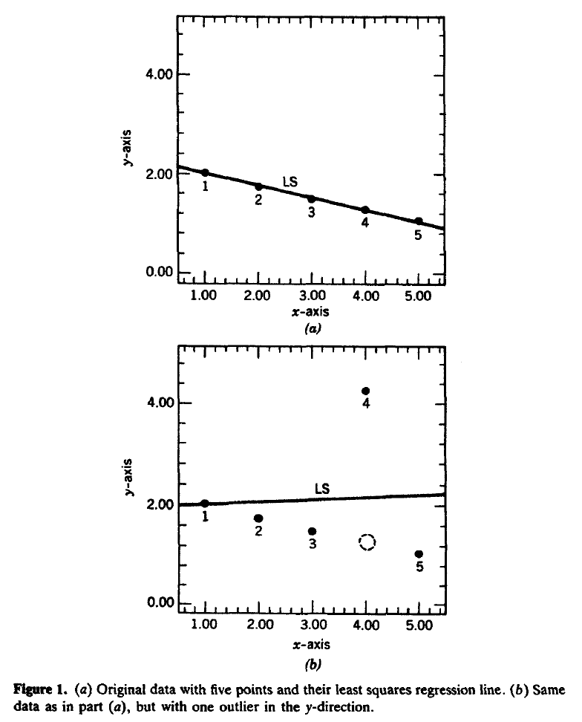
Outlier in the y direction
The outlier may be detected by means of large residuals obtained form the conventional LS method.
PETER J. ROUSSEEUW, "Robust Regression and Outlier Detection"

Slide 9
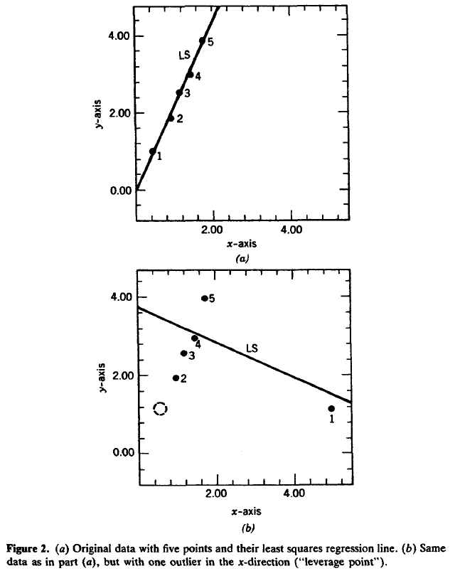
Outlier in the x direction
Also called 'leverage [槓桿作用, 槓桿率, 槓桿裝置] point'
Its effect on the least squares etimator is very large because it actually tilts the LS line.
No outlier can not be detected by means of large residuals obtained form the conventional LS method.
PETER J. ROUSSEEUW, "Robust Regression and Outlier Detection"

Slide 10
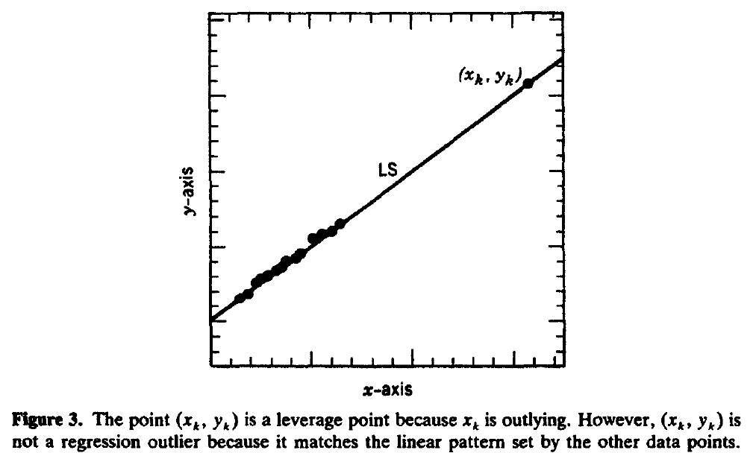
We call an observation (x_{k} ,y_{k}) a leverage point whenever x_{k} lies far away from the bulk of the observed x_{i} in the sample.
When (x_{k} ,y_{k}) lies close to the regression line determined by the majority of the data, then it can be considered a 'good' leverage point.
To say that (x_{k},y_{k}) is a leverage point refers only to its potential for strongly affecting the regression coefficients.
PETER J. ROUSSEEUW, "Robust Regression and Outlier Detection"

Slide 11
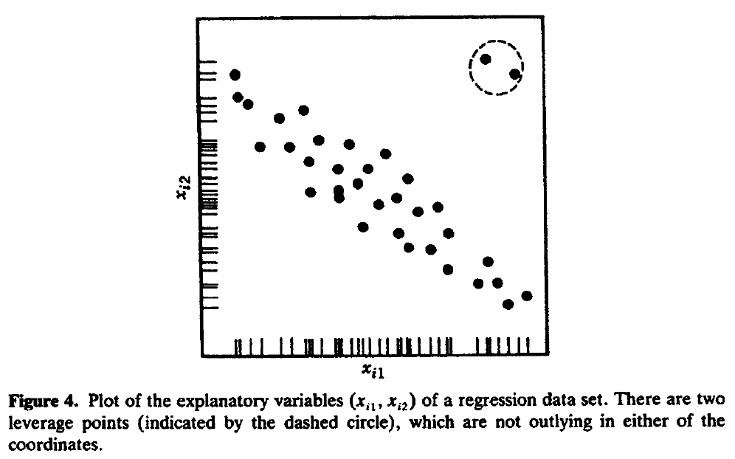
無法利用單一維度統計量偵測
PETER J. ROUSSEEUW, "Robust Regression and Outlier Detection"

Slide 12
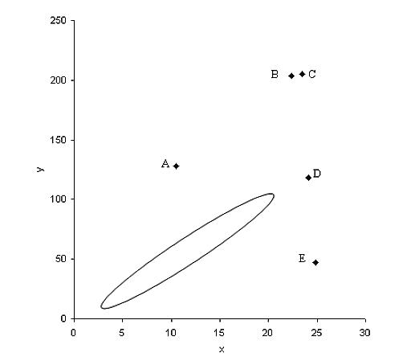
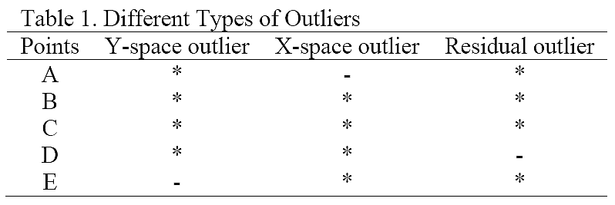

Slide 13
Duncan data
type income education prestige
-------------------------------------------------
accountant prof 62 86 82
pilot prof 72 76 83
architect prof 75 92 90
author prof 55 90 76
chemist prof 64 86 90
minister prof 21 84 87
professor prof 64 93 93
dentist prof 80 100 90
reporter wc 67 87 52
engineer prof 72 86 88
undertaker prof 42 74 57
lawyer prof 76 98 89
physician prof 76 97 97
welfare.worker prof 41 84 59
teacher prof 48 91 73
conductor wc 76 34 38
contractor prof 53 45 76
factory.owner prof 60 56 81
store.manager prof 42 44 45
banker prof 78 82 92
bookkeeper wc 29 72 39
mail.carrier wc 48 55 34
insurance.agent wc 55 71 41
type income education prestige
-------------------------------------------------
store.clerk wc 29 50 16
carpenter bc 21 23 33
electrician bc 47 39 53
RR.engineer bc 81 28 67
machinist bc 36 32 57
auto.repairman bc 22 22 26
plumber bc 44 25 29
gas.stn.attendant bc 15 29 10
coal.miner bc 7 7 15
streetcar.motorman bc 42 26 19
taxi.driver bc 9 19 10
truck.driver bc 21 15 13
machine.operator bc 21 20 24
barber bc 16 26 20
bartender bc 16 28 7
shoe.shiner bc 9 17 3
cook bc 14 22 16
soda.clerk bc 12 30 6
watchman bc 17 25 11
janitor bc 7 20 8
policeman bc 34 47 41
waiter bc 8 32 10
The Duncan data frame has 45 rows and 4 columns. Data on the prestige and other characteristics of 45 U. S. occupations in 1950.
type: Type of occupation. A factor with the following levels: prof, professional and managerial; wc, white-collar; bc, blue-collar.
income: Percent of males in occupation earning $3500 or more in 1950.
education: Percent of males in occupation in 1950 who were high-school graduates.
prestige: Percent of raters in NORC study rating occupation as excellent or good in prestige.
Notes:
Duncan {car} R Documentation
Duncan's Occupational Prestige Data
Description
The Duncan data frame has 45 rows and 4 columns. Data on the prestige and other characteristics of 45 U. S. occupations in 1950.
Usage
data(Duncan)
Format
This data frame contains the following columns:
type
Type of occupation. A factor with the following levels: prof, professional and managerial; wc, white-collar; bc, blue-collar.
income
Percent of males in occupation earning $3500 or more in 1950.
education
Percent of males in occupation in 1950 who were high-school graduates.
prestige
Percent of raters in NORC study rating occupation as excellent or good in prestige.
Source
Duncan, O. D. (1961) A socioeconomic index for all occupations. In Reiss, A. J., Jr. (Ed.) Occupations and Social Status. Free Press [Table VI-1].
References
Fox, J. (1997) Applied Regression, Linear Models, and Related Methods. Sage.

Slide 14
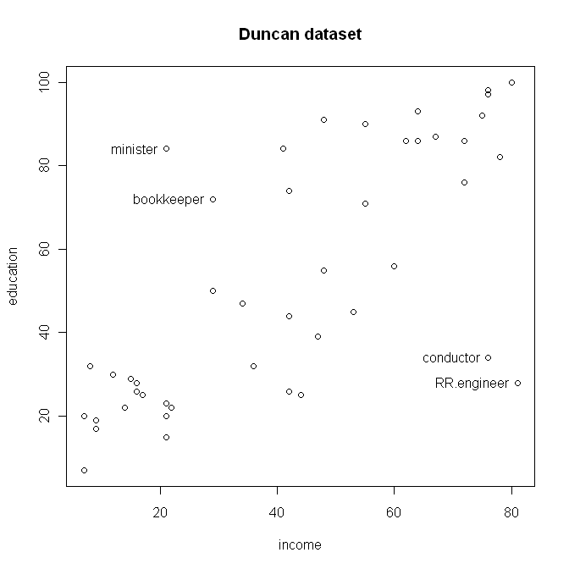
Duncan data
John Fox, "An R Companion to Applied Regression"
Notes:
library(car)
plot(Duncan[,c(2,3)],main='Duncan dataset')
identify(Duncan[,2],Duncan[,3],row.names(Duncan))

Slide 15
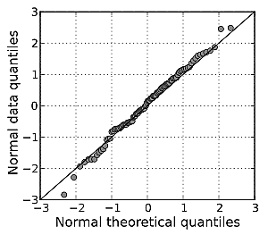
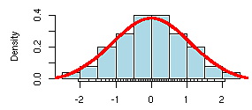
Q-Q plot
A graphical method for comparing two probability distributions by plotting their quantiles against each other.
http://en.wikipedia.org/wiki/Q-Q_plot

Slide 16
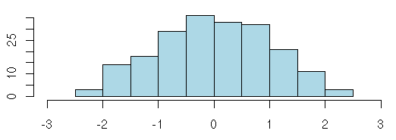
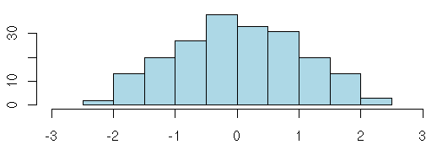
Q-Q plot
http://en.wikipedia.org/wiki/Q-Q_plot

Slide 17
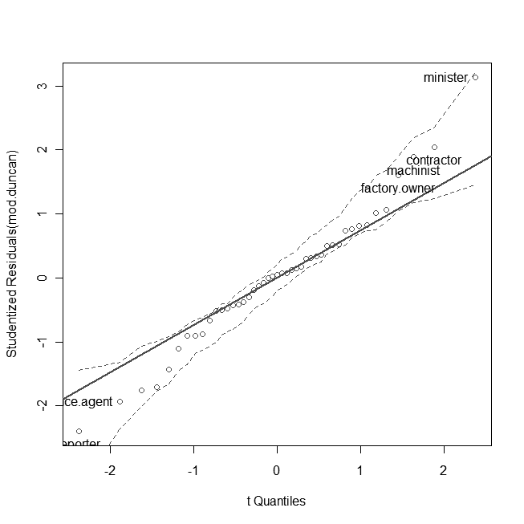
Q-Q plot for unusual data
John Fox, "An R Companion to Applied Regression"
Notes:
library(car)
data(Duncan)
attach(Duncan)
mod.duncan=lm(prestige~income+education)
qq.plot(mod.duncan,simulate=T,labels=row.names(Duncan))

Slide 18
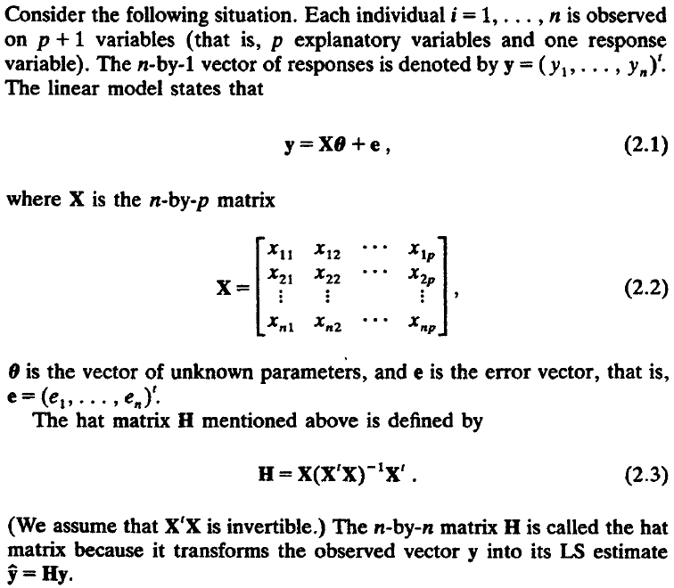
The hat matrix H
PETER J. ROUSSEEUW, "Robust Regression and Outlier Detection"

Slide 19
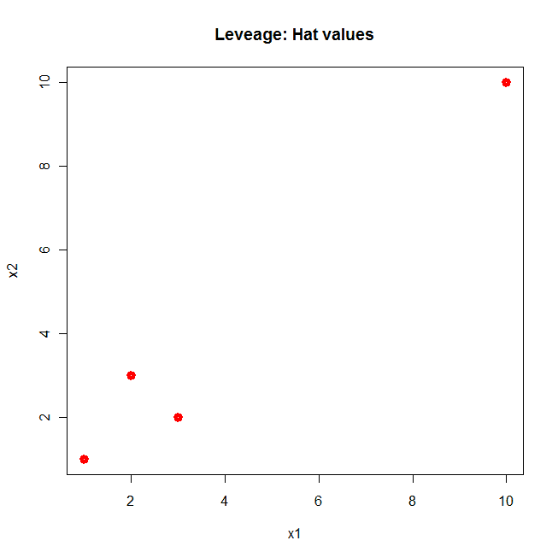
The hat matrix H
ŷ=Hy=X(X'X)⁻¹X'y
H=X(X'X)⁻¹X'
y的估計值ŷ為H乘上原來y
(H)_{ii}: hat values
  可用於判斷leverage point
  可用於判斷對迴歸無幫助點
X
[,1] [,2]
[1,] 1 1
[2,] 2 3
[3,] 3 2
[4,] 10 10
H
[,1] [,2] [,3] [,4]
[1,] 0.01 0.02 0.02 0.09
[2,] 0.02 0.56 -0.44 0.22
[3,] 0.02 -0.44 0.56 0.22
[4,] 0.09 0.22 0.22 0.88
PETER J. ROUSSEEUW, "Robust Regression and Outlier Detection"
Notes:
X=matrix(c(1,2,3,10,1,3,2,10),4)
X %*% solve(t(X) %*% X) %*% t(X)
plot(X,col=2,xlab='x1',ylab='x2',main='Leveage: Hat values',lwd=5)

Slide 20
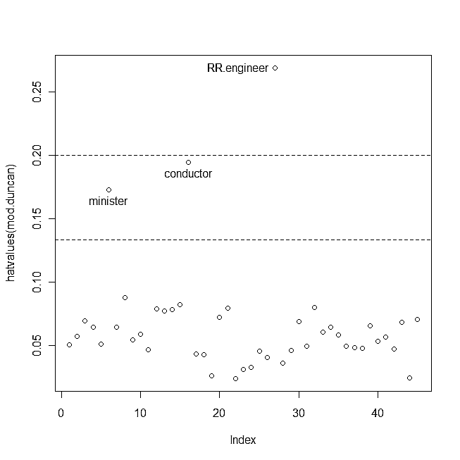
The hat values
John Fox, "An R Companion to Applied Regression"
Notes:
library(car)
data(Duncan)
attach(Duncan)
mod.duncan=lm(prestige~income+education)
plot(hatvalues(mod.duncan))
abline(h=c(2,3)*3/45,lty=2)
identify(1:45,hatvalues(mod.duncan),row.names(Duncan))

Slide 21
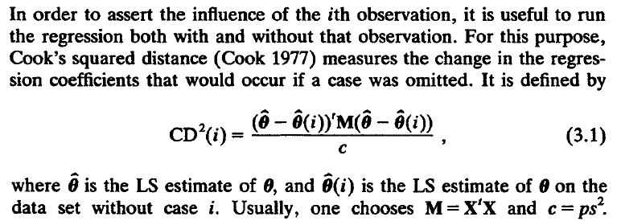
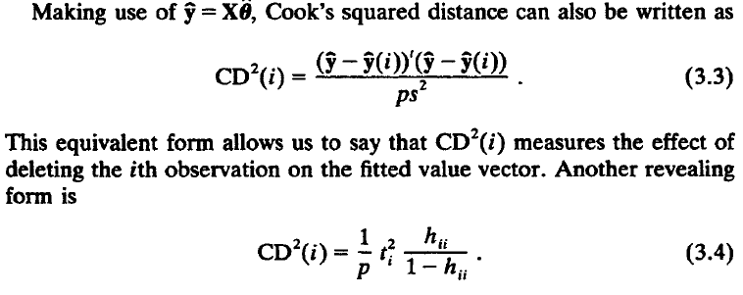
Cook's distance
PETER J. ROUSSEEUW, "Robust Regression and Outlier Detection"

Slide 22
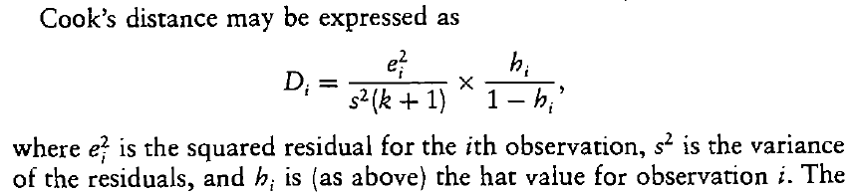
Cook's distance
John Fox, "An R Companion to Applied Regression"

Slide 23
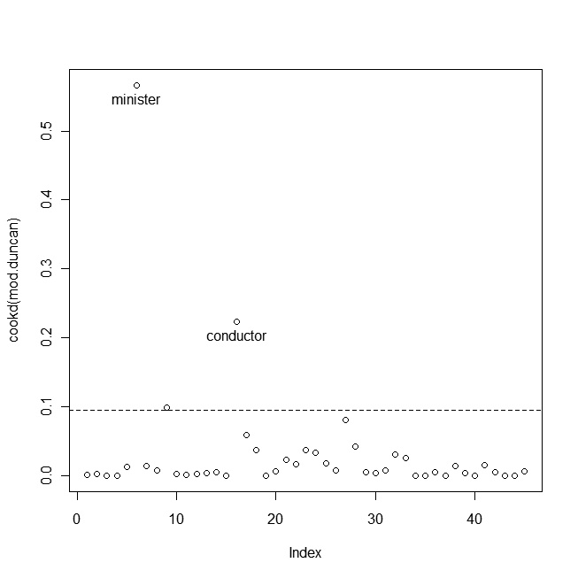
Cook's distance
John Fox, "An R Companion to Applied Regression"
Notes:
library(car)
data(Duncan)
attach(Duncan)
mod.duncan=lm(prestige~income+education)
plot(cookd(mod.duncan))
abline(h=4/42,lty=2)
identify(1:45,cookd(mod.duncan),row.names(Duncan))

Slide 24
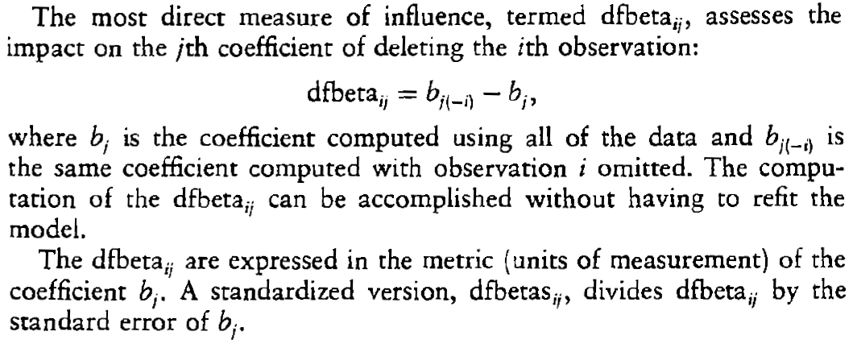
DEBETAS
John Fox, "An R Companion to Applied Regression"
Notes:
library(car)
data(Duncan)
attach(Duncan)
mod.duncan=lm(prestige~income+education)
dfbs.duncan=dfbetas(mod.duncan)
plot(dfbs.duncan[,c(2,3)])
identify(dfbs.duncan[,c(2)],dfbs.duncan[,c(3)],row.names(Duncan))

Slide 25
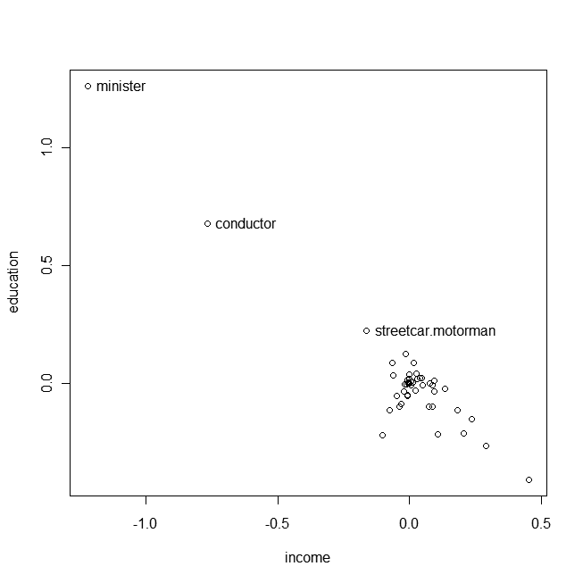
DEBETAS
John Fox, "An R Companion to Applied Regression"
Notes:
library(car)
data(Duncan)
attach(Duncan)
mod.duncan=lm(prestige~income+education)
dfbs.duncan=dfbetas(mod.duncan)
plot(dfbs.duncan[,c(2,3)])
identify(dfbs.duncan[,c(2)],dfbs.duncan[,c(3)],row.names(Duncan))

Slide 26
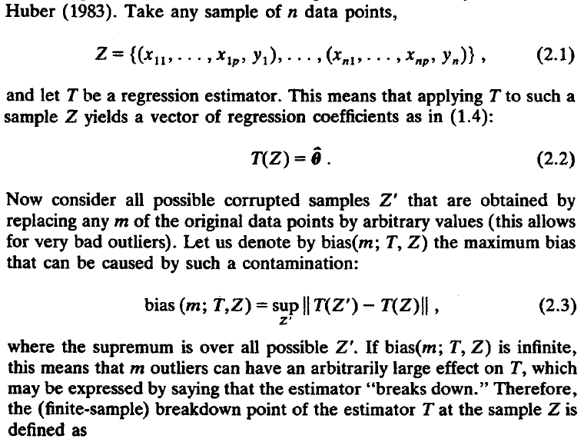

The breakdown[崩潰, 故障] point
PETER J. ROUSSEEUW, "Robust Regression and Outlier Detection"

Slide 27
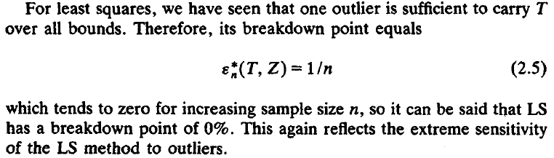
(Ordinary) LS (OLS) estimator
PETER J. ROUSSEEUW, "Robust Regression and Outlier Detection"

Slide 28
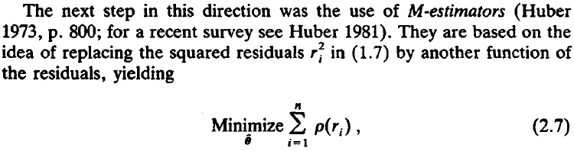
M estimator
Being robust with respect to outliers in y.
Its breakdown point is 1/n, because not robust with respect to outliers in x.
PETER J. ROUSSEEUW, "Robust Regression and Outlier Detection"

Slide 29
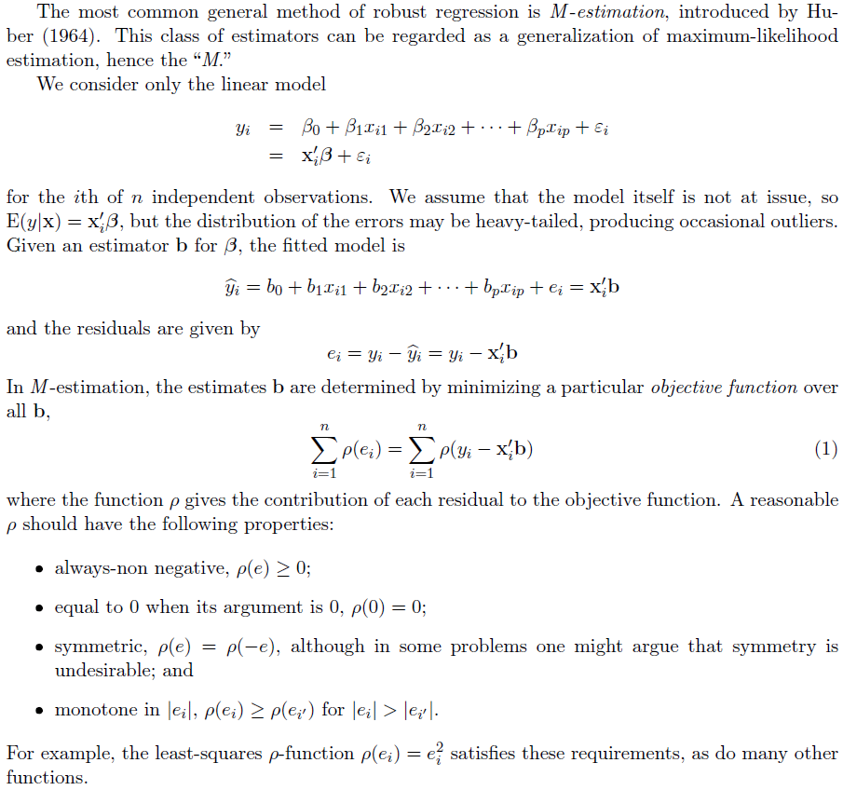
John Fox, "An R Companion to Applied Regression"

Slide 30
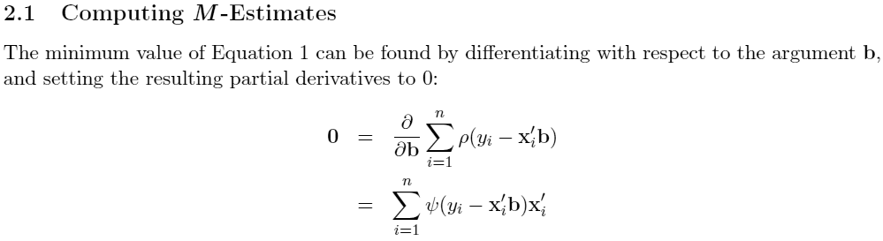
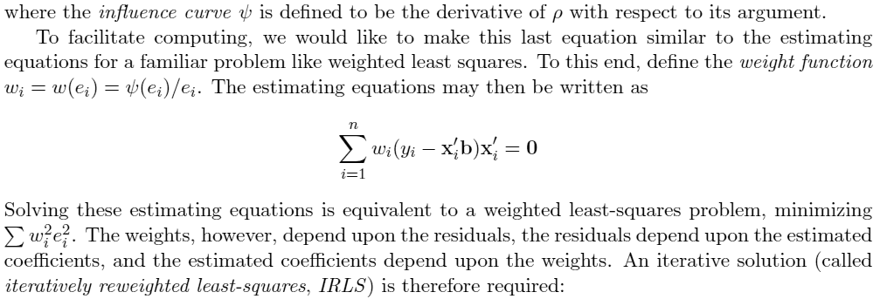
John Fox, "An R Companion to Applied Regression"

Slide 31
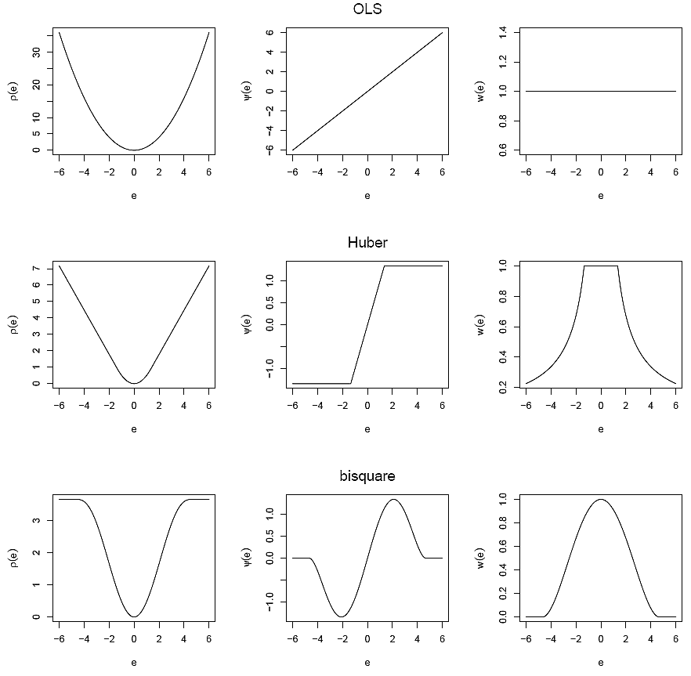
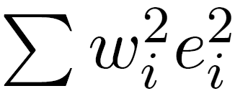
Objective functions
Influence functions
Weight functions
John Fox, "An R Companion to Applied Regression"

Slide 32
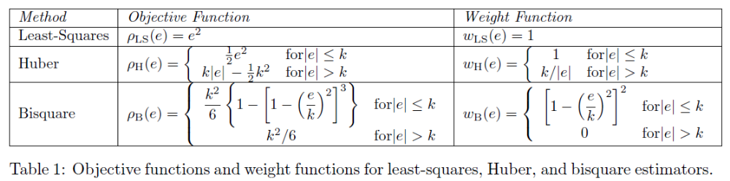
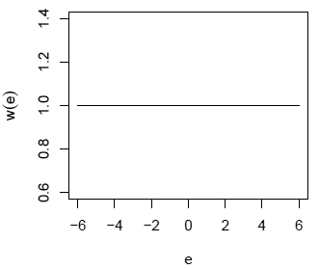
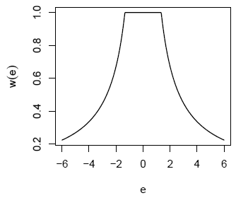
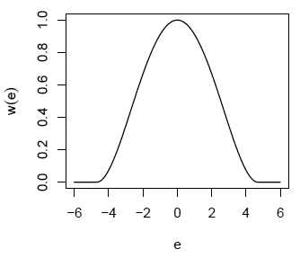
Objective & weight function
weight for LS
weight for Huber
weight for Bisquare
John Fox, "An R Companion to Applied Regression"

Slide 33
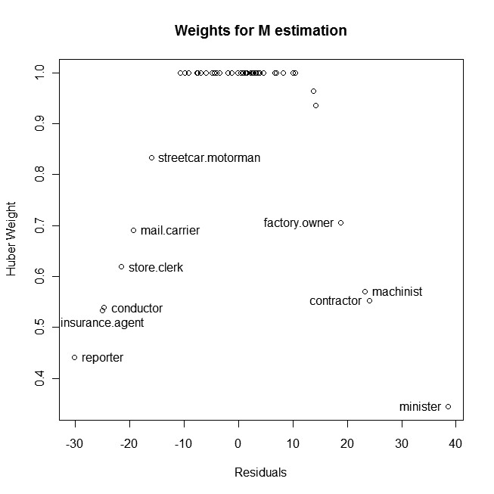
weight for Huber
Notes:
library(MASS)
mod.huber <- rlm(prestige ~ income + education, data=Duncan)
summary(mod.huber)
plot(mod.huber$w, ylab="Huber Weight",main='Weights for M estimation')
smallweights <- which(mod.huber$w < 0.8)
identify(1:45, mod.huber$w,row.names(Duncan))
x11()
plot(mod.huber$residuals,mod.huber$w, xlab='Residuals',ylab="Huber Weight",main='Weights for M estimation')
identify(mod.huber$residuals, mod.huber$w,row.names(Duncan))

Slide 34
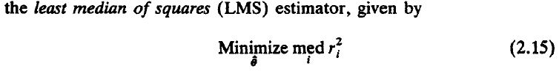
LMS (least median of squares) estimator
This estimator is very robust with respect to outliers in y as well as outliers in x.
Its breakdown point is 50%, the highest possible value.
The LMS performs poorly from the point of view of asymptotic efficiency (it has an abnormally slow convergence rate).
PETER J. ROUSSEEUW, "Robust Regression and Outlier Detection"

Slide 35
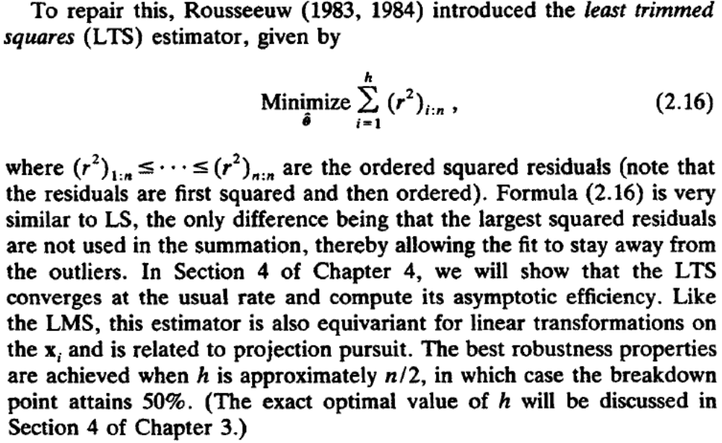
LTS (least trimmed squares) estimator
PETER J. ROUSSEEUW, "Robust Regression and Outlier Detection"

Slide 36
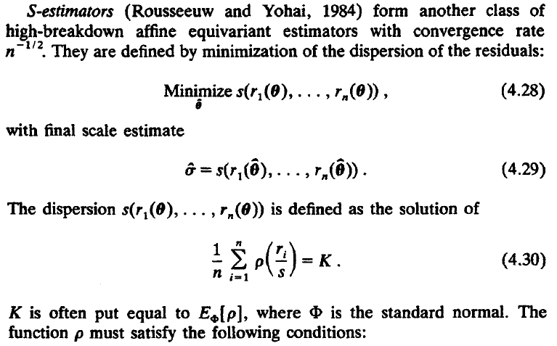

S estimator
PETER J. ROUSSEEUW, "Robust Regression and Outlier Detection"

Slide 37
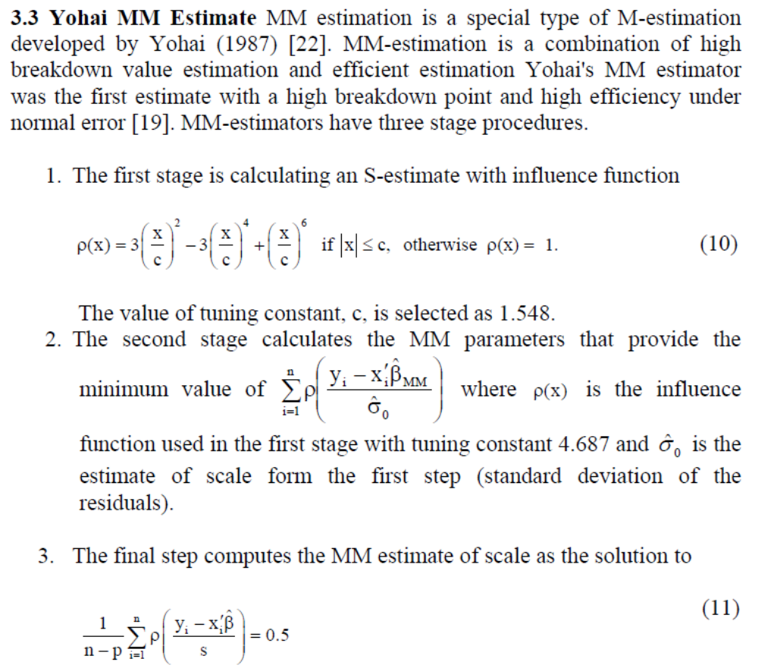
MM estimator

Slide 38
Experiments on Duncan dataset
Method | Coefficients | RMSE | R-squares
 | (Intercept) income education
OLS | -6.0646629 0.5987328 0.5458339 | 12.91571 | 0.828173
OLS removing obs. 6 &16 | -6.4089856 0.8673986 0.3322408 | 11.01011 | 0.875974
M estimation | -7.1107028 0.7014493 0.4854390 | 13.02876 | 0.825675
MM estimation | -7.3885535 0.7825414 0.4233197 | 13.27934 | 0.819434
LTS estimation | -7.1459622 0.8061856 0.4329897 | 13.47772 | 0.819179
LMS estimation | -7.8574007 1.0685921 0.2238267 | 15.18302 | 0.777611
S estimation | -8.6163070 0.8105516 0.4448441 | 13.45701 | 0.818964
Notes:
library(car)
data(Duncan)
attach(Duncan)
mod.ls=lm(prestige~income+education)
summary(mod.ls)
mod=mod.ls
print(sqrt(mean(mod$residuals^2)))
print(mod$coefficients)
print(cor(mod$model$prestige,mod$fitted.values)^2)
mod.ls.2=update(mod.ls,subset=-c(6,16))
summary(mod.ls.2)
mod=mod.ls.2
print(sqrt(mean(mod$residuals^2)))
print(mod$coefficients)
print(cor(mod$model$prestige,mod$fitted.values)^2)
library(MASS)
mod.huber <- rlm(prestige ~ income + education, data=Duncan)
summary(mod.huber)
mod=mod.huber
print(sqrt(mean(mod$residuals^2)))
print(mod$coefficients)
print(cor(mod$model$prestige,mod$fitted.values)^2)
mod.MM <- rlm(prestige ~ income + education, data=Duncan,method='MM')
summary(mod.MM)
mod=mod.MM
print(sqrt(mean(mod$residuals^2)))
print(mod$coefficients)
print(cor(mod$model$prestige,mod$fitted.values)^2)
mod.lts <- lqs(prestige ~ income + education, data=Duncan,method='lts')
summary(mod.lts)
mod=mod.lts
print(sqrt(mean(mod$residuals^2)))
print(mod$coefficients)
print(cor(mod$model$prestige,mod$fitted.values)^2)
mod.lms <- lqs(prestige ~ income + education, data=Duncan,method='lms')
summary(mod.lms)
mod=mod.lms
print(sqrt(mean(mod$residuals^2)))
print(mod$coefficients)
print(cor(mod$model$prestige,mod$fitted.values)^2)
mod.S <- lqs(prestige ~ income + education, data=Duncan,method='S')
summary(mod.S)
mod=mod.S
print(sqrt(mean(mod$residuals^2)))
print(mod$coefficients)
print(cor(mod$model$prestige,mod$fitted.values)^2)

Slide 39

R-square (R²)
衡量迴歸好壞的方法
y=[4.17,5.58,5.18,6.11,4.5,4.61,5.17,4.53,5.33,5.14,4.81,4.17,4.41,3.59,5.87,3.83,6.03,4.89,4.32,4.69], mean(y)=4.8465
ŷ=[5.032,5.032,5.032,5.032,5.032,5.032,5.032,5.032,5.032,5.032,4.661,4.661,4.661,4.661,4.661,4.661,4.661,4.661,4.661,4.661]
r=[-0.862,0.548,0.148,1.078,-0.532,-0.422,0.138,-0.502,0.298,0.108,0.149,-0.491,-0.251,-1.071,1.209,-0.831,1.369,0.229,-0.341,0.029]
SS_{Total}=Σ(y_{i}-4.865)²=9.417455, SS_{Error}=Σr_{i}²=8.72925
R²=1-SS_{Error}/SS_{Total}=cor²(y,ŷ)=1-8.72925/9.417455=0.0730776

Slide 40
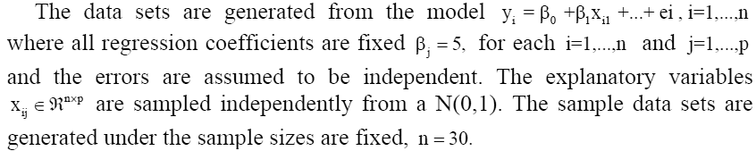
Data
Outliers were placed in two different locations to simulate different types of outliers. These placements of data points represent both x-axis and y-axis outliers (2x, 2y, σ; 4x, 4y, σ).

Slide 41

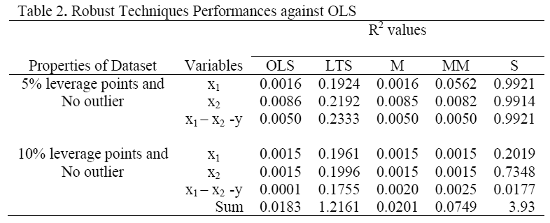
Experiment 1
For the high percentage of X’s leverage points, S estimator method performs like LTS method.

Slide 42
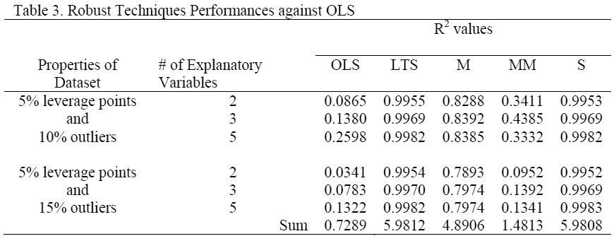
Experiment 2
outlier in the y axis

Slide 43
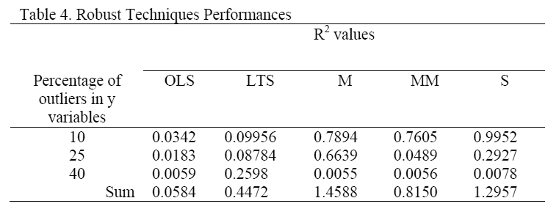
Summary performance

Slide 44
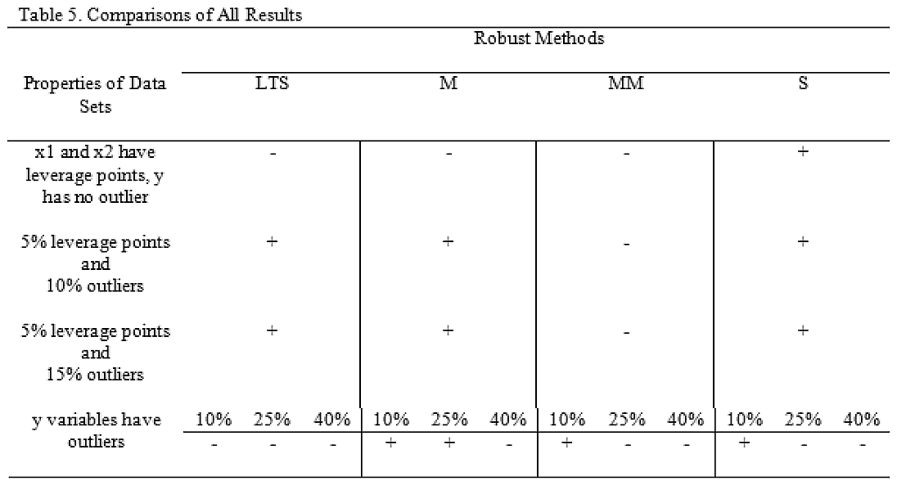
Summary performance

