Slide 1
Integrating a Piecewise Linear Representation Method with Dynamic Time warping system for Stock Trading Decision Making
Pei-Chann Chang, Chin-Yuan Fan, Jun-Lin Lin and Jyun-Jie Lin
Natural Computation, 2008. ICNC 08.
Fourth International Conference on
Presenter: Chang-Hao Huang
Date: Sept. 19, 2011

Slide 2
Abstract(1/2)
Stock turning points detection is a very interesting subject arising in numerous financial and economic planning problems. In this paper, a piecewise linear representation method with Dynamics Time Warping system for stock turning points detection is presented. The piecewise linear representation method is able to generate numerous stocks turning points from the historic data base, then the Dynamic Time Warping system will be applied to retrieve similar stock price patterns from historic data for training the system. These turning points represent short-term trading signals for selling or buying stocks from the market. A Back-Propagation neural network (B.P.N) is further applied to learn the connection weights from these historic turning points and afterwards it is applied to forecast the future turning points from the set of test data.

Slide 3
Abstract(2/2)
Experimental results demonstrate that the system integrating PLR and neural networks can make a significant amount of profit when compared with other approaches using stock data. A Back-Propagation neural network (B.P.N) is further applied to learn the connection weights from these historic turning points and afterwards it is applied to forecast the future turning points from the set of test data. Experimental results demonstrate that the system integrating PLR and neural networks can make a significant amount of profit when compared with other approaches using stock data.

Slide 4
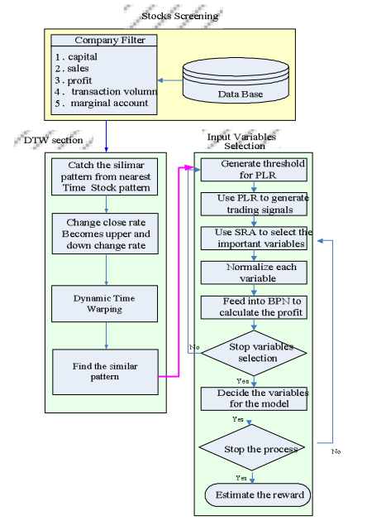

Slide 5
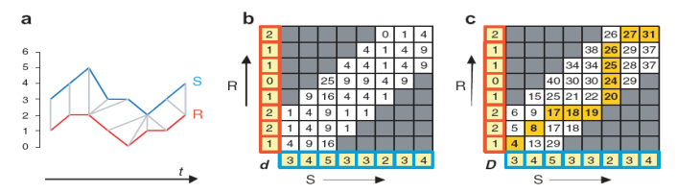
Dynamic Time Warping(DTW)

Slide 6
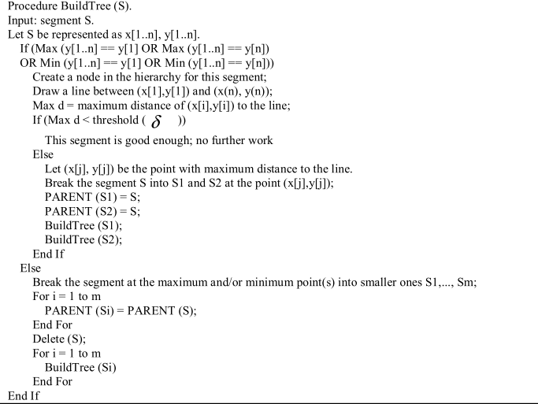
Piecewise Linear Representation(PLR)

Slide 7
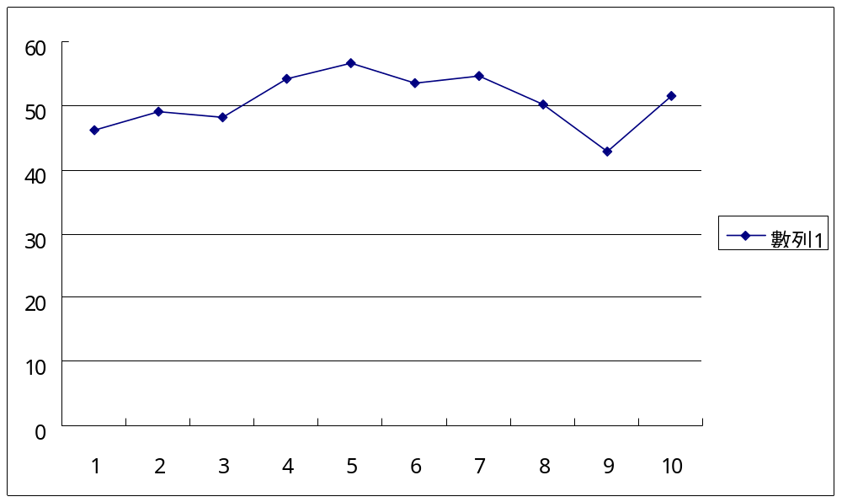

Slide 8
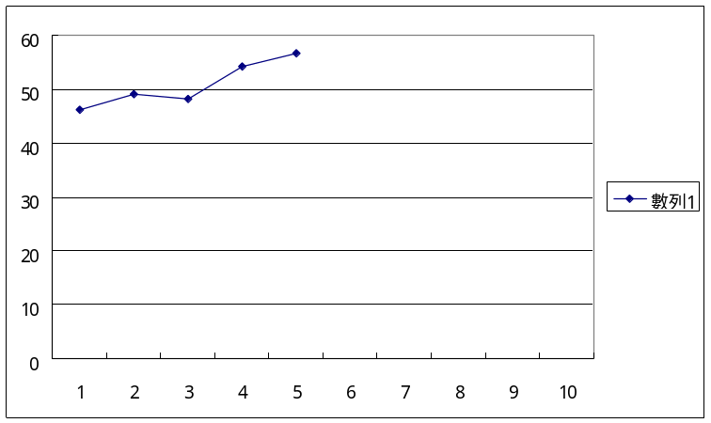
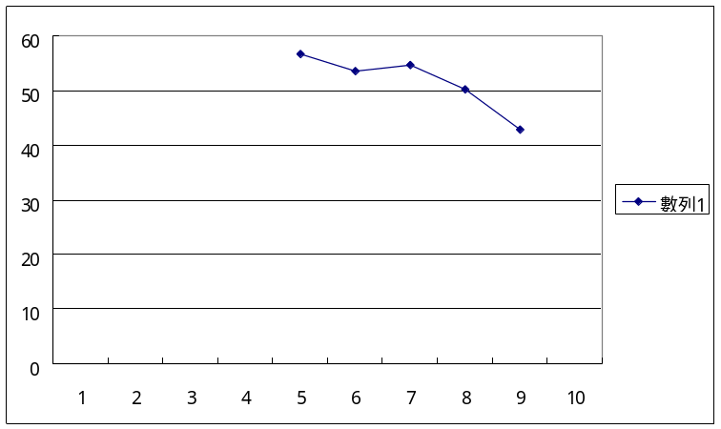
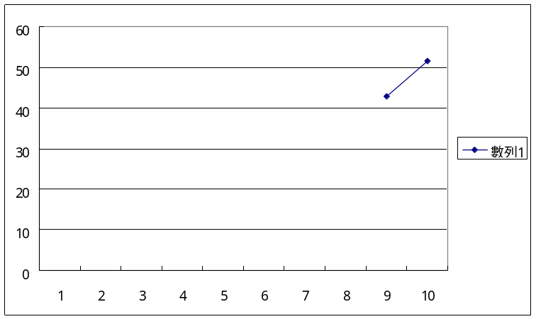
Sub-segment

Slide 9
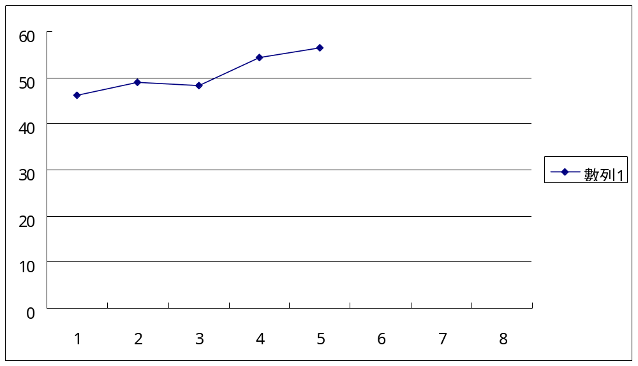

Slide 11
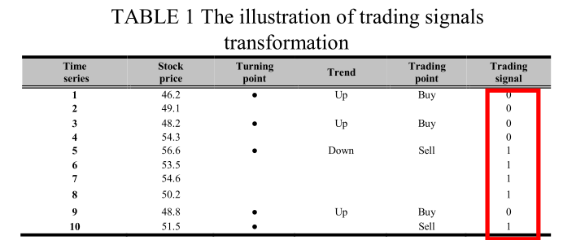
Back Propagation Network(BPN)
E_{k.} x ≧ E. x + δ ， Etrend = UP
E_{k.} x ≦ E. x - δ ， Etrend = DOWN
E. x – δ ＜ E_{k.} x ＜ E.x + δ ， Etrend = NOTREND

Slide 12
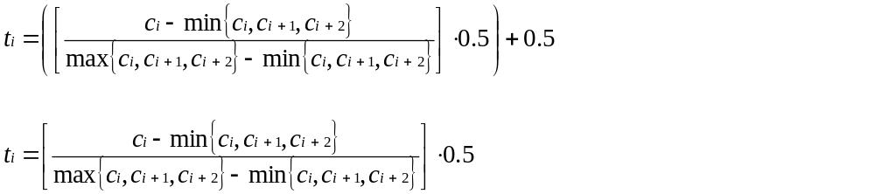
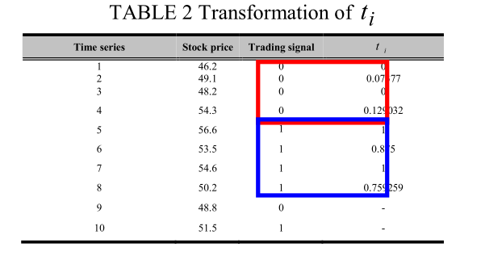
If up-trend ，
If down-trend ，

Slide 13
In this study, the average of t_{i} in training stage will be regarded as the boundary when make a trading decision as shown in Table II and Table III. In the case example, 0.508 is the boundary.

Slide 14
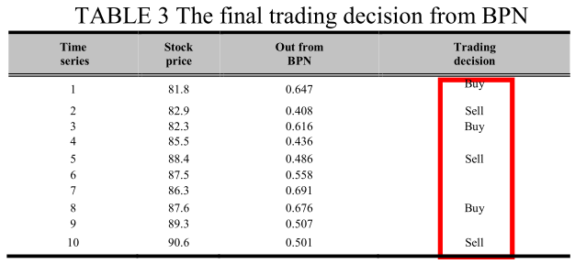

Slide 15
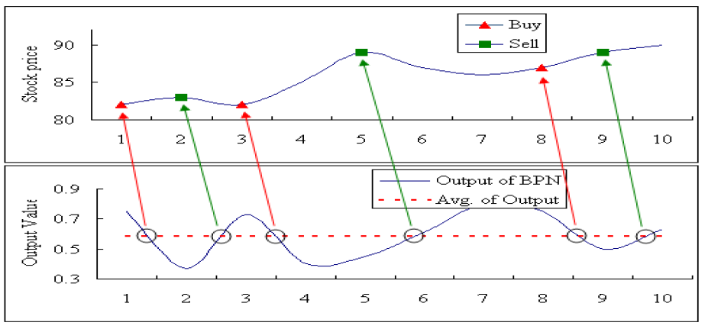

Slide 16
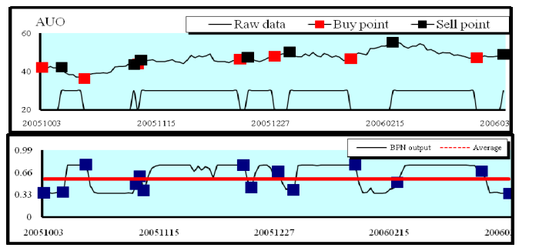
Fig 5 The Forecasted Trading points by BPN in AUO(Up-trend decision)

Slide 17
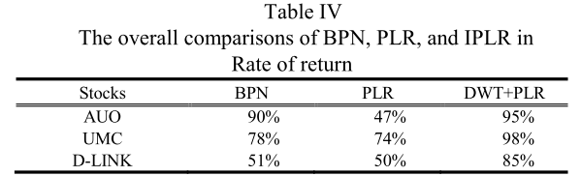
Conclusion
Stocks BPN PLR DTW+PLR

