Slide 1

Gad M. Landau , Eugene Myers , Michal Ziv-Ukelson
Journal of Computer and System Sciences
Vol. 73, 1095–1117, 2007
Speaker: Kai-Yuan Cheng
Date: Sep. 26, 2011

Slide 2
Abstract
The problem of aligning two sequences A and B to determine their similarity is one of the fundamental problems in pattern matching. A challenging, basic variation of the sequence similarity problem is the incremental string comparison problem, denoted Consecutive Suffix Alignment, which is, given two strings A and B, to compute the alignment solution of each suffix of A versus B.
Here, we present two solutions to the Consecutive Suffix Alignment Problem under the LCS (Longest Common Subsequence) metric, where the LCS metric measures the subsequence of maximal length common to A and B. The first solution is an O(nL) time and space algorithm for constant alphabets, where the size of the compared strings is O(n) and L ≦ n denotes the size of the LCS of A and B.
The second solution is an O(nL+n log |Σ|) time and O(n) space algorithm for general alphabets, where Σ denotes the alphabet of the compared strings.

Slide 3
Consecutive Suffix Alignment
Definition 1 The Consecutive Suffix Alignment problem is, given two strings A and B, to compute the alignment solution of each suffix of A versus B.

Slide 4
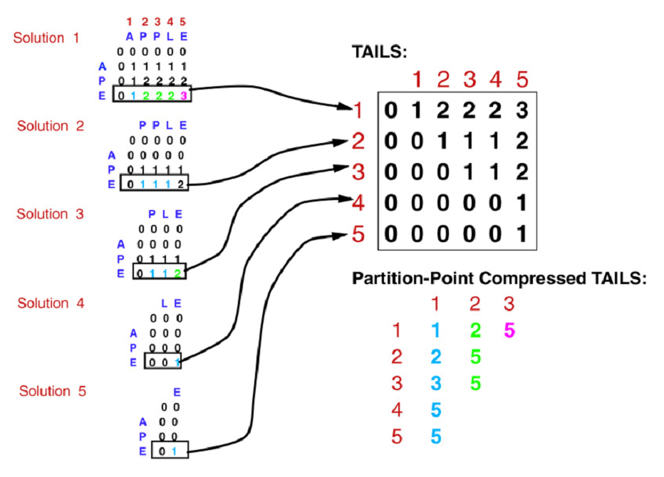

Slide 5
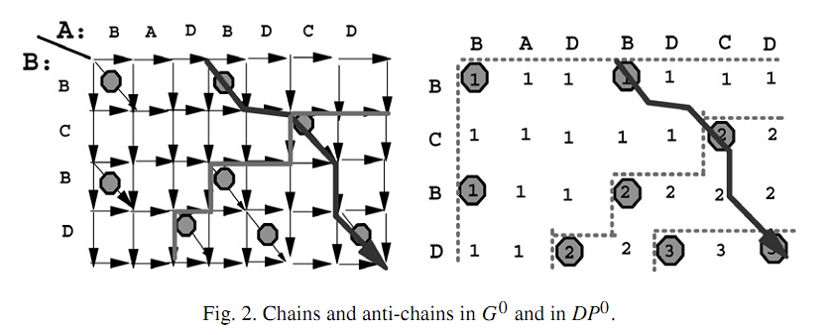

Slide 6
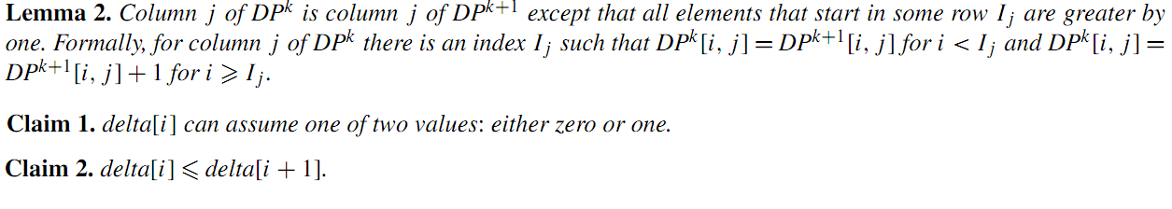
Partition point

Slide 7
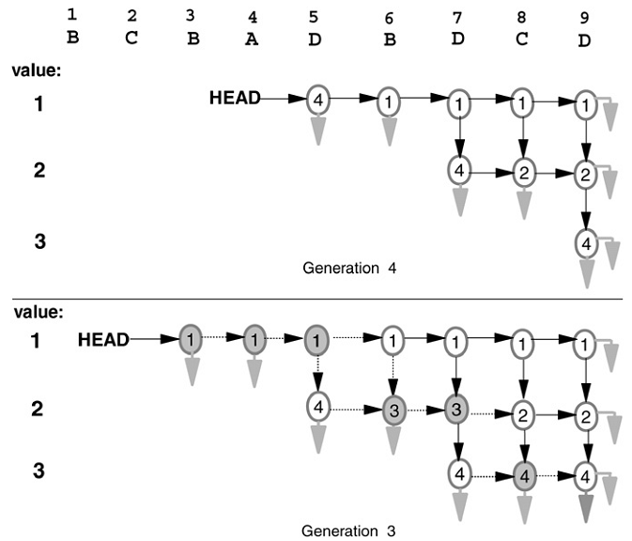
Partition point
 |  | B | C | B | A | D | B | D | C | D
B |  |  |  |  |  | 0 | 1 | 1 | 1 | 1
C |  |  |  |  |  | 0 | 1 | 1 | 2 | 2
B |  |  |  |  |  | 0 | 1 | 1 | 2 | 2
D |  |  |  |  |  | 1 | 1 | 2 | 2 | 3
 |  | B | C | B | A | D | B | D | C | D
B |  |  |  | 1 | 1 | 1 | 1 | 1 | 1 | 1
C |  |  |  | 1 | 1 | 1 | 1 | 1 | 2 | 2
B |  |  |  | 1 | 1 | 1 | 2 | 2 | 2 | 2
D |  |  |  | 1 | 1 | 2 | 2 | 3 | 3 | 3

Slide 8


New partition point
Let I_{j} denote the index of the new partition point in column j of P^{k}
Let I_{j-1} denote the index of the new partition point in column j-1 of P^{k}
Let

Slide 9

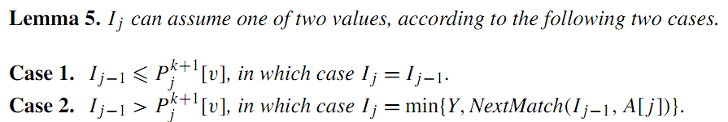
Lemma 4, 5

Slide 10
 |  |  |  | 1
 |  |  |  | 2
 |  |  |  | 1
 |  | I_{j-1} |  | 2
 |  |  |  | 3

Slide 11
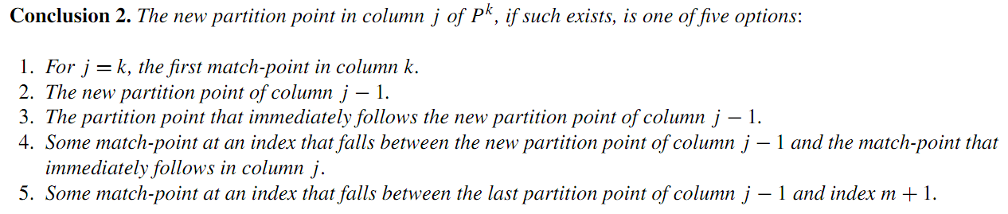
Conclusion 2

Slide 12
Time and space complexity
NextMatch table for string B : O(n|Σ|) time and space, and in O(n) time and space if |Σ| is constant.
Algorithm : O(nL) time and space complexity

Slide 13
Thank you!!!

