Slide 1
Cysteine separations profiles on protein sequences infer disulfide connectivity East Zhao, Hsuan-Liang Liu, Chi-Hung Tsai, Huai-Kuang Tsai, Chen-hsiung Chan and Cheng-Yan Kao Bioinformatics, vol. 21, no. 8, pp. 1415–1420, 2005
Presenter: Hong-Yu Chen
Date: Sept. 26, 2011

Slide 2
Abstract (1/3)
Motivation: Disulfide bonds play an important role in protein folding. A precise prediction of disulfide connectivity can strongly reduce the conformational search space and increase the accuracy in protein structure prediction. Conventional disulfide connectivity predictions use sequence information, and prediction accuracy is limited. Here, by using an alternative scheme with global information for disulfide connectivity prediction, higher performance is obtained with respect to other approaches.

Slide 3
Abstract (2/3)
Result: Cysteine separation profiles have been used to predict the disulfide connectivity of proteins. The separations among oxidized cysteine residues on a protein sequence have been encoded into vectors named cysteine separation profiles (CSPs). Through comparisons of their CSPs, the disulfide connectivity of a test protein is inferred from a non-redundant template set. For non-redundant proteins in SwissProt 39 (SP39) sharing less than 30% sequence identity, the prediction accuracy of a fourfold cross-validation is 49%. The prediction accuracy of disulfide connectivity for proteins in SwissProt 43 (SP43) is even higher (53%).

Slide 4
Abstract (3/3)
The relationship between the similarity of CSPs and the prediction accuracy is also discussed. The method proposed in this work is relatively simple and can generate higher accuracies compared to conventional methods. It may be also combined with other algorithms for further improvements in protein structure prediction.

Slide 5
Introduction
A disulfide connectivity pattern can be used to discriminate the structural similarity between proteins.
It has been shown that proteins with similar disulfide bonding patterns also share similar folds.
The prediction of disulfide connectivity is based on the comparisons of vectors from testing and template dataset, in which similar vectors imply similar connection patterns.

Slide 6
Datasets
SP39: SwissProt release No. 39, filtered according to procedures described in two previous works (Fariselli and Casadio, 2001; Vullo and Frasconi, 2004).
SP39-ID30: redundant sequences with pairwise sequence identity of more than 30% were removed.
SP43: redundant sequences with pairwise sequence identity of more than 25% in SP43 were also removed.
SP39-TEMPLATE: filtered as in SP39 and SP43, except for the PDB filter. Only sequences sharing less than 30% identity with those in SP43 were kept.

Slide 7
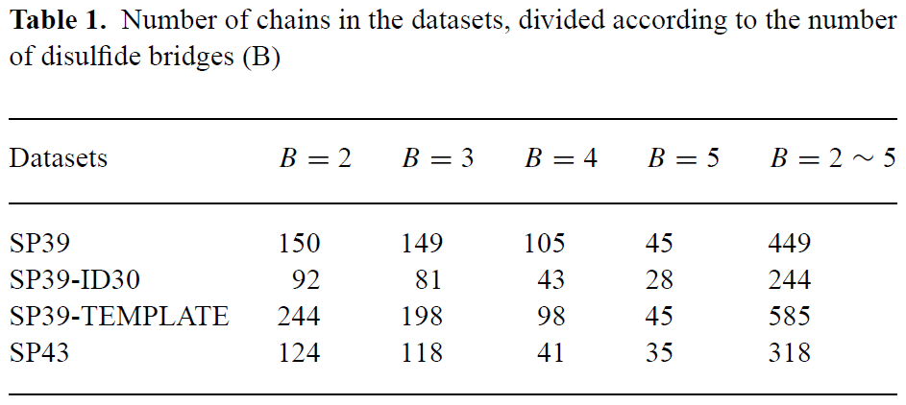
Datasets

Slide 8
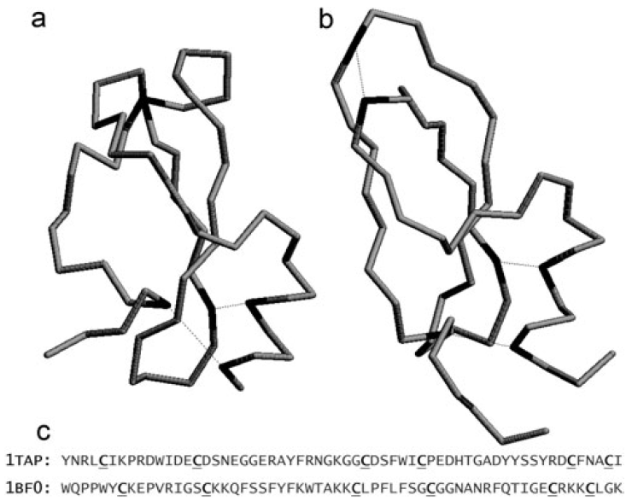
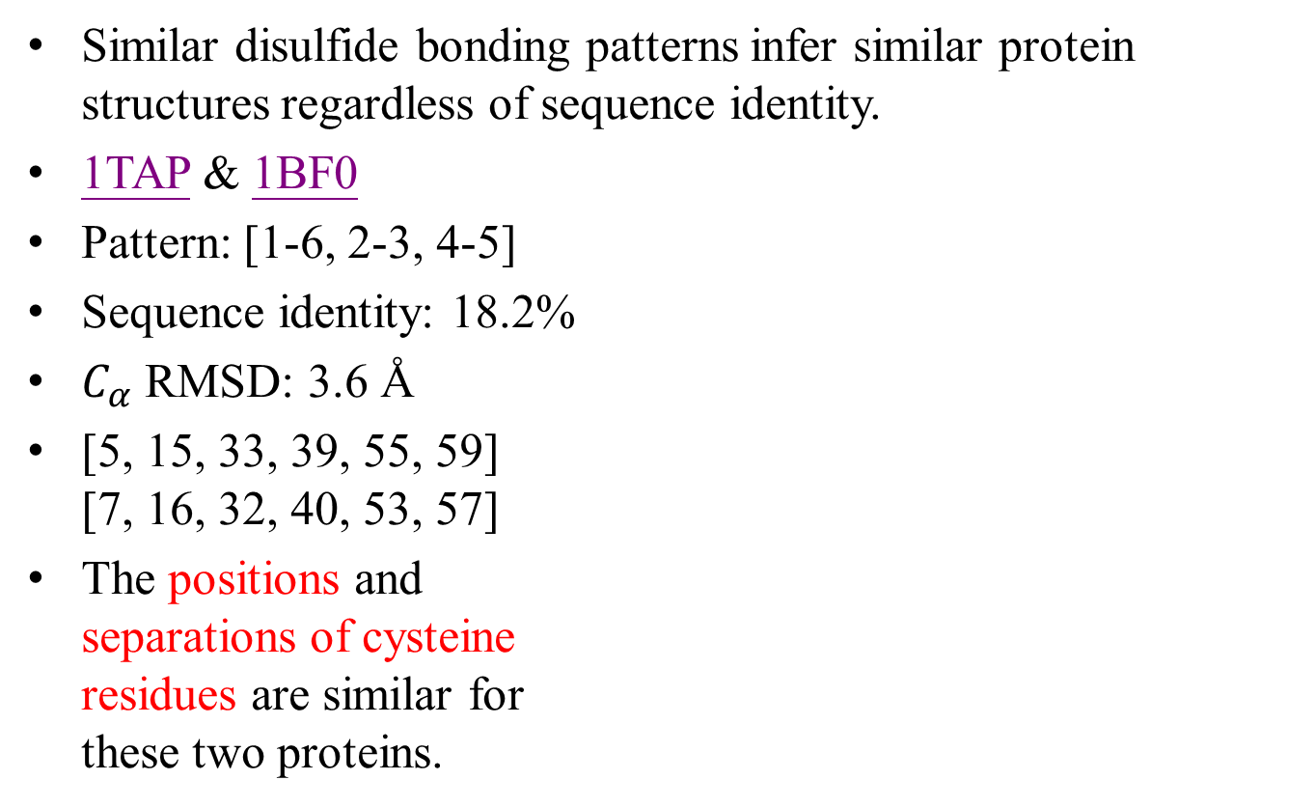
Basic assumption
Similar disulfide bonding patterns infer similar protein structures regardless of sequence identity.
1TAP & 1BF0
Pattern: [1-6, 2-3, 4-5]
Sequence identity: 18.2%
$C_{α}$ RMSD: 3.6 Å
[5, 15, 33, 39, 55, 59] [7, 16, 32, 40, 53, 57]
The positions and separations of cysteine residues are similar for these two proteins.

Slide 9
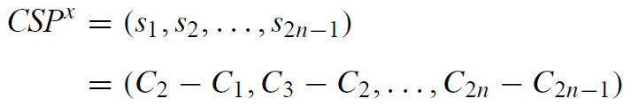
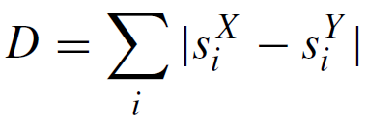
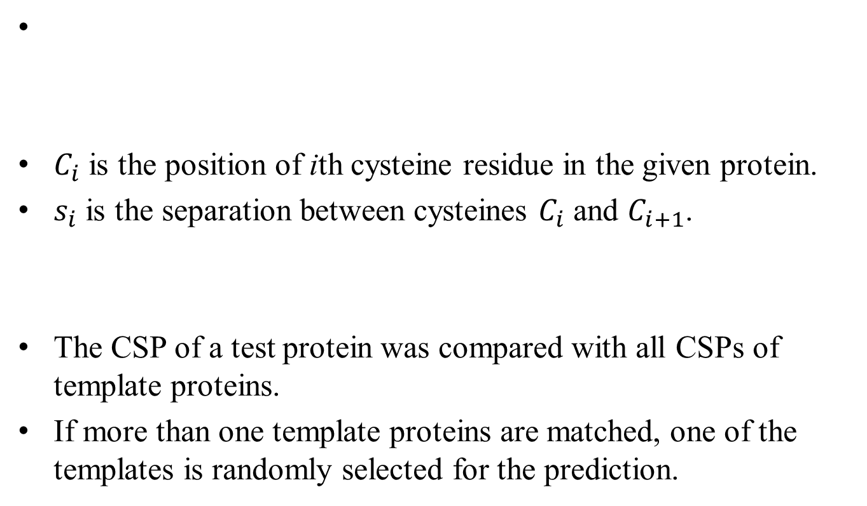
CSP (Cysteine separations profiles)
$C_{i}$ is the position of ith cysteine residue in the given protein.
$s_{i}$ is the separation between cysteines $C_{i}$ and $C_{i+1}$.
The CSP of a test protein was compared with all CSPs of template proteins.
If more than one template proteins are matched, one of the templates is randomly selected for the prediction.

Slide 10
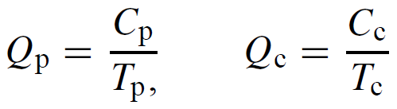
Evaluation of prediction accuracy
The method is basically a nearest-neighbor (NN) approach.
1-NN v.s. k-NN

Slide 11
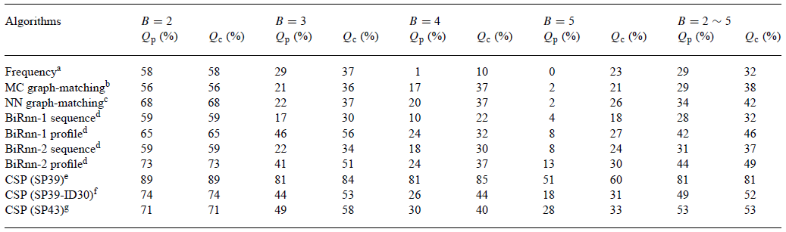
Fourfold cross validation
There are 37.4% of matched profiles and 62.6% of mismatched profiles patterns in the SP39 dataset.

Slide 12
Fourfold cross validation
Frequency – Most frequently observed pattern
MC graph-matching – Monte Carlo
NN graph-matching – Neural Networks
BiRnn – Recursive neural networks with sequence and evolutionary information

Slide 13
Handout prediction of new sequences from SP43
The pairwise identities of sequences in the template set and SP43 are less than 30%.
Increasing even the number of non-redundant templates may improve the prediction accuracy of CSP.

Slide 14
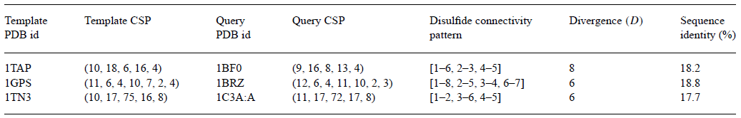
Examples
The divergence scores are all smaller than 10, implying that they share similar disulfide positioning and connectivity patterns.
The sequence identities are all lower than 20%, thus structure similarity from sequence homology can be ruled out.

Slide 15
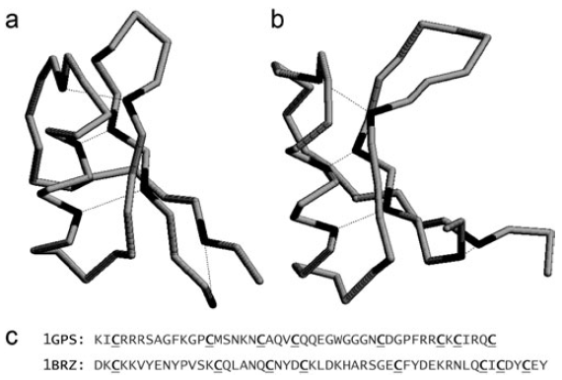
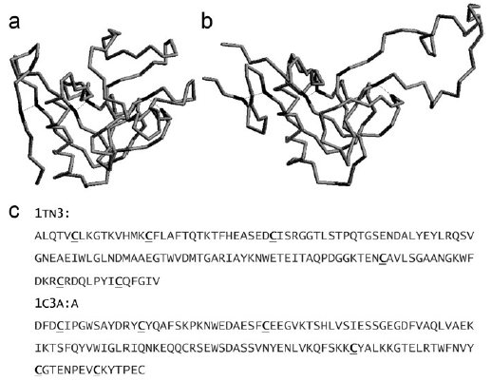
Examples
1GPS & 1BRZ 1TN3 & 1C3A:A
Pattern: [1-8, 2-5, 3-4, 6-7] Pattern: [1-2, 3-6, 4-5]
Sequence identity: 18.8% Sequence identity: 17.7%

Slide 16
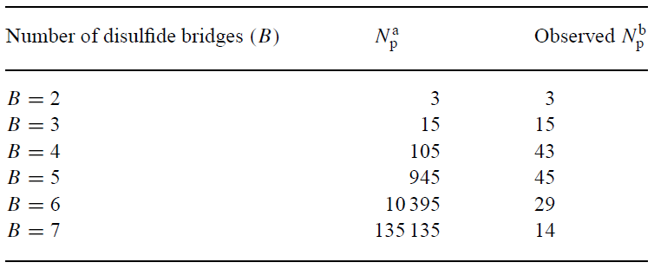
Discussions
The disulfide connectivity pattern of a protein sequence can be predicted from a limited set of templates.
One limitation of the approach is that a pattern not presented in the training set cannot be predicted correctly.

Slide 17
Divergence coverage
The divergence coverage means that a profile matches with a divergence score smaller than or equal to that specified.
Ex: divergence coverage 5 means profiles matched with a divergence score ≤5.
Divergence coverage can be used as an index for adoption of CSP or other machine-learning approaches to predict disulfide connectivity.

Slide 18
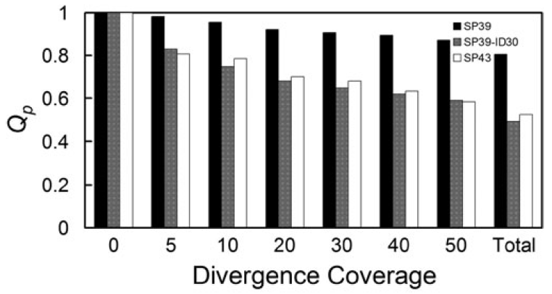
Divergence coverage
However, these divergence scores are not normalized according to the number of disulfide bridges and the lengths of protein sequences.

Slide 19
Conclusions
In this work, we have shown that cysteine separation profiles (CSPs) can be used in predicting disulfide connectivity patterns based on the hypothesis that proteins with similar cysteine separations in sequences may have similar disulfide bonding patterns.

