Slide 1
A stock recommendation system exploiting rule discovery in stock databases
You-Min Ha, Sanghyun Park, Sang-Wook Kim,
Jung-Im Won, Jee-Hee Yoon
Information and Software Technology 51 (2009) 1140–1149
Presenter: Chang-Hao Huang
Date: Oct. 17, 2011

Slide 2
Abstract
This paper addresses an approach that recommends investment types to stock investors by discovering useful rules from past changing patterns of stock prices in databases. First, we define a new rule model for recommending stock investment types. For a frequent pattern of stock prices, if its subsequent stock prices are matched to a condition of an investor, the model recommends a corresponding investment type for this stock. The frequent pattern is regarded as a rule head, and the subsequent part a rule body. We observed that the conditions on rule bodies are quite different depending on dispositions of investors while rule heads are independent of characteristics of investors in most cases.

Slide 3
With this observation, we propose a new method that discovers and stores only the rule heads rather than the whole rules in a rule discovery process. This allows investors to impose various conditions on rule bodies flexibly, and also improves the performance of a rule discovery process by reducing the number of rules to be discovered. For efficient discovery and matching of rules, we propose methods for discovering frequent patterns, constructing a frequent pattern base, and its indexing. We also suggest a method that finds the rules matched to a query from a frequent pattern base, and a method that recommends an investment type by using the rules. Finally, we verify the effectiveness and the efficiency of our approach through extensive experiments with real-life stock data.

Slide 4
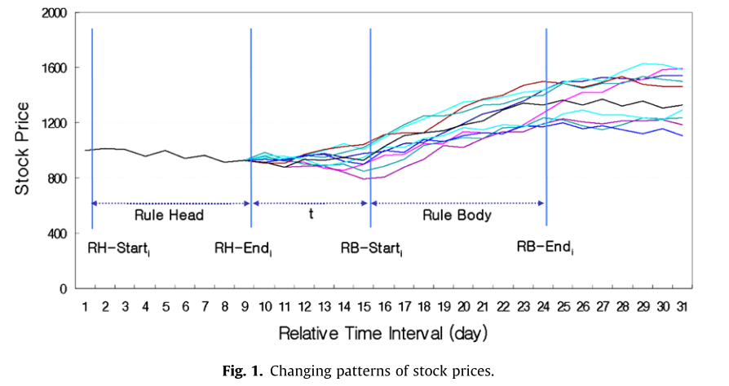
Motivating Example

Slide 5

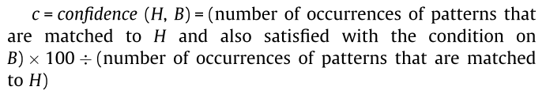
Our approach discovers those rules whose support and confidence are both larger than predetermined thresholds during analyzing the past stock sequences.

Slide 6
A pattern is called a frequent pattern when it has a support larger than a predefined threshold called a minimum support (MinSup).
A pattern is called a candidate pattern when it is not judged as infrequent.
EX: <A> <B> are frequent patterns, and <C> is infrequent pattern. <AB> <BA> are possible to be frequent pattern.

Slide 7
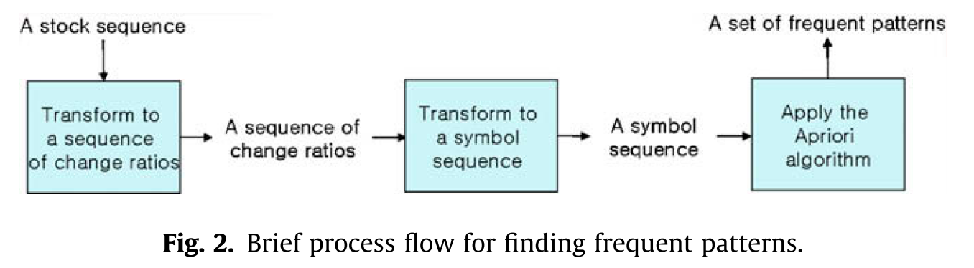
Construction of a frequent pattern base

Slide 8

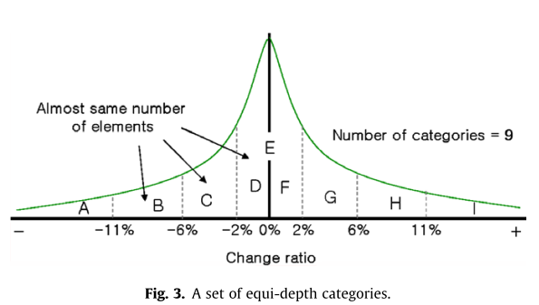
S = <5000, 5100, 4900, 5400>
S’ = <2.00%, -3.92%, 10.20%>
S’’ = <F, C, H>
Change ratio ➔

Slide 9
Apriori algorithm
Discover a set of frequent patterns F₁ of length 1 by scanning S’’
Perform the self-join of F_{k-1}(2≦k ≦Len(S’’)) to produce a set of candidate patterns C_{k} of length k.
For each pattern α in C_{k}, we scan S’’ to decide whether the support of α is greater than or equal to a predefined minimum support MinSup. If α’s support is greater than or equal to MinSup, then α is inserted into F_{k}.
We repeat the above process with incrementing k until no candidates in C_{k} are judged as frequent and thus there are no elements in F_{k}.

Slide 10
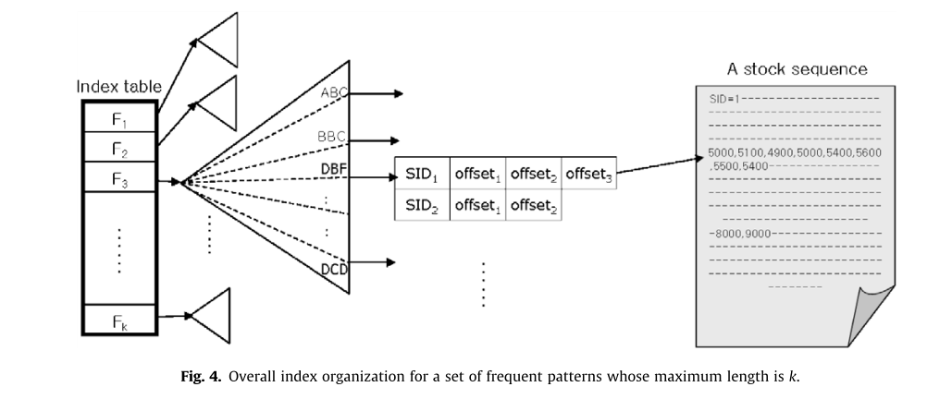

Slide 11
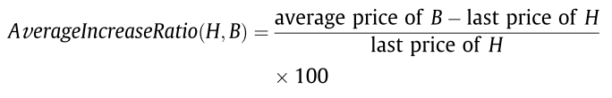
Rule matching and recommendation
Queries for requesting recommendation types are specified by
EX : Q = (1, QP, 0, 3, [-5%, +5%], 50%)
QP = <5000,5100,4900, 5400>
[minHold, maxHold] denotes the range of average increase ratio for retaining the current stock item

Slide 12
Procedure
Step 1: Symbolization of a query pattern:
Step 2: Searching for matched rule head:
Step 3: Retrieval of actual element values of rule heads and bodies:
Step 4: Calculation of average increase ratio:
Step 5: Calculation of confidence:
Step 6: Rule generation:
Step 7: Recommendation of an investment type:

Slide 13
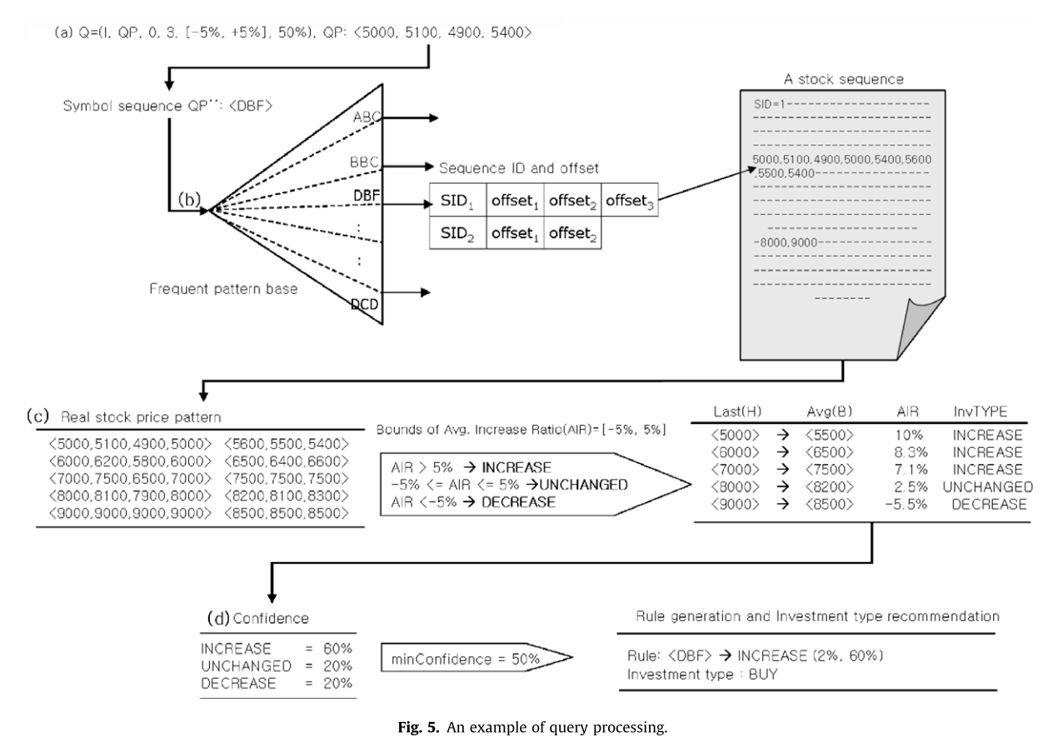

Slide 14
Performance evaluation
We selected 10 blue-chip stock items included in the Korean Composite Stock Price Index (KOSPI) For each stock item, we collected a sequence of more than 5500 real numbers that represent the daily closing stock prices for 20 years from 28 May 1985 to 27 May 2005.
70% of KOSPI Data was used for constructing a frequent pattern base, and 30% of KOSPI Data was used for forming query sequences.

Slide 15

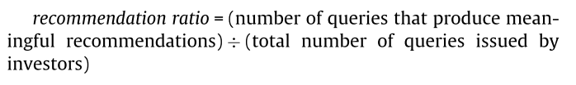
The satisfaction level (sLevel) indicates the percentage of the average increase ratio with which investors are actually satisfied.
[minHold, maxHold] → rule
[minHold*sLevel, maxHold*sLevel] →satisfied range
EX: sLevel = 20%
[-20%, 20%] → buy
[-4%, 4%]

Slide 16
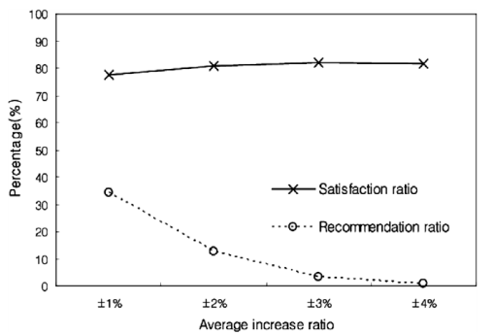
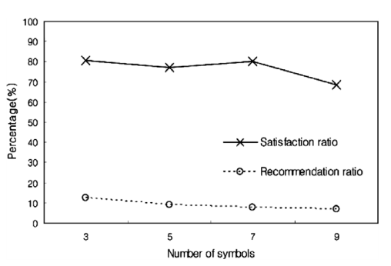
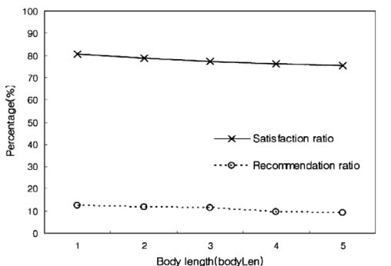
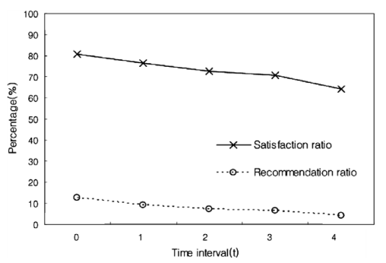

Slide 17
