Slide 1
Integrating atom-based and residue-based scoring functions for protein–protein docking
Thom Vreven, Howook Hwang, and Zhiping Weng* PROTEIN SCIENCE 2011 Vol 20:1576-1586 Presenter: Guo Yi-Pu 2011/10/17

Slide 2
Abstract (1/2)
Most scoring functions for protein–protein docking algorithms are either atom-based or residue-based, with the former being able to produce higher quality structures and latter more tolerant to conformational changes upon binding.
Earlier, we developed the ZRANK algorithm for reranking docking predictions, with a scoring function that contained only atom-based terms. Here we combine ZRANK’s atom-based potentials with five residue-based potentials published by other labs, as well as an atom-based potential IFACE that we published after ZRANK.

Slide 3
Abstract (2/2)
We simultaneously optimized the weights for selected combinations of terms in the scoring function, using decoys generated with the protein–protein docking algorithm ZDOCK. We performed rigorous cross validation of the combinations using 96 test cases from a docking benchmark. Judged by the integrative success rate of making 1000 predictions per complex, addition of IFACE and the best residue-based pair potential reduced the number of cases without a correct prediction by 38 and 27% relative to ZDOCK and ZRANK, respectively.
Thus combination of residue-based and atom-based potentials into a scoring function can improve performance for protein–protein docking. The resulting scoring function is called IRAD (integration of residue- and atom-based potentials for docking) and is available at http://zlab.umassmed.edu.

Slide 4
Introduction
1.

Slide 5
protein–protein docking
To predict a complex structure starting from the unbound structures of the component proteins.
Complex (Multi-protein complex) is a group of two or more associated polypeptide (多肽) chains. - Wiki

Slide 6
How?
The proteins are kept rigid (剛硬), and search the six-dimensional (6D) rotational and translational space. ← time consuming.
So, approached in a stepwise fashion (逐步形成):
Initial stage: rapidly computable scoring functions
↓ many possible (1,000 to 10,000)
Refinement stage: more time consuming scoring functions

Slide 7
ZDOCK
For initial stage docking.
Performs an exhaustive rigid body search in the 6D rotational and translational space.
Euler angles: 15° or 6°
3 translational degrees of freedom: 1.2 Å
For each set of rotational angles, only the best scoring translation is retained.
15° → 3600; 6° → 54,000 predictions.

Slide 8
IFACE
A new statistical pair potential.
In the latest version, ZDOCK 3.0.

Slide 9
ZRANK
A reranking program.
Developed before ZDOCK 3.0.
Effective in reranking ZDOCK 2.1 and ZDOCK 2.3 predictions with high computational speed.

Slide 10
Conformational changes
Proteins undergo (經歷) conformational (結構上) changes upon complex formation (形成):
often only on surface side chains
sometimes on the backbones of surface loops
sometimes involving entire domains

Slide 11
Atom-based vs. Residue-based
Atom-based potentials
can be more accurate than residue-based potentials on high quality structures.
Residue-based potentials
can better tolerate (容許) conformational changes.
The parameterization is residue-type specific, which may be able to capture the biophysical interactions missed by the atom types used in atom-based potentials.

Slide 12
Atom-based + Residue-based
Previous work:
were applied to different stages of the pipeline, but not within a single scoring function.
This work:
the atom-based potentials in ZRANK +
several residue-based potentials (other labs) +
the atom-based potential IFACE

Slide 13
Results
2.

Slide 14
Results
2-1. The potentials

Slide 15
The potentials (atom-based)
ZRANK scoring function
Van der Waals (attractive/repulsive)
Electrostatics (short-range/long-range)
ACE desolvation contact energy
ZDOCK 3.0
Van der Waals (attractive/repulsive)
Electrostatics
IFACE desolvation contact energy

Slide 16
The potentials (residue-based)
Glaser, Steinberg, Vakser, and Ben-Tal (GSVB)
Tobi and Bahar (TB)
Lu, Lu, and Skolnick (LLS)
The pair potential developed for protein folding:
Zhang, Kolinski, and Skolnick (ZKS)
uses an alternative definition of the interaction site (ZKS/a).
Nonpairwise:
Chakrabarti and Janin (CJ).

Slide 18
Results
2-2. Combining potentials

Slide 19
Combining potentials (1/4)
We tested the reranking performance of linear combinations of the potentials introduced above.
Because the number of terms we can combine with this procedure is limited, we only tested combinations of up to 10 different potentials.

Slide 20
Combining potentials (2/4)
Decoys: generated with ZDOCK 3.0 for the complexes from our docking benchmark (3.0).
For training and testing: 8-fold cross-validation
Optimize weights: downhill simplex algorithm

Slide 21
Combining potentials (3/4)
Success rate
The number of cases that have at least one hit in a set of predictions.
Where a hit has a RMSD of less than 2.5 Å relative to the native complex.
Hit rate
The number of hits in a set of predictions.

Slide 22
Combining potentials (4/4)
Integrated success rate (ISR)
the area under the success rate curve for 1–1000 predictions, normalized to 1.
The worst performance is at ISR = 0; the perfect performance is at ISR = 1.

Slide 23
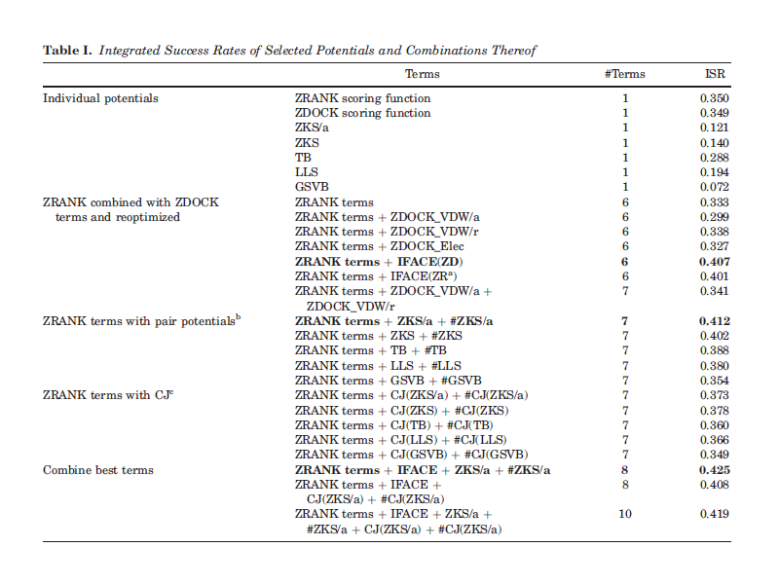

Slide 24
Methods
3.

Slide 26
Conclusions
4.

Slide 27
the IRAD scoring function improves over ZDOCK and ZRANK:
an gain in success rate of about 10%.
reducing the number of cases for which ZDOCK and ZRANK do not find hits by up to 40% for the top 1000 predictions.
The resulting scoring function is balanced for the different types of complexes.

Slide 28
The End
Thanks.

