Slide 1
LoCo: a novel main chain scoring function for protein structure prediction based on local coordinates
Stewart E Moughon and Ram Samudrala
BMC Bioinformatics, Vol. 12, pp. 368-381, 2011
Presenter: Hsin-Fang Wu
Date: Oct. 17, 2011

Slide 2
Abstract (1/3)
Background:
Successful protein structure prediction requires accurate low-resolution scoring functions so that
protein main chain conformations that are close to the native can be identified. Once that is accomplished, a more detailed and time-consuming treatment to produce all-atom models can be undertaken. The earliest low-resolution scoring used simple distance-based “contact potentials,” but more recently, the relative orientations of interacting amino acids have been taken into account to improve performance.

Slide 3
Abstract (2/3)
Results: We developed a new knowledge-based scoring function, LoCo, that locates the interaction partners of each individual residue within a local coordinate system based only on the position of its main chain N, Ca and C atoms. LoCo was trained on a large set of experimentally determined structures and optimized using standard sets of modeled structures, or “decoys.” No structure used to train or optimize the function was included among those used to test it. When tested against 29 other published main chain functions on a group of 77 commonly used decoy sets, our function outperformed all others in Ca RMSD rank of the best-scoring decoy, with statistically significant p-values < 0.05 for 26 out of the 29 other functions considered. LoCo is fast, requiring on average less
than 6 microseconds per residue for interaction and scoring on commonly-used computer hardware.

Slide 4
Abstract (3/3)
Conclusions: Our function demonstrates an unmatched combination of accuracy, speed, and simplicity and shows excellent promise for protein structure prediction. Broader applications may include protein-protein interactions and protein design.

Slide 5
Background (1/3)
Protein structure can be viewed in a hierarchical manner.
Oligomer (低聚物)
Polypeptide chain
Amino acid
atom

Slide 6
Background (2/3)
In the initial stages, coarse-grained functions using highly simplified representations of amino acids are employed to quickly evaluate a large number of proposed main chain conformations. Only a small fraction of these structures are selected for more detailed assessment.
If the low-resolution functions used to select that small
fraction are unable to discriminate near-native main
chains from incorrect ones, then a successful prediction
is effectively impossible using this approach.

Slide 7
Background (3/3)
As a practical consideration, it is important to model the smallest number of main chain conformations needed to ensure that conformations good enough to be considered successful predictions (or able to lead to successful predictions) are among those sampled.
The goal is to be able to discriminate the native and near-native conformations from the non-native ones.
Further, we focus on the problem of quickly and accurately
assessing proposed main chain conformations, ignoring side chains.

Slide 8
Types of functions (1/2)
There are two categories of functions that are applied to protein structures to evaluate their likelihood of being correct: physics-based functions and knowledge-based functions.
Physics-based functions attempt to model the actual physics that determine the behavior of proteins.
Knowledge-based functions are derived from statistical profiles taken from sets of known protein structures.
One common approach is to measure the separations between all pairs of residues and apply the function to all of them that fall below a given cutoff distance. These separations are typically between Cα atoms, Cβ atoms or presumed centers of mass for each residue. These so-called “contact” potentials depend on the identities of both residues.

Slide 9
Types of functions (2/2)
We present a new coarse-grained function for evaluating protein main chain conformations by scoring interactions between amino acids within a single polypeptide chain, using only the positions of main chain N, Cα and C atoms.
All pairwise residue-residue interactions are actually considered to be two interactions: one from the perspective of each residue. All other residues within a specified cutoff distance are considered to be potential interaction partners.
Scoring is carried out by locating all interaction partners for any given residue within a local Cartesian coordinate system defined by that residue’s main chain N, Cα and C atoms.
This local coordinate system is divided into cubic 1Å bins, and every interaction partner is assigned to a bin.

Slide 10
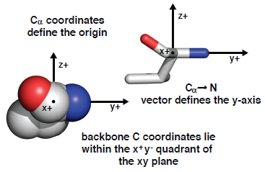
Methods - LoCo Methodology (1/3)
The Cα is at the origin of this coordinate system.
The N coordinates define the y-axis, and position of the main chain C atom defines the x- and z-axes. A different coordinate system is generated for each residue.
We refer to the amino acid at the origin as the “observing” residue and all nearby residues eligible to interact with the observing residue as “partner” residues.

Slide 11
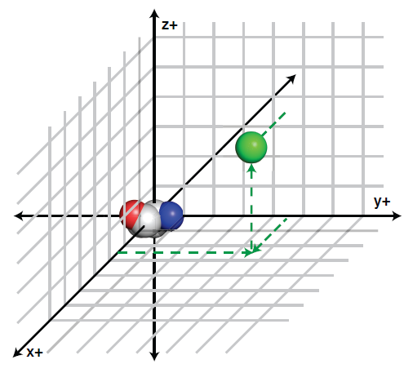
Methods - LoCo Methodology (2/3)
The partner residue is assigned a score based on the likelihood of its being observed in that bin, given the types of both residues. The total score for any given observing residue is the sum of all the scores for its partners, and the score for the protein is the sum of all residue scores when every residue has been treated as an observing residue.
The Ca atom of an interacting residue is displayed separately in green within bin +3,+5, +4.

Slide 12
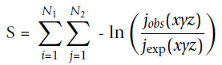
Methods - LoCo Methodology (3/3)
The individual interaction scores are derived from statistics
that have been obtained from a large set of non-homologous
protein domains. Here is the formula:
S is the total score for all pairwise residue-residue interactions, and i and j are the observing and interacting residues, respectively.
j_{obs}(xyz) is the number of times a residue of type i has observed a residue of type j in the training set at bin coordinates x, y and z in its local coordinate system.
The reference state, jexp(xyz) is the number of times a residue of type j would be expected to be observed at those coordinates.
N1 represents all amino acids in the polypeptide chain; N2 represents only those residues that are eligible to be interaction partners for i.

Slide 13
Methods - Function Training (1/2)
All versions of the LoCo scoring databases were taken from the ASTRAL 1.73 set of 9527 non-homologous protein domains. As noted above, we also used a “training group” of 154 decoy sets to find an optimal set of function parameters.
When optimizing our function parameters, we followed a process of tenfold cross-validation. We established a baseline zero-count penalty equal to the worst score calculated for each pair of residue types, then tested penalties equal to 1, 2 or 3 times the baseline. This gave us a total of 84 different versions of the LoCo scoring function.

Slide 14
Methods - Function Training (2/2)
The training group was divided into ten randomly selected subsets–six containing 15 decoy sets and four containing 16. Nine of these subsets were scored using all 84 versions of the LoCo function, and the average Cα RMSD between the native and the best-scoring non-native structure was calculated for each version.
The version of LoCo with the lowest average Cα RMSD across all nine subsets was used to score the remaining subset. The LoCo version selected was the one with the lowest overall average Cα RMSD among all ten remaining subsets.

Slide 15
Methods - Decoy sets for evaluation of scoring functions
“Decoy” structures representing a mix of near-and non-native conformations for a particular amino acid sequence.
We used 231 decoy sets from the “Decoys R Us” database, we divided these 231 decoy sets into the same two groups, a 154 set group for function optimization (the “training group”) and a 77 set group for performance evaluation (the “testing group”).

Slide 16
Methods - Performance Measures (1/2)
We use five performance measures for native structure
recognition: Ranknat, RMSDbest, Znat, CCnat and FEnat.
Eight measures–RB1, RB10, RMSDdecoy, Zdecoy, CCdecoy,
FEdecoy, log(PB1) and log(PB10)–are used for decoy discrimination.
Ranknat: score rank of the native structure among all decoys.
RMSDbest: Cα RMSD of the best-scoring structure.
Znat: Z-score of the score of the native structure relative to all other scores in that decoy set.
CCnat: Pearson’s correlation coefficient between score and Cα RMSD for all structures in the set.
FEnat: fraction enrichment among all decoys after scoring.

Slide 17
Methods - Performance Measures (2/2)
RB1: Cα RMSD ranking among decoys only of our best-scoring structure.
RB10: lowest Cα RMSD rank among the 10 best-scoring structures from the decoy set.
RMSDdecoy: Cα RMSD of the best-scoring structure.
Zdecoy: Z-score of the score of the lowest-RMSD decoy relative to all other scores in that decoy set.
CCdecoy: correlation coefficient between score and Cα
RMSD for all structures in the set, excluding the native.
FEdecoy: fraction enrichment among all decoys after scoring. The measures log(PB1) and log(PB10) are the common logarithms of the probabilities of selecting the RB1 and RB10 structures. These probabilities are simply the values of RB1 and RB10 divided by the total number of decoy structures in the set.

Slide 18
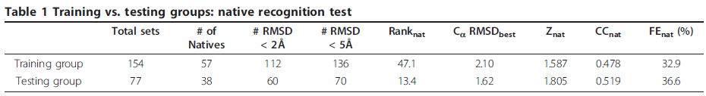
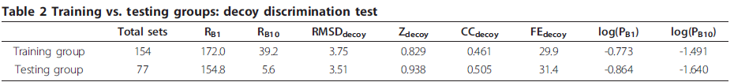
Results
Very near native
near native
For the training group, the best-scoring structure in each set was very near native for 112 of 154 decoy sets (72.7% of the time) and near native for 136 sets (88.3% of the time). For the test group, the best-scoring structures were very near native
in 60 of 77 cases (77.9%) and near native for 70 of 77 sets (90.9% of the time).
The average Cα RMSD (from the native) of the best-scoring structures from all of the training group was 2.10Å. For the test group it was 1.62Å, a difference of less than 0.5Å.
< 0.25Å

Slide 19
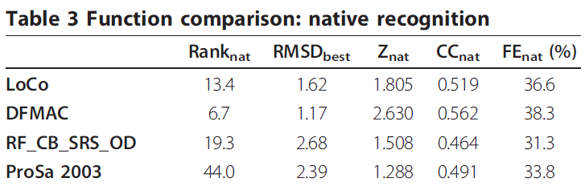
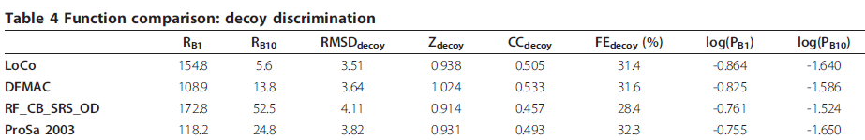
Results
比DFMAC差，比其他兩個好
有include ω-angle 因此 Ranknat 和 Znat 有顯著差異
best
略低
略高

Slide 20
Results - Speed
The average total processing time for a single structure
in the final testing group was 2.6 milliseconds. This time includes reading the structure from the hard disk drive, loading it into the program, determining all relevant interactions, scoring the structure and clearing it from memory.
The standard deviations for total processing time and interaction determination and scoring time were relatively large: 1.4 ms (54%) and 0.32 ms (68%), respectively.
On a “per residue” basis the times were more consistent.
The average total processing time per residue was 0.032 ms with a standard deviation of 0.0037 ms (12%).
The average interaction determination and scoring time per residue was 0.0054 ms with a standard deviation of 0.0011 ms (20%).

Slide 21
Conclusion
We present a novel scoring function, “LoCo,” for evaluating
protein main chain conformations. Our method considers relative positioning in all three dimensions and examines every interaction from the perspective of both partners.
LoCo provides an unprecedented combination of speed and accuracy. Since a local coordinate system can be generated for any chiral group of atoms, there are many possible ways the fundamental concept could be applied.

Slide 22
Thanks for your listening !!

