Slide 1
Two algorithms for LCS Consecutive Suffix Alignment
Gad M. Landau , Eugene Myers , Michal Ziv-Ukelson
Journal of Computer and System Sciences
Vol. 73, 1095–1117, 2007
Speaker: Kai-Yuan Cheng
Date: Oct. 24, 2011

Slide 2
Abstract
The problem of aligning two sequences A and B to determine their similarity is one of the fundamental problems in pattern matching. A challenging, basic variation of the sequence similarity problem is the incremental string comparison problem, denoted Consecutive Suffix Alignment, which is, given two strings A and B, to compute the alignment solution of each suffix of A versus B.
Here, we present two solutions to the Consecutive Suffix Alignment Problem under the LCS (Longest Common Subsequence) metric, where the LCS metric measures the subsequence of maximal length common to A and B. The first solution is an O(nL) time and space algorithm for constant alphabets, where the size of the compared strings is O(n) and L ≦ n denotes the size of the LCS of A and B.
The second solution is an O(nL+n log |Σ|) time and O(n) space algorithm for general alphabets, where Σ denotes the alphabet of the compared strings.

Slide 3
Consecutive Suffix Alignment
Definition 1 The Consecutive Suffix Alignment problem is, given two strings A and B, to compute the alignment solution of each suffix of A versus B.

Slide 4
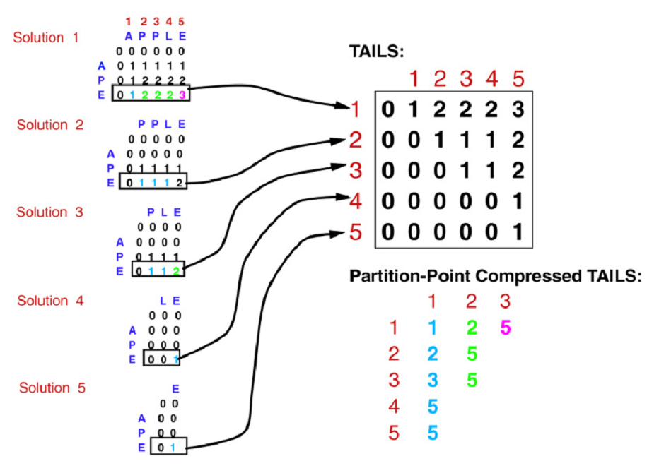

Slide 5
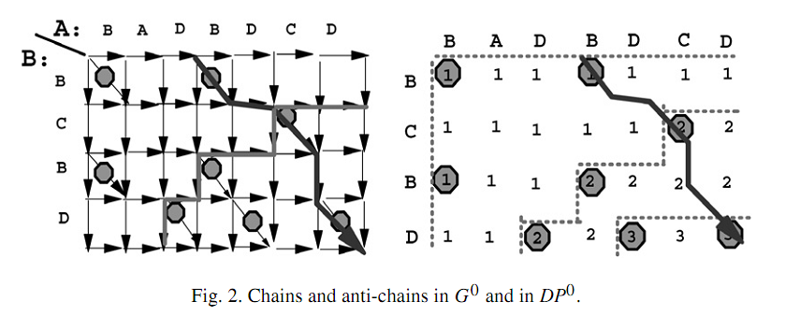

Slide 6
The second algorithm

Slide 7
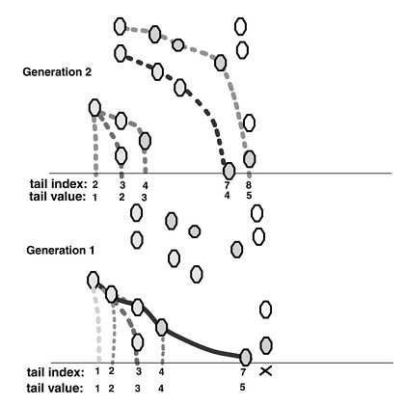
tail, head, active chain

Slide 8
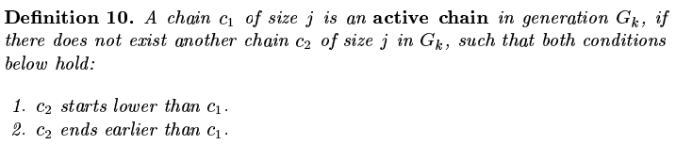
active chain

Slide 9
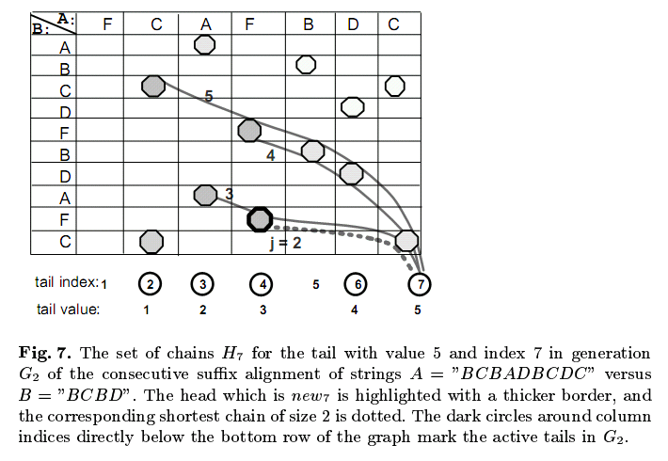


Slide 10
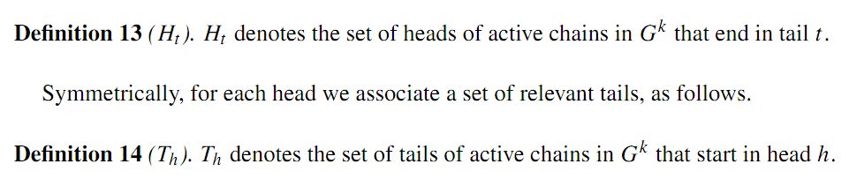
Head, tail

Slide 11
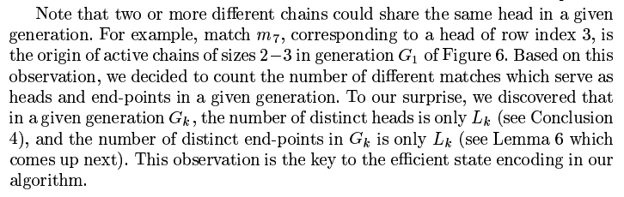
The number of distinct heads is only L_{k} in G_{k}, and the number of distinct heads is only L_{k} too.

Slide 12
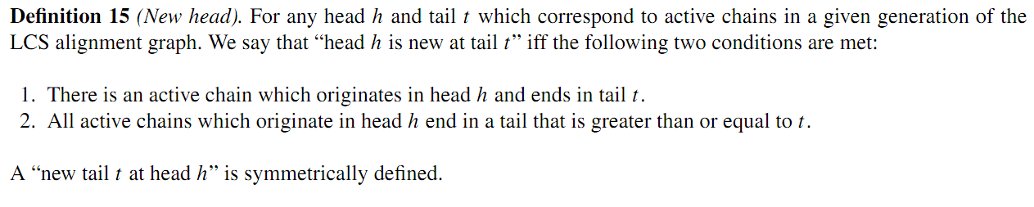
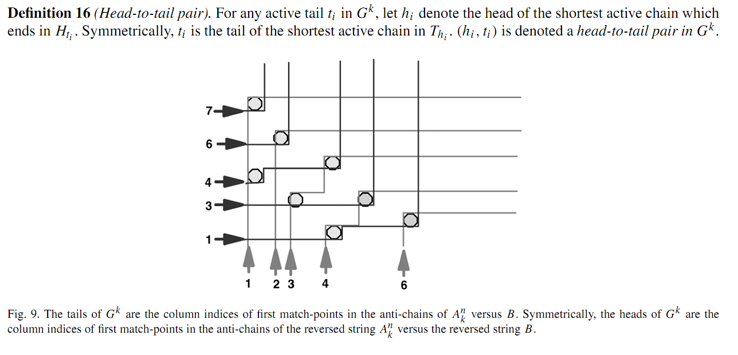
Definition of new

Slide 13
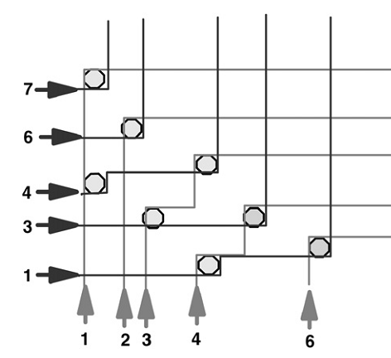
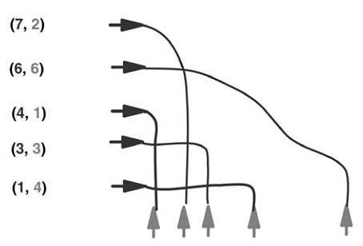

Slide 14
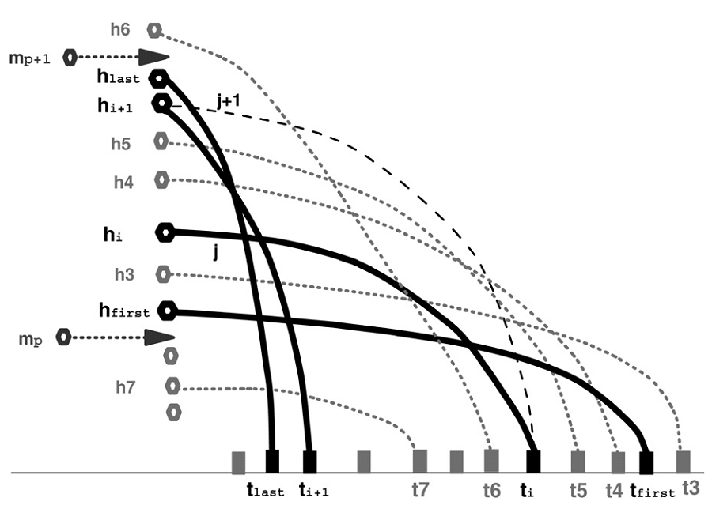

Slide 15
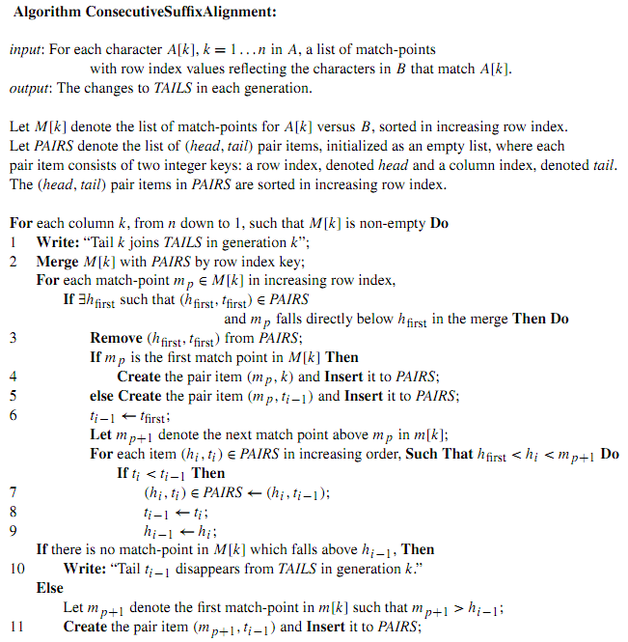

Slide 16
Time and space complexity
O(nL + n log |Σ|) time. (Note that, since we only need to create MatchLists for characters appearing in B, an alphabet of size |Σ| >n can be reduced in O(n log n) time to an n-sized alphabet. Therefore, throughout the paper we assume |Σ| ≦ n.)
O(n) space of MatchLists

Slide 17
Thank you!!!

