Slide 1
Gene Expression Programming: A New Adaptive Algorithm for Solving Problems Complex Systems, Vol. 13, issue 2: 87-129, 2001
Cândida Ferreira†
Departamento de Ciências Agrárias
Universidade dos Açores
9701-851 Terra-Chã
Angra do Heroísmo, Portugal
Presenter: Chen Yun-Shiun
Date:2011/11/7

Slide 2
Abstract
Gene expression programming, a genotype/phenotype genetic algorithm (linear and ramified), is presented here for the first time as a new technique for the creation of computer programs. Gene expression programming uses character linear chromosomes composed of genes structurally organized in a head and a tail. The chromosomes function as a genome and are subjected to modification by means of mutation, transposition, root transposition, gene transposition, gene recombination, and one- and two-point recombination. The chromosomes encode expression trees which are the object of selection. The creation of these separate entities (genome and expression tree) with distinct functions allows the algorithm to perform with high efficiency that greatly surpasses existing adaptive techniques. The suite of problems chosen to illustrate the power and versatility of gene expression programming includes symbolic regression, sequence induction with and without constant creation, block stacking, cellular automata rules for the density-classification problem, and two problems of boolean concept learning: the 11-multiplexer and the GP rule problem.

Slide 3
Genetic Algorithm
Proposed by John Holland, 1975
仿效生物界中的物競天擇的自然進化的法則。由物種中選擇較好特性的母代，隨機性相互交換位元資訊，以期產生更為優秀的的子代，重複下去，產生適應性最強的最佳物種。

Slide 4
Genetic Programming
在1989年時，John Koza將遺傳演算法（Genetic Algorithm, GA）再延伸成基因規劃法（Genetic Program, GP），將演化單位從固定長度的二元字串擴充成可以變動大小和形狀的分析樹（parse tree），用以代表電腦程式、函數或交易策略。而在1992年，他利用基因演算法發展了一套電腦程式來解決了一些問題，他稱此程式為「 Genetic Programming」，他使用 LISP 語言來撰寫他的程式，因為 LISP 語言可以表示分析樹的型式。

Slide 5
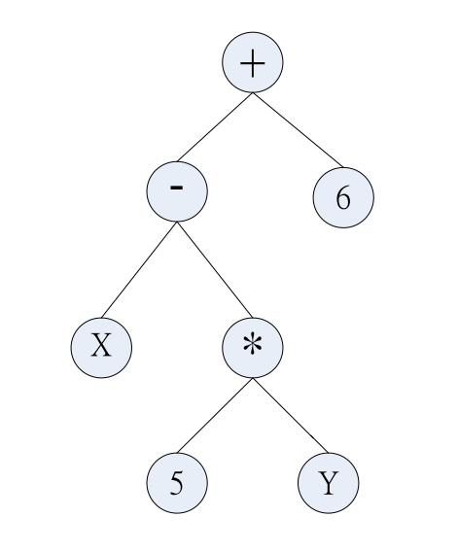
Genetic Programming(GP)
Extension of genetic algorithm (GA)
Major difference between GP and GA: the representation of the candidate solution
The tree structure of GP which represents a formula
X – 5*Y +6

Slide 6
開始
產生初始解
計算適應度函數
複製
交配
突變
取代
是否達到終止條件
結束

Slide 7
crossover
交配運算式，依據交配率從一族群中隨機地任意兩個字元串，經彼此交換字元串的某些位元資訊而產生兩個新位元字串的一種過程，一般而言交配運算可以用:
(a)單點交配
(b)兩點交配
(c)定點交配

Slide 8
單點交配
1 | 0 | 0 | 1 | 0 | 1 | 1 | 0 | 0 | 1
0 | 0 | 0 | 1 | 1 | 0 | 1 | 0 | 1 | 0
1 | 0 | 0 | 1 | 0 | 0 | 1 | 0 | 1 | 0
0 | 0 | 0 | 1 | 1 | 1 | 1 | 0 | 0 | 1

Slide 9
兩點交配
1 | 0 | 0 | 1 | 0 | 1 | 1 | 0 | 0 | 1
0 | 0 | 0 | 1 | 1 | 0 | 1 | 0 | 1 | 0
1 | 0 | 0 | 1 | 1 | 0 | 1 | 0 | 0 | 1
0 | 0 | 0 | 1 | 0 | 1 | 1 | 0 | 1 | 0

Slide 10
reproduction
1.複製是依據每一物種的適應程度來決定下一代中應被淘汰或複製且保留的個數多寡的一種運算過程
2.複製過程有三種形式:(a)輪盤式策略(b)競爭式策略(c)完全式策略

Slide 11
(a)輪盤式選擇(roulette wheel selection)
在每一代的演化過程中，首先依每個物種(字串)的適應函數值的大小來分割輪盤的位置，適應函數值越大的話，則在輪盤上佔有的面積比例也越大，每個物種在輪盤上佔有的面積比例越大代表被挑選到交配池中的機率越大，然後隨機選取輪盤的一點，其所對應的物種即被選入到交配池中。

Slide 12
Mutation
突變的過程是隨機的選取一物種的字串，並隨機選取突變點，並改變物種字串裡的位元資訊突變過程發生機率由突變機率所控制。
(a)位元突變
(b)雙點突變
(c)隨機選取突變
1 | 0 | 0 | 1 | 0 | 1 | 1 | 0 | 0 | 1
1 | 0 | 0 | 1 | 0 | 0 | 1 | 0 | 0 | 1

Slide 13
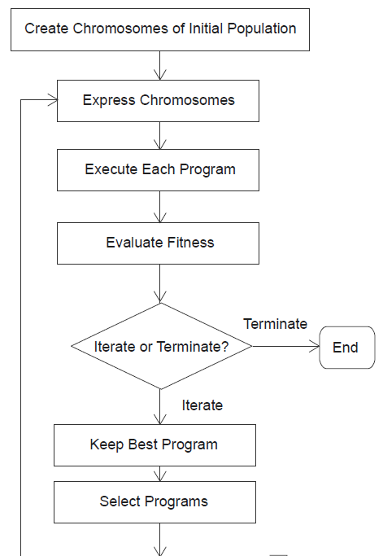
Flowchart of gene expression algorithm

Slide 14
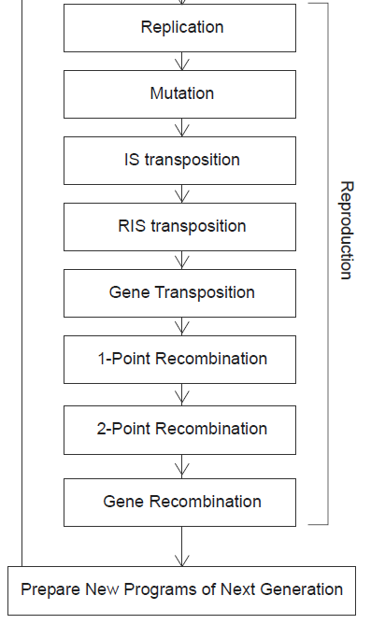
Flowchart of gene expression algorithm

Slide 15
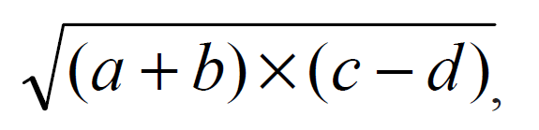
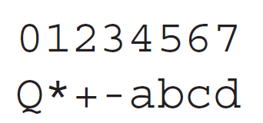
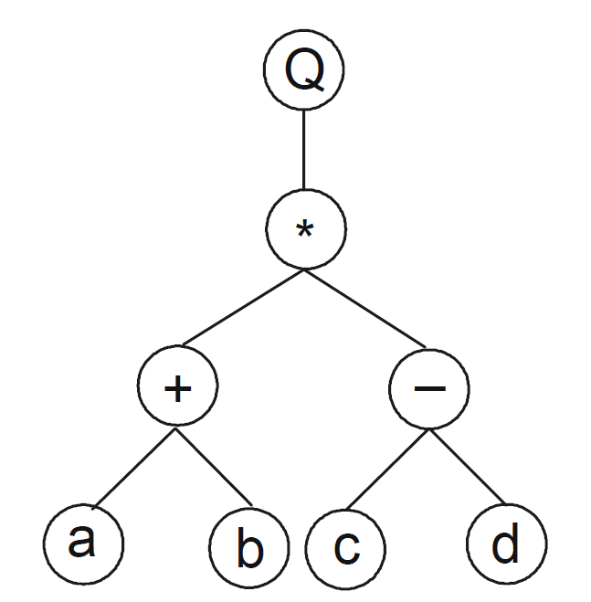
Open reading frames (ORFs)
Algebraic expression:
Expression Tree:
K expression:

Slide 16
Open reading frames (ORFs)
ET to K-expression
Top to down, left to right
K-expression to ET
Top to down, left to right
Stop when all the leaves are terminal

Slide 17
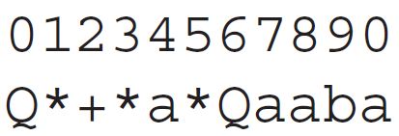
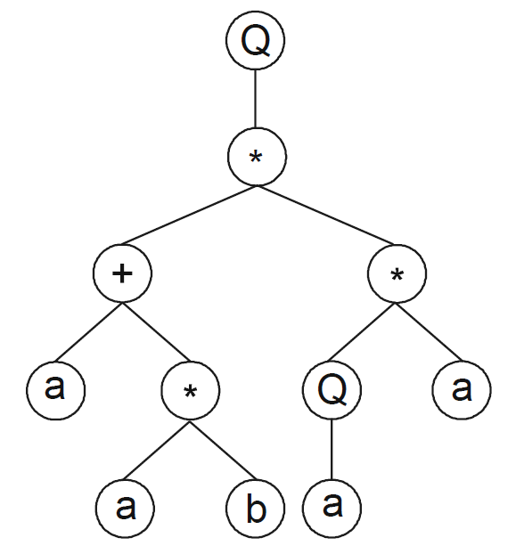
Example of ORFs

Slide 18

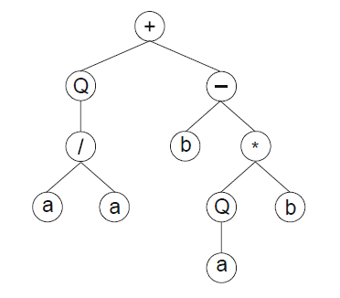
Example of ORFs

Slide 19
Advantages of using ORFs
Any modification made in the genome always results in a valid ET.
Much more like the gene in the nature.

Slide 20
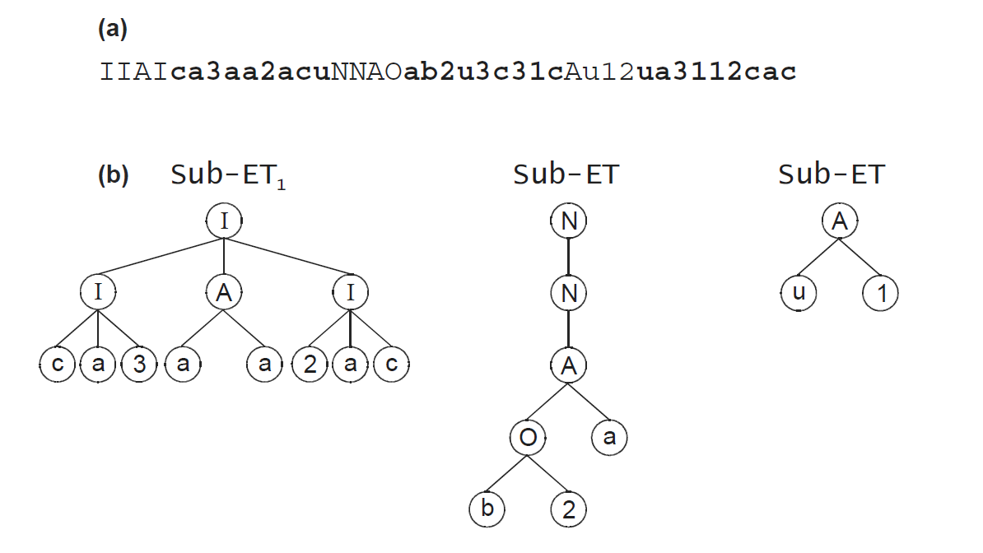
example of ORFs (multigenic)

Slide 21
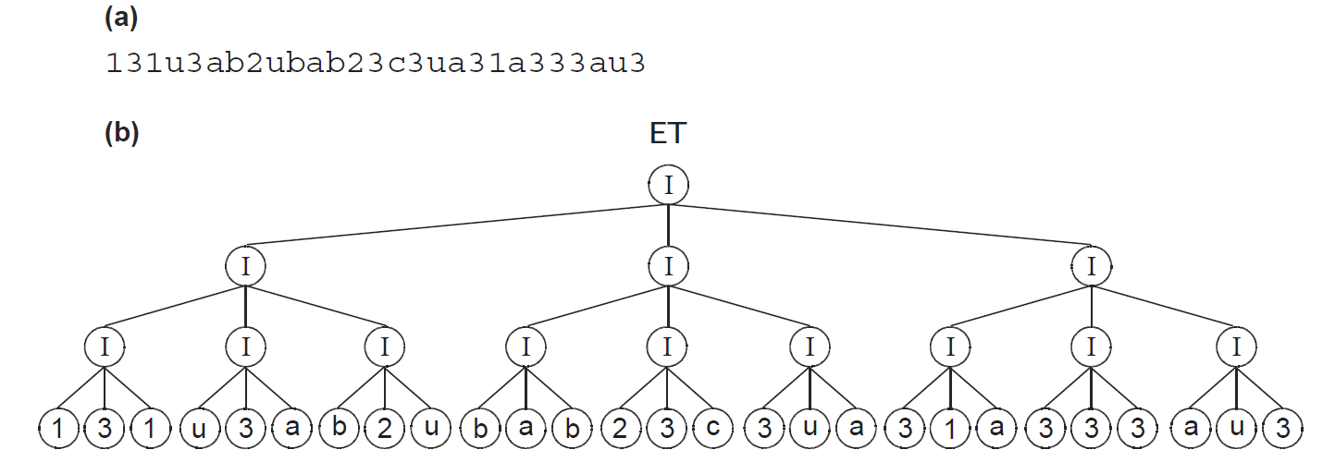
example of ORFs (multigenic)

Slide 22
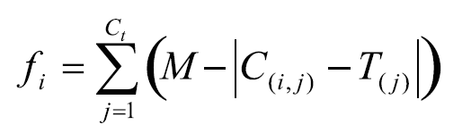
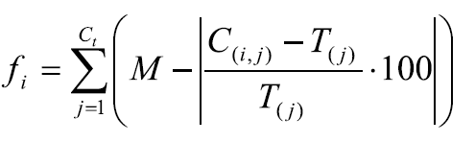
Fitness functions
Absolute error
Relative error

Slide 23
Reproduction with modification
Replication
Mutation
Transposition of insertion sequence elements(IS)
Root Transposition
Crossover
One-point recombination
Two-point recombination
Gene recombination

Slide 24
gene expression programming in problem solving
Symbolic regression (SR)
Sequence induction
Sequence induction using ephemeral random constants (SI*)
Block stacking (BS)
11-multiplexer (11-M)
Cellular autometa

Slide 25
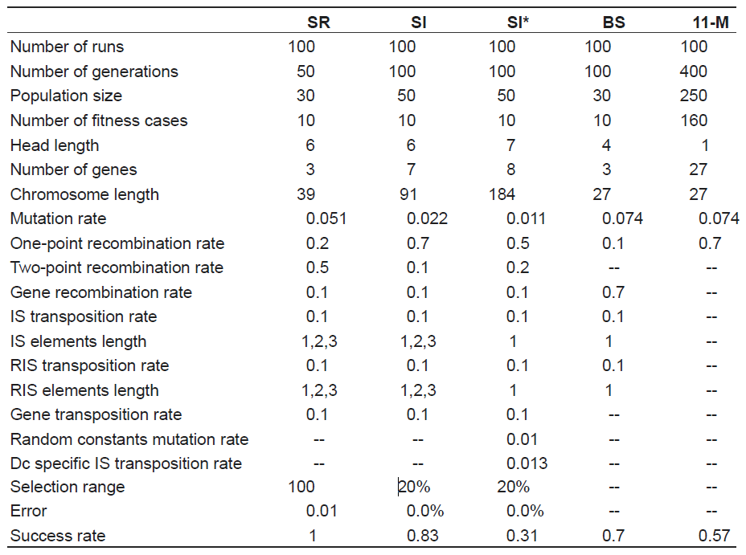

Slide 26
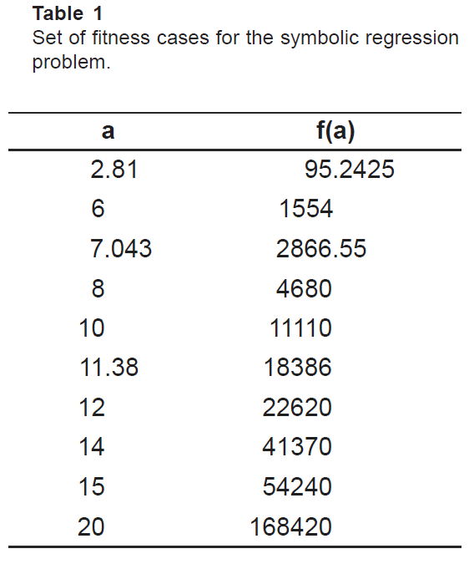
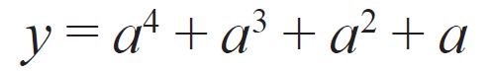
Experiment of symbolic regression
Target function:

Slide 27
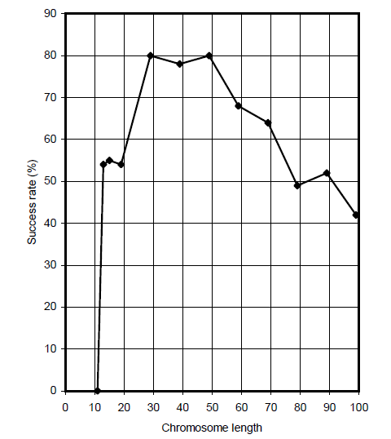
Variation of success rate (P_{s}) with chromosome length

Slide 28
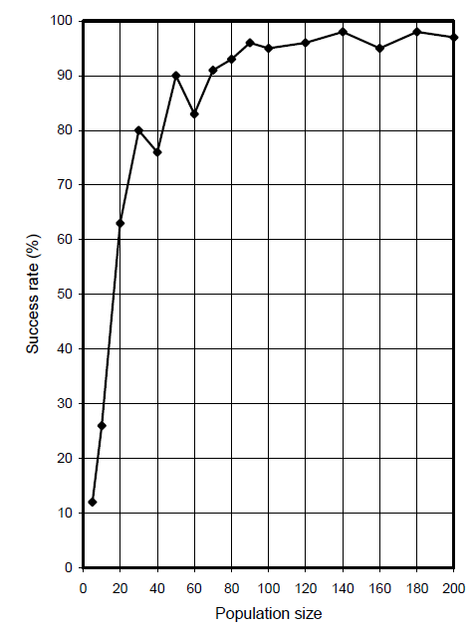
Variation of success rate (P_{s}) with population size

Slide 29
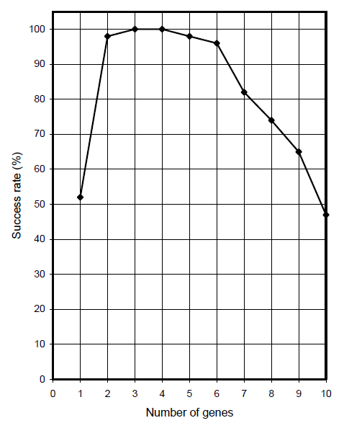
Variation of success rate (P_{s}) with the number of genes

Slide 30
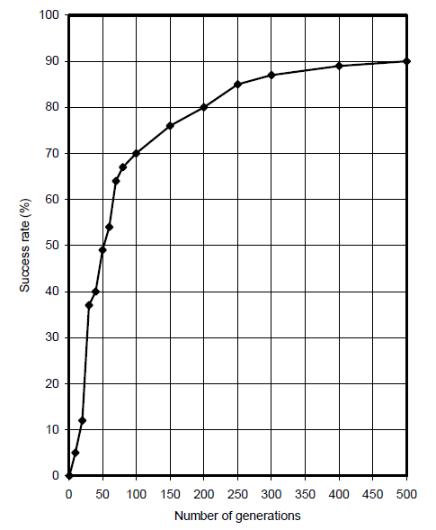
Variation of success rate (P_{s}) with the number of generations

Slide 31
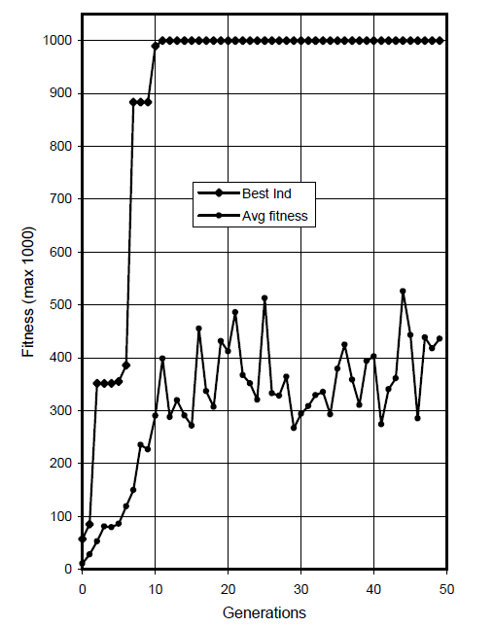
Progression of average fitness of the population and the fitness of the best individual

Slide 32
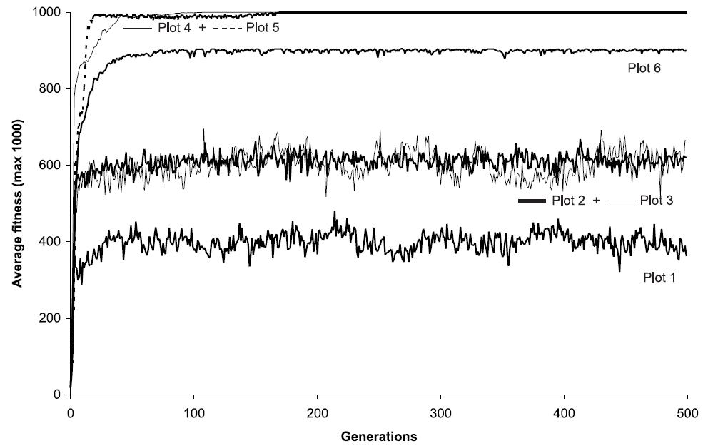
Possible evolutionary dynamics for GEP generation

Slide 33
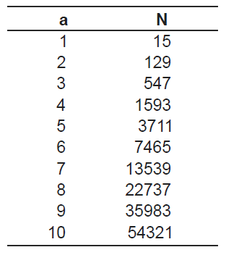
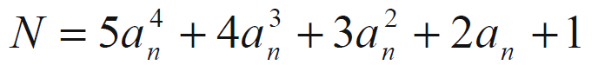
Sequence induction
Difinition:
給一串數列，問這串數列的關係式為?
Sequence: 1, 15, 129, 547, 1593, 3711, 7465, 13539,22737, 35983, 54321,...
Goal:

Slide 34
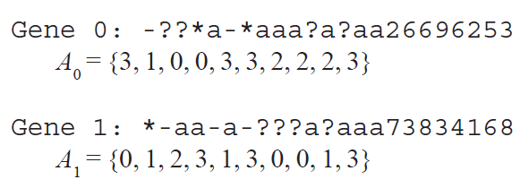
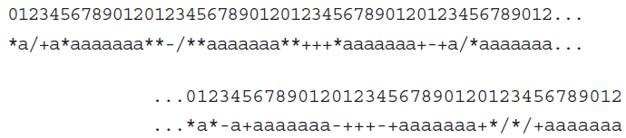
Sequence induction
With ephemeral random number
Without ephemeral random number

Slide 35
Sequence induction
The probability of success for this problem is 0.31, considerably lower than the 0.83 of the first approach.
For real-world applications where the magnitude and type of coefficients is unknown, it is more appropriate to let the system find the constants for itself.
However, for some numerical applications the discovery of constants is fundamental and they can be easily created as indicated here.

Slide 36
Block Stacking
The goal is to find a plan that takes any initial configuration of blocks randomly distributed between the stack and the table and places them in the stack in the correct order.

Slide 37
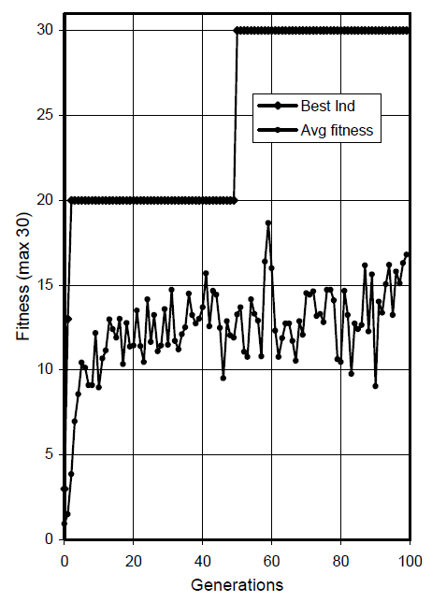
Progression of average fitness of the generation and the fitness of the best individual

Slide 38
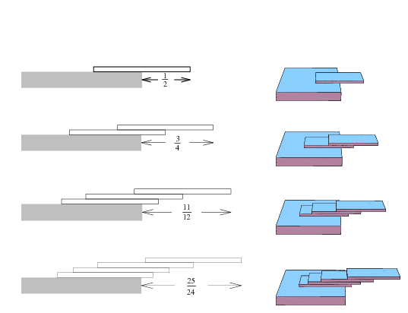
Book (Block) stacking problem

Slide 39
11-multiplexer problem
The task of the 11-bit boolean multiplexer is to decode a 3-bit binary address (000, 001, 010, 011, 100, 101, 110, 111) and return the value of the corresponding data register (d0, d1, d2, d3, d4, d5, d6, d7).
T = {a, b, c, 1, 2, 3, 4, 5, 6, 7, 8}
respectively, to {a0, a1, a2, d0, d1, d2, d3, d4, d5, d6, d7}

Slide 40
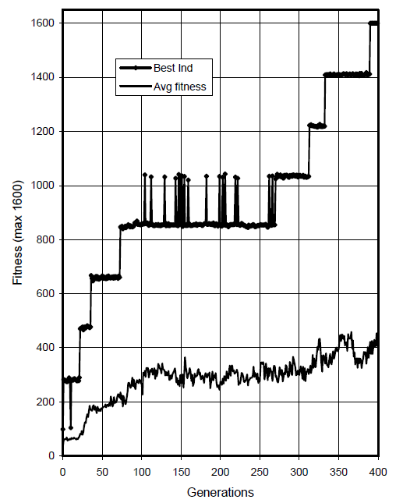
11-multiplexer problem

Slide 41
Thank you!
Special thanks to 周孝岷 and 陳紘昕.

