Slide 1
The binding site distance test score: a robust method for the assessment of predicted protein binding sites
Daniel B. Roche, Stuart J. Tetchner and Liam J. McGufﬁn
Bioinformatics Vol.26, no.22, 2010, pages 2920–2921
Presenter: Chun-Chieh Dai
Date: November 7, 2011

Slide 2
Abstract(1/2)
We propose a novel method for scoring the accuracy of protein binding site predictions—the Binding-site Distance Test (BDT) score. Recently, the Matthews Correlation Coefficient(MCC) has been used to evaluate binding site predictions, both by developers of new methods and by the assessors for the community-wide prediction experiment—CASP8. While being a rigorous scoring method, the MCC does not take into account the actual 3D location of the predicted residues from the observed binding site. Thus, an incorrectly predicted site that is nevertheless close to the observed binding site will obtain an identical score to the same number of non-binding residues predicted at random. The MCC is somewhat affected by the subjectivity of determining observed binding residues and the ambiguity of choosing distance cutoffs.

Slide 3
Abstract(2/2)
By contrast the BDT method produces continuous scores ranging between 0 and 1, relating to the distance between the predicted and observed residues. Residues predicted close to the binding site will score higher than those more distant, providing a better reflection of the true accuracy of predictions. The CASP8 function predictions were evaluated using both the MCC and BDT methods and the scores were compared. The BDT was found to strongly correlate with the MCC scores while also being less susceptible to the subjectivity of defining binding residues. We therefore suggest that this new simple score is a potentially more robust method for future evaluations of protein–ligand binding site predictions.

Slide 4
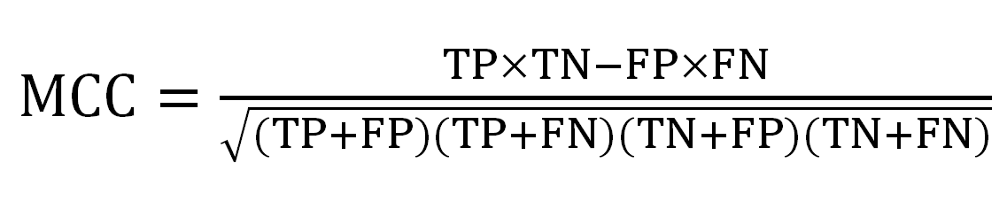
Matthews Correlation Coefﬁcient
 |  | prediction outcome
actual value |  | P | N
 | P’ | True Positive | False Negative
 | N’ | False Positive | True Negative

Slide 5
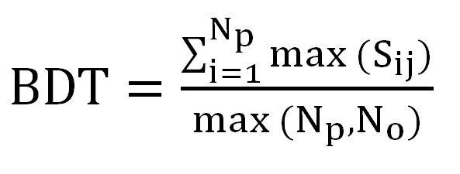
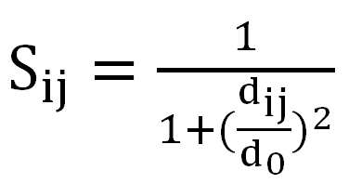
Binding-site Distance Test
S_{ij}: the S-score between a predicted residue i and an observed residue j
d_{ij}: the Euclidean distance between the Cα coordinates of residues i and j
d₀: a distance threshold
max(S_{ij} ): determine for each predicted residue
N_{p}: the number of predicted residues
N_{o}: the number of observed residues

Slide 6
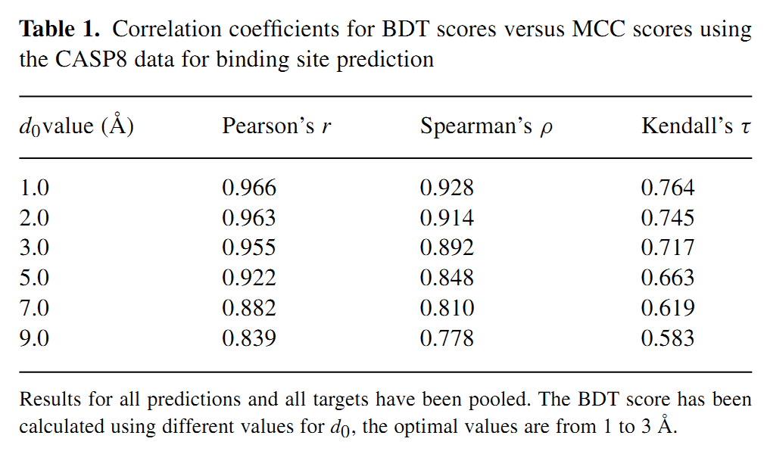

Slide 7
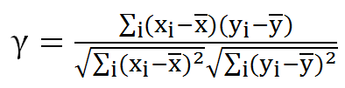
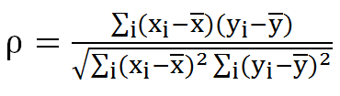
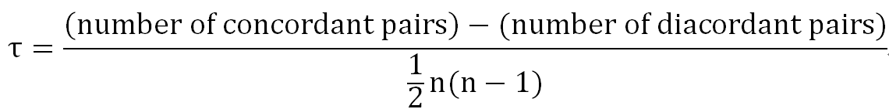

Slide 8
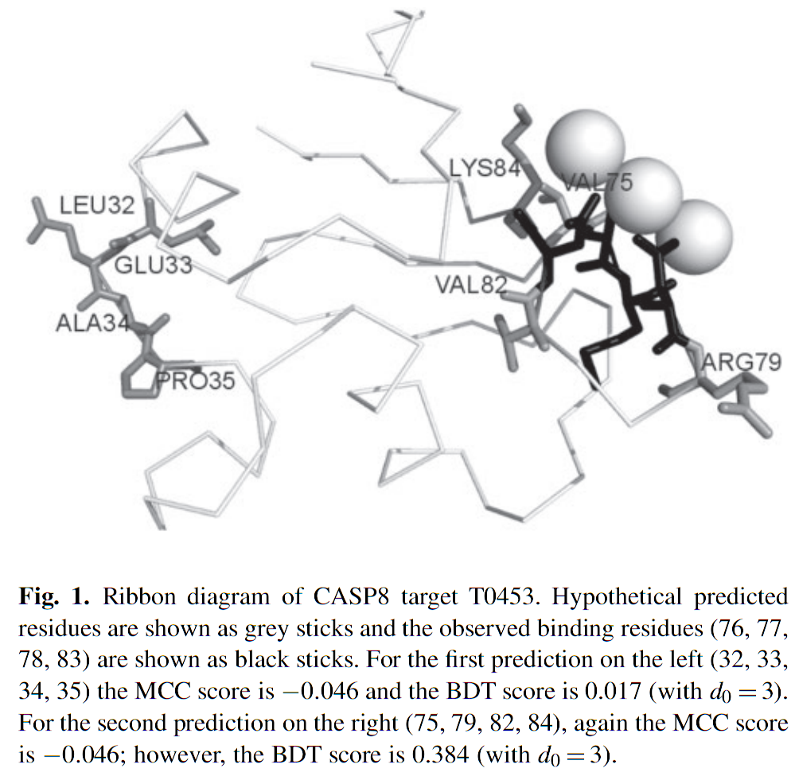

Slide 9
