Slide 1
An Asymptotic Equivalence of Choice of Model by Cross-Validation and Akaike's Criterion
M. Stone
Journal of the Royal Statistical Society. Series B (Methodological), Vol. 39,
No. 1(1977), pp. 44-47

Slide 2
Abstract
A logarithmic assessment of the performance of a predicting density is found to lead to asymptotic equivalence of choice of model by cross-validation and Akaike's criterion, when maximum likelihood estimation is used within each model.

Slide 3
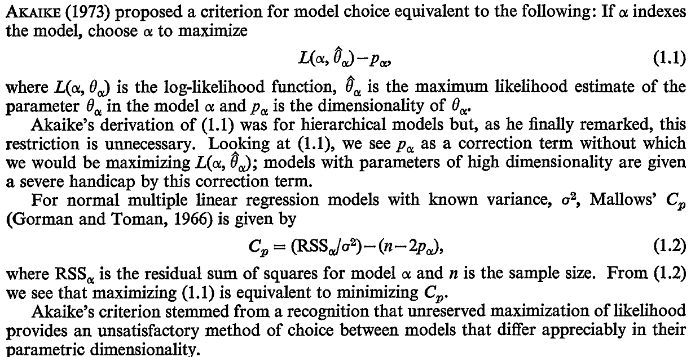
L(α,θ)=Σ{-(yi-ŷi)²/2σ²}, yi and ŷi are i’th target and predicted values.

Slide 4
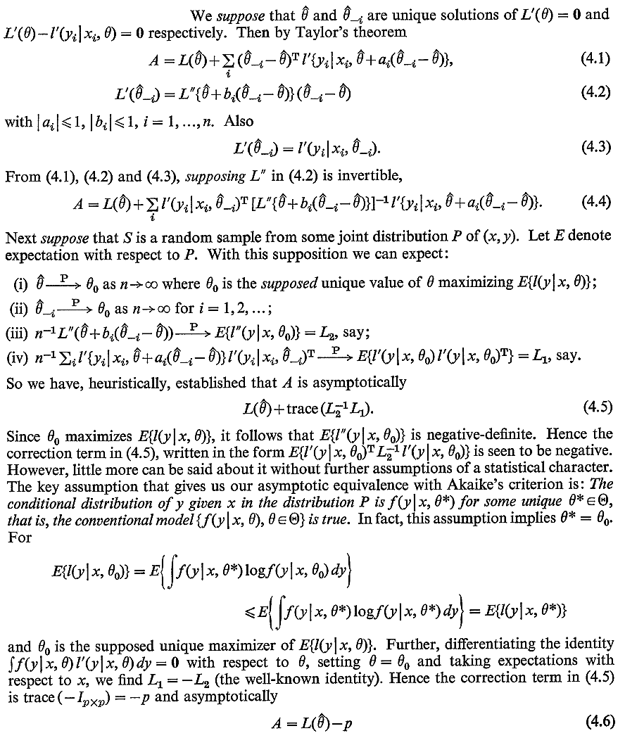
先由LOOCV定義A
最終求到A=>AIC

Slide 5
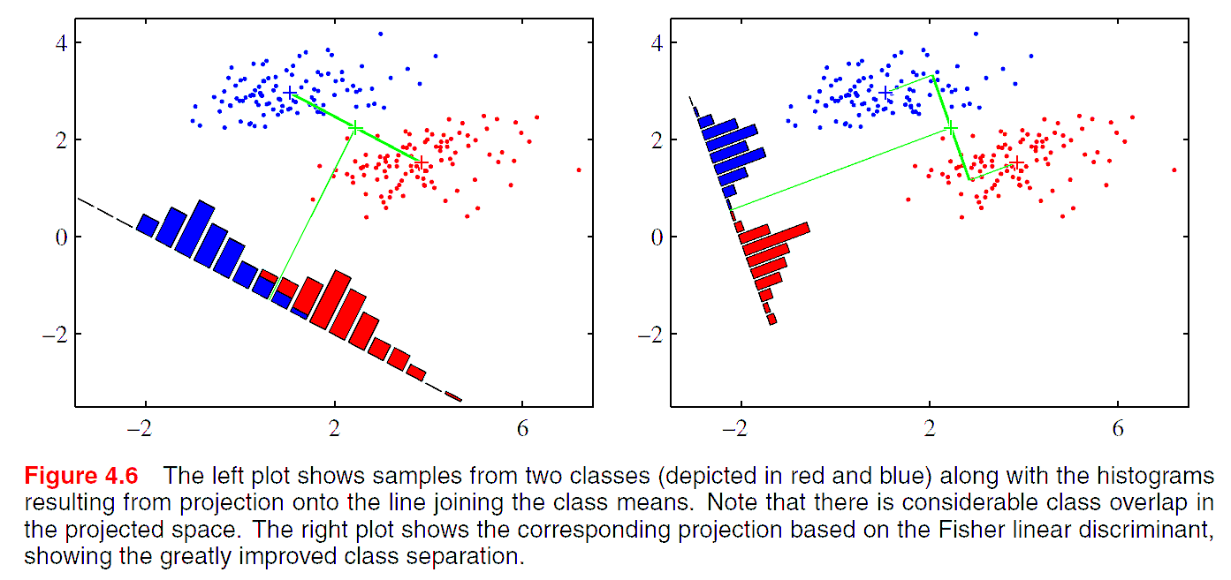

Linear model for classification
The dicriminant function is:
Christopher M. Bishop., “Pattern Recognition and Machine Learning"

Slide 6
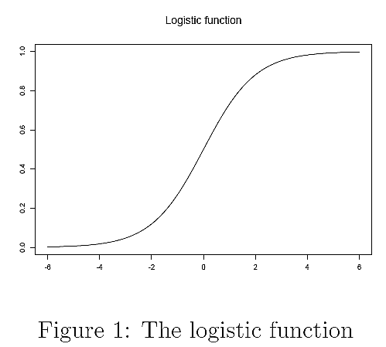
(Binary) Logit regression
The dicriminant score (β^{T}x): -∞~+∞
o (odd): 0~∞
p (probability belonging to class 1): 0~1
p
用(o,p)=(0,0.5)來二分
x^{T}β
Christopher Manning., “Logistic regression"

Slide 7
Logit regression example
A researcher is interested in how variables, such as GRE (Graduate Record Exam scores), GPA (grade point average) and prestige[名望, 威望, 聲望] of the undergraduate institution, effect admission into graduate school.
admit gre gpa rank
0 380 3.61 3
1 660 3.67 3
1 800 4 1
1 640 3.19 4
0 520 2.93 4
1 760 3 2
1 560 2.98 1
…
離散資料
http://www.ats.ucla.edu/stat/R/dae

Slide 8
Logit regression example
admit gre gpa rank
0 380 3.61 3
1 660 3.67 3
1 800 4 1
1 640 3.19 4
0 520 2.93 4
1 760 3 2
1 560 2.98 1
…
admit gre gpa rank)1 rank)2 rank)3 rank)4
0 380 3.61 0 0 1 0
1 660 3.67 0 0 1 0
1 800 4 1 0 0 0
1 640 3.19 0 0 0 1
0 520 2.93 0 0 0 1
1 760 3 0 1 0 0
1 560 2.98 1 0 0 0
...
http://www.ats.ucla.edu/stat/R/dae

Slide 9
Logit regression example
admit gre gpa rank)1 rank)2 rank)3 rank)4
0 380 3.61 0 0 1 0
1 660 3.67 0 0 1 0
1 800 4 1 0 0 0
1 640 3.19 0 0 0 1
0 520 2.93 0 0 0 1
1 760 3 0 1 0 0
1 560 2.98 1 0 0 0
...
Coefficients:
(Intercept)β0 greβ1 gpaβ2 rank)2β3 rank)3 β4 rank)4 β5
-3.989979 0.002264 0.804038 -0.675443 -1.340204 -1.551464
Degrees of Freedom: 399 Total (i.e. Null); 394 Residual
Null Deviance: 500
Residual Deviance: 458.5 AIC: 470.5
http://www.ats.ucla.edu/stat/R/dae

Slide 10
Logit regression example
New data1
gre gpa rank
1 587.7 3.3899 1
2 587.7 3.3899 2
3 587.7 3.3899 3
4 587.7 3.3899 4
Prediction
gre gpa rank Predicted_Probability_of_admit
1 587.7 3.3899 1 0.5166016
2 587.7 3.3899 2 0.3522846
3 587.7 3.3899 3 0.2186120
4 587.7 3.3899 4 0.1846684
New data2
gre gpa rank
1 200 3.3899 2
2 300 3.3899 2
3 400 3.3899 2
4 500 3.3899 2
5 600 3.3899 2
6 700 3.3899 2
7 800 3.3899 2
Prediction
gre gpa rank Predicted_Probability_of_admit
1 200 3.3899 2 0.1843830
2 300 3.3899 2 0.2208900
3 400 3.3899 2 0.2623007
4 500 3.3899 2 0.3084017
5 600 3.3899 2 0.3586658
6 700 3.3899 2 0.4122390
7 800 3.3899 2 0.4679753
http://www.ats.ucla.edu/stat/R/dae

Slide 11
Apparent (training) error rate
The observed inaccuracy of the fitted model applied to the original data points
Usually underestimates[低估] the true error rate because the model is selected to lie near the observed points
Bradley Efron, “ How Biased is the Apparent Error Rate of a Prediction Rule"

Slide 12
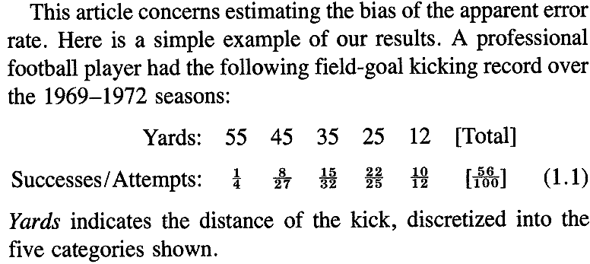
Apparent (training) error rate
假設目標是要根據Yards特徵，判斷踢進球門機會是否超過0.5，用所有100筆資料訓練後，認為小於或等於35碼踢進球門機會超過0.5，則
Apparent error rate = (1+8+17+3+2)/100=0.31
Bradley Efron, “ How Biased is the Apparent Error Rate of a Prediction Rule"

Slide 13
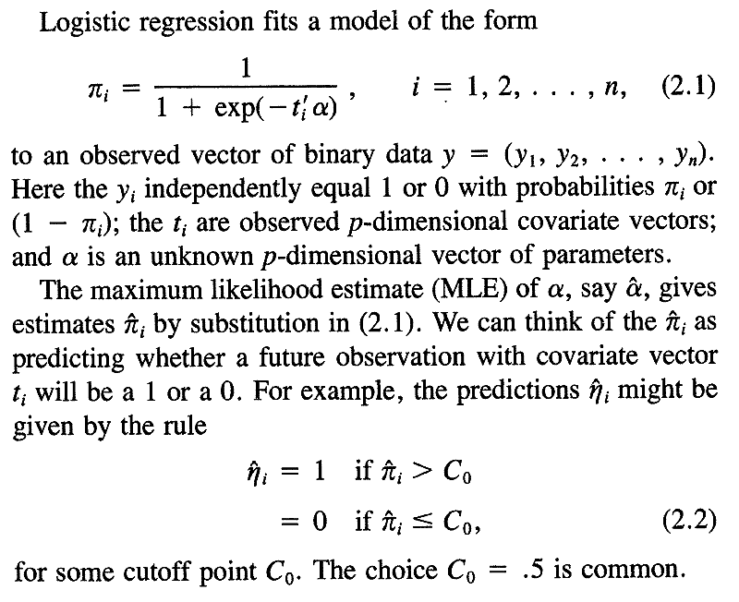
π
用(o,p)=(0,0.5)來二分
t’α
Bradley Efron, “ How Biased is the Apparent Error Rate of a Prediction Rule"

Slide 14
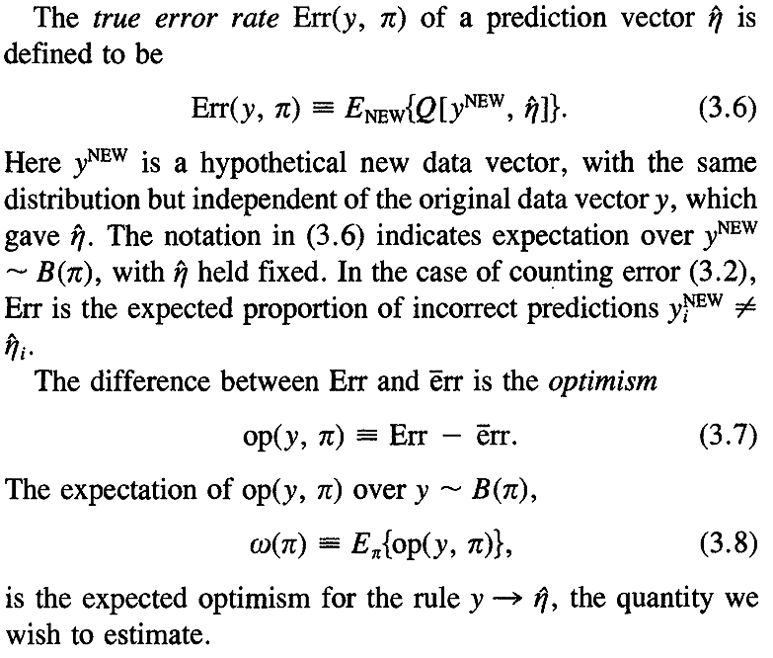

Optimism
Bradley Efron, “ How Biased is the Apparent Error Rate of a Prediction Rule"

Slide 15
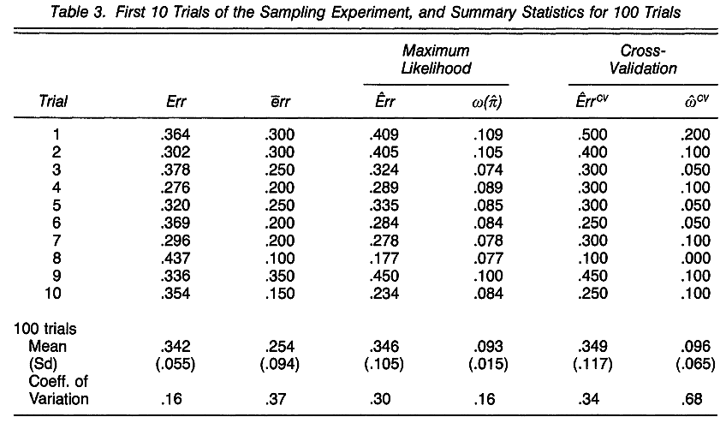
Example
有公式，見下頁
Training error rate
LOOCV
True error rate
僅用training data估算
True error rate - Training error rate = 0.88
僅用training data估算
Bradley Efron, “ How Biased is the Apparent Error Rate of a Prediction Rule"

Slide 16
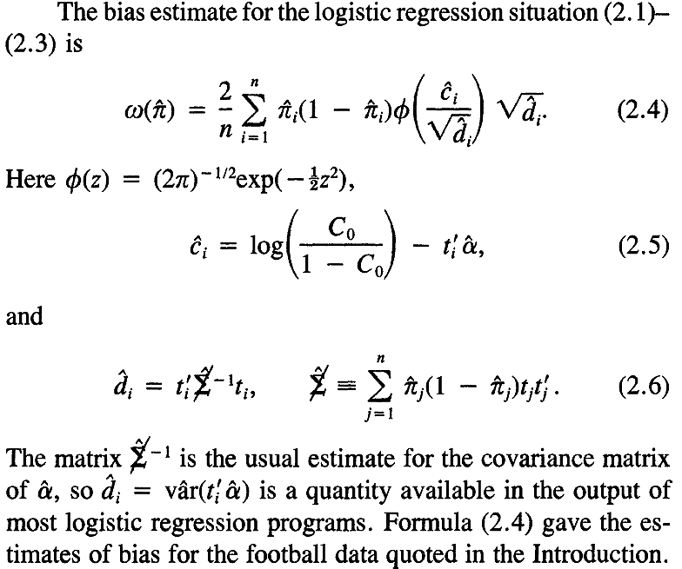
Formula for the optimism in logistic regressions
Bradley Efron, “ How Biased is the Apparent Error Rate of a Prediction Rule"

Slide 17
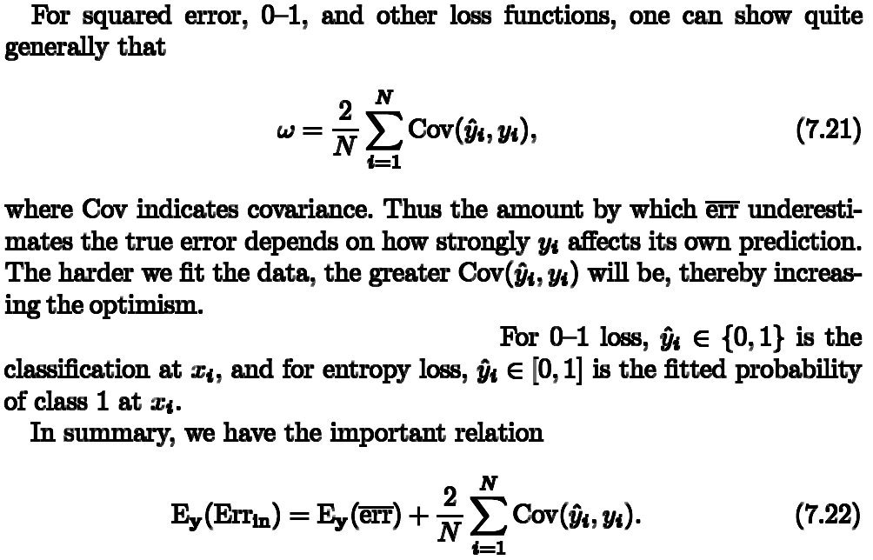
Optimism
(Expected) Training error rate
(Expected) Optimism
(Expected) True error rate
Christopher M. Bishop., “Pattern Recognition and Machine Learning"

Slide 18
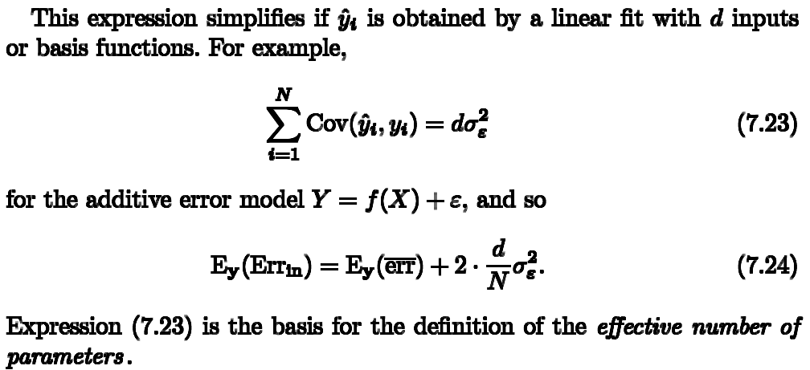
Optimism
Christopher M. Bishop., “Pattern Recognition and Machine Learning"

Slide 19
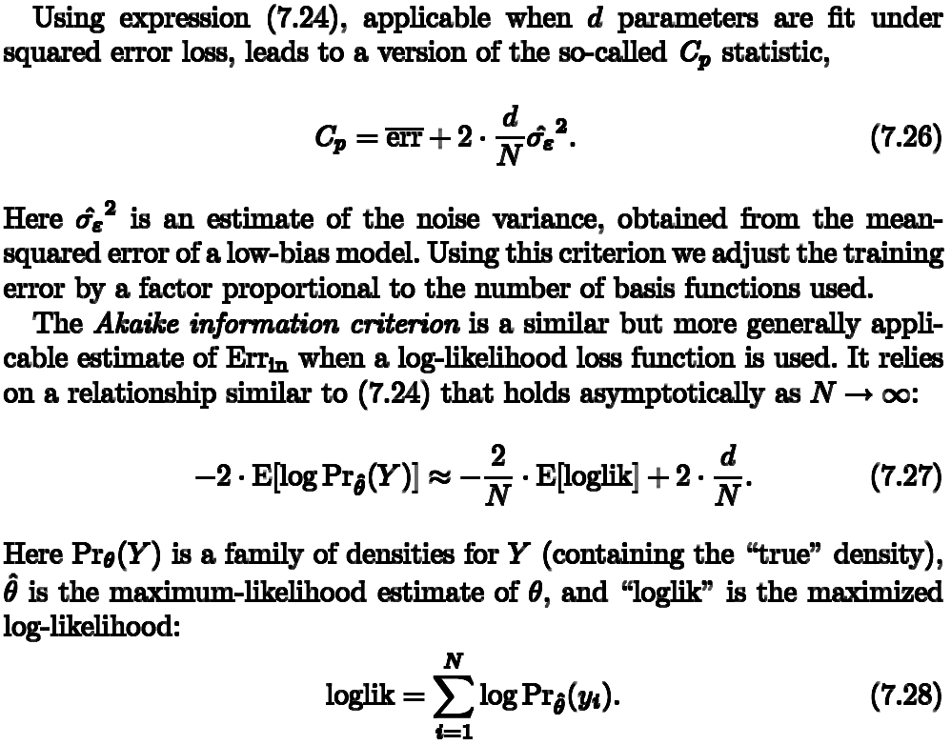
Christopher M. Bishop., “Pattern Recognition and Machine Learning"

Slide 20
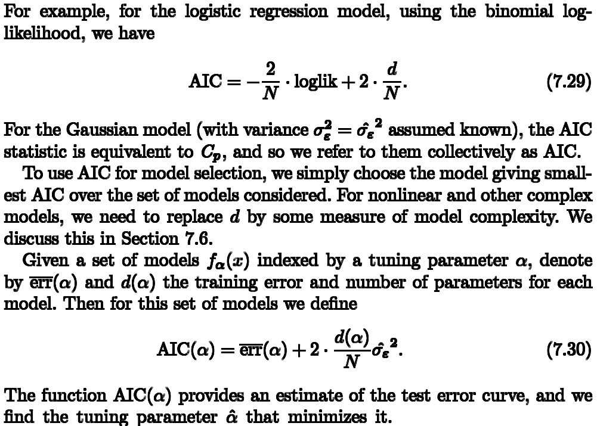
Christopher M. Bishop., “Pattern Recognition and Machine Learning"

Slide 21
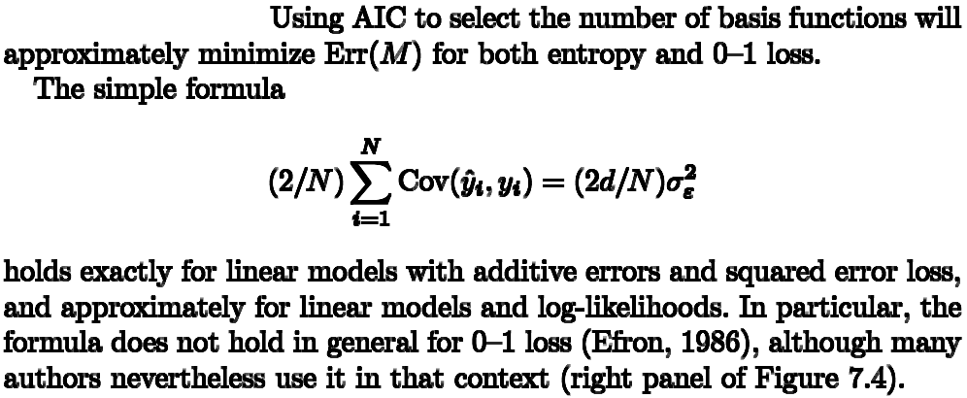
雖然AIC不太適用於0-1 loss(分類問題)，但有許多人用，具實務上效果
Christopher M. Bishop., “Pattern Recognition and Machine Learning"

Slide 22
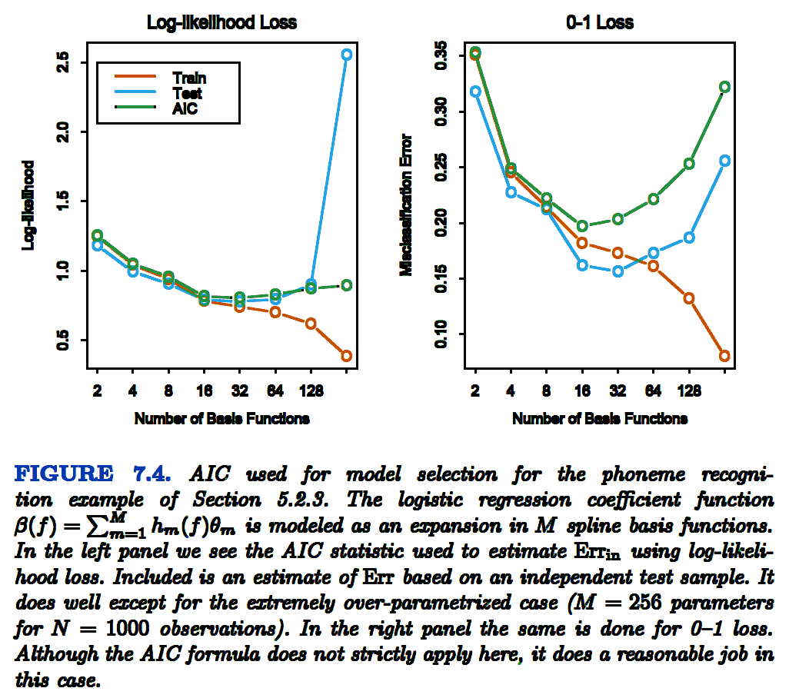
Christopher M. Bishop., “Pattern Recognition and Machine Learning"

Slide 23
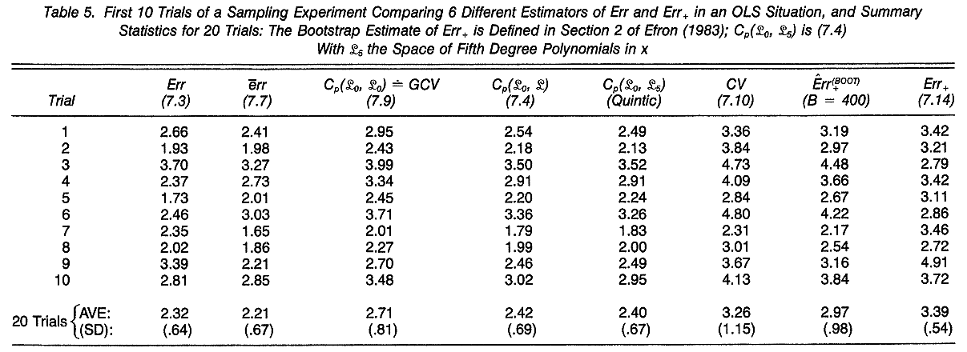
Example
True error rate
Training error rate
True error rate > Training error rate
Cp估計True test error rate相當準確 (FOR THIS LOGISTIC REGRESSION CASE)
Bradley Efron, “ How Biased is the Apparent Error Rate of a Prediction Rule"

Slide 24
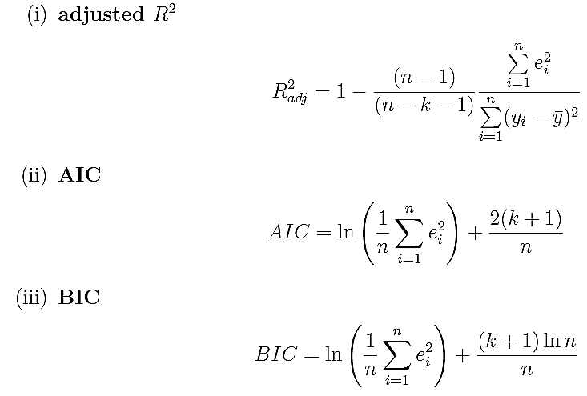
AIC or BIC
Akaike's Information Criterion (AIC)
Bayesian Information Criterion (BIC)
R²描述：
誤差越小越接近1
e:誤差
k:變數#
AIC or BIC描述：
誤差小且使用變數少則值越小
n:資料#
http://www.statoek.wiso.uni-goettingen.de/veranstaltungen/non_semi_models/AkaikeLsg.pdf

Slide 25
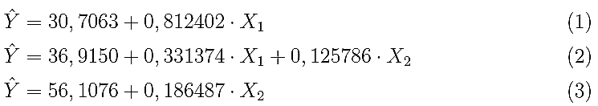
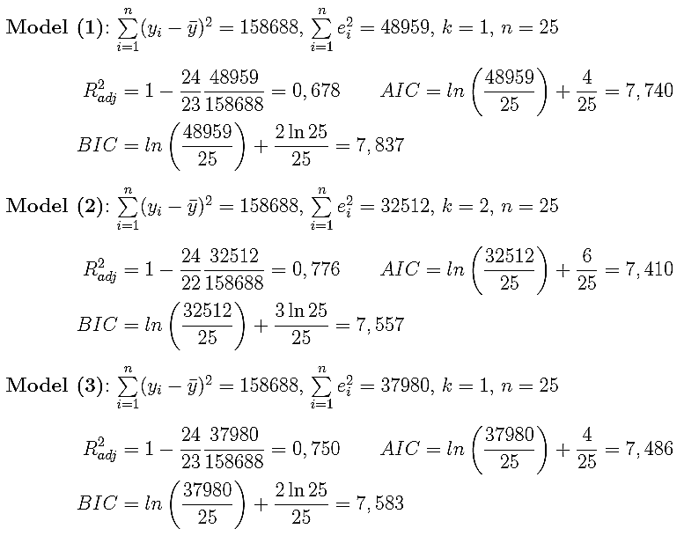
AIC or BIC example
http://www.statoek.wiso.uni-goettingen.de/veranstaltungen/non_semi_models/AkaikeLsg.pdf

Slide 26
Training & extra-sample error
An obvious way to estimate prediction error is to estimate the optimism and then add it to the training error err. The methods, Cp, AIC, BIC and others, work in this way, for a special class of estimates that are linear in their parameters. ?
Cross-validation and bootstrap methods are direct estimates of the extra-sample error. These general tools can be used with any loss function, and with nonlinear, adaptive fitting techniques.
Christopher M. Bishop., “Pattern Recognition and Machine Learning"

Slide 27
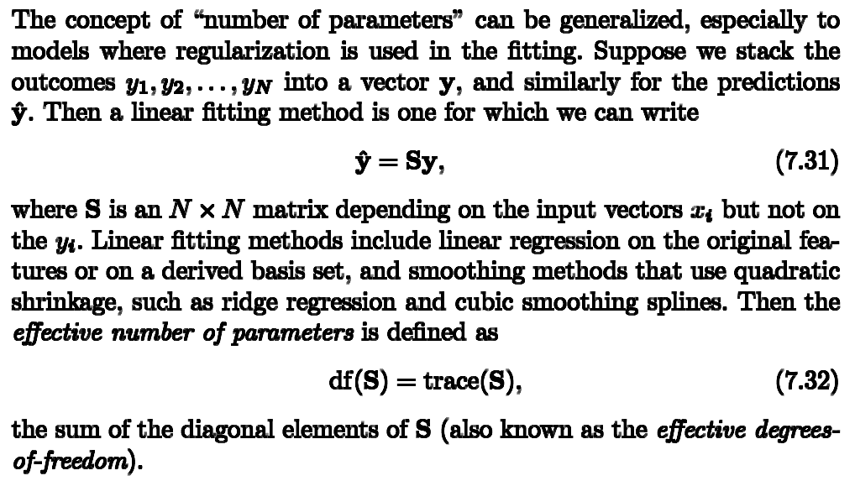
AIC in non-linear models
Christopher M. Bishop., “Pattern Recognition and Machine Learning"

Slide 28
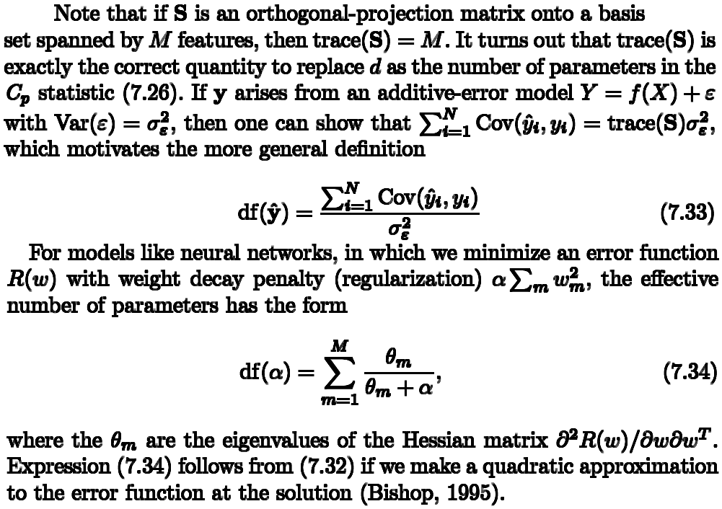
AIC in non-linear models
Christopher M. Bishop., “Pattern Recognition and Machine Learning"

Slide 29

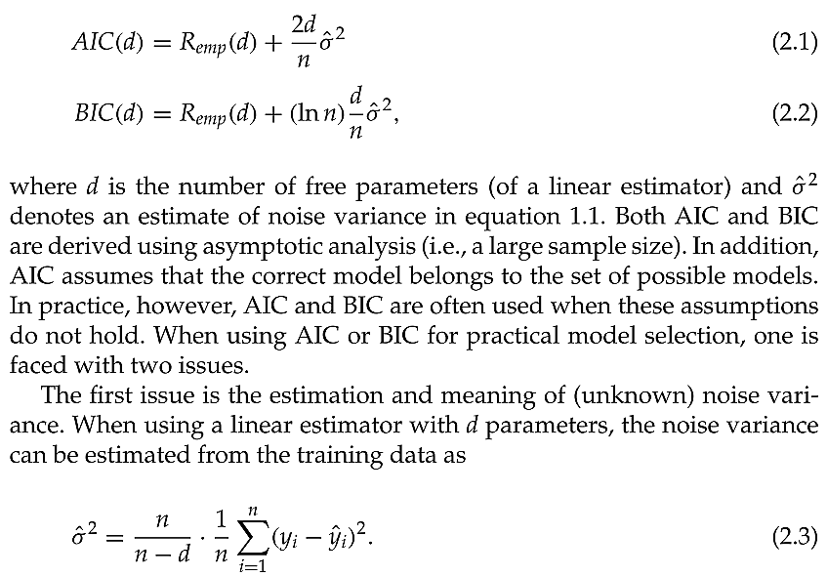
AIC & BIC in non-linear models
Vladimir Cherkassky, “Comparison of Model Selection for Regression"

Slide 30
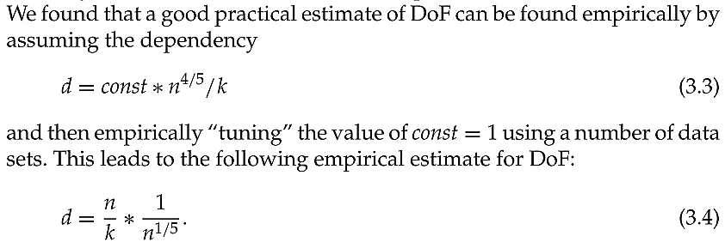
AIC & BIC – effective dimension for k nearest neighbor regression
Vladimir Cherkassky, “Comparison of Model Selection for Regression"

