Slide 1
A space efficient algorithm for the longest common subsequence in k-length substrings
Daxin Zhu, Lei Wang, Tinran Wang, Xiaodong Wang
Theoretical Computer Science
Volume 687, 29 July 2017, Pages 79-92
Presenter: Kuo-Feng Huang
Date: 2018/07/24

Slide 2
Abstract
Two space efficient algorithms to solve the LC Sk problem and LCS≥k problem are presented in this paper. The algorithms improve the time and space complexities of the algorithms of Benson et al. [4]. The space cost of the first algorithm to solve the LCSk problem is reduced from O(n²) to O(kn), if the size of the two input sequences are both n. The time and space costs of the second algorithm to solve the LCS≥k problem are both improved. The time cost is reduced from O(kn²) to O(n2), and the space cost is reduced from O(n²) to O(kn). In the case of k = O(1), the two algorithms are both linear space algorithms.

Slide 3
LCS
X : 3, 5, 6, 1, 2, 7, 5, 7
Y : 3, 5, 6, 2, 1, 5, 7, 4
LCS: 3, 5, 6, 2, 5, 7 或 3, 5, 6, 1, 5, 7

Slide 4
LCSk
X : 3, 5, 6, 1, 2, 7, 5, 7
Y : 3, 5, 6, 2, 1, 5, 7, 4
LCS2: 3, 5, 5, 7 (k=2，{3, 5}跟{5, 7}無overlap， LCS2=2)
5, 6, 5, 7也是答案之一

Slide 5
LCS≥k
X : 3, 5, 6, 1, 2, 7, 5, 7
Y : 3, 5, 6, 2, 1, 5, 7, 4
LCS ≥ 2: 3, 5, 6, 5, 7 (k=2，LCS₂=5)

Slide 6
LCS
 | 4 | 3 | 1 | 5 | 2
1 | 0 | 0 | 1 | 1 | 1
4 | 1 | 1 | 1 | 1 | 1
3 | 1 | 2 | 2 | 2 | 2
5 | 1 | 2 | 2 | 3 | 3
2 | 1 | 2 | 2 | 3 | 4

Slide 7
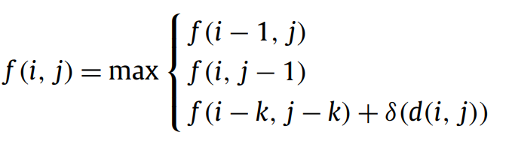
LCSk
 | 4 | 3 | 1 | 5 | 2
1 | 0 | 0 | 0 | 0 | 0
4 | 0 | 0 | 0 | 0 | 0
3 | 0 | 1 | 1 | 1 | 1
5 | 0 | 1 | 1 | 1 | 1
2 | 1 | 1 | 1 | 1 | 2

Slide 8
LCSk
 | 4 | 3 | 1 | 5 | 2
1 | 0 | 0 | 0 | 0 | 0
4 | 0 | 0 | 0 | 0 | 0
3 | 0 | 1 | 1 | 1 | 1
5 | 0 | 1 | 1 | 1 | 1
2 | 1 | 1 | 1 | 1 | 2
λ(i) = (i − 1) mod k + 1.

Slide 9
LCSk
X:
Y:
X:
Y:

Slide 10
LCSk
X:
Y:
K
X:
Y:
從K*N種切線找出切完之後，選左右兩邊LCSk和為最大的切線分成左右兩塊
繼續divde and conquer，直到左右其中一邊長度為1

Slide 11
LCSk
i0
i= (i1 − i0 + 1 + k)/2
i1
X:
Y:
i0
i= (i1 − i0 + 1 + k)/2
i1
X:
Y:
k
i0
i= (i1 − i0 + 1 + k)/2
i1
X:
Y:

Slide 12
LCSk
X:
Y:
X:
Y:
X:
Y:
長度1時輸出substring

Slide 13
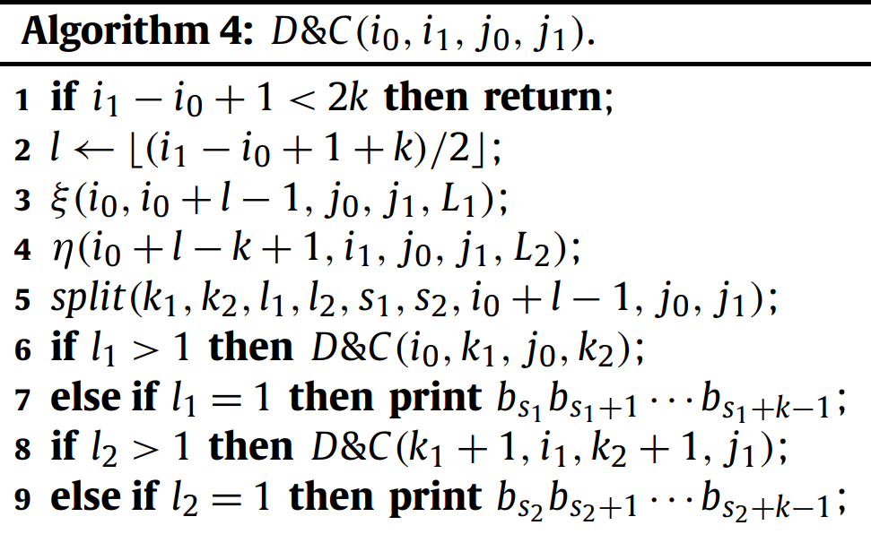
LCSk

Slide 14
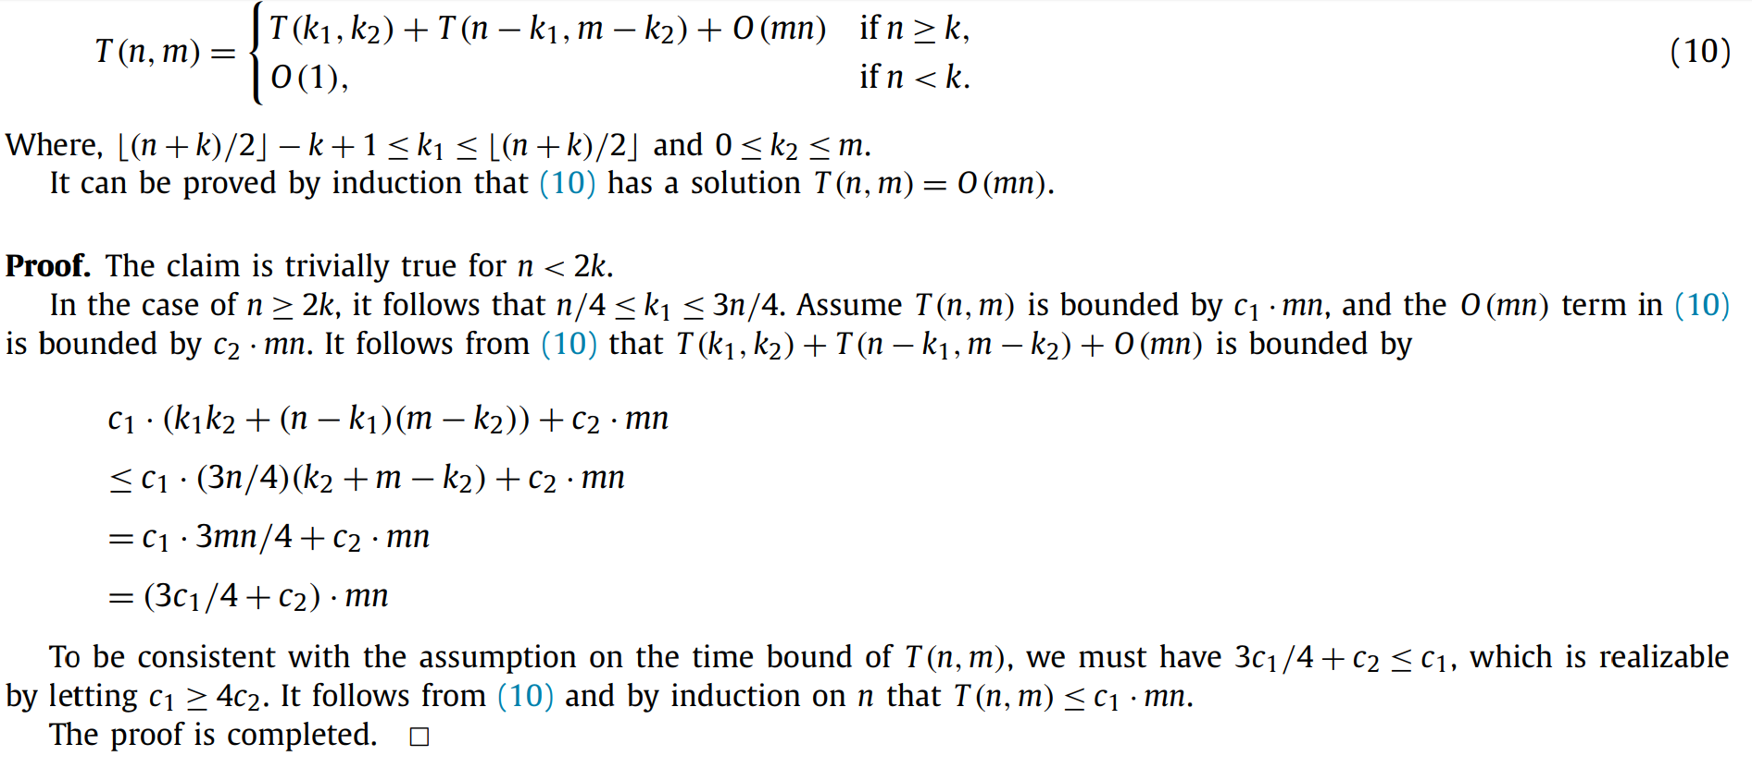
LCSk

