Slide 1
Selecting local constraint for alignment of batch process data with dynamic time warping
Max Spooner, David Kold, Murat Kulahci
Chemometrics and Intelligent Laboratory Systems
Vol. 167, 2017, Pages 161-170
Presenter: Shan-Ru Liu
Date: 2018/07/24

Slide 2
Abstract (1/2)
There are two key reasons for aligning batch process data. The first is to obtain same-length batches so that standard methods of analysis may be applied, whilst the second reason is to synchronise events that take place during each batch so that the same event is associated with the same observation number for every batch. Dynamic time warping has been shown to be an effective method for meeting these objectives. This is based on a dynamic programming algorithm that aligns a batch to a reference batch, by stretching and compressing its local time dimension. The resulting ”warping function” may be interpreted as a progress signature of the batch which may be appended to the aligned data for further analysis.

Slide 3
Abstract (2/2)
For the warping function to be a realistic reflection of the progress of a batch, it is necessary to impose some constraints on the dynamic time warping algorithm, to avoid an alignment which is too aggressive and which contains pathological warping. Previous work has focused on addressing this issue using global constraints. In this work, we investigate the use of local constraints in dynamic time warping and define criteria for evaluating the degree of time distortion and variable synchronisation obtained. A local constraint scheme is extended to include constraints not previously considered, and a novel method for selecting the optimal local constraint with respect to the two criteria is proposed. For illustration, the method is applied to real data from an industrial bacteria fermentation process.

Slide 4
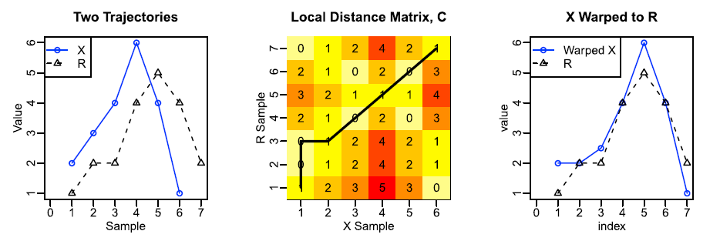
DTW
X: 2,3,4,6,4,1
R: 1,2,2,4,5,4,2

Slide 5
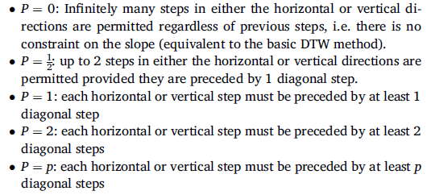
Local constraint

Slide 6
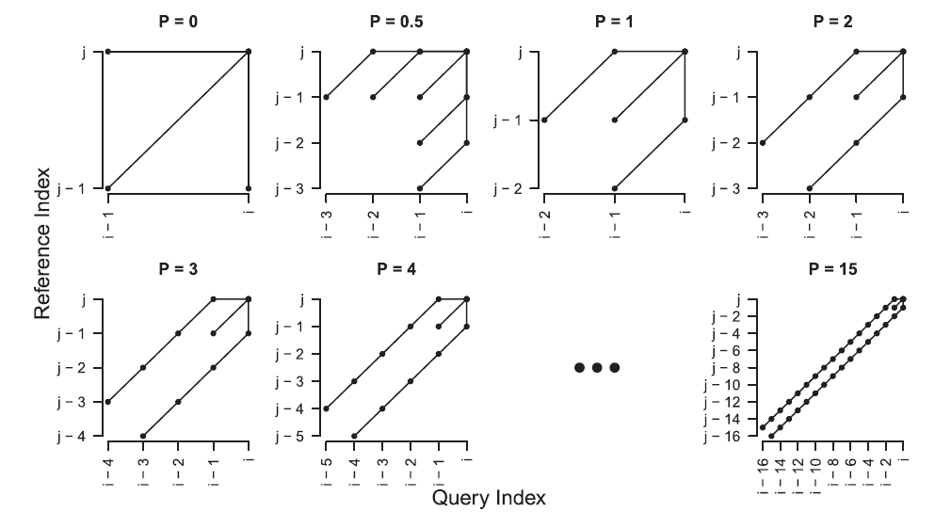
Local constraint
Sakoe and Chiba

Slide 7
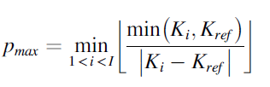
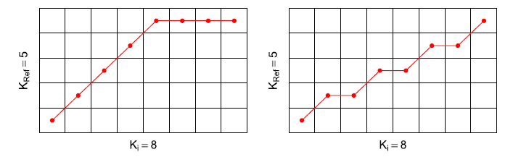
Local constraint

Slide 8

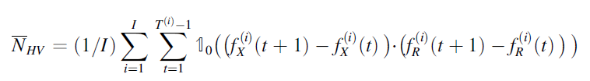

Local constraint

Slide 9

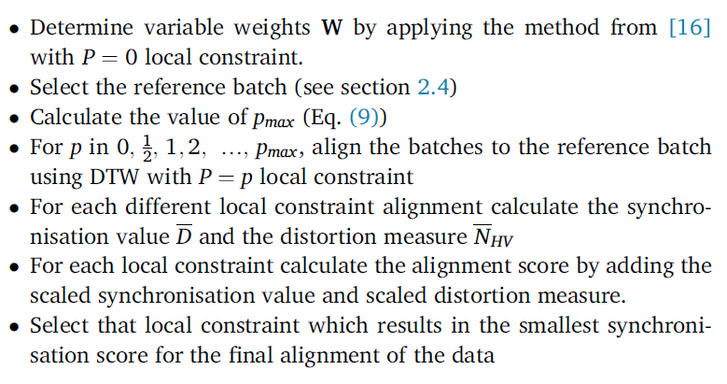
Local constraint

Slide 10
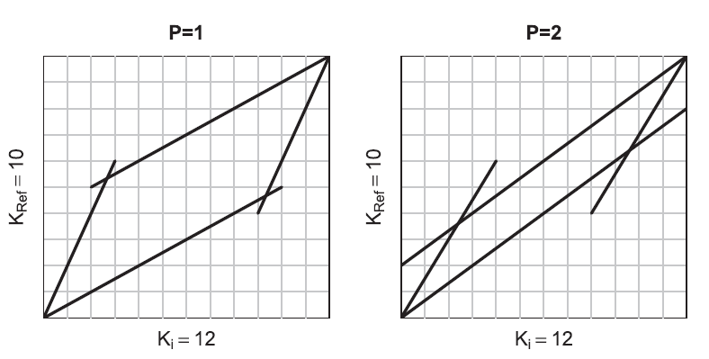
Local constraint
Itakura parallelogram

Slide 11
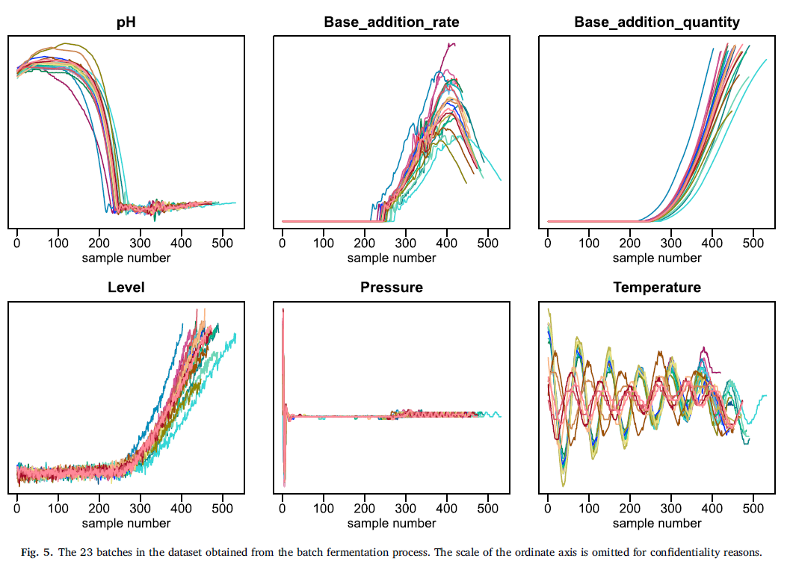
Data

Slide 12
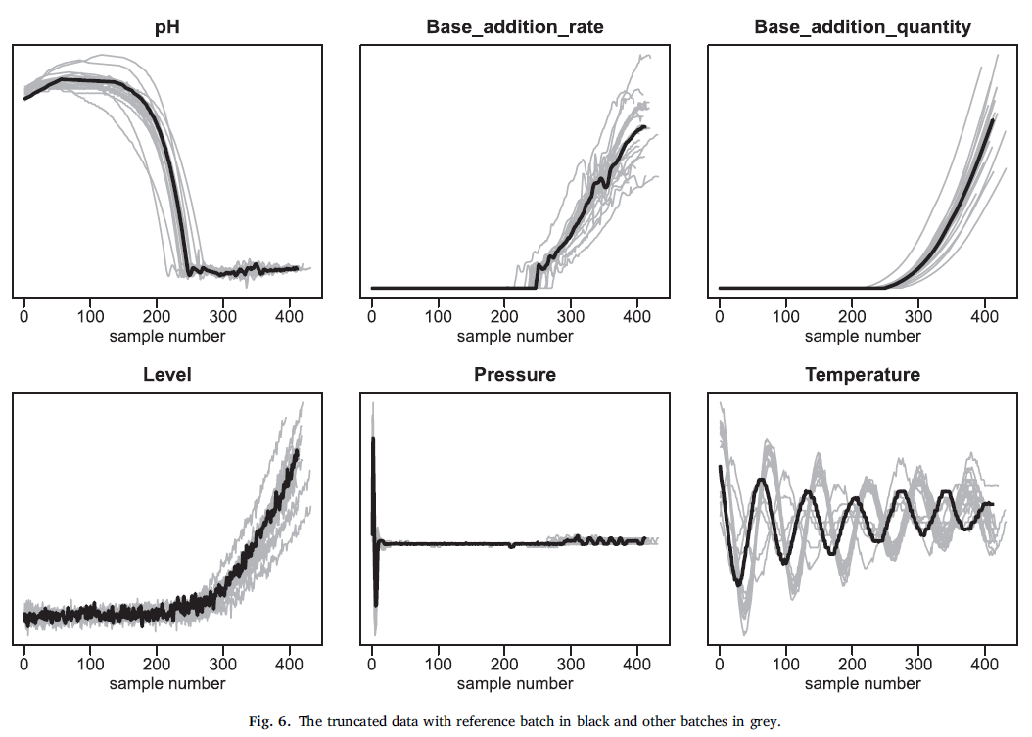
Processing data and selecting reference batch

Slide 13
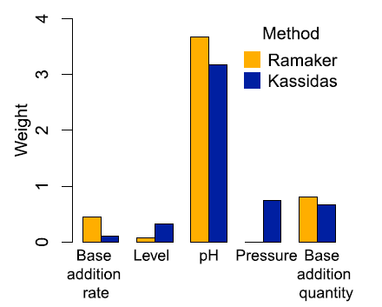
Variable weights

Slide 14
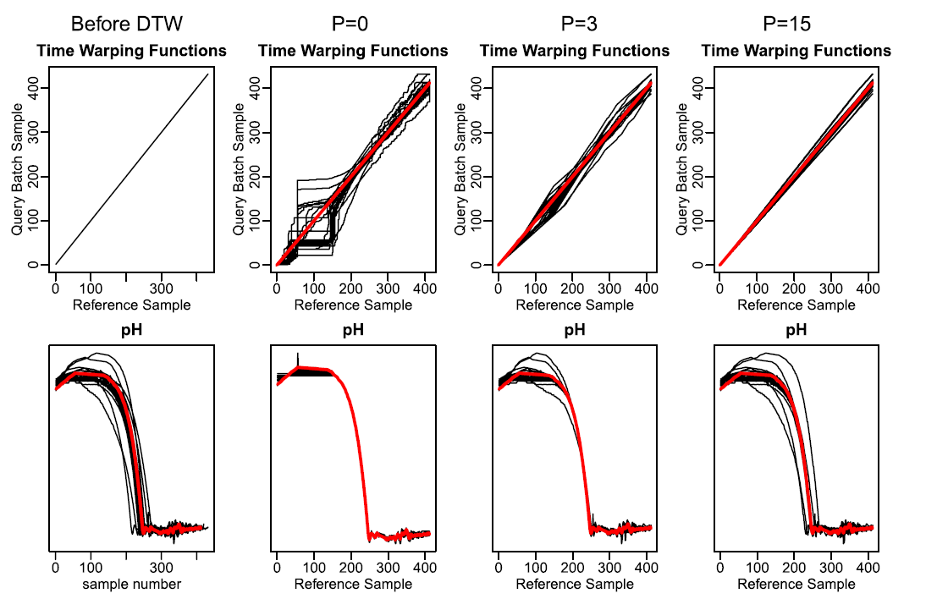
Selecting local constraint

Slide 15
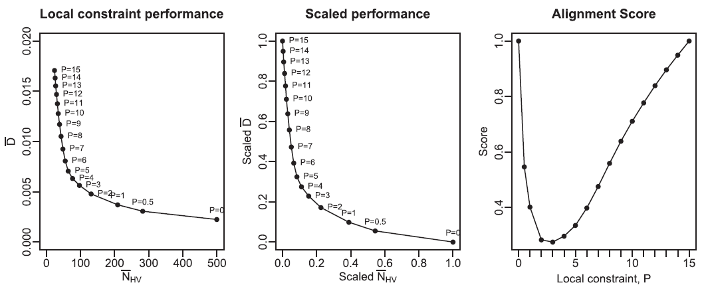
Selecting local constraint

Slide 16
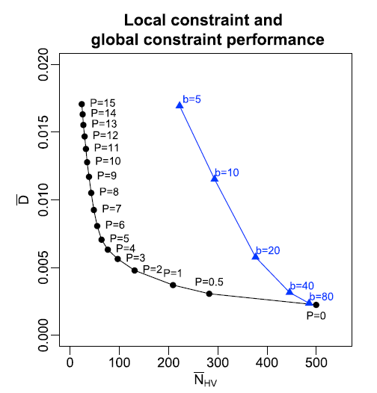
Comparison to DTW with global constraint

