Slide 1
AWarp: Fast Warping Distance for Sparse Time Series
Abdullah Mueen, Nikan Chavoshi, Noor Abu-El-Rub, Hossein Hamooni, Amanda Minnich
2016 IEEE 16th International Conference on Data Mining (ICDM)
12-15 Dec. 2016, Barcelona, Spain
Presenter: Shan-Ru Liu
Date: 2018/09/11

Slide 2
Abstract (1/2)
Dynamic Time Warping (DTW) distance has been effectively used in mining time series data in a multitude of domains. However, in its original formulation DTW is extremely inefficient in comparing long sparse time series, containing mostly zeros and some unevenly spaced non-zero observations. Original DTW distance does not take advantage of this sparsity, leading to redundant calculations and a prohibitively large computational cost for long time series. We derive a new time warping similarity measure (AWarp) for sparse time series that works on the run-length encoded representation of sparse time series. The complexity of AWarp is quadratic on the number of observations as opposed to the range of time of the time series.

Slide 3
Abstract (2/2)
Therefore, AWarp can be several orders of magnitude faster than DTW on sparse time series. AWarp is exact for binary-valued time series and a close approximation of the original DTW distance for any-valued series. We discuss useful variants of AWarp: bounded (both upper and lower), constrained, and multidimensional. We show applications of AWarp to three data mining tasks including clustering, classification, and outlier detection, which are otherwise not feasible using classic DTW, while producing equivalent results. Potential areas of application include bot detection, human activity classification, and unusual review pattern mining.

Slide 4
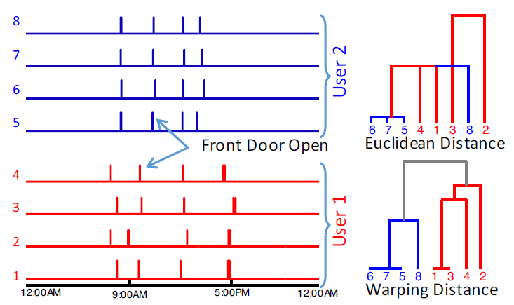
Sparse time series (Euclidean vs. Warping)

Slide 5
Representations
T = < 7, 0, 0, 9, 6, 0, 0, 0, 1 >
Time-value Sequence: T_{v} = {(1, 7), (4, 9), (5, 6), (9, 1)}
Length-Encoded series: T_{e} = < 7, (2), 9, 6, (3), 1 >
Partially Encoded series: T_{pe} = < 7, (2), 9, 6, (2), (1), 1 >

Slide 6
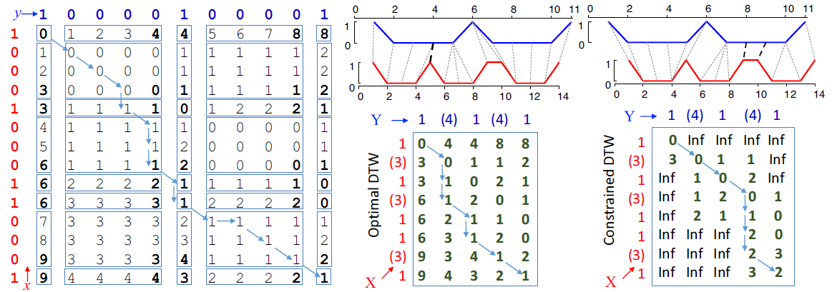
DTW matrix vs. Awarp matrix
1
14 x 11
8 x 5

Slide 7
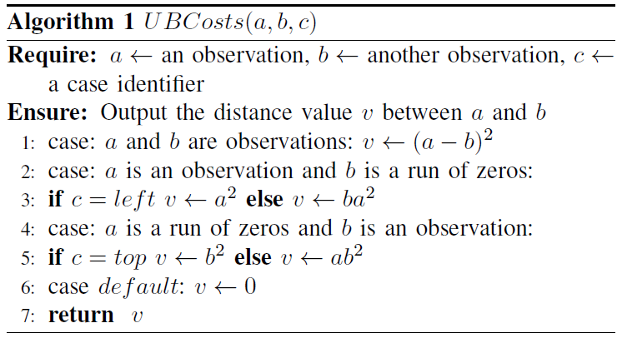
Awarp (Binary-valued Series) (1/3)

Slide 8
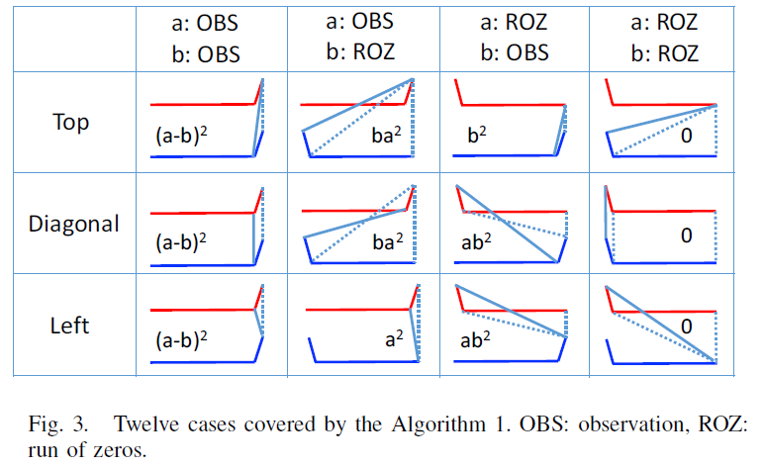
Awarp (Binary-valued Series) (2/3)

Slide 9
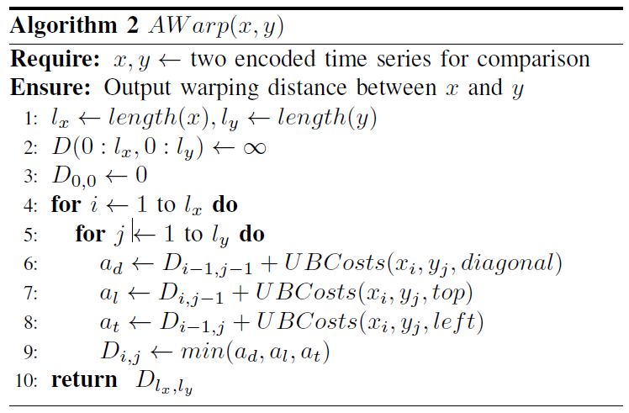
Awarp (Binary-valued Series) (3/3)

Slide 10
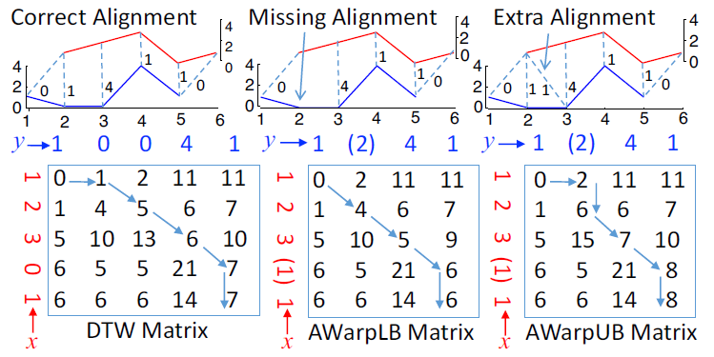
Awarp (Any-valued Series) (1/3)

Slide 11
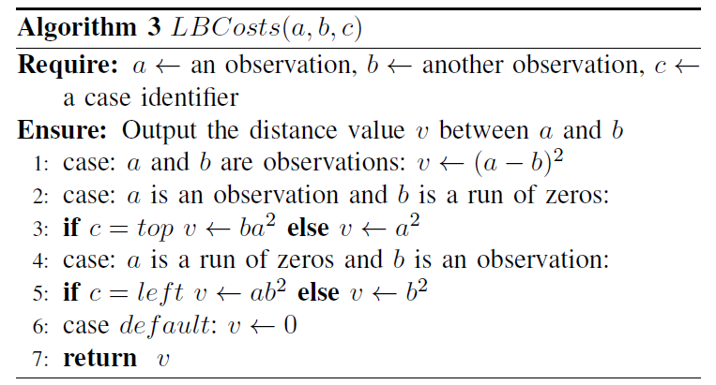
Awarp (Any-valued Series) (2/3)

Slide 12
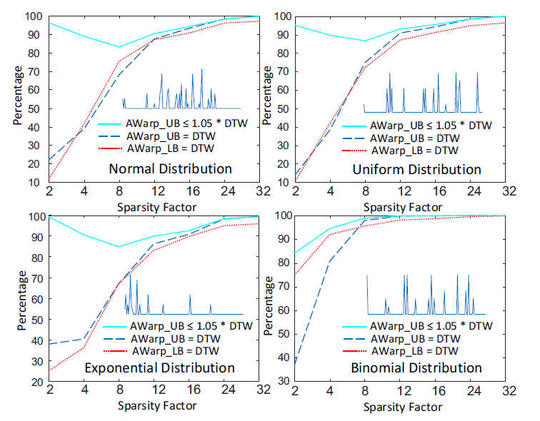
Awarp (Any-valued Series) (3/3)

Slide 13
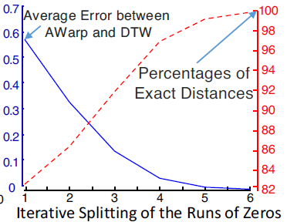
Awarp (Invariance to Partial Encoding)

Slide 14
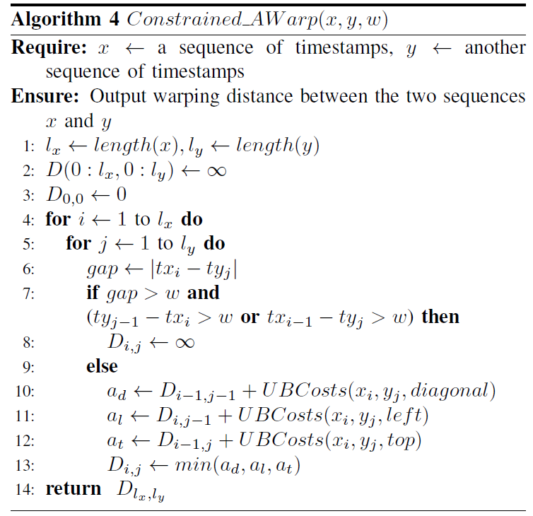
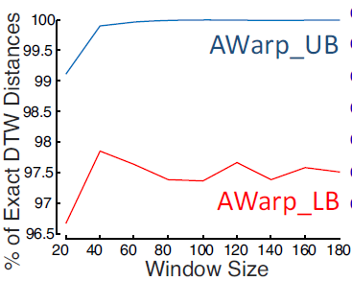
Awarp (Constrained Warping)

Slide 15
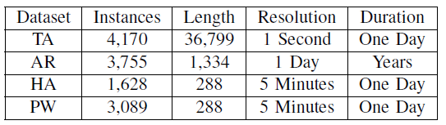
Experiments (Datasets)
TA: Twitter user activity time series
AR: app review time series
HA: human activity tme series
PW: power usage time series

Slide 16
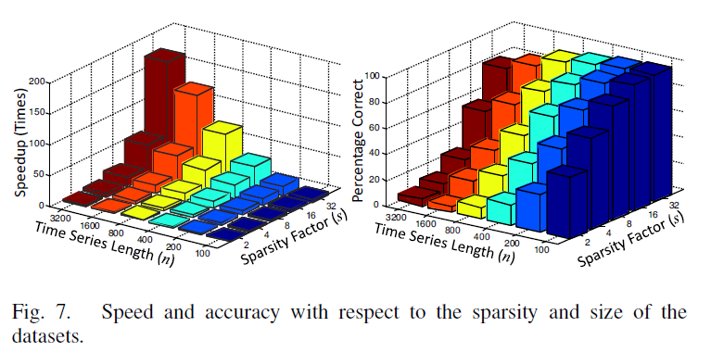
Experiments (Result)

Slide 17
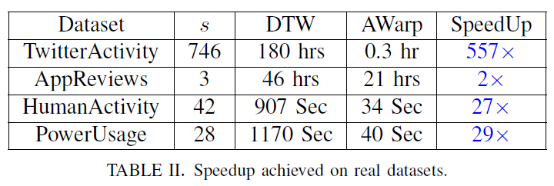
Experiments (Result)

