Slide 1
Financial Time-series Data Analysis using Deep Convolutional Neural Networks
Jou-Fan Chen(陳柔帆), Wei-Lun Chen(陳韋綸), Chun-Ping Huang(黃君平),
Szu-Hao Huang(黃思皓), and An-Pin Chen(陳安斌)
7th International Conference on Cloud Computing and Big Data,
Macau, China,16-18 Nov. 2016
Presenter: Cheng-Han Wu
Date:2018/9/11

Slide 2
Abstract(1/2)
A novel financial time-series analysis method based on deep learning technique is proposed in this paper. In recent years, the explosive growth of deep learning researches have led to several successful applications in various artificial intelligence and multimedia fields, such as visual recognition, robot vision, and natural language processing. In this paper, we focus on the time-series data processing and prediction in financial markets. Traditional feature extraction approaches in intelligent trading decision support system are used to applying several technical indicators and expert rules to extract numerical features. The major contribution of this paper is to improve the algorithmic trading framework with the proposed planar feature representation methods and deep convolutional neural networks (CNN).

Slide 3
Abstract(2/2)
The proposed system is implemented and benchmarked in the historical datasets of Taiwan Stock Index Futures. The experimental results show that the deep learning technique is effective in our trading simulation application, and may have greater potentialities to model the noisy financial data and complex social science problems. In the future, we expected that the proposed methods and deep learning framework could be applied to more innovative applications in the next financial technology (FinTech) generation.

Slide 4
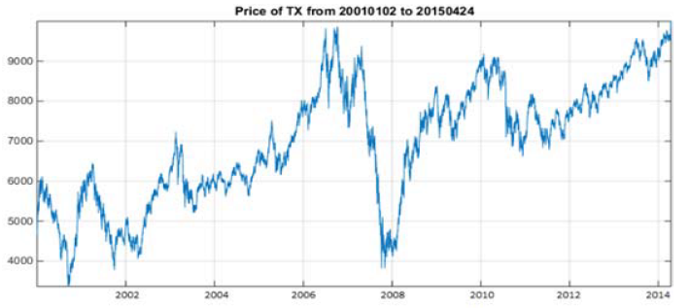
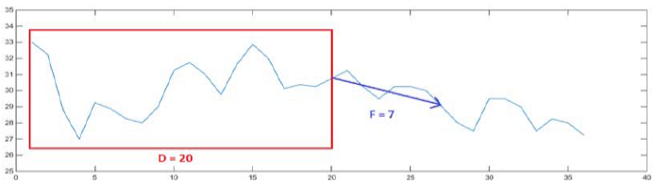
Financial Data
TFX OHLC (2001/1/2~2015/4/24)
Image Size : 20*20
Prediction future time : 7 days
Training period : 4-years data for training and 1-year data for testing

Slide 5

Data visualization
Gramian Angular Field (GAF)
Moving Average Mapping (MAM)
Double Moving Average Mapping (DMAM)
$$X_{new}=\frac{x−x_{min}}{x_{max}−x_{min}}$$

Slide 6
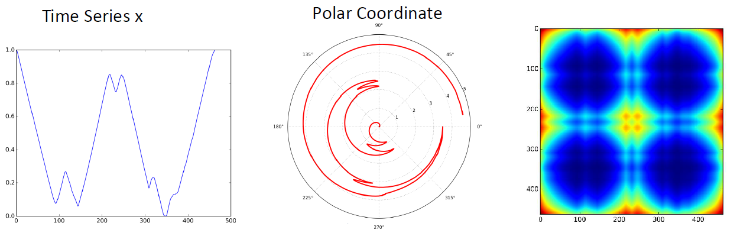

GAF
$G=\left[\begin{matrix}<\tilde{x_{1}},\tilde{x_{1}}> & ⋯ & <\tilde{x_{1}},\tilde{x_{n}} > \\ ⋮ & ⋱ & ⋮ \\ <\tilde{x_{n}},\tilde{x_{1}} > & ⋯ & <\tilde{x_{n}},\tilde{x_{n}} >\end{matrix}\right]$
$<x,y> =x∙y−\sqrt{1−x^{2}}∙\sqrt{1−y^{2}}$

Slide 7
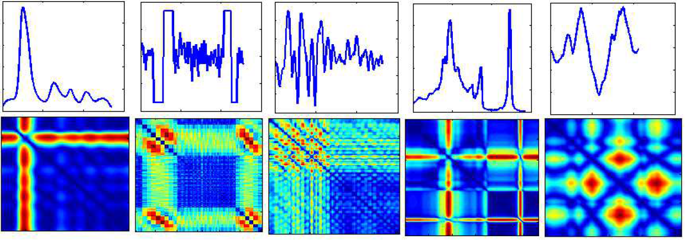
GAF

Slide 8

MAM & DMAM
$MAM=\left[\begin{matrix}<MA_{t−D+1,1}> & ⋯ & <MA_{t,1}> \\ ⋮ & ⋱ & ⋮ \\ <MA_{t−D+1,D}> & ⋯ & <MA_{t,D}>\end{matrix}\right]$
$MA=\frac{p_{1}+p_{2}+…+p_{n}}{n}$
$DMA=\frac{q_{1}+q_{2}+…+q_{n}}{n}$

Slide 9
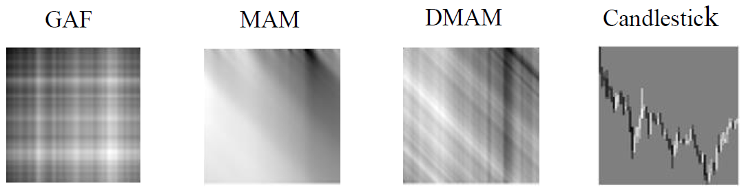
Image

Slide 10
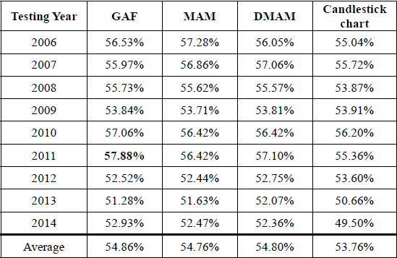
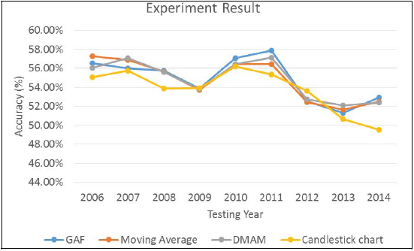
Result

