Slide 1
Speeding up the detection of tandem repeats over the edit distance
Dina Sokol, Justin Tojeira
Theoretical Computer Science 525 (2014) 103–110
Speaker: Guan-Zhi Chen
Date: 2018.10.09
Notes:
Brooklyn College of the City University of New York 紐約市立大學布魯克林學院
The Graduate Center of the City University of New York

Slide 2
Abstract (1/2)
A tandem repeat in a string is a sequence of two or more contiguous, approximate copies of a pattern. Finding an efficient, deterministic algorithm to perform an exhaustive search for tandem repeats in a string is an important and practical problem, due to the relevance of tandem repeats in several areas, including human identity testing, disease diagnosis, sequence homology, and population studies.

Slide 3
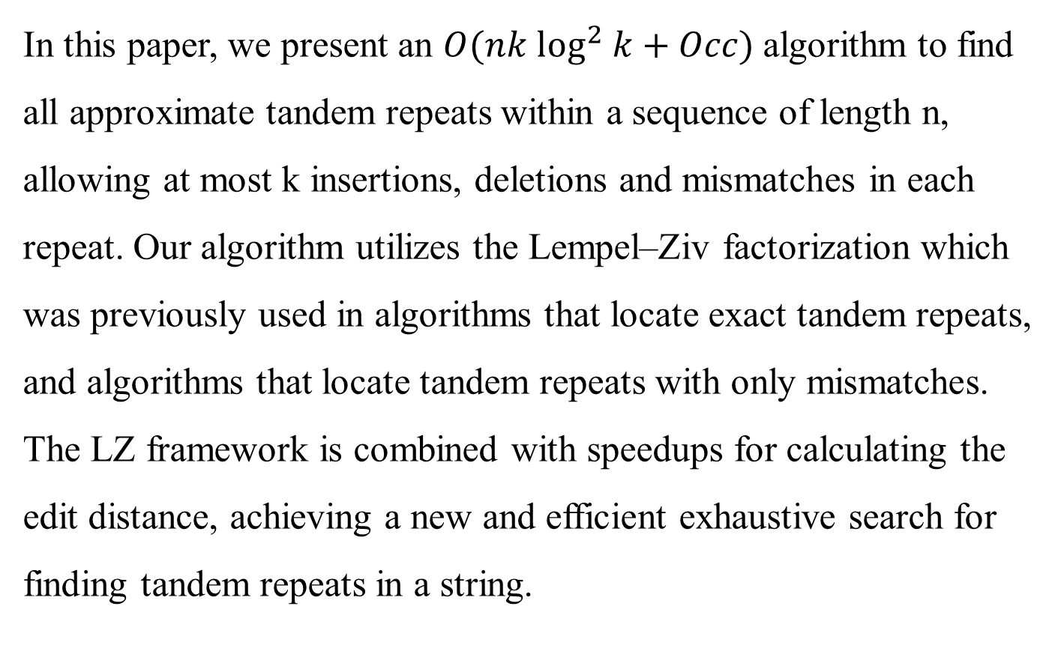
Abstract (2/2)
In this paper, we present an $O(nk \log^{2} k+Occ)$algorithm to find all approximate tandem repeats within a sequence of length n, allowing at most k insertions, deletions and mismatches in each repeat. Our algorithm utilizes the Lempel–Ziv factorization which was previously used in algorithms that locate exact tandem repeats, and algorithms that locate tandem repeats with only mismatches. The LZ framework is combined with speedups for calculating the edit distance, achieving a new and efficient exhaustive search for finding tandem repeats in a string.

Slide 4
Definition
Tandem repeat: two or more adjacent copies
ACT ACT GCG GCG
Exact tandem repeat: identical copies
CAG CAG CAG CAG
Approximate tandem repeat: have some degree of deviation
CAG GAG CAC CAG

Slide 5


Definition (Edit distance)
Edit distance :
the minimum number of edit operations between two strings
$$ed(s_{1},s_{2})$$
Edit operations (each cost = 1) :
insertion, deletion, substitution
S:
A - A B A A A A
$$ed\left(S,T\right)=3$$
T:
A B A - A A C A
Insertion
Substitution(mismatch)
Deletion

Slide 6
The k-edit repeat (1/3)
Evolutive tandem repeat:
GTCC GTTC GTTA CTTA CATA
K-edit repeat:
An evolutive tandem repeat, there are at most k edit operations, overall, between all consecutive copies of the repeat.

Slide 7
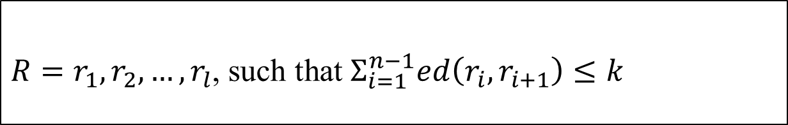
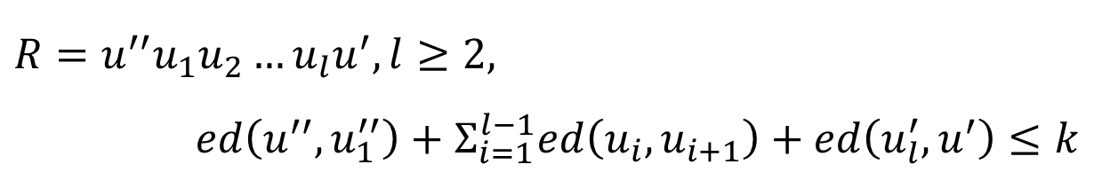

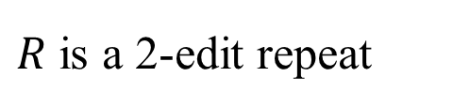


The k-edit repeat (2/3)
1. A string R is a k-edit repeat if 可以被切成連續子字串，滿足:
$R=r_{1}, r_{2},…,r_{l}$, such that $Σ_{i=1}^{n−1}ed\left(r_{i}, r_{i+1}\right)≤k$
$$R=u^{′′}u_{1}u_{2}…u_{l}u^{′},l≥2,$$
$ed\left(u^{′′},u_{1}^{′′}\right)+Σ_{i=1}^{l−1}ed\left(u_{i},u_{i+1}\right)+ed\left(u_{l}^{′},u^{′}\right)≤k$
for R=CAAGCTCCAGCTCCGC:
CAAGCT
CCAGCT
CC-GC
$$ed\left( \right)=1$$
$R$ is a 2-edit repeat
$$ed\left( \right)=1$$
$$(Σed=2≤k)$$
Dina Sokol, Gary Benson, Justin Tojeira, Tandem repeats over the edit distance, Bioinformatics 23 (2) (2007) e30–e35

Slide 8
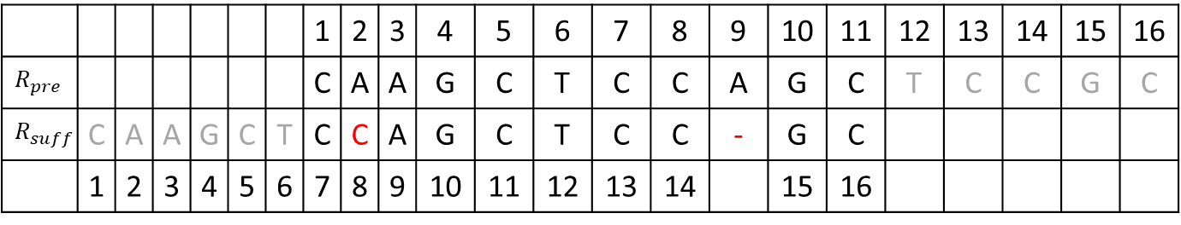
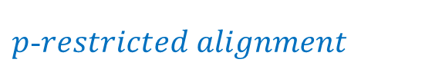

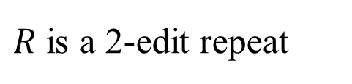
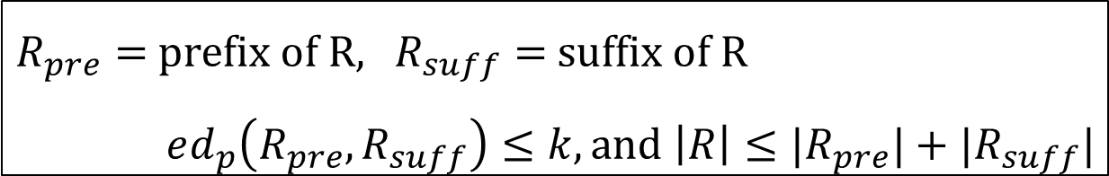
The k-edit repeat (3/3)
2. A string R is a k-edit repeat if and only if
$R_{pre}=$prefix of R, $R_{suff}=$ suffix of R
$ed_{p}\left(R_{pre}, R_{suff}\right)≤k, and$ $\left|R\right|≤|R_{pre}|+|R_{suff}|$
$p$-$restricted alignment$
Optimal Sequence Alignment of $R_{pre}$ and $R_{suff}$:
 |  |  |  |  |  |  | 1 | 2 | 3 | 4 | 5 | 6 | 7 | 8 | 9 | 10 | 11 | 12 | 13 | 14 | 15 | 16
$$R_{pre}$$ |  |  |  |  |  |  | C | A | A | G | C | T | C | C | A | G | C | T | C | C | G | C
$$R_{suff}$$ | C | A | A | G | C | T | C | C | A | G | C | T | C | C | - | G | C
 | 1 | 2 | 3 | 4 | 5 | 6 | 7 | 8 | 9 | 10 | 11 | 12 | 13 | 14 |  | 15 | 16
$R$ is a 2-edit repeat
$$(ed_{p}=2≤k, \left|R\right|=16≤11+10=21)$$

Slide 9
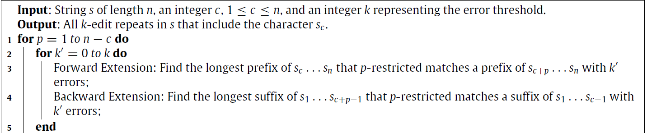


Algorithm for finding repeats with a particular character (1/2)
c
c+p
1
n
 | … |  | … |  | …
c
$$forward$$
 | …
c+p
 | …
c-1
…
$$backward$$
…
c+p-1

Slide 10
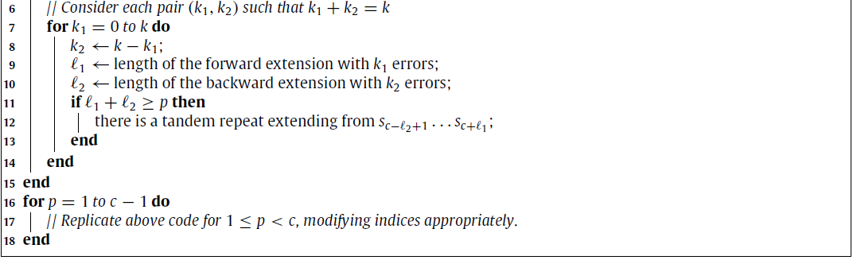
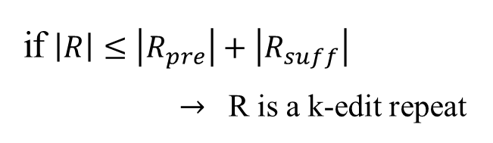

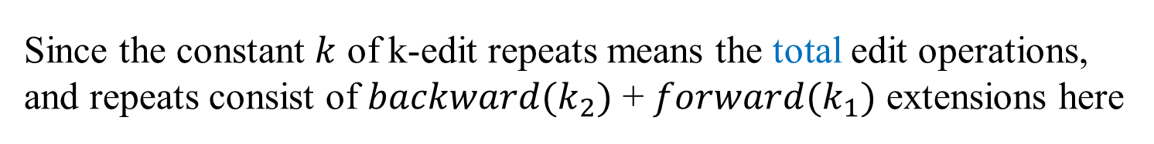
Algorithm for finding repeats with a particular character (2/2)
Since the constant $k$ of k-edit repeats means the total edit operations, and repeats consist of $backward(k_{2})$ + $forward(k_{1})$ extensions here
$∴k=k_{1}+k_{2}$
if $\left|R\right|≤\left|R_{pre}\right|+\left|R_{suff}\right|$
$→$ R is a k-edit repeat

Slide 11
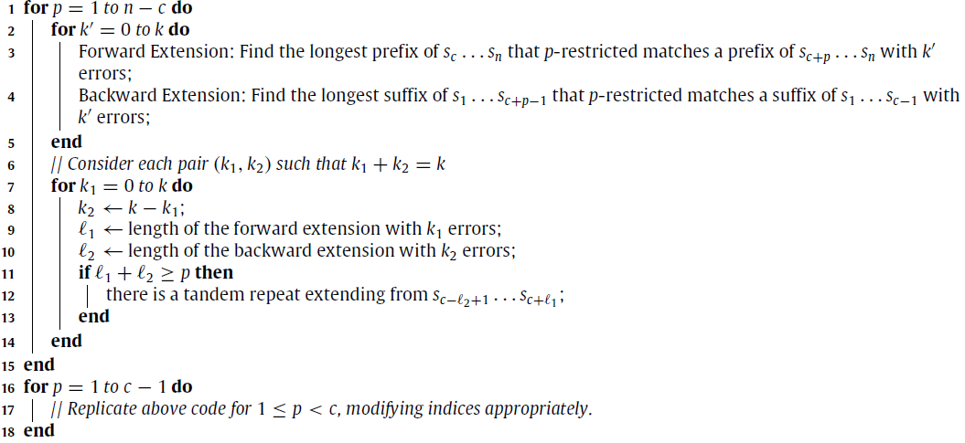
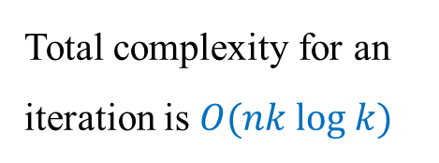
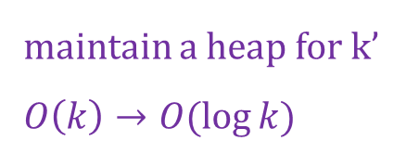
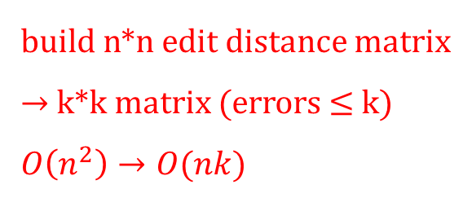
Time complexity of the algorithm
build n*n edit distance matrix
$→$ k*k matrix (errors$≤$k)
$$O\left(n^{2}\right)→O(nk)$$
Total complexity for an iteration is $O(nk log k)$
maintain a heap for k’
$$O\left(k\right)→O(\log{k})$$

Slide 12

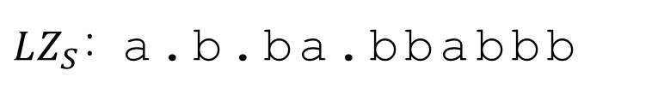



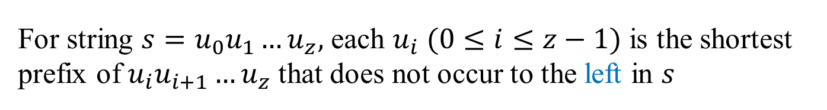
Lempel-Ziv factorization (LZ-factorization)
For string $s=u_{0}u_{1}…u_{z},$ each $u_{i}$ $(0≤i≤z−1)$ is the shortest prefix of $u_{i}u_{i+1}…u_{z}$ that does not occur to the left in $s$
S:
abbabbabbb
left
$$u_{0}$$
a
$$u_{1}$$
b
$$u_{2}$$
b
a
b
a
b
b
$$u_{3}$$
b
b
$LZ_{S}$: a.b.ba.bbabbb
A. Lempel, J. Ziv, On the complexity of finite sequences, IEEE Trans. Inform. Theory 22 (1976) 75–81.
J. Ziv, A. Lempel, A universal algorithm for sequential data compression, IEEE Trans. Inform. Theory IT-23 (3) (1977) 337–343.

Slide 13
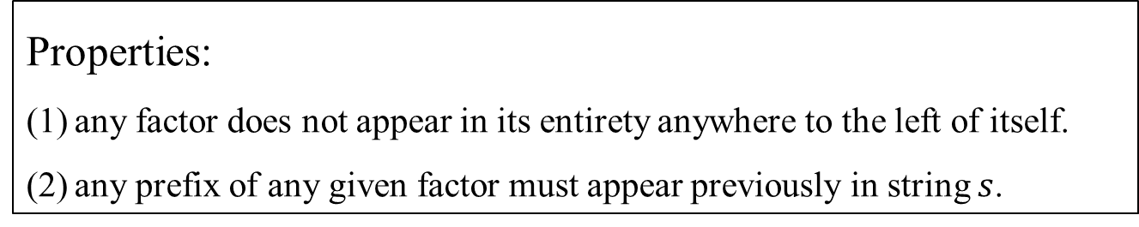
Lempel-Ziv factorization (LZ-factorization)
Properties:
any factor does not appear in its entirety anywhere to the left of itself.
any prefix of any given factor must appear previously in string $s$.
S:
abbabbabbb
left
$$u_{0}$$
a
$$u_{1}$$
b
a
$$u_{2}$$
b
a
a.b.b
b
a.b.ba.bbabb
a
b
b
$$u_{3}$$
b
b

Slide 14


Algorithm for finding all k-edit repeats within a string
Stage 1. find repeats that reach block boundary
$Complexity: constant time$
Stage 2. find repeats that reach a factor boundary
$$Complexity:O(\log{k})$$
Stage 3. Find repeats contained within a single factor
$Complexity:O\left(n+Occ\right), Occ$is the number of found repeats

Slide 15

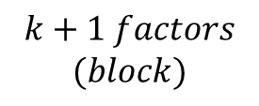
Algorithm for finding all k-edit repeats within a string
$$factor$$
 | …
 | …
 | …
 | …
$$k+1 factors$$
$$(block)$$
Stage 1. find repeats that reach block boundary
Stage 2. find repeats that reach a factor boundary
Stage 3. Find repeats contained within a single factor

Slide 16
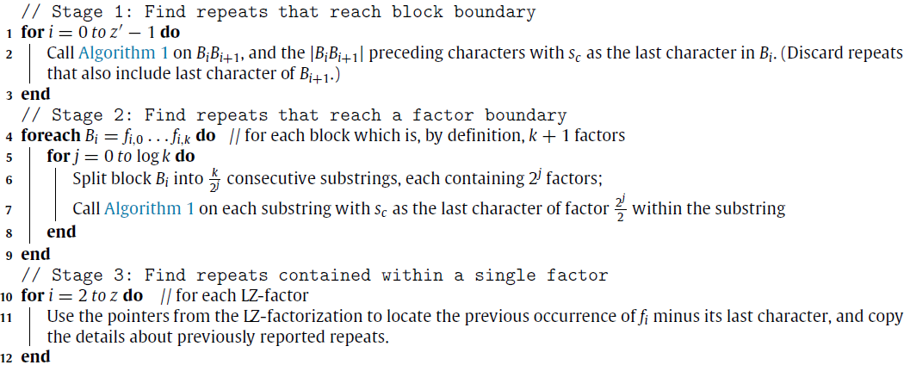

Algorithm for finding all k-edit repeats within a string
$$Total complexity :O(nk\log^{2}{k}+Occ)$$

Slide 17
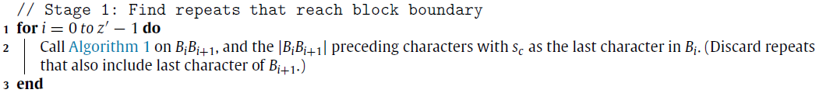
Algorithm for finding all k-edit repeats within a string
Stage 1. find repeats that reach block boundary

