Slide 1
A Novel Parallel Scheme for Fast Similarity Search in Large Time Series
Hong Yin, Shuqiang Yang, Shaodong Ma, Fei Liu, Zhikun Chen
China Communications
Vol. 12, Feb, 2015, Pages 129-140
Presenter: Shan-Ru Liu
Date: 2018/10/09

Slide 2
Abstract (1/2)
The similarity search is one of the fundamental components in time series data mining, e.g. clustering, classification, association rules mining. Many methods have been proposed to measure the similarity between time series, including Euclidean distance, Manhattan distance, and dynamic time warping (DTW). In contrast, DTW has been suggested to allow more robust similarity measure and be able to find the optimal alignment in time series. However, due to its quadratic time and space complexity, DTW is not suitable for large time series datasets. Many improving algorithms have been proposed for DTW search in large databases, such as approximate search or exact indexed search.

Slide 3
Abstract (2/2)
Unlike the previous modified algorithm, this paper presents a novel parallel scheme for fast similarity search based on DTW, which is called MRDTW (MapRedcue-based DTW). The experimental results show that our approach not only retained the original accuracy as DTW, but also greatly improved the efficiency of similarity measure in large time series.

Slide 4
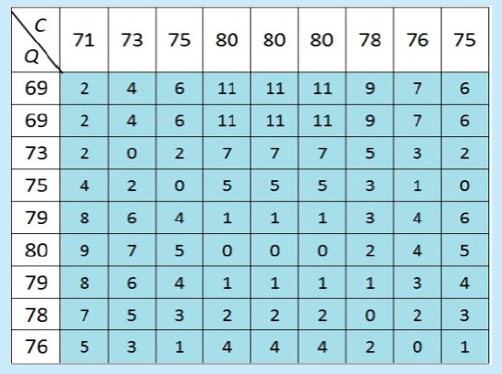
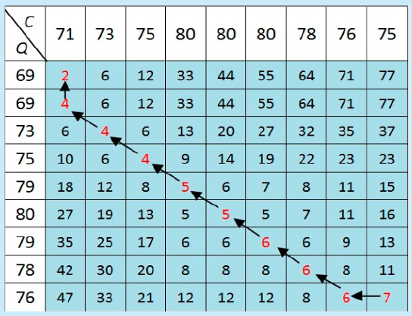
Parallelization of DTW (1/2)

Slide 5
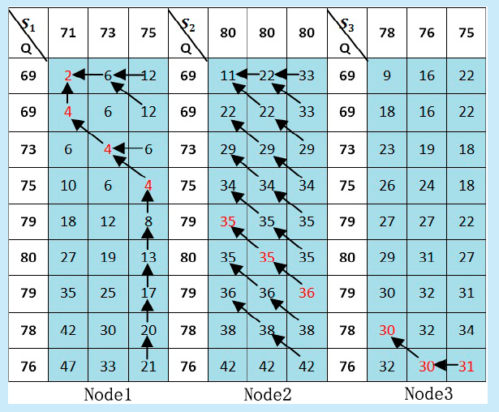
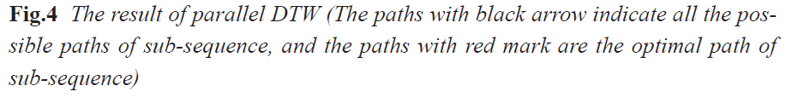
Parallelization of DTW (2/2)
W₁ = {(1,1),(1,2),(2,3),(3,4)}
W₃ = {(7,8),(8,9),(9,9)}
W2 = {(4,7),(5,8),(6,9)},
{(4,6),(5,7),(6,8)},
{(4,5),(5,6),(6,7)},
{(4,4),(5,5),(6,6)},
{(4,3),(5,4),(6,5)},
{(4,2),(5,3),(6,4)},
{(4,1),(5,2),(6,3)},
{(4,1),(5,1),(6,2)},
{(4,1),(5,1),(6,1)}

Slide 6
Pruning of warping paths
W2 = {(4,7),(5,8),(6,9)},
{(4,6),(5,7),(6,8)},
{(4,5),(5,6),(6,7)},
{(4,4),(5,5),(6,6)},
{(4,3),(5,4),(6,5)},
{(4,2),(5,3),(6,4)},
{(4,1),(5,2),(6,3)},
{(4,1),(5,1),(6,2)},
{(4,1),(5,1),(6,1)}

Slide 7
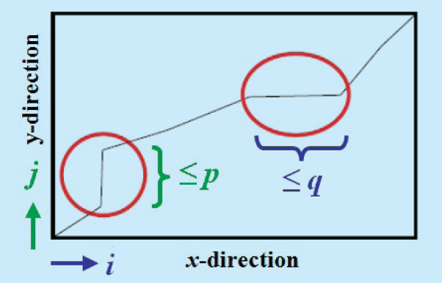
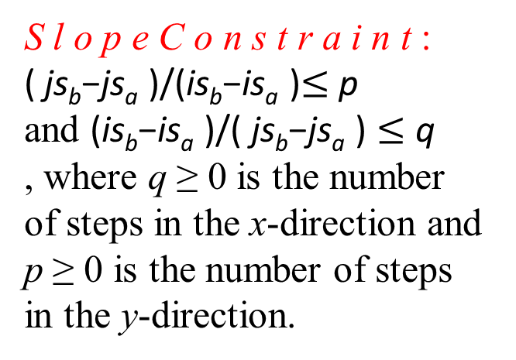
The example of slope constraint
S l o p e C o n s t r a i n t :
( js_{b}−js_{a} )/(is_{b}−is_{a} )$≤$ p
and (is_{b}−is_{a} )/( js_{b}−js_{a} ) $≤$ q
, where q ≥ 0 is the number of steps in the x-direction and p ≥ 0 is the number of steps
in the y-direction.

Slide 8
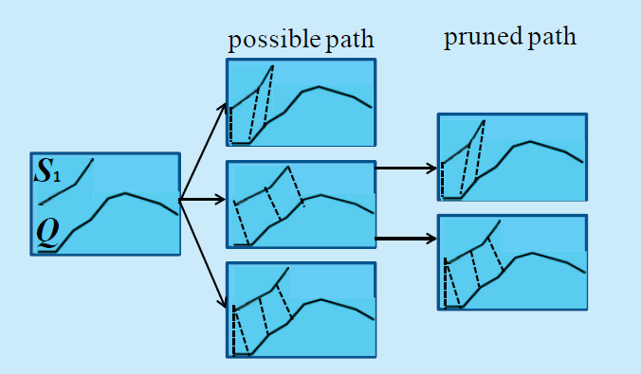
The process of Map for DTW

Slide 9
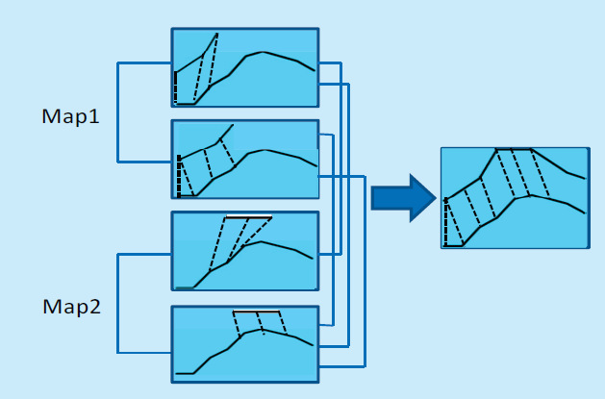
The process of Reduce for DTW

Slide 10
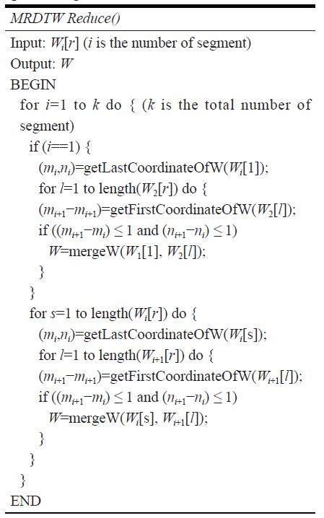
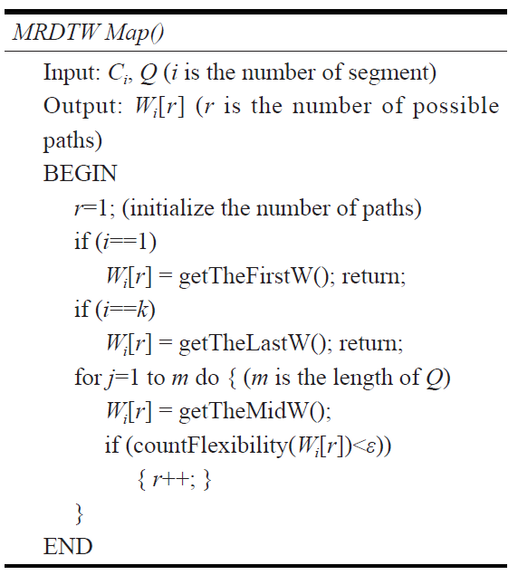
Algorithm Implementation of MRDTW

Slide 11
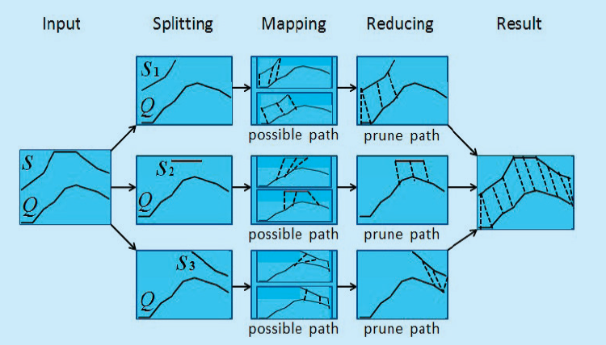
The process of MapReduce of DTW

Slide 12
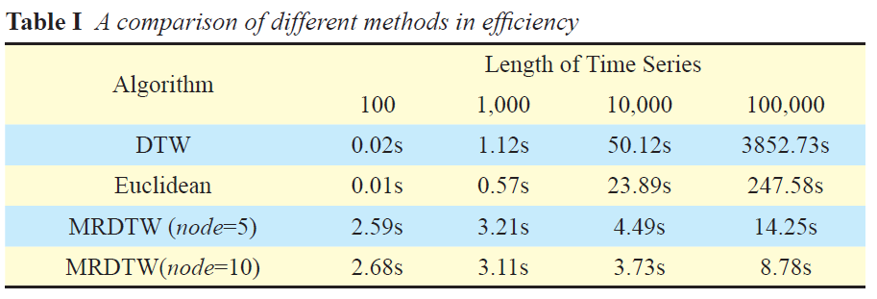
Result (1/5)

Slide 13
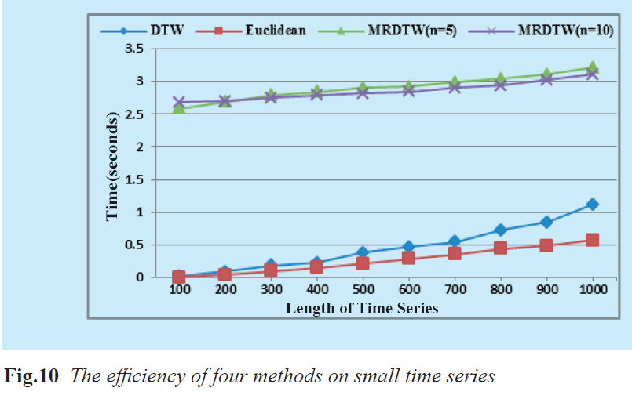
Result (2/5)

Slide 14
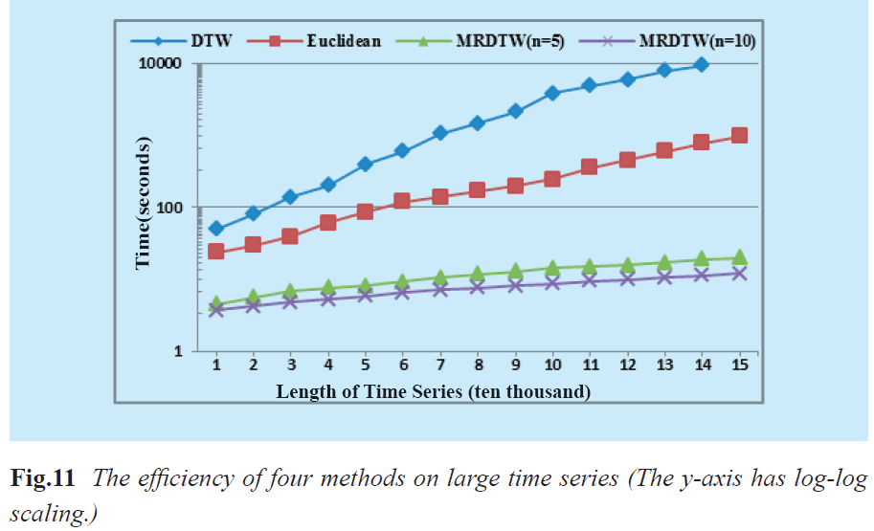
Result (3/5)

Slide 15
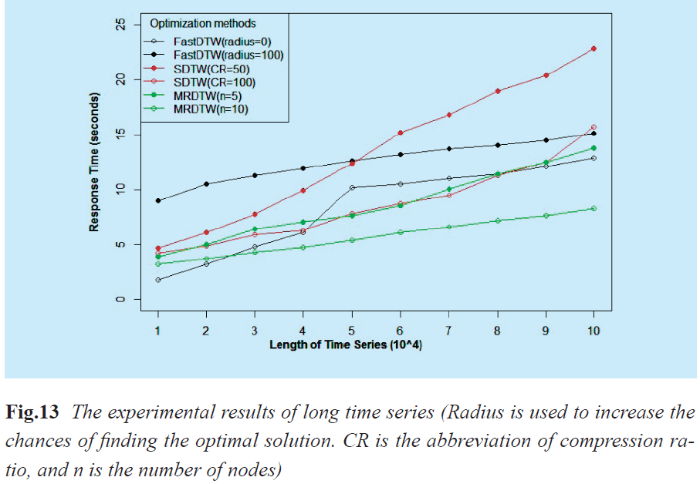
Result (4/5)

Slide 16
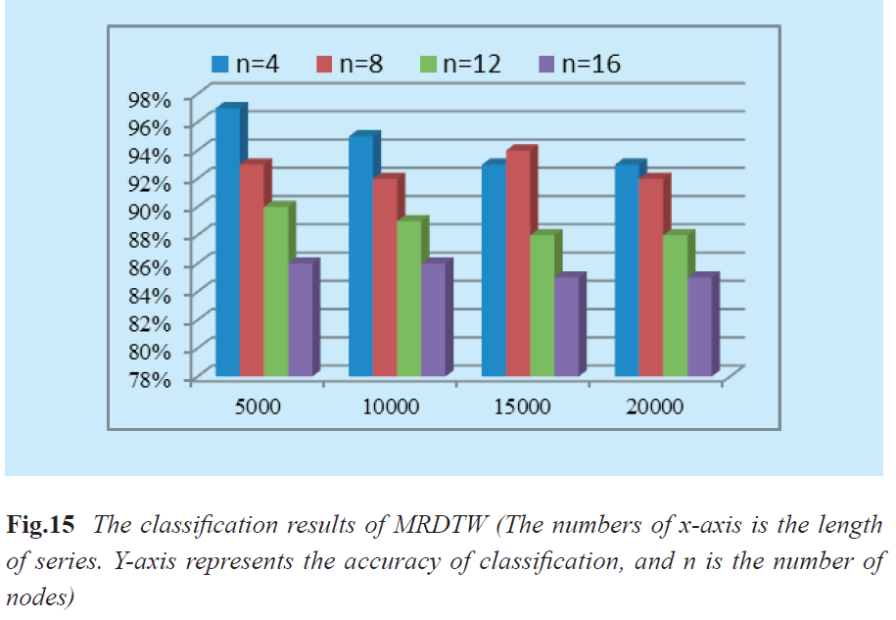
Result (5/5)

