Slide 1
Computing the Longest Common Substring with One Mismatch
M. A. Babenko and T. A. Starikovskaya
Chair of Mathematical Logic and Theory of Algorithms, Faculty of Mechanics and Mathematics, Lomonosov Moscow State University
Problems of Information Transmission 47 (2011) 28–33
Speaker: Guan-Zhi Chen
Date: 2018.11.06

Slide 2
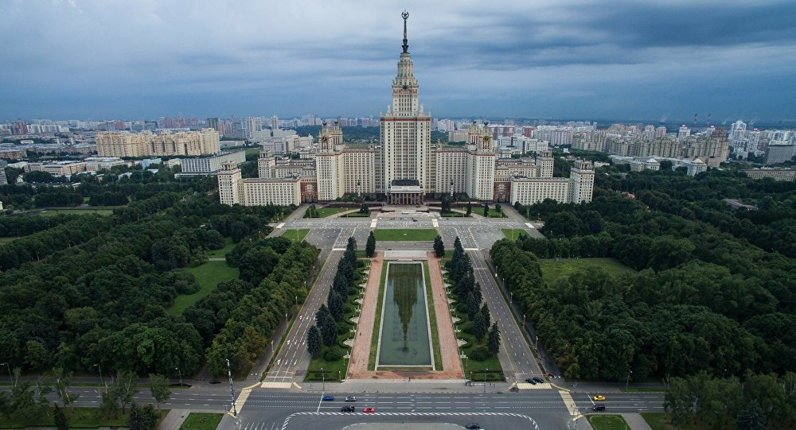
莫斯科國立米哈伊爾·瓦西里耶維奇·羅蒙諾索夫大學(1755)
Lomonosov Moscow State University
主樓(1953)共36層樓，中心塔高240m，當時歐洲最高的建築物。
Notes:
莫斯科國立大學
創辦人的名字
1755建立

Slide 3
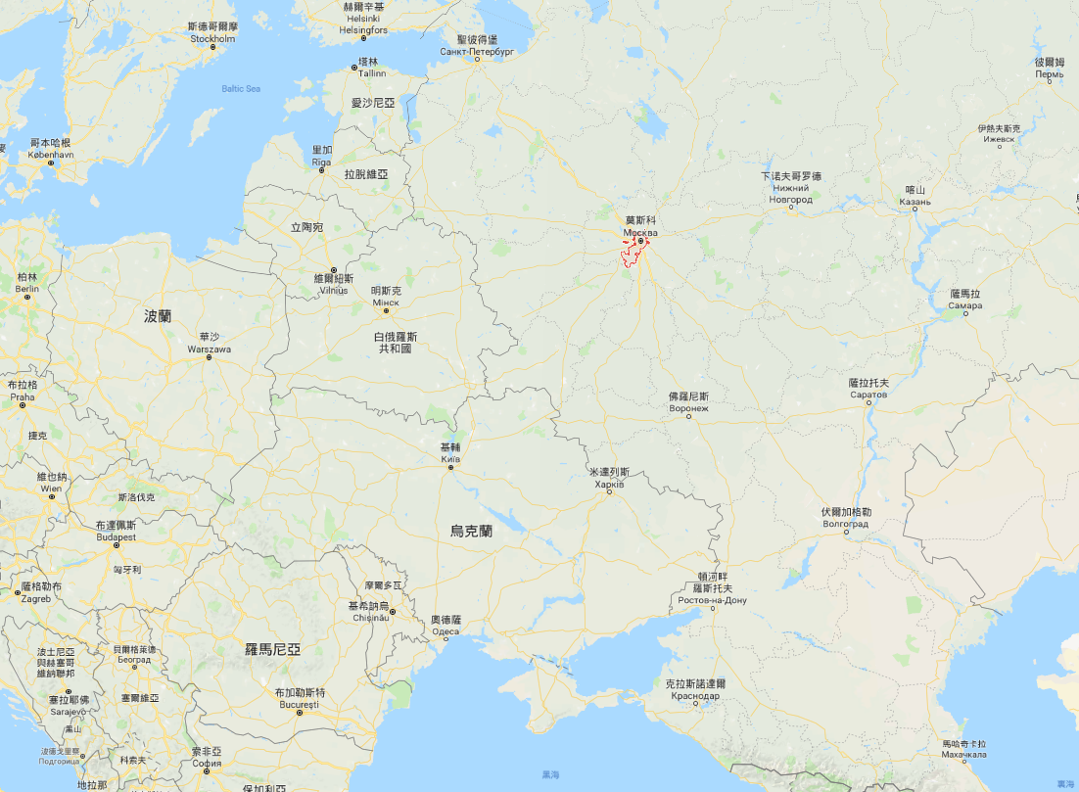
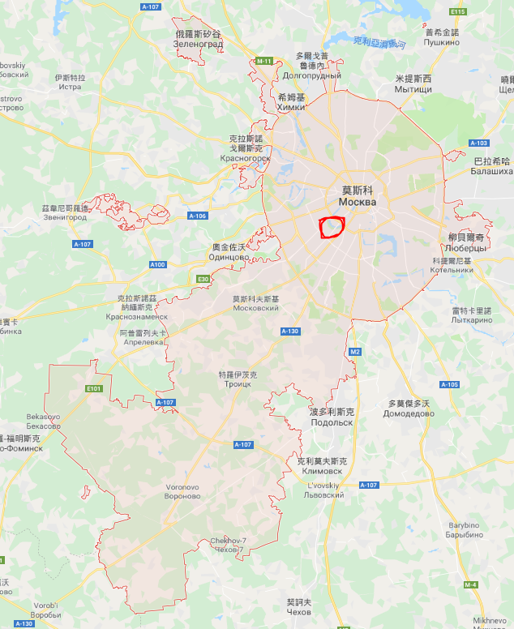
Notes:
莫斯科國立大學

Slide 4
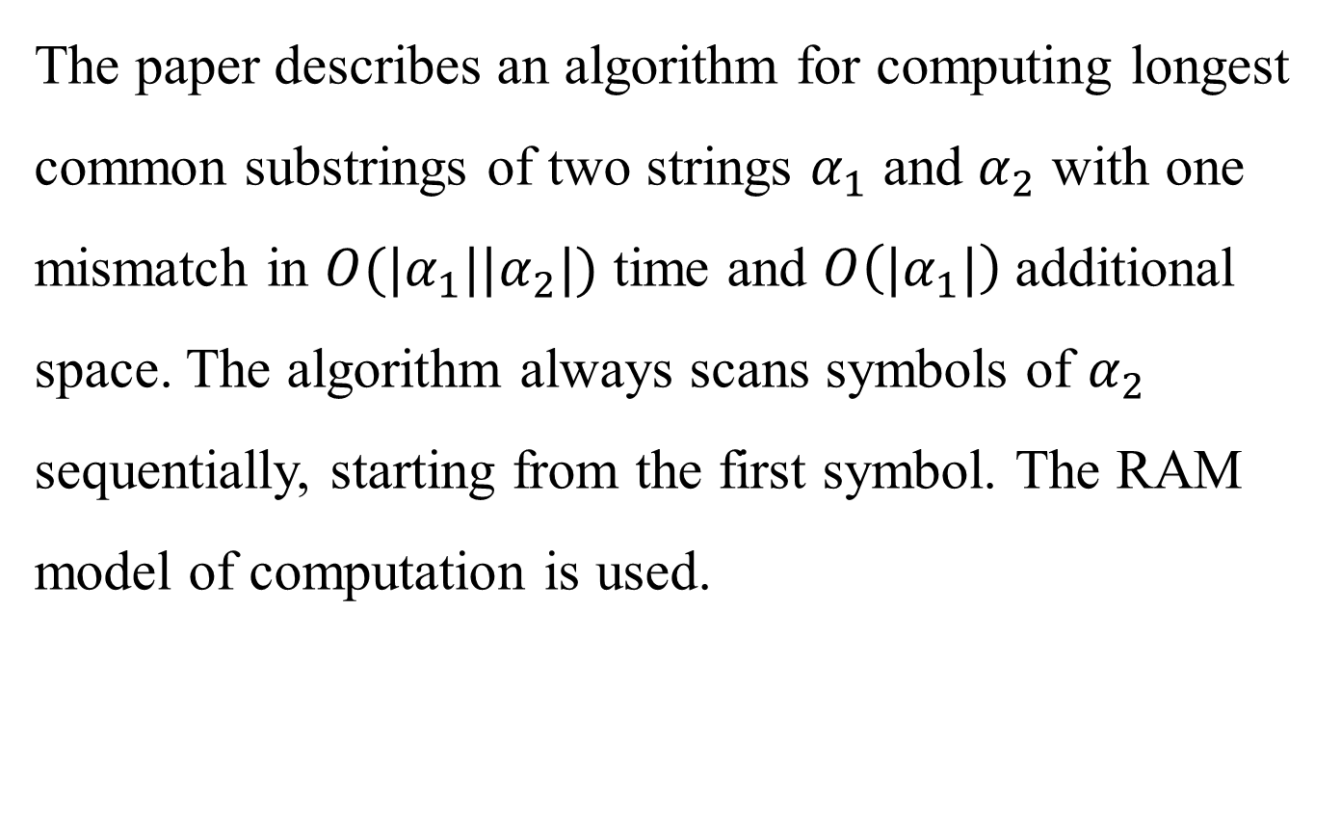
Abstract
The paper describes an algorithm for computing longest common substrings of two strings $α_{1}$ and $α_{2}$ with one mismatch in $O(|α_{1}||α_{2}|)$ time and $O\left(|α_{1}|\right)$additional space. The algorithm always scans symbols of $α_{2}$ sequentially, starting from the first symbol. The RAM model of computation is used.

Slide 5
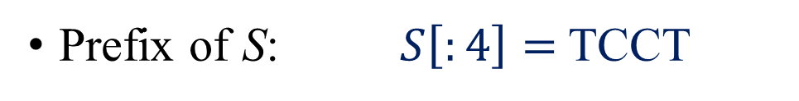

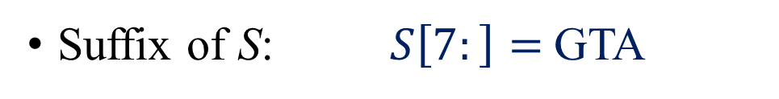
Definition (1/3)
S | = | T | C | C | T | C | G | G | T | A
T | = | T | C | G | A | G | G | T | A | A
S | = | T | C | C | T | C | G | G | T | A
S | = | T | C | C | T | C | G | G | T | A
S | = | T | C | C | T | C | G | G | T | A
T | = | T | C | G | A | G | G | T | A | A
Substring of S: $S\left[2:6\right]=$ CCTCG
Prefix of S: $S\left[:4\right]=$TCCT
Suffix of S: $S\left[7:\right]=$GTA
Longest common substring of S & T: GGTA

Slide 6
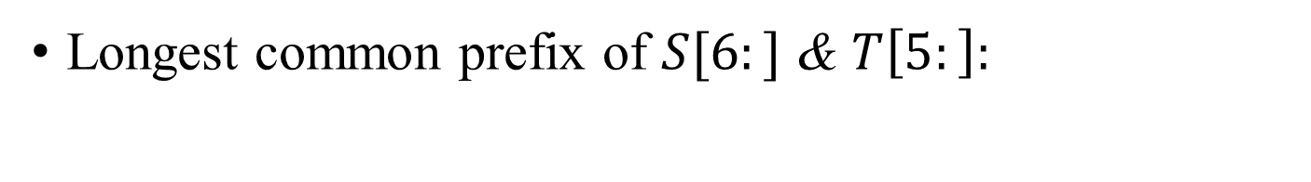
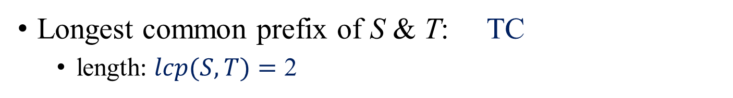
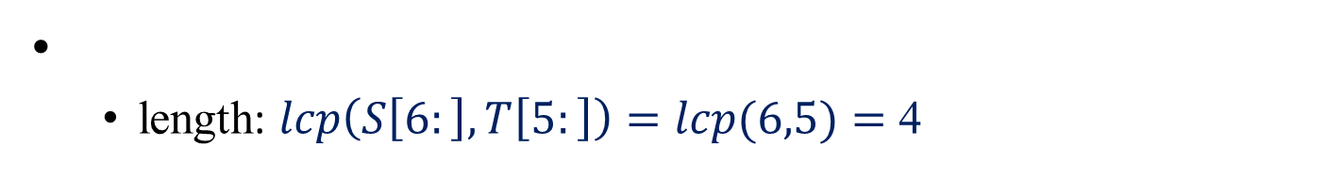
Definition (2/3)
S | = | T | C | C | T | C | G | G | T | A
T | = | T | C | G | A | G | G | T | A | A
S | = | T | C | C | T | C | G | G | T | A
T | = | T | C | G | A | G | G | T | A | A
S | = | T | C | C | T | C | G | G | T | A
T | = | T | C | G | A | G | G | T | A | A
Longest common prefix of S & T: TC
length: $lcp(S,T)=$ 2
Longest common prefix of $S[6:]$ & $T\left[5:\right]:$
length: $lcp\left(S\left[6:\right],T\left[5:\right]\right)=lcp(6,5)=$ 4
GGTA

Slide 7
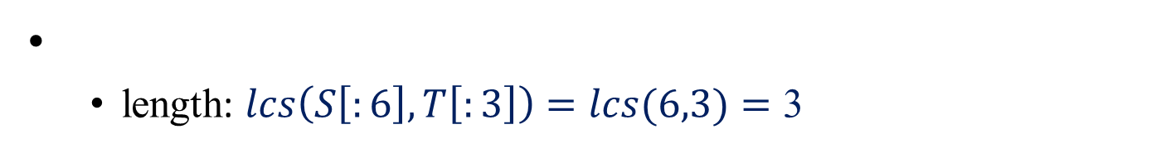
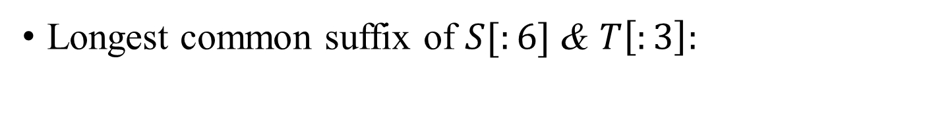
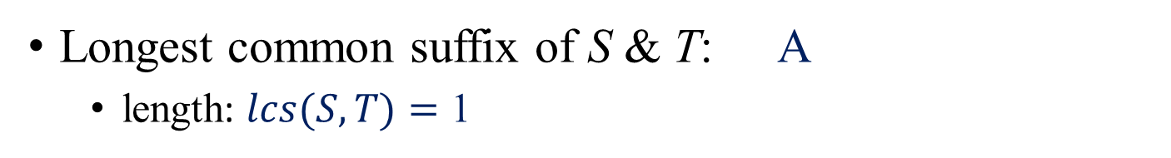
Definition (3/3)
S | = | T | C | C | T | C | G | G | T | A
T | = | T | C | G | A | G | G | T | A | A
S | = | T | C | C | T | C | G | G | T | A
T | = | T | C | G | A | G | G | T | A | A
S | = | T | C | C | T | C | G | G | T | A
T | = | T | C | G | A | G | G | T | A | A
Longest common suffix of S & T: A
length: $lcs(S,T)=$ 1
Longest common suffix of $S[:6]$ & $T\left[:3\right]:$
length: $lcs\left(S\left[:6\right],T\left[:3\right]\right)=lcs(6,3)=$ 3
TCG

Slide 8
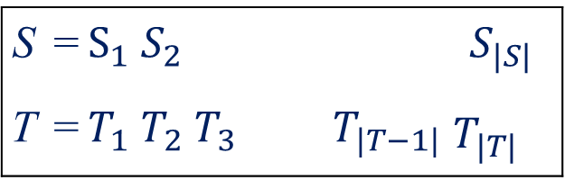
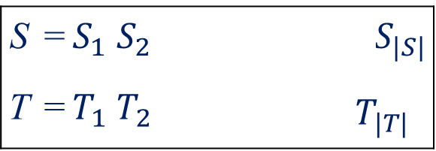
A naive algorithm
(for computing longest common substrings with one mismatch)
Compare all substrings of length d symbol by symbol, 1 ≤ d ≤ |S|
…
…
S | = | $$S_{1}$$ | $$S_{2}$$ |  |  |  |  |  |  | $$S_{|S|}$$
T | = | $$T_{1}$$ | $$T_{2}$$ |  |  |  |  |  | $$T_{|T|}$$
S | = | $$S_{1}$$ | $$S_{2}$$ |  |  |  |  |  | $$S_{|S|}$$
T | = | $$T_{1}$$ | $$T_{2}$$ | $$T_{3}$$ |  |  | $$T_{|T−1|}$$ |  | $$T_{|T|}$$
…
…
…
Time complexity: $O({\left|S\right|}^{2}{\left|T\right|}^{2})$

Slide 9
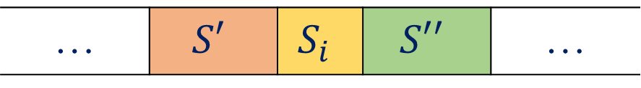
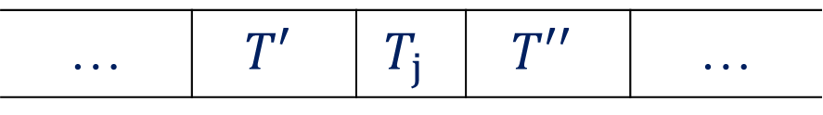
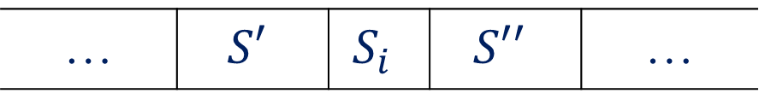
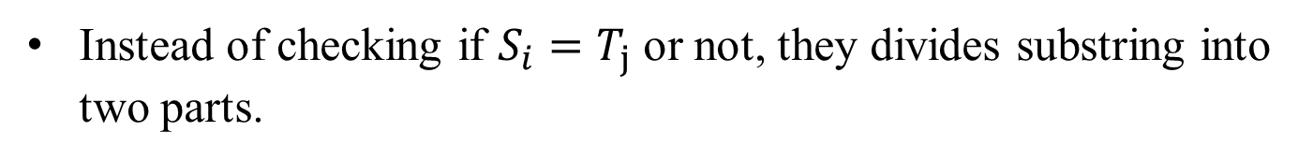


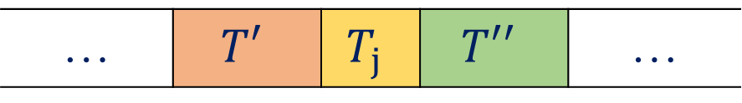
The notion of their algorithm (1/2)
… | $$S′$$ | $$S_{i}$$ | $$S′′$$ | …
$$S$$
… | $$S′$$ | $$S_{i}$$ | $$S′′$$ | …
substring
… | $$T′$$ | $$T_{j}$$ | $$T′′$$ | …
$$T$$
… | $$T′$$ | $$T_{j}$$ | $$T′′$$ | …
substring
Instead of checking if $S_{i}=T_{j}$ or not, they divides substring into two parts.
$s\left(i,j\right)=lcs\left(i−1,j−1\right)+1+lcp\left(i+1,j+1\right)$

Slide 10



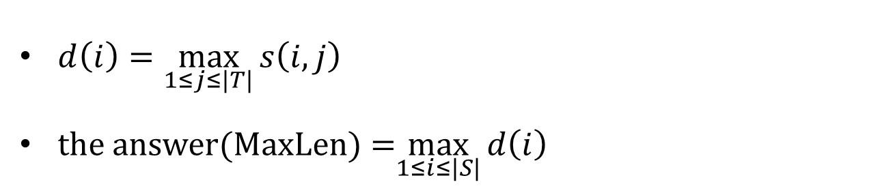




The notion of their algorithm (2/2)
$d\left(i\right)=\max_{1≤j≤|T|}{s\left(i,j\right)}$
the answer(MaxLen) =$\max_{1≤i≤|S|}{d\left(i\right)}$
$$for i=1 to |S|$$
$$for j=1 to |T|$$
$$(by LCP algo)$$
$$(by LCS algo)$$
$compute lcp\left(i+1,j+1\right)$& $lcs(i−1,j−1$)
$$compute s(i,j)$$
$$d=d>s\left(i,j\right) ?d :s(i,j)$$
$$MaxLen=MaxLen>d ?MaxLen :d$$

Slide 11



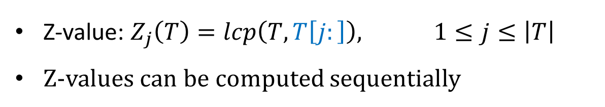

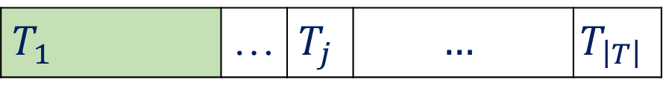
LCP algorithm (1/2)
$$T$$
$$T_{1}$$ | … | $$T_{j}$$ | $$…$$ | $$T_{\left|T\right|}$$
$$T[j:]$$
$$T_{j}$$ | $$…$$ | $$T_{\left|T\right|}$$
$$({the j}_{th} prefix of T)$$
Z-value: $Z_{j}\left(T\right)=lcp\left(T,T\left[j:\right]\right),$ $1≤j≤\left|T\right|$
Z-values can be computed sequentially
Notes:
可以知道上下的綠色區塊是相同的
假設要求$Z_{k+1}，可以從綠色之後開始比對$

Slide 12
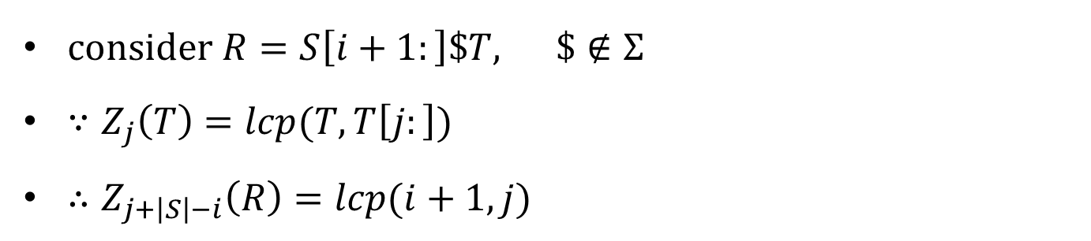


LCP algorithm (2/2)
consider $R=S\left[i+1:\right]\$T,$ $\$∉Σ$
$∵Z_{j}\left(T\right)=lcp(T, T\left[j:\right])$
$∴Z_{j+\left|S\right|−i}\left(R\right)=lcp(i+1,j)$
$$S_{i+1}$$ | $$…$$ | $$S_{\left|S\right|}$$
$$T_{j}$$ | $$…$$ | $$T_{\left|T\right|}$$

Slide 13
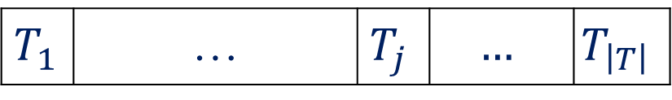




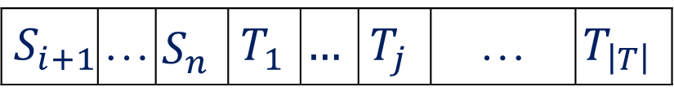

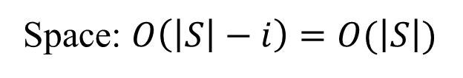

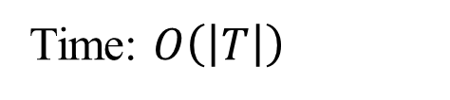



LCP algorithm (2/2)
$$j$$
$$Z_{j+(\left|S\right|−i) }\left(R\right)$$
$$j+(\left|S\right|−i)$$
$$Z_{j}\left(T\right)$$
$$S_{i+1}$$ | … | $$S_{n}$$ | $$T_{1}$$ | $$…$$ | $$T_{j}$$ | … | $$T_{\left|T\right|}$$
$$T$$
$$T_{1}$$ | … | $$T_{j}$$ | $$…$$ | $$T_{\left|T\right|}$$
$$R$$
$$R[j+(\left|S\right|−i):]$$
$$T_{j}$$ | $$…$$ | $$T_{\left|T\right|}$$
$$T[j:]$$
consider $R=S\left[i+1:\right]\$T,$ $\$∉Σ$
$∵Z_{j}\left(T\right)=lcp(T, T\left[j:\right])$
$∴Z_{j+\left|S\right|−i}\left(R\right)=lcp(i+1,j)$
$$S_{i+1}$$ | $$…$$ | $$S_{\left|S\right|}$$
Time: $O\left(\left|T\right|\right)$
$$T_{j}$$ | $$…$$ | $$T_{\left|T\right|}$$
Space: $O\left(\left|S\right|−i\right)=O(\left|S\right|)$

Slide 14
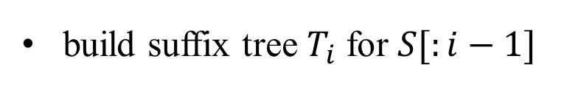
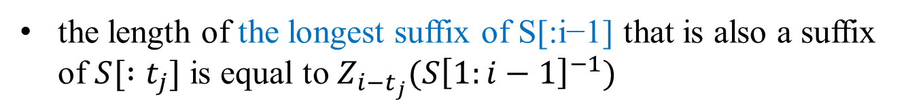
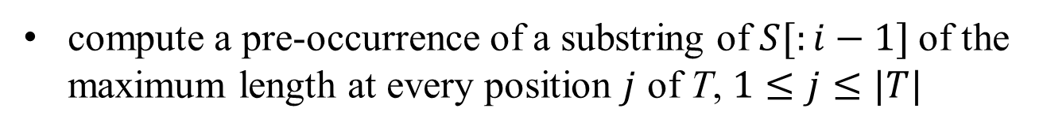
LCS algorithm
C
$
TC
S | = | T | C | C | T | C | G | G | T | A
T | = | T | C | G | A | G | G | T | A | A
CTC$
$
TC$
$
CTC$
suffix tree of string: TCCTC
build suffix tree $T_{i}$ for $S[:i−1]$
compute a pre-occurrence of a substring of $S[:i−1]$of the maximum length at every position $j$ of T, $1≤j≤|T|$
the length of the longest suffix of S[:i−1] that is also a suffix of $S[ :t_{j}]$ is equal to $Z_{i−t_{j}}(S{\left[1:i−1\right]}^{−1})$
Z-values for $S{\left[ :i−1\right]}^{−1}$ and $T_{i}$ : $O(|S|)$time and space

Slide 15
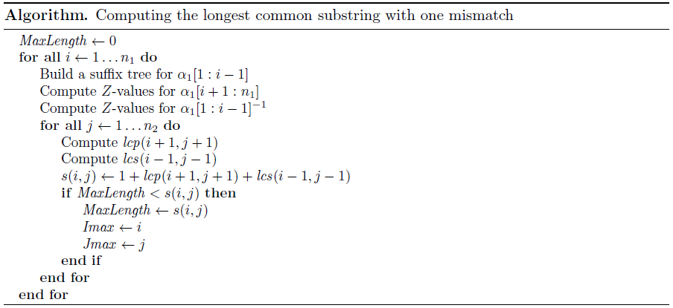
Their algorithm

Slide 16


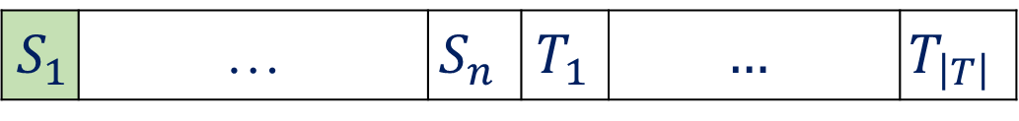

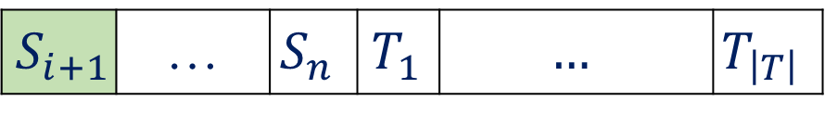
S | = | T | C | C | T | C | G | G | T | A
T | = | T | C | G | A | G | G | T | A | A
Z | = | 9 | 0 | 0 | 0 | 0 | 0 | 1 | 0 | 0
C
$
TC
$$Z_{1}\left(T\right)=lcp\left(T,T\right)=9$$
CTC$
$
TC$
$
CTC$
$$Z_{1+1}\left(T\right)=lcp\left(T,T[2:]\right)=0$$
$$S_{1}$$ | … | $$S_{n}$$ | $$T_{1}$$ | $$…$$ | $$T_{\left|T\right|}$$
$$S_{i+1}$$ | … | $$S_{n}$$ | $$T_{1}$$ | $$…$$ | $$T_{\left|T\right|}$$
$Z_{\left|S\right|+j−i}\left(R\right)=lcp(i+1,j)$

