Slide 1
Alphabet dependence parameterized matching
Amihood Amir, Martin Farach, S. Muthukrishnan
Information Processing Letters 49, pp. 111-115, 1994
Presenter: Yung-Hsing Peng
Date: Aug. 02, 2006

Slide 2
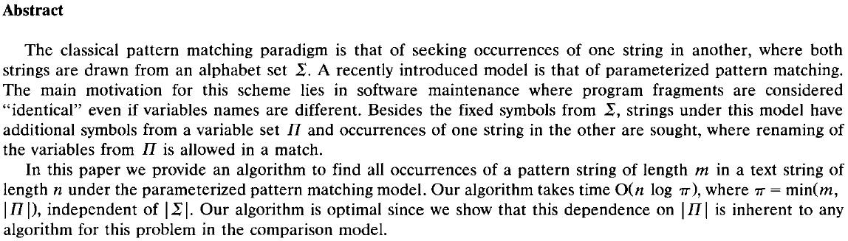

Slide 3
The Mapped Match (m-match)
P=attgac
T=cgattgacatcgaatgcagctcttgca
match
m-match
m-match
From P to T
a → g
t → a
g → t
c → c
From P to T
a → c
t → t
g → g
c → a
The mapping must be bijective.

Slide 4
The Parameterized Match (p-match)
Some letters are not allowed for renaming.
Ex: In previous example, let Σ={c} and Π={a, g, t}, the p-match would be gaatgc.

Slide 5
The Main Idea (1/2)
The authors showed that the p-matching problem can be solved by using both classical matching and m-matching.
Let P=attgac, T=cgattgacatcgaatgcagctcttgca, Σ={c} and Π={a, g, t}
Let P’=xxxxxc, T’=cxxxxxxcxxcxxxxxcxxcxcxxxcx
P’’= attgay, T’’=ygattgayatygaatgyagytyttgya
Solve the classical string matching problem of P’ in T’
Solve the m-matching problem of P’’ in T’’.
→The common solutions of (1)&(2) give the p-matched positions of P in T.

Slide 6
The Main Idea (2/2)
Obviously, classical string matching can be solved in O(n) time by using the KMP algorithm.
The authors further showed that the m-matching problem can also be solved by adapting the KMP algorithm.

Slide 7
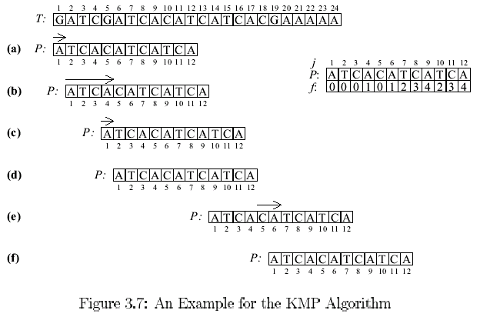
An Example for KMP Algorithm
Phase 2
Phase 1
matched

Slide 8
Time Complexity of KMP Algorithm
Time complexity: O(m+n)
  O(m) for computing function f
  O(n) for searching P
Question:
(1) Does KMP ignore useful positions?
(2) Redundant computation for comparison?

Slide 9
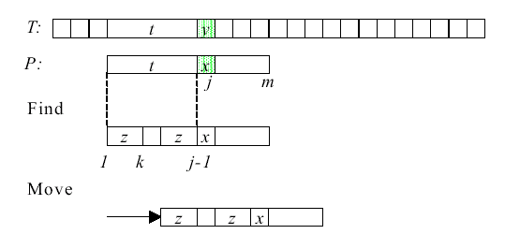
Principle of KMP Algorithm
a
a

Slide 10
Adapting KMP for the m-matching Problem
In fact, only the definition of “a match” should be adapted.
Two characters are matched if the renaming rule is kept.
→ Comparing time increases from constant to O(logπ)

Slide 11
The Idea of Rule Checking (1/2)
 |  | a |  |  |  |  |  |  | a
Case1: A new renaming rule occurs
→ Match!
 |  |  |  |  | g
 |  | a |  |  |  | a |  |  | a
Case2: Renaming rules are kept
→ Match!
 |  | g |  |  | g
 |  | a |  |  |  |  | a |  | a
Case3: Renaming rules are broken
→ Mismatch!
 |  | g |  |  | g

Slide 12
The Idea of Rule Checking (2/2)
In a matching position of P in T, the matches must be consecutive. One can simply check the nearest identical symbol to see if the rule can be kept. → O(logπ) time for each check.
One should add this check to both phase 1 and 2 in KMP algorithm.

Slide 13
Some Notes
In the case of integer alphabets or constant-sized alphabets, the m-matching problem can be solved in O(n) time
The authors showed that they achieve the lower bound by reducing the element distinctness problem to the m-matching problem.
In Amir’s algorithm for solving the real scaled matching problem, the idea of m-matching is very crucial.

