Slide 1
Hidden Markov model approach for identifying the modular framework of the protein backbone
Protein Engineering vol.12 no.12 pp.1063–1073, 1999
A.C.Camproux, P.Tuffery, J.P.Chevrolat, J.F.Boisvieux, S.Hazout
Presenter: Jen-Hui, Wang
Date: Oct. 27, 2006

Slide 2
Abstract
The hidden Markov model (HMM) was used to identify
recurrent short 3D structural building blocks (SBBs)
describing protein backbones, independently of any a priori knowledge. Polypeptide chains are decomposed into a series of short segments defined by their inter-α-carbon distances. Basically, the model takes into account the sequentiality of the observed segments and assumes that each one corresponds to one of several possible SBBs. Fitting the model to a database of non-redundant proteins allowed us to decode proteins in terms of 12 distinct SBBs with different roles in protein structure. Some SBBs correspond to classical regular secondary structures.

Slide 3
Abstract (cont.)
Others correspond to a significant subdivision of their bounding regions previously considered to be a single pattern. The major contribution of the HMM is that this model implicitly takes into account the sequential connections between SBBs and thus describes the most probable pathways by which the blocks are connected to form the framework of the protein structures. Validation of the SBBs code was performed by extracting SBB series repeated in recoding proteins and examining their structural similarities. Preliminary results on the sequence specificity of SBBs suggest promising perspectives for the prediction of SBBs or series of SBBs from the protein sequences.

Slide 4
Database
100 non-homologous proteins was extracted from the PDB
  Crystallographic resolution < 2.5Å
  Limited sequence homology (≦25% sequence identity)
  All non-contiguous protein chains were eliminated from the database

Slide 5

Short protein segments
d₁(j), d₂(j), d₃(j)
  The distance between non-successive α-carbon (|U_{(j,j+2)}|, |U_{(j,j+3)}|, |U_{(j+1,j+3)}|)
  This descriptor is proportional to the distance of the fourth Cα to a plane P built by the first three Cαand provides information about the volume and the direction of the polypeptide fold
  [d₁(j), d₂(j), d₃(j), d₄(j)] summarized in vector y_{j} provide a unique representation of the conformation of each four-residue segment j

Slide 6
Hidden Markov model
Stochastic process:
  一些狀態的序列，其中任一狀態的產生可能與之前的狀態有關
Markov chain:
  為一隨機過程，滿足
    可能的狀態數為有限
    每個狀態會發生的機率只與前一個狀態有關
    每個狀態會發生的機率為常數

Slide 7
Hidden Markov model (cont.)
HMM可以視為一個雙層的隨機序列，包含了隱藏層的狀態序列（state sequence）和可觀察層的觀測序列（observation sequence），可由七個元素來表示:
  S: 所有狀態的集合，S = {s₁,s₂,…,s_{N}}
  K: 所有觀測符號的集合，K = {k₁,k₂,…,k_{M}}
  N: 表示模型中所有狀態的個數
  M: 表示模型中所有觀測符號的數目
  Π= (π_{i}): 代表狀態初始的機率向量， π_{i} = P(q₁= s_{i})，1≦i ≦N，表示在 t = 1時，狀態為 s_{i} 的機率，且滿足∑ π_{i} = 1 的條件。
  A=[a_{ij}]: 代表狀態轉移機率矩陣，a_{ij}=P(q_{t+1}=s_{j}|q_{t}=s_{i}), 表示從狀態s_{i}到狀態s_{j} 的機率
  B=[b_{j}(k)]: 代表觀測符號矩陣，b_{j}(k)=P(o_{t}=v_{k}|q_{t}=s_{j})，表示狀態為 s_{j} 時，觀測符號為 v_{k} 的機率

Slide 8
Hidden Markov model (cont.)
給定輸入之觀察序列O=o₁o₂…o_{n} (o_{t} 表示在時間 t 所對應的觀測符號)。隱藏式馬可夫模型的目的就是要選出一個對應於觀測序列之最佳的狀態序列Q=q₁q₂…q_{n} (q_{t} 表示在時間 t 所對應的狀態)
State
S₃
S₃
S₃
S₃
S₃
S₂
S₂
S₂
S₂
S₂
S₁
S₁
S₁
S₁
S₁
1 2 3 T-1 T Time
o₁
o₂
o₃
o_{T-1}
o_{T}

Slide 9
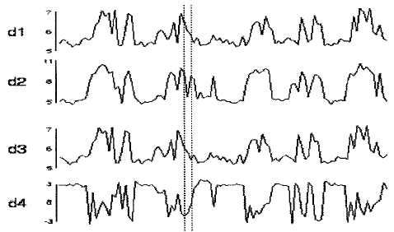
Structure of the model
The series y₁, y₂, ..., y_{N} of successive four-dimensional distance vectors describing the sequence of N four-residue segments obtained on the S polypeptide chains provide the basic data
Figure shows the evolution of an observed signal of 100 segments along a fragment of polypeptide chain
Similar regions appear in the successive profiles of the four observed sigals, suggesting the existence of patterns specific to different local 3D structure

Slide 10
Structure of the model (cont.)
The evolution of the Markov chain
  The law v_{s} = [v_{s}(i) ] of the initial state of each polypeptide chain s, (1≦s ≦S), i.e. the probability that a polypeptide chain s start in the R different states
  The matrix of transition probability π= (π_{ii’}), 1 ≦ i, i’ ≦ R between R different states of the Markov chain, where π_{ii’} = P(X_{j}=i’|X_{j-1}=i) is the probability of different proteins evolving from state i to i’ at any position j

Slide 11
Structure of the model (cont.)
Finally, each state i, (1≦ i ≦R), of the Markov chain generates segments following a continuous multidimensional density f_{i}(y, θ_{i}) of unknown parameter θ_{i}, meaning that to each SBB of the proteins corresponds an average four-residue segment with specific variability
Four-dimensional Gaussian density was chosen as the continuous density f_{i}(y, θ_{i}) to ensure that parameters can be estimated in a consistent way (Rabiner, 1989)
This results in unknown 14-dimensional parameter θ_{i}

Slide 12
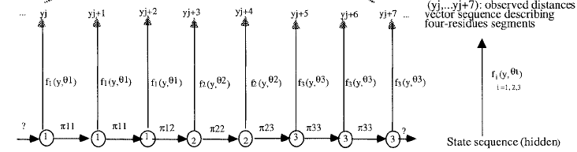
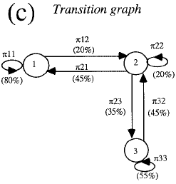


Structure of the model (cont.)

Slide 13
Estimation of model parameters
To compare the conformations associated with the blocks and the actual conformations of fragments, we calculate the probability of observing the 3D structure of different fragments for a given model defined by parameters
Unknown parameters v_{s} , (1≦ s ≦S), π, and θ_{i}, (1≦ i ≦R) of the HMM are estimated by maximizing the complete likelihood of the model, computed recursively by exploiting the underlying Markov structure of the model, following the algorithm of Baum et al.(1970) [Baum-Welch algorithm]

Slide 14
Reconstructing protein by SBBs
The resulting model is a hidden Mrakov model
The SBBs sequence has not been observed (it is hidden), only the four-dimensional distance vector sequence is observed
Ultimate goal is to reconstruct the unobserved SBB sequences of the polypeptide chains, given the observed sequence y₁,…,y_{N}
To find the most probable path of SBBs among all possible paths in {1,…,R}^{N} using the Viterbi algorithm (Rabiner, 1989; Camproux et al., 1996)

Slide 15
Result
Fitting the HMM to the 19017 experimental four-residue segments obtained from the database of 100 polypeptide chains resulted in a representative set of 12 distinct SBBs
As a first step, we used a number of states of three (R=3). The simplest model was able to identify only one SBB corresponding to α-helices and two non really specific SBBs. When increasing R up to 12, HMM progressively identified β-strands and decomposed coil regions.
Limiting the number of SBBs to 12 allows one to obtain representative SBBs corresponding to ta least 3% of the segments database and keep a reasonable number of parameters

Slide 16
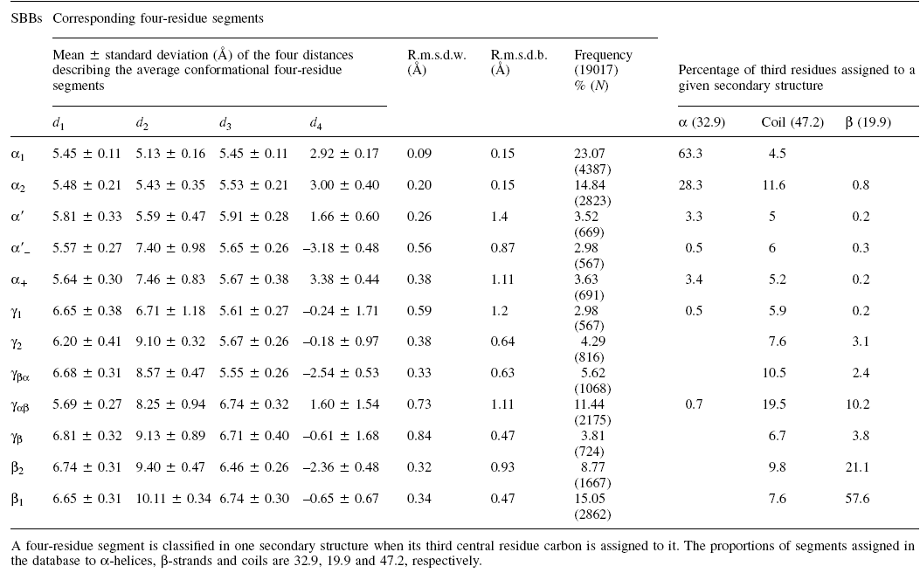
Structural description of SBBs

Slide 17
Structural description of SBBs (cont.)
SBBs α1 and α2, representing 37.9% of the observed four-residue segments, provide the segments for 91.6% of the α-helices. Their associated segments have the lowest means and variabilities for the first three distances and the highest mean for the volumetric parameter, in agreement with their α-helices correspondence. Segments associated with SBB α1 have the smallest variability (r.m.s.d.w. = 0.09Å) while SBB α2 appears to correspond to somewhat more irregular and less compact structure (r.m.s.d.w. = 0.2 Å).
SBBs β1 and β2 contain 23.8% of the segments. They appear mostly located in β-strands: they provide the segments for 78.7% of the β-strands. They correspond to well-defined stretched structures (r.m.s.d.w. ≦0.35 Å). The geometry of β1 (no volume) is compatible with flat β-strands while SBB β2 describes a somewhat shorter structure with a clearly negative trigonometric orientation.

Slide 18
Structural description of SBBs (cont.)
SBBs α’, α’₊ and α’– each represent about 3% of the observed segments. Their associated segments represent about 7% of the helices and 16% of the coils. Corresponding segments are geometrically close to those of cluster A but suggest longer forms. Segments associated with SBBs α’₊ and α’– present larger length and variability than SBBs α’ and are distinguishable by their opposite topological orientation.
Transitory SBBs γ appear located in more than 80% in coils (data not shown). Especially SBB γ1 appears almost exclusively in coils. SBB γ_{αβ} is noteworthy because of its high occurrence frequency (11.4%), whereas others represent about 4% each of the observed segments, and because it takes into account about 20% of the coils. The r.m.s.d.w. values of these blocks are acceptable (0.33–0.84 Å). Only γ_{βα} and γ_{αβ} describe segments with volume and clear trigonometric orientation, negative for γ_{βα} and positive for γ_{αβ}.

Slide 19
Structural description of SBBs (cont.)
SBB γ_{αβ} describes a structure inverse to γ_{βα} (inverted d₁ and d₃ values and opposite orientations)
SBBs γ_{β} and γ_{αβ} correspond to the less well defined structures (0.84, 0.73 Å). In particular, their d₂ values present large variabilities (9.13 ± 0.89, 8.25 ± 0.94 Å).

Slide 20
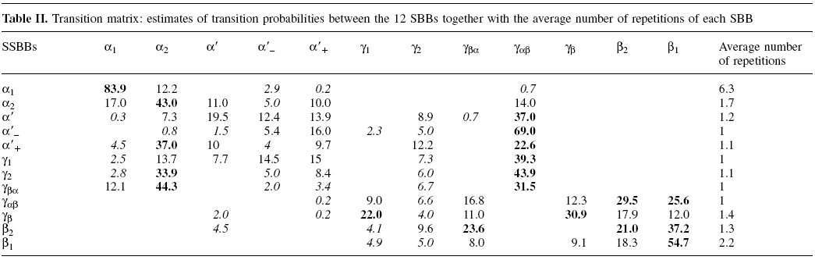
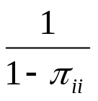
Analysing the SBB connections

Slide 21
Analysing the SBB connections (cont.)
clusters A and B describing regular secondary structures correspond to the most repeated structures while other blocks appear rather like transitory structures
cluster A exits towards to γ_{αβ} either directly or indirectly after some paths in one of the three SBBs α’, α’– and α’₊ which present few switchings
From SBB γ_{αβ}, proteins transit directly to cluster B or enter a path through other SBBs γ
From cluster B, proteins transit to SBBs γ_{βα}, γ1 or γ2 which are the preferred ways of entrance in cluster A
There are some paths within SBBs γ, associated with coil regions, mainly unidirectional

Slide 22
Analysing the SBB connections (cont.)
The average length of an α-helix in this database, 11.6 ± 5.6 residues, is compatible with the estimated average number of residues corresponding to series of SBB α including one or two SBBs α2 of 11 or 12.7 residues, respectively (for instance 6.3 repetitions of SBBs α1 plus 1.7 for α2 plus 3 since SBBs correspond to a four-residue length)
Considering β-strands are decomposed into both SBBs β1 and β2, the additive average number of repetitions is about 3.5 (~2.2 plus 1.3), corresponding to an average number of residues of 6.5, in agreement with the observed length of β-strands in the database: 6.4 ± 2.8 residues.

Slide 23
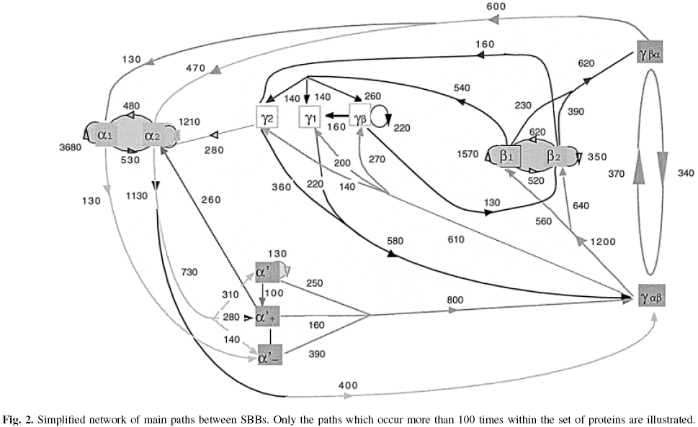
Analysing the SBB connections (cont.)

Slide 24
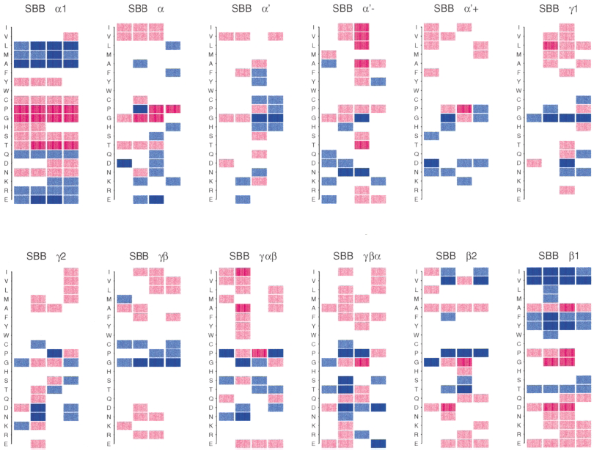
Do SBBs exhibit some sequence specificity?

Slide 25
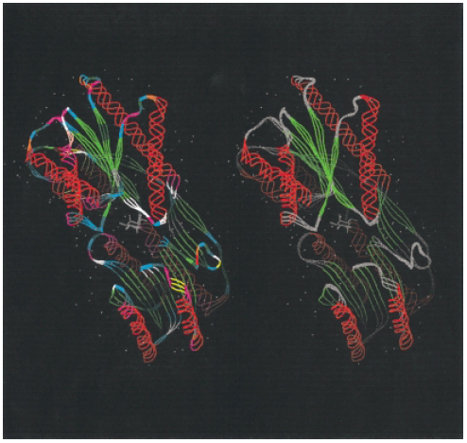
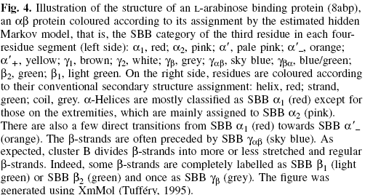
Can SBBs code form a structural alphabet?

