Slide 1
Beyond Accuracy: Behavioral Testing of NLP Models with CheckList
Marco Tulio Ribeiro, Tongshuang Wu, Carlos Guestrin, Sameer Singh
July 2020
Proceedings of the 58th Annual Meeting of the Association for Computational Linguistics
Present: Chia-Lin Chen
Date: Jan. 5, 2021
Notes:
ACL2020年的最佳論文
作者來自:第一位:微軟研究院,第二位:華盛頓大學,第三四位:加州大學
1

Slide 2
Abstract(1/2)
Although measuring held-out accuracy has been the primary approach to evaluate generalization, it often overestimates the performance of NLP models, while alternative approaches for evaluating models either focus on individual tasks or on specific behaviors. Inspired by principles of behavioral testing in software engineering, we introduce CheckList, a task-agnostic methodology for testing NLP models.

Slide 3
Abstract(2/2)
CheckList includes a matrix of general linguistic capabilities and test types that facilitate comprehensive test ideation, as well as a software tool to generate a large and diverse number of test cases quickly. We illustrate the utility of CheckList with tests for three tasks, identifying critical failures in both commercial and state-of-art models. In a user study, a team responsible for a commercial sentiment analysis model found new and actionable bugs in an extensively tested model. In another user study, NLP practitioners with CheckList created twice as many tests, and found almost three times as many bugs as users without it.
Notes:
加cap找到近兩倍的bugs
加cap加test type找到近三倍的bugs

Slide 4
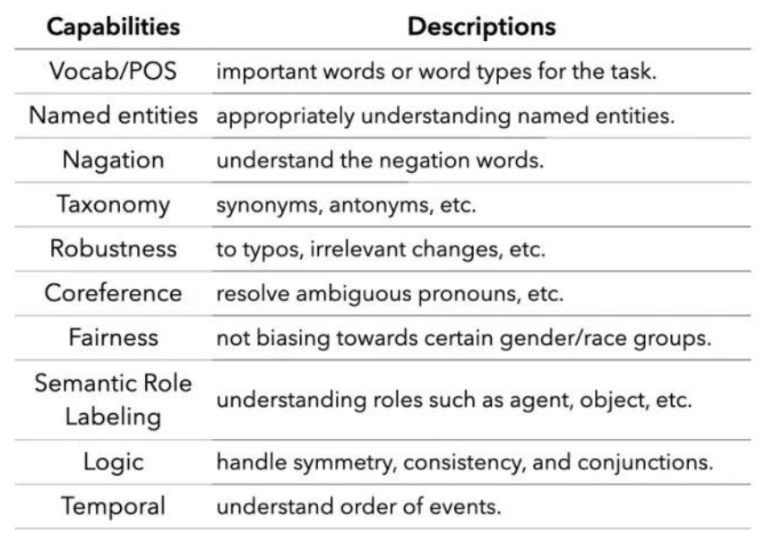
CheckList
1-1.Capabilities:
1-2. Behavioral Testing:
Blackbox—focus on input/output
is expected or not.
2.Test Types:
2-1. Minimum Functionality Test(MFT)
2-2. INVariance Test(INV)
2-3. DIRectional Expectation Test(DIR)
Notes:
Named Entity(NER)名詞標註/辨識:人名,組織,地名,職稱等
Negation:否定語句
Taxonomy:分類,synonym:代名詞;anytomyn反義詞
Robustness:文章完整度;Typo錯字;irrelevant:不恰當的字
Coreference:指示代名詞
Fairness:公平,不偏袒性別/種族等

Slide 5
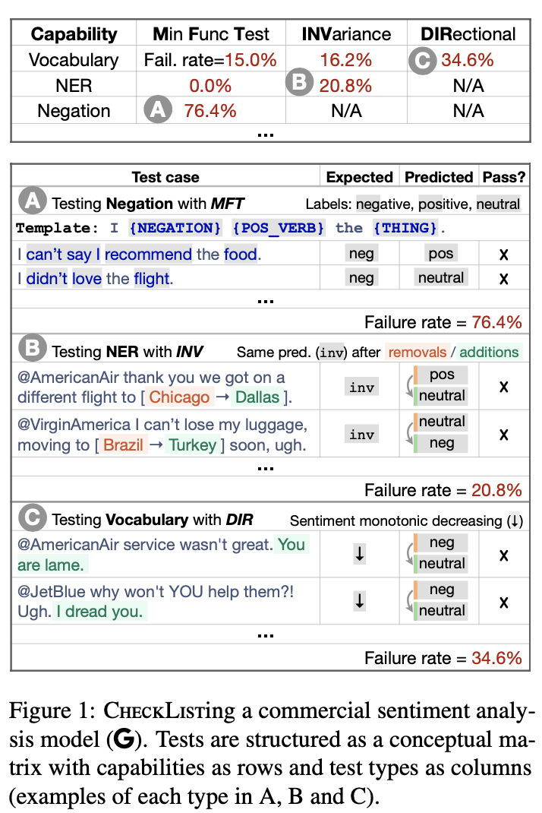

Slide 6
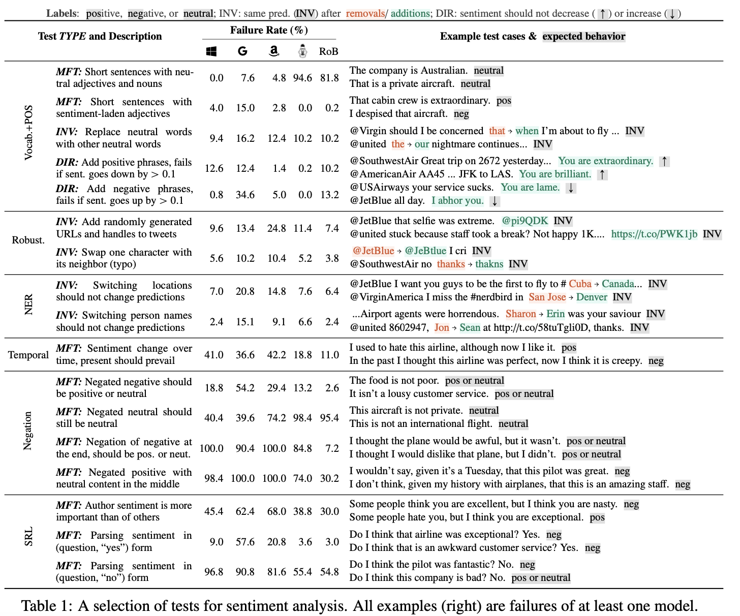

Slide 8
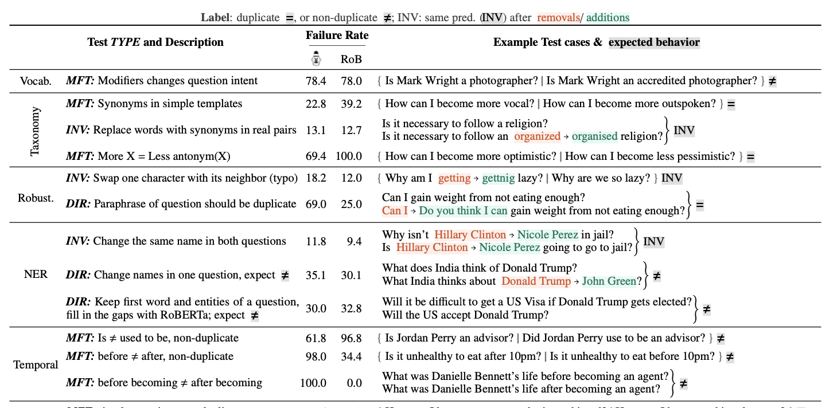

Slide 9
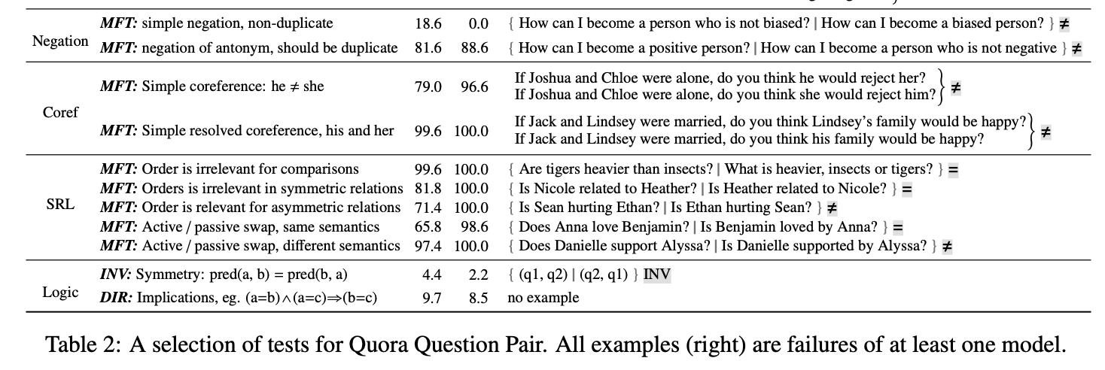

Slide 10
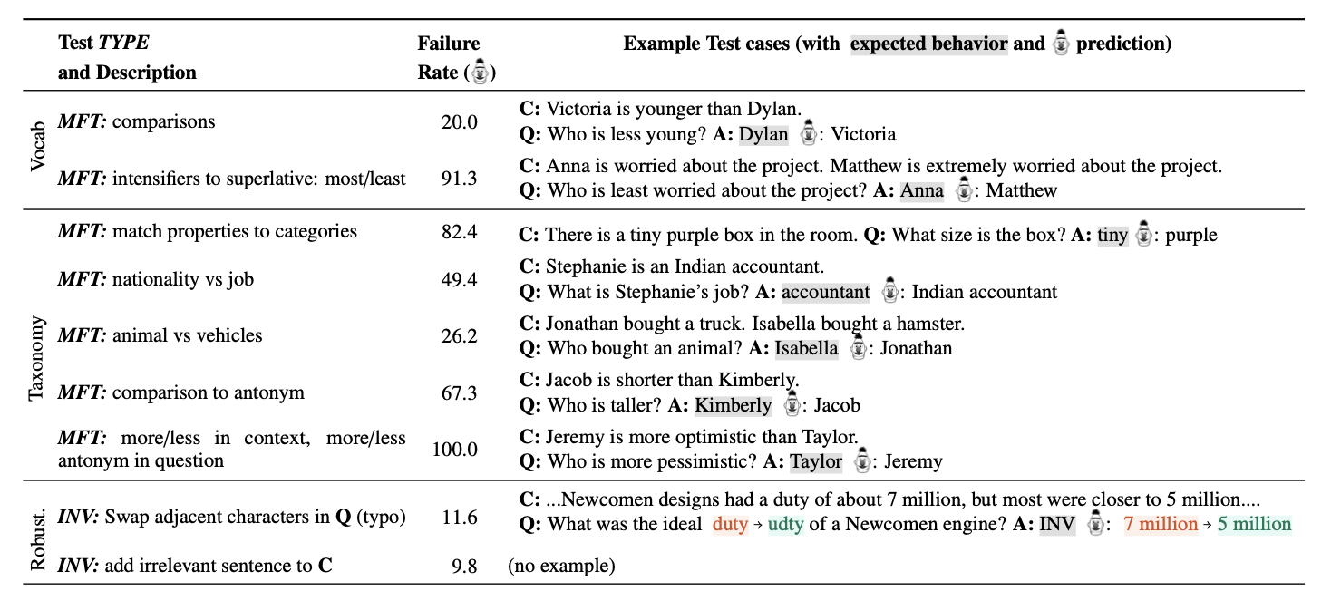

Slide 11
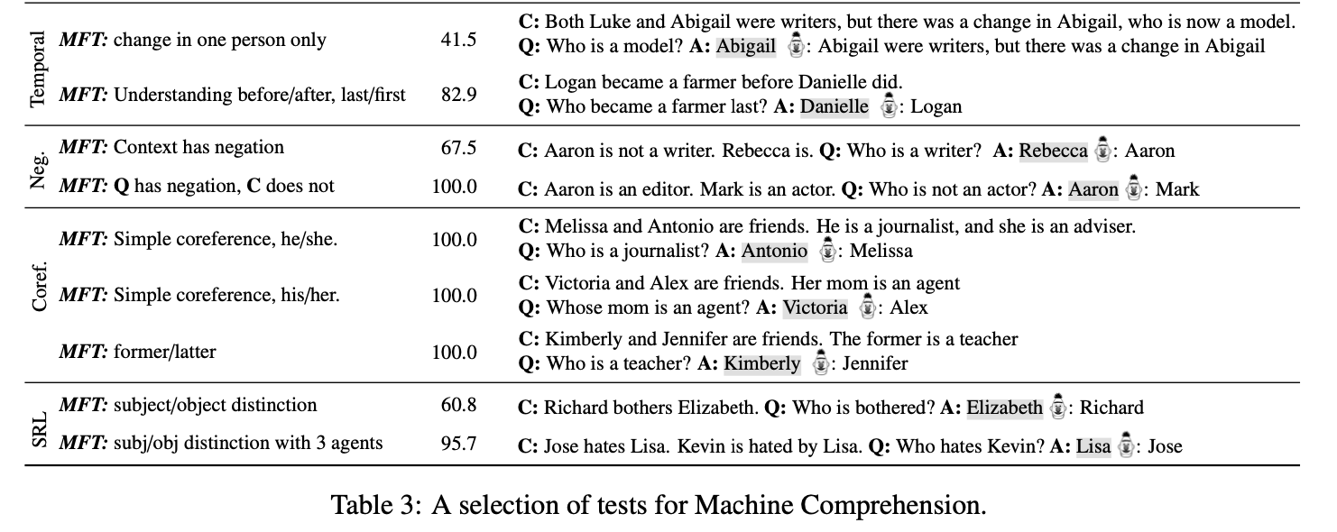

Slide 12
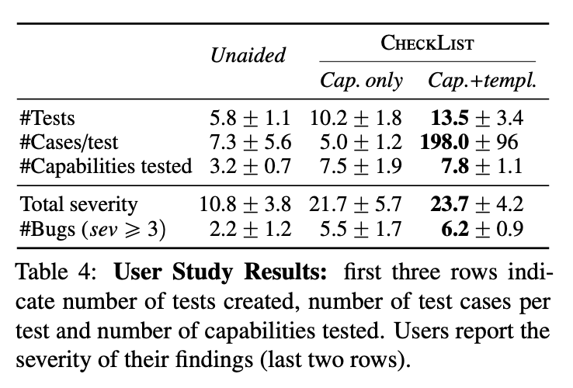
此實驗請18人驗證
(8位自業界,10位自學界)

Slide 13
Conclusion:
With CHECKLIST, find bugs easily.
Finding significant bugs with CHECKLIST in a SOTA model in only 2 hours.
Open source, but one package wasn’t allowed to download.

Slide 14
Thank you!

