Slide 1
A dominant point-based parallel algorithm that finds all longest common subsequences for a constrained-MLCS problem Armel Nkonjoh Ngomade, Jean Frédéric Myoupo, Vianney Kengne Tchendji
Journal of Computational Science 40 (2020) 101070
Presenter : Yu-Ju, Liao
Date :Mar. 17, 2021

Slide 2
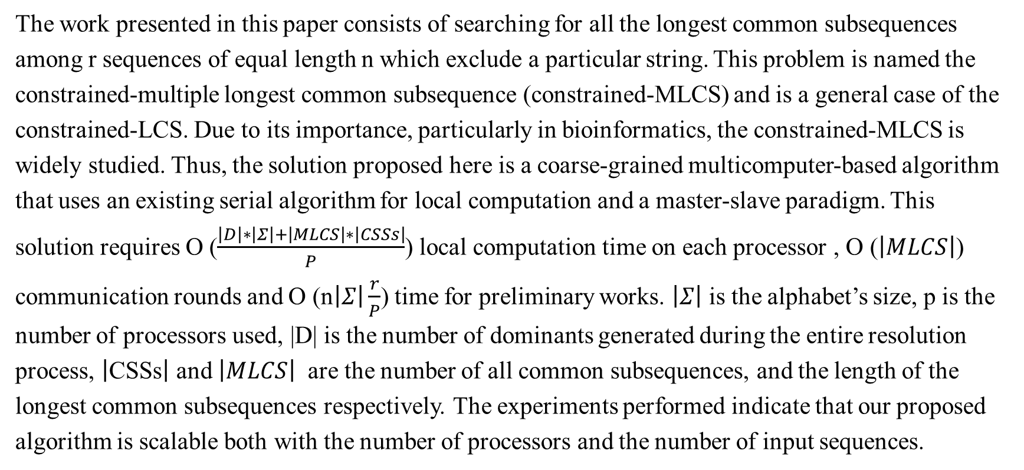
Abstract
The work presented in this paper consists of searching for all the longest common subsequences among r sequences of equal length n which exclude a particular string. This problem is named the constrained-multiple longest common subsequence (constrained-MLCS) and is a general case of the constrained-LCS. Due to its importance, particularly in bioinformatics, the constrained-MLCS is widely studied. Thus, the solution proposed here is a coarse-grained multicomputer-based algorithm that uses an existing serial algorithm for local computation and a master-slave paradigm. This solution requires O ($\frac{\left|D\right|∗\left|Σ\right|+\left|MLCS\right|∗\left|CSSs\right|}{P}$) local computation time on each processor , O ($\left|MLCS\right|$) communication rounds and O (n$\left|Σ\right|\frac{r}{P}$) time for preliminary works. $\left|Σ\right|$ is the alphabet’s size, p is the number of processors used, |D| is the number of dominants generated during the entire resolution process, $\left|\text{CSSs}\right|$ and $\left|MLCS\right|$ are the number of all common subsequences, and the length of the longest common subsequences respectively. The experiments performed indicate that our proposed algorithm is scalable both with the number of processors and the number of input sequences.

Slide 3
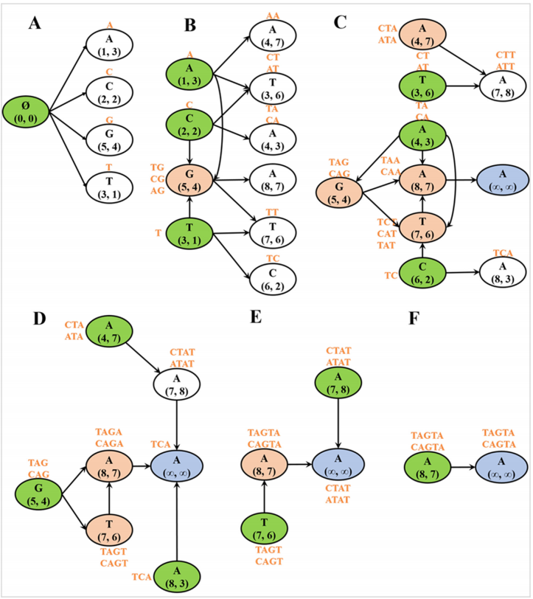
Algorithm for the constrained-MLCS problem
S1 = ACTAGCTA
S2 = TCAGGTAT

Slide 4
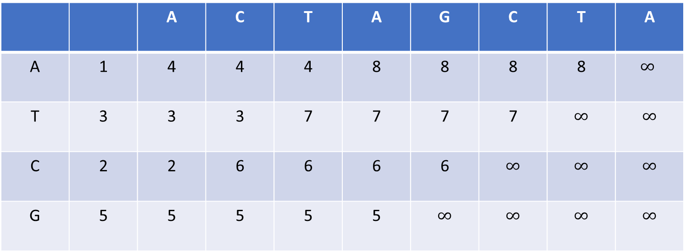
Successor table
S1 = ACTAGCTA
 |  | A | C | T | A | G | C | T | A
A | 1 | 4 | 4 | 4 | 8 | 8 | 8 | 8 | $$∞$$
T | 3 | 3 | 3 | 7 | 7 | 7 | 7 | $$∞$$ | $$∞$$
C | 2 | 2 | 6 | 6 | 6 | 6 | $$∞$$ | $$∞$$ | $$∞$$
G | 5 | 5 | 5 | 5 | 5 | $$∞$$ | $$∞$$ | $$∞$$ | $$∞$$

Slide 5
Successor table
S1 = ACTAGCTA
 |  | A | C | T | A | G | C | T | A
A | 1 | 4 | 4 | 4 | 8 | 8 | 8 | 8 | $$∞$$
T | 3 | 3 | 3 | 7 | 7 | 7 | 7 | $$∞$$ | $$∞$$
C | 2 | 2 | 6 | 6 | 6 | 6 | $$∞$$ | $$∞$$ | $$∞$$
G | 5 | 5 | 5 | 5 | 5 | $$∞$$ | $$∞$$ | $$∞$$ | $$∞$$

Slide 6
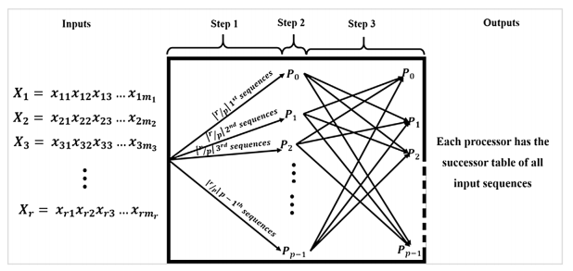
Successor table

Slide 7
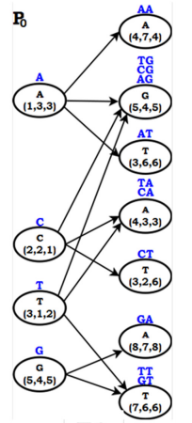
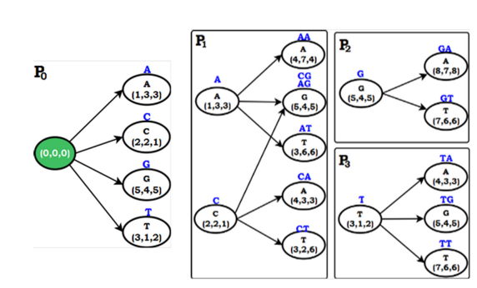
Parallel solution _ algorithm 1
3
S1 = ACTAGCTA S2 = TCAGGTAT
S3 = CTAAGTTA
2
1

Slide 8
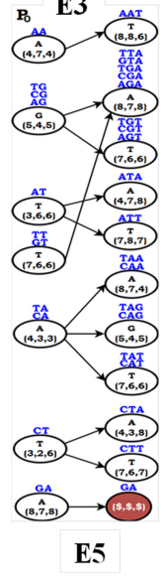
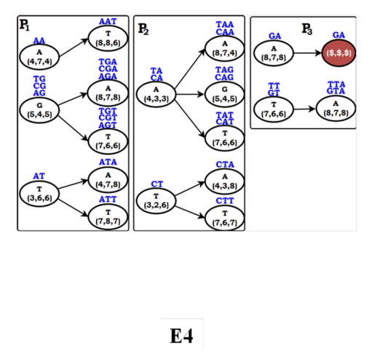
Parallel solution _ algorithm 1
5
4
Notes:
兩次溝通

Slide 9
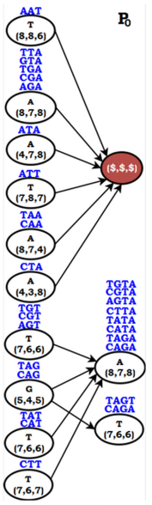
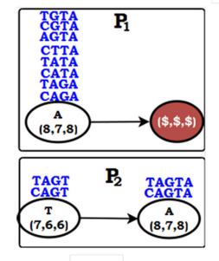
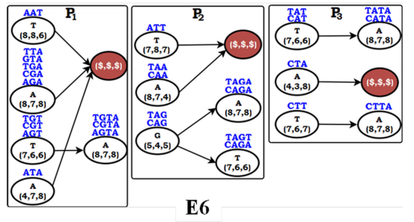
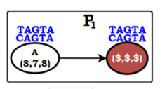
Parallel solution _ algorithm 1
6
7
8
9
Notes:
兩次溝通

Slide 10
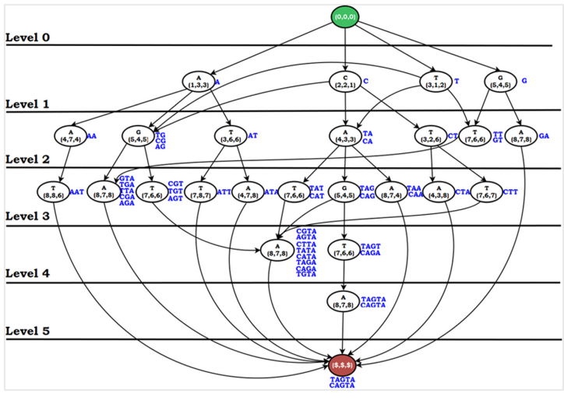
Parallel solution _ algorithm 1
Notes:
兩次溝通

Slide 11
Parallel solution _ algorithm 2
TA
X
X
Notes:
兩次溝通

Slide 12
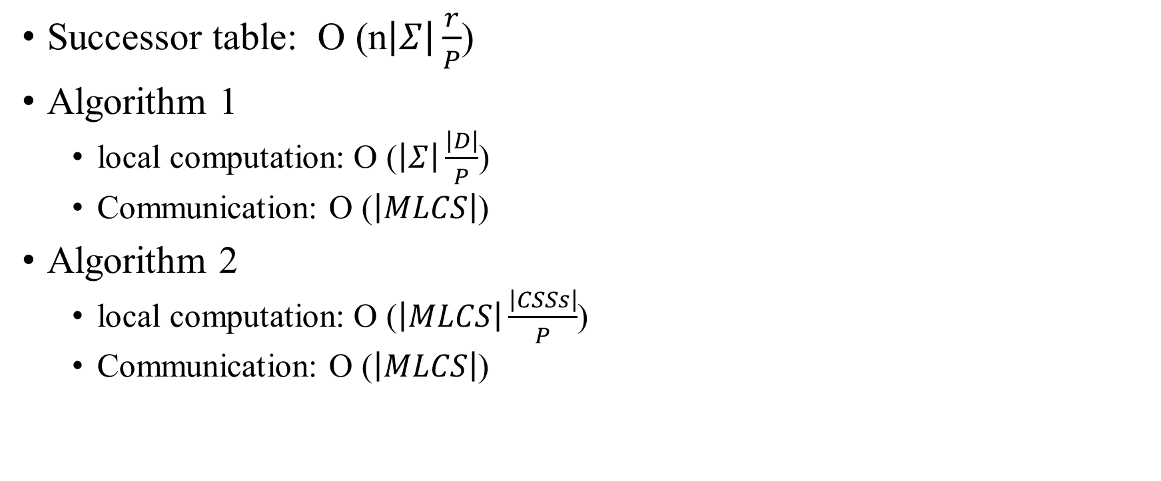
Time complexity
Successor table: O (n$\left|Σ\right|\frac{r}{P}$)
Algorithm 1
local computation: O ($\left|Σ\right|\frac{\left|D\right|}{P}$)
Communication: O ($\left|MLCS\right|$)
Algorithm 2
local computation: O ($\left|MLCS\right|\frac{\left|CSSs\right|}{P}$)
Communication: O ($\left|MLCS\right|$)
Notes:
兩次溝通

Slide 13
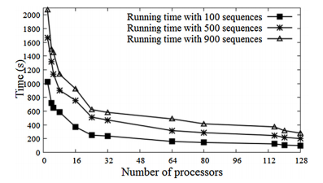
Results
Notes:
NODE 太少

Slide 14
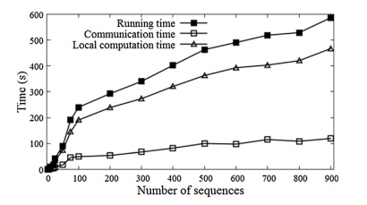
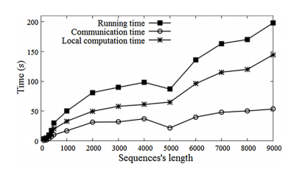
Results
Notes:
NODE 太少

