Slide 1
The longest almost-increasing subsequence
Amr Elmasry
Information Processing Letters
Volume 110, Issue 16, 31 July 2010, Pages 655-658
Presenter: Shin-Cheng Lin
Date: Mar. 17, 2021

Slide 2
Abstract
Given a sequence of n elements, we introduce the notion of an almost-increasing subsequence as the longest subsequence that can be converted to an increasing subsequence by possibly adding a value, that is at most a fixed constant, to each of the elements. We show how to optimally construct such subsequence in O(n logk) time, where k is the length of the output subsequence.

Slide 3
LaIS
Given a sequence x₁, x₂, . . . , x_{n} and a constant c > 0, constructing a longest subsequence y₁, y₂, . . . , y_{k} such that ∀i y_{i} > max(y₁, y₂, . . . , y_{i-1}) － c.
c=2
(7, 15, 2, 14, 14, 6, 8, 11, 17, 15, 14, 13)
(7, 15, 14, 14, 15, 14)
(7, 6, 8, 11, 15, 14)
(2, 6, 8, 11, 15, 14)
(7, 6, 8, 11, 14, 13)
(2, 6, 8, 11, 14, 13)

Slide 4
Each iteration
Step 1:
Find a longest almost-increasing subsequence whose largest element is x_{i}.
look for an index k < i such that l_{k} ≧ l_{j} among all indexes j < i having x_{j} < x_{i}. The length l_{i} is then set to l_{k} +1, and the index p_{i} is set to k.
Step 2:
append x_{i} to every subsequence found so far whose largest element is larger or equal to x_{i} and smaller than x_{i} + c.
for all j < i, set l_{j} to l_{j} + 1 if x_{i} ≦ x_{j} ＜ x_{i} + c.

Slide 5
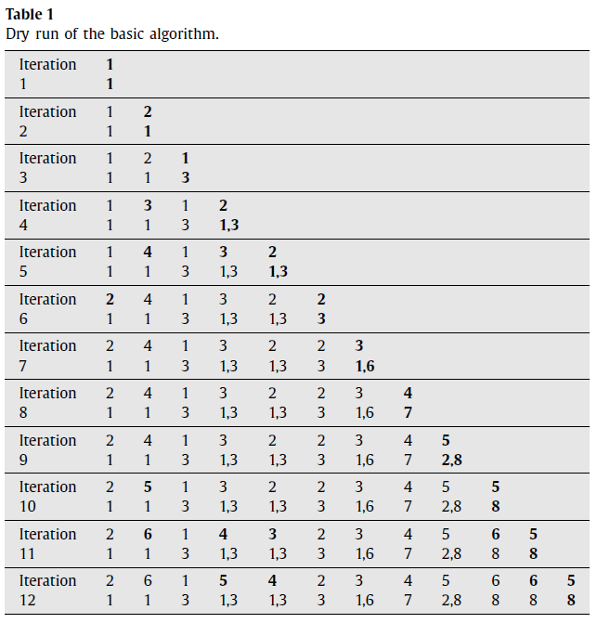
i=2
l₂=l₁+1
p₂=1
l_{i}(first row)
p_{i}(second row)
(7, 15, 2, 14, 14, 6, 8, 11, 17, 15, 14, 13)

Slide 6
i=3
l₃=1
p₃=3
l_{i}(first row)
p_{i}(second row)
(7, 15, 2, 14, 14, 6, 8, 11, 17, 15, 14, 13)

Slide 7
i=4
l₄=max(l₁,l₃)+1
p₄=(1,3)
l₁==l₃
l₂=l₂+1
14≦15＜14+2
l_{i}(first row)
p_{i}(second row)
(7, 15, 2, 14, 14, 6, 8, 11, 17, 15, 14, 13)

Slide 8
i=5
l₅=max(l₁,l₃)+1
p₅=(1,3)
l₁==l₃
l₂=l₂+1
14≦15＜14+2
l₄=l₄+1
14≦14＜14+2
l_{i}(first row)
p_{i}(second row)
(7, 15, 2, 14, 14, 6, 8, 11, 17, 15, 14, 13)

Slide 9
i=6
l₆=l₃+1
p₆=3
l₁=l₁+1
6≦7＜6+2
l_{i}(first row)
p_{i}(second row)
(7, 15, 2, 14, 14, 6, 8, 11, 17, 15, 14, 13)

Slide 10
i=7
l₇=max(l₁,l₃,l₆)+1
p₇=(1,6)
l₁==l₆
l_{i}(first row)
p_{i}(second row)
(7, 15, 2, 14, 14, 6, 8, 11, 17, 15, 14, 13)

Slide 11
i=8
l₈=max(l₁,l₃,l₆ ,l₇)+1
p₇=7
l_{i}(first row)
p_{i}(second row)
(7, 15, 2, 14, 14, 6, 8, 11, 17, 15, 14, 13)

Slide 12
i=11
l₁₁=max(l₁,l₃,l₆,l₇,l₈)+1
p₁₁=8
l₂=l₂+1
l₄=l₄+1
l₅=l₅+1
l₁₀=l₁₀+1
l_{i}(first row)
p_{i}(second row)
(7, 15, 2, 14, 14, 6, 8, 11, 17, 15, 14, 13)

Slide 13
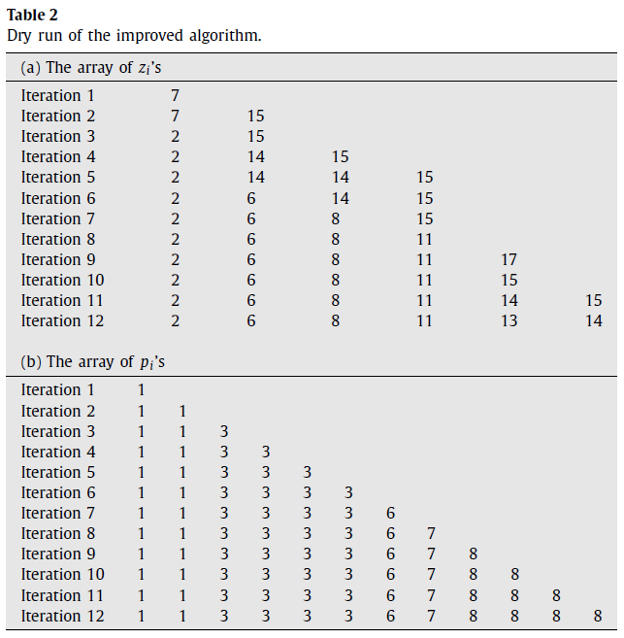
n² => nlogk
use binary search to locate the predecessor of x_{i} and that of x_{i} + c in O(logk) time.
(7, 15, 2, 14, 14, 6, 8, 11, 17, 15, 14, 13)

Slide 14
