Slide 1
A high performance algorithm for static task scheduling in heterogeneous distributed computing systems
Mohammad I. Daoud and Nawwaf Kharma
Journal of Parallel and Distributed Computing, Volume 68, Issue 4, April 2008, Pages 399-409
Presenter : Chih-Kai Wu
Date: Mar.17, 2021.

Slide 2
Abstract(1/2)
Effective task scheduling is essential for obtaining high performance in heterogeneous distributed computing systems (HeDCSs). However, finding an effective task schedule in HeDCSs requires the consideration of both the heterogeneity of processors and high interprocessor communication overhead, which results from non-trivial data movement between tasks scheduled on different processors. In this paper, we present a new high-performance scheduling algorithm, called the longest dynamic critical path (LDCP) algorithm, for HeDCSs with a bounded number of processors. The LDCP algorithm is a list-based scheduling algorithm that uses a new attribute to efficiently select tasks for scheduling in HeDCSs.

Slide 3
Abstract(2/2)
The efficient selection of tasks enables the LDCP algorithm to generate high-quality task schedules in a heterogeneous computing environment. The performance of the LDCP algorithm is compared to two of the best existing scheduling algorithms for HeDCSs: the HEFT and DLS algorithms. The comparison study shows that the LDCP algorithm outperforms the HEFT and DLS algorithms in terms of schedule length and speedup. Moreover, the improvement in performance obtained by the LDCP algorithm over the HEFT and DLS algorithms increases as the inter-task communication cost increases. Therefore, the LDCP algorithm provides a practical solution for scheduling parallel applications with high communication costs in HeDCSs.

Slide 4
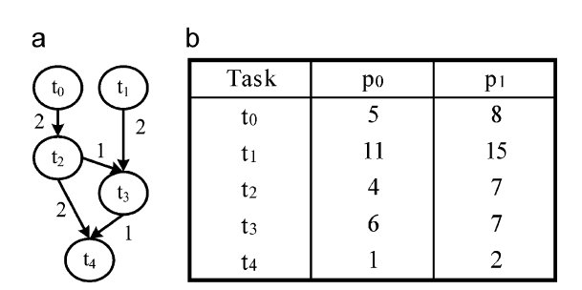
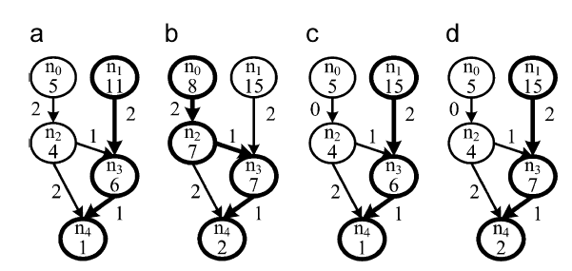
Task priorities
21
28
25
27

Slide 5
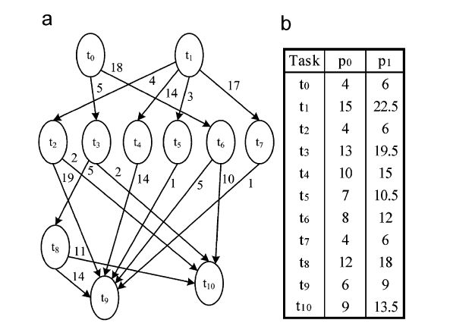
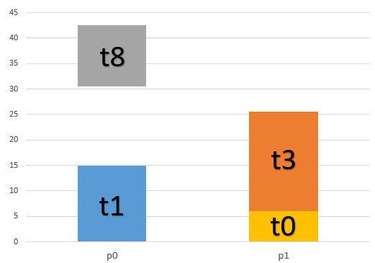
Task | processor
t1 | P0
t0 | P1
t3 | P1
t8 | P0
LDCP 0-3-8-10
T0=78
T3=67
T8=42.5
T10=13.5

Slide 6
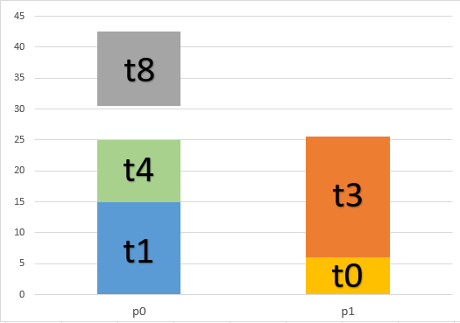
Task | processor
t1 | P0
t0 | P1
t3 | P1
t8 | P0
t4 | P0
LDCP 4-9
T4=38
T9=9

Slide 7
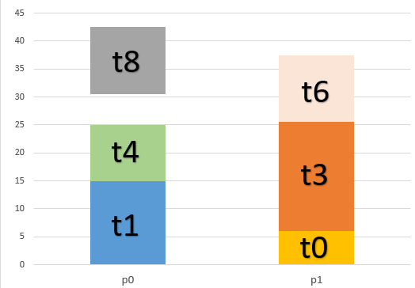
Task | processor
t1 | P0
t0 | P1
t3 | P1
t8 | P0
t4 | P0
t6 | P1
LDCP 6-10
T6=35.5
T10=13.5

Slide 8
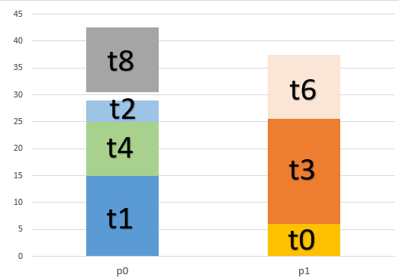
Task | processor
t1 | P0
t0 | P1
t3 | P1
t8 | P0
t4 | P0
t6 | P1
t2 | P0
LDCP 2-9
T2=34
T9=9

Slide 9
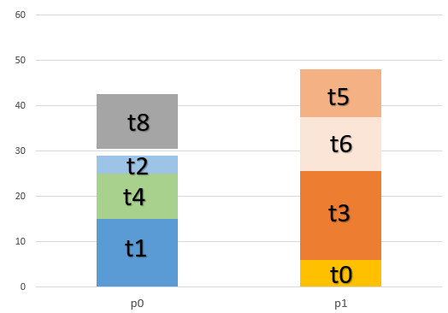
Task | processor
t1 | P0
t0 | P1
t3 | P1
t8 | P0
t4 | P0
t6 | P1
t2 | P0
t5 | P1
LDCP 5-9
T5=20.5
T9=9

Slide 10
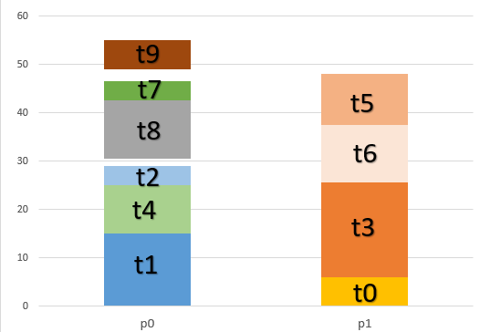
Task | processor
t1 | P0
t0 | P1
t3 | P1
t8 | P0
t4 | P0
t6 | P1
t2 | P0
t5 | P1
t7 | P0
t9 | P0
LDCP 7-9
T7=13
T9=6

Slide 11
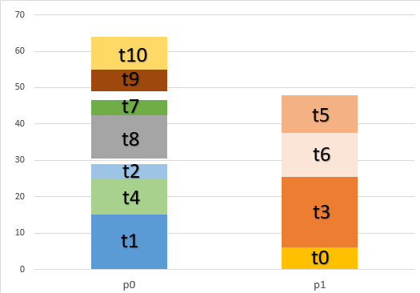
Task | processor
t1 | P0
t0 | P1
t3 | P1
t8 | P0
t4 | P0
t6 | P1
t2 | P0
t5 | P1
t7 | P0
t9 | P0
t10 | P0
makespan=64

Slide 12
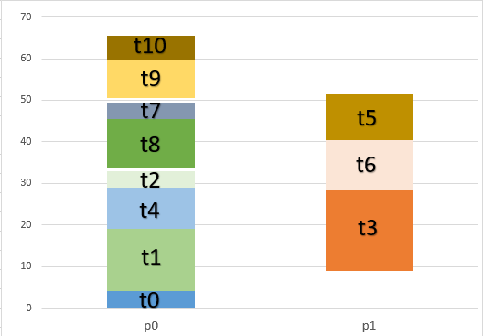

Slide 13
