Slide 1
Learning Without Human Expertise: A Case Study of the Double Dummy Bridge Problem
Krzysztof Mossakowski and Jacek Man´dziuk
IEEE TRANSACTIONS ON NEURAL NETWORKS, VOL. 20, NO. 2, FEBRUARY 2009
Presenter: Jing-Ping Jan
Date: Aug. 3, 2021

Slide 2
Abstract
Artificial neural networks, trained only on sample deals, without presentation of any human knowledge or even rules of the game, are used to estimate the number of tricks to be taken by one pair of bridge players in the so-called double dummy bridge problem (DDBP). Four representations of a deal in the input layer were tested leading to significant differences in achieved results. In order to test networks’ abilities to extract knowledge from sample deals, experiments with additional inputs representing estimators of hand’s strength used by humans were also performed. The superior network trained solely on sample deals outperformed all other architectures, including those using explicit human knowledge of the game of bridge. Considering the suit contracts, this network, in a sample of 100 000 testing deals, output a perfect answer in 53.11% of the cases and only in 3.52% of them was mistaken by more than one trick. The respective figures for notrump contracts were equal to 37.80% and 16.36%.

Slide 3
Abstract
The above results were compared with the ones obtained by 24 professional human bridge players—members of The Polish Bridge Union—on test sets of sizes between 27 and 864 deals per player (depending on player’s time availability). In case of suit contracts, the perfect answer was obtained in 53.06% of the testing deals for ten upper-classified players and in 48.66% of them, for the remaining 14 participants of the experiment. For the notrump contracts, the respective figures were equal to 73.68% and 60.78%. Except for checking the ability of neural networks in solving the DDBP, the other goal of this research was to analyze connection weights in trained networks in a quest for weights’ patterns that are explainable by experienced human bridge players. Quite surprisingly, several such patterns were discovered (e.g., preference for groups of honors, drawing special attention to Aces, favoring cards from a trump suit, gradual importance of cards in one suit—from two to the Ace, etc.).

Slide 4
Abstract
Both the numerical figures and weight patterns are stable and repeatable in a sample of neural architectures (differing only by randomly chosen initial weights). In summary, the piece of research described in this paper provides a detailed comparison between various data representations of the DDBP solved by neural networks. On a more general note, this approach can be extended to a certain class of binary classification problems.

Slide 5
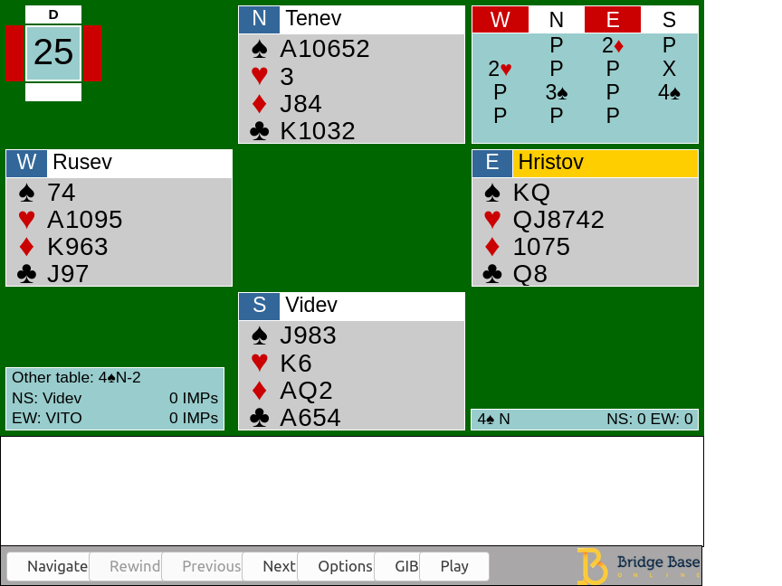
Introduction
Bidding stage Find the most profitable contract for the playing stage
Playing stage 13 rounds of a card-strength competition

Slide 6
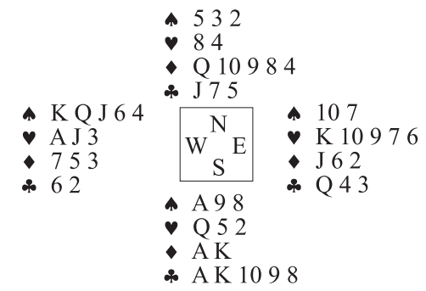
Double Dummy Bridge Problem(DDBP)

Slide 7
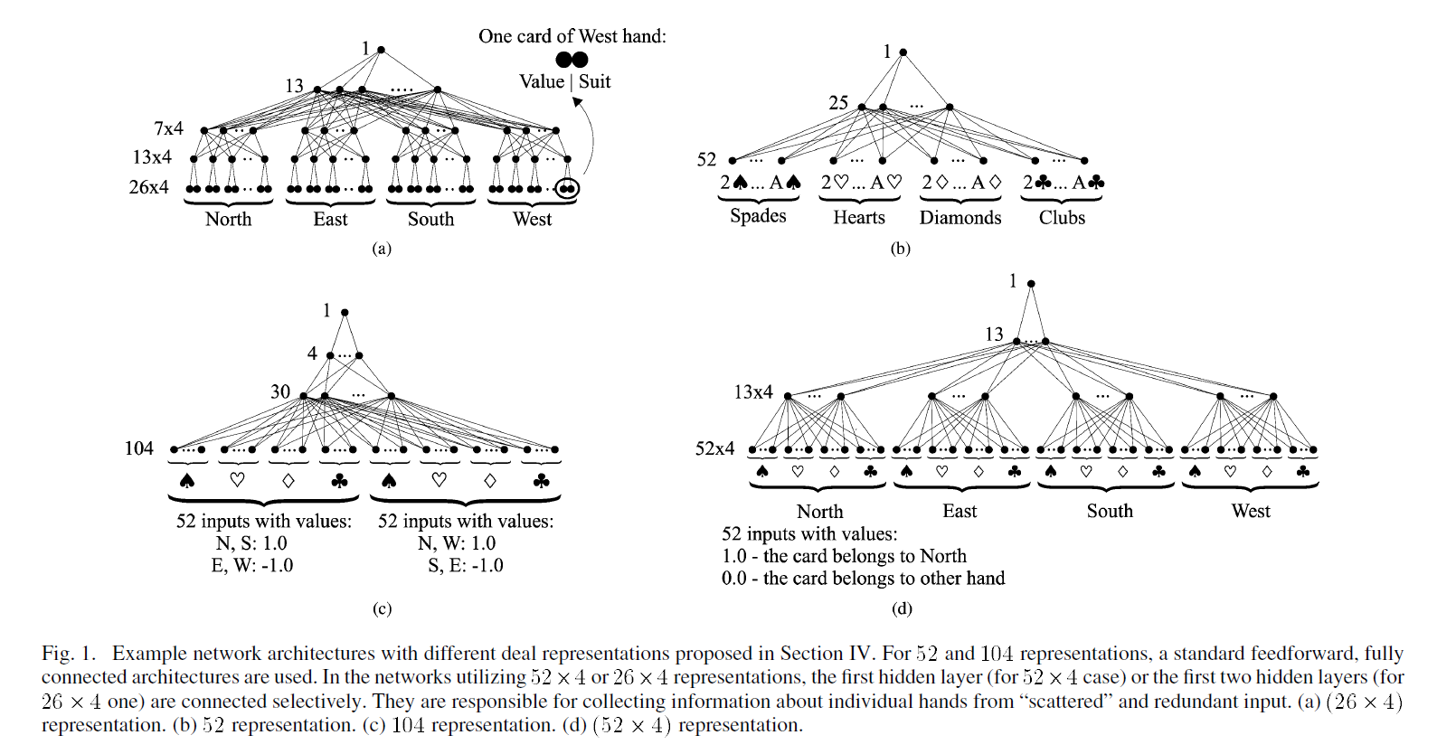
Representation of a deal

Slide 8
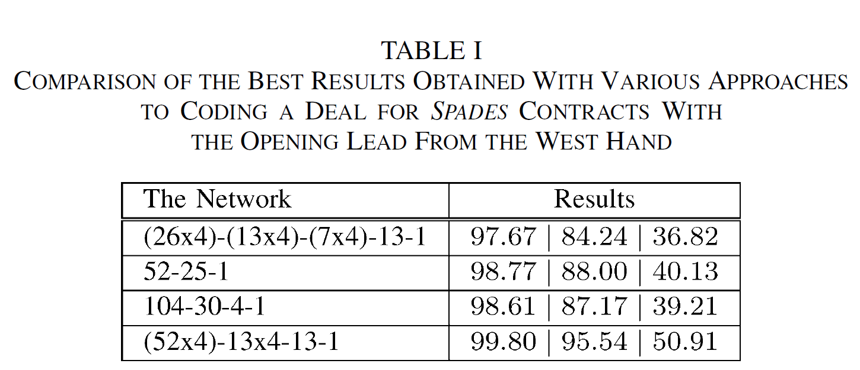
Different representation

Slide 9
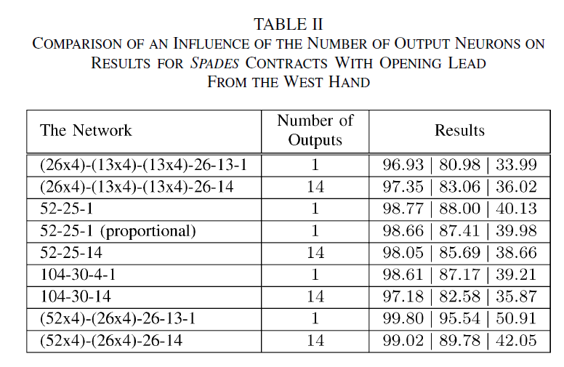
Different output neurons

Slide 10
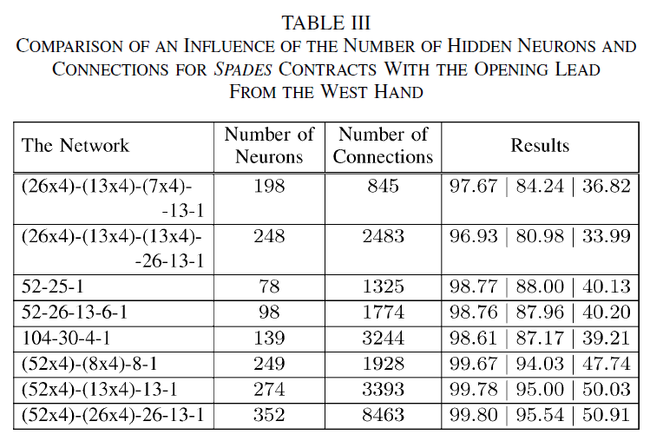
Different hidden layers

Slide 11
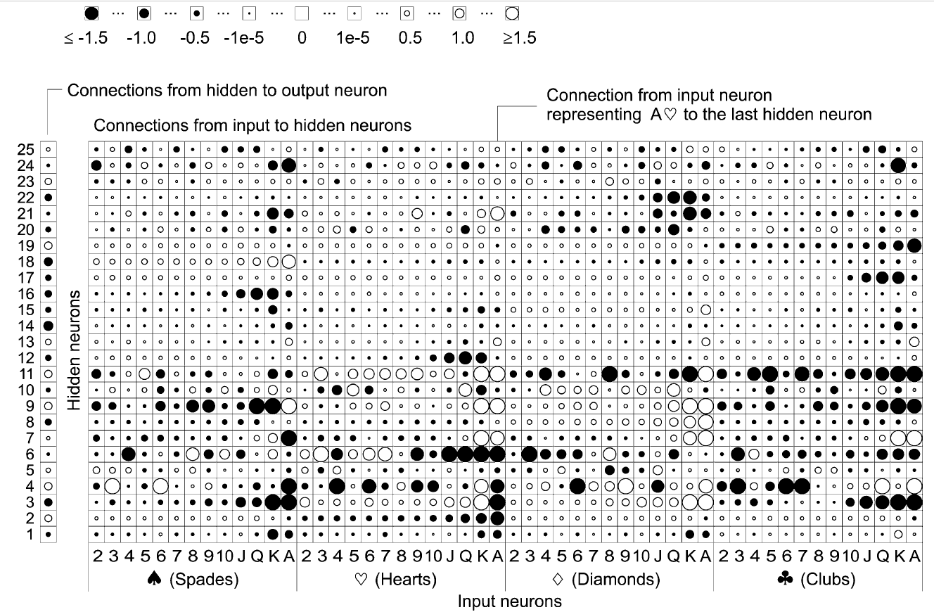
Weight analysis

Slide 12
Weight analysis

Slide 13
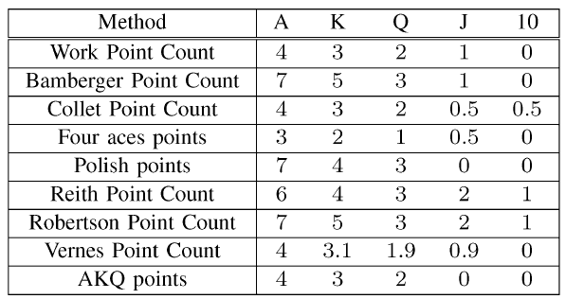
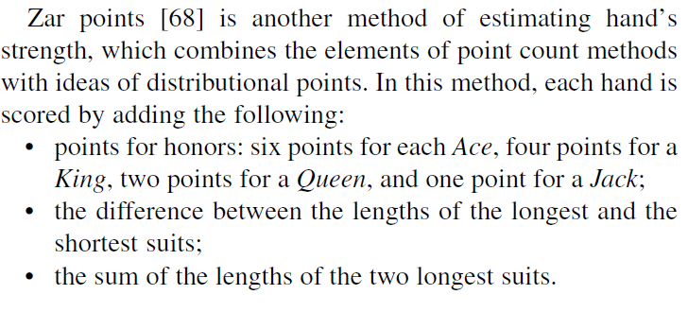
Point count methods

Slide 14
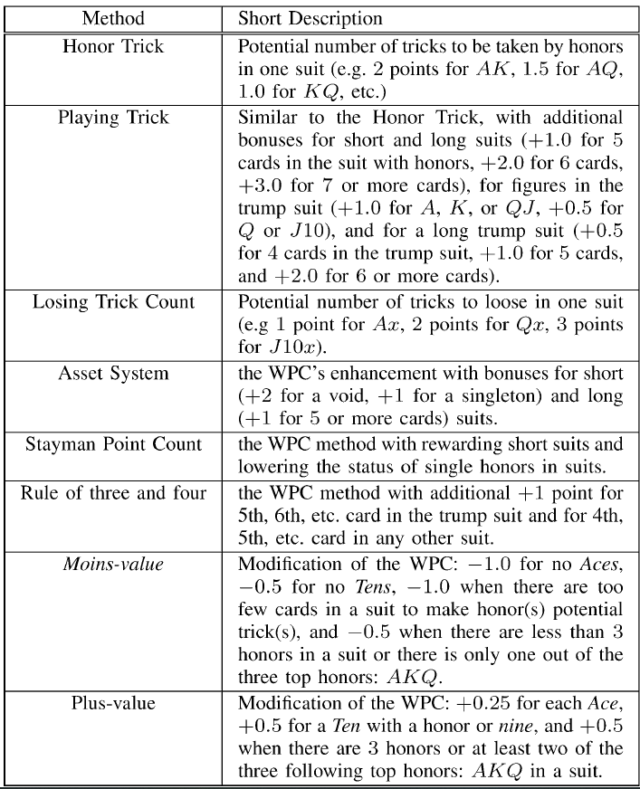
Distribution Point methods

Slide 15
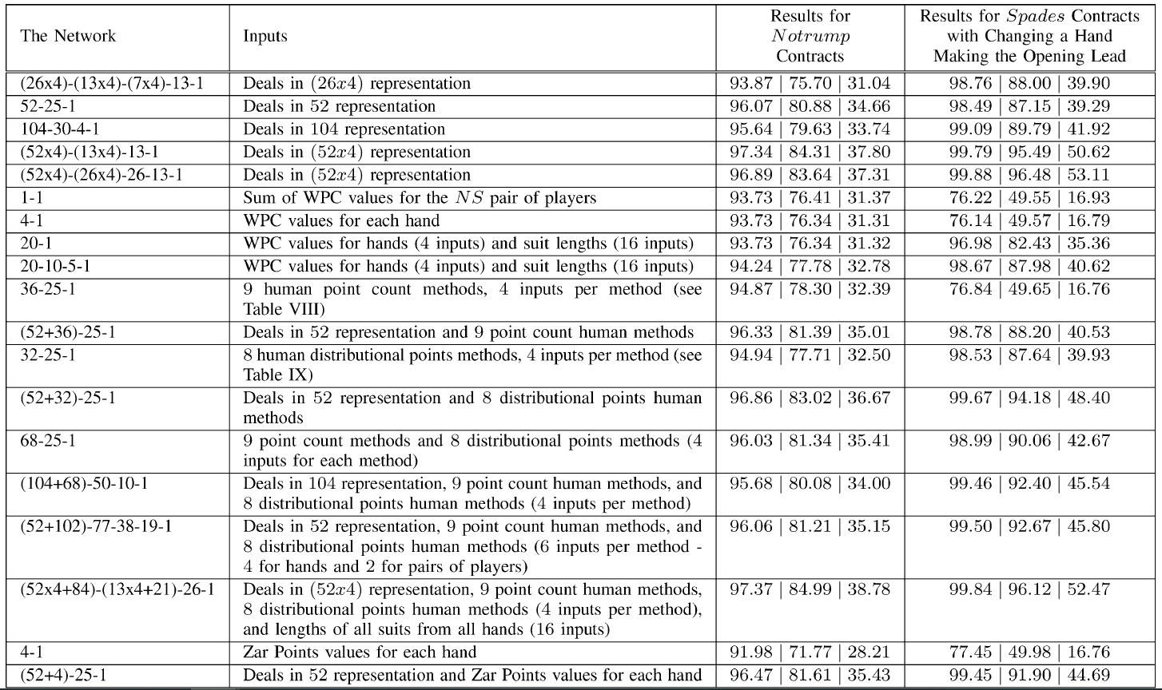
With and without human knowledge

Slide 16
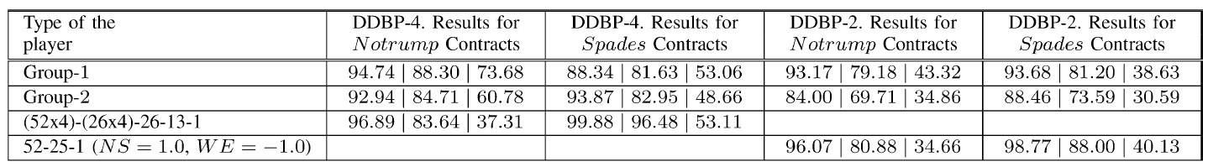
Comparison with human bridge players
DDBP-4: fully uncovered version of the problem
DDBP-2:opponents’ hands being hidden
Group1:four Grand Masters, three International Masters, and three Masters, playing in the First or the Second Polish Bridge League
Group2:the lower ranked bridge teams, each having a professional bridge title
27~864 instances / player

Slide 17
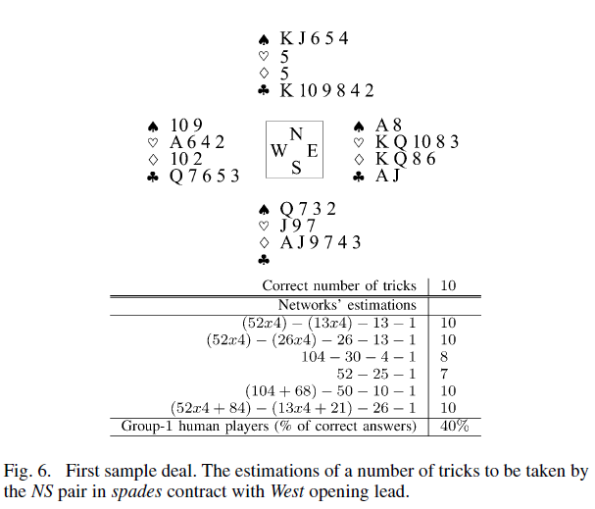
Neural network vs Players

Slide 18
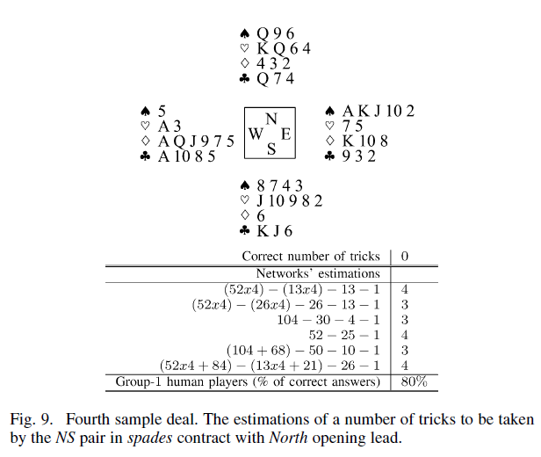
Neural network vs Players

Slide 19
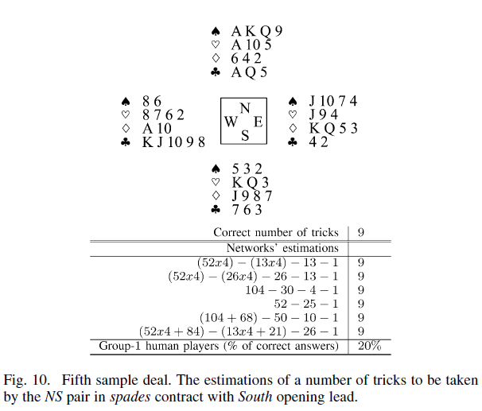
Neural network vs Players

Slide 20
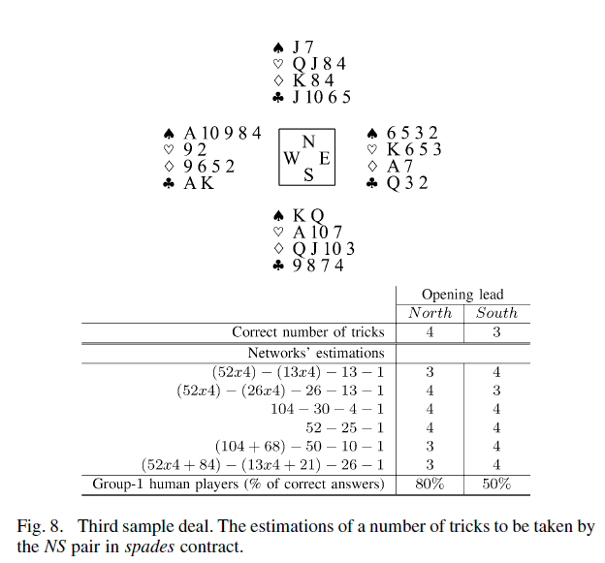
Neural network vs Players

