Slide 1
Genetic Algorithm with Ant Colony Optimization (GA-ACO) for Multiple Sequence Alignment
Zne-Jung Lee, Shun-Feng Su, Chen-Chia Chuang, Kuan-Hung Liu
Applied Soft Computing, 2008
Volume 8, Issue 1, pp. 55-78
Presenter: Tsung-Lin Lu
Date: Aug. 3, 2021
Notes:
李仁宗（華梵資管）、蘇順豐（台科電機）、莊鎮嘉（宜大電機）、劉冠宏（台科電機）

Slide 2
Abstract
Multiple sequence alignment, known as NP-complete problem, is among the most important and challenging tasks in computational biology. For multiple sequence alignment, it is difficult to solve this type of problems directly and always results in exponential complexity. In this paper, we present a novel algorithm of genetic algorithm with ant colony optimization for multiple sequence alignment. The proposed GA-ACO algorithm is to enhance the performance of genetic algorithm (GA) by incorporating local search, ant colony optimization (ACO), for multiple sequence alignment. In the proposed GA-ACO algorithm, genetic algorithm is conducted to provide the diversity of alignments. Thereafter, ant colony optimization is performed to move out of local optima. From simulation results, it is shown that the proposed GA-ACO algorithm has superior performance when compared to other existing algorithms.

Slide 3
Outline
GA-ACO algorithm
Initialization
Sexual reproduction
Mutation
Selection
Ant colony optimization (ACO)

Slide 4
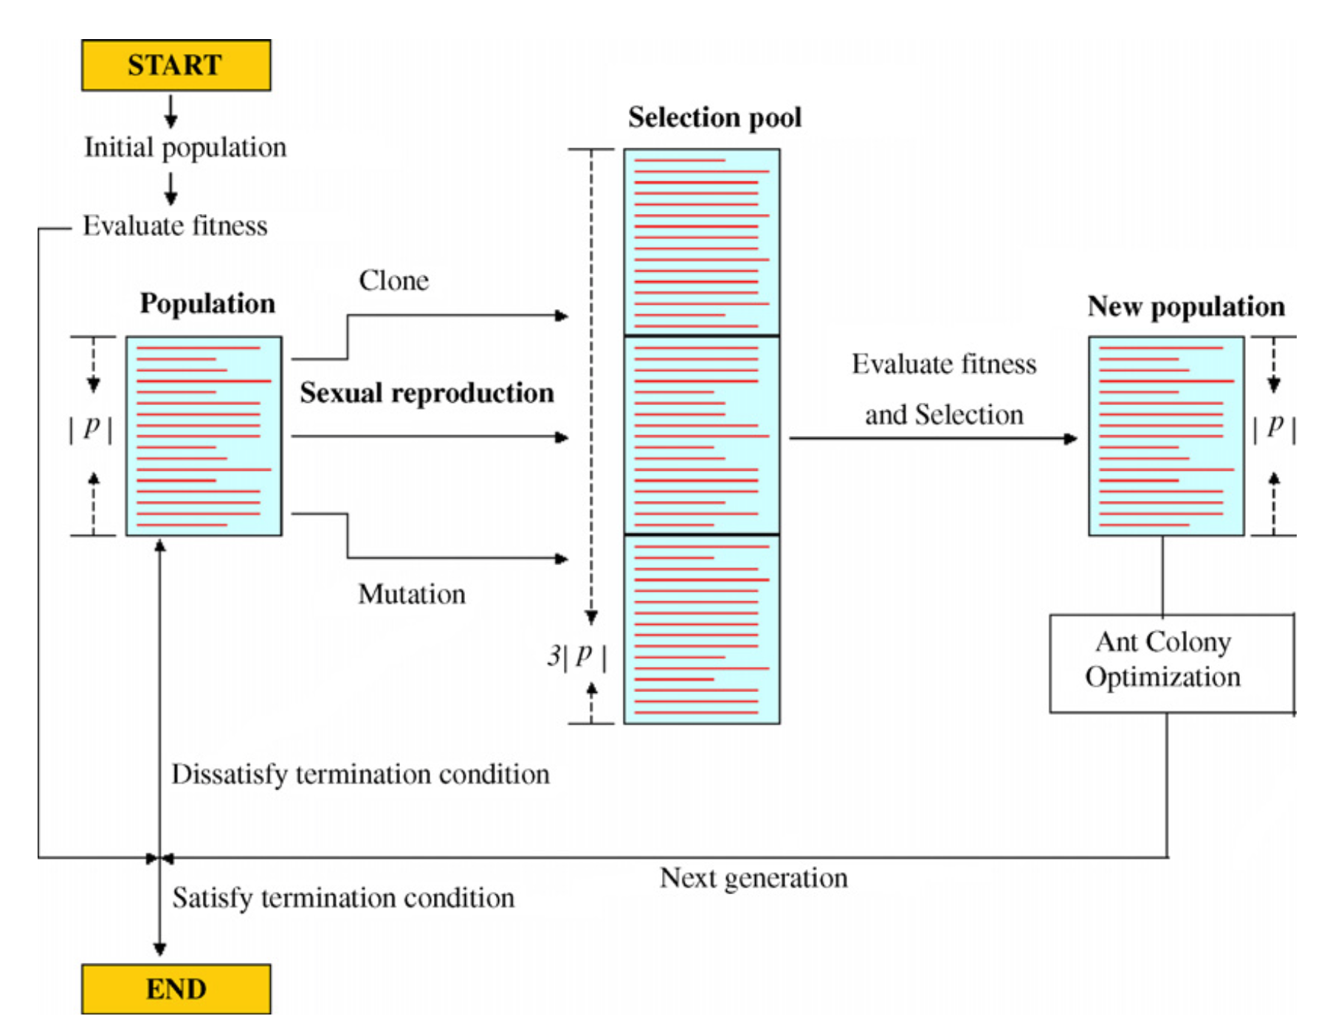
GA-ACO
Initialization
Sexual reproduction
Mutation
Selection

Slide 5
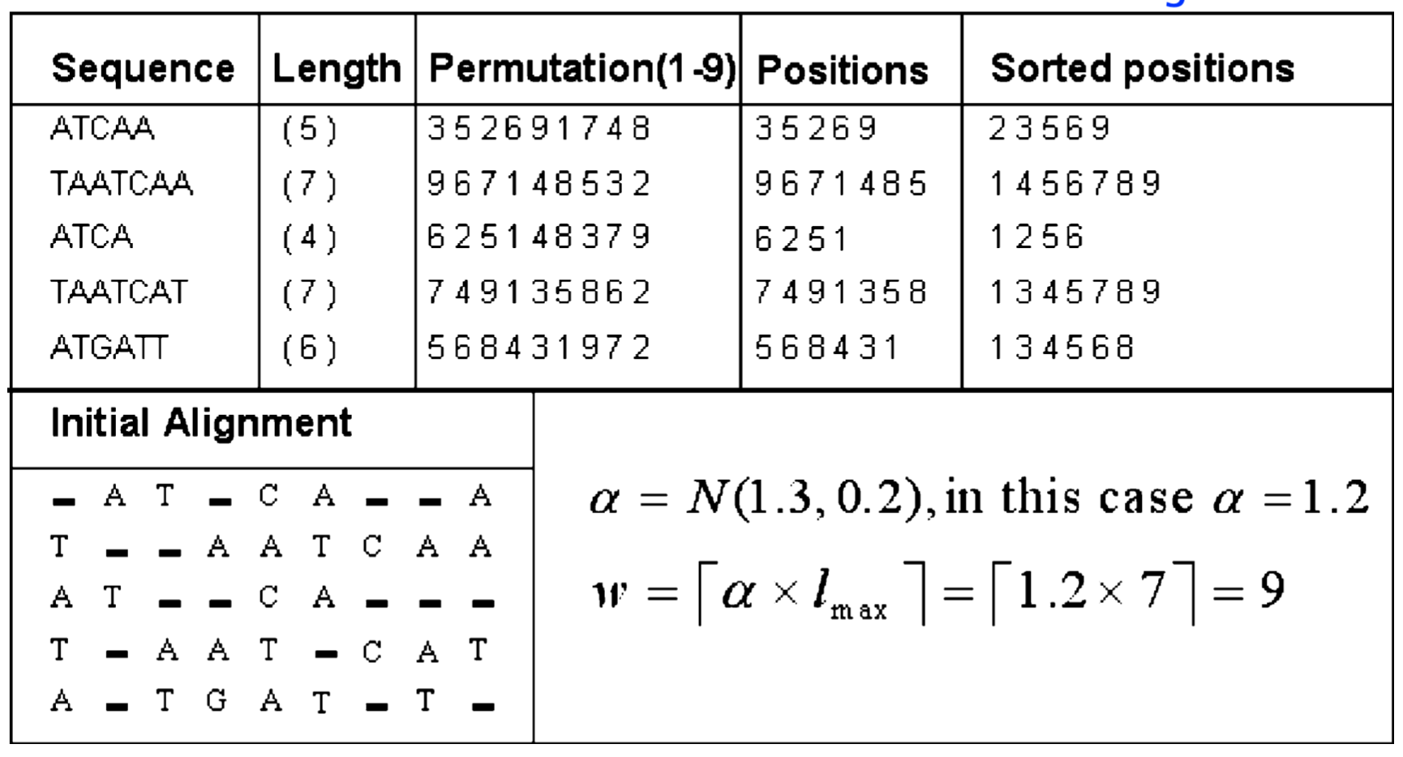
Initialization

Slide 6
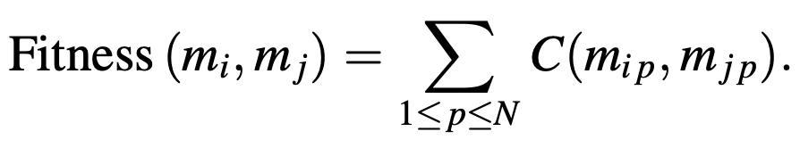
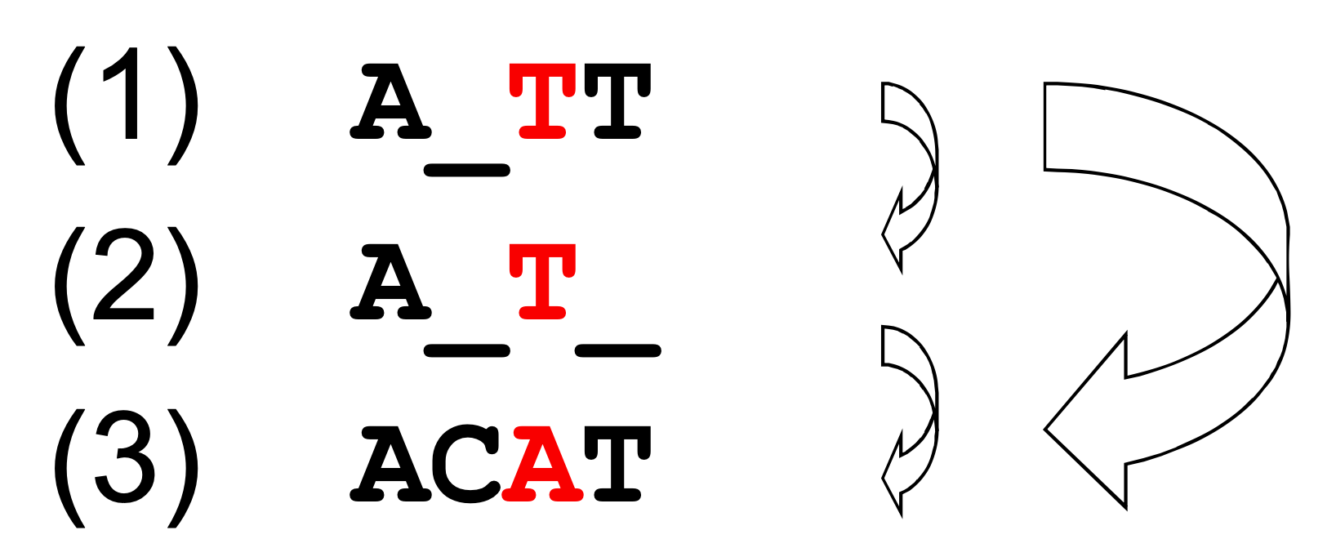
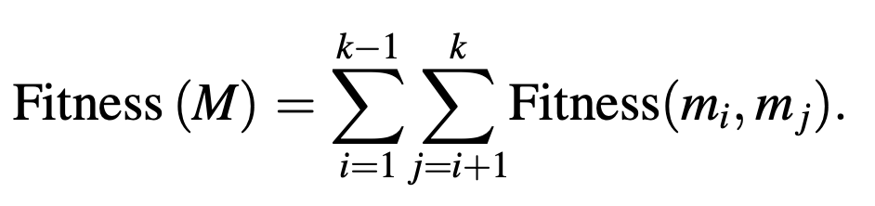
Fitness calculation
Sum of pair method

Slide 7
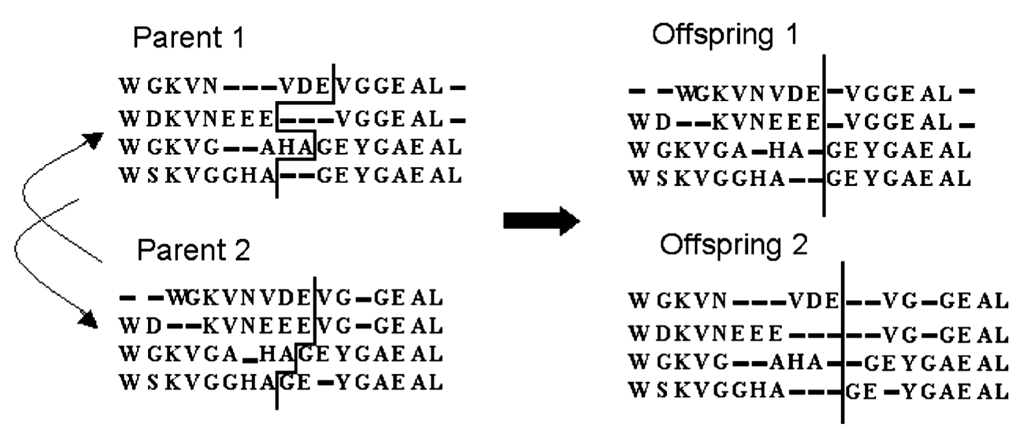
Sexual reproduction (1/3) singlepoint

Slide 8
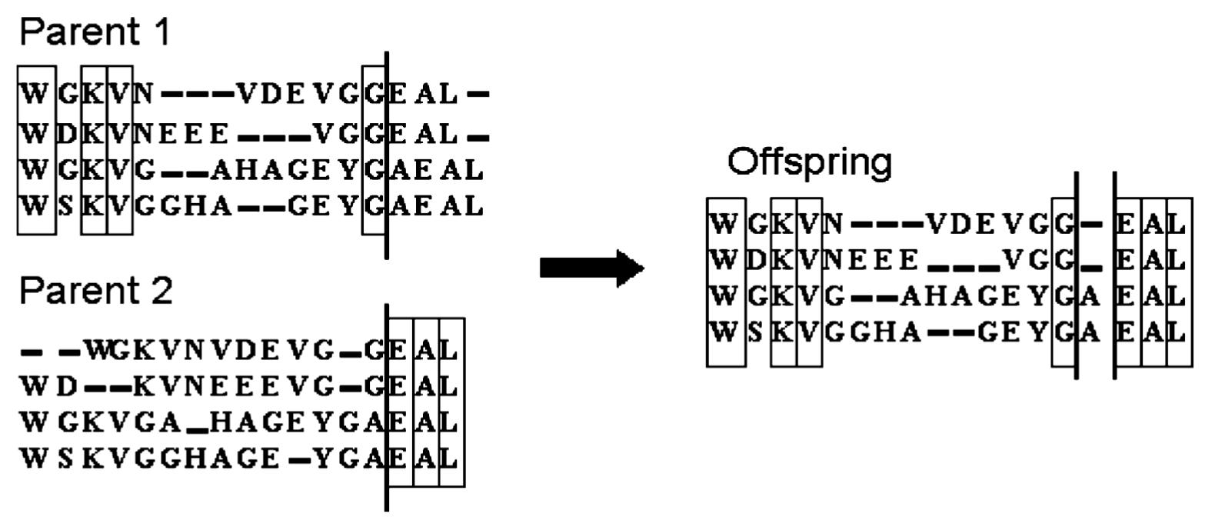
Sexual reproduction (2/3) recombinematchcolumn

Slide 9
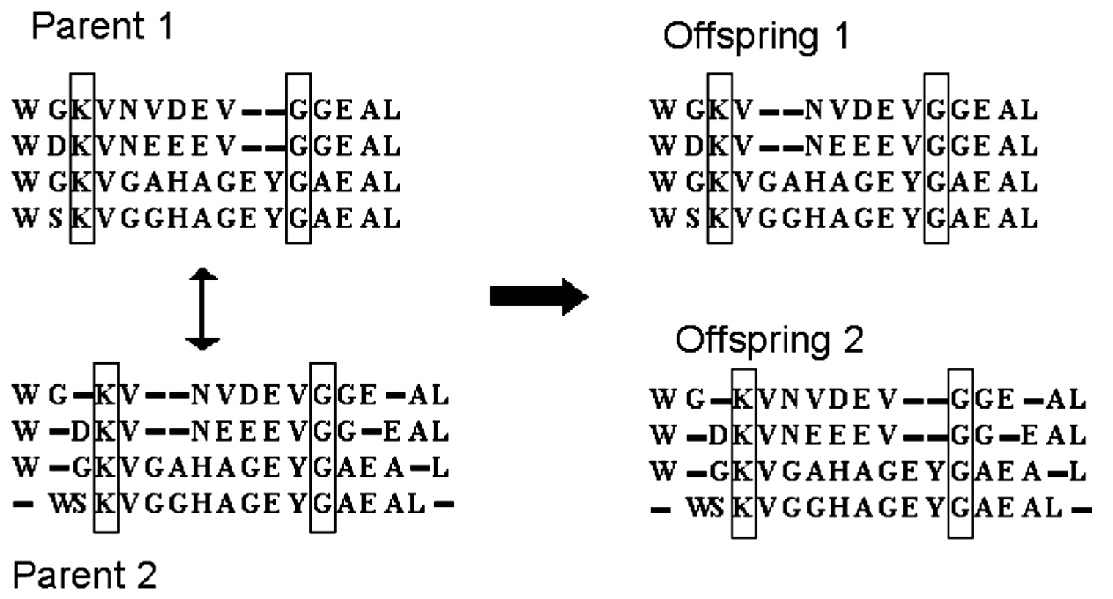
Sexual reproduction (2/3) uniformexchangeblock

Slide 10
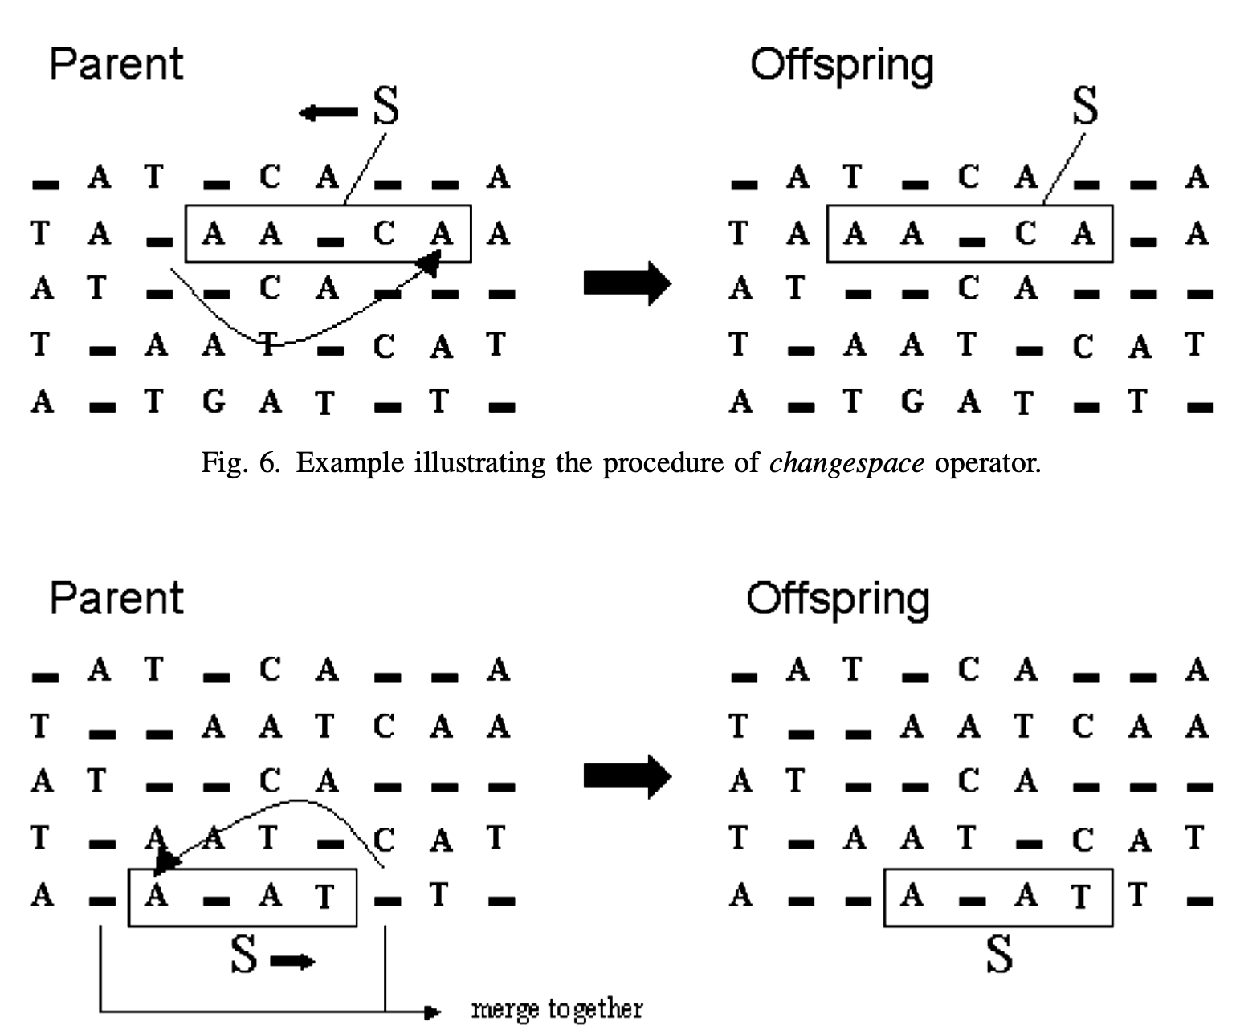
Mutation (1/4) changespace

Slide 11
Mutation (2/4) mergespace

Slide 12
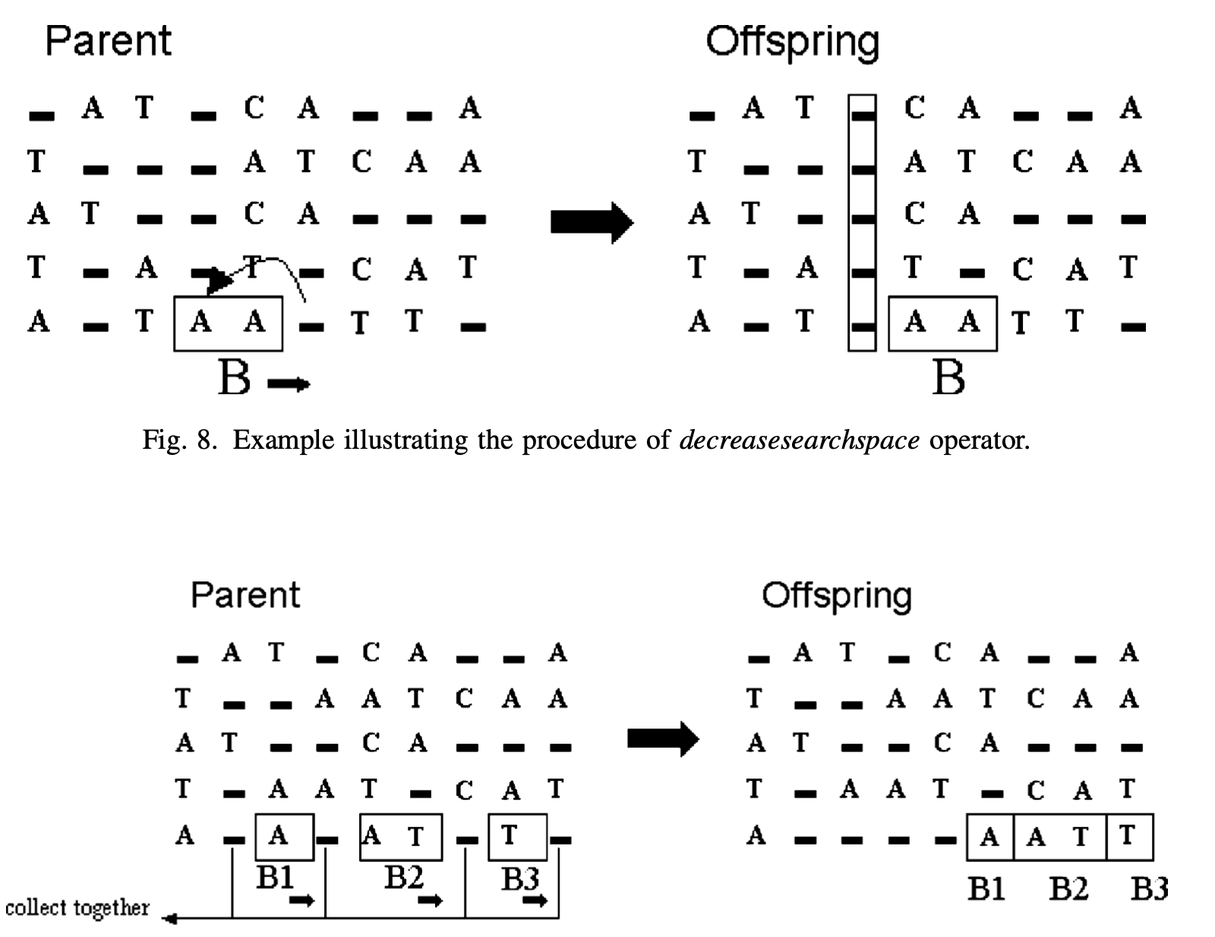
Mutation (3/4) decreasesearchspace

Slide 13
Mutation (4/4) collectspace

Slide 14
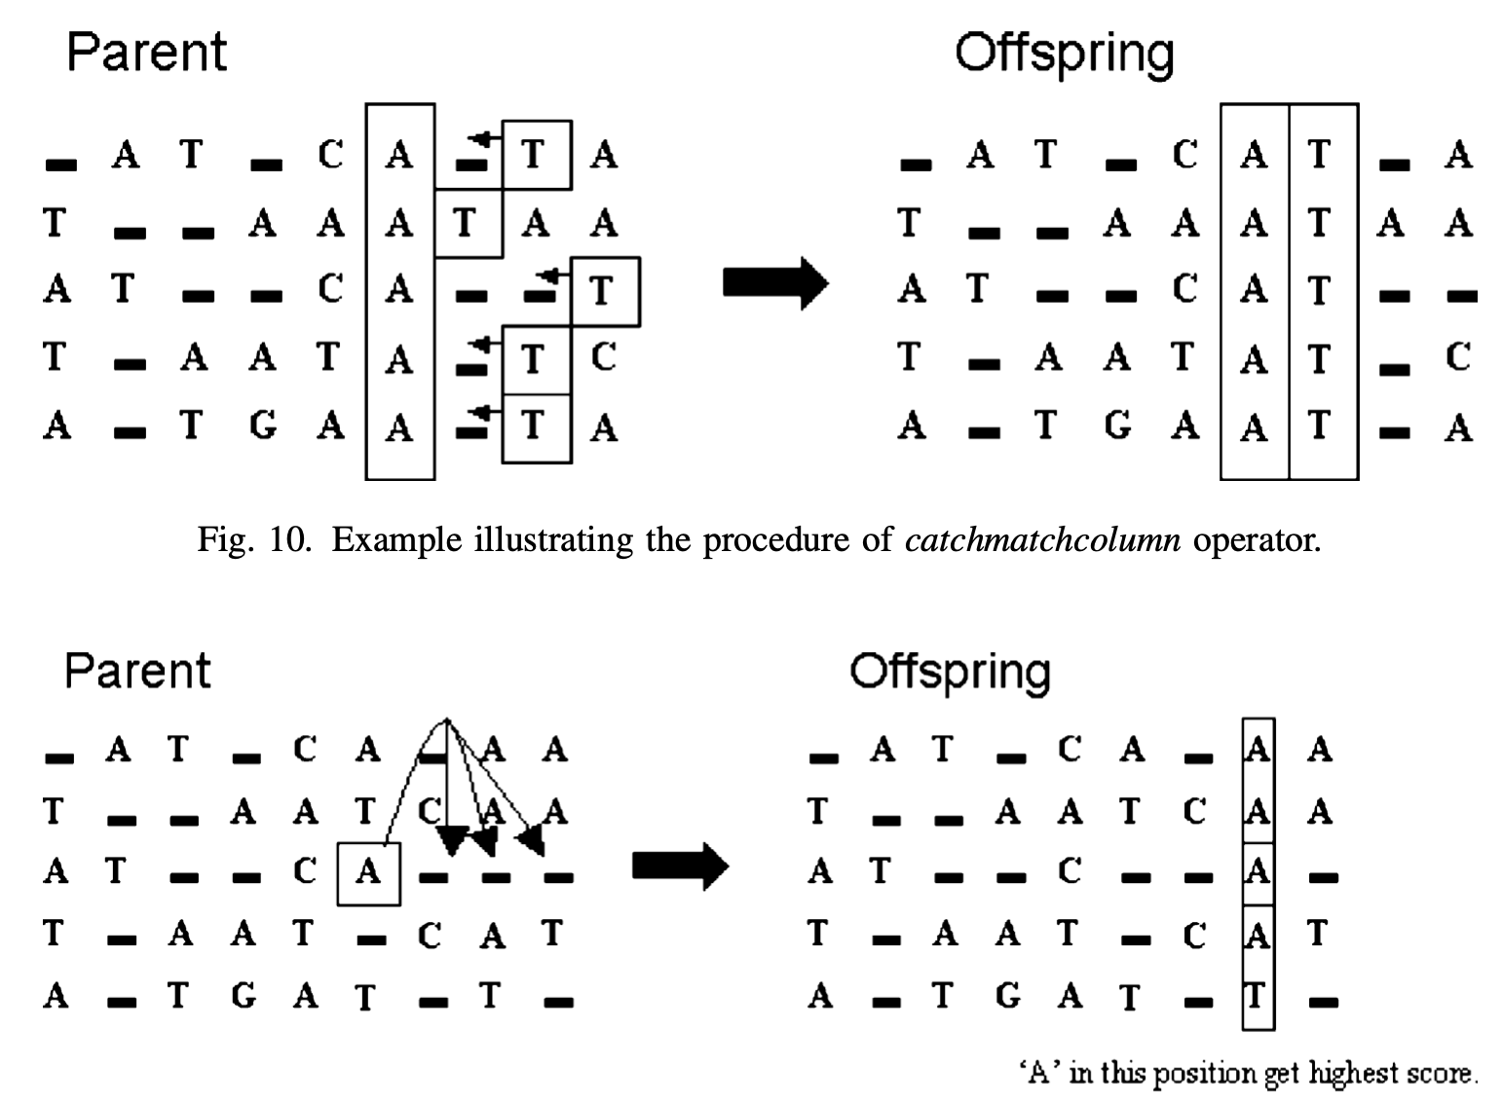
Heuristic (1/2) catchmatchcolumn

Slide 15
Heuristic (2/2) movetohigherscoreposition

Slide 16
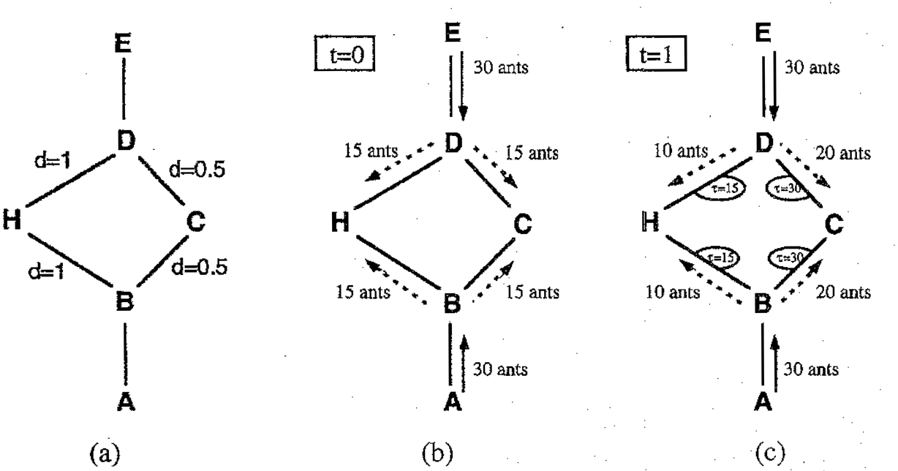
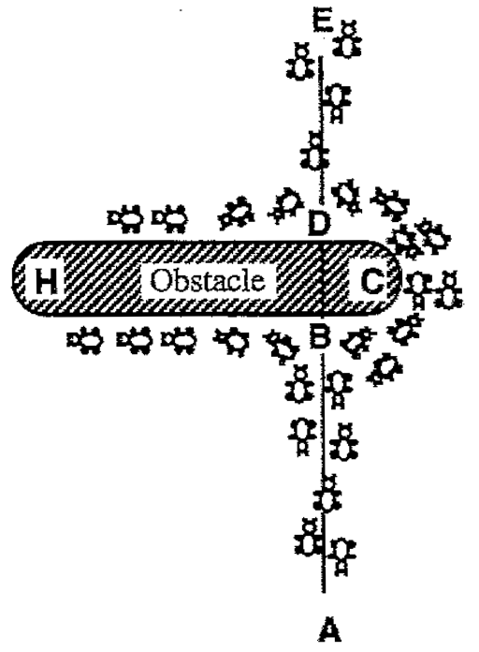
Ant colony optimization (ACO) (1/4)

Slide 17
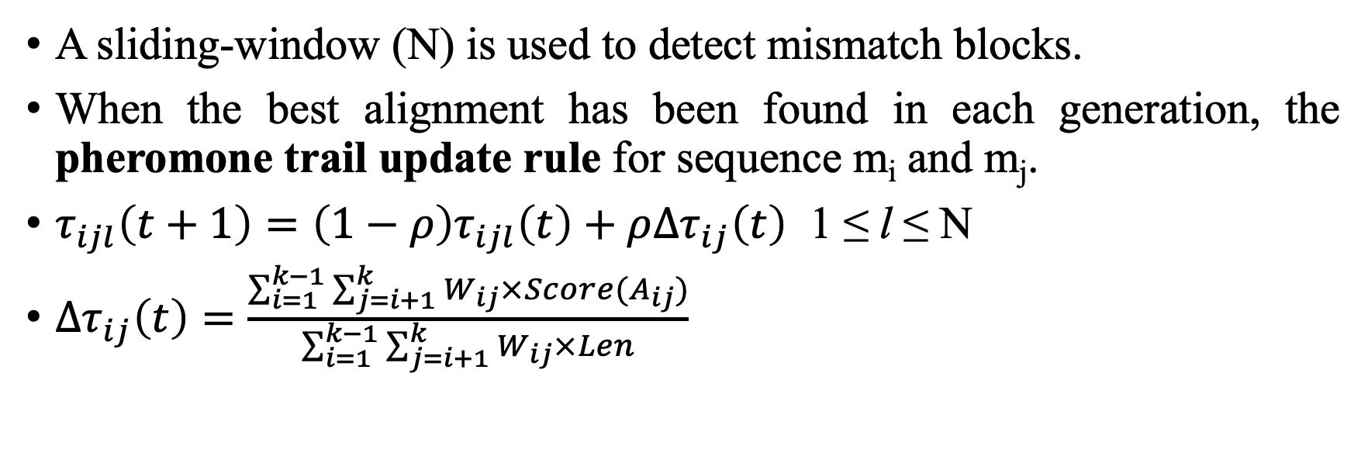
ACO (2/4)
A sliding-window (N) is used to detect mismatch blocks.
When the best alignment has been found in each generation, the pheromone trail update rule for sequence m_{i} and m_{j}.
$τ_{ijl}\left(t+1\right)=\left(1−ρ\right)τ_{ijl}\left(t\right)+ρ{∆τ}_{ij}\left(t\right)$ 1 ≤ l ≤ N
${∆τ}_{ij}\left(t\right)=\frac{\sum_{i=1}^{k−1}{\sum_{j=i+1}^{k}{W_{ij}×Score(A_{ij})}}}{\sum_{i=1}^{k−1}{\sum_{j=i+1}^{k}{W_{ij}×Len}}}$
𝜏 is the pheromone trail
0 < 𝜌 ≤ 1 is a parameter governing the pheromone decay process
l is the position of residue
t is time
W_{ij} is the percent identity between two aligned sequences m_{i} and m_{j}
A_{ij} is the pairwise projection of sequence m_{i} and m_{j} from the multiple sequence alignment
Score(A_{ij}) is the number of aligned pairs of residues that are shared between A_{ij} and the library
Len is the length of this alignment

Slide 18
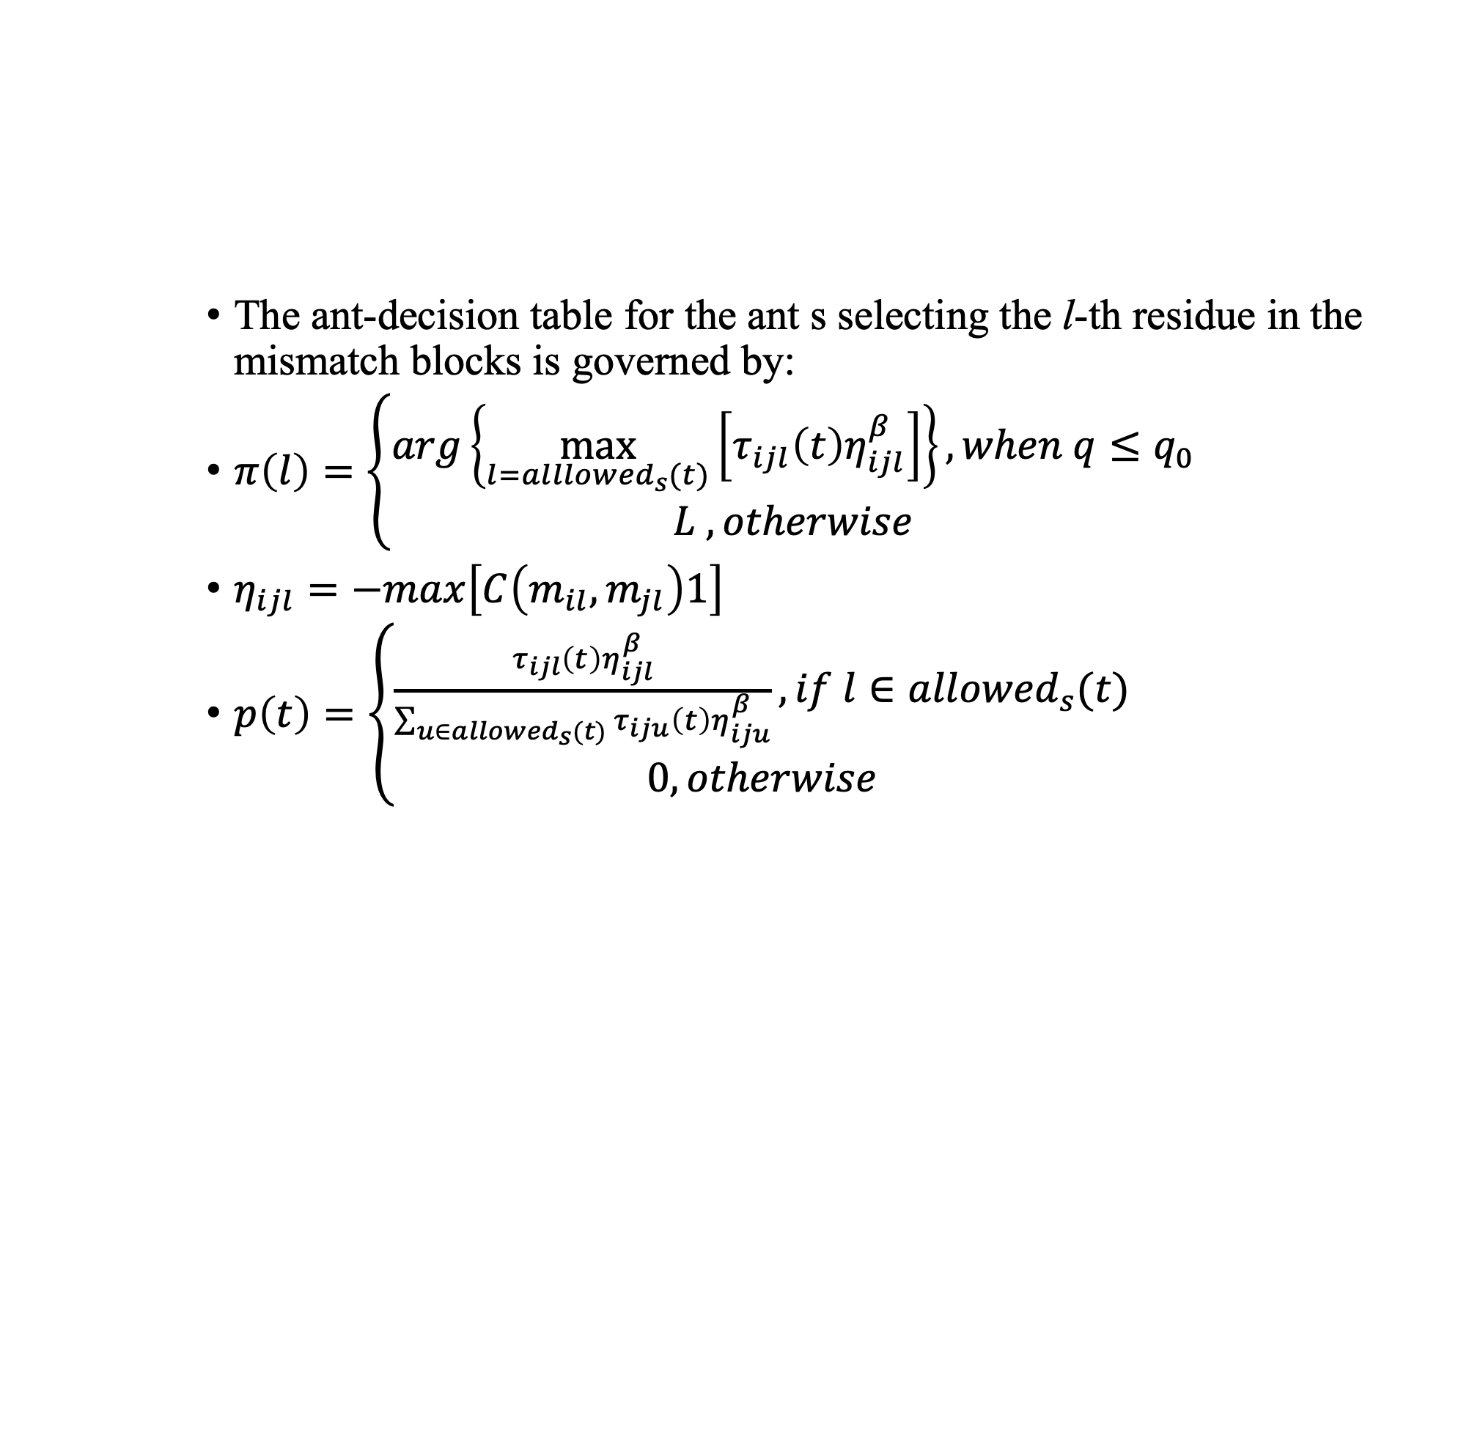
ACO (3/4)
The ant-decision table for the ant s selecting the l-th residue in the mismatch blocks is governed by:
$π\left(l\right)=\left\{\begin{aligned}arg\left\{\max_{l={alllowed}_{s}(t)}\left[τ_{ijl}\left(t\right)η_{ijl}^{β}\right]\right\},when q≤q_{0} \\ L , otherwise\end{aligned}\right.$
$η_{ijl}=−max\left[C\left(m_{il},m_{jl}\right)1\right]$
$p\left(t\right)=\left\{\begin{aligned}\frac{τ_{ijl}\left(t\right)η_{ijl}^{β}}{\sum_{u∈{allowed}_{s}(t)}{τ_{iju}\left(t\right)η_{iju}^{β}}}, if l∈{allowed}_{s}(t) \\ 0, otherwise\end{aligned}\right.$
𝜂_{ijl} is the heuristic information
𝛽 is a parameter of importance
q is a random number
allowed_{s}(t) is the set of ordered and feasible residues for the ant s at time t
p is probability

Slide 19
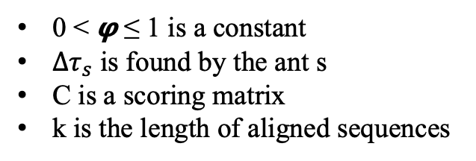
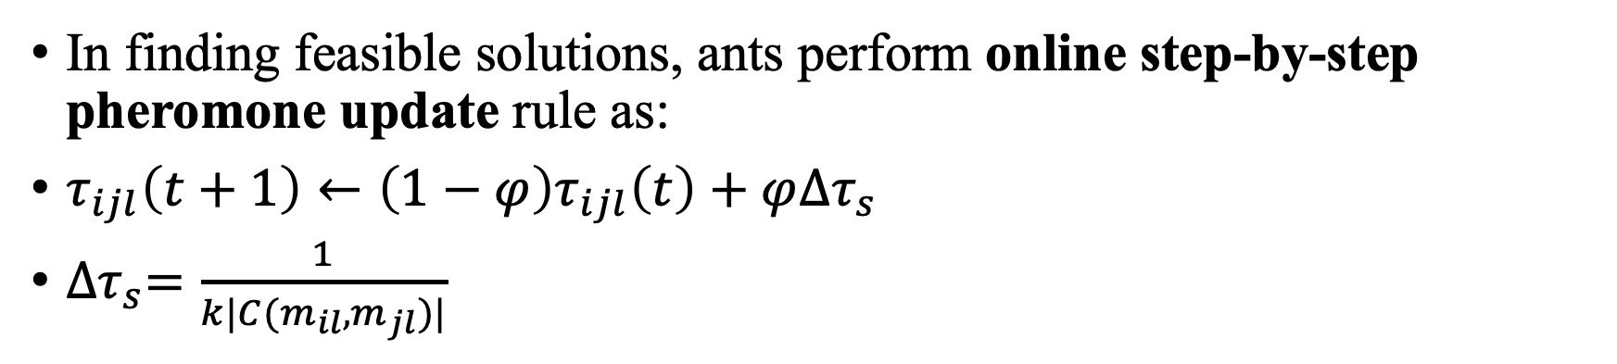
ACO (4/4)
In finding feasible solutions, ants perform online step-by-step pheromone update rule as:
$τ_{ijl}\left(t+1\right)←\left(1−φ\right)τ_{ijl}\left(t\right)+φ{∆τ}_{s}$
${∆τ}_{s}=\frac{1}{k|C(m_{il},m_{jl})|}$
0 < 𝞅 ≤ 1 is a constant
${∆τ}_{s}$ is found by the ant s
C is a scoring matrix
k is the length of aligned sequences

Slide 20
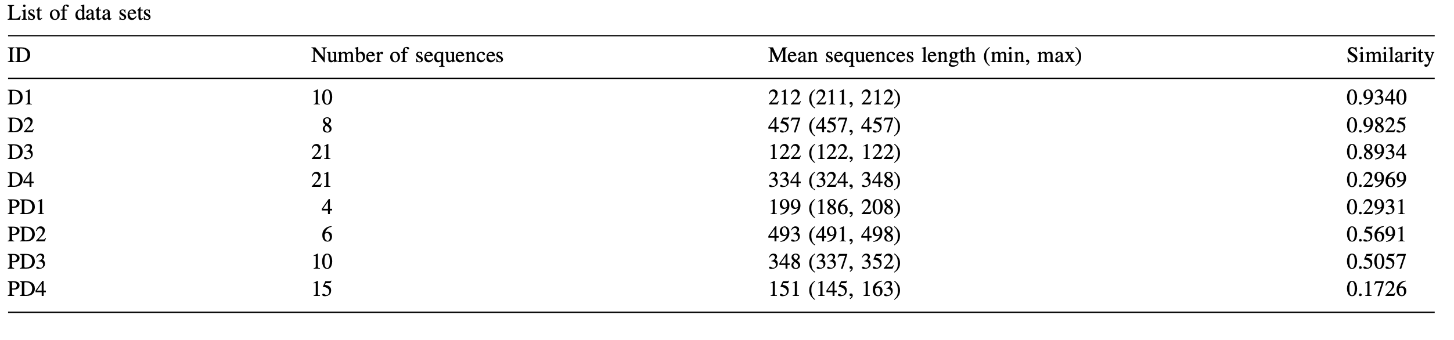
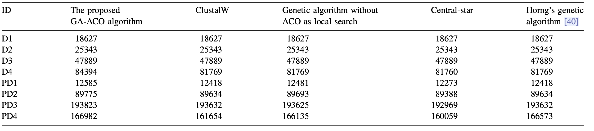
Results
SWISS- PROT benchmark
DNA
Protein
fitness value

Slide 21
Thank you for listening

Slide 22
Abstract
s

