Slide 1
A Branch Elimination-based Efficient Algorithm for Large-scale Multiple Longest Common Subsequence Problem ​ Shiwei Wei, Yuping Wang and Yiu-ming Cheung
IEEE Transactions on Knowledge and Data Engineering, 2021
pp. 1-14
Presenter: Chih-Hsuan Chien
Date: Nov. 02, 2021

Slide 2
Abstract(1/2)
It is a key issue to find out all longest common subsequences of multiple sequences over a set of finite alphabets, namely MLCS problem, in computational biology, pattern recognition and information retrieval, to name a few. However, it is very challenging to tackle the large-scale MLCS problem effectively and efficiently due to the high complexity of time and space. To this end, this paper will therefore propose a Branch Elimination-based Space and Time efficient algorithm called BEST-MLCS, which includes the following four key strategies: 1) Estimation scheme for the lower bound of the length of MLCS. 2) Estimation scheme for the upper bound of the length of the paths through the current match point.

Slide 3
Abstract(2/2)
3) Branch elimination strategy by finding all useless match points and removing the branches not on the longest paths. 4) A new Directed Acyclic Graph (DAG) construction method for constructing the smallest DAG among the existing ones. As a result, the proposed algorithm BEST-MLCS can save a lot of space and time and can handle much larger scale MLCS problems than the existing algorithms. Extensive experiments conducted on biological DNA sequences show that the performance of the proposed algorithm BEST-MLCS outperforms three state-of-the-art algorithms in terms of run-time and memory consumption.

Slide 4

succ():q is called a successor of p with respect to σ, if there is no other match point r satisfying that p ≺ r ⪯ q and cch(r) = cch(q) = σ, denoted by q = succ(p).
e.g., succ(A(2, 1)) = {A(3, 7), C(5, 4), G(4, 2), T(7, 3)}.

Slide 5
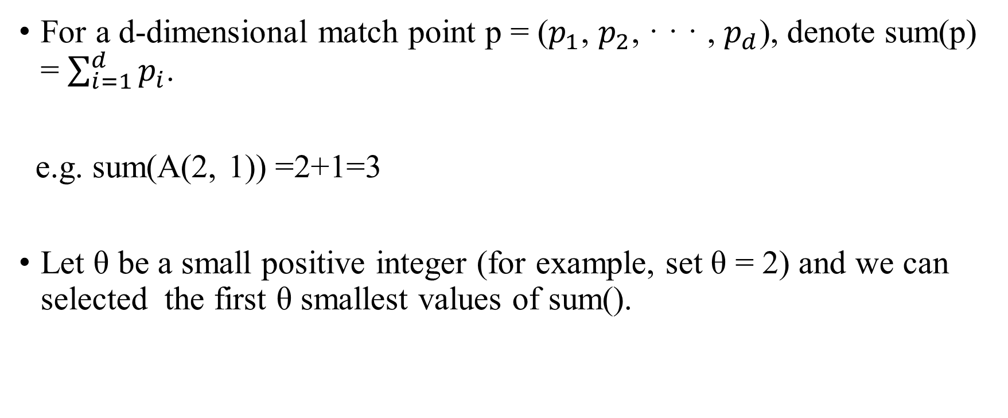
For a d-dimensional match point p = ($p_{1}$, $p_{2}$, · · · , $p_{d}$), denote sum(p) = $\sum_{i=1}^{d}{p_{i}}$.
e.g. sum(A(2, 1)) =2+1=3
Let θ be a small positive integer (for example, set θ = 2) and we can selected the first θ smallest values of sum().

Slide 6
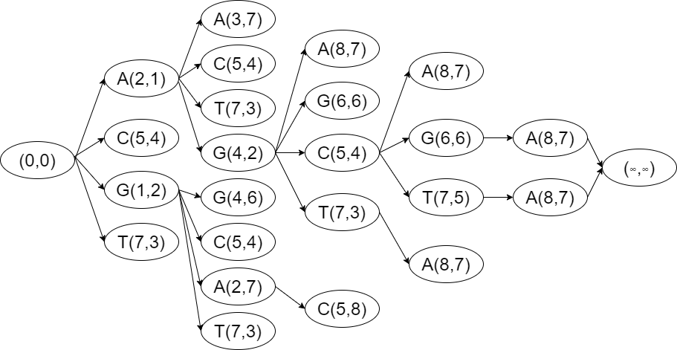
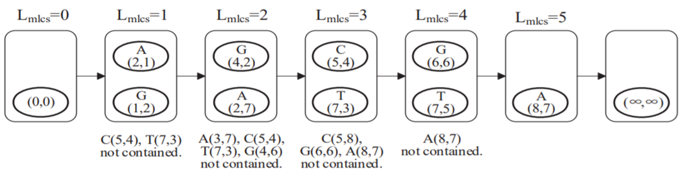
Lower Bound

Slide 7
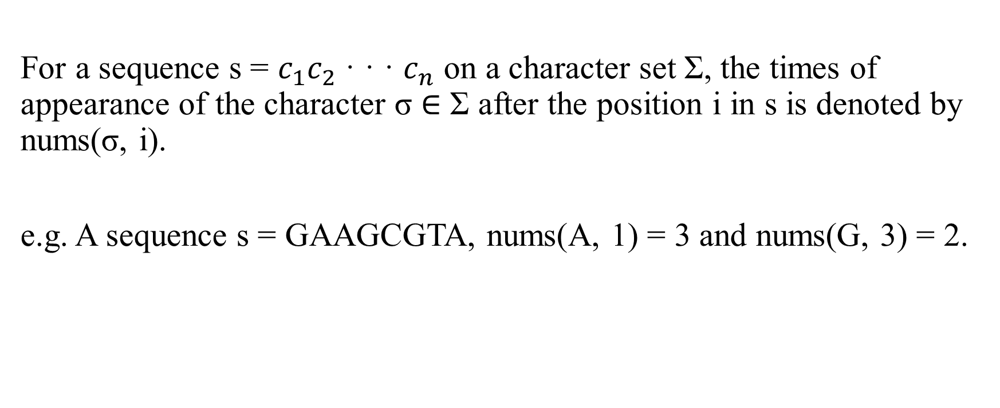
Upper Bound
For a sequence s = ${c_{1}c}_{2}$· · · $c_{n}$ on a character set Σ, the times of appearance of the character σ ∈ Σ after the position i in s is denoted by nums(σ, i).
e.g. A sequence s = GAAGCGTA, nums(A, 1) = 3 and nums(G, 3) = 2.

Slide 8
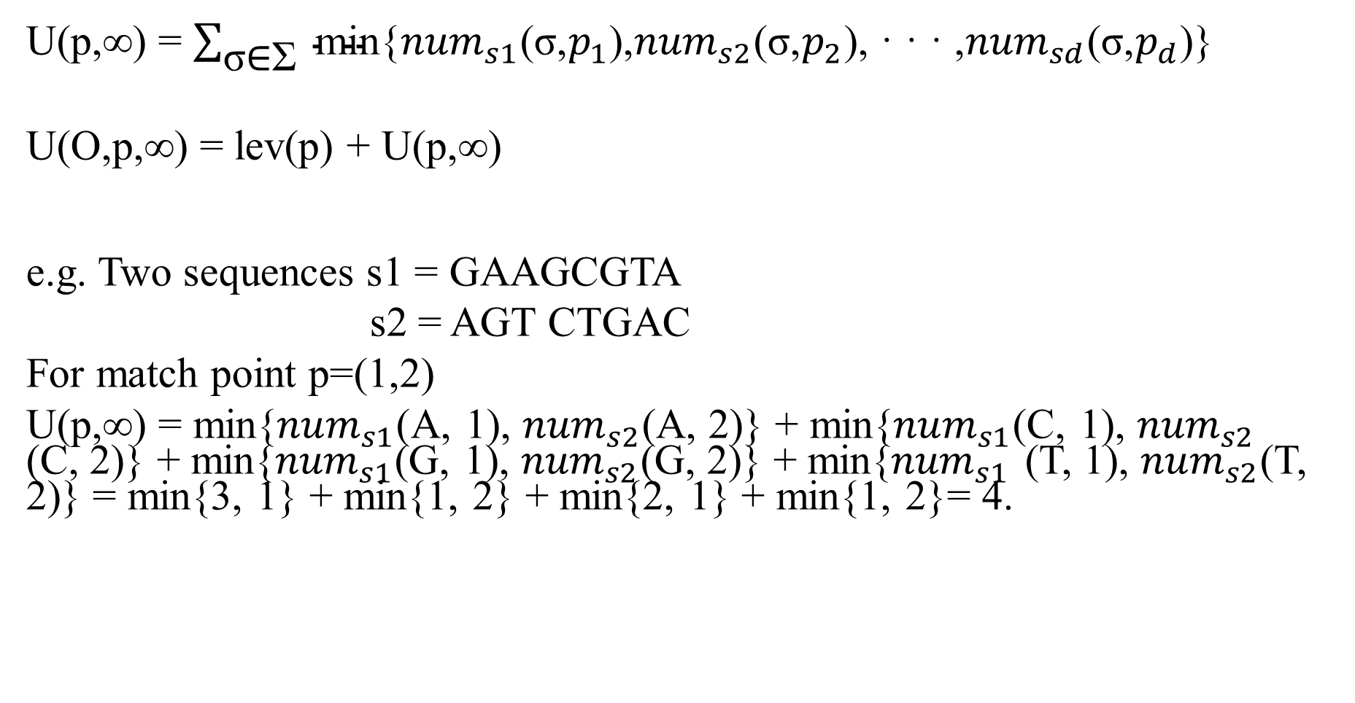
U(p,∞) = $\sum_{\text{σ}\text{∈}\text{Σ}}{ \text{min}\text{\{}{num}_{s1}\text{(}\text{σ}\text{,}p_{1}\text{),}{num}_{s2}\text{(}\text{σ}\text{,}p_{2}\text{), · · · ,}{num}_{sd}\text{(}\text{σ}\text{,}p_{d}\text{)\}}}$
U(O,p,∞) = lev(p) + U(p,∞)
e.g. Two sequences s1 = GAAGCGTA
s2 = AGT CTGAC
For match point p=(1,2)
U(p,∞) = min{${num}_{s1}$(A, 1), ${num}_{s2}$(A, 2)} + min{${num}_{s1}$(C, 1), ${num}_{s2}$ (C, 2)} + min{${num}_{s1}$(G, 1), ${num}_{s2}$(G, 2)} + min{${num}_{s1}$ (T, 1), ${num}_{s2}$(T, 2)} = min{3, 1} + min{1, 2} + min{2, 1} + min{1, 2}= 4.

Slide 9
Construct Smaller DAG
1)Select any match point p ∈ L k , search its successor set succ(p).
2) For each successor q ∈ succ(p), check whether q has already existed in DAG. If not, set the level of q (i.e., the length of the current longest path from O to q) as lev(q) = k + 1, go to step 3). Otherwise, compute the level lev(q) of q in two cases:
• If lev(q) < k + 1, it indicates that the existing longest path(s) from O to q is (are) shorter than the new longest path from O to q through p. Update lev(q) = k + 1 and shift q from L lev(q) to L k+1. Remove all existing paths through q. Go to step 4).
• If lev(q) = k + 1, it indicates that the path from O to q through p is also a new longest path from O to q, keep lev(q) unchanged. Go to step 4).
3) Identify whether q is a useless match point according to Theorem 2. If yes, do not put q in DAG, go to setp 5). Otherwise, put q into L k+1 .
4) Add a directed edge from p to q in DAG.
5) If successors of all match points in L k have been checked, the construction of L k+1 is finished. Otherwise, go to step 1).

Slide 10

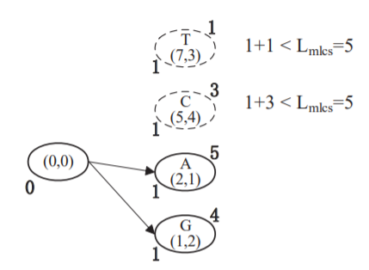

Two sequences s1 = GAAGCGTA
s2 = AGT CTGAC

Slide 11

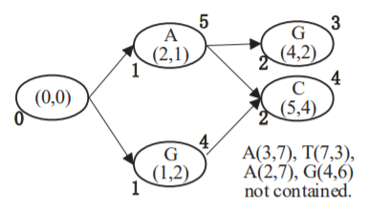

Lmcs=5
A(2,1) | A(2,7) | A(3,7) | A(8,7) | C(5,4) | G(1,2) | G(4,2) | G(4,6) | G(6,6) | T(7,3) | T(7,5)
5 | 1 | 1 | 0 | 3 | 4 | 3 | 2 | 1 | 1 | 1

Slide 12

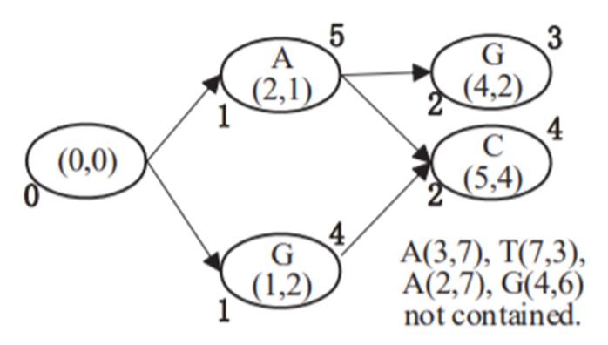
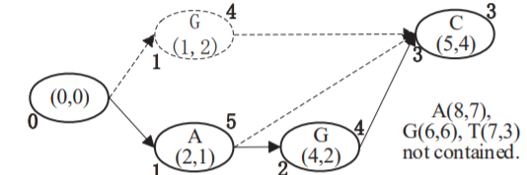

Slide 13


Slide 14
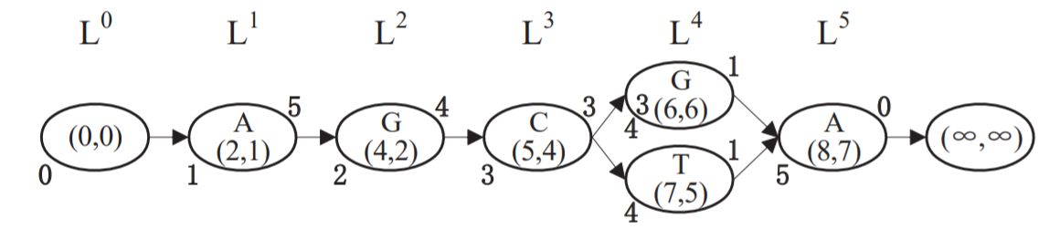


Slide 15
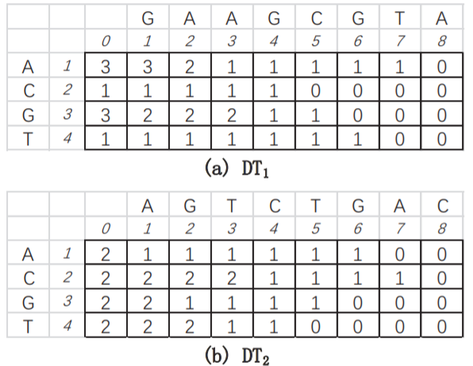
data structures
Successor Table
Hash Table
Distance Tables

Slide 16
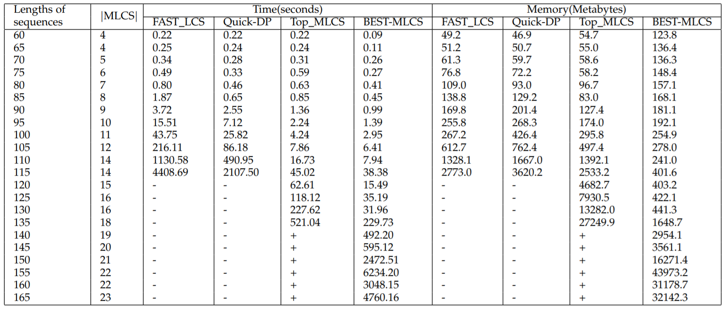
EXPERIMENTAL RESULTS
-:over execution time +:memory overflow

Slide 17
