Slide 1
All Simulations Are Not Equal: Simulation Reweighing for Imperfect Information Games
Qucheng Gong and Yuandong Tian
International Conference on Learning Representations, ICLR 2020, Millennium Hall, Addis Ababa ETHIOPIA, April 26, 2020 - April 30, 2020
Presenter: Jing-Ping Jan
Date: Nov. 2, 2021

Slide 2
Abstract
Imperfect information games are challenging benchmarks for artificial intelligent systems. To reason and plan under uncertainty is a key towards general AI. Traditionally, large amounts of simulations are used in imperfect information games, and they sometimes perform sub-optimally due to large state and action spaces. In this work, we propose a simulation reweighing mechanism using neural networks. It performs backwards verification to public previous actions and assign proper belief weights to the simulations from the information set of the current observation, using an incomplete state solver network (ISSN). We use simulation reweighing in the playing phase of the game contract bridge, and show that it outperforms previous state-of-the-art Monte Carlo simulation based methods, and achieves better play per decision.

Slide 3
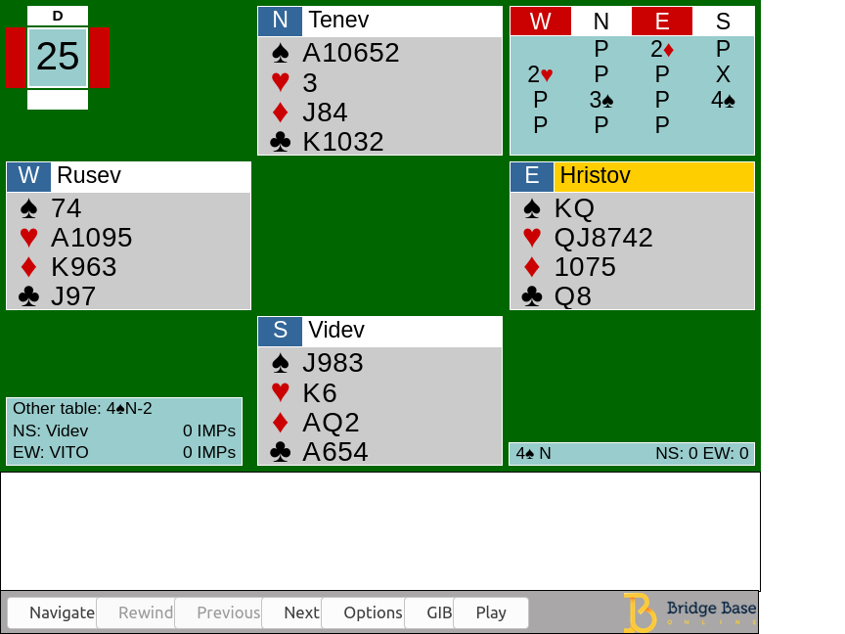
Introduction
Bidding stage Find the most profitable contract for the playing stage
Playing stage 13 rounds of a card-strength competition

Slide 4
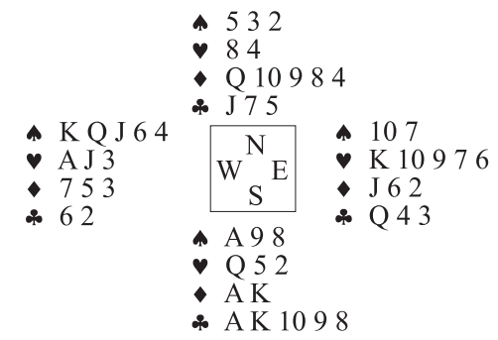
Double Dummy Bridge Problem(DDBP)

Slide 5
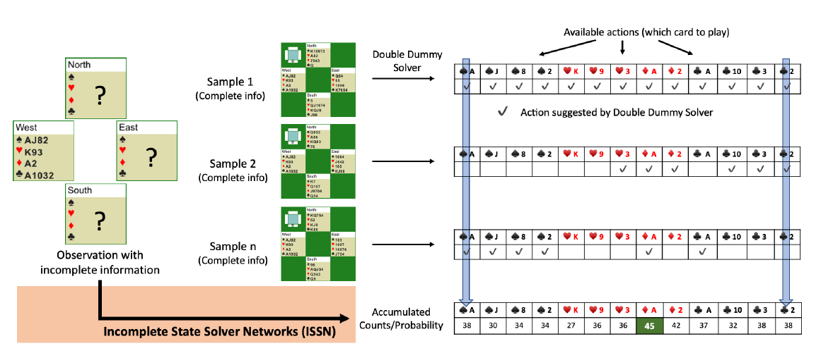
Incomplete State Solver Network(ISSN)

Slide 6
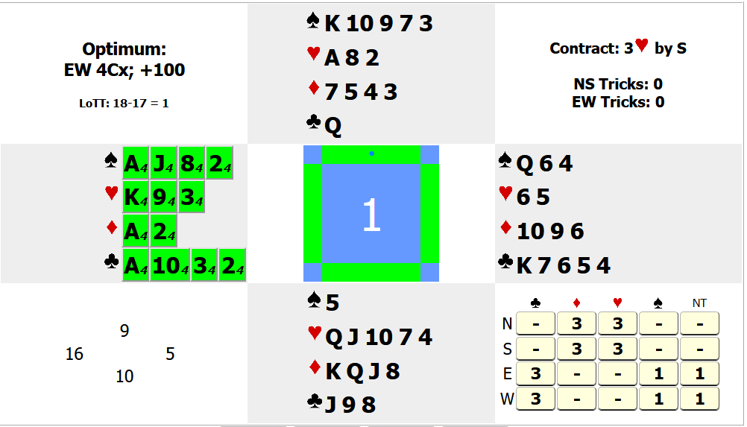
Incomplete State Solver Network(ISSN)

Slide 7
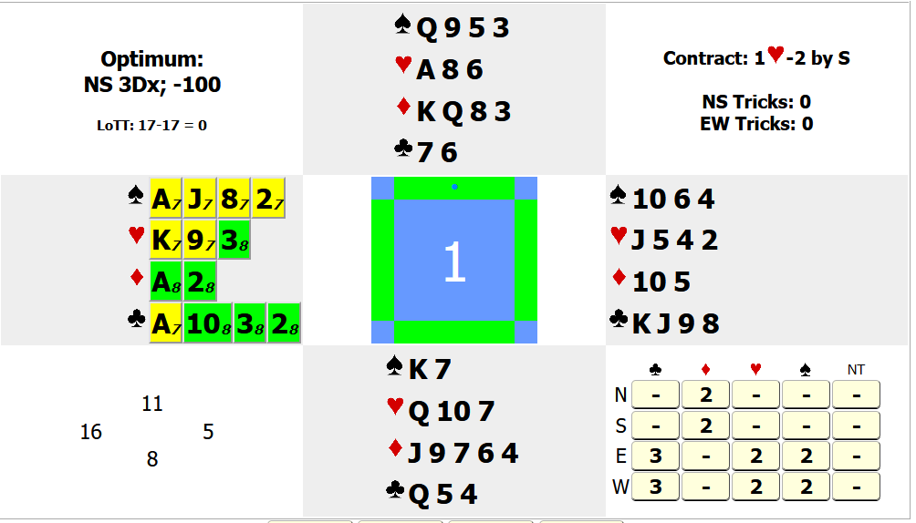
Incomplete State Solver Network(ISSN)

Slide 8
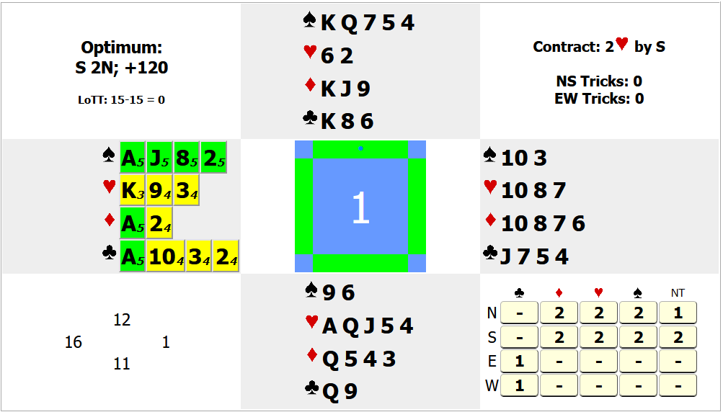
Incomplete State Solver Network(ISSN)

Slide 9
Incomplete State Solver Network(ISSN)

Slide 10
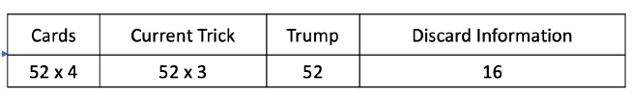
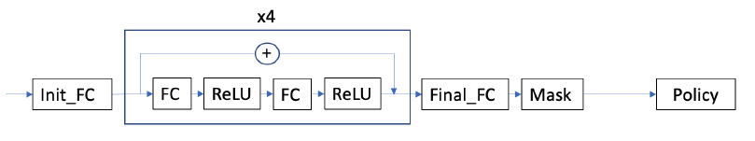
Network
Input:
Hidden layers: 8*100, a skipped connection is addes every 2 layers
Output: 52 possibilities

Slide 11
Network
432
100
100
100
100
…
mask
52
8

Slide 12
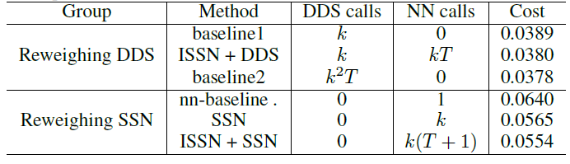
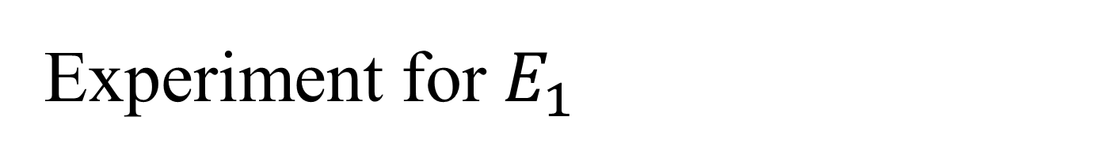
Experiment for $E_{1}$
Data: 84k hands from expert tournament play, 2.4 million positions.
Baseline1: DDS simulate result
Baseline2: k simulations and for each simulation run k simulations
nn-baseline: only ISSN
Cost: Trick loss per state

Slide 13
Incomplete State Solver Network(ISSN)

Slide 14
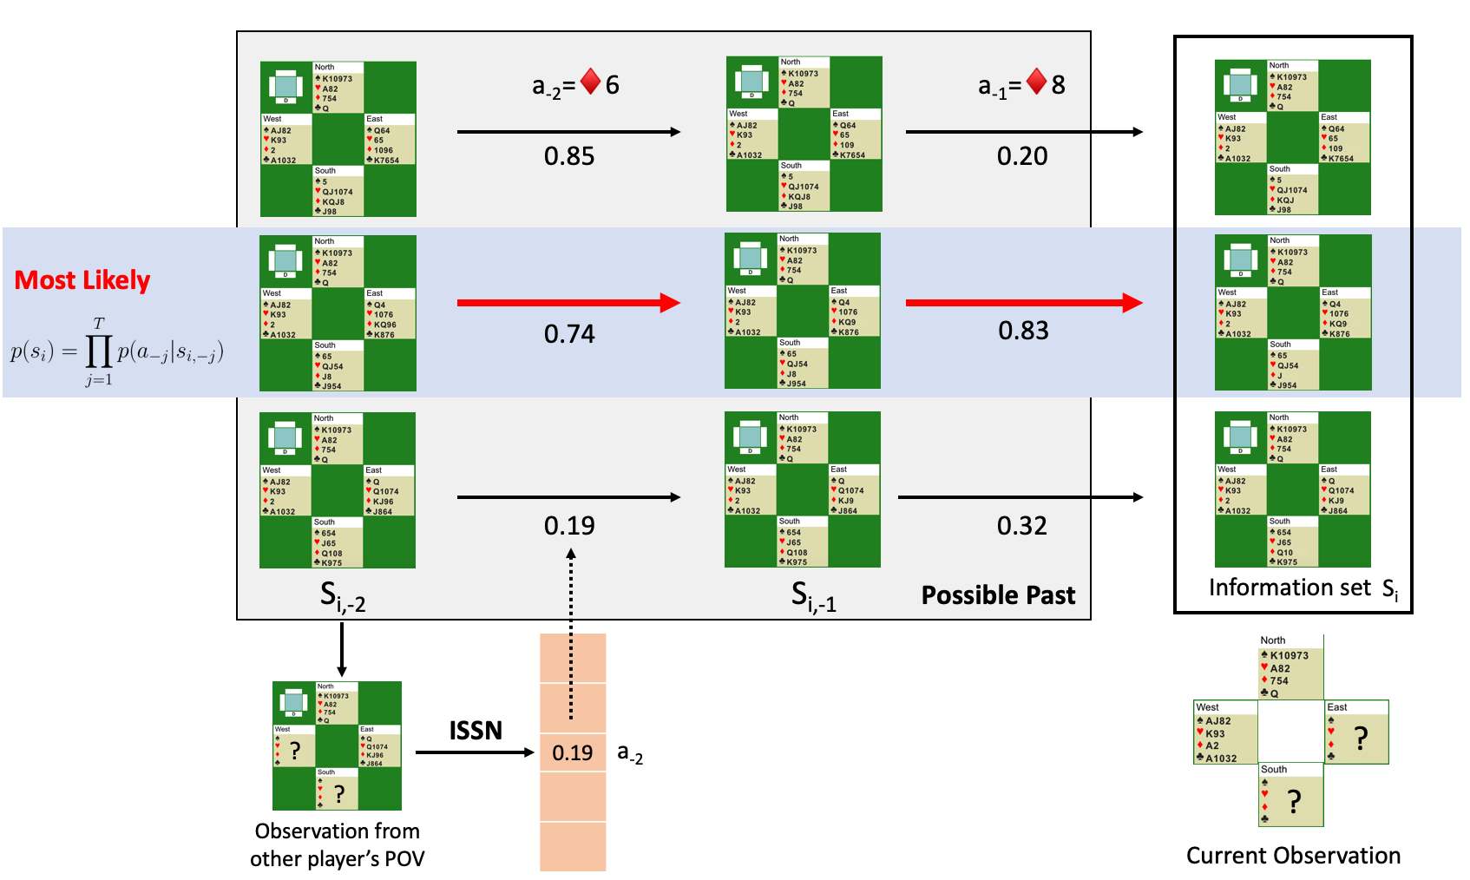
Incomplete State Solver Network(ISSN)

