Slide 1
Energy-efficient bi-objective single-machine scheduling with power-down mechanism
Che, Ada, Wu, Xueqi, Peng, Jing, Yan, Pengyu
Computers & Operations Research Volume 85, September 2017, Pages 172-183
Date: Oct. 26, 2021
Presenter: Jue-Jun Wu
Notes:
車 無薛琦 鵬竟

Slide 2
Abstract
This paper considers a single-machine scheduling problem with power-down mechanism to minimize both total energy consumption and maximum tardiness. The aim is to find an optimal processing sequence of jobs and determine if the machine should be executed a power-down operation between two consecutive jobs. To formulate the problem, a mixed-integer linear programming (MILP) model is developed. Then a basic ε − constraint method is proposed to obtain the complete Pareto front of the problem. Considering the particularity of the problem, we also develop local search, preprocessing technique and valid inequalities to strengthen the basic ε − constraint method. Finally, to obtain approximate Pareto fronts for large-size problems, we utilize the method of cluster analysis to divide the jobs into several sorted clusters according to their release times and due dates. Any job in a preceding cluster must be processed before all jobs in a subsequent cluster. Thus, the solution space is reduced significantly. Computational experiments on benchmark and randomly generated instances demonstrate the effectiveness of the proposed exact and approximation approaches.

Slide 3
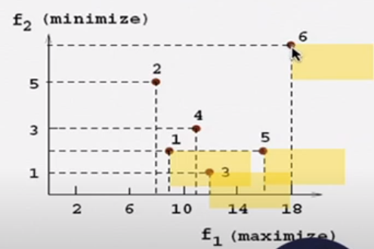
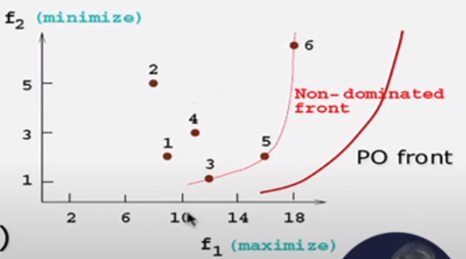
Pareto Optimal Solutions
Definition 1
For any pair of solutions x1 and x2 ∈X, we say x1 dominates x2 if f1(x1) ≤ f1(x2) and f2(x1) < f2(x2) hold or f1(x1) < f1(x2) and f2(x1) ≤ f2(x2) hold.
Definition 2
A Pareto optimal solution is the one that no solution x ∈ X dominates it.
Definition 3 :
All the Pareto optimal points over the objective space for a problem are called its Pareto front.
Notes:
Search for non-dominated points(找出這些 則all optimal)
3 5 6 不能被dominate 。3沒better5 反之亦然 不是每個pair都成立

Slide 4
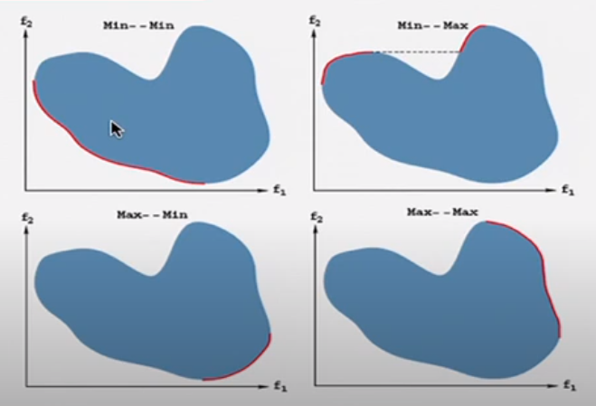

Slide 5
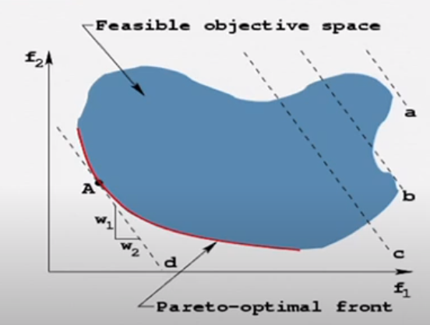
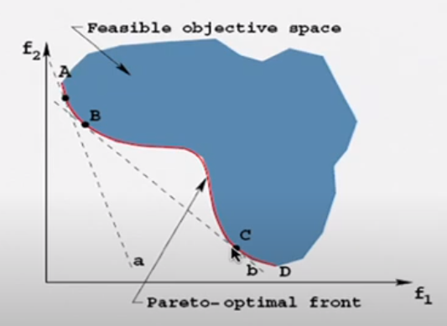

Weighted sum scalarization method
F(x)=$\sum_{i=1}^{M}{w_{i}f_{i}(x)}$
Notes:
Convex 成立只要更換w的比值就可以找到不同的點。pereto optimal front
Not convex就不行 BC段就找不到 所以要用ε
只改變了目標的權重，沒有施加額外的約束，只要能輕鬆解決相應的單目標優化問題，子問題就很容易解決。

Slide 6
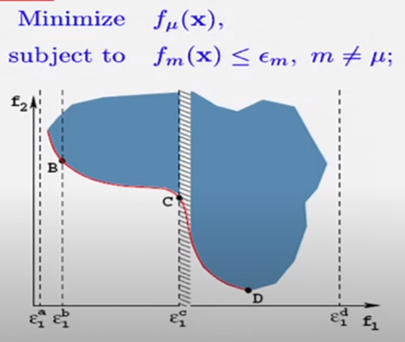

An advanced ε–constraint method
Notes:
由於這兩個目標是相互衝突的，因此沒有同時優化它們的方法。
將雙目標優化問題轉化為單目標問題，並形成所謂的 ε-約束問題。
使一個目標最小化為一個由參數 ε 從上方界定的約束 約束每一個點，我們可以獲得問題的所有帕累托最優點。

Slide 7
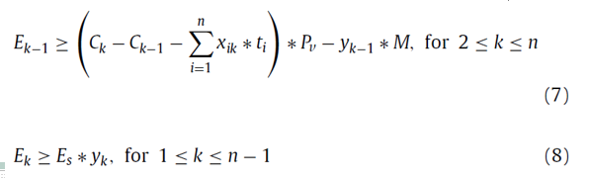
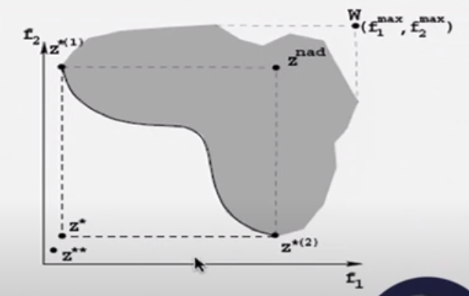
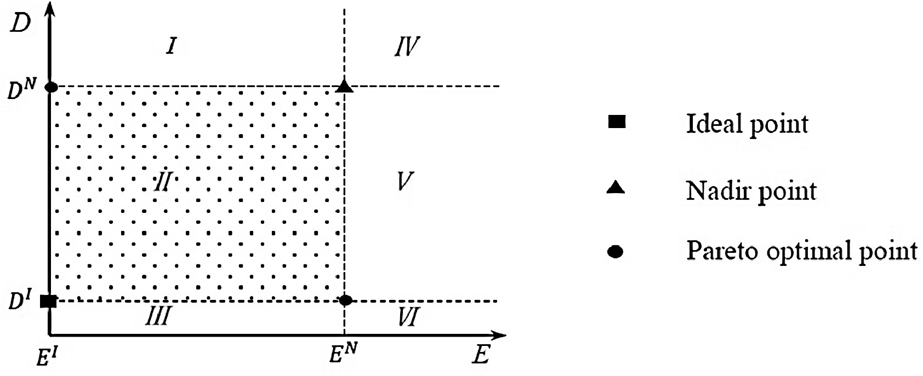
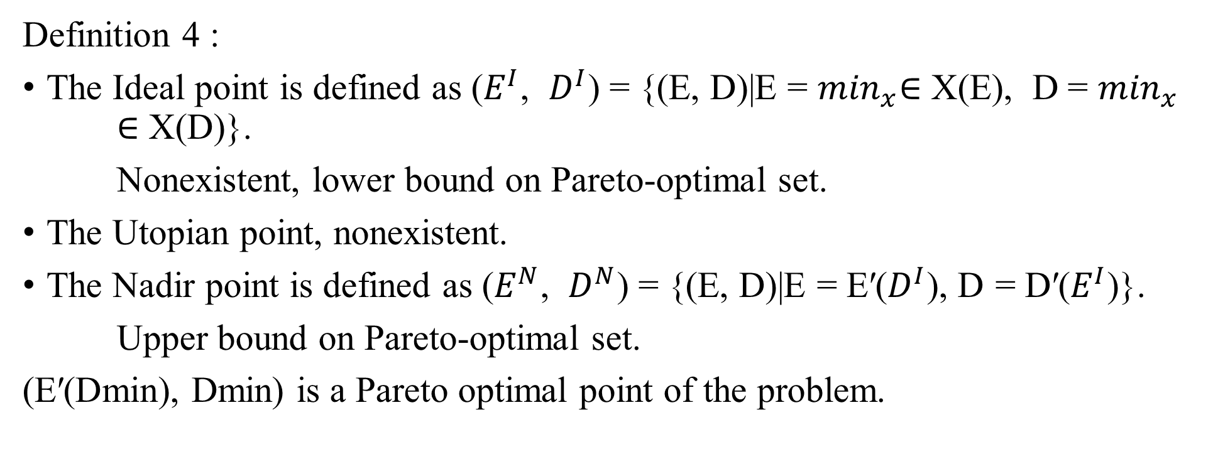
Definition 4 :
The Ideal point is defined as ($E^{I}$, $D^{I}$) = {(E, D)|E = $\min_{x}$∈ X(E), D = $\min_{x}$ ∈ X(D)}.
Nonexistent, lower bound on Pareto-optimal set.
The Utopian point, nonexistent.
The Nadir point is defined as ($E^{N}$, $D^{N}$) = {(E, D)|E = E′($D^{I}$), D = D′($E^{I}$)}.
Upper bound on Pareto-optimal set.
(E′(Dmin), Dmin) is a Pareto optimal point of the problem.
Notes:
更好地固定ε的區間， 段 II 包含所有帕累托最優點。換句話說，這一部分是我們唯一需要考慮的部分。
特定情況（時間表），其中第一個作業在足夠晚的時間處理，以便所有其他作業可以在其前一個作業處理完畢後立即處理，沒有任何延遲。 這樣，機器在整個加工過程中不會閒置或經歷任何關機操作。

Slide 8
8-
讓我們考慮一種特定情況（時間表），其中第一個作業在足夠晚的時間處理，以便所有其他作業可以在其前一個作業處理完畢後立即處理，沒有任何延遲。 這樣，機器在整個加工過程中不會閒置或經歷任何關機操作。 在這種情況下，所有連續作業對（即 E）之間消耗的總能量自然為零。

Slide 9
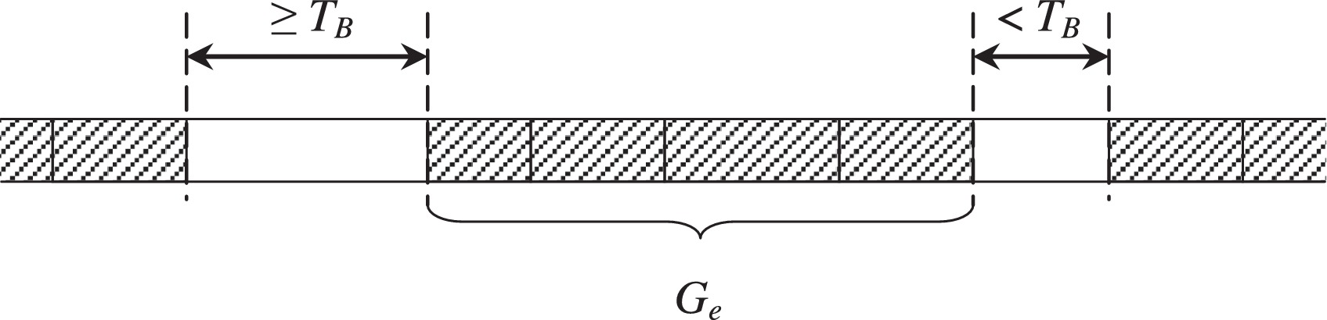
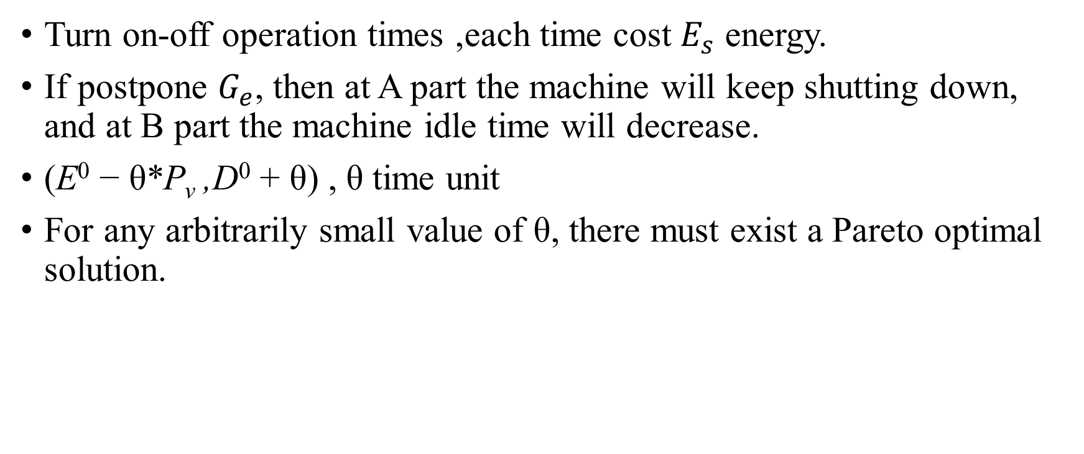
Turn on-off operation
Turn on-off operation times ,each time cost $E_{s}$ energy.
If postpone $G_{e}$, then at A part the machine will keep shutting down, and at B part the machine idle time will decrease.
(E⁰ − θ*P_{v} ,D⁰ + θ) , θ time unit
For any arbitrarily small value of θ, there must exist a Pareto optimal solution.

Slide 10
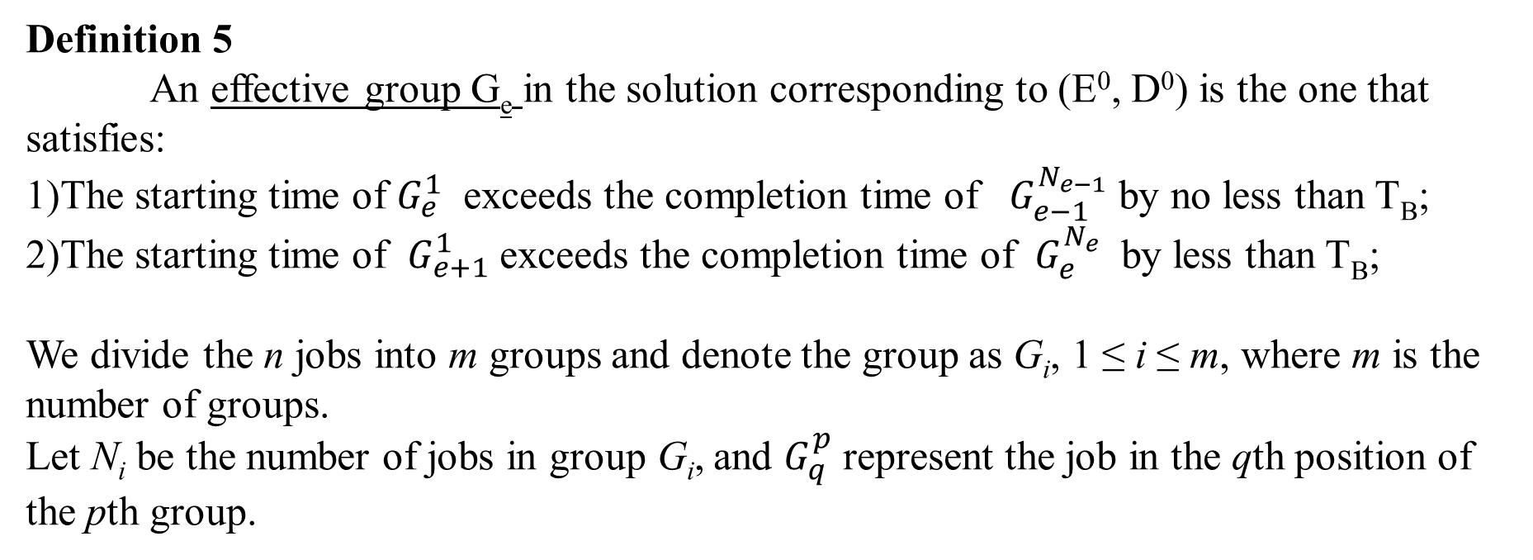
Definition 5
An effective group G_{e} in the solution corresponding to (E⁰, D⁰) is the one that satisfies:
1)The starting time of $G_{e}^{1}$ exceeds the completion time of $G_{e−1}^{N_{e−1}}$ by no less than T_{B};
2)The starting time of $G_{e+1}^{1}$exceeds the completion time of $G_{e}^{N_{e}}$ by less than T_{B};
We divide the n jobs into m groups and denote the group as G_{i}, 1 ≤ i ≤ m, where m is the number of groups.
Let N_{i} be the number of jobs in group G_{i}, and $G_{q}^{p}$ represent the job in the qth position of the pth group.
Notes:
推持有效組中的machine working time 可能會讓總效能降低
前面的>= machine is shut down, 後面< is idle cost E，
有效群，如果它滿足定義 5 的條件 2），我們就認為它是一個有效群。
推遲 有效組中作業的開始時間將導致總能耗降低

Slide 11
Theorem 4
In the solution corresponding to the Pareto optimal point (E⁰, D⁰), there must exist a job with the maximum tardiness D⁰ in any effective group.
Theorem 5
If there exists an effective group in the solution corresponding to (E⁰, D⁰), then for any arbitrarily small value of θ, there must exist a feasible point (E⁰ − θ*P_{v} , D⁰ + θ) that cannot be dominated by (E⁰, D⁰).
Notes:
在帕累托最優點（E0，D0）對應的解中，在任何有效組中都必須存在一個具有最大延遲D0的作業。
則推遲前最大延誤時間為 D0 的作業的延誤時間增加 θ 時間單位

Slide 12
If there exists an effective group in any Pareto optimal point of the problem, then it has infinite number of Pareto optimal points.
We only consider the situation where E and D are restricted to integer values for the following three reasons.
First, we can find all Pareto optimal integer points by decreasing the value of ε by one each time.
Second, such a restriction also allows us to devise and incorporate specific local search algorithms to enhance the basic ε-constraint method.
Third, the difference between an optimal integer value and an optimal real value can be made arbitrarily small by scaling on input data.
Set maximum tardiness as the primary objective and use the ε-constraint to formulate the energy consumption.
Notes:
若存在無限個optimal points，是不可能全部獲得的，所以當限制ED 都為整數時
第三，最佳整數值和最佳實數值之間的差異可以通過對輸入數據進行縮放來任意減小。
我們以最大延遲為主要目標，並使用 ε 約束來製定能耗，因為這樣，稍後將介紹的局部搜索和預處理技術可以更容易應用，

Slide 13
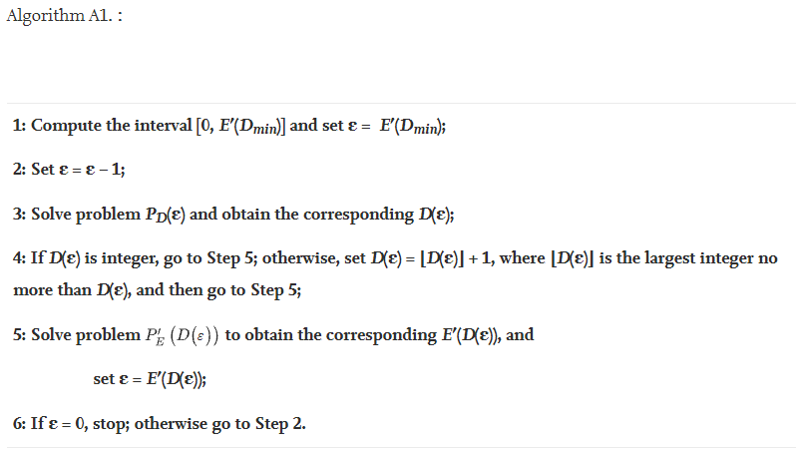
Notes:
A1, we can obtain the exact integer Pareto front of the problem.
精確整數帕累托前沿。但單獨使用它，我們只能解決小規模的問題，其計算效率普遍較低。
考慮到問題的特殊性，我們提出了局部搜索、預處理技術和有效不等式來增強基本的ε - 約束方法，這將顯著提高其速度。

Slide 14
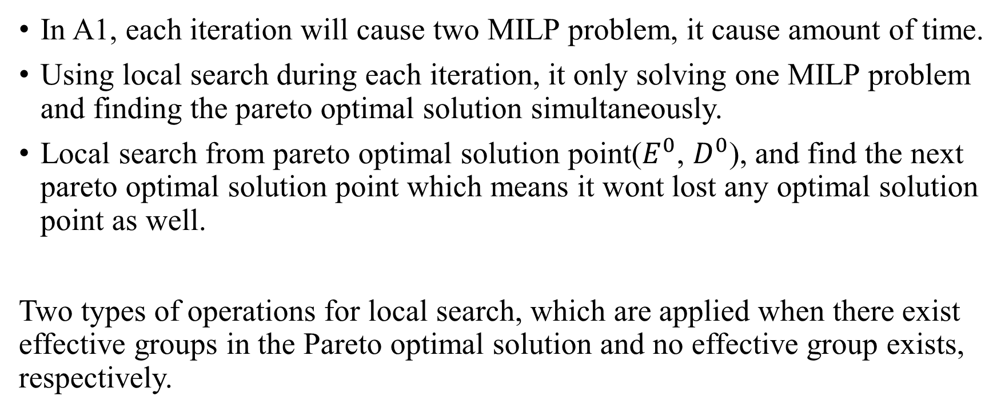
Local search to enhanced ε–constraint method
In A1, each iteration will cause two MILP problem, it cause amount of time.
Using local search during each iteration, it only solving one MILP problem and finding the pareto optimal solution simultaneously.
Local search from pareto optimal solution point($E^{0}$, $D^{0}$), and find the next pareto optimal solution point which means it wont lost any optimal solution point as well.
Two types of operations for local search, which are applied when there exist effective groups in the Pareto optimal solution and no effective group exists, respectively.
Notes:
有效組中所有作業的開始時間推遲一個時間單位。那麼我們就可以得到一個可行解

Slide 15
對於(E0,D0)對應的解中存在有效組的情況，第一種局部搜索是將每個有效組中所有作業的開始時間推遲一個時間單位。那麼我們就可以得到一個可行解，
local search fails when there exists no effective group in the solution.
當解決方案中不存在有效組時，上述本地搜索將失敗。
The next step after postponement is to check the Pareto optimality of the point (E⁰ − k₁*P_{v},D⁰ + 1).

Slide 16
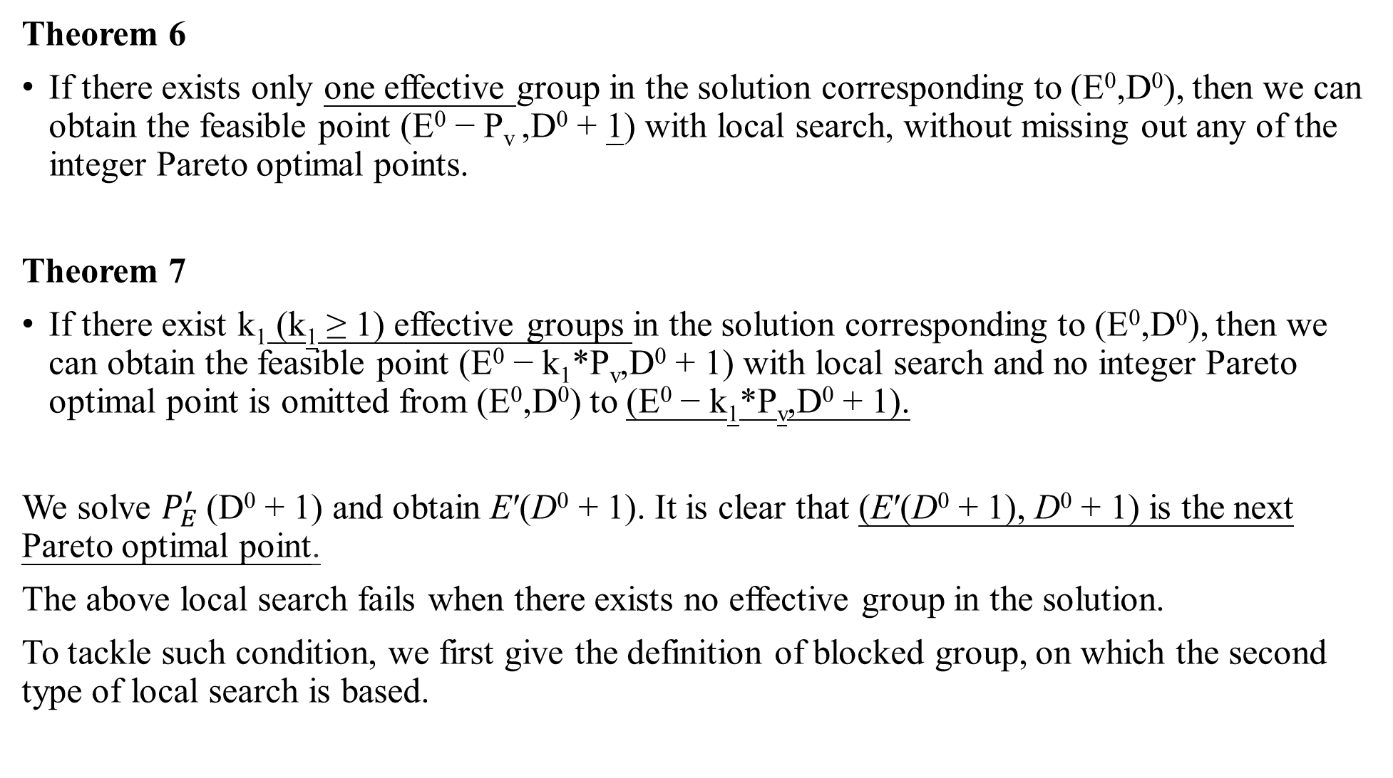
Theorem 6
If there exists only one effective group in the solution corresponding to (E⁰,D⁰), then we can obtain the feasible point (E⁰ − P_{v} ,D⁰ + 1) with local search, without missing out any of the integer Pareto optimal points.
Theorem 7
If there exist k₁ (k₁ ≥ 1) effective groups in the solution corresponding to (E⁰,D⁰), then we can obtain the feasible point (E⁰ − k₁*P_{v},D⁰ + 1) with local search and no integer Pareto optimal point is omitted from (E⁰,D⁰) to (E⁰ − k₁*P_{v},D⁰ + 1).
We solve $P_{E}^{′}$(D⁰ + 1) and obtain E′(D⁰ + 1). It is clear that (E′(D⁰ + 1), D⁰ + 1) is the next Pareto optimal point.
The above local search fails when there exists no effective group in the solution.
To tackle such condition, we first give the definition of blocked group, on which the second type of local search is based.
Notes:
local search fails when there exists no effective group in the solution. 跟定理五很像
第一種局部搜索是將每個有效組中所有作業的開始時間推遲一個時間單位

Slide 17
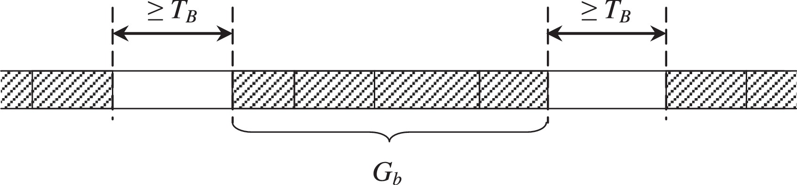
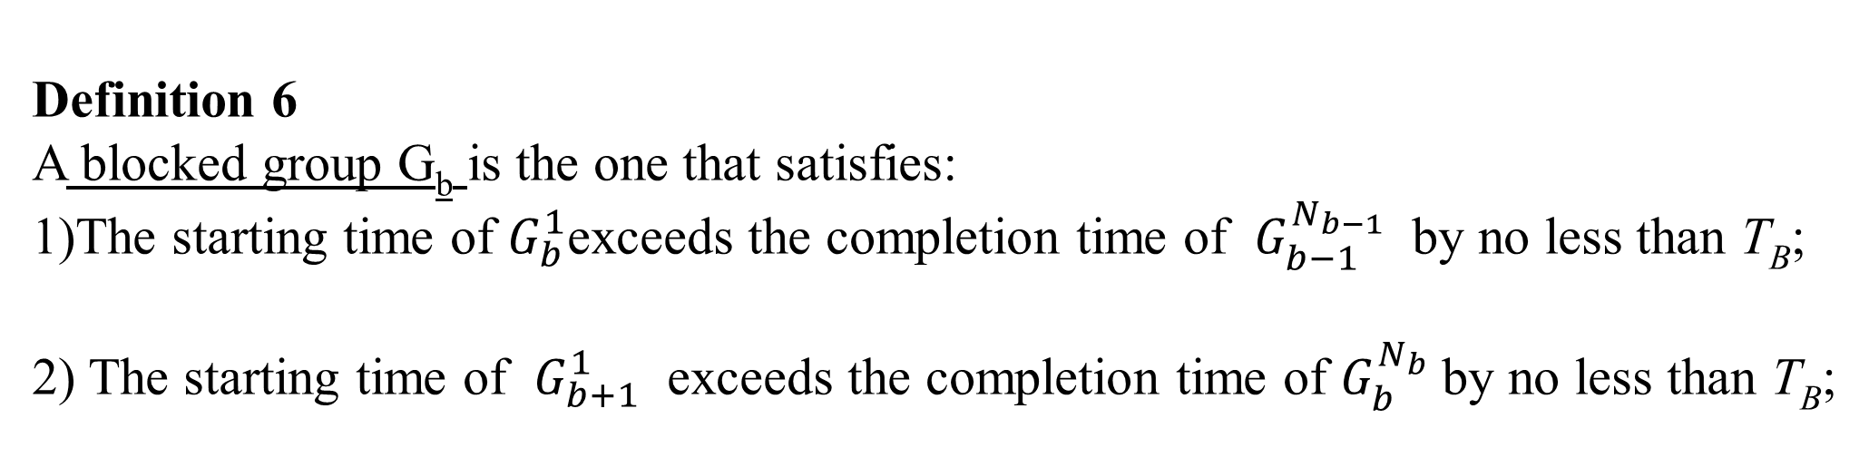
Definition 6
A blocked group G_{b} is the one that satisfies:
1)The starting time of $G_{b}^{1}$exceeds the completion time of $G_{b−1}^{N_{b−1}}$ by no less than T_{B};
2) The starting time of $G_{b+1}^{1}$ exceeds the completion time of $G_{b}^{N_{b}}$by no less than T_{B};
Notes:
在阻塞組之前和之後都執行了關閉-開啟操作
滿足條件2) 可視為blocked group。只有一個group的話 不算effective or blocked 無須local search。在下文中，我們只考慮至少有兩個組的解決方案。

Slide 18
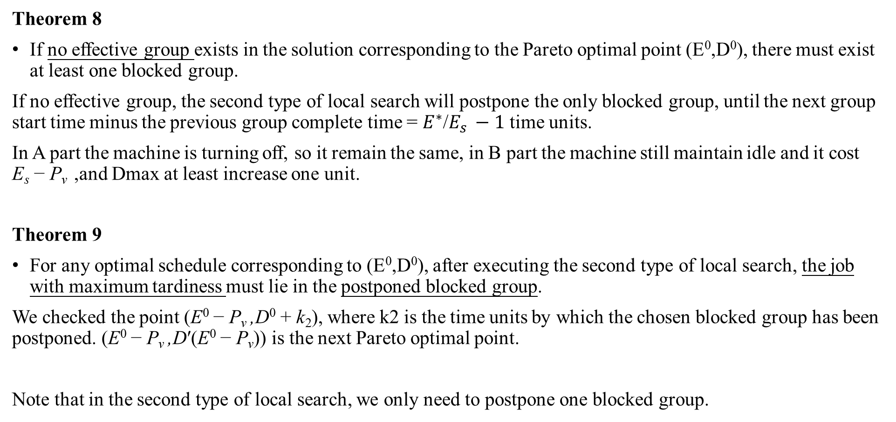
Theorem 8
If no effective group exists in the solution corresponding to the Pareto optimal point (E⁰,D⁰), there must exist at least one blocked group.
If no effective group, the second type of local search will postpone the only blocked group, until the next group start time minus the previous group complete time = $E^{∗}$/$E_{s }−1$ time units.
In A part the machine is turning off, so it remain the same, in B part the machine still maintain idle and it cost E_{s} − P_{v} ,and Dmax at least increase one unit.
Theorem 9
For any optimal schedule corresponding to (E⁰,D⁰), after executing the second type of local search, the job with maximum tardiness must lie in the postponed blocked group.
We checked the point (E⁰ − P_{v} ,D⁰ + k₂), where k2 is the time units by which the chosen blocked group has been postponed. (E⁰ − P_{v} ,D′(E⁰ − P_{v})) is the next Pareto optimal point.
Note that in the second type of local search, we only need to postpone one blocked group.

Slide 19
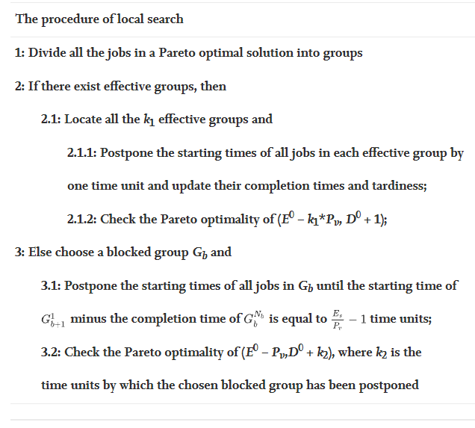

Slide 20
Dynamic preprocessing technique and valid inequalities
In MILP model the numbers of binary variable will affect the computation time, so why don’t we predetermine the value of some binary variables.
Theorem 10
Given maximum tardiness D*, for any pair of jobs i and j, if r_{i} ≥ d_{j} + D* − t_{j} holds, then job i must be processed after job j.
When the D* value is smaller, each time minus D* little by little, the more formulations will accelerate the algorithm and then preprocessing can be the most powerful
Postponing different blocked groups brings about different values of maximum tardiness.
Notes:
D* 和 E* 會隨著迭代的進行而動態變化，
yk 表示在第 k 個作業和第 (k + 1) 個作業之間是否應該存在關閉-開啟操作

Slide 21
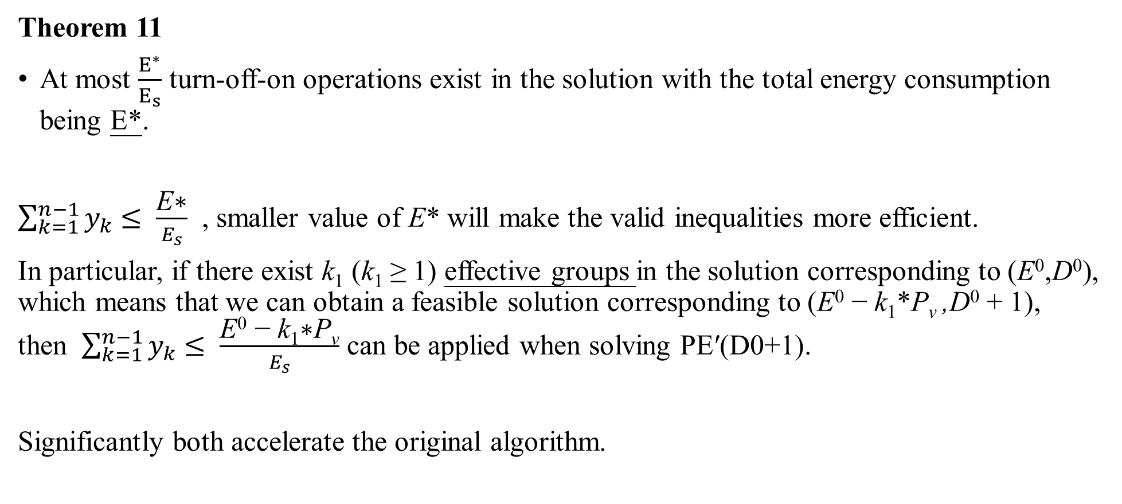
Theorem 11
At most $\frac{E^{∗}}{E_{s}}$ turn-off-on operations exist in the solution with the total energy consumption being E*.
$\sum_{k=1}^{n−1}{y_{k}}$ $≤ \frac{\text{E}\text{∗}}{E_{s}}$ , smaller value of E* will make the valid inequalities more efficient.
In particular, if there exist k₁ (k₁ ≥ 1) effective groups in the solution corresponding to (E⁰,D⁰), which means that we can obtain a feasible solution corresponding to (E⁰ − k₁*P_{v} ,D⁰ + 1), then $\sum_{k=1}^{n−1}{y_{k}}$ $≤ \frac{\text{E}\text{0}\text{ − }\text{k}\text{1}\text{∗}\text{P}\text{v}}{E_{s}}$ can be applied when solving PE′(D0+1).
Significantly both accelerate the original algorithm.

Slide 22
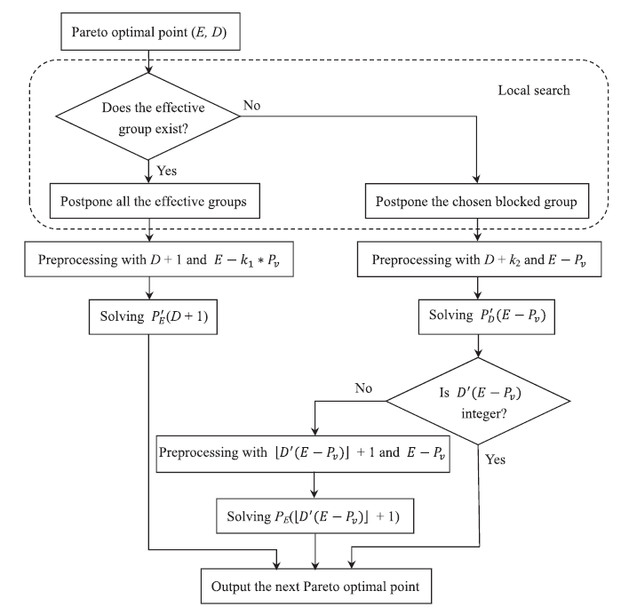
Notes:
請注意，k1 表示對應於 (E, D) 的解中有效組的數量，而 k2 是所選阻塞組被推遲的時間單位。

Slide 23
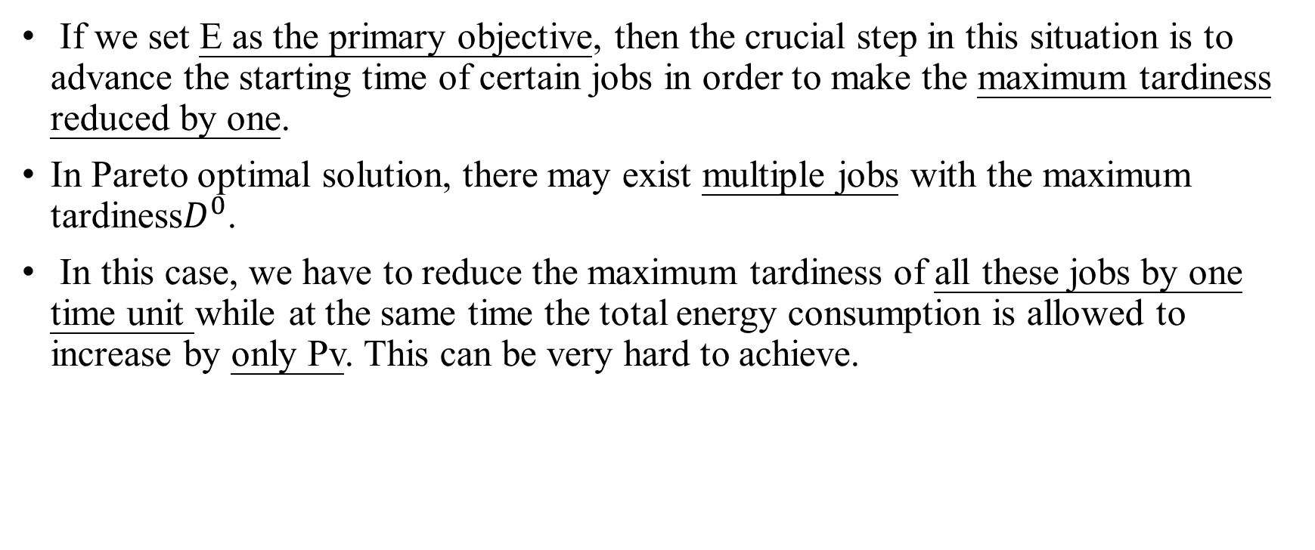
Why we choose the maximum tardiness as the primary objective function?
If we set E as the primary objective, then the crucial step in this situation is to advance the starting time of certain jobs in order to make the maximum tardiness reduced by one.
In Pareto optimal solution, there may exist multiple jobs with the maximum tardiness$D^{0}$.
In this case, we have to reduce the maximum tardiness of all these jobs by one time unit while at the same time the total energy consumption is allowed to increase by only Pv. This can be very hard to achieve.

Slide 24
Why we choose the maximum tardiness as the primary objective function?
From the perspective of preprocessing, it is based on a known maximum tardiness, which means if we have no idea of the value of D before solving PD(E), preprocessing cannot be applied.

Slide 25
在局部搜索方面，如果我們以E為首要目標，那麼在這種情況下，關鍵的一步就是提前某些作業的開始時間，使最大延遲減少1。
問題在於，在帕累托最優解中，可能存在多個具有最大延遲 D0 的作業。在這種情況下，我們必須將所有這些作業的最大延遲減少一個時間單位，同時總能耗只允許增加 Pv。這可能很難實現。從預處理的角度來看，如前所述，它基於已知的最大延遲，這意味著如果我們在求解 PD(E) 之前不知道 D 的值，則無法應用預處理。
就ε-約束法而言，第一步是計算次要目標的有效區間。如果我們將 E 作為主要目標，那麼我們必須計算 D 的有效區間（即 [Dmin,D'(Emin)]），其中不能應用預處理。但是，如果我們以D為主要目標，我們可以利用預處理來計算E的有效區間，這可能會在一定程度上加速算法。

Slide 26
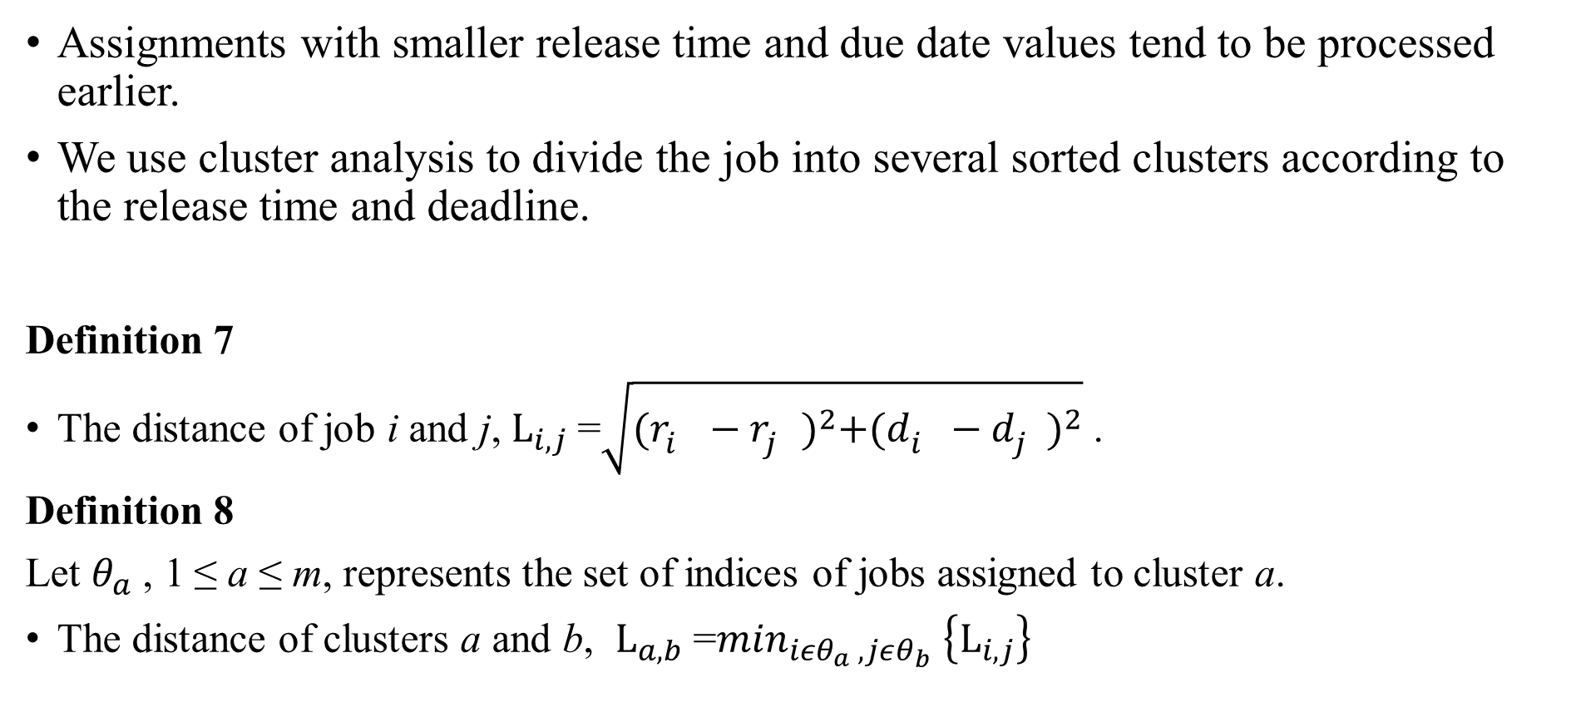
Clustering of jobs to obtain approximate Pareto front
Assignments with smaller release time and due date values tend to be processed earlier.
We use cluster analysis to divide the job into several sorted clusters according to the release time and deadline.
Definition 7
The distance of job i and j, $L_{i,j}$=$\sqrt{{(r_{i}^{}−r_{j}^{})}^{2}+{(d_{i}^{}−d_{j}^{})}^{2}}$ .
Definition 8
Let $θ_{a}$, 1 ≤ a ≤ m, represents the set of indices of jobs assigned to cluster a.
The distance of clusters a and b, $L_{a,b}$=$\min_{iεθ_{a} , jεθ_{b}} \left\{L_{i,j}\right\}$
Notes:
生成的集群總數需要預先確定。在每次迭代中，距離最短的兩個簇合併為一個，直到簇數等於 m。

Slide 27
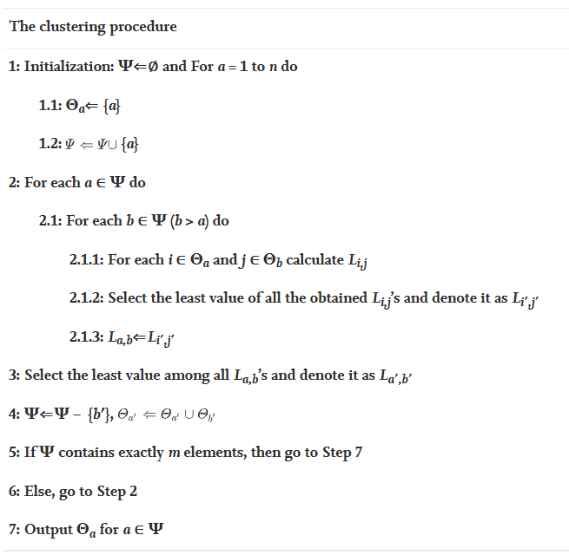
Notes:
在每次迭代中，距離最短的兩個簇合併為一個，直到簇數等於 m。

Slide 28
Why the above clustering procedure is able to accelerate the proposed approach?
We assume that the sth cluster contains N_{s} jobs, 1 ≤ s ≤ m.
Since the processing sequence of clusters is fixed, all jobs in cluster s must be processed before those in cluster s + 1 for any 1 ≤ s ≤ m-1.
After examining all the jobs, the values of considerable quantity of binary variables can be fixed, which significantly reduces the computational time for the algorithm to solve the problem.
Note that with less number of clusters, we will fix the values of less binary variables, which leads to more precise Pareto front while consuming more computational time.
Notes:
請注意，使用較少的集群數量，我們將修復較少的二元變量的值，這會導致更精確的帕累托前沿，同時消耗更多的計算時間。

Slide 29
Experiments
C++ solved by the MIP solver of CPLEX (Version 12.5). The experiments are performed on a HP PC with an Intel Core i5-2400 CPU operating at 3.10 GHz.

Slide 30
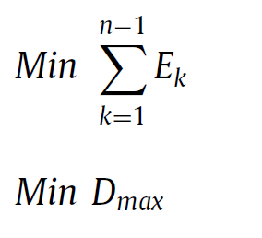
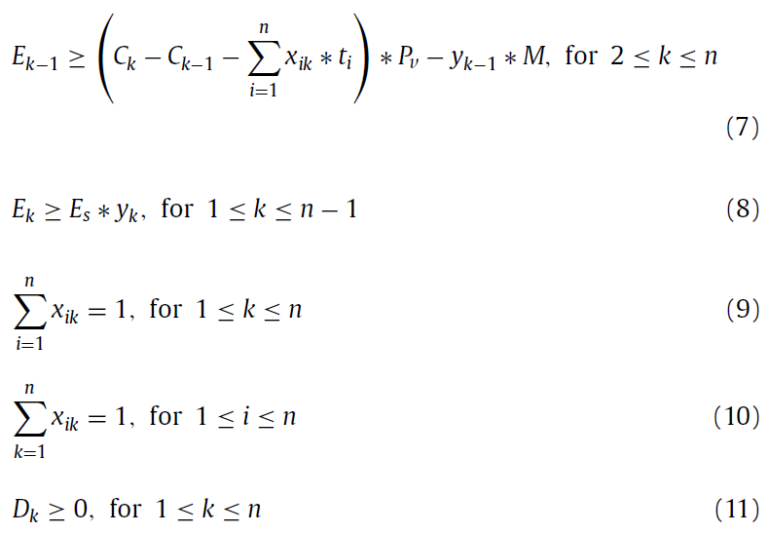
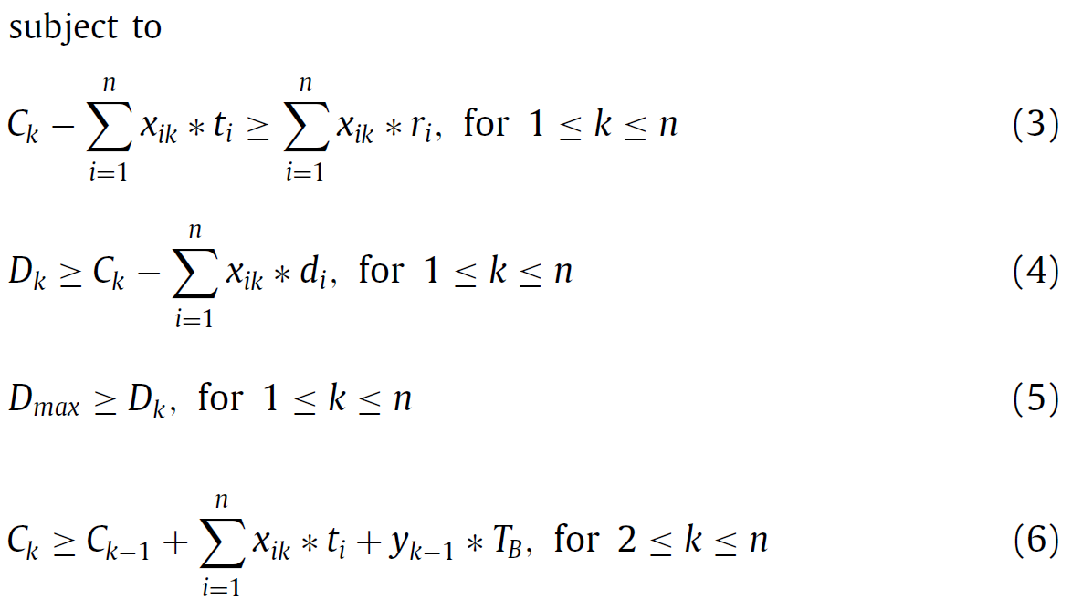

Slide 31
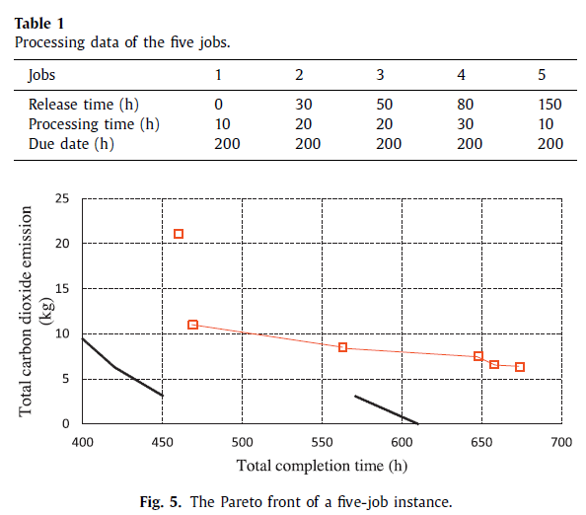
Benchmark instances
Their aim is to minimize the total carbon dioxide emission and the total completion time simultaneously.
The machine consumes 0.4 kw when it is idle and 3 kw when working.
Each turn-off-on operation takes 12 h and requires 4 kwh of electricity.
Liu et al.(2014)
Author’s

Slide 32
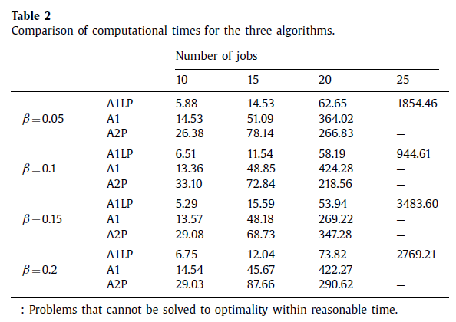
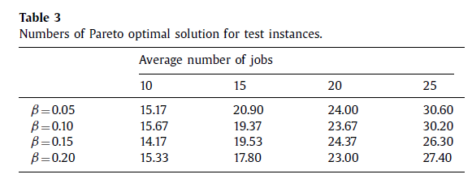

Slide 33
Randomly generated instance
1. The processing time of each job follows a uniform distribution between 1 and 5 time units.
2. The release time of each job follows an exponential distribution with a mean of 10 time units.
3. The due date of each job is the sum of three parts: its release time, processing time and a slack time
4. The parameter β reflects the degree of how far the due date deviates from the release time. As the value of β increases, the due dates become more spread over time.
Notes:
最多 25 個作業的問題可以在合理的時間內得到最佳解決。

Slide 34
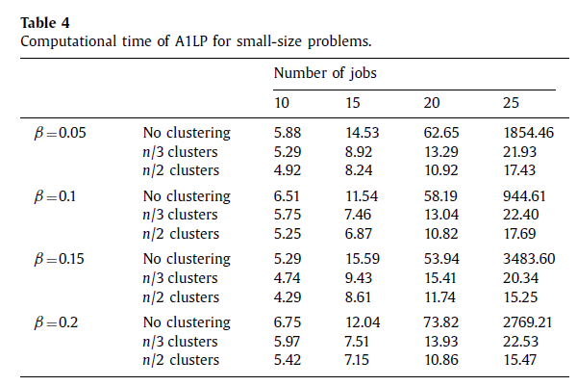
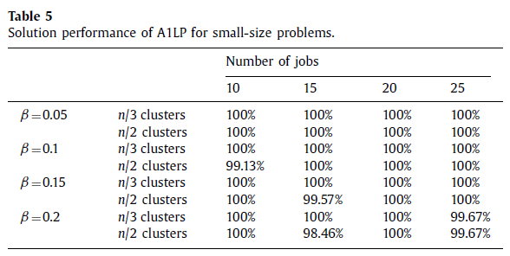
Notes:
它的解決方案性能幾乎不受作業聚類的影響。然而，在聚類過程的幫助下，我們的算法得到了極大的加速。

Slide 35
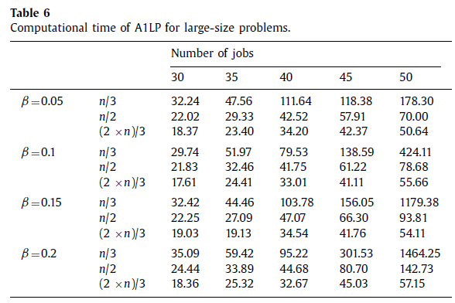
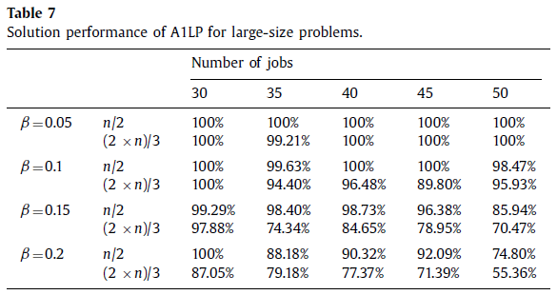

Slide 36
Conclusion
Author proposed a basic ε − constraint method and developed local search, preprocessing technique and valid inequalities to enhance the proposed model.
In its practical significance, the proposed model and methods provide production managers with a decision support tool to make reasonable trade-offs between energy consumption and maximum tardiness in production scheduling.
Notes:
掉電機制的單機調度問題

Slide 37
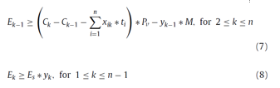
Dmin is the lower bound of the maximum tardiness for this problem.

Slide 38

The lower bound of E (i.e. E^{I}) is zero.
The lower bound of E can be obtained by solving the MILP model without constraint (5) to minimize E.
Notes:
E 代表閒置機器和所有關機操作所消耗的總能量 所以最差情況下lower bound為0

Slide 39
