Slide 1
A survey on tree edit distance and related problems
Philip Bille, IT University of Copenhagen
Theoretical Computer Science, vol 337, Issues 1-3, pp. 217-239, June 9, 2005
Presenter: Syuan-Chung Chiou
Date:2016/1/5

Slide 2
Abstract
We survey the problem of comparing labeled trees based on simple local operations of deleting, inserting and relabeling nodes. These operations lead to the tree edit distance, alignment distance and inclusion problem. For each problem we review the results available and present, in detail, one or more of the central algorithms for solving the problem.

Slide 3
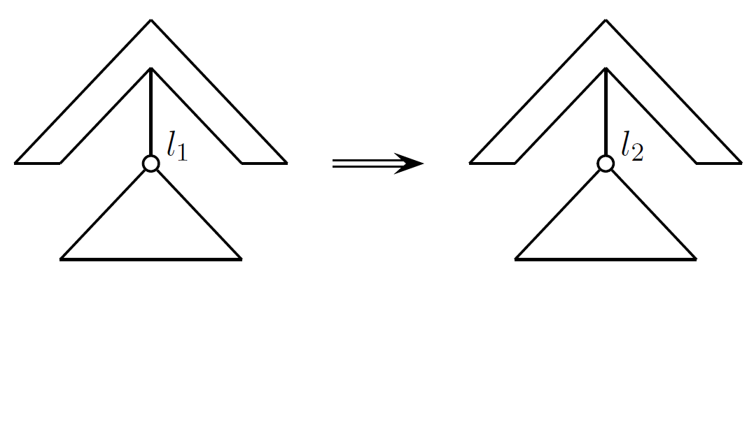
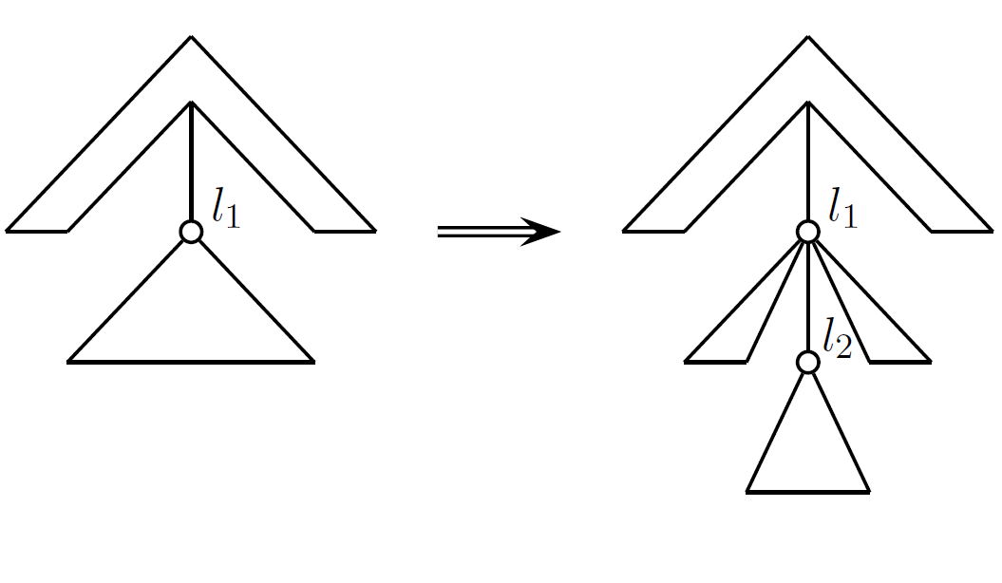
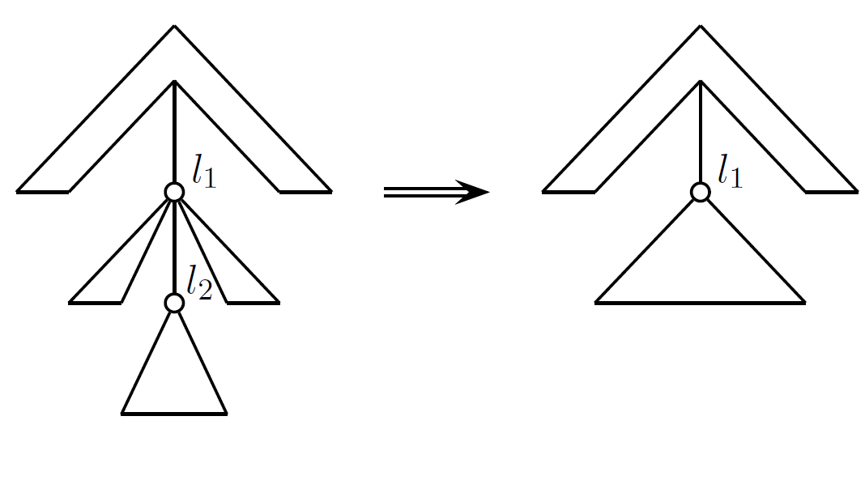
Introduction
Relabel insert
delete

Slide 4
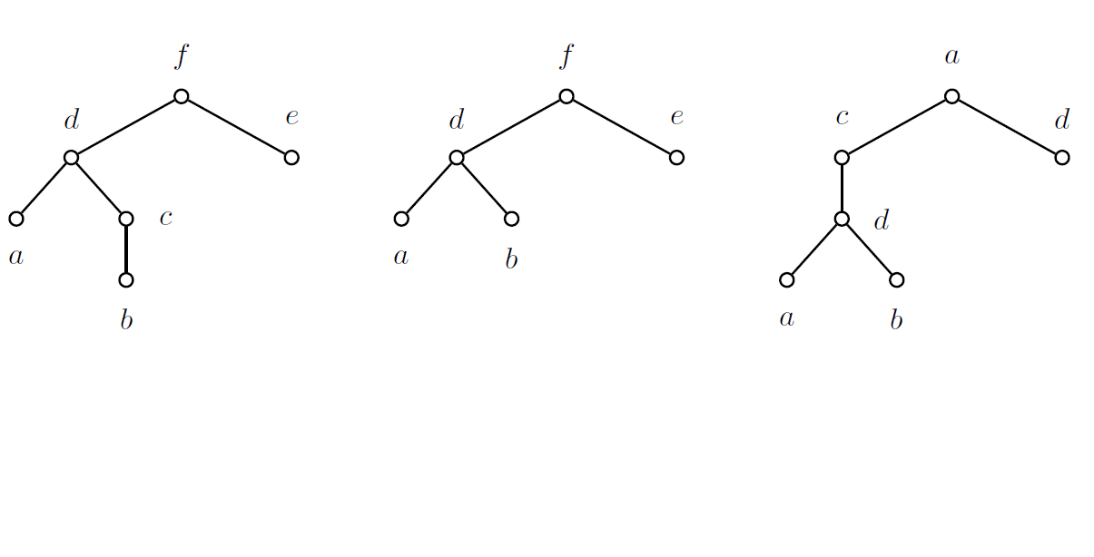
Tree Edit Distance

Slide 5

Edit operations and edit mappings
We represent each edit operation by $(l_{1}→l_{2})$.
Relabel $\left(l_{1}→l_{2}\right) l_{1},l_{2}≠λ$
Delete $\left(l_{1}→λ\right)$
Insert $\left(λ→l_{2}\right)$

Slide 6

Edit operations and edit mappings
For any pair $\left(v_{1},w_{1}\right),(v_{2},w_{2})∈M$
$v_{1}=v_{2}$ iff $w_{1}=w_{2}$.
$v_{1}$ is an ancestor of $v_{2}$ iff $w_{1}$ is an ancestor of $w_{2}$.
$v_{1}$ is to the left of $v_{2}$ iff $w_{1}$ is to the left of $w_{2}$.

Slide 7
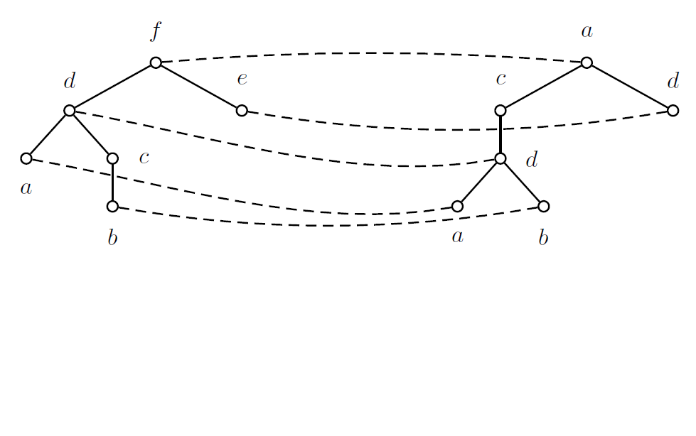

Edit operations and edit mappings
$$γ\left(M\right)=\sum_{(v,w)∈M}{γ(v→w)}+\sum_{v∈N_{1}}{γ(v→λ)}+\sum_{w∈N_{2}}{γ(λ→w)}$$

Slide 8
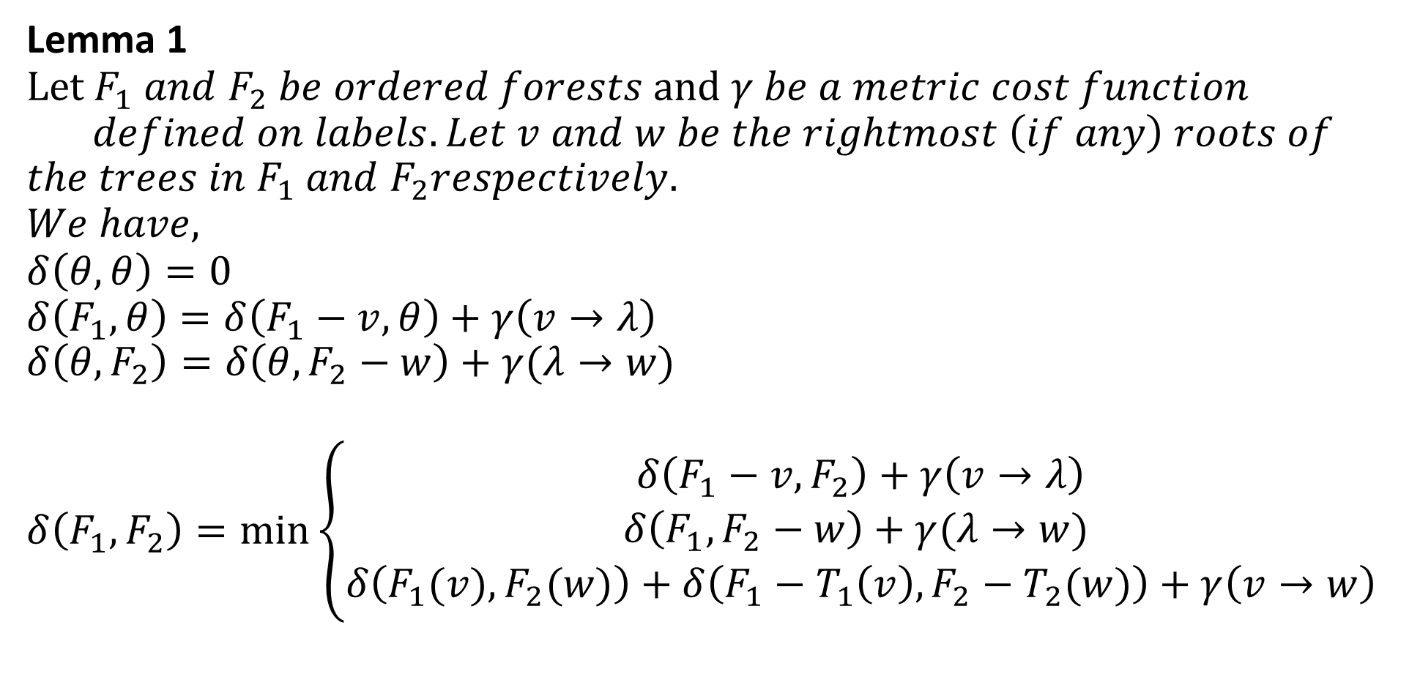
A simple algorithm
Lemma 1 $Let F_{1} and F_{2} be ordered forests and γ be a metric cost function$
$$defined on labels.Let v and w be the rightmost \left(if any\right) roots of$$
$$the trees in F_{1} and F_{2}respectively.$$
$$We have,$$
$$δ\left(θ,θ\right)=0$$
$$δ\left(F_{1},θ\right)=δ\left(F_{1}−v,θ\right)+γ\left(v→λ\right)$$
$$δ\left({θ,F}_{2}\right)=δ\left(θ,F_{2}−w\right)+γ(λ→w)$$
$$δ\left(F_{1},F_{2}\right)=\min_{}\left\{\begin{matrix}δ\left(F_{1}−v,F_{2}\right)+γ\left(v→λ\right) \\ δ\left(F_{1},F_{2}−w\right)+γ(λ→w) \\ δ\left(F_{1}(v),F_{2}(w)\right)+δ\left(F_{1}−T_{1}\left(v\right),F_{2}−T_{2}(w)\right)+γ\left(v→w\right)\end{matrix}\right.$$

Slide 9
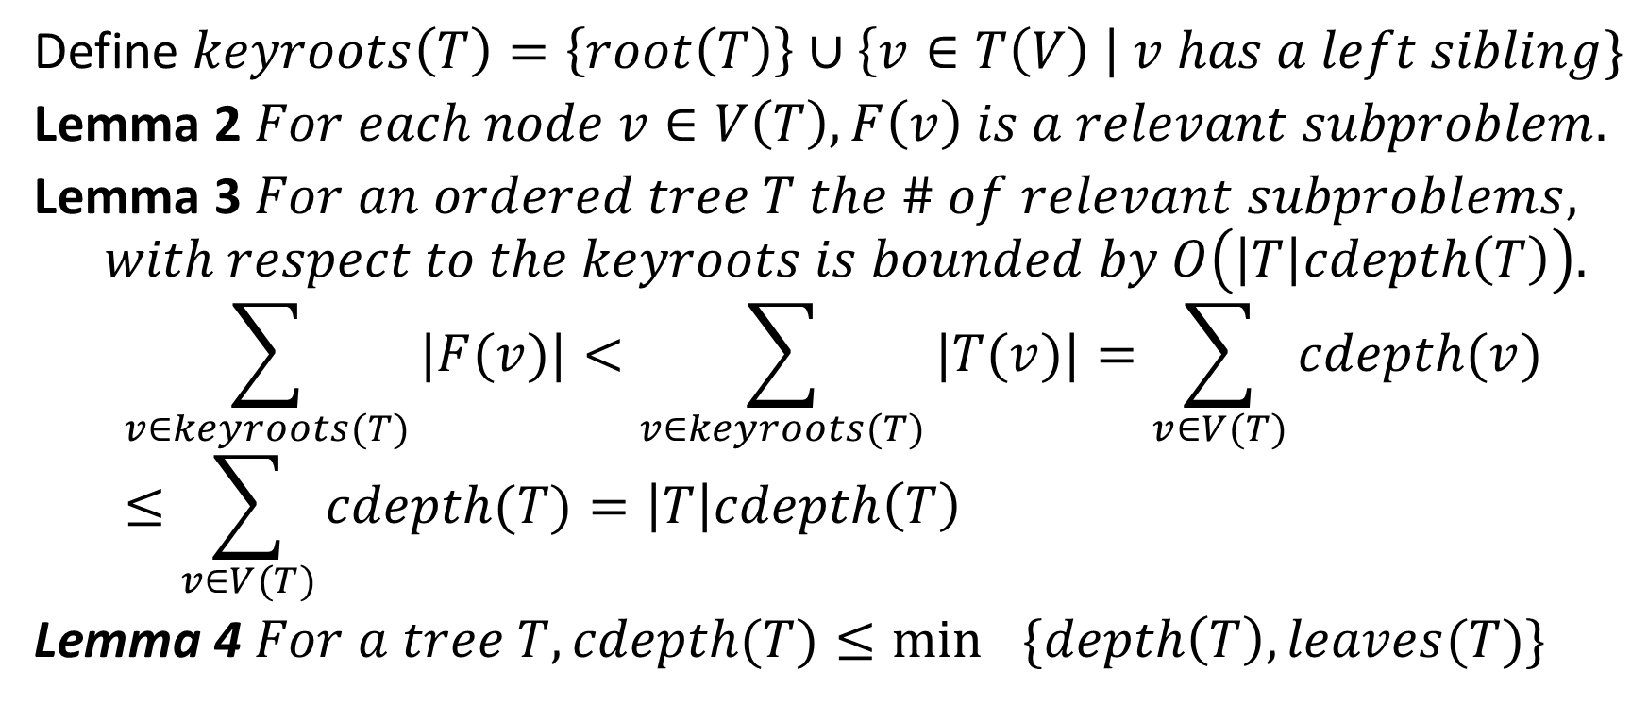
Zhang and Shasha’s algorithm
Define $keyroots\left(T\right)=\left\{root\left(T\right)\right\}∪\left\{v∈T\left(V\right) \right| v has a left sibling\}$
Lemma 2 $For each node v∈V\left(T\right),F\left(v\right) is a relevant subproblem.$
Lemma 3 $For an ordered tree T the \# of relevant subproblems,$
$$with respect to the keyroots is bounded by O\left(\left|T\right|cdepth\left(T\right)\right).$$
$$\sum_{v∈keyroots(T)}{|F(v)|}<\sum_{v∈keyroots(T)}{|T(v)|}=\sum_{v∈V(T)}{cdepth(v)}≤\sum_{v∈V(T)}{cdepth(T)}=\left|T\right|cdepth\left(T\right)$$
Lemma 4 $For a tree T, cdepth(T)≤\min_{}{\{depth\left(T\right),leaves(T)\}}$

Slide 10
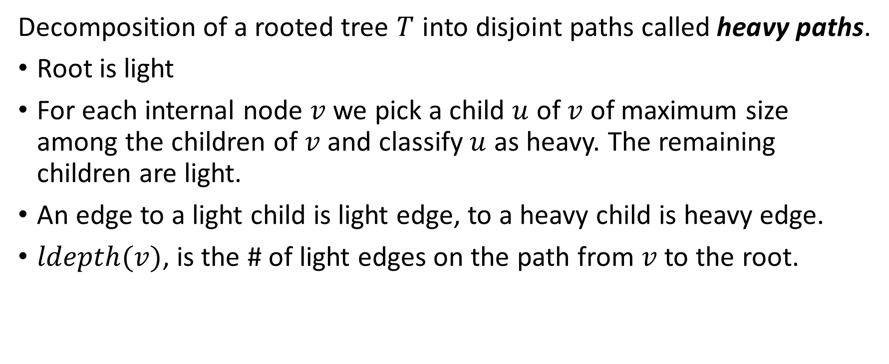
Klein’s algorithm
Decomposition of a rooted tree $T$ into disjoint paths called heavy paths.
Root is light
For each internal node $v$ we pick a child $u$ of $v$ of maximum size among the children of $v$ and classify $u$ as heavy. The remaining children are light.
An edge to a light child is light edge, to a heavy child is heavy edge.
$ldepth(v)$, is the # of light edges on the path from $v$ to the root.

Slide 11

Klein’s algorithm
Lemma 5 $For any tree T and v∈V\left(T\right),ldepth\left(v\right)≤\log\left|T\right|+O\left(1\right).$
Lemma 6 $For an ordered tree T the \# of relevant subproblems$
$$with respect to the light nodes is bounded by O\left(\left|T\right|ldepth\left(T\right)\right).$$

Slide 12
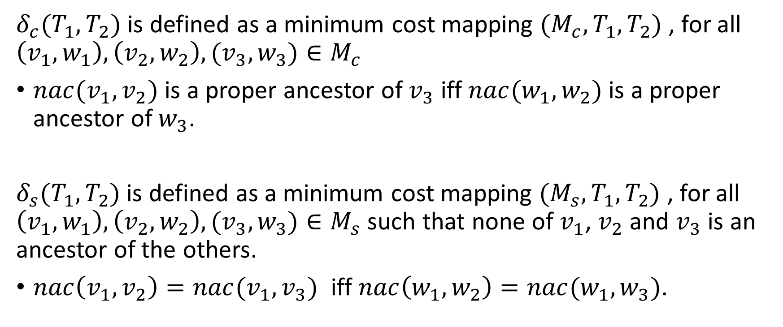
Constrained edit distance
$δ_{c}(T_{1},T_{2})$ is defined as a minimum cost mapping $(M_{c},T_{1},T_{2})$ , for all $\left(v_{1},w_{1}\right),\left(v_{2},w_{2}\right),(v_{3},w_{3})∈M_{c}$
$nac(v_{1},v_{2})$ is a proper ancestor of $v_{3}$ iff $nac(w_{1},w_{2})$ is a proper ancestor of $w_{3}$.
$δ_{s}(T_{1},T_{2})$ is defined as a minimum cost mapping $(M_{s},T_{1},T_{2})$ , for all $\left(v_{1},w_{1}\right),\left(v_{2},w_{2}\right),(v_{3},w_{3})∈M_{s}$ such that none of $v_{1}$, $v_{2}$ and $v_{3}$ is an ancestor of the others.
$nac\left(v_{1},v_{2}\right)=nac(v_{1},v_{3})$ iff $nac\left(w_{1},w_{2}\right)=nac(w_{1},w_{3})$.

Slide 13
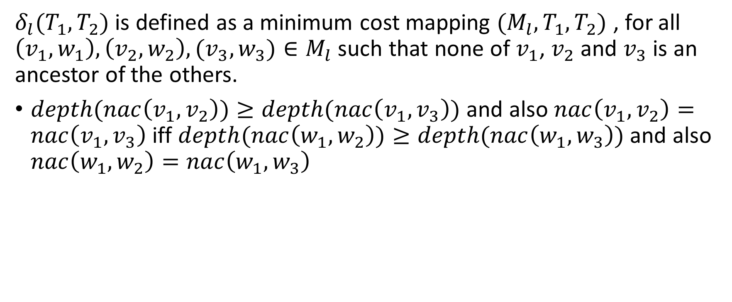
Constrained edit distance
$δ_{l}(T_{1},T_{2})$ is defined as a minimum cost mapping $(M_{l},T_{1},T_{2})$ , for all $\left(v_{1},w_{1}\right),\left(v_{2},w_{2}\right),(v_{3},w_{3})∈M_{l}$ such that none of $v_{1}$, $v_{2}$ and $v_{3}$ is an ancestor of the others.
$depth(nac\left(v_{1},v_{2}\right))≥depth(nac\left(v_{1},v_{3}\right))$ and also $nac\left(v_{1},v_{2}\right)=nac\left(v_{1},v_{3}\right)$ iff $depth(nac\left(w_{1},w_{2}\right))≥depth(nac\left(w_{1},w_{3}\right))$ and also $nac\left(w_{1},w_{2}\right)=nac\left(w_{1},w_{3}\right)$

Slide 14
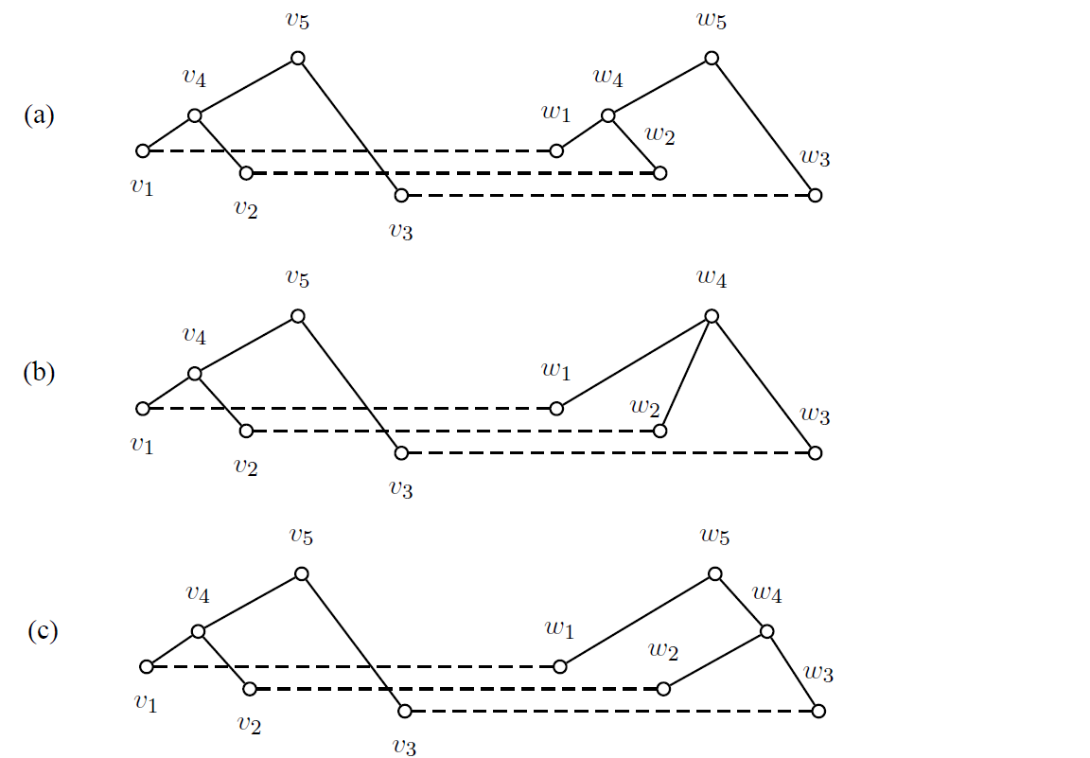
Constrained edit distance

Slide 15
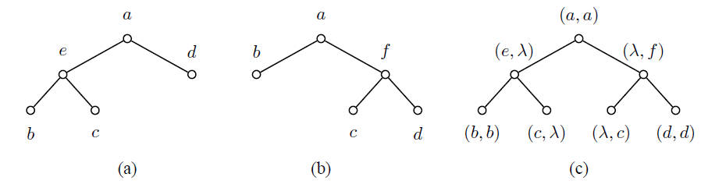
Tree Alignment Distance

Slide 16
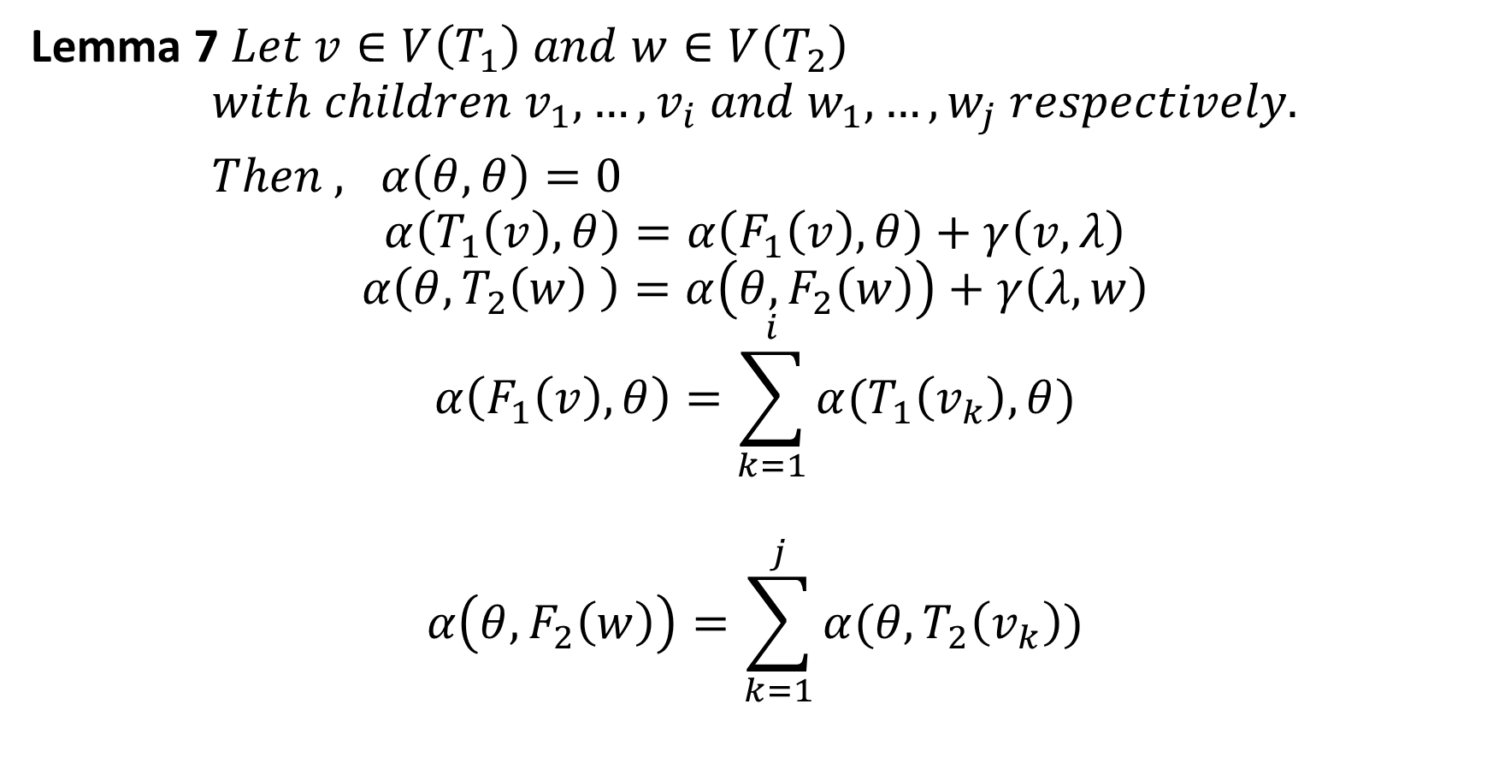
Tree Alignment Distance
Lemma 7 $Let v∈V\left(T_{1}\right) and w∈V\left(T_{2}\right)$
$$with children v_{1},…,v_{i} and w_{1},…,w_{j} respectively.$$
$Then , α\left(θ,θ\right)=0$
$$α\left(T_{1}\left(v\right),θ\right)=α\left(F_{1}\left(v\right),θ\right)+γ\left(v,λ\right)$$
$$α\left(θ,T_{2}\left(w\right) \right)=α\left(θ,F_{2}\left(w\right)\right)+γ\left(λ,w\right)$$
$$α\left(F_{1}\left(v\right),θ\right)=\sum_{k=1}^{i}{α(T_{1}\left(v_{k}\right),θ)}$$
$$α\left(θ,F_{2}\left(w\right)\right)=\sum_{k=1}^{j}{α(θ,T_{2}\left(v_{k}\right))}$$

Slide 17
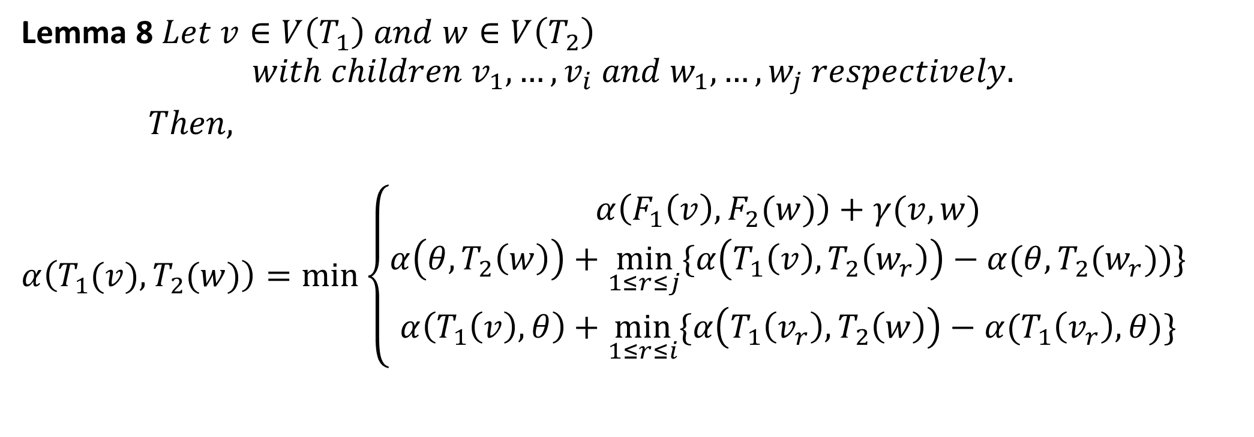
Tree Alignment Distance
Lemma 8 $Let v∈V\left(T_{1}\right) and w∈V\left(T_{2}\right)$
$$with children v_{1},…,v_{i} and w_{1},…,w_{j} respectively.$$
$Then,$
$$α\left(T_{1}(v),T_{2}(w)\right)=\min_{}\left\{\begin{aligned}α\left(F_{1}\left(v\right),F_{2}(w)\right)+γ(v,w) \\ α\left(θ,T_{2}\left(w\right)\right)+\min_{1≤r≤j}{\{α\left(T_{1}\left(v\right),T_{2}\left(w_{r}\right)\right)−α(θ,T_{2}(w_{r}))\}} \\ α\left(T_{1}\left(v\right),θ\right)+\min_{1≤r≤i}{\{α\left(T_{1}\left(v_{r}\right),T_{2}\left(w\right)\right)−α(T_{1}\left(v_{r}\right),θ)\}}\end{aligned}\right.$$

Slide 18
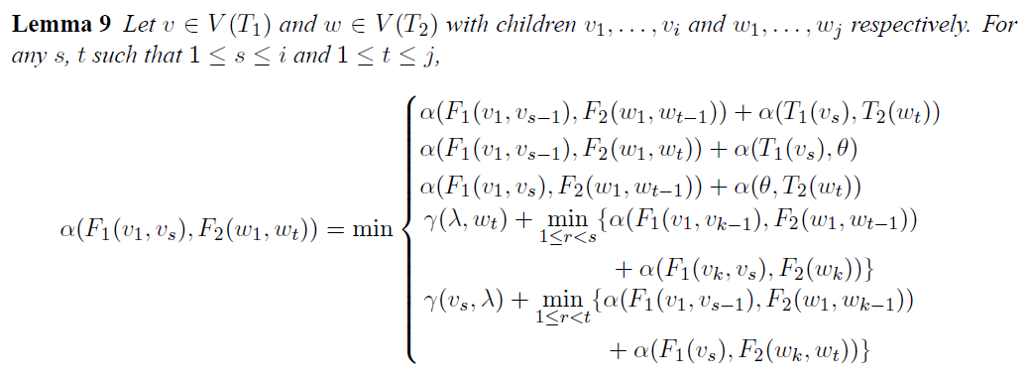
Tree Alignment Distance

Slide 19
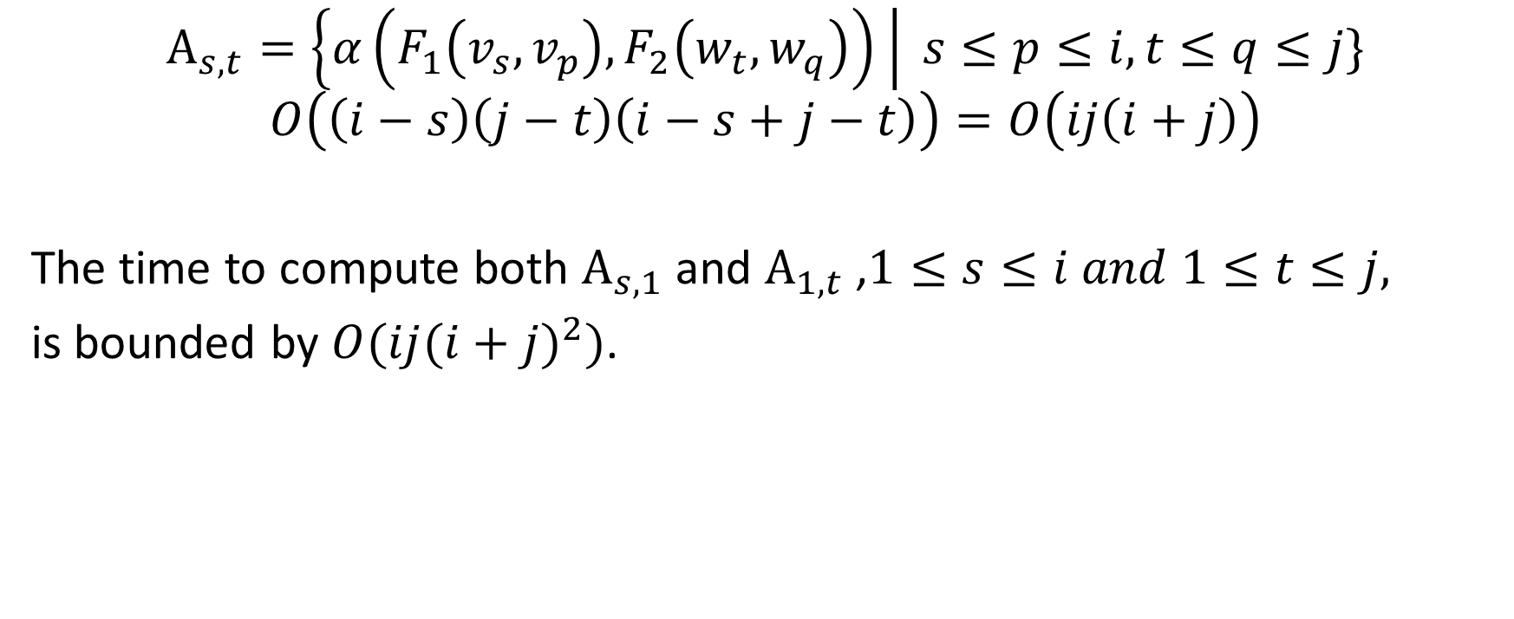
Tree Alignment Distance
$$A_{s,t}=\left\{α\left(F_{1}\left(v_{s},v_{p}\right),F_{2}\left(w_{t},w_{q}\right)\right) \right| s≤p≤i, t≤q≤j\}$$
$$O\left(\left(i−s\right)\left(j−t\right)\left(i−s+j−t\right)\right)=O\left(ij\left(i+j\right)\right)$$
The time to compute both $A_{s,1}$ and $A_{1,t}$ ,$1≤s≤i and 1≤t≤j,$
is bounded by $O(ij{(i+j)}^{2})$.

Slide 20
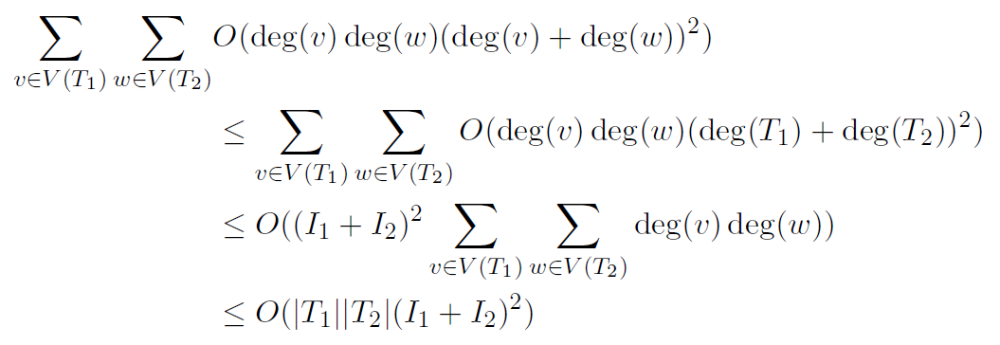
Tree Alignment Distance

Slide 21
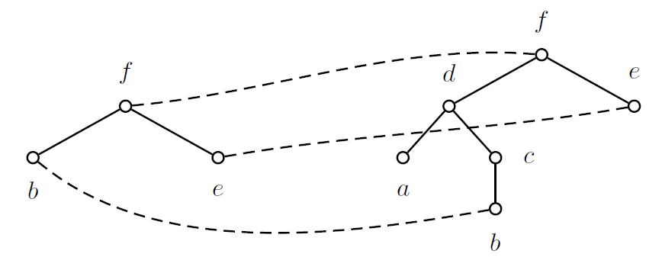

Tree Inclusion
Define an $ordered embedding (f,T_{1},T_{2})$ as an infective function
$f :V(T_{1})→V\left(T_{2}\right)$ such that for all nodes $u,v∈V\left(T_{1}\right),$
$label\left(v\right)=label\left(f\left(v\right)\right).$
$v$ is an ancestor of $u$ iff $f(v)$ is an ancestor of $f(u)$.
$v$ is to the left of $u$ iff $f(v)$ is to the left of $f(u)$.

Slide 22
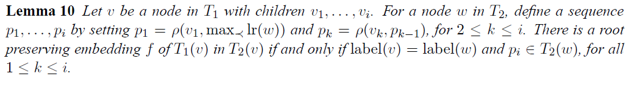

Kilpelӓinen and Mannila’s algorithm
$$ρ\left(v,w\right)=\min_{≺}{\{\left\{w^{′}∈rr\left(w\right)\right|∃f∈R(T_{1}(v),T_{2}(w′))\}⋃\{⊺\}\}}$$

Slide 23
