Slide 1
The Longest Common Subsequence Problem for Small Alphabet Size Between Many Strings
Algorithms and Computation
Volume 650 of the series Lecture Notes in Computer Science
pp.469-478 June 2005
Koji Hakata Hiroshi Imai
Department of Information Science, University of Tokyo
Tokyo 113, Japan
Presentor:Shih-Jhan Huang
Date:2016/1/5

Slide 2
Abstract
Given two or more strings (for example, DNA and amino acid sequences), the longest common subsequence (LCS) problem is to determine the longest common subsequence obtained by deleting zero or more symbols from each string. The algorithms for computing an LCS between two strings were given by many papers, but there is no efficient algorithm for computing an LCS between more than two strings.
This paper proposes a method for computing efficiently the LCS between three or more strings of small alphabet size. Specifically, our algorithm computes the LCS of d(≥3) strings of length n on alphabet of size s in O(nsd + Dsd(log^{d-3}n + log^{d-2}s)) time, where D is the number of dominant matches and is much smaller than n d. Through computational experiments, we demonstrate the effectiveness of our algorithm.

Slide 3
The LCS Problem
Sequence X: TAGTCACG
Sequence Y: AGACTGTC
Common subsequences:GG, AGC, AGACG
Longest Common Subsequences: AGACG

Slide 4
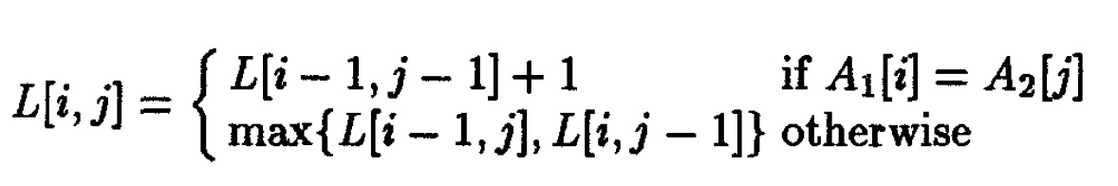
2-dimentional LCS Problem by dynamic programming

Slide 5
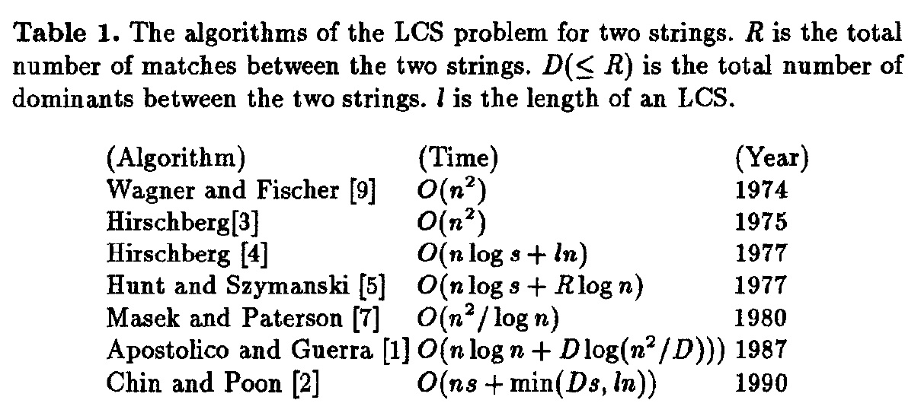

Slide 6
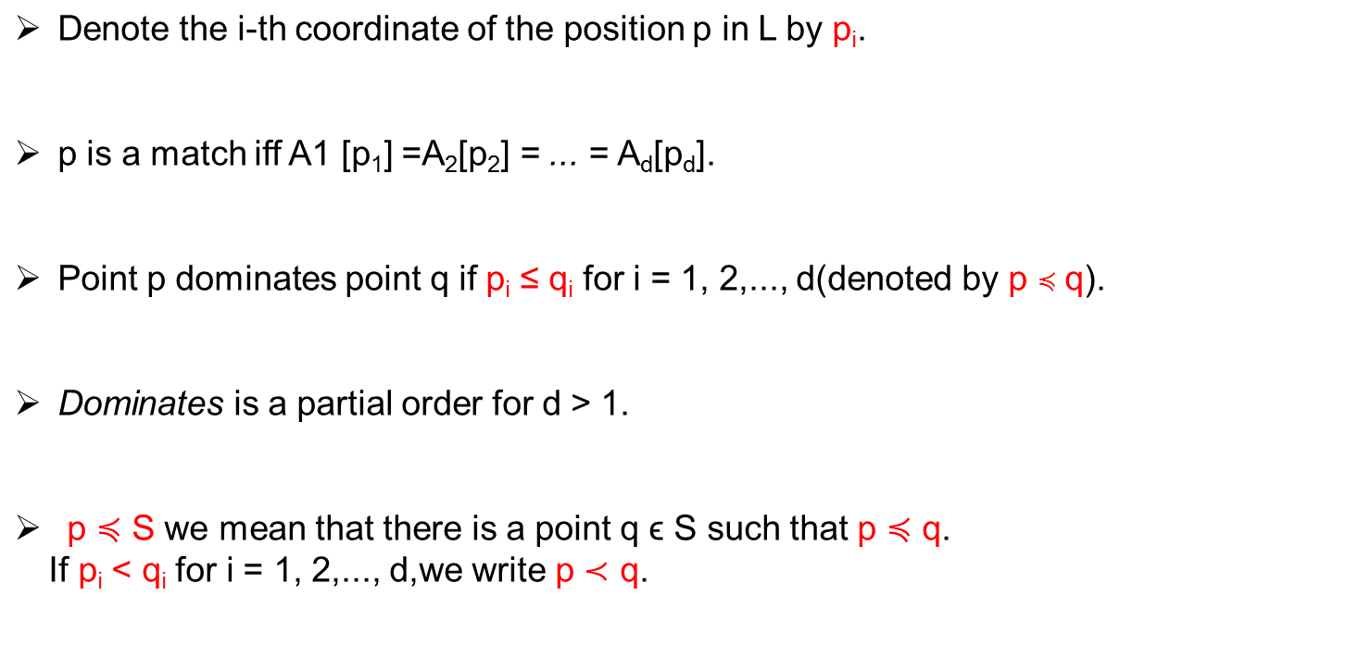
Preliminaries

Slide 7
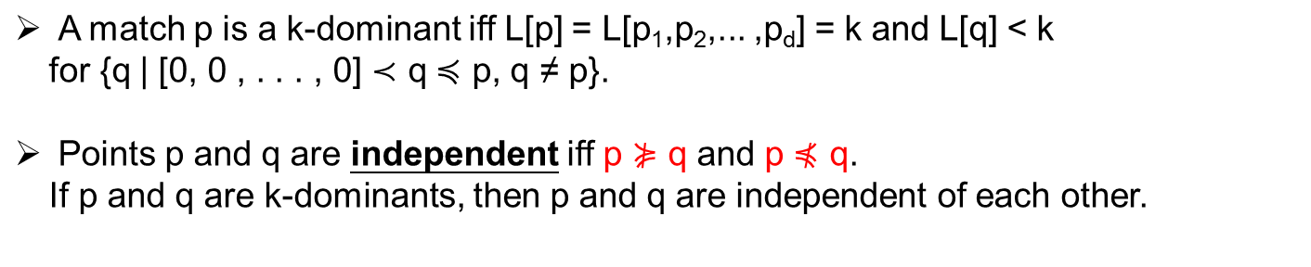
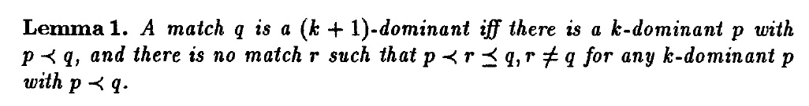

Slide 8
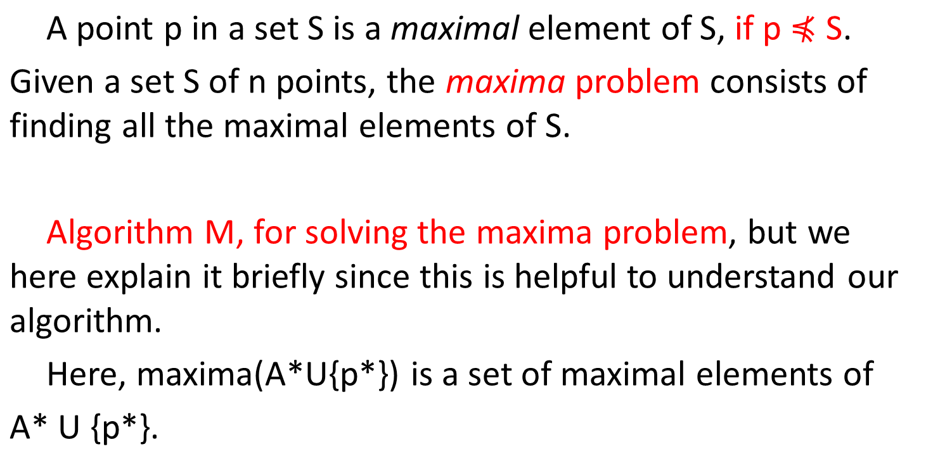
5

Slide 9
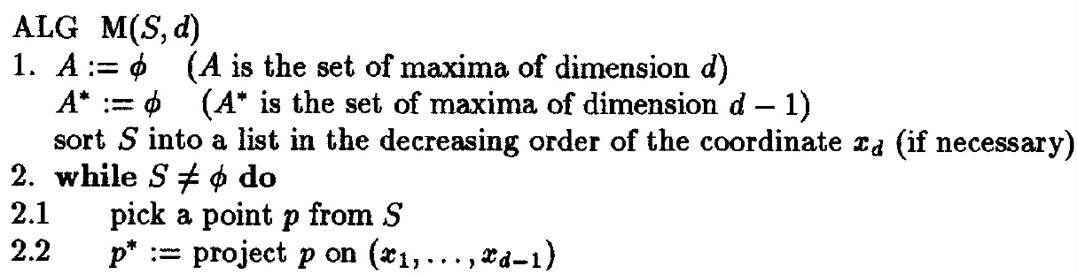
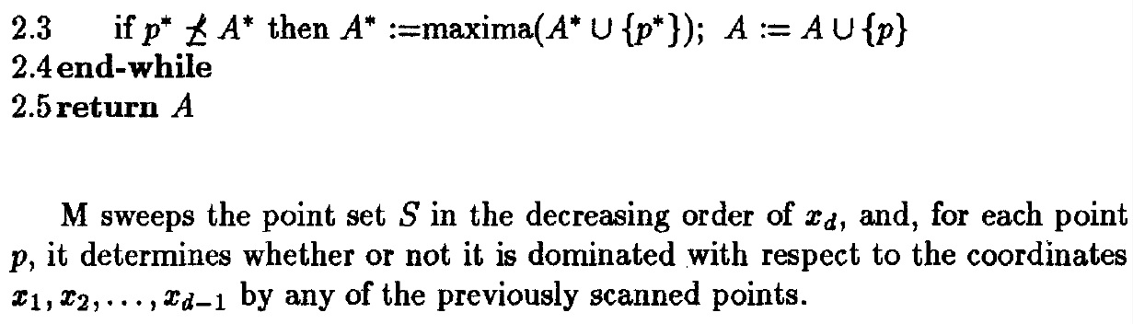
6

Slide 10
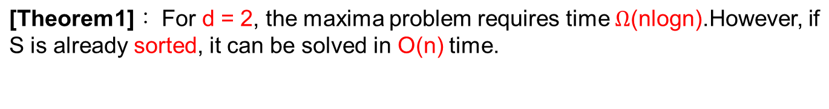
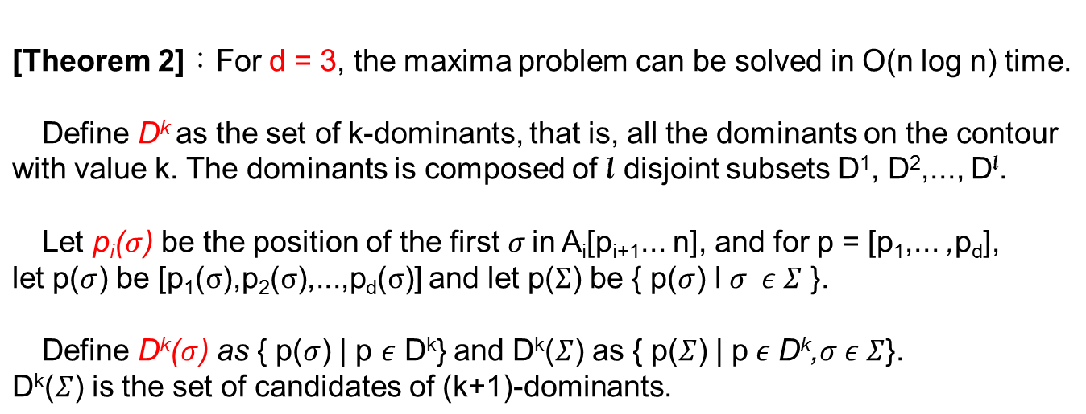
6

Slide 11
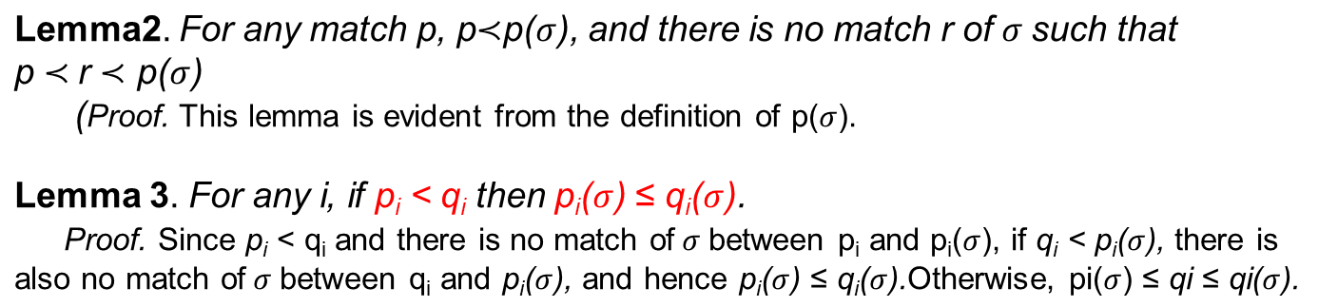
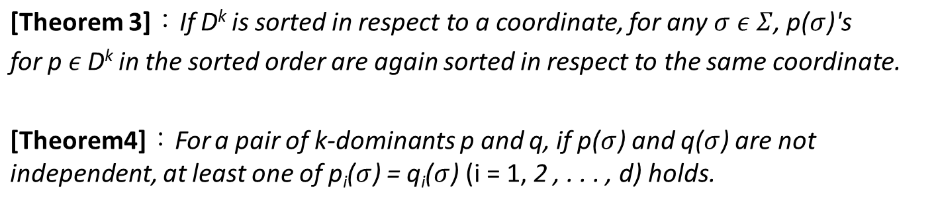
6

Slide 12
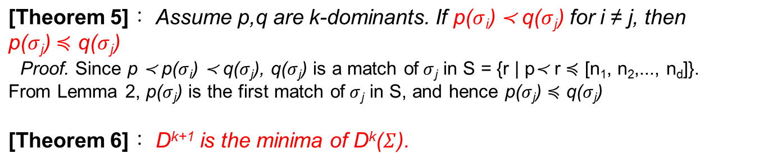
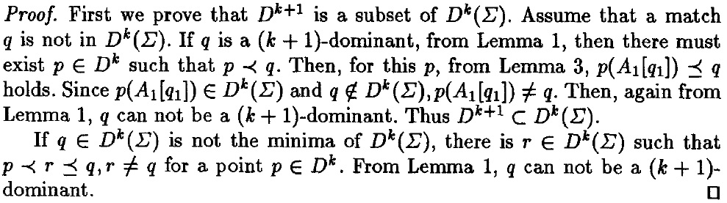

Slide 13
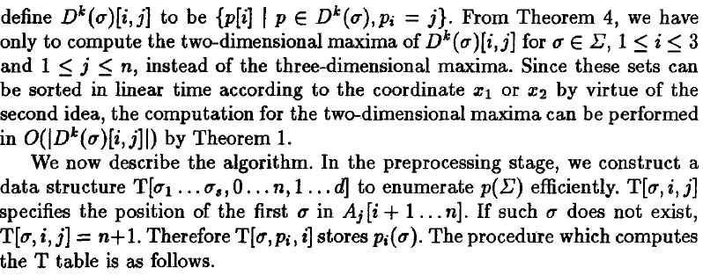
Algorithm 相關定義

Slide 14
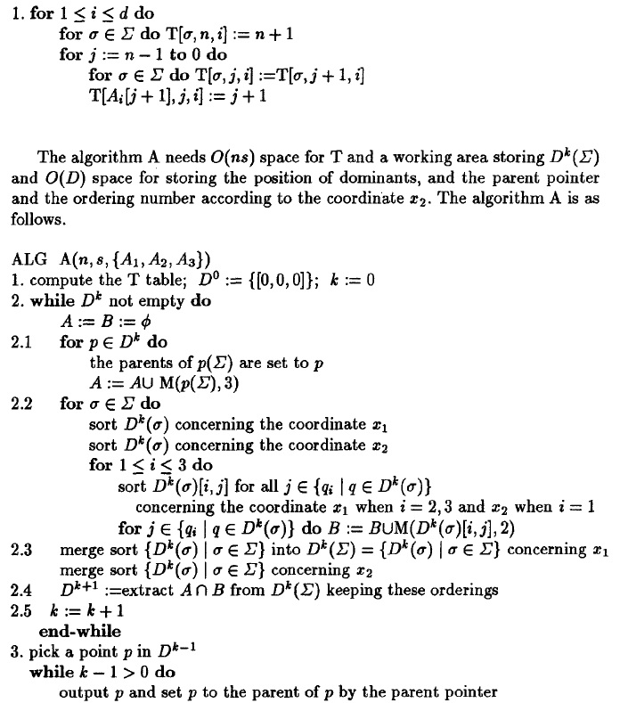

Preprocessing time：O(ns)
Time complexity of algo A:
O(ns + Ds logs)
(where D is again the number of dominants between the three strings.)
The principle of the algorithm： Compute repeatedly the minima of D^{k}, as proved in Theorem 6.

Slide 15
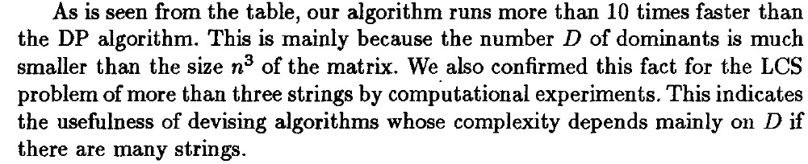
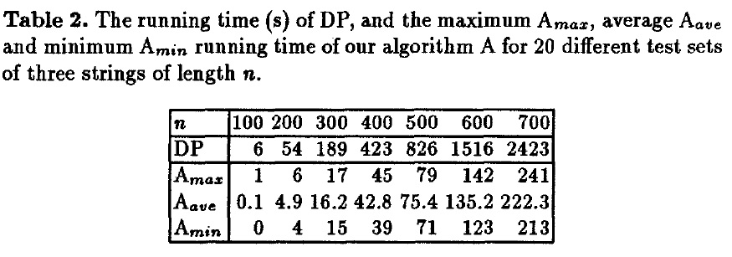
3 strings
Alphabet of size s = 4

Slide 16
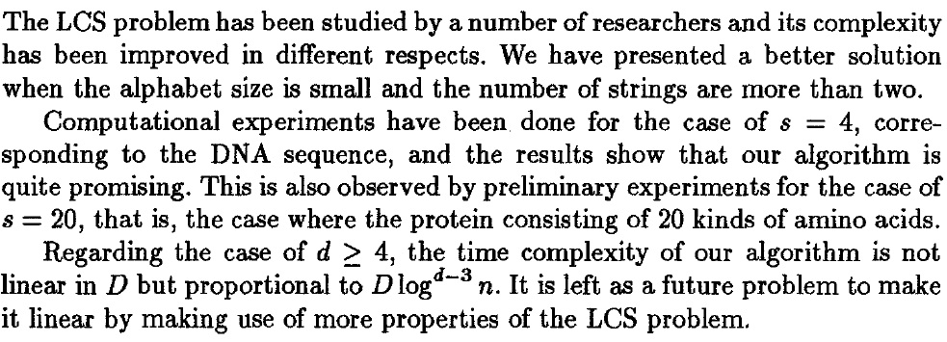
Conclusion

Slide 17
The End
Thanks for listening.

