Slide 1
Order preserving pattern matching revisited
Pattern Recognition Letters
Volume 55,P15-21
Received 18 March 2014
Available online 11 December 2014
Md.MahbubulHasan,
A.S.M.ShohidullIslam,
MohammadSaifurRahman, M.SohelRahman
Presenter: Shu-Kai Hung Date:2016/1/5

Slide 2
Abstract
In this paper , we study the order preserving pattern matching(OPPM) problem, which is a very recent variant of the classic pattern matching problem. We revisit this variant, present a new interesting pattern matching algorithm and for the first time consider string regularities from this new perspective.

Slide 3
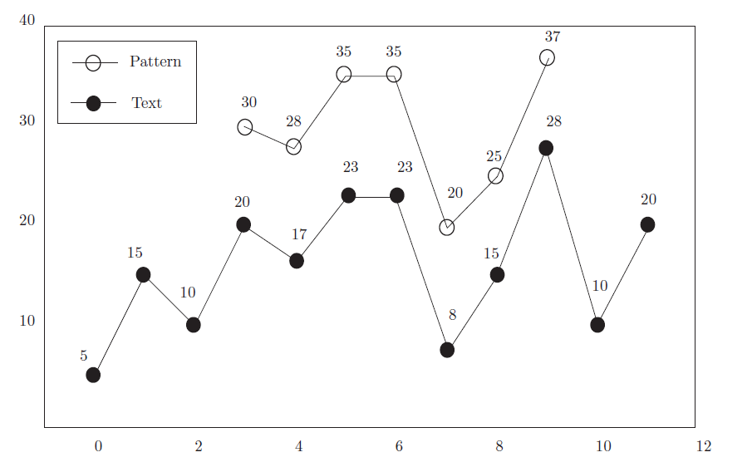
order preserving pattern matching(OPPM)
Find exact same regularities as Pattern in Text.

Slide 4
Gusfield's Algorithm （ Z Algorithm ）
z(i): Refers to the string by the s [i] beginning, and s [0] string can be matched to the start how long.(string s , s[i] : the i th value)
※ compare with prefix
Example:
S[i] | A | C | A | G | G | T | A | C | A | G | A | C
Z(i) | 1 | 0 | 1 | 0 | 0 | 0 | 4 | 0 | 1 | 0 | 2 | 0

Slide 5

Modified Z - function
To useful from the order preserving point of view
Example:
Time complexity : $O(n^{2})$
S[i] | 11 | 18 | 24 | 26 | 20 | 25 | 23 | 29 | 30
Z(i) | 9 | 3 | 2 | 1 | 2 | 1 | 3 | 2 | 1

Slide 6
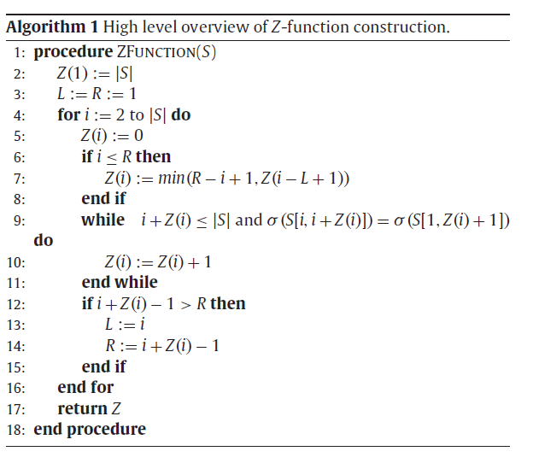


Slide 7
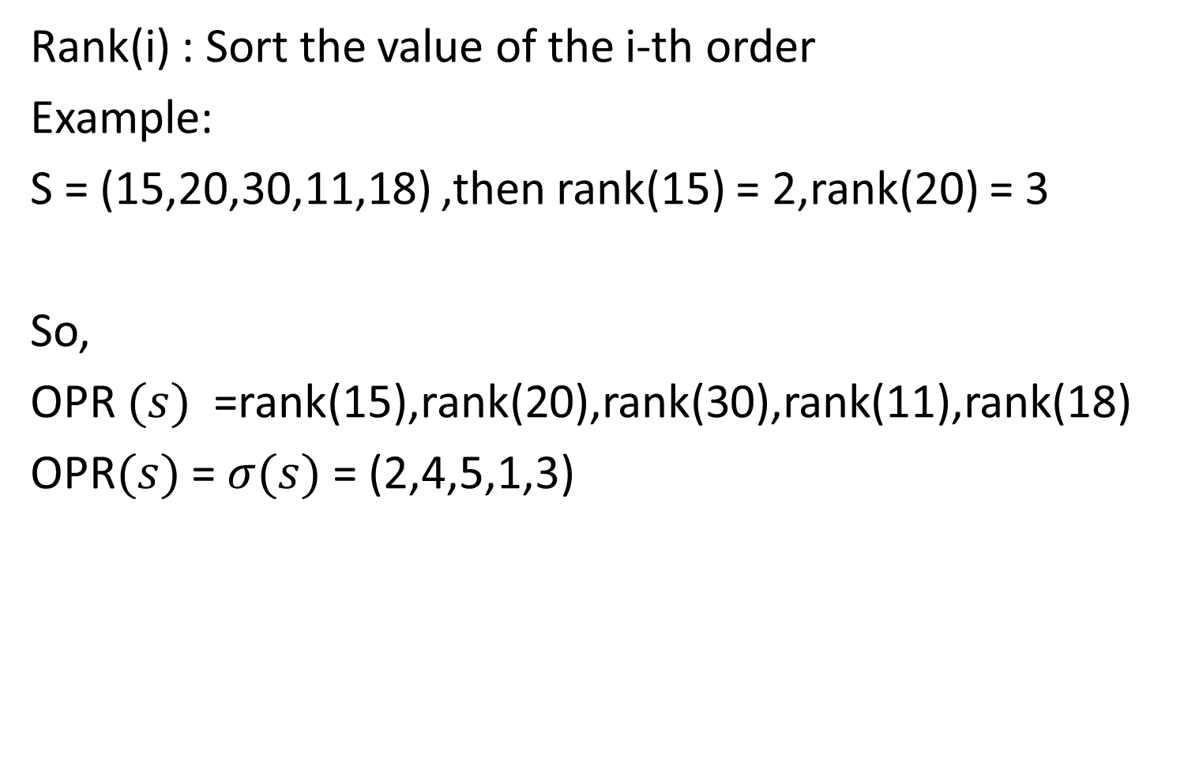
Order preserving representation(OPR)
Rank(i) : Sort the value of the i-th order
Example:
S = (15,20,30,11,18) ,then rank(15) = 2,rank(20) = 3
So,
OPR $(s)$ =rank(15),rank(20),rank(30),rank(11),rank(18)
OPR$(s)$ = $σ(s)$ = (2,4,5,1,3)

Slide 8
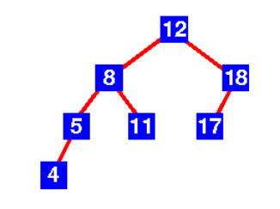
Balance binary search tree
A binary search tree is a binary tree where, for each node m, the left sub-tree only has nodes with keys smaller than the key of m, while the right sub-tree only has nodes with keys larger than the key of m.

Slide 9
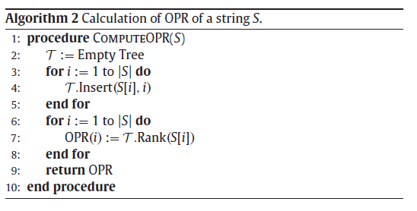

Algorithm 2(with Algorithm 1)
Time Complexity : $O\left(nlogn\right)$
Checking equality of two OPRs:$O(n)$
Constructing Tree(include insert(x,i) , Rank(x) )
example:
S = (11,18,24,20,25,29) OPRs = (1,2,4,3,5,6)
24
18
25
11
20
29

Slide 10
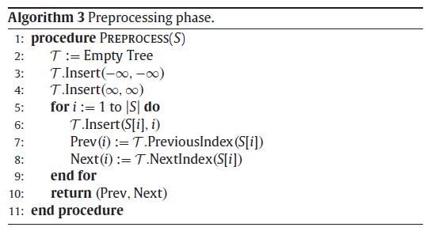

Algorithm3 & 4
Two new operation :
PreviousIndex(x) : Finds the value of pair having largest key less than x
NextIndex(x) : Finds the value of pair having smallest key greater than x
Time complexity of Algorithm 4 : $O(nlogn)$
Array Prev , Array Next can check the equality of two OPRs in constant time

Slide 11
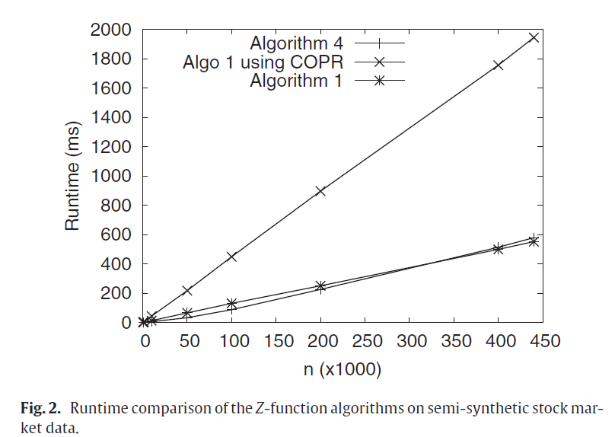
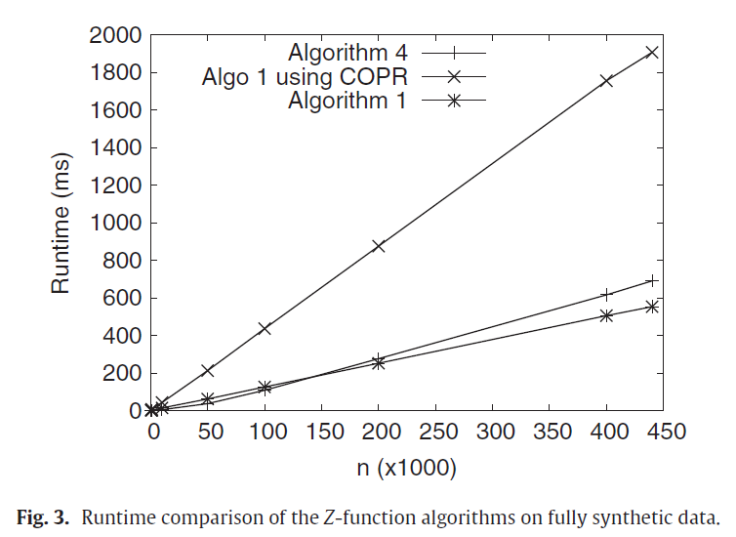
Experiments

