Slide 1
A Longest Common Subsequence Algorithm Suitable for Similar Text Strings
Narao Nakatsu, Yahiko Kambayashi and Shuzo Yajima Acta Informatica 18, 1982 PP.171 - 179
Presenter：Siang-Huai Hung
Date：2016/03/08

Slide 2
Abstract
Efficient algorithms for computing the longest common subsequence (LCS for short) are discussed. O(p n) algorithm and O(p(m -p) log n) algorithm [Hirschberg 1977] seem to be best among previously known algorithms, where p is the length of an LCS and m and n are the lengths of given two strings (m ≤ n). There are many applications where the expected length of an LCS is close to m.
In this paper, O(n(m-p)) algorithm is presented. When p is close to m (in other words, two given strings are similar), the algorithm presented here runs much faster than previously known algorithms.

Slide 3
Definition(1/2)
String A = A(1)A(2)…A(m) String B = B(1)B(2)…B(n)
m and n denote the lengths of string a and b.
Assumed m ≤ n.

Slide 4
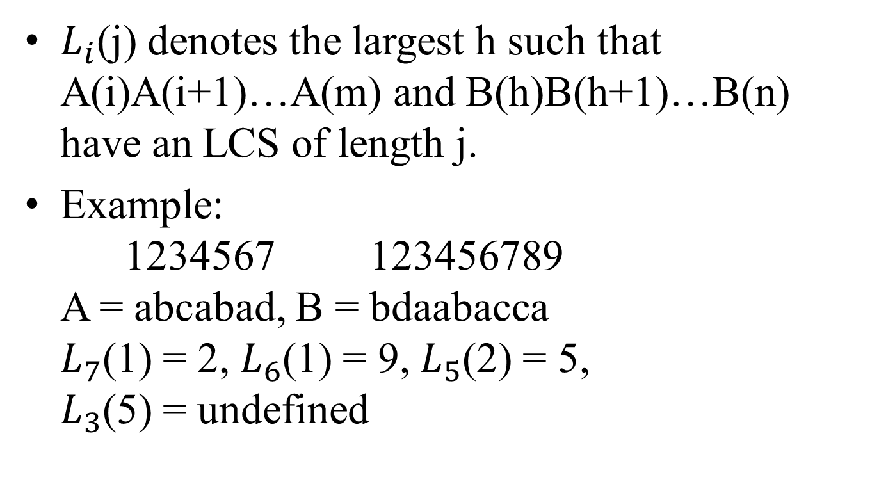
Definition(2/2)
$L_{i}$(j) denotes the largest h such that A(i)A(i+1)…A(m) and B(h)B(h+1)…B(n) have an LCS of length j.
Example: 1234567 123456789 A = abcabad, B = bdaabacca $L_{7}$(1) = 2, $L_{6}$(1) = 9, $L_{5}$(2) = 5, $L_{3}$(5) = undefined

Slide 5
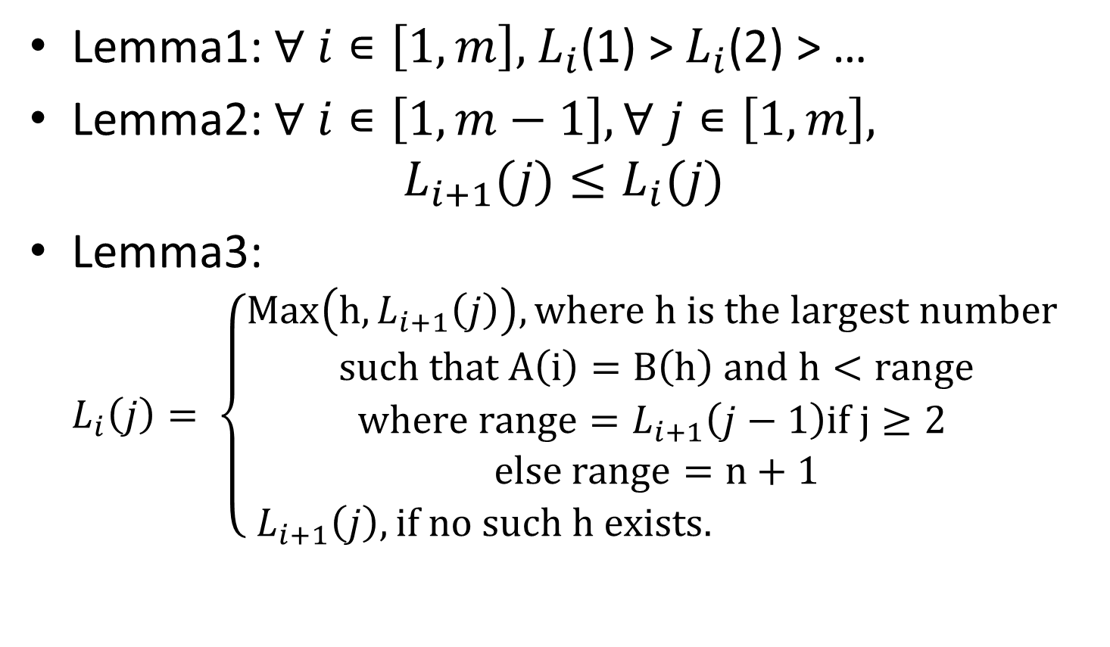
Lemma1: $∀ i∊\left[1,m\right],$ $L_{i}$(1) > $L_{i}$(2) > …
Lemma2: $∀ i∊\left[1,m−1\right],∀ j∊\left[1,m\right],$ $L_{i+1}(j)≤L_{i}(j)$
Lemma3: $L_{i}\left(j\right)= \left\{\begin{aligned}Max\left(h,L_{i+1}\left(j\right)\right), where h is the largest number \\ such that A\left(i\right)=B\left(h\right) and h<range \\ where range=L_{i+1}\left(j−1\right)if j≥2 \\ else range=n+1 \\ L_{i+1}\left(j\right), if no such h exists. \end{aligned} \right.$

Slide 6
Example
1234567 123456789 A = abcabad, B = bdaabacca
j |  | 1 | 2 | 3 | 4 | 5 | 6 | 7 | 8 | 9
i |  | b | d | a | a | b | a | c | c | a
1 | a | 0 | 0 | 0 | 0 | 0 | 0 | 0 | 0 | 0
2 | b | 0 | 0 | 0 | 0 | 0 | 0 | 0 | 0 | 0
3 | c | 0 | 0 | 0 | 0 | 0 | 0 | 0 | 0 | 0
4 | a | 0 | 0 | 0 | 0 | 0 | 0 | 0 | 0 | 0
5 | b | 0 | 0 | 0 | 0 | 0 | 0 | 0 | 0 | 0
6 | a | 0 | 0 | 0 | 0 | 0 | 0 | 0 | 0 | 0
7 | d | 0 | 0 | 0 | 0 | 0 | 0 | 0 | 0 | 0
8 |  | 0 | 0 | 0 | 0 | 0 | 0 | 0 | 0 | 0

Slide 7
Example
1234567 123456789 A = abcabad, B = bdaabacca
j |  | 1 | 2 | 3 | 4 | 5 | 6 | 7 | 8 | 9
i |  | b | d | a | a | b | a | c | c | a
1 | a | 0 | 0 | 0 | 0 | 0 | 0 | 0 | 0 | 0
2 | b | 0 | 0 | 0 | 1 | 0 | 0 | 0 | 0 | 0
3 | c | 0 | 0 | 0 | 0 | 0 | 0 | 0 | 0 | 0
4 | a | 0 | 0 | 4 | 0 | 0 | 0 | 0 | 0 | 0
5 | b | 0 | 5 | 0 | 0 | 0 | 0 | 0 | 0 | 0
6 | a | 0 | 0 | 0 | 0 | 0 | 0 | 0 | 0 | 0
7 | d | 2 | 0 | 0 | 0 | 0 | 0 | 0 | 0 | 0
8 |  | 0 | 0 | 0 | 0 | 0 | 0 | 0 | 0 | 0

Slide 8
Example
1234567 123456789 A = abcabad, B = bdaabacca
j |  | 1 | 2 | 3 | 4 | 5 | 6 | 7 | 8 | 9
i |  | b | d | a | a | b | a | c | c | a
1 | a | 0 | 0 | 0 | 0 | 0 | 0 | 0 | 0 | 0
2 | b | 0 | 0 | 0 | 1 | 0 | 0 | 0 | 0 | 0
3 | c | 0 | 0 | 0 | 0 | 0 | 0 | 0 | 0 | 0
4 | a | 0 | 0 | 4 | 0 | 0 | 0 | 0 | 0 | 0
5 | b | 0 | 5 | 0 | 0 | 0 | 0 | 0 | 0 | 0
6 | a | 9 | 0 | 0 | 0 | 0 | 0 | 0 | 0 | 0
7 | d | 2 | 0 | 0 | 0 | 0 | 0 | 0 | 0 | 0
8 |  | 0 | 0 | 0 | 0 | 0 | 0 | 0 | 0 | 0

Slide 9

Example
1234567 123456789 A = abcabad, B = bdaabacca
$L_{7}(1)$=8, $L_{6}\left(2\right)$=7, $L_{5}(3)$=5, $L_{4}\left(4\right)$=3$,L_{2}(5)$=1 show the common subsequence:
B(1)B(4)B(5)B(9)
=A(2)A(4)A(5)A(6)
=baba
j |  | 1 | 2 | 3 | 4 | 5 | 6 | 7 | 8 | 9
i |  | b | d | a | a | b | a | c | c | a
1 | a | 0 | 0 | 0 | 0 | 0 | 0 | 0 | 0 | 0
2 | b | 0 | 0 | 0 | 1 | 0 | 0 | 0 | 0 | 0
3 | c | 0 | 0 | 4 | 0 | 0 | 0 | 0 | 0 | 0
4 | a | 0 | 6 | 4 | 0 | 0 | 0 | 0 | 0 | 0
5 | b | 9 | 5 | 0 | 0 | 0 | 0 | 0 | 0 | 0
6 | a | 9 | 0 | 0 | 0 | 0 | 0 | 0 | 0 | 0
7 | d | 2 | 0 | 0 | 0 | 0 | 0 | 0 | 0 | 0
8 |  | 0 | 0 | 0 | 0 | 0 | 0 | 0 | 0 | 0

Slide 10
Thanks for listening

