Slide 1
Mastermind is NP-Complete
Jeff Stuckman
Guo-Qiang Zhang
INFOCOMP Journal of Computer Science,
vol. 5, pp.25-28 (2006)
Presenter: Shiou-Zong Chiou
Date:2016/03/14

Slide 2
Abstract
In this paper we show that the Mastermind Satisfiability Problem (MSP) is NP-complete. The Mastermind is a popular game which can be turned into a logical puzzle called Mastermind Satisfiability Problem in a similar spirit to the Minesweeper puzzle. By proving that MSP is NP-complete, we reveal its intrinsic computational property that makes it challenging and interesting. This serves as an addition to our knowledge about a host of other puzzles, such as Minesweeper, Mah-Jongg, and the 15-puzzle.

Slide 3
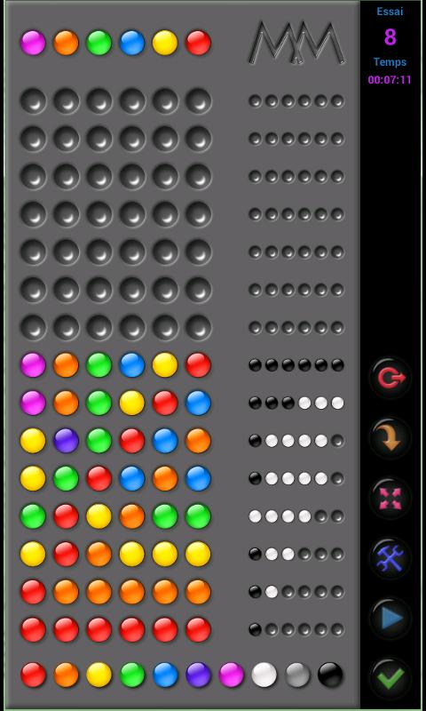
Mastermind

Slide 4
Mastermind Satisfiability Problem
Input: 給數個猜測，和相對應的分數
Ouput: YES,如果有可能的解; NO,沒有可能的解
1234 2A
5678 2A
1234 2A
5678 3A
1278
5238
5634
.
.
.

Slide 5


Vertex-Cover Problem
Input: 無向圖 G=(V,E) 和自然數 n
Output: YES,如果存在個數為n的頂點子集形成
Vertex-Cover; NO,不存在上述情況

Slide 6
MSP is NP
只要花多項式時間就可以檢查答案是否正確。

Slide 7
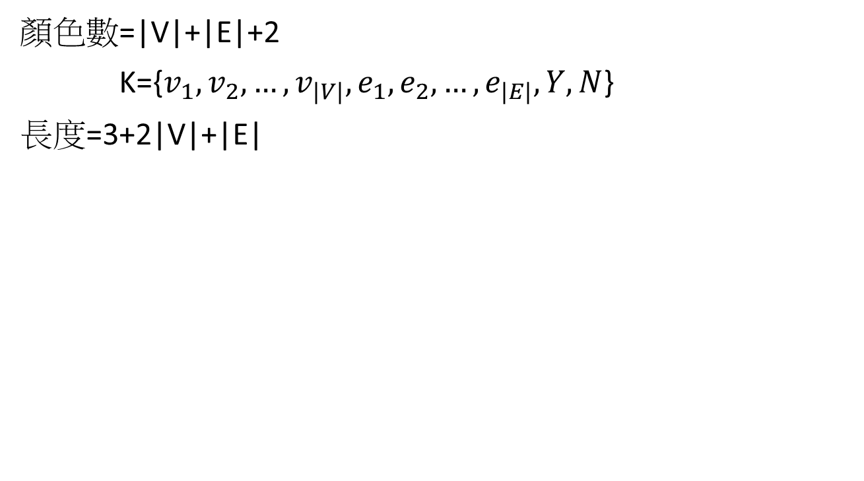

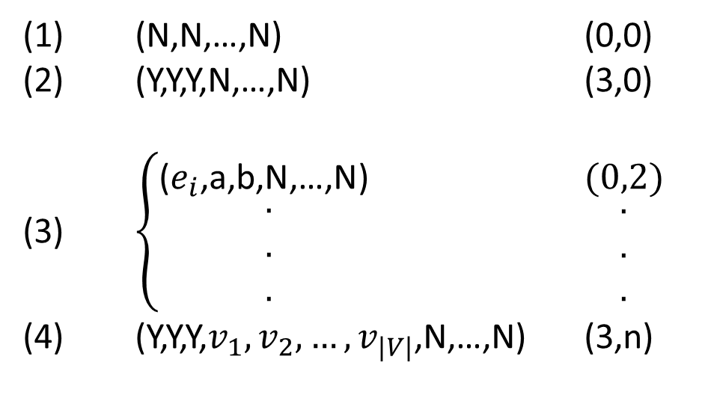
Vertex-Cover Problem $∝$ MSP
顏色數=|V|+|E|+2
K={$v_{1},v_{2},…,v_{|V|},e_{1},e_{2},…,e_{|E|},Y,N$}
長度=3+2|V|+|E|
(1) (N,N,…,N) (0,0)
(2) (Y,Y,Y,N,…,N) (3,0)
(3) $\left\{\begin{matrix}\text{(}e_{i}\text{,}\text{a}\text{,}\text{b}\text{,}\text{N}\text{,…,}\text{N}\text{) } \\ \begin{matrix}. \\ . \\ .\end{matrix}\end{matrix}\right.$ $\begin{matrix}(0,2) \\ \begin{matrix}. \\ . \\ .\end{matrix}\end{matrix}$
(4) (Y,Y,Y,$v_{1},v_{2},…,v_{|V|}$,N,…,N) (3,n)

Slide 8
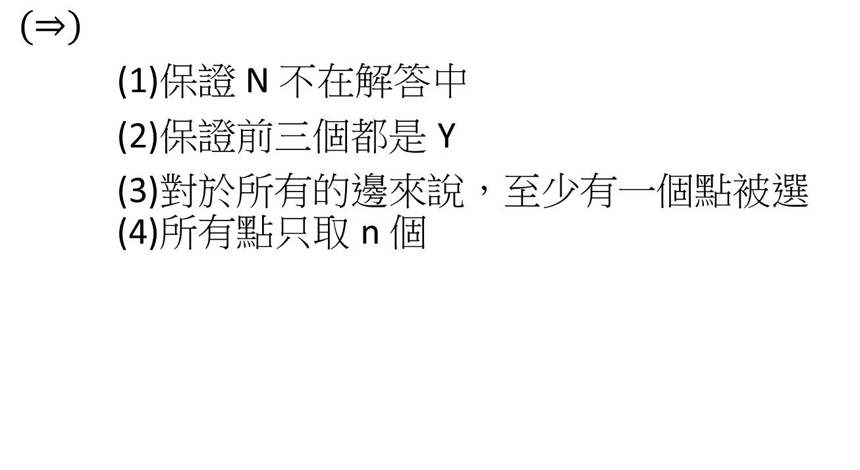
Vertex-Cover Problem $∝$ MSP
$$(⇒)$$
(1)保證 N 不在解答中
(2)保證前三個都是 Y
(3)對於所有的邊來說，至少有一個點被選 (4)所有點只取 n 個

Slide 9
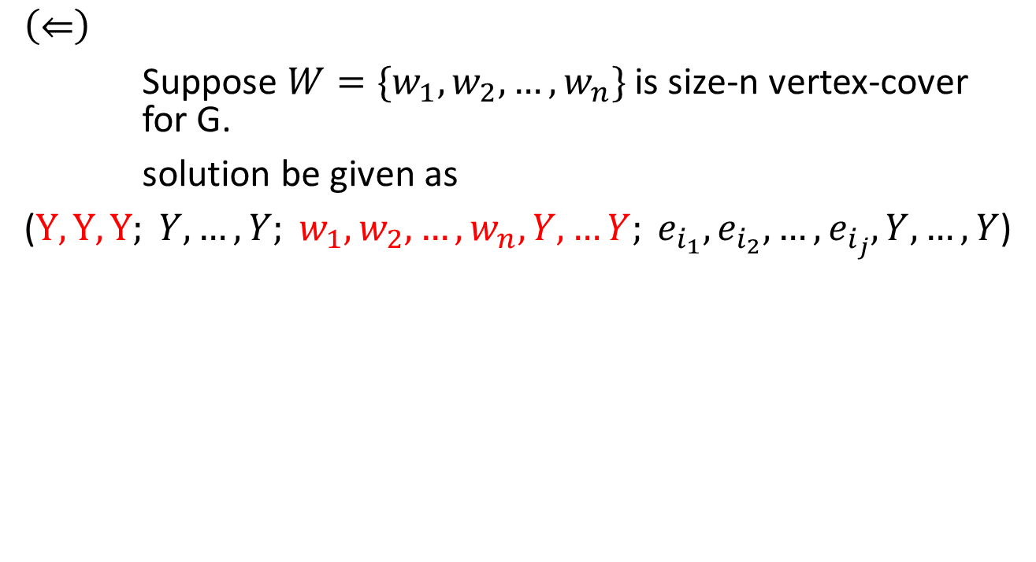
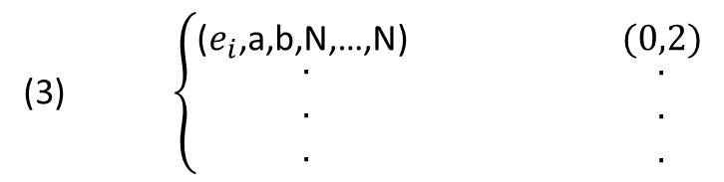
Vertex-Cover Problem $∝$ MSP
$$\left(⇐\right)$$
Suppose $W=\{w_{1},w_{2},…,w_{n}\}$ is size-n vertex-cover for G.
solution be given as
($Y,Y,Y; Y,…,Y; w_{1},w_{2},…,w_{n},Y,…Y; e_{i_{1}},e_{i_{2}},…,e_{i_{j}},Y,…,Y$)
(3) $\left\{\begin{matrix}\text{(}e_{i}\text{,}\text{a}\text{,}\text{b}\text{,}\text{N}\text{,…,}\text{N}\text{) } \\ \begin{matrix}. \\ . \\ .\end{matrix}\end{matrix}\right.$ $\begin{matrix}(0,2) \\ \begin{matrix}. \\ . \\ .\end{matrix}\end{matrix}$

Slide 10
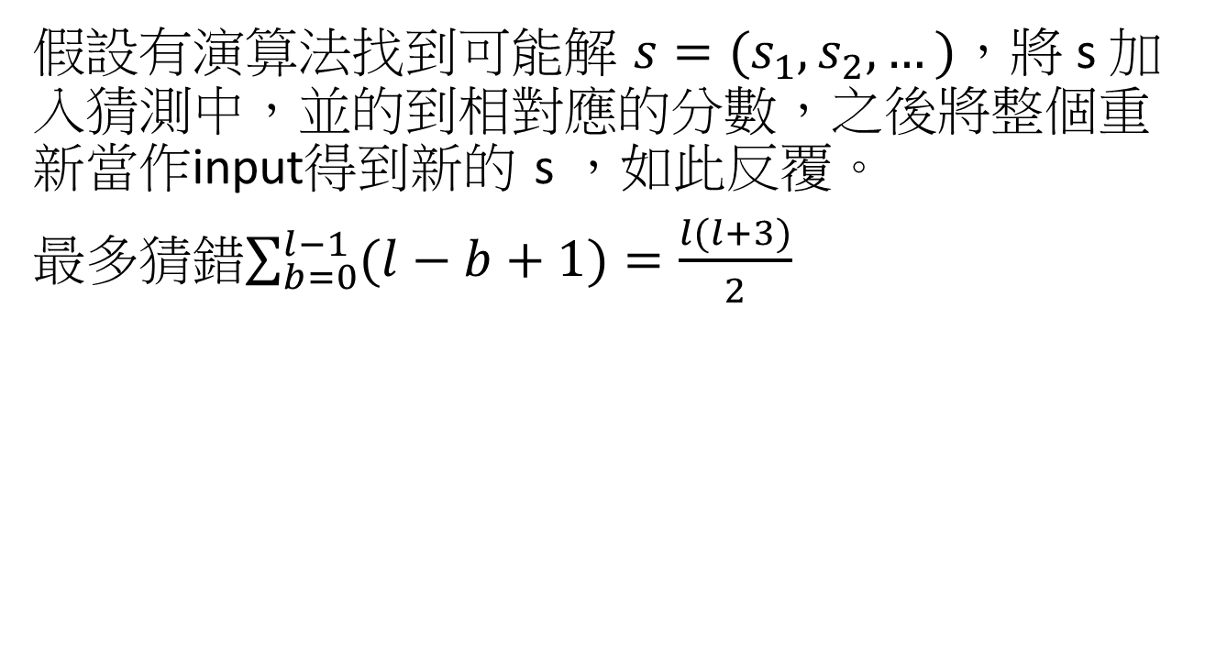
Uniqueness of Solution
假設有演算法找到可能解 $s=(s_{1},s_{2},…)$，將 s 加入猜測中，並的到相對應的分數，之後將整個重新當作input得到新的 s ，如此反覆。
最多猜錯$\sum_{b=0}^{l−1}{(l−b+1)}=\frac{l(l+3)}{2}$

