Slide 1
Extracting Powers and Periods in a Word from Its Runs
M. Crochemore, C.S. Iliopoulos, M. Kubicad,
J. Radoszewski, W. Rytter, T. Waleń
Theoretical Computer Science,
Vol. 521, pp. 29 - 41 ( 2014 )
Presenter: Tzu-Chiang Hsu (徐子強)
2016/03/14

Slide 2
Abstract (1/4)
A breakthrough in the field of text algorithms was the discovery of the fact that the maximal number of runs in a word of length n is O(n) and that they can all be computed in O(n) time. We study some applications of this result.

Slide 3
Abstract (2/4)
New simpler O(n) time algorithms are presented for classical textual problems: computing all distinct k-th word powers for a given k, in particular squares for k = 2, and finding all local periods in a given word of length n.

Slide 4
Abstract (3/4)
Additionally, we present an efficient algorithm for testing primitivity of factors of a word and computing their primitive roots. Applications of runs, despite their importance, are underrepresented in existing literature (approximately one page in the paper of Kolpakov and Kucherov, 1999 [25] and [26]).

Slide 5
Abstract (4/4)
In this paper we attempt to fill in this gap. We use Lyndon words and introduce the Lyndon structure of runs as a useful tool when computing powers. In problems related to periods we use some versions of the Manhattan skyline problem.

Slide 6
① Compute all k-th powers in a word
Gusfield et al. ( 2004 ) J. Comput. Syst. Sci.
Linear time algorithms for finding and representing
all the tandem repeats in a string
② Compute all local periods in a word
Duval et al. ( 2004 ) Theor. Comput. Sci.
Linear time computation of local periods
③ Factor primitivity query
Kociumaka et al. ( 2009 )
Efficient Data Structures for the Factor Periodicity Problem

Slide 7
Finding Maximal Repetitions in a Word in Linear Time
R. Kolpakov and G. Kucherov ( 1999 )
Proceedings of the 40th Annual Symposium on
Foundations of Computer Science
Detecting Leftmost Maximal Periodicities
M. G. Main ( 1989 )
Discrete Applied Mathematics

Slide 8
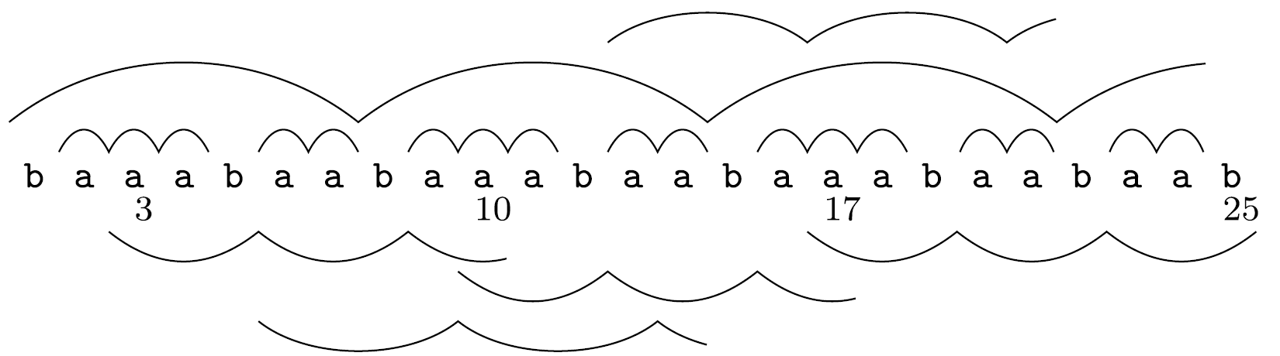

Slide 9
( 3, 10, 3 )
( 10, 17, 3 )
( 17, 25, 3 )
( 6, 14, 4 )
( 13, 21, 4 )
( 1, 24, 7 )

Slide 10
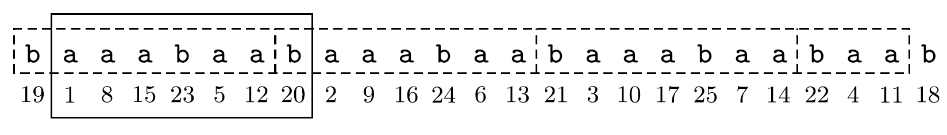
Lyndon words
baaabaa
aaabaab
aabaaba
...

Slide 11
Lyndon representation
λ = aaabaab
λ⁽¹⁾ λ³ λ₍₂₎

Slide 12
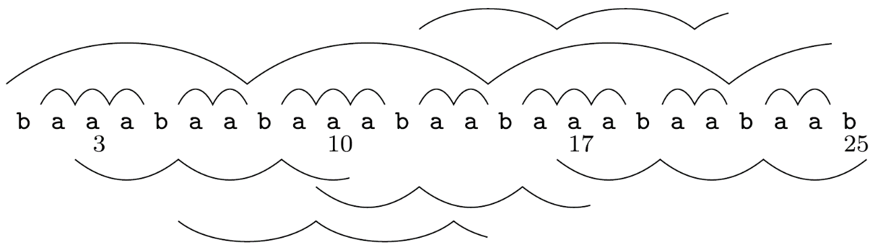
① Compute all k-th powers in a word
( 2, 4, 1 )
( 6, 7, 1 )
( 9, 11, 1 )
( 13, 14, 1 )
( 16, 18, 1 )
( 20, 21, 1 )
( 23, 24, 1 )
( 3, 10, 3 )
( 10, 17, 3 )
( 17, 25, 3 )
( 6, 14, 4 )
( 13, 21, 4 )
( 1, 24, 7 )

Slide 13
① Compute all k-th powers in a word
( 2, 4, 1 )
( 6, 7, 1 )
( 9, 11, 1 )
( 13, 14, 1 )
( 16, 18, 1 )
( 20, 21, 1 )
( 23, 24, 1 )
( 3, 10, 3 )
( 10, 17, 3 )
( 17, 25, 3 )
( 6, 14, 4 )
( 13, 21, 4 )
( 1, 24, 7 )
baaabaabaaabaabaaabaabaab
suffix array |  | longest common prefix
1 | 2 | aaabaabaaabaabaaabaabaab | undef
2 | 9 | aaabaabaaabaabaab | 16
3 | 16 | aaabaabaab | 9
4 | 23 | aab | 2
5 | 6 | aabaaabaabaaabaabaab | 3
6 | 13 | aabaaabaabaab | 12
7 | 20 | aabaab | 5
...

Slide 14
suffix array |  | longest common prefix
1 | 2 | aaabaabaaabaabaaab | undef
2 | 9 | aaabaabaaabaabaab | 16
3 | 16 | aaabaabaab | 9
4 | 23 | aab | 2
7 | 20 | aabaab | 5
8 | 3 | aabaabaaabaabaaabaabaab | 6
9 | 10 | aabaabaaabaabaab | 15
10 | 17 | aabaabaab | 8
11 | 24 | ab | 1
( 3, 10, 3 )
( 10, 17, 3 )
( 17, 25, 3 )
( 6, 14, 4 )
( 13, 21, 4 )
( 1, 24, 7 )

Slide 15
suffix array |  | longest common prefix
1 | 2 | aaabaabaaabaabaaab | undef
2 | 9 | aaabaabaaabaabaab | 16
3 | 16 | aaabaabaab | 9
4 | 23 | aab | 2
7 | 20 | aabaab | 5
8 | 3 | aabaabaaabaabaaabaabaab | 6
9 | 10 | aabaabaaabaabaab | 15
10 | 17 | aabaabaab | 8
11 | 24 | ab | 1
( 3, 10, 3 )
( 10, 17, 3 )
( 17, 25, 3 )
( 6, 14, 4 )
( 13, 21, 4 )
( 1, 24, 7 )

Slide 16
Example:
Compute all cubes in word (ab)⁹a
abababababababababa
11111111111111
11111111
11

Slide 17
② Compute all local periods in a word
baaabaabaaabaabaaabaabaab
4 1 1 7 3 1 3 7 1 1 7 3 1 3 7 1 1 3 1 3 3 1 3
24

Slide 18
Local period:
① Internal,
② One-side-external,
③ Both-side-external.

Slide 19
Mantattan Skyline Problem
( 2, 4, 1 )
( 6, 7, 1 )
( 9, 11, 1 )
( 13, 14, 1 )
( 16, 18, 1 )
( 20, 21, 1 )
( 23, 24, 1 )
( 3, 10, 3 )
( 10, 17, 3 )
( 17, 25, 3 )
( 6, 14, 4 )
( 13, 21, 4 )
( 1, 24, 7 )
8
7
6
5
4
3
2
1
b | a | a | a | b | a | a | b | a | a | a | b | a | a | b | a | a | a | b | a | a | b | a | a | b

Slide 20
Mantattan Skyline Problem
( 2, 4, 1 )
( 6, 7, 1 )
( 9, 11, 1 )
( 13, 14, 1 )
( 16, 18, 1 )
( 20, 21, 1 )
( 23, 24, 1 )
( 3, 10, 3 )
( 10, 17, 3 )
( 17, 25, 3 )
( 6, 14, 4 )
( 13, 21, 4 )
( 1, 24, 7 )
8
7
6
5
4
3
2
1
b | a | a | a | b | a | a | b | a | a | a | b | a | a | b | a | a | a | b | a | a | b | a | a | b
 | 1 | 1 |  |  | 1 |  |  | 1 | 1 |  |  | 1 |  |  | 1 | 1 |  |  | 1 |  |  | 1

Slide 21
Mantattan Skyline Problem
( 2, 4, 1 )
( 6, 7, 1 )
( 9, 11, 1 )
( 13, 14, 1 )
( 16, 18, 1 )
( 20, 21, 1 )
( 23, 24, 1 )
( 3, 10, 3 )
( 10, 17, 3 )
( 17, 25, 3 )
( 6, 14, 4 )
( 13, 21, 4 )
( 1, 24, 7 )
8
7
6
5
4
3
2
1
b | a | a | a | b | a | a | b | a | a | a | b | a | a | b | a | a | a | b | a | a | b | a | a | b
∞ | 1 | 1 | ∞ | 3 | 1 | 3 | 7 | 1 | 1 | 7 | 3 | 1 | 3 | 7 | 1 | 1 | ∞ | 3 | 1 | 3 | 3 | 1 | ∞

Slide 22
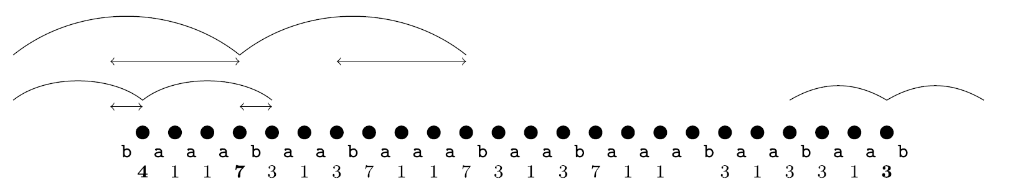
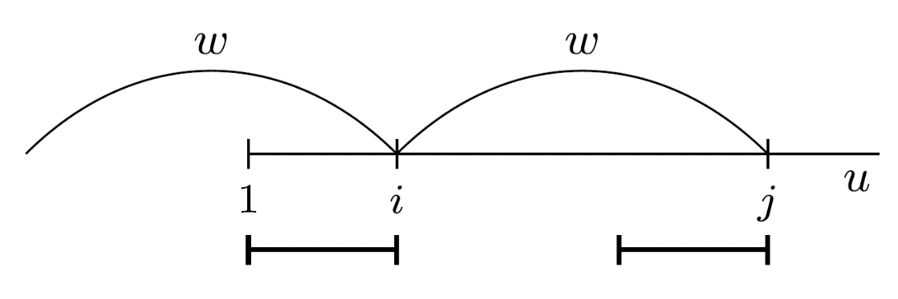
One-side-external

Slide 23
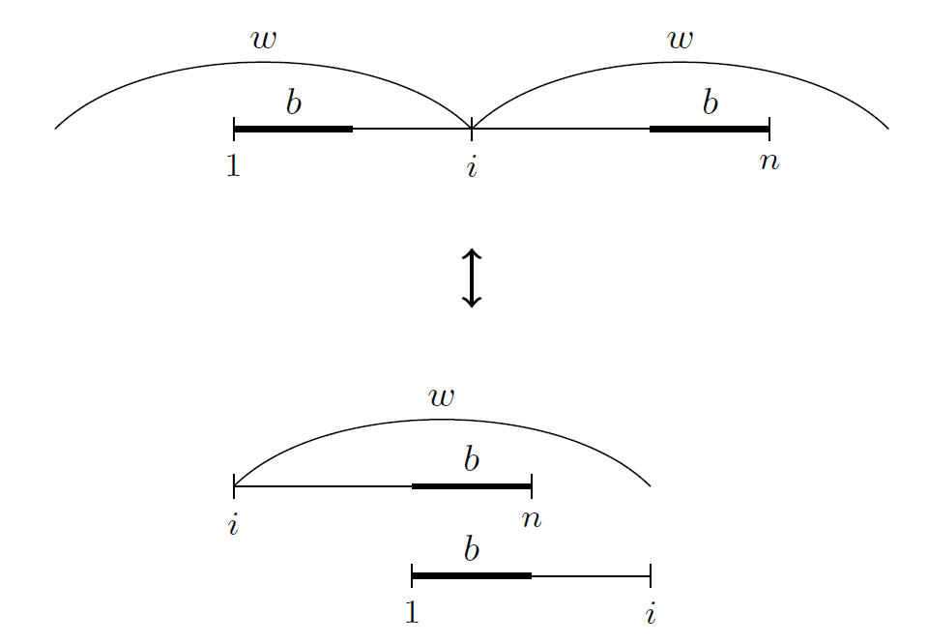
Both-side-external

Slide 24
Border
cgtcgtc
ctgctgc
cgtcgtc
ctgctgc

Slide 25
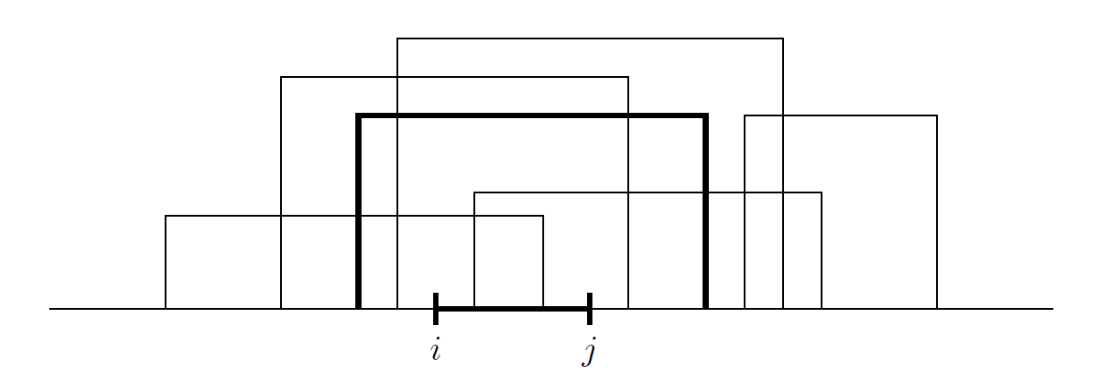
③ Factor primitivity query

