Slide 1
The use of data mining and neural networks for forecasting stock market returns
David Enke, Suraphan Thawornwong
University of Missouri, USA
Expert Systems with Applications 29, pp.927–940, 2005
Presenter : Shih-jhan Huang
Date : 2016/6/14

Slide 2
Abstract
It has been widely accepted by many studies that non-linearity exists in the financial markets and that neural networks can be effectively used to uncover this relationship. Unfortunately,many of these studies fail to consider alternative forecasting techniques,the relevance of input variables, or the performance of the models when using different trading strategies. This paper introduces an information gain technique used in machine learning for data mining to evaluate the predictive relationships of numerous financial and economic variables. Neural network models for level estimation and classification are then examined for their ability to provide an effective forecast of future values. A cross-validation technique is also employed to improve the generalization ability of several models. The results show that the trading strategies guided by the classification models generate higher risk-adjusted profits than the buy-and-hold strategy,as well as those guided by the level-estimation based forecasts of the neural network and linear regression models.

Slide 3
Preprocess：Data selection (for input layer)
15 variables were selected by the information gain data mining analysis.(15/31)
M1、T3、T6、T120、CD1、CD3、CD6、SP、TE2、TE3、TE4、DE2、DE3、DE5、DE7
前處理：Normalizing (-1 ～ +1)
→變數數值範圍縮小，可避免訓練時產生較大的誤差。
(參數的選擇對於整個model的預測結果好壞影響很大。)

Slide 4
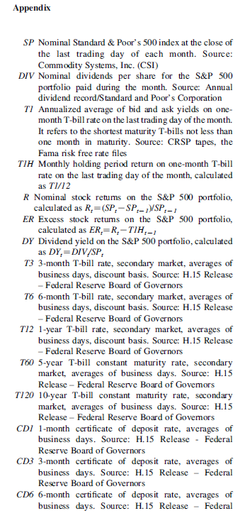
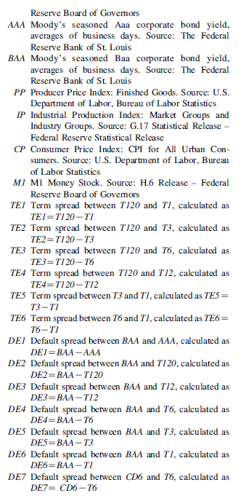

Slide 5
Level v.s. Classification
Level estimation model：(use General Regression Neural Network)
Estimate the value(level) of excess stock returns on the S&P 500 index portfolio.
Classification model：(use Probabilistic Neural Network)
Classify the direction(sign) of excess stock returns on the S&P 500 index portfolio.

Slide 6
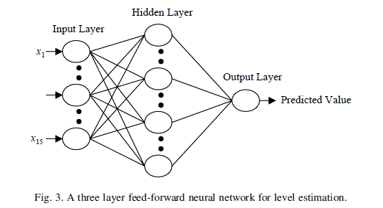
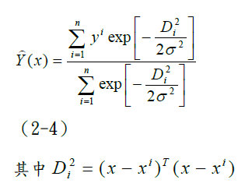
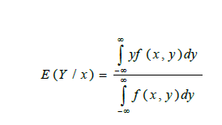
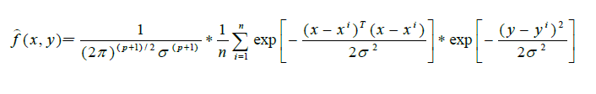
Neural network models for level estimation – use GRNN
分為三層：輸入層、隱藏層、輸出層(value of level)。
簡化

Slide 7
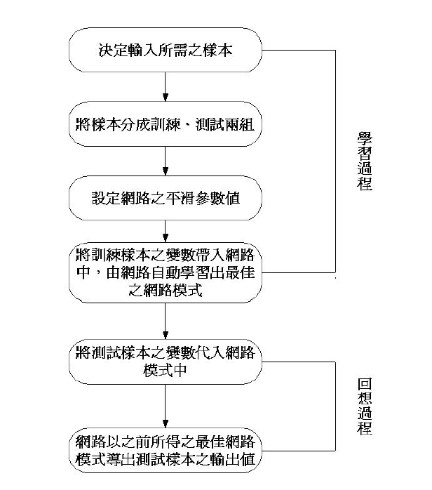

Slide 8


GRNN
Validation
y_{i} : predicted excess stock return t_{i} : actual excess stock return n : the number of validation cases
(40 months in each fold for this study)
y1, y2, y3, y4, y5 : the predicted excess stock
returns of the five neural network models developed from
the five-fold cross-validation experiment.
註：
RMSE：root-mean squared error
WER：weighted excess return

Slide 9
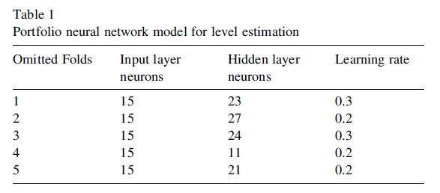

Slide 10
Neural network models for classification - use PNN
PNN基本原理是由機率模型所啟發 (Ex:貝氏分類)
假設有一分類問題，其類別有ｋ個：
藉由訓練樣本集合Ｘ，找出每個類別c_{j}的
機率密度函數 f_{j}(X)，j=1,…,k
未來若有新的待分類資料Ｘ’進入該網路，則將該待分類資料代入各類別的機率密度函數，計算Ｘ’屬於各類別的機率值
P(c_{j}|X) = f_{j}(X’)，j = 1,…,k
具有最大機率值之類別，即為資料Ｘ’的所屬類別。

Slide 11
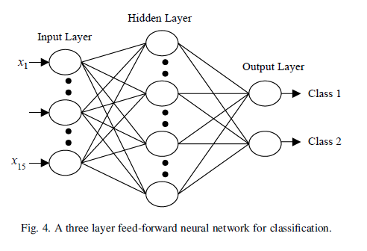
分為三層：輸入層、隱藏層、輸出層(signs of direction)。
假設樣本空間中有n 筆訓練樣本，
k 個類別C = {c₁ , c₂ , …, c_{k} } ，每個類別內可有z 筆樣本(1≤ z ≤n)。
這n筆樣本是由m個變數(m 維) ，X={x₁ , x₂ , …, x_{m} } 所組成。

Slide 12
在PNN中，每一個訓練樣本在每個不同的分類上皆可形成機率密度函數。
實際上，無法事先了解訓練樣本的真實機率密度函數。
所以每個訓練樣本於不同的類別上，必須假設一個機率密度函數，為了方便運算，所有的機率密度函數皆為相同的形式
(例：常態分配)

Slide 13
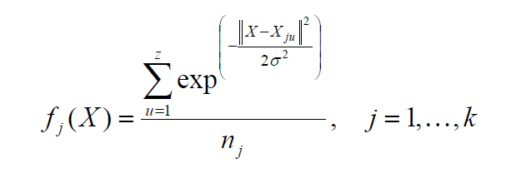
PNN機率密度函數
經過整理簡化過可得下列函數:
j : 第j類別
u : 第u個樣本
σ : 平滑參數 n_{j} : 第j個類別的樣本數
k 個類別C = {c₁ , c₂ , …, c_{k} } ，每個類別內可有z 筆樣本(1≤ z ≤n)。

Slide 14
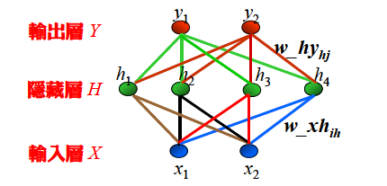
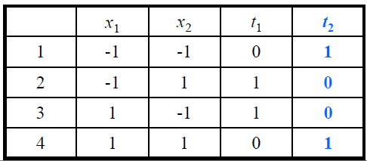
範例
假設有一個XOR分類問題，以PNN網路解此問題
設定網路參數採四個隱藏層處理單元，其網路結構如下圖所示：
平滑參數 σ = 0.5
真值表如下所示：

Slide 15
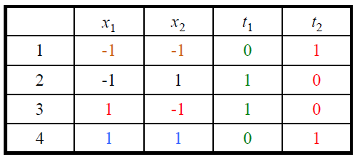
輸入層與隱藏層間的加權值給定如下：
w_xh11 = -1 w_xh21 = -1
w_xh12 = -1 w_xh22 = 1
w_xh13 = 1 w_xh23 = -1
w_xh14 = 1 w_xh24 = 1
隱藏層與輸出層間的加權值給定如下：
w_hy11 = 0 w_hy12 = 1
w_hy21 = 1 w_hy22 = 0
w_hy31 = 1 w_hy32 = 0
w_hy41 = 0 w_hy42 = 1

Slide 16
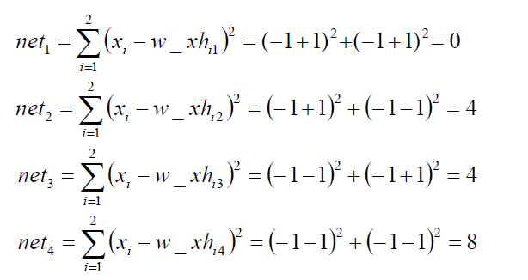
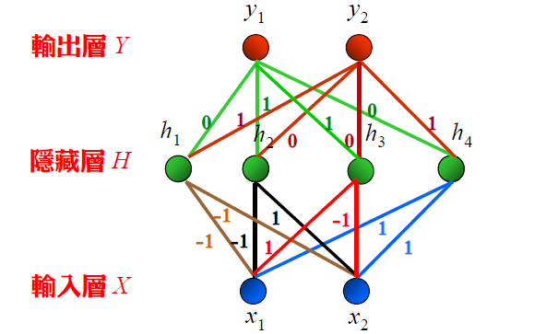
輸入一組測試(待推)範例x1 = -1，x2 = -1，PNN網路的計算過程如下：
1.計算隱藏層處理單元輸出值H = {h1, h2, h3, h4}。
h1 = exp(- net₁ /2σ²) = exp(-0/2) = 1
h2 = exp(- net₂ /2σ²) = exp(-4/2) = 0.135
h3 = exp(- net₃ /2σ²) = exp(-4/2) = 0.135
h4 = exp(- net₄ /2σ²) = exp(-8/2) = 0.0183

Slide 17
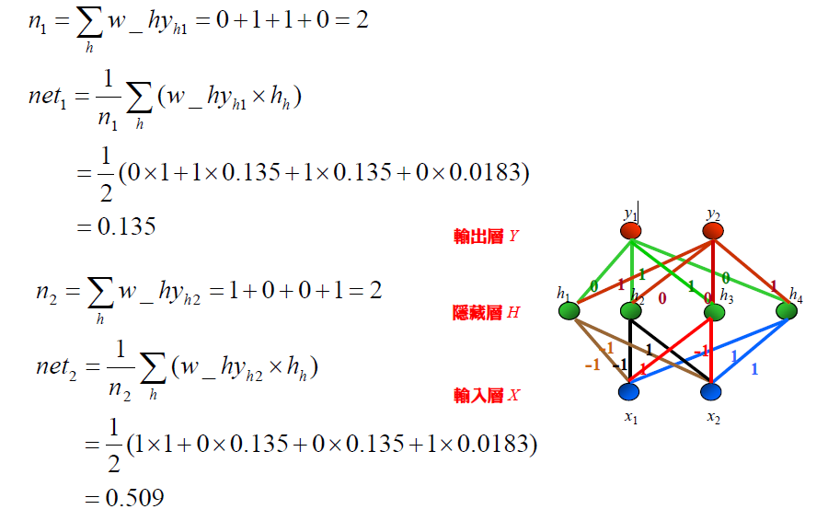
2.計算輸出層輸出向量Y。
因net₂ 最大，故y₁ = 0，y₂ = 1。與目標輸出向量完全相同。

Slide 18
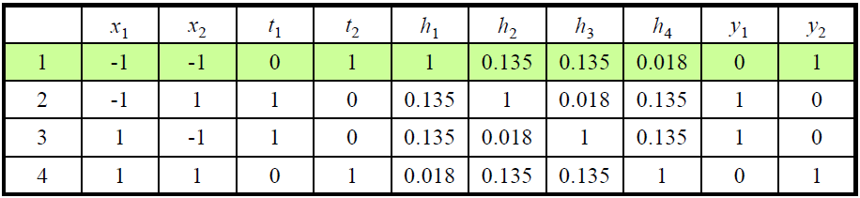
其它三個範例的學習過程如下表所示。
隱藏層處理單元輸出值H = {h1, h2, h3, h4}

Slide 19

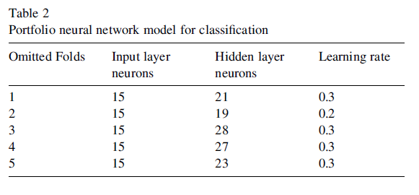
Validation：
y1, y2 : the predicted classes of excess stock return of
the two output neurons.
t1, t2 : the actual classes of excess stock return.
n : the number of validation cases.(40 in this study)

Slide 20
K-fold cross-validation
初始採樣分割成K個子樣本，一個單獨的子樣本被保留作為驗證模型的數據，其他K-1個樣本用來訓練。
交叉驗證重複K次，每個子樣本驗證一次，平均K次的結果，最終得到一個單一估測。
這個方法的優勢在於，同時重複運用隨機產生的子樣本進行訓練和驗證，每次的結果驗證一次，基本來說可增加準確性。

Slide 21
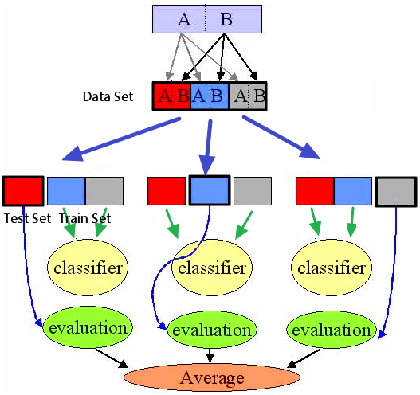
3-fold cross-validation

Slide 22
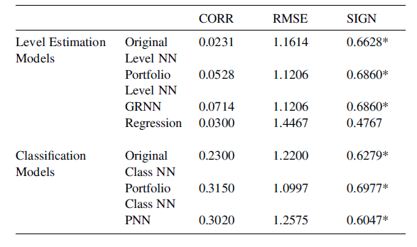
Experiment result
註：
CORR：refers to the Pearson correlation coefficient between the actual and predicted signs of excess stock return.
SIGN：denotes the proportion of times the predicted signs of excess stock returns are correctly classified
Table: Performance measures

Slide 23
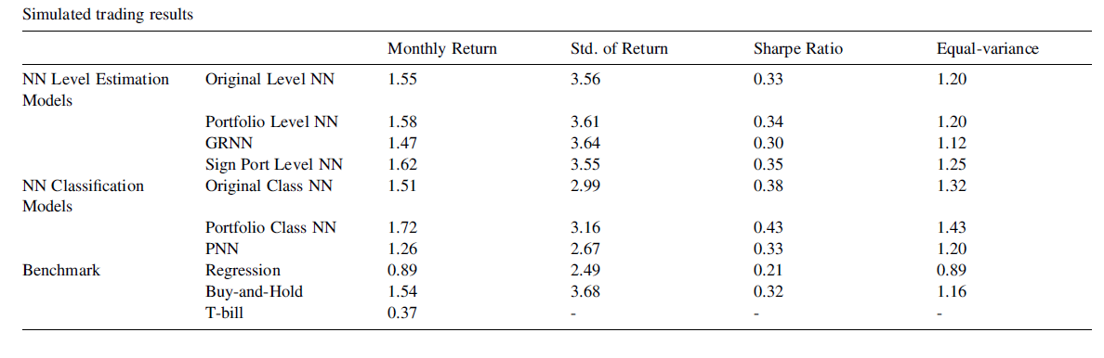
Simulated trading results

Slide 24
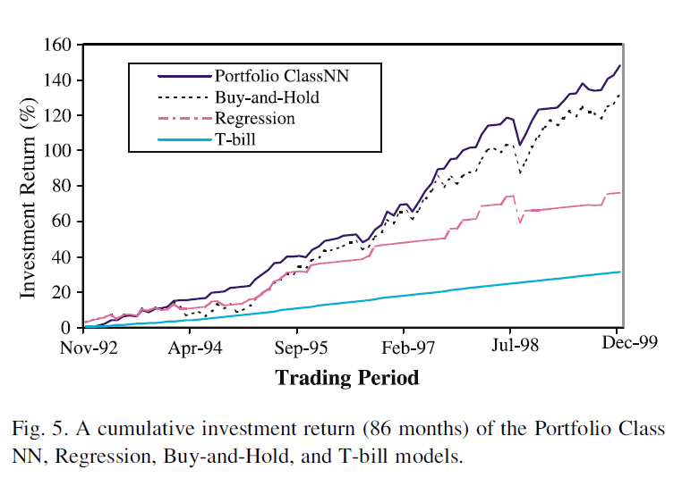
各交易策略累積收益比較

