Slide 1
Two algorithms for LCS Consecutive Suffix Alignment
Gad M. Landau, Eugene Myers, Michal Ziv-Ukelson
Journal of Computer and System Sciences, Vol. 73, No. 7, pp. 1095-1117, 2007
Presenter: Bi-Shiang Lin
Date:2016/6/14

Slide 2
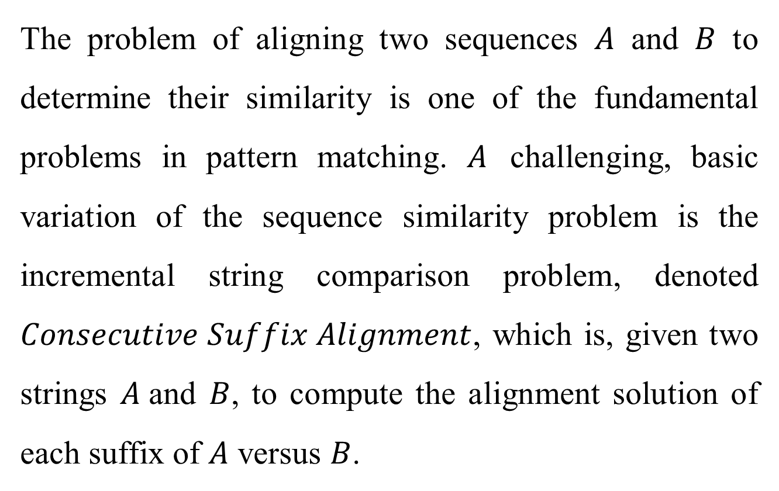
Abstract(1/3)
The problem of aligning two sequences $A$ and $B$ to determine their similarity is one of the fundamental problems in pattern matching. $A$ challenging, basic variation of the sequence similarity problem is the incremental string comparison problem, denoted $Consecutive Suffix Alignment$, which is, given two strings $A$and $B$, to compute the alignment solution of each suffix of $A$ versus $B$.

Slide 3
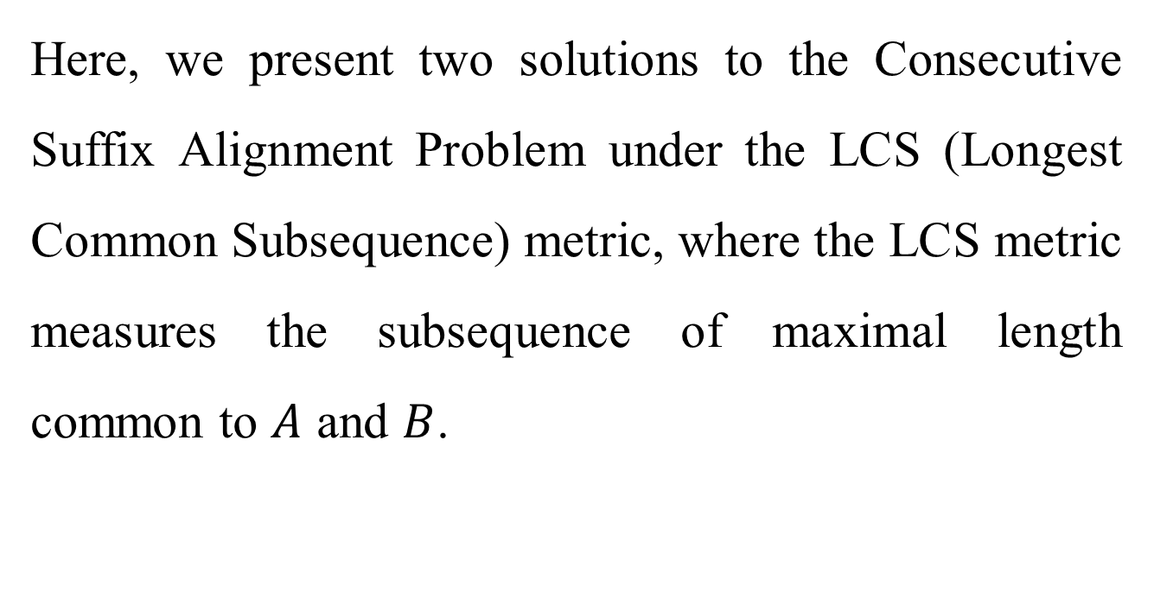
Abstract(2/3)
Here, we present two solutions to the Consecutive Suffix Alignment Problem under the LCS (Longest Common Subsequence) metric, where the LCS metric measures the subsequence of maximal length common to $A$ and $B$.

Slide 4
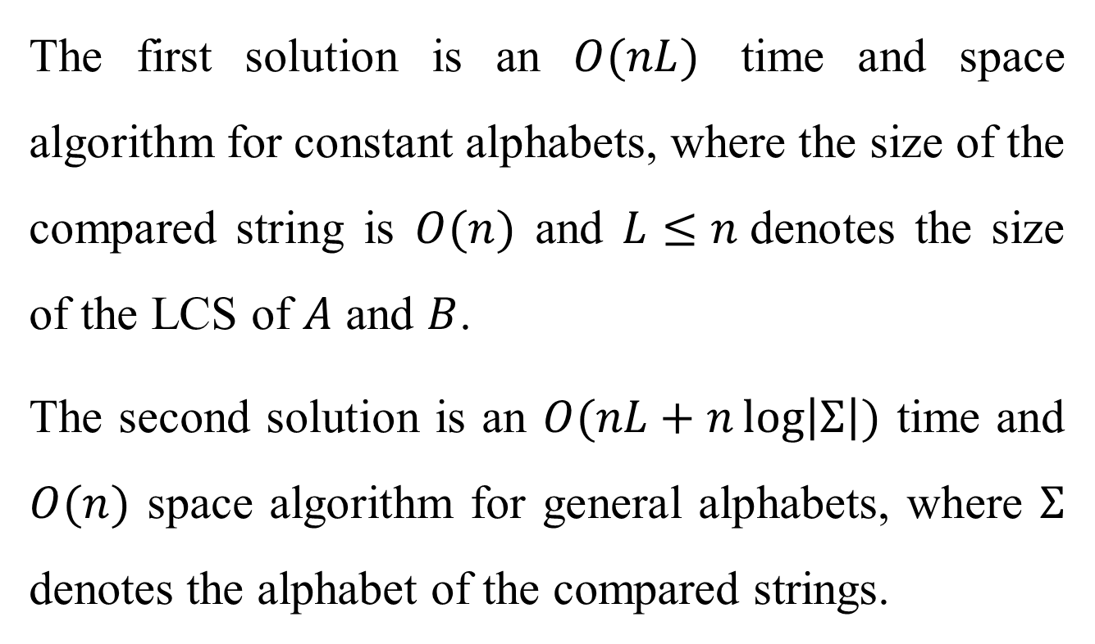
Abstract(3/3)
The first solution is an $O(nL)$ time and space algorithm for constant alphabets, where the size of the compared string is $O(n)$ and $L≤n$denotes the size of the LCS of $A$ and $B$.
The second solution is an $O(nL+n\log\left|Σ\right|)$ time and $O(n)$ space algorithm for general alphabets, where $Σ$ denotes the alphabet of the compared strings.

Slide 5
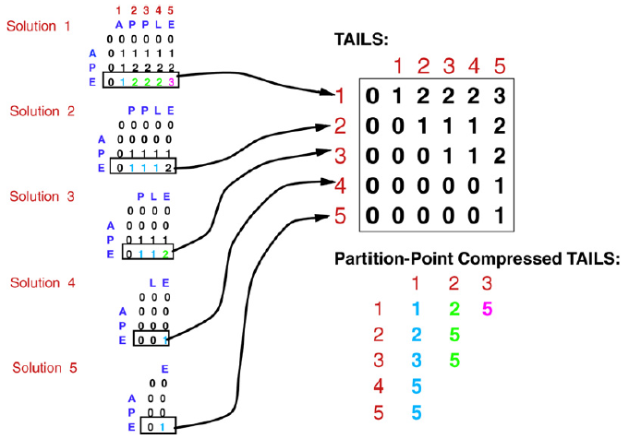
Consecutive Suffix Alignment Problem under LCS

Slide 6

The first algorithm
String $A=BCBADBDCD$ and $B=BCBD$.
 | 0 | 1 | 2 | 3 | 4
A | x | x | x | x | x
B | 1 | 3 | 3 | x | x
C | 2 | 2 | x | x | x
D | 4 | 4 | 4 | 4 | x

Slide 7
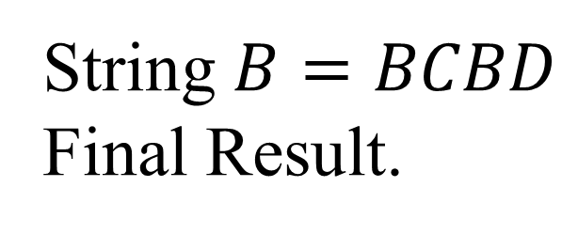
 | 0 | 1 | 2 | 3 | 4
A | x | x | x | x | x
B | 1 | 3 | 3 | x | x
C | 2 | 2 | x | x | x
D | 4 | 4 | 4 | 4 | x
String $B=BCBD$
Final Result.
 | B | C | B | A | D | B | D | C | D
1 | 1 | 1 | 1 | 1 | 1 | 1 | 1 | 1 | 1
2 |  | 2 | 2 | 2 | 2 | 2 | 2 | 2 | 2
3 |  |  | 3 | 3 | 3 | 3 | 3 | 3 | 3
4 |  |  |  |  | 4 | 4 | 4 | 4 | 4

Slide 8

 | 0 | 1 | 2 | 3 | 4
A | x | x | x | x | x
B | 1 | 3 | 3 | x | x
C | 2 | 2 | x | x | x
D | 4 | 4 | 4 | 4 | x
String $B=BCBD$
 | B | C | B | A | D | B | D | C | D
1
2
3
4

Slide 9
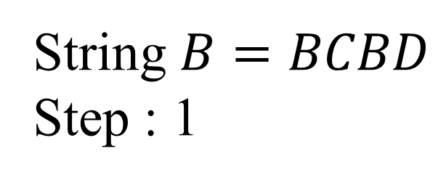
 | 0 | 1 | 2 | 3 | 4
A | x | x | x | x | x
B | 1 | 3 | 3 | x | x
C | 2 | 2 | x | x | x
D | 4 | 4 | 4 | 4 | x
String $B=BCBD$
Step : 1
 | B | C | B | A | D | B | D | C | D
1 |  |  |  |  |  |  |  |  | 4
2
3
4

Slide 10

 | 0 | 1 | 2 | 3 | 4
A | x | x | x | x | x
B | 1 | 3 | 3 | x | x
C | 2 | 2 | x | x | x
D | 4 | 4 | 4 | 4 | x
String $B=BCBD$
 | B | C | B | A | D | B | D | C | D
1 |  |  |  |  |  |  |  |  | 4
2
3
4

Slide 11
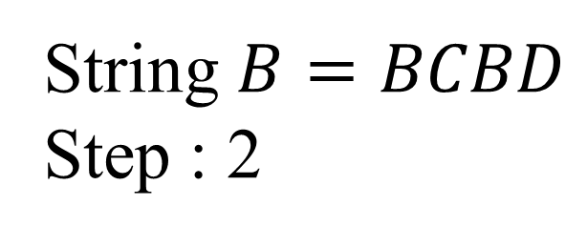
 | 0 | 1 | 2 | 3 | 4
A | x | x | x | x | x
B | 1 | 3 | 3 | x | x
C | 2 | 2 | x | x | x
D | 4 | 4 | 4 | 4 | x
String $B=BCBD$
Step : 2
 | B | C | B | A | D | B | D | C | D
1 |  |  |  |  |  |  |  | 2 | 4
2
3
4

Slide 12
 | 0 | 1 | 2 | 3 | 4
A | x | x | x | x | x
B | 1 | 3 | 3 | x | x
C | 2 | 2 | x | x | x
D | 4 | 4 | 4 | 4 | x
String $B=BCBD$
 | B | C | B | A | D | B | D | C | D
1 |  |  |  |  |  |  |  | 2 | 4
2
3
4

Slide 13
 | 0 | 1 | 2 | 3 | 4
A | x | x | x | x | x
B | 1 | 3 | 3 | x | x
C | 2 | 2 | x | x | x
D | 4 | 4 | 4 | 4 | x
String $B=BCBD$
 | B | C | B | A | D | B | D | C | D
1 |  |  |  |  |  |  |  | 2 | 2
2 |  |  |  |  |  |  |  |  | 4
3
4

Slide 14
 | 0 | 1 | 2 | 3 | 4
A | x | x | x | x | x
B | 1 | 3 | 3 | x | x
C | 2 | 2 | x | x | x
D | 4 | 4 | 4 | 4 | x
String $B=BCBD$
 | B | C | B | A | D | B | D | C | D
1 |  |  |  |  |  |  |  | 2 | 2
2 |  |  |  |  |  |  |  |  | 4
3
4

Slide 15
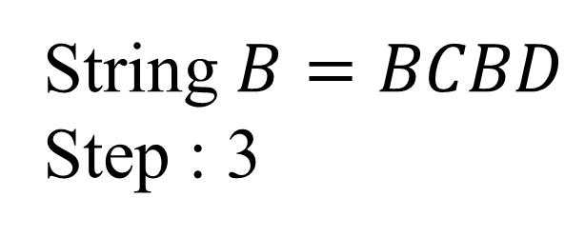
 | 0 | 1 | 2 | 3 | 4
A | x | x | x | x | x
B | 1 | 3 | 3 | x | x
C | 2 | 2 | x | x | x
D | 4 | 4 | 4 | 4 | x
String $B=BCBD$
Step : 3
 | B | C | B | A | D | B | D | C | D
1 |  |  |  |  |  |  | 4 | 2 | 2
2 |  |  |  |  |  |  |  |  | 4
3
4

Slide 16
 | 0 | 1 | 2 | 3 | 4
A | x | x | x | x | x
B | 1 | 3 | 3 | x | x
C | 2 | 2 | x | x | x
D | 4 | 4 | 4 | 4 | x
String $B=BCBD$
 | B | C | B | A | D | B | D | C | D
1 |  |  |  |  |  |  | 4 | 2 | 2
2 |  |  |  |  |  |  |  |  | 4
3
4

Slide 17
 | 0 | 1 | 2 | 3 | 4
A | x | x | x | x | x
B | 1 | 3 | 3 | x | x
C | 2 | 2 | x | x | x
D | 4 | 4 | 4 | 4 | x
String $B=BCBD$
 | B | C | B | A | D | B | D | C | D
1 |  |  |  |  |  |  | 4 | 2 | 2
2 |  |  |  |  |  |  |  |  | 4
3
4

Slide 18
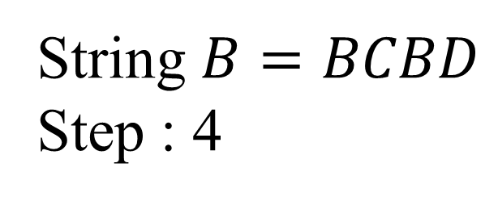
 | 0 | 1 | 2 | 3 | 4
A | x | x | x | x | x
B | 1 | 3 | 3 | x | x
C | 2 | 2 | x | x | x
D | 4 | 4 | 4 | 4 | x
String $B=BCBD$
Step : 4
 | B | C | B | A | D | B | D | C | D
1 |  |  |  |  |  | 1 | 4 | 2 | 2
2 |  |  |  |  |  |  |  |  | 4
3
4

Slide 19
 | 0 | 1 | 2 | 3 | 4
A | x | x | x | x | x
B | 1 | 3 | 3 | x | x
C | 2 | 2 | x | x | x
D | 4 | 4 | 4 | 4 | x
String $B=BCBD$
 | B | C | B | A | D | B | D | C | D
1 |  |  |  |  |  | 1 | 4 | 2 | 2
2 |  |  |  |  |  |  |  |  | 4
3
4

Slide 20
 | 0 | 1 | 2 | 3 | 4
A | x | x | x | x | x
B | 1 | 3 | 3 | x | x
C | 2 | 2 | x | x | x
D | 4 | 4 | 4 | 4 | x
String $B=BCBD$
 | B | C | B | A | D | B | D | C | D
1 |  |  |  |  |  | 1 | 1 | 2 | 2
2 |  |  |  |  |  |  | 4 |  | 4
3
4

Slide 21
 | 0 | 1 | 2 | 3 | 4
A | x | x | x | x | x
B | 1 | 3 | 3 | x | x
C | 2 | 2 | x | x | x
D | 4 | 4 | 4 | 4 | x
String $B=BCBD$
 | B | C | B | A | D | B | D | C | D
1 |  |  |  |  |  | 1 | 1 | 2 | 2
2 |  |  |  |  |  |  | 4 |  | 4
3
4

Slide 22
 | 0 | 1 | 2 | 3 | 4
A | x | x | x | x | x
B | 1 | 3 | 3 | x | x
C | 2 | 2 | x | x | x
D | 4 | 4 | 4 | 4 | x
String $B=BCBD$
 | B | C | B | A | D | B | D | C | D
1 |  |  |  |  |  | 1 | 1 | 1 | 2
2 |  |  |  |  |  |  | 4 | 2 | 4
3
4

Slide 23
 | 0 | 1 | 2 | 3 | 4
A | x | x | x | x | x
B | 1 | 3 | 3 | x | x
C | 2 | 2 | x | x | x
D | 4 | 4 | 4 | 4 | x
String $B=BCBD$
 | B | C | B | A | D | B | D | C | D
1 |  |  |  |  |  | 1 | 1 | 1 | 2
2 |  |  |  |  |  |  | 4 | 2 | 4
3
4

Slide 24
 | 0 | 1 | 2 | 3 | 4
A | x | x | x | x | x
B | 1 | 3 | 3 | x | x
C | 2 | 2 | x | x | x
D | 4 | 4 | 4 | 4 | x
String $B=BCBD$
 | B | C | B | A | D | B | D | C | D
1 |  |  |  |  |  | 1 | 1 | 1 | 1
2 |  |  |  |  |  |  | 4 | 2 | 2
3 |  |  |  |  |  |  |  |  | 4
4

Slide 25
 | 0 | 1 | 2 | 3 | 4
A | x | x | x | x | x
B | 1 | 3 | 3 | x | x
C | 2 | 2 | x | x | x
D | 4 | 4 | 4 | 4 | x
String $B=BCBD$
 | B | C | B | A | D | B | D | C | D
1 |  |  |  |  |  | 1 | 1 | 1 | 1
2 |  |  |  |  |  |  | 4 | 2 | 2
3 |  |  |  |  |  |  |  |  | 4
4

Slide 26
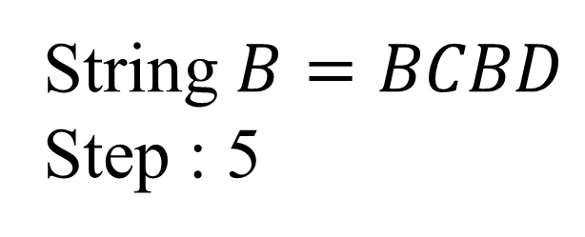
 | 0 | 1 | 2 | 3 | 4
A | x | x | x | x | x
B | 1 | 3 | 3 | x | x
C | 2 | 2 | x | x | x
D | 4 | 4 | 4 | 4 | x
String $B=BCBD$
Step : 5
 | B | C | B | A | D | B | D | C | D
1 |  |  |  |  | 4 | 1 | 1 | 1 | 1
2 |  |  |  |  |  |  | 4 | 2 | 2
3 |  |  |  |  |  |  |  |  | 4
4

Slide 27
 | 0 | 1 | 2 | 3 | 4
A | x | x | x | x | x
B | 1 | 3 | 3 | x | x
C | 2 | 2 | x | x | x
D | 4 | 4 | 4 | 4 | x
String $B=BCBD$
 | B | C | B | A | D | B | D | C | D
1 |  |  |  |  | 4 | 1 | 1 | 1 | 1
2 |  |  |  |  |  |  | 4 | 2 | 2
3 |  |  |  |  |  |  |  |  | 4
4

Slide 28
 | 0 | 1 | 2 | 3 | 4
A | x | x | x | x | x
B | 1 | 3 | 3 | x | x
C | 2 | 2 | x | x | x
D | 4 | 4 | 4 | 4 | x
String $B=BCBD$
 | B | C | B | A | D | B | D | C | D
1 |  |  |  |  | 4 | 1 | 1 | 1 | 1
2 |  |  |  |  |  |  | 4 | 2 | 2
3 |  |  |  |  |  |  |  |  | 4
4

Slide 29
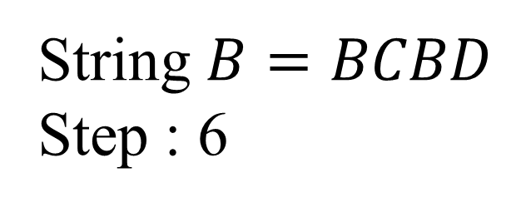
 | 0 | 1 | 2 | 3 | 4
A | x | x | x | x | x
B | 1 | 3 | 3 | x | x
C | 2 | 2 | x | x | x
D | 4 | 4 | 4 | 4 | x
String $B=BCBD$
Step : 6
 | B | C | B | A | D | B | D | C | D
1 |  |  |  |  | 4 | 1 | 1 | 1 | 1
2 |  |  |  |  |  |  | 4 | 2 | 2
3 |  |  |  |  |  |  |  |  | 4
4

Slide 30
 | 0 | 1 | 2 | 3 | 4
A | x | x | x | x | x
B | 1 | 3 | 3 | x | x
C | 2 | 2 | x | x | x
D | 4 | 4 | 4 | 4 | x
String $B=BCBD$
 | B | C | B | A | D | B | D | C | D
1 |  |  |  |  | 4 | 1 | 1 | 1 | 1
2 |  |  |  |  |  |  | 4 | 2 | 2
3 |  |  |  |  |  |  |  |  | 4
4

Slide 31
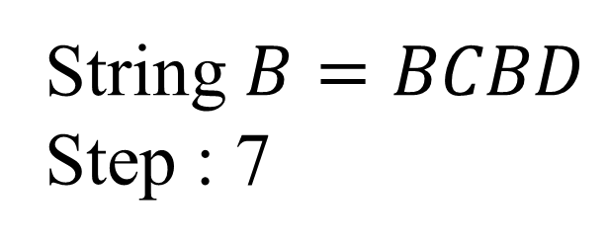
 | 0 | 1 | 2 | 3 | 4
A | x | x | x | x | x
B | 1 | 3 | 3 | x | x
C | 2 | 2 | x | x | x
D | 4 | 4 | 4 | 4 | x
String $B=BCBD$
Step : 7
 | B | C | B | A | D | B | D | C | D
1 |  |  | 1 |  | 4 | 1 | 1 | 1 | 1
2 |  |  |  |  |  |  | 4 | 2 | 2
3 |  |  |  |  |  |  |  |  | 4
4

Slide 32
 | 0 | 1 | 2 | 3 | 4
A | x | x | x | x | x
B | 1 | 3 | 3 | x | x
C | 2 | 2 | x | x | x
D | 4 | 4 | 4 | 4 | x
String $B=BCBD$
 | B | C | B | A | D | B | D | C | D
1 |  |  | 1 | 1 | 4 | 1 | 1 | 1 | 1
2 |  |  |  |  |  |  | 4 | 2 | 2
3 |  |  |  |  |  |  |  |  | 4
4

Slide 33
 | 0 | 1 | 2 | 3 | 4
A | x | x | x | x | x
B | 1 | 3 | 3 | x | x
C | 2 | 2 | x | x | x
D | 4 | 4 | 4 | 4 | x
String $B=BCBD$
 | B | C | B | A | D | B | D | C | D
1 |  |  | 1 | 1 | 4 | 1 | 1 | 1 | 1
2 |  |  |  |  |  |  | 4 | 2 | 2
3 |  |  |  |  |  |  |  |  | 4
4

Slide 34
 | 0 | 1 | 2 | 3 | 4
A | x | x | x | x | x
B | 1 | 3 | 3 | x | x
C | 2 | 2 | x | x | x
D | 4 | 4 | 4 | 4 | x
String $B=BCBD$
 | B | C | B | A | D | B | D | C | D
1 |  |  | 1 | 1 | 1 | 1 | 1 | 1 | 1
2 |  |  |  |  | 4 |  | 4 | 2 | 2
3 |  |  |  |  |  |  |  |  | 4
4

Slide 35
 | 0 | 1 | 2 | 3 | 4
A | x | x | x | x | x
B | 1 | 3 | 3 | x | x
C | 2 | 2 | x | x | x
D | 4 | 4 | 4 | 4 | x
String $B=BCBD$
 | B | C | B | A | D | B | D | C | D
1 |  |  | 1 | 1 | 1 | 1 | 1 | 1 | 1
2 |  |  |  |  | 4 |  | 4 | 2 | 2
3 |  |  |  |  |  |  |  |  | 4
4

Slide 36
 | 0 | 1 | 2 | 3 | 4
A | x | x | x | x | x
B | 1 | 3 | 3 | x | x
C | 2 | 2 | x | x | x
D | 4 | 4 | 4 | 4 | x
String $B=BCBD$
 | B | C | B | A | D | B | D | C | D
1 |  |  | 1 | 1 | 1 | 1 | 1 | 1 | 1
2 |  |  |  |  | 4 | 3 | 4 | 2 | 2
3 |  |  |  |  |  |  |  |  | 4
4

Slide 37
 | 0 | 1 | 2 | 3 | 4
A | x | x | x | x | x
B | 1 | 3 | 3 | x | x
C | 2 | 2 | x | x | x
D | 4 | 4 | 4 | 4 | x
String $B=BCBD$
 | B | C | B | A | D | B | D | C | D
1 |  |  | 1 | 1 | 1 | 1 | 1 | 1 | 1
2 |  |  |  |  | 4 | 3 | 4 | 2 | 2
3 |  |  |  |  |  |  |  |  | 4
4

Slide 38
 | 0 | 1 | 2 | 3 | 4
A | x | x | x | x | x
B | 1 | 3 | 3 | x | x
C | 2 | 2 | x | x | x
D | 4 | 4 | 4 | 4 | x
String $B=BCBD$
 | B | C | B | A | D | B | D | C | D
1 |  |  | 1 | 1 | 1 | 1 | 1 | 1 | 1
2 |  |  |  |  | 4 | 3 | 3 | 2 | 2
3 |  |  |  |  |  |  | 4 |  | 4
4

Slide 39
 | 0 | 1 | 2 | 3 | 4
A | x | x | x | x | x
B | 1 | 3 | 3 | x | x
C | 2 | 2 | x | x | x
D | 4 | 4 | 4 | 4 | x
String $B=BCBD$
 | B | C | B | A | D | B | D | C | D
1 |  |  | 1 | 1 | 1 | 1 | 1 | 1 | 1
2 |  |  |  |  | 4 | 3 | 3 | 2 | 2
3 |  |  |  |  |  |  | 4 |  | 4
4

Slide 40
 | 0 | 1 | 2 | 3 | 4
A | x | x | x | x | x
B | 1 | 3 | 3 | x | x
C | 2 | 2 | x | x | x
D | 4 | 4 | 4 | 4 | x
String $B=BCBD$
 | B | C | B | A | D | B | D | C | D
1 |  |  | 1 | 1 | 1 | 1 | 1 | 1 | 1
2 |  |  |  |  | 4 | 3 | 3 | 2 | 2
3 |  |  |  |  |  |  | 4 | 4 | 4
4

Slide 41
 | 0 | 1 | 2 | 3 | 4
A | x | x | x | x | x
B | 1 | 3 | 3 | x | x
C | 2 | 2 | x | x | x
D | 4 | 4 | 4 | 4 | x
String $B=BCBD$
 | B | C | B | A | D | B | D | C | D
1 |  |  | 1 | 1 | 1 | 1 | 1 | 1 | 1
2 |  |  |  |  | 4 | 3 | 3 | 2 | 2
3 |  |  |  |  |  |  | 4 | 4 | 4
4

Slide 42
 | 0 | 1 | 2 | 3 | 4
A | x | x | x | x | x
B | 1 | 3 | 3 | x | x
C | 2 | 2 | x | x | x
D | 4 | 4 | 4 | 4 | x
String $B=BCBD$
 | B | C | B | A | D | B | D | C | D
1 |  |  | 1 | 1 | 1 | 1 | 1 | 1 | 1
2 |  |  |  |  | 4 | 3 | 3 | 2 | 2
3 |  |  |  |  |  |  | 4 | 4 | 4
4

Slide 43
 | 0 | 1 | 2 | 3 | 4
A | x | x | x | x | x
B | 1 | 3 | 3 | x | x
C | 2 | 2 | x | x | x
D | 4 | 4 | 4 | 4 | x
String $B=BCBD$
Final Result.
 | B | C | B | A | D | B | D | C | D
1 | 1 | 1 | 1 | 1 | 1 | 1 | 1 | 1 | 1
2 |  | 2 | 2 | 2 | 2 | 2 | 2 | 2 | 2
3 |  |  | 3 | 3 | 3 | 3 | 3 | 3 | 3
4 |  |  |  |  | 4 | 4 | 4 | 4 | 4

Slide 44

Conclusion
Match Table : $O(n\left|Σ\right|)$ time and space.
Get the solution : $O(nL)$ time and space.
For constant alphabets.

