Slide 1
Approximating Maximum Clique by Removing Subgraphs
Uriel Feige
SIAM J. DISCRETE MATH, Vol.18, No.2, pp. 219-225 (2004)
Presenter: Shiou-Zong Chiou
Date:2016/08/23

Slide 2
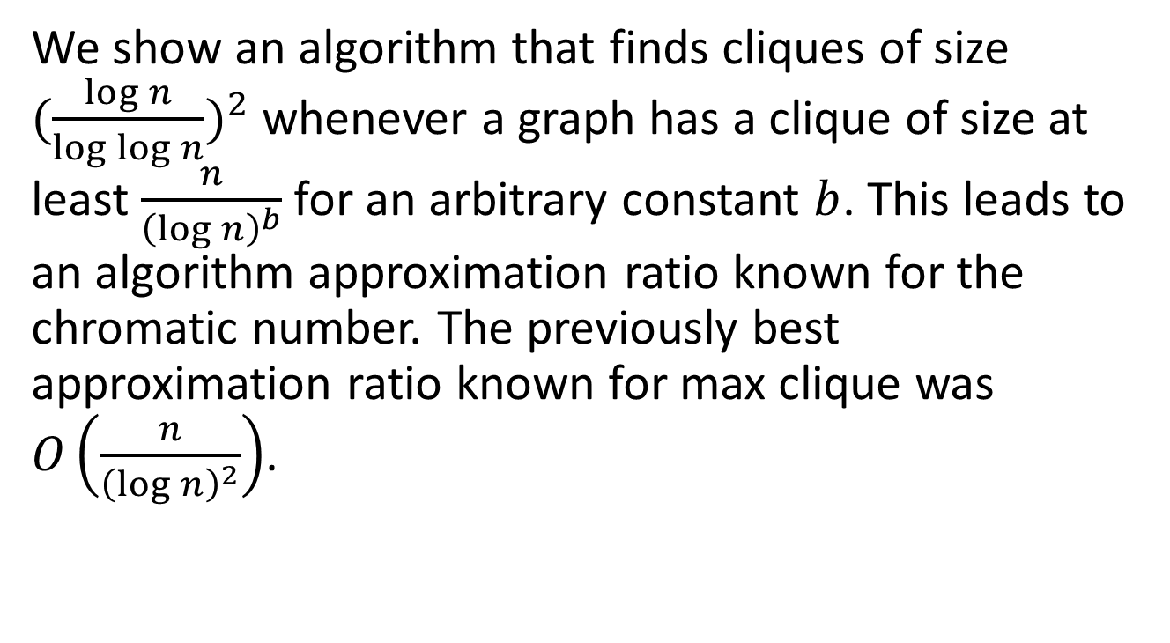
Abstract
We show an algorithm that finds cliques of size ${(\frac{\log{n}}{\log{\log{n}}})}^{2}$ whenever a graph has a clique of size at least $\frac{n}{{\left(\log{n}\right)}^{b}}$ for an arbitrary constant $b$. This leads to an algorithm approximation ratio known for the chromatic number. The previously best approximation ratio known for max clique was $O\left(\frac{n}{{\left(\log{n}\right)}^{2}}\right)$.

Slide 3
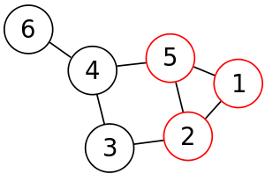
Max Clique Problem

Slide 4

Algorithm
Let $G$ be a graph with a clique of size $\frac{n}{k}.$
We call a subgraph $S$ is poor if it does not contain a clique of size $\frac{\left|S\right|}{2k}$.

Slide 5
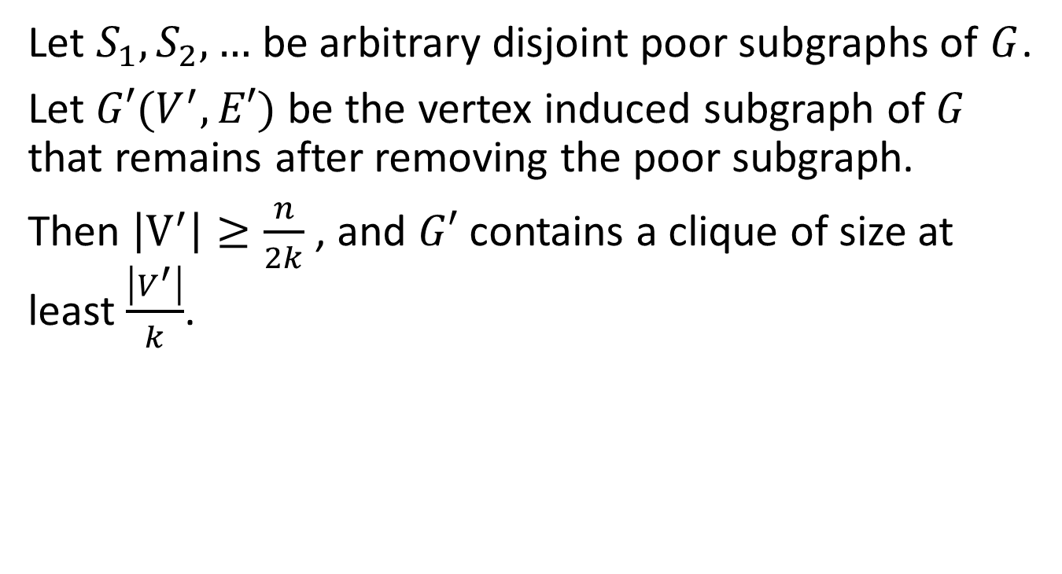
Algorithm
Let $S_{1},S_{2},…$ be arbitrary disjoint poor subgraphs of $G$.
Let $G′(V^{′},E′)$ be the vertex induced subgraph of $G$ that remains after removing the poor subgraph.
Then $\left|V^{′}\right|≥\frac{n}{2k}$ , and $G′$ contains a clique of size at least $\frac{\left|V^{′}\right|}{k}$.

Slide 6
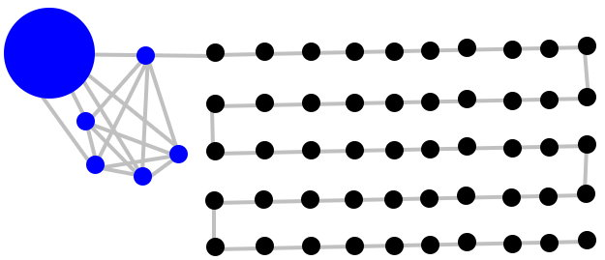
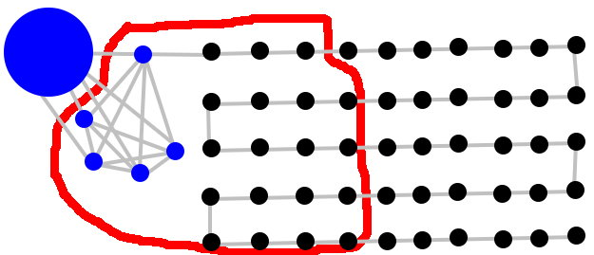
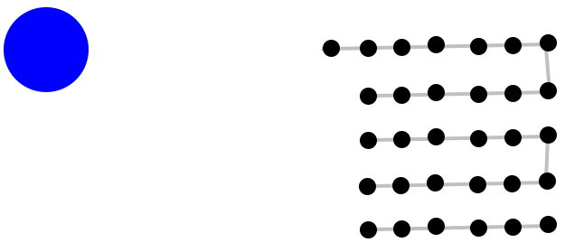

Algorithm
$$k=2$$
$$\frac{24}{2k}=6$$

Slide 7
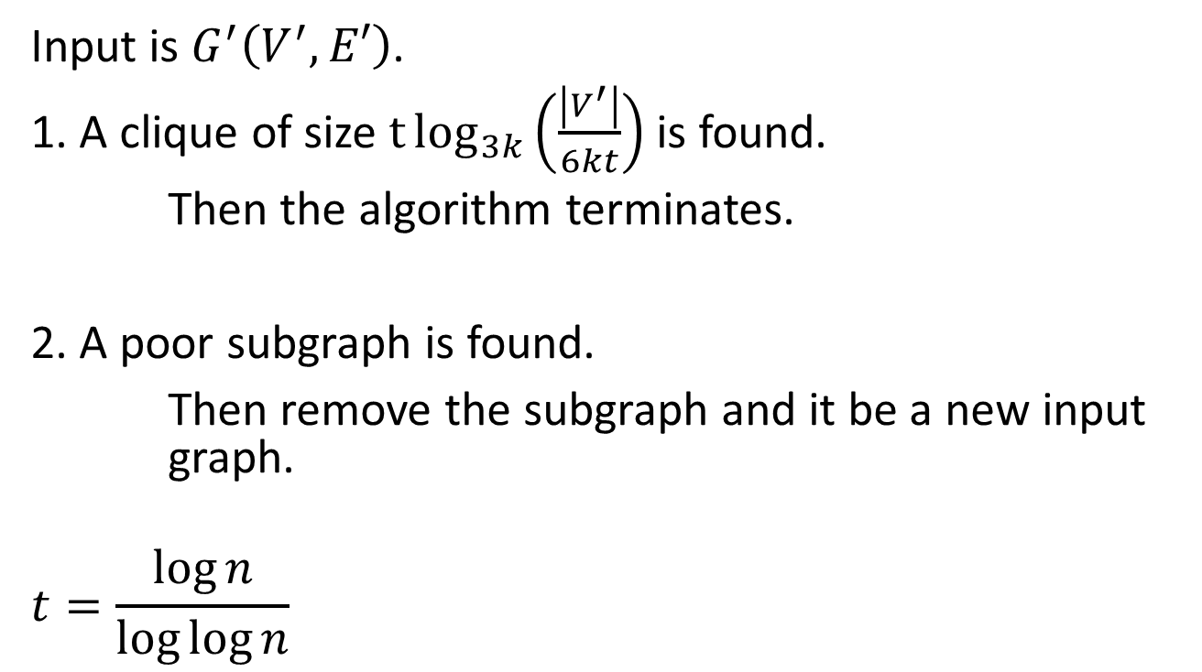
Algorithm
Input is $G^{′}\left(V^{′},E′\right)$.
1. A clique of size $t\log_{3k}\left(\frac{\left|V^{′}\right|}{6kt}\right)$ is found.
Then the algorithm terminates.
2. A poor subgraph is found.
Then remove the subgraph and it be a new input graph.
$$t=\frac{\log{n}}{\log{\log{n}}}$$

Slide 8
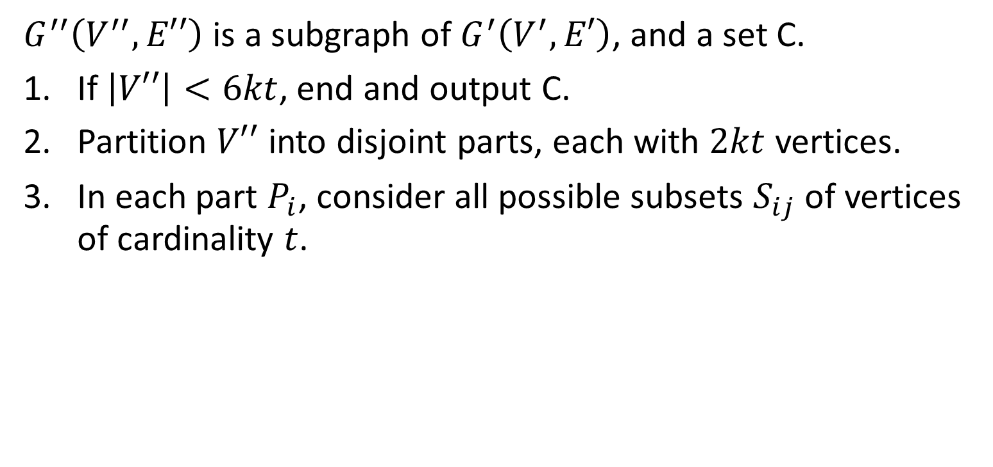
Algorithm
$G^{′′}\left(V^{′′},E′′\right)$ is a subgraph of $G^{′}\left(V^{′},E′\right)$, and a set C.
If $\left|V′′\right|<6kt$, end and output C.
Partition $V′′$ into disjoint parts, each with $2kt$ vertices.
In each part $P_{i}$, consider all possible subsets $S_{ij}$ of vertices of cardinality $t$.

Slide 9
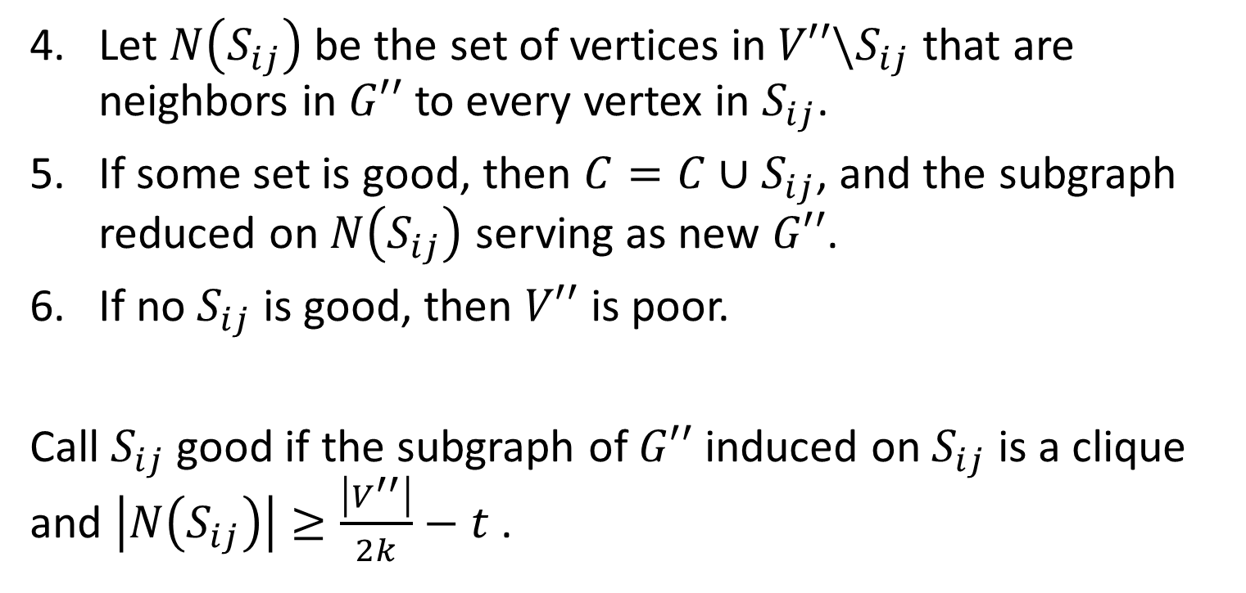
Algorithm
Let $N\left(S_{ij}\right)$ be the set of vertices in $V′′\backslash S_{ij}$ that are neighbors in $G′′$ to every vertex in $S_{ij}$.
If some set is good, then $C=C∪S_{ij}$, and the subgraph reduced on $N\left(S_{ij}\right)$ serving as new $G′′$.
If no $S_{ij}$ is good, then $V′′$ is poor.
Call $S_{ij}$ good if the subgraph of $G′′$ induced on $S_{ij}$ is a clique and $\left|N\left(S_{ij}\right)\right|≥\frac{\left|V^{′′}\right|}{2k}−t$ .

Slide 10
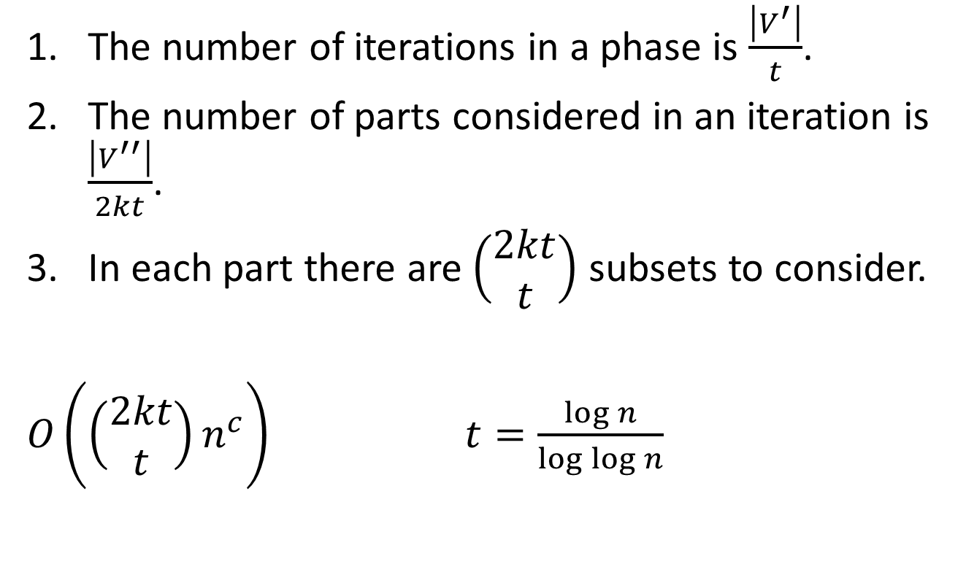
Time Complexity
The number of iterations in a phase is $\frac{\left|V^{′}\right|}{t}$.
The number of parts considered in an iteration is $\frac{\left|V^{′′}\right|}{2kt}$.
In each part there are $\left(\begin{matrix}2kt \\ t\end{matrix}\right)$ subsets to consider.
$O\left(\left(\begin{matrix}2kt \\ t\end{matrix}\right)n^{c}\right)$ $t=\frac{\log{n}}{\log{\log{n}}}$

Slide 11
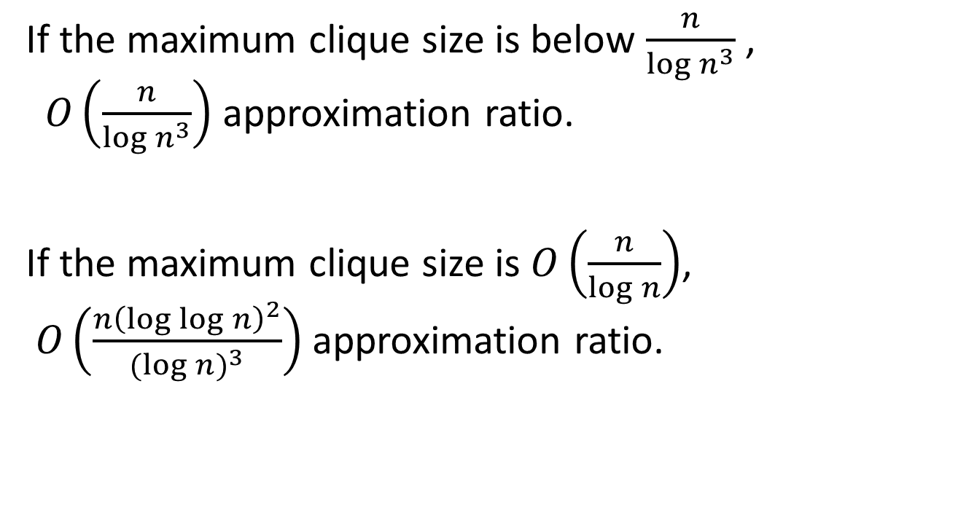
Approximation Ratio
If the maximum clique size is below $\frac{n}{{\log{n}}^{3}}$ , $O\left(\frac{n}{{\log{n}}^{3}}\right)$ approximation ratio.
If the maximum clique size is $O\left(\frac{n}{\log{n}}\right)$, $O\left(\frac{n{\left(\log{\log{n}}\right)}^{2}}{{(log{n})}^{3}}\right)$ approximation ratio.

