Slide 1
New Efficient Algorithms for LCS and Constrained LCS Problem
Information Processing Letters
Vol. 106, 31 March 2008, pp. 13–18
Costas S. Iliopoulos, M. Sohel Rahman
Presenter：Siang-Huai Hung
Date：2016/08/23

Slide 2
Abstract
In this paper, we study the classic and well-studied longest common subsequence (LCS) problem and a recent variant of it namely constrained LCS (CLCS) problem. In CLCS, the computed LCS must also be a supersequence of a third given string. In this paper, we first present an efficient algorithm for the traditional LCS problem that runs in O(Rlog log n + n) time, where R is the total number of ordered pairs of positions at which the two strings match and n is the length of the two given strings. Then, using this algorithm, we devise an algorithm for the CLCS problem having time complexity O(pRlog log n + n) in the worst case, where p is the length of the third string. Note that, if R = o(n²), our algorithm will perform very well but, if R = O(n²), then, due to the log log n term, our algorithms will behave slightly worse than the existing algorithms.

Slide 3
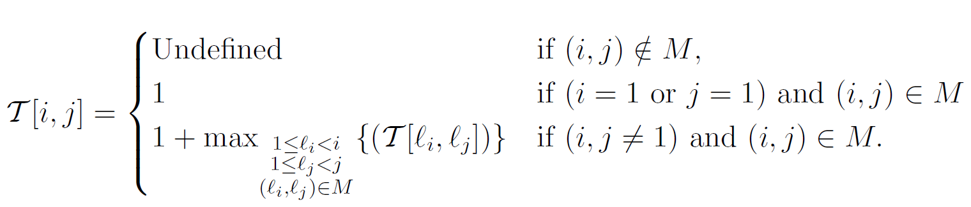
A new Algorithm for Problem LCS
T[i,j]:
 |  | 1 | 2 | 3 | 4 | 5 | 6
 |  | A | C | C | A | A | G
1 | T | - | - | - | - | - | -
2 | C | - | 1 | 1 | - | - | -
3 | C | - | 1 | 2 | - | - | -
4 | A | 1 | - | - | 3 | 3 | -
5 | C | - | 2 | 2 | - | - | -
6 | A | 1 | - | - | 3 | 4 | -
A = TCCACA
B = ACCAAG

Slide 4
BoundedHeap
1. Insert(H, pos, val, data): Insert into the BoundedHeap H the position pos with value val and associated information data.
2. Increase Value(H, pos, val, data): If H does not already contain the position pos, perform Insert(H, pos, val, data). Otherwise, set this position's value to max{val, val’}, where val’ is its previous value.
3. BoundedMax(H, pos): Return the item (with additional data) that has maximum value among all items in H with position smaller than pos. If H does not contain any items with position smaller than pos, return 0.
4.O(log log n) time, O(n) space

Slide 5
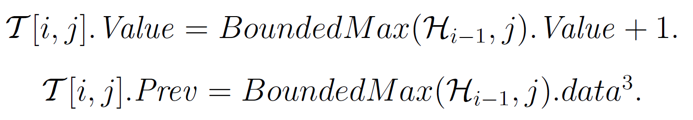

Slide 6
H₀
 |  | 1 | 2 | 3 | 4 | 5 | 6
 |  | A | C | C | A | A | G
1 | T | - | - | - | - | - | -
2 | C | - | 1 | 1 | - | - | -
3 | C | - | 1 | 2 | - | - | -
4 | A | 1 | - | - | 3 | 3 | -
5 | C | - | 2 | 2 | - | - | -
6 | A | 1 | - | - | 3 | 4 | -
1 | 2 | 3 | 4 | 5 | 6
€ | € | € | € | € | €
H₁
1 | 2 | 3 | 4 | 5 | 6
€ | € | € | € | € | €
A = TCCACA
B = ACCAAG

Slide 7
 |  | 1 | 2 | 3 | 4 | 5 | 6
 |  | A | C | C | A | A | G
1 | T | - | - | - | - | - | -
2 | C | - | 1 | 1 | - | - | -
3 | C | - | 1 | 2 | - | - | -
4 | A | 1 | - | - | 3 | 3 | -
5 | C | - | 2 | 2 | - | - | -
6 | A | 1 | - | - | 3 | 4 | -
H₁
1 | 2 | 3 | 4 | 5 | 6
€ | € | € | € | € | €
H₂
1 | 2 | 3 | 4 | 5 | 6
€ | 1,(2,2) | 1,(2,3) | € | € | €
A = TCCACA
B = ACCAAG

Slide 8
 |  | 1 | 2 | 3 | 4 | 5 | 6
 |  | A | C | C | A | A | G
1 | T | - | - | - | - | - | -
2 | C | - | 1 | 1 | - | - | -
3 | C | - | 1 | 2 | - | - | -
4 | A | 1 | - | - | 3 | 3 | -
5 | C | - | 2 | 2 | - | - | -
6 | A | 1 | - | - | 3 | 4 | -
H₂
1 | 2 | 3 | 4 | 5 | 6
€ | 1,(2,2) | 1,(2,3) | € | € | €
H₃
A = TCCACA
B = ACCAAG
1 | 2 | 3 | 4 | 5 | 6
€ | 1,(2,2) | 2,(3,3) | € | € | €

Slide 9
 |  | 1 | 2 | 3 | 4 | 5 | 6
 |  | A | C | C | A | A | G
1 | T | - | - | - | - | - | -
2 | C | - | 1 | 1 | - | - | -
3 | C | - | 1 | 2 | - | - | -
4 | A | 1 | - | - | 3 | 3 | -
5 | C | - | 2 | 2 | - | - | -
6 | A | 1 | - | - | 3 | 4 | -
H₃
A = TCCACA
B = ACCAAG
1 | 2 | 3 | 4 | 5 | 6
€ | 1,(2,2) | 2,(3,3) | € | € | €
H₄
1 | 2 | 3 | 4 | 5 | 6
1,(4,1) | 1,(2,2) | 2,(3,3) | 3,(4,4) | 3,(4,5) | €

Slide 10
 |  | 1 | 2 | 3 | 4 | 5 | 6
 |  | A | C | C | A | A | G
1 | T | - | - | - | - | - | -
2 | C | - | 1 | 1 | - | - | -
3 | C | - | 1 | 2 | - | - | -
4 | A | 1 | - | - | 3 | 3 | -
5 | C | - | 2 | 2 | - | - | -
6 | A | 1 | - | - | 3 | 4 | -
A = TCCACA
B = ACCAAG
H₄
1 | 2 | 3 | 4 | 5 | 6
1,(4,1) | 1,(2,2) | 2,(3,3) | 3,(4,4) | 3,(4,5) | €
H₅
1 | 2 | 3 | 4 | 5 | 6
1,(4,1) | 1,(2,2) | 2,(3,3) | 3,(4,4) | 3,(4,5) | €

Slide 11
 |  | 1 | 2 | 3 | 4 | 5 | 6
 |  | A | C | C | A | A | G
1 | T | - | - | - | - | - | -
2 | C | - | 1 | 1 | - | - | -
3 | C | - | 1 | 2 | - | - | -
4 | A | 1 | - | - | 3 | 3 | -
5 | C | - | 2 | 2 | - | - | -
6 | A | 1 | - | - | 3 | 4 | -
A = TCCACA
B = ACCAAG
H₅
1 | 2 | 3 | 4 | 5 | 6
1,(4,1) | 1,(2,2) | 2,(3,3) | 3,(4,4) | 3,(4,5) | €
H₆
1 | 2 | 3 | 4 | 5 | 6
1,(4,1) | 1,(2,2) | 2,(3,3) | 3,(4,4) | 4,(6,5) | €

Slide 12
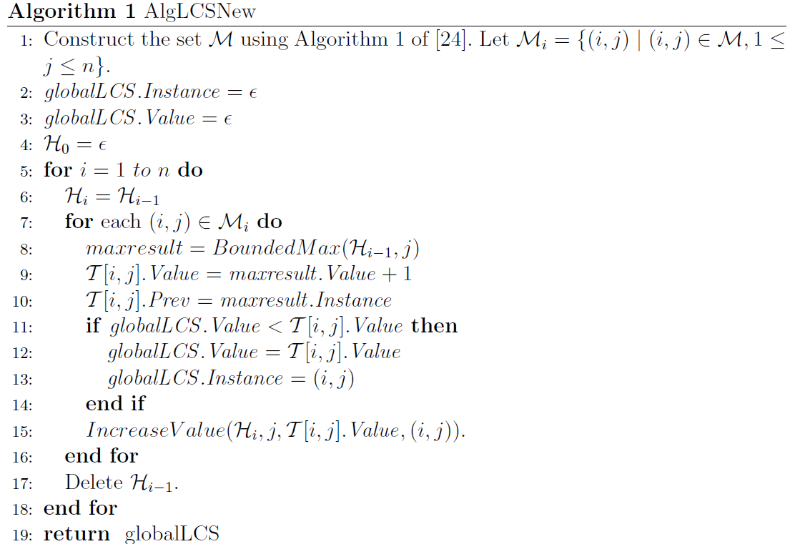

Slide 13
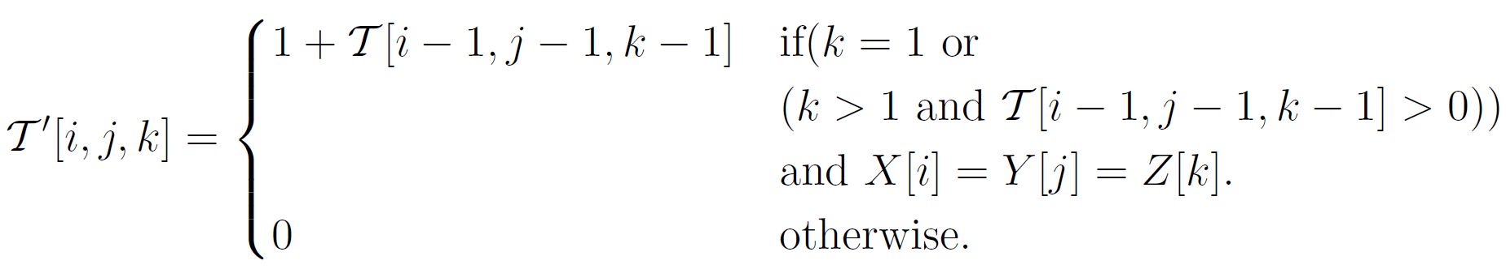
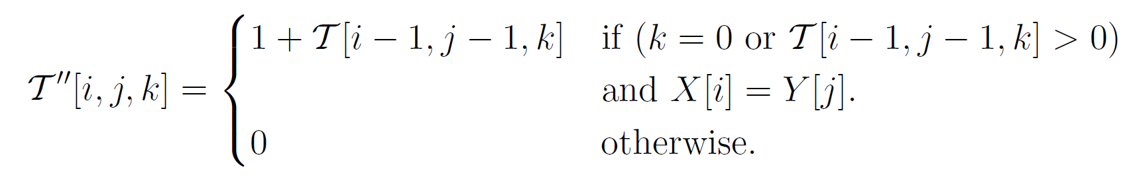
CLCS Algorithm
A = TCCACA
B = ACCAAG
C = AC

Slide 14
T[i,j,0]:
 |  | 0 | 1 | 2 | 3 | 4 | 5 | 6
 |  | - | A | C | C | A | A | G
0 | - | 0 | 0 | 0 | 0 | 0 | 0 | 0
1 | T | 0 | 0 | 0 | 0 | 0 | 0 | 0
2 | C | 0 | 0 | 1 | 1 | 1 | 1 | 1
3 | C | 0 | 0 | 1 | 2 | 2 | 2 | 2
4 | A | 0 | 1 | 1 | 2 | 3 | 3 | 3
5 | C | 0 | 1 | 2 | 2 | 3 | 3 | 3
6 | A | 0 | 1 | 2 | 2 | 3 | 4 | 4
T [i, j, k] = max{T’[i, j, k], T”[i, j, k],
T [i, j-1, k], T [i-1, j, k]}
T [i, 0, k] = T [0, j, k] = 0,
0 ≤ i, j ≤ n, 0 ≤ k ≤ p.
T’[i,j,0]:
T’’[i,j,0]:
 |  | 0 | 1 | 2 | 3 | 4 | 5 | 6
 |  | - | A | C | C | A | A | G
0 | - | 0 | 0 | 0 | 0 | 0 | 0 | 0
1 | T | 0 | 0 | 0 | 0 | 0 | 0 | 0
2 | C | 0 | 0 | 0 | 0 | 0 | 0 | 0
3 | C | 0 | 0 | 0 | 0 | 0 | 0 | 0
4 | A | 0 | 0 | 0 | 0 | 0 | 0 | 0
5 | C | 0 | 0 | 0 | 0 | 0 | 0 | 0
6 | A | 0 | 0 | 0 | 0 | 0 | 0 | 0
 |  | 0 | 1 | 2 | 3 | 4 | 5 | 6
 |  | - | A | C | C | A | A | G
0 | - | 0 | 0 | 0 | 0 | 0 | 0 | 0
1 | T | 0 | 0 | 0 | 0 | 0 | 0 | 0
2 | C | 0 | 0 | 1 | 1 | 0 | 0 | 0
3 | C | 0 | 0 | 1 | 2 | 0 | 0 | 0
4 | A | 0 | 1 | 0 | 0 | 3 | 3 | 0
5 | C | 0 | 0 | 2 | 2 | 0 | 0 | 0
6 | A | 0 | 1 | 0 | 0 | 3 | 4 | 0

Slide 15
T[i,j,1]:
 |  | 0 | 1 | 2 | 3 | 4 | 5 | 6
 |  | - | A | C | C | A | A | G
0 | - | 0 | 0 | 0 | 0 | 0 | 0 | 0
1 | T | 0 | 0 | 0 | 0 | 0 | 0 | 0
2 | C | 0 | 0 | 0 | 0 | 0 | 0 | 0
3 | C | 0 | 0 | 0 | 0 | 0 | 0 | 0
4 | A | 0 | 1 | 1 | 1 | 3 | 3 | 3
5 | C | 0 | 1 | 2 | 2 | 3 | 3 | 3
6 | A | 0 | 1 | 2 | 2 | 3 | 4 | 4
T [i, j, k] = max{T’[i, j, k], T”[i, j, k],
T [i, j-1, k], T [i-1, j, k]}
T [i, 0, k] = T [0, j, k] = 0,
0 ≤ i, j ≤ n, 0 ≤ k ≤ p.
T’[i,j,1]:
T’’[i,j,1]:
 |  | 0 | 1 | 2 | 3 | 4 | 5 | 6
 |  | - | A | C | C | A | A | G
0 | - | 0 | 0 | 0 | 0 | 0 | 0 | 0
1 | T | 0 | 0 | 0 | 0 | 0 | 0 | 0
2 | C | 0 | 0 | 0 | 0 | 0 | 0 | 0
3 | C | 0 | 0 | 0 | 0 | 0 | 0 | 0
4 | A | 0 | 1 | 0 | 0 | 3 | 3 | 0
5 | C | 0 | 0 | 0 | 0 | 0 | 0 | 0
6 | A | 0 | 1 | 0 | 0 | 3 | 4 | 0
 |  | 0 | 1 | 2 | 3 | 4 | 5 | 6
 |  | - | A | C | C | A | A | G
0 | - | 0 | 0 | 0 | 0 | 0 | 0 | 0
1 | T | 0 | 0 | 0 | 0 | 0 | 0 | 0
2 | C | 0 | 0 | 0 | 0 | 0 | 0 | 0
3 | C | 0 | 0 | 0 | 0 | 0 | 0 | 0
4 | A | 0 | 0 | 0 | 0 | 0 | 0 | 0
5 | C | 0 | 0 | 2 | 2 | 0 | 0 | 0
6 | A | 0 | 0 | 0 | 0 | 3 | 4 | 0

Slide 16
T[i,j,2]:
 |  | 0 | 1 | 2 | 3 | 4 | 5 | 6
 |  | - | A | C | C | A | A | G
0 | - | 0 | 0 | 0 | 0 | 0 | 0 | 0
1 | T | 0 | 0 | 0 | 0 | 0 | 0 | 0
2 | C | 0 | 0 | 0 | 0 | 0 | 0 | 0
3 | C | 0 | 0 | 0 | 0 | 0 | 0 | 0
4 | A | 0 | 0 | 0 | 0 | 0 | 0 | 0
5 | C | 0 | 0 | 2 | 2 | 2 | 2 | 2
6 | A | 0 | 0 | 2 | 2 | 3 | 3 | 3
T [i, j, k] = max{T’[i, j, k], T”[i, j, k],
T [i, j-1, k], T [i-1, j, k]}
T [i, 0, k] = T [0, j, k] = 0,
0 ≤ i, j ≤ n, 0 ≤ k ≤ p.
T’[i,j,2]:
T’’[i,j,2]:
 |  | 0 | 1 | 2 | 3 | 4 | 5 | 6
 |  | - | A | C | C | A | A | G
0 | - | 0 | 0 | 0 | 0 | 0 | 0 | 0
1 | T | 0 | 0 | 0 | 0 | 0 | 0 | 0
2 | C | 0 | 0 | 0 | 0 | 0 | 0 | 0
3 | C | 0 | 0 | 0 | 0 | 0 | 0 | 0
4 | A | 0 | 0 | 0 | 0 | 0 | 0 | 0
5 | C | 0 | 0 | 2 | 2 | 0 | 0 | 0
6 | A | 0 | 0 | 0 | 0 | 0 | 0 | 0
 |  | 0 | 1 | 2 | 3 | 4 | 5 | 6
 |  | - | A | C | C | A | A | G
0 | - | 0 | 0 | 0 | 0 | 0 | 0 | 0
1 | T | 0 | 0 | 0 | 0 | 0 | 0 | 0
2 | C | 0 | 0 | 0 | 0 | 0 | 0 | 0
3 | C | 0 | 0 | 0 | 0 | 0 | 0 | 0
4 | A | 0 | 0 | 0 | 0 | 0 | 0 | 0
5 | C | 0 | 0 | 0 | 0 | 0 | 0 | 0
6 | A | 0 | 0 | 0 | 0 | 3 | 3 | 0

Slide 17
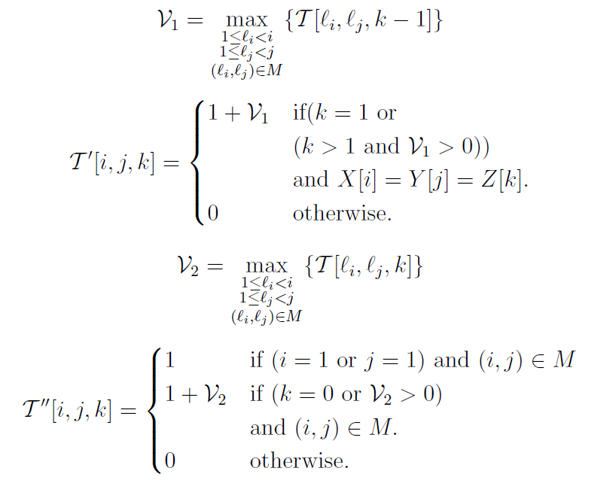

Slide 18
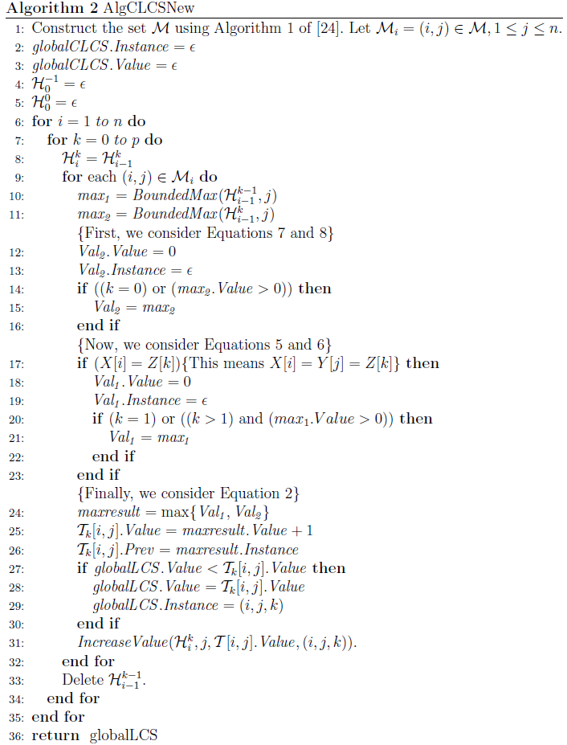

Slide 19
Thanks for listening

