Slide 1
Classification of Time Series Data by One Class Classifier using DTW-D
Kumar Vasimalla ,
C. Narasimham ,
B. Sujith
Procedia Computer Science 54 (2015)343-352
Presenter : Shu-Kai, Hung
Date : 2016/8/23

Slide 2
Abstract
Time series data classification is an important problem and it have number of applications in scientific environment, activity and gesture recognition, anthropology, entomology, sports etc. The most of the research community working on time series classification typically testing their algorithms using datasets available in UCR and other data repositories, which contain labeled training data and test data. But in reality getting labeled time series data is often very difficult and requires some expert help on that domain. But it is possible to get real time series data with one class label. The possible approach to solve this problem is semi-supervised learning algorithm with a special distance measure DTW-D, and compared this approach with semi-supervised learning with Euclidean Distance, semi-supervised learning with Dynamic Time Warping. We showed that our approach is better one compared to other two approaches, and also explained why other approaches have less accuracy. We demonstrate our ideas on diverse real world problems.

Slide 3


dynamic time warping(DTW)
Two times series:
X = (1,1,2,3,2,0)
Y = (0,1,1,2,3,2,1)
$d\left(x,y\right)=$ ${{(d}_{x}−d_{y})}^{2}$

Slide 4
機器學習
監督式學習 :輸入數據被稱為「訓練數據」(training data) ，每組數據有一明確標示，學習過程不段跟預測結果做調整，直到達到所要預測的準確率
非監督式學習：數據並不被特別標識，學習模型是為了推斷出數據的一些內在結構。Ex: K-means
半監督式學習 semi-supervised learning(SSL)：輸入數據部分被標識，部分沒有被標識，這種學習模型可以用來進行預測，但是模型首先需要學習數據的內在結構以便合理的組織數據來進行預測。

Slide 5
Positive Unlabeled learning (PU Learning)
Definition 1. P is a set of training data including all positive labelled objects.
P 為被分類過且訓練過的一群object
Definition 2. U is the set of unlabeled data.
U 為未被分類且未被訓練過或已被訓練過的一群object，大部分為未被訓練的
其中object即為一組time series

Slide 6
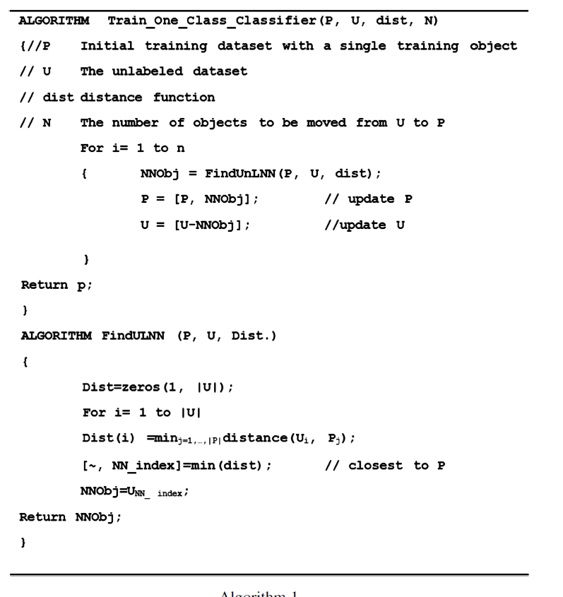
data
training
P set(one single object)
U set
algorithm
Distance function(DTW-D)

Slide 7
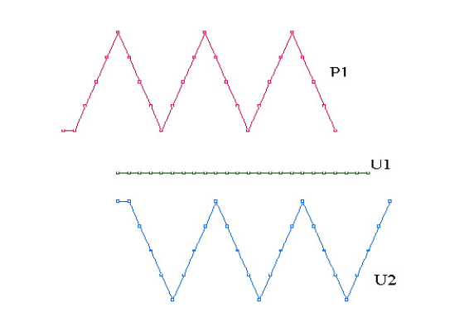
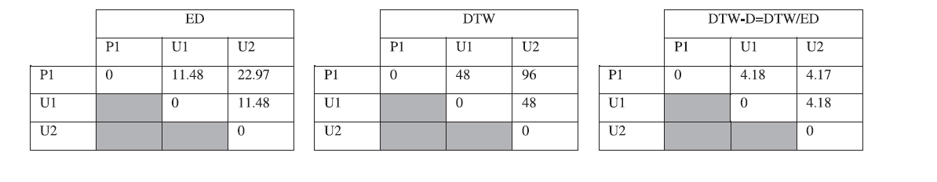
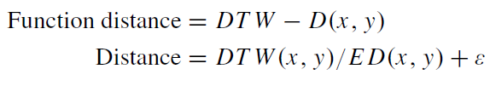
DTW-D(ratio of distance)
P1 = 5, 5, 6, 7, 8, 9, 8, 7, 6, 5, 6, 7, 8, 9, 8, 7, 6, 5, 6, 7, 8, 9, 8, 7, 6, 5.
U1 = 5, 5, 5, 5, 5, 5, 5, 5, 5, 5, 5, 5, 5, 5, 5, 5, 5, 5, 5, 5, 5, 5, 5, 5, 5, 5.
U2 = 5, 5, 4, 3, 2, 1, 2, 3, 4, 5, 4, 3, 2, 1, 2, 3, 4, 5, 4, 3, 2, 1, 2, 3, 4, 5.
P1-U1 = 0,0,1,2,3,4,3,2,1,0,1,2,3,4,3,2,1,0,1,2,3,4,3,2,1,0
P1-U2 = 0,0,2,4,6,8,6,4,2,0,2,4,6,8,6,4,2,0,2,4,6,8,6,4,2,0

Slide 8
Assumption of DTW-D
Assumption 1 : P contain time wrapped version of some platonic ideal (some proto typical shape) possibly with other type of noise.
Assumption 2. The negative class may be very distinct, and occasionally by chance produces objects close to a member of the positive class, even under DTW.

Slide 9
