Slide 1
Clustering stocks using partial correlation coefficients
Sean S. Jung, Woojin Chang
Department of Industrial Engineering, Seoul National University, Republic of Korea
Physica A, 462, pp. 410–420 (2016)
Presenter:Shih-jhan Huang
Date:2016/8/30

Slide 2
Abstract
A partial correlation analysis is performed on the Korean stock market (KOSPI). The difference between Pearson correlation and the partial correlation is analyzed and it is found that when conditioned on the market return, Pearson correlation coefficients are generally greater than those of the partial correlation, which implies that the market return tends to drive up the correlation between stock returns. A clustering analysis is then performed to study the market structure given by the partial correlation analysis and the members of the clusters are compared with the Global Industry Classification Standard(GICS). The initial hypothesis is that the firms in the same GICS sector are clustered together since they are in a similar business and environment. However, the result is inconsistent with the hypothesis and most clusters are a mix of multiple sectors suggesting that the traditional approach of using sectors to determine the proximity between stocks may not be sufficient enough to diversify a portfolio.

Slide 3
Partial correlation
淨相關，亦有譯為偏相關，是指在控制第三個變項(z變項)的情況下，用來分析兩個變項(x變項和y變項)之間關係的方法。也就是兩個變項(x變項和y變項)同時去除z變項的影響後，所得的相關程度稱為淨相關。
當研究者想知道二個連續變項在第三個變項出現時，會對原先的二個變項產生什麼樣的變化，即可用淨相關分析。

Slide 4
Correlation
Correlation is one of the key variables an investor needs to consider.
Why?
When it comes to the construction of portfolio of assets. (可以分散風險)
When multiple assets are considered together, the return series are often correlated and the correlation tends to become larger during a financial crisis [8,9].

Slide 5
Pearson correlation’s weakness
the market dynamics are nonlinear in nature and so are the correlations between assets, but Pearson correlation measures a linear co-movement between two random variables.
Analysis of firms in a similar environment, one should consider the common factors affecting the firms.
(Ex: growth rate of market、foreign exchange rates.)
Common factors may have an influence on the stocks, resulting in a bias in analysis. Such bias may skew the results to favor one side to the other, giving it a false correlation.

Slide 6

Data
The monthly adjusted closing price series of KOSPI and the stocks listed in the index from December of 2004 to December of 2014.
(Note that not all the firms existed for the entire period of time resulting in different number of firms and different size of correlation matrices for each period.)
where Pi(t) denotes the adjusted closing price of firm i at time t.
The log return series are used for analyses which covered ten years from January of 2005 to December of 2014.

Slide 7
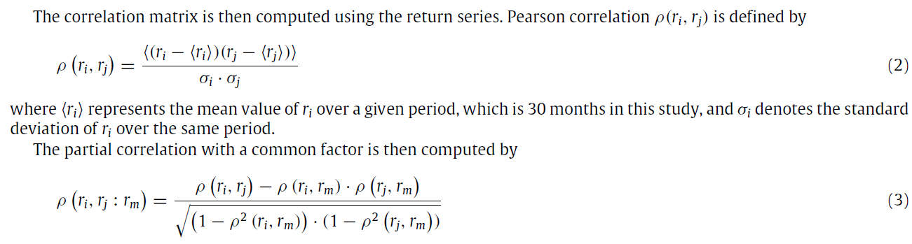
where r_{m} represents a common factor which in this case is the KOSPI index return series.
Pearson correlation and the partial correlation are computed for every 30 months.
(The time series are split into four subperiods, each of which is 30 months long.)

Slide 8
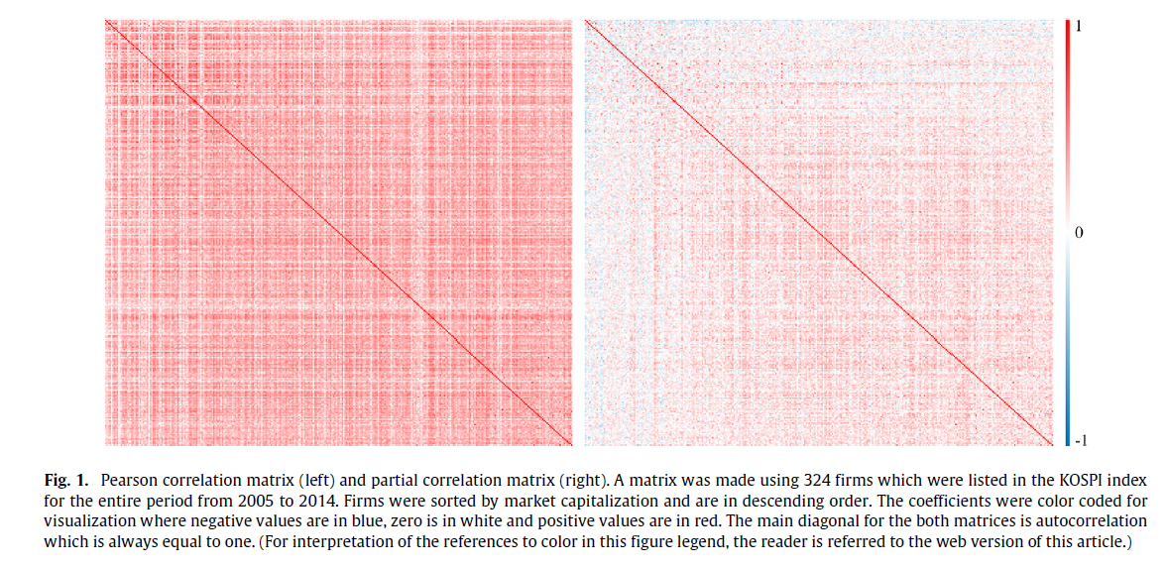
Pearson correlation vs. Partial correlation(1/2)
a b . . .
正相關
a
b
.
.
.
負相關
Pearson：有較多的紅色值，代表大部份由正係數值組成。
Partial：顏色較淡，且顯現出某一些對應到負係數的值。
Deduce : Pearson > Partial

Slide 9
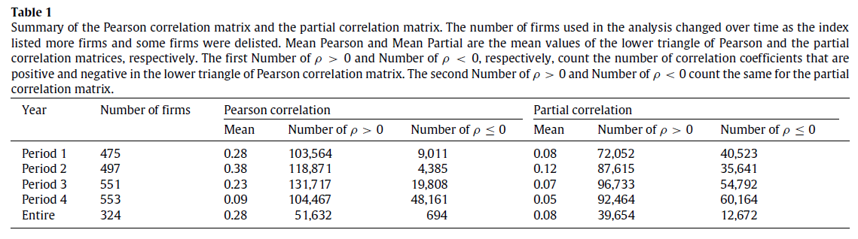
Pearson correlation vs. Partial correlation(2/2)
The mean value of the Pearson correlation was always greater than that of Partial correlation which is consistent with the hypothesis that the index, which serves as a proxy for the systematic risk of the market, drives up the correlations between firms.
Pearson相關係數矩陣中，“ρ > 0”的數量較多，代表有較多的企業具有正相關。
去除Common driving force of index 之後，係數值將降低或者為負值，可以看出 Partial相關係數矩陣中，已經沒有受到市場的影響(共同影響因子)，這些係數可拿來度量股票個別的表現。

Slide 10

Clustering analysis
where n_{i} is the number of objects in C_{i} , o_{i} is an object belongs to C_{i} and δ(o_{i} − o_{j}) is the distance between o_{i} and o_{j}.

Slide 11
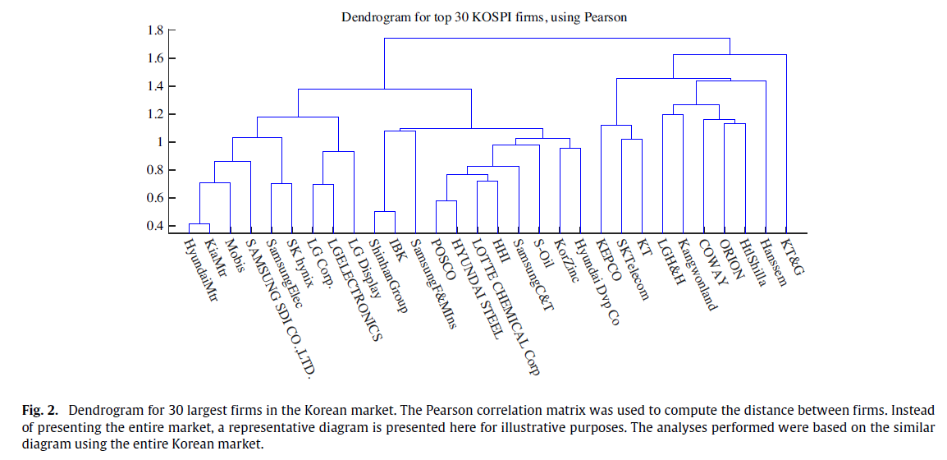

Slide 12
MSCI’s GICS
CD—consumer discretionary
F—financials
I—industrials
IT—information technology
M—materials
CS—consumer staples
E—energy
H—healthcare
T—telecommunication services
U—utilities)

Slide 13
In this study, the firms are divided into ten clusters.
Ten clusters are chosen because they can then be directly compared with MSCI’s Global Industry Classification Standard (GICS).
GICS分類依據:
Reviewed annually to determine its principal business activity and classified into one of ten sectors.

Slide 14
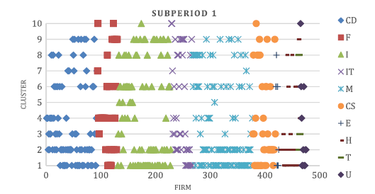
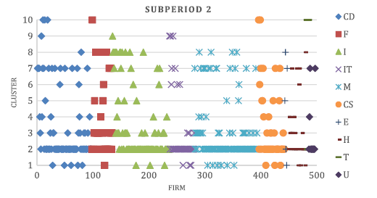

Slide 15
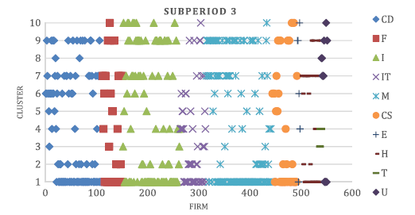
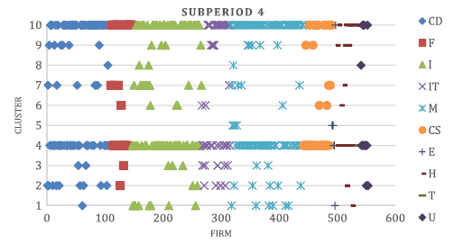

Slide 16
討論
The same symbols are found in almost every cluster for every period. (分散分佈)
GICS sector classification is not the best one to divide the firms if one seeks to minimize the correlation in stock returns.
In most cases, the firms in the same sector are not grouped together into a single cluster.
(energy,telecomm,utility組成企業數量少(8,3,5)，以致於同個sector機率上有可能會有被分到同cluster的情況發生)

Slide 17
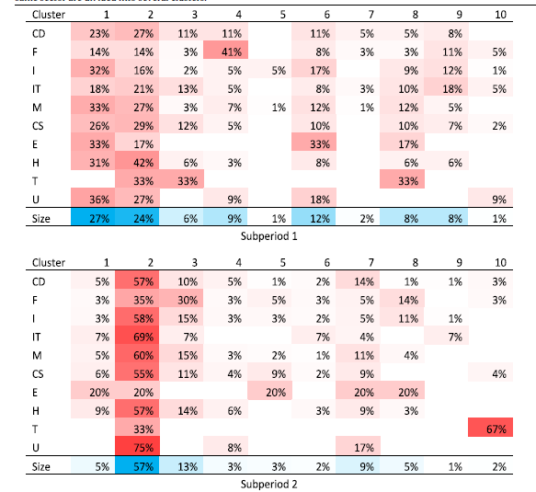

Slide 18
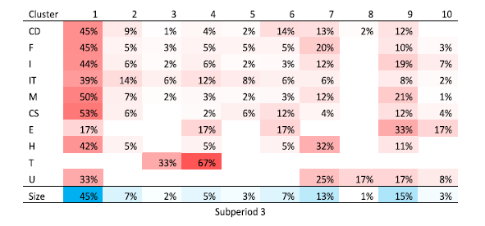
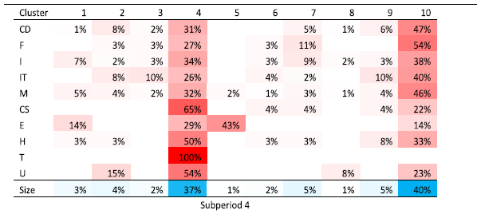

Slide 19
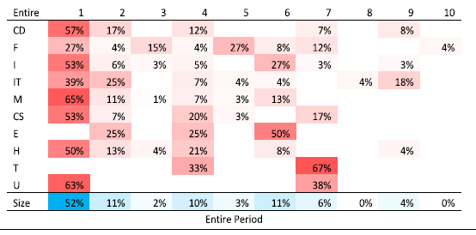

Slide 20
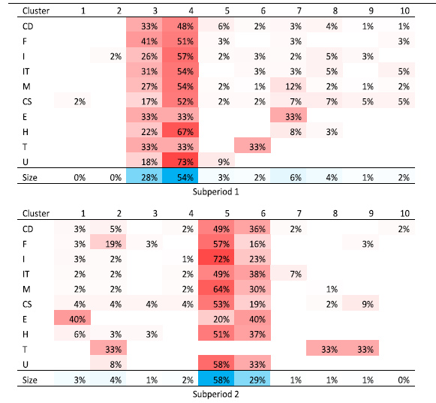

Slide 21
Pearson correlation coefficients are used for clustering.
不同之地方:
In most cases, the majority of the firms are clustered into one or two clusters together suggesting that a large number of firms are similar to each other.
Pearson correlation is unable to distinguish firms even when they are involved in a vastly different business, and the clustering analyses result in poorly divided groups.

Slide 22
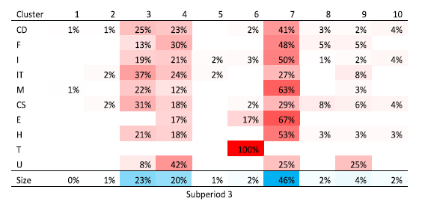
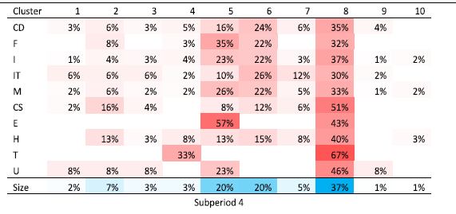

Slide 23
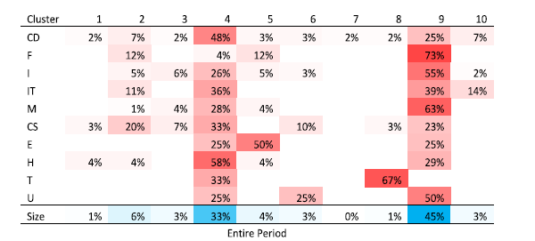

Slide 24
Conclusion
many financial time series are subjected to common factors which may skew the results of an analysis.
By removing this common factor, this study successfully demonstrates that many pairs of firms have a negative value of correlation compared
Diversification in regard to sector may not be sufficient because the firms’ stock returns may still be correlated with each other. to Pearson correlation.

