Slide 1
Most Probable Longest Common Subsequence for Recognition of Gesture Character Input
Darya Frolova, Helman Stern, and Sigal Berman
IEEE TRANSACTIONS ON CYBERNETICS,
VOL. 43, NO. 3, JUNE 2013
Presenter: Chong-Xuan Lo
Date:2016/8/30

Slide 2
Abstract(1/2)
This paper presents a technique for trajectory classiﬁcation with applications to dynamic free-air hand gesture recognition. Such gestures are unencumbered and drawn in free air.
Our approach is an extension to the longest common subsequence (LCS) classiﬁcation algorithm. A learning preprocessing stage is performed to create a probabilistic 2-D template for each gesture, which allows taking into account different trajectory distortions with different probabilities.

Slide 3
Abstract(2/2)
The modiﬁed LCS, termed the most probable LCS (MPLCS), is developed to measure the similarity between the probabilistic template and the hand gesture sample. The ﬁnal decision is based on the length and probability of the extracted subsequence. Validation tests using a cohort of gesture digits from video-based capture show that the approach is promising with a recognition rate of more than 98% for video stream preisolated digits. The MPLCS algorithm can be integrated into a gesture recognition interface to facilitate gesture character input. This can greatly enhance the usability of such interfaces.

Slide 4
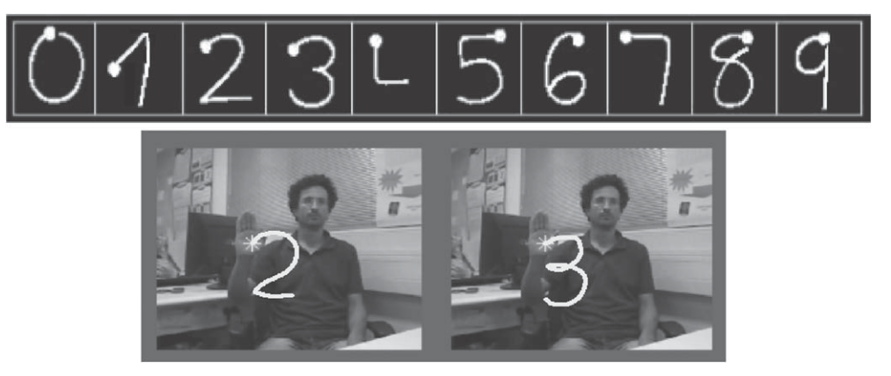

Slide 5
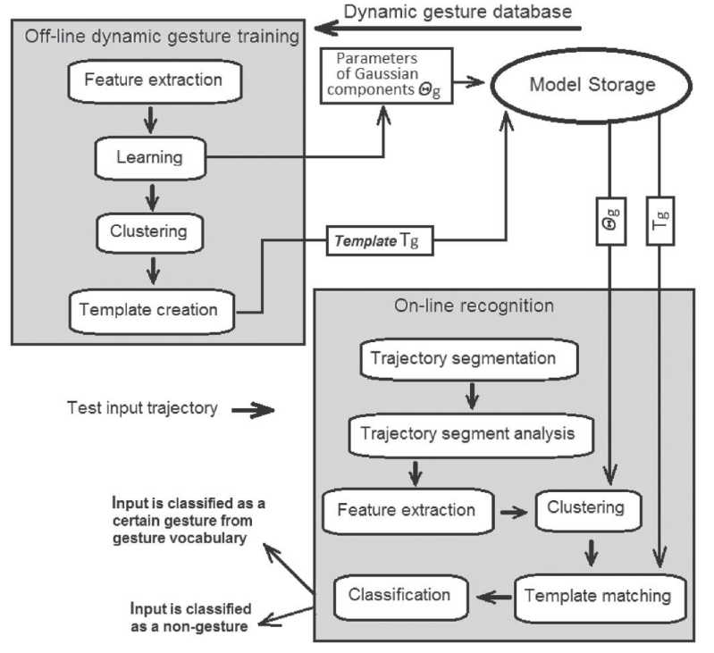

Slide 6
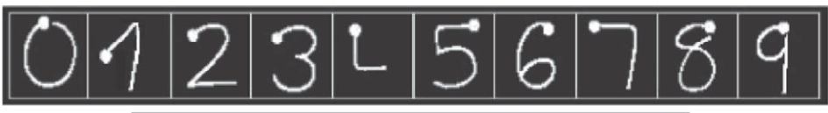

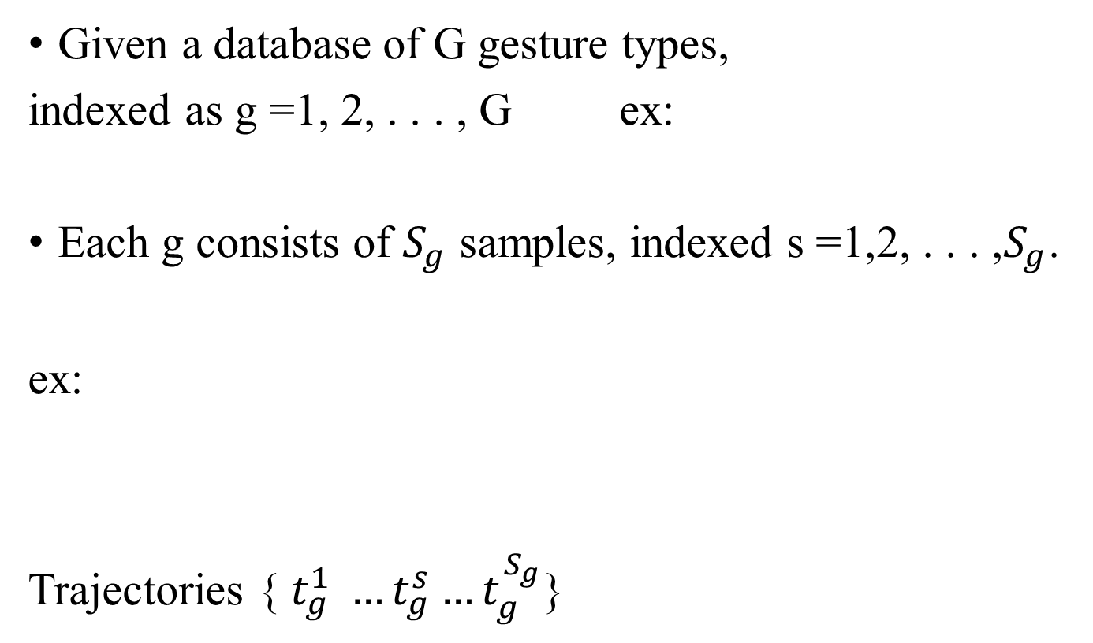
OFFLINE DYNAMIC GESTURE TRAINING
Given a database of G gesture types,
indexed as g =1, 2, . . . , G ex:
Each g consists of $S_{g}$ samples, indexed s =1,2, . . . ,$S_{g}$.
ex:
Trajectories { $t_{g}^{1} …t_{g}^{s}…t_{g}^{S_{g}}$}

Slide 7
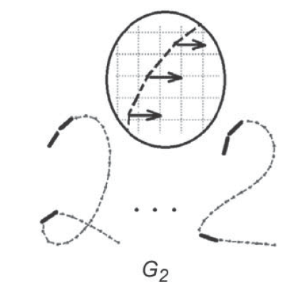
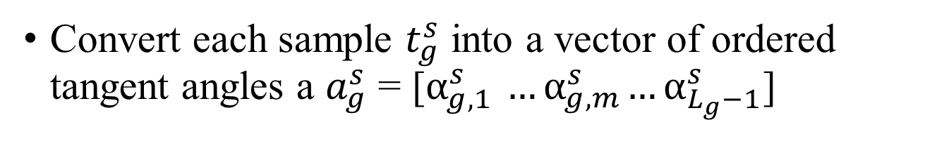
OFFLINE DYNAMIC GESTURE TRAINING
Convert each sample $t_{g}^{s}$ into a vector of ordered tangent angles a $a_{g}^{s}$ = [$α_{g,1}^{s}{ …α}_{g,m}^{s}…α_{L_{g}−1}^{s}$]

Slide 8
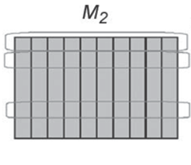
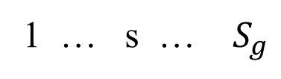
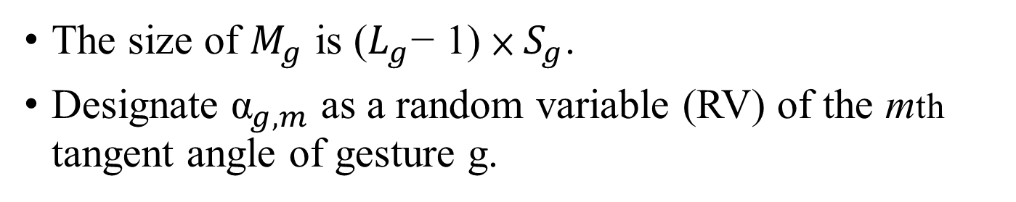


OFFLINE DYNAMIC GESTURE TRAINING
1 … s … $S_{g}$
1
…
m
…
$$L_{g}−1$$
$${\text{α}}_{g,m}$$
The size of $M_{g}$ is ($L_{g}$− 1) × $S_{g}$.
Designate ${\text{α}}_{g,m}$ as a random variable (RV) of the mth tangent angle of gesture g.

Slide 10
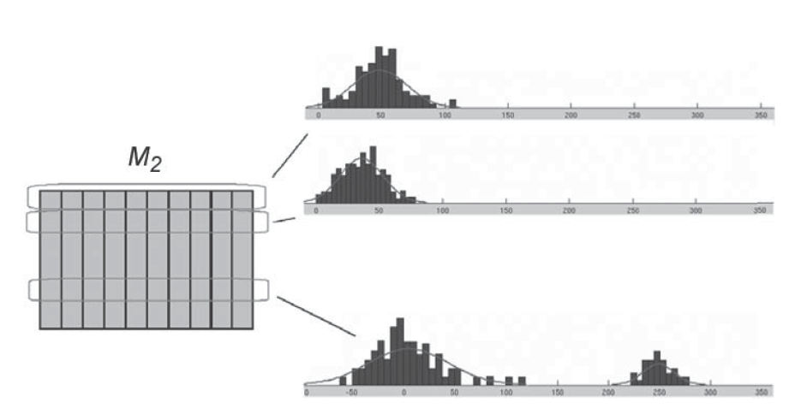
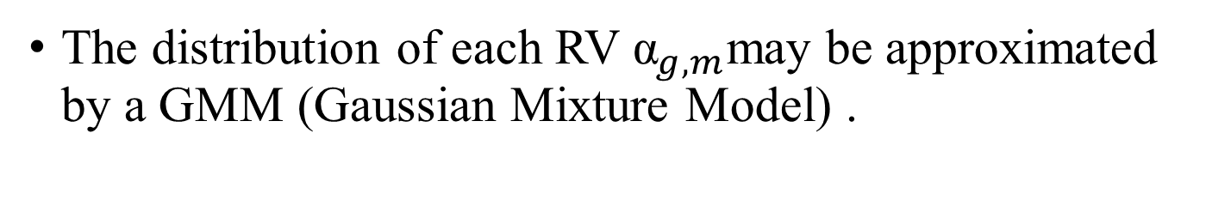
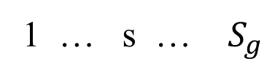
OFFLINE DYNAMIC GESTURE TRAINING
1 … s … $S_{g}$
1
…
m
…
$$L_{g}−1$$
The distribution of each RV ${\text{α}}_{g,m}$may be approximated by a GMM (Gaussian Mixture Model) .

Slide 11
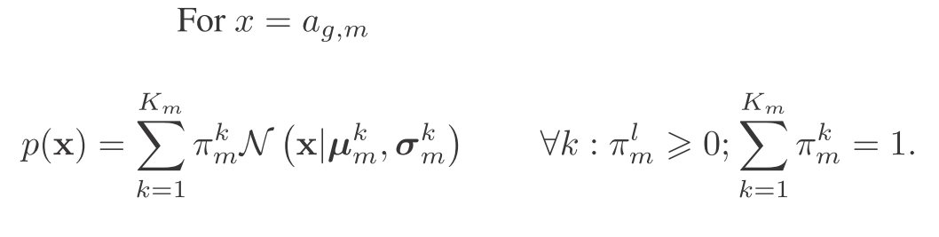

GMM (Gaussian Mixture Model)
每個GMM由$K_{m}$個Gaussian分佈組成，每個Gaussian稱為一個“Component”，這些Component線性加成在一起就組成了GMM的機率密度函數

Slide 12
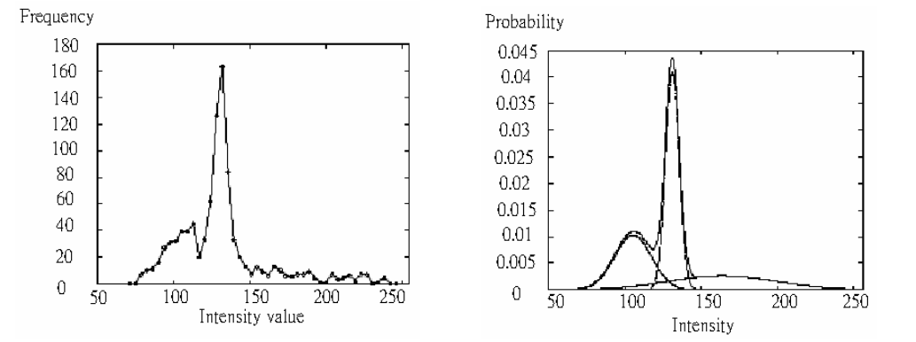
GMM (Gaussian Mixture Model)
左圖是某像素強度的分布曲線，可以看出可以用三個高斯分布的組合來近似它。
右圖則是近似後的分布曲線

Slide 13


GMM (Gaussian Mixture Model)
Denote by $θ_{g}^{k}$the parameters of the kth component of the gesture type g (k = 1 :${ K}_{g}$, g = 1 : G)

Slide 15




Template creation
compute the probability $p_{g}^{s}$(k, m) that the sth sample of the mth tangent angle belongs to the Gaussian component k.
Denote $P_{g}^{s}$as a matrix of size $K_{g}$× ($L_{g}$ − 1),
$$P_{g}^{s}$$
1 … m … $L_{g}−$1
 |  | p(k,m)
1
…
k
…
$$K_{g}$$

Slide 16


Template creation
Compute pointwise average of matrices $P_{g}^{s}$over s
samples, and denote it by ${ T}_{g}$. ${ T}_{g}$ is a template that represents gesture number g.
$$P_{g}^{s}$$
1 … m … $L_{g}−$1
 |  | p(k,m)
1
…
k
…
$$K_{m}$$

Slide 17
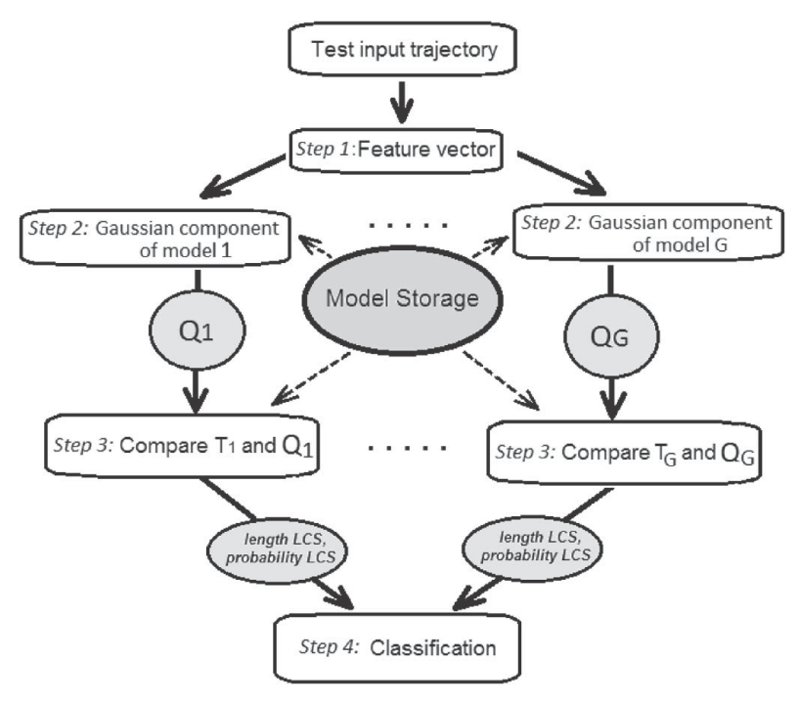
On-line recognition

Slide 18
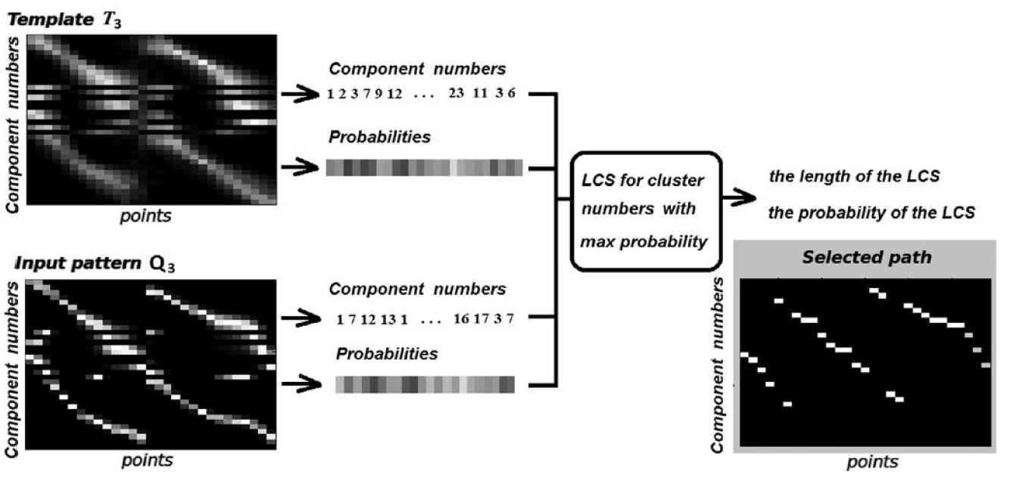
Image intensities (from 0—black to 1—white)
encode the probabilities of the points to belong to the Gaussians.

Slide 19
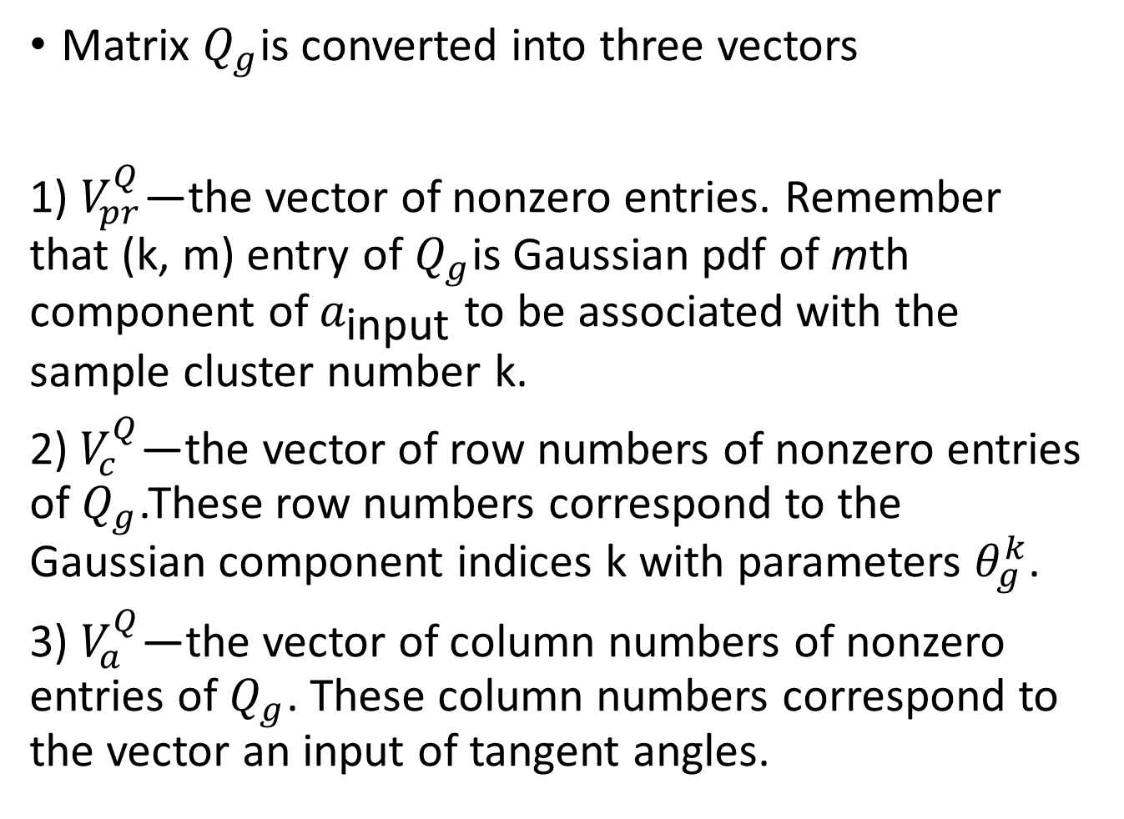
Algorithm Procedure
Matrix $Q_{g}$is converted into three vectors
1) $V_{pr}^{Q}$—the vector of nonzero entries. Remember that (k, m) entry of $Q_{g}$is Gaussian pdf of mth component of $a_{\text{input}}$ to be associated with the sample cluster number k.
2)${ V}_{c}^{Q}$—the vector of row numbers of nonzero entries of $Q_{g}$.These row numbers correspond to the Gaussian component indices k with parameters $θ_{g}^{k}$.
3) $V_{a}^{Q}$—the vector of column numbers of nonzero entries of $Q_{g}$. These column numbers correspond to the vector an input of tangent angles.

Slide 20

Algorithm Procedure
Similarly, matrix $T_{g}$is decomposed into three vectors $V_{pr}^{T}$, ${ V}_{c}^{T}$, $V_{a}^{T}$

Slide 21
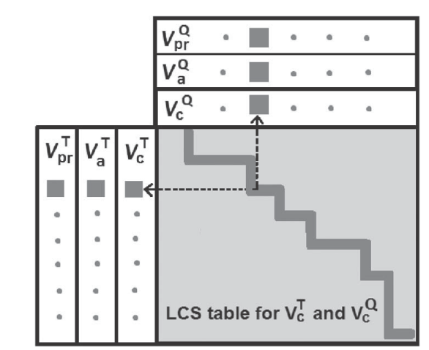

Algorithm Procedure
Dynamic programming is used to create a classical LCS table for vectors of cluster numbers ${ V}_{c}^{T}$and ${ V}_{c}^{T}$

Slide 22
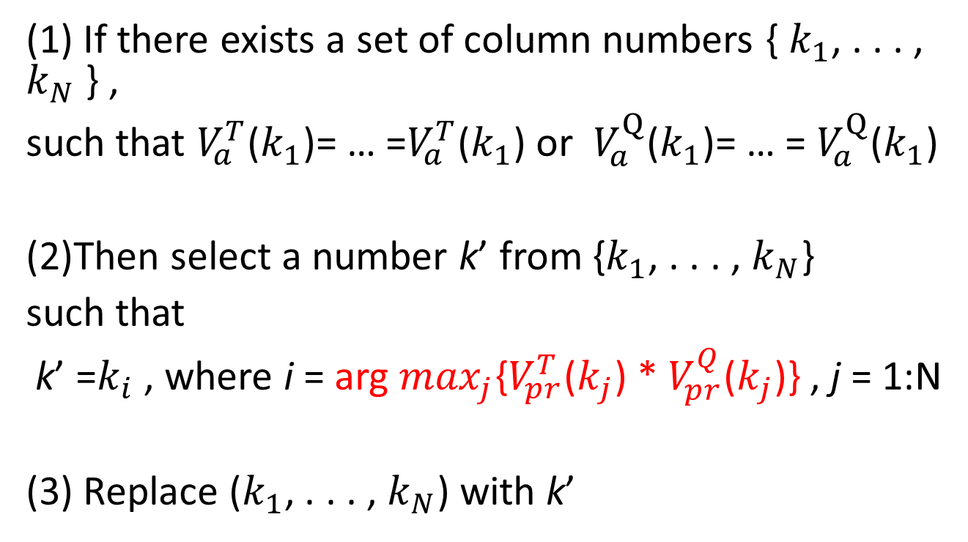
Maximum likelihood estimation (最大似然估計)
(1) If there exists a set of column numbers { $k_{1}$, . . . , $k_{N}$ } ,
such that $V_{a}^{T}$($k_{1}$)= … =$V_{a}^{T}$($k_{1}$) or $V_{a}^{Q}$($k_{1}$)= … = $V_{a}^{Q}$($k_{1}$)
(2)Then select a number k’ from {$k_{1}$, . . . , $k_{N}$}
such that
k’ =$k_{i}$ , where i = arg $\max_{j}${$V_{pr}^{T}$($k_{j}$) * $V_{pr}^{Q}$($k_{j}$)} , j = 1:N
(3) Replace ($k_{1}$, . . . , $k_{N}$) with k’
Notes:
最大似然估計 (maximum likelihood estimation)

Slide 23
Image intensities (from 0—black to 1—white)
encode the probabilities of the points to belong to the Gaussians.

Slide 24
https://www.facebook.com/CTimefans/videos/1201113743268157/

