Slide 1
A combined approach for clustering based on K-means and gravitational search algorithms
Abdolreza Hatamlou, Salwani Abdullah, Hossein Nezamabadi-pour
Swarm and Evolutionary Computation 6 (2012) 47–52
Department of Electrical Engineering, Shahid Bahonar University of Kerman, Kerman, Iran
Presenter: 方鈞毅
Date: Jun. 21, 2013

Slide 2
Abstract
Clustering is an attractive and important task in data mining that is used in many applications. Clustering refers to grouping together data objects so that objects within a cluster are similar to one another, while objects in different clusters are dissimilar.
K-means is a simple and efﬁcient algorithm that is widely used for data clustering. However, its performance depends on the initial state of centroids and may trap in local optima.
The gravitational search algorithm (GSA) is one effective method for searching problem space to ﬁnd a near optimal solution.
In this paper, we present a hybrid data clustering algorithm based on GSA and k-means (GSA-KM), which uses the advantages of both algorithms.

Slide 3
Abstract
The GSA-KM algorithm helps the k-means algorithm to escape from local optima and also increases the convergence speed of the GSA algorithm.
We compared the performance of GSA-KM with other well-known algorithms, including k-means, genetic algorithm (GA), simulated annealing (SA), ant colony optimization (ACO), honey bee mating optimization (HBMO), particle swarm optimization (PSO) and gravitational search algorithm (GSA). Five real and standard datasets from the UCI repository have been used to demonstrate the results of the algorithms.
The experimental results are encouraging in terms of the quality of the solutions and the convergence speed of the proposed algorithm.

Slide 4
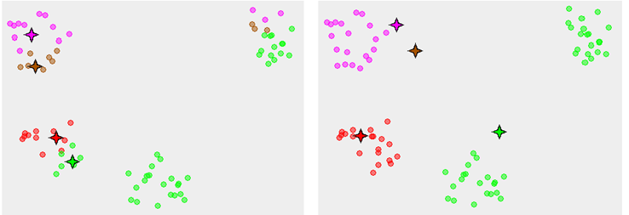
K-means Local Optima
K-means有可能會因為，起始點的選擇不佳，而產生局部最佳而非全域最佳的情況。

Slide 5



Gravitational Search Algorithm (GSA)
利用牛頓第一跟第二運動所得到的啟發
Fitness function –quality of the cluster
(total mean-square quantisation error (MSE))

Slide 6
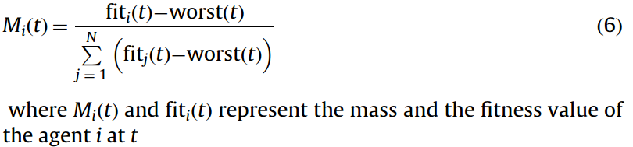
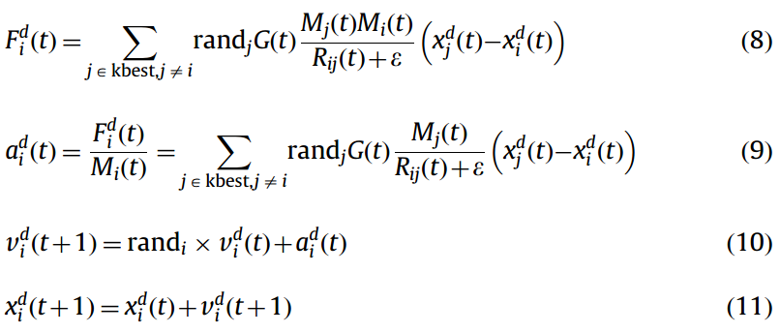
Gravitational Search Algorithm (GSA)

Slide 7
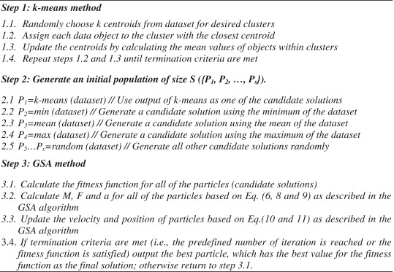
GSA-KM steps

Slide 8
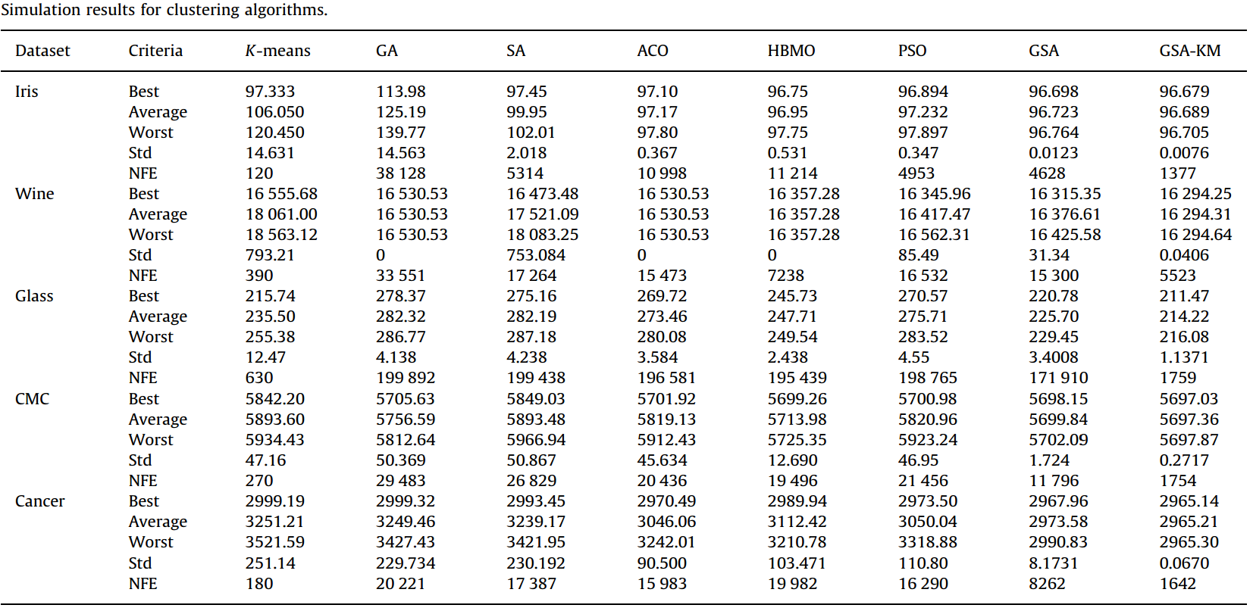
Experimental Results

