Slide 1
Mutual funds trading strategy based on particle swarm optimization
Ling-Yuan Hsu, Shi-Jinn Horng, Mingxing He, Pingzhi Fan, Tzong-Wann Kao,Muhammad Khurram Khan, Ray-Shine Run, Jui-Lin Lai, Rong-Jian Chen,
Expert Systems with Applications 38 (2011) 7582–7602
Presenter: Cheng-Han Lee
Date:2013/01/15

Slide 2
Abstract
Mutual funds have become the most popular products for diversity of investment, since they are able to disperse investment risks to the smallest degree. In selecting mutual funds, the past performance of funds plays a central role in the expectations of the future performance of funds. In 2008, the U.S. sub-prime broke out; numerous investors lost more than half of the capitals donated. Therefore, a good trading strategy is necessary. In this paper, a new funds trading strategy that combines turbulent particle swarm optimization (named TPSO) and mixed moving average techniques is presented and used to find the proper content of technical indicator parameters to achieve high profit and low risk on a mutual fund. The time interval of moving average of the proposed method is adjustable and the trading model could avoid and reduce loss by providing several good buy and sell points. We tested the proposed model using the historical prices of last 10 years and the experimental results show that the performance of the proposed model is far better than the best original performance.

Slide 3
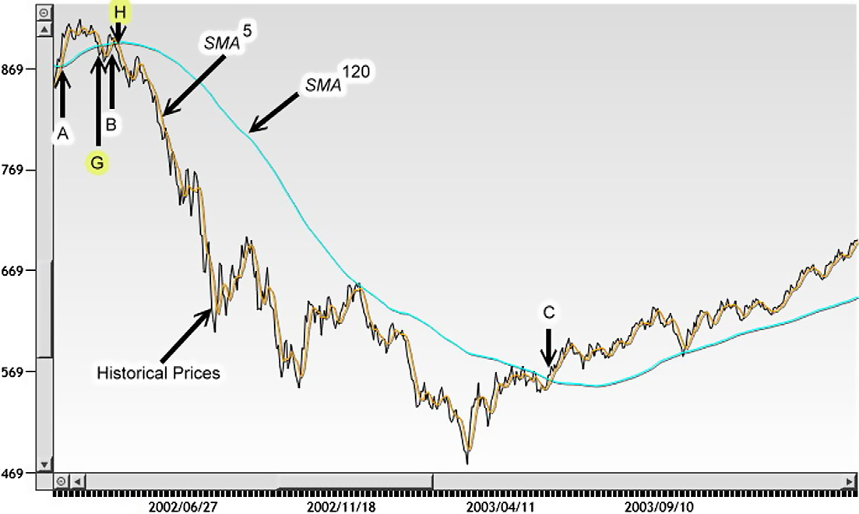

Indicators
${SMA}_{k}^{T} =\frac{1}{T}\sum_{k−T+1}^{k}{{Price}_{t}}$

Slide 4
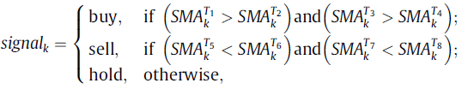
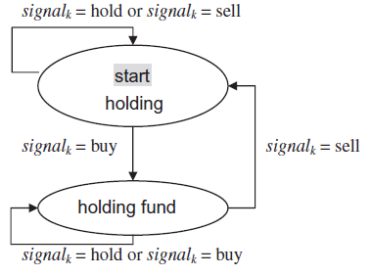
Trading strategy

Slide 5
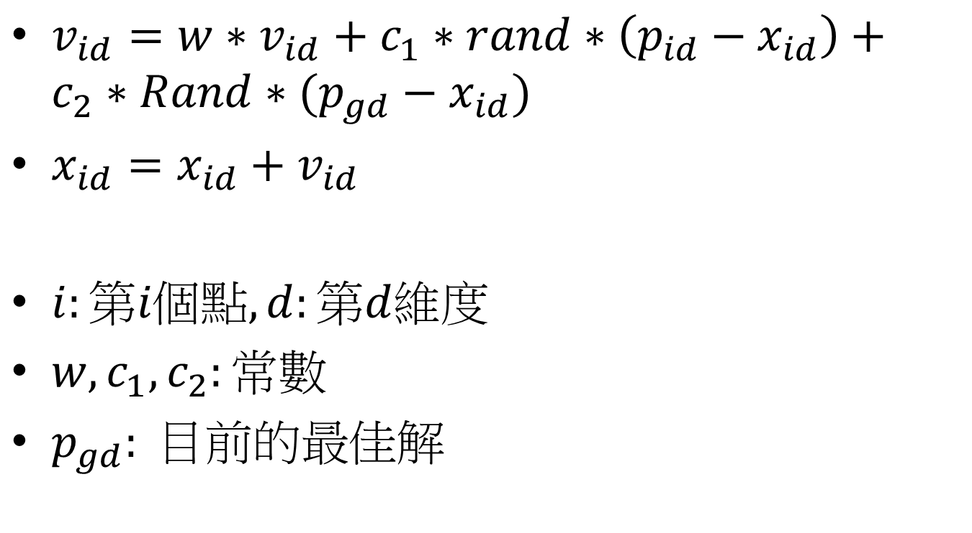
Particle Swarm Optimization
$v_{id}=w∗v_{id}+c_{1}∗rand∗\left(p_{id}−x_{id}\right)+c_{2}∗Rand∗(p_{gd}−x_{id})$
$x_{id}=x_{id}+v_{id}$
$i:第i個點,d:第d維度$
$w,c_{1},c_{2}:常數$
$p_{gd}: 目前的最佳解$

Slide 6
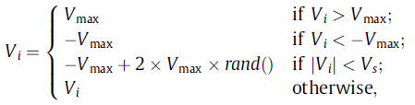
TPSO (Turbulent PSO)
TPSO (Turbulent PSO)

Slide 7
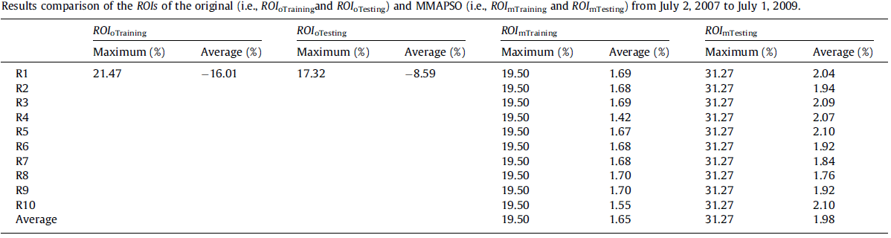
Experimental results

Slide 8
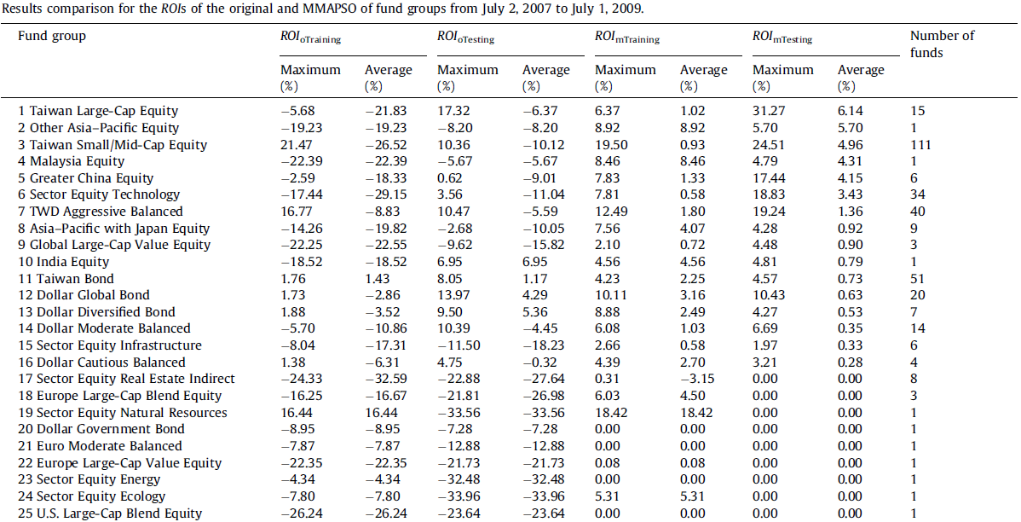
‧
‧
‧
Notes:
1.http://fund.cnyes.com/Detail/intro/A13030.html

Slide 9
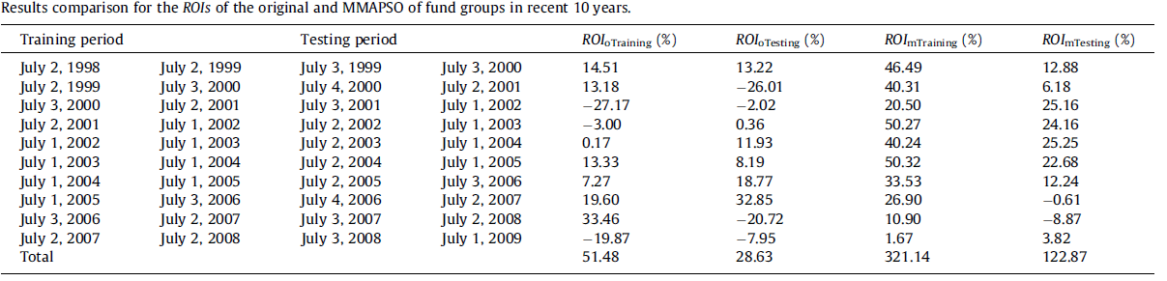
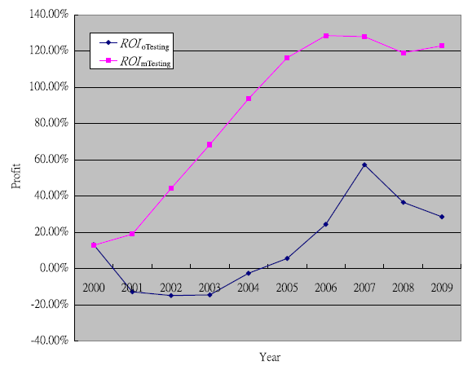

Slide 10
THE END

