Slide 1
On Optimizing The Longest Common Subsequence Problem by Loop Unrolling Along Wavefronts
Johann Steinbrecher and Weijia Shang
2012 20th Euromicro International Conference on Parallel, Distributed and Network-based Processing
Presenter: Cing-Yao Chen

Slide 2
Abstract
Loop unrolling is a loop transformation where a few loop iterations are grouped as a super iteration for exploring more independent instructions and to decrease the total loop overhead.
This paper characterizes loop unrolling by the unrolling factor, the number of iterations in a super iteration and the unrolling direction, the choice of iterations to be grouped to form the super iteration. We use loop unrolling for maximizing instructionlevel parallelism in the longest common subsequence problem.
To increase the number of independent instructions in the super iteration, we use a linear schedule to group iterations on the same wavefront, a hyperplane in the loop iteration space.

Slide 3
Abstract
Then, the loop is unrolled along the wavefront which guarantees all iterations in the same super iteration are independent.
The selection of the optimal unrolling factor is based on the assumption that if all the pipelines are saturated, the performance should not be bad.
Two necessary conditions and a sufﬁcient condition for optimality are presented and used to ﬁnd the optimal unrolling factor.
The total execution time is expressed as a function of algorithm parameters, architecture parameters and the unrolling factor.
A benchmark of the technique scores a 1.475 speed-up over traditional methods.

Slide 4
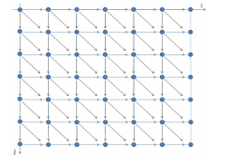
Introduction
C
A
T
A
G
G
LCS:
for (i=0; i <= M; i++) {
for (j=0; j <= N; j++) {
if (i == 0 || j == 0)
c[i][j] = 0;
else if (x[i] == y[j])
c[i][j] = c[i-1][j-1] + 1;
else
c[i][j] = max(c[i][j-1], c[i-1][j]);
}
}
A
C
T
A
G
A

Slide 5
One iteration
LCS:
for (i=0; i <= M; i++) {
for (j=0; j <= N; j++) {
if (i == 0 || j == 0)
c[i][j] = 0;
else if (x[i] == y[j])
c[i][j] = c[i-1][j-1] + 1;
else
c[i][j] = max(c[i][j-1], c[i-1][j]);
}
}
I1: load x[i], R1
I2: load y[j], R2
I3: cmp R1, R2
I4: load c[i][j-1], R3
I5: load c[i-1][j], R4
I6: max R5, R3, R4
I7: store c[i][j], R5

Slide 6
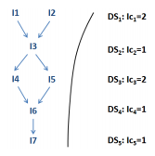
One iteration
LCS:
I1: load x[i], R1
I2: load y[j], R2
I3: cmp R1, R2
I4: load c[i][j-1], R3
I5: load c[i-1][j], R4
I6: max R5, R3, R4
I7: store c[i][j], R5

Slide 7
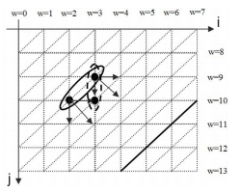
Basic idea

Slide 8
Loop unrolling
LCS:
for (i=0; i<=M; i++) {
for (j=0; j<N; j+=2) {
if (i == 0 || j == 0)
c[i][j] = 0;
else if (x[i] == y[j])
c[i][j] = c[i-1][j-1] + 1;
else
c[i][j] = max(c[i][j-1],c[i-1][j]);
if (i == 0 || j+1 == 0)
c[i][j+1] = 0;
else if (x[i] == y[j+1])
c[i][j+1] = c[i-1][j] + 1;
else
c[i][j+1] = max(c[i][j],c[i-1][j+1]);
}
}

Slide 9
Loop unrolling
J+=2
LCS:
for (i=0; i<=M; i++) {
for (j=0; j<N; j+=2) {
if (i == 0 || j == 0)
c[i][j] = 0;
else if (x[i] == y[j])
c[i][j] = c[i-1][j-1] + 1;
else
c[i][j] = max(c[i][j-1],c[i-1][j]);
if (i == 0 || j+1 == 0)
c[i][j+1] = 0;
else if (x[i] == y[j+1])
c[i][j+1] = c[i-1][j] + 1;
else
c[i][j+1] = max(c[i][j],c[i-1][j+1]);
}
}
相同，
但下面的 j 多加一

Slide 10
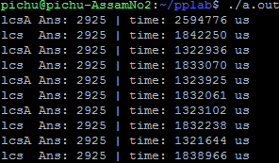
Loop unrolling➔Result
1.38x

Slide 11
Loop unrolling ➔ One iteration
LCS:
for (i=0; i<=M; i++) {
for (j=0; j<N; j+=2) {
if (i == 0 || j == 0)
c[i][j] = 0;
else if (x[i] == y[j])
c[i][j] = c[i-1][j-1] + 1;
else
c[i][j] = max(c[i][j-1],c[i-1][j]);
if (i == 0 || j+1 == 0)
c[i][j+1] = 0;
else if (x[i] == y[j+1])
c[i][j+1] = c[i-1][j] + 1;
else
c[i][j+1] = max(c[i][j],c[i-1][j+1]);
}
}
I1: load x[i], R1
I2: load y[j], R2
I3: cmp R1, R2
I4: load c[i][j-1], R3
I5: load c[i-1][j], R4
I6: max R5, R3, R4
I7: store c[i][j], R5
I8: load y[j+1], R6
I9: cmp R1, R6
I10: load c[i-1][j+1], R7
I11: max R7, R7, R5
I12: store c[i][j+1], R7

Slide 12
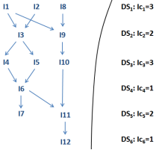
Loop unrolling ➔ One iteration
LCS:
I1: load x[i], R1
I2: load y[j], R2
I3: cmp R1, R2
I4: load c[i][j-1], R3
I5: load c[i-1][j], R4
I6: max R5, R3, R4
I7: store c[i][j], R5
I8: load y[j+1], R6
I9: cmp R1, R6
I10: load c[i-1][j+1], R7
I11: max R7, R7, R5
I12: store c[i][j+1], R7

Slide 13
Compare
LCS:
Notes:
C. Architecture model
A computer system is modeled by the parameters (p, pstage,
nregf ile, nstr) where p is the number of pipelines in the
system, pstage is the number of stages in each pipeline,
nregf ile is the number of registers, and nstr is the number
of stalls to resolve a pipeline hazard. It is assumed it takes the
same number of stalls to resolve all kinds of hazards (control
or data hazard). Other architectural features such as ALU
arithmetic as well as memory and cache access latencies have
been abstracted away to simplify our calculations. They will
be considered in future research. Clearly, the total execution
time of an algorithm is also a function of the architecture
parameters.

Slide 14
Wavefront

Slide 15
Wavefront ➔ Problem

Slide 16
Wavefront ➔ Problem
Critical Path

Slide 17
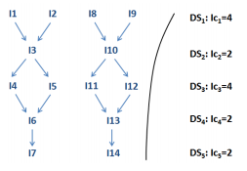
Wavefront

Slide 18


Wavefront

Slide 19
Wavefront
5
10
15

Slide 20
Discussion
The key reason for this improvement is that the length of the critical path does not increase with the unrolling factor in the latter case and the completion time can not be shorter than the critical path length.
Therefore, it is possible to cut more and more loop overhead with increasing unrolling factors without increasing the critical path length.
In contradiction by unrolling along the inner loop the critical path length increases with the unrolling factor.
This causes the execution time to increase independent of any architectural parameters.

Slide 21
Discussion
Loop unrolling along wavefronts can saturate massively parallel systems without increasing the critical path length of its super iterations.
One observation is that u = 2 may not be the optimal unrolling factor because many cycles are unused as indicated by ﬁgure 14.

Slide 22

Discussion
P=3
nstr=2
Pstage=5
==>u=9

Slide 23
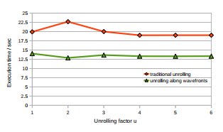
Banchmark
1.475x

