Slide 1
Benchmarking Dynamic Time Warping for Music Retrieval PETRA '10 Proceedings of the 3rd International Conference on PErvasive Technologies Related to Assistive Environments Article No. 59
Jefrey Lijffijt, Panagiotis Papapetrou,
Jaakko Hollmen, Vassilis Athitsos Department of Information and Computer Science, Aalto University School of Science and Technology, Finland
Helsinki Institute for Information Technology, Finland
Computer Science and Engineering Department, University of Texas at Arlington, USA
Presentor：Hsin-Chuan Yuan

Slide 2
Content
Introduction
Music Normalization
Dynamic Time Warping (DTW)
Constrained Dynamic Time Warping (cDTW)
SPRING
Experimental Evaluation

Slide 3
Abstract
We study the performance of three dynamic programming methods on music retrieval. The methods are designed for time series matching but can be directly applied to retrieval of music. Dynamic Time Warping (DTW) identifies an optimal alignment between two time series, and computes the matching cost corresponding to that alignment. Significant speed-ups can be achieved by constrained Dynamic Time Warping (cDTW), which narrows down the set of positions in one time series that can be matched with specific positions in the other time series. Both methods are designed for full sequence matching but can also be applied for subsequence matching, by using a sliding window over each database sequence to compute a matching score for each database subsequence.

Slide 4
Abstract
In addition, SPRING is a dynamic programming approach designed for subsequence matching, where the query is matched with a database subsequence without requiring the match length to be equal to the query length. SPRING has a lower computational cost than DTW and cDTW. Our database consists of a set of MIDI files taken from the web. Each MIDI file has been converted to a 2-dimensional time series, taking into account both note pitches and durations. We have used synthetic queries of fixed size and different noise levels. Surprisingly, when looking for the top-K best matches, all three approaches show similar behavior in terms of retrieval accuracy for small values of K. This suggests that for the specific application area, a computationally cheaper method, such as SPRING, is sufficient to retrieve the best top-K matches.

Slide 5
Introduction
We study the performance of three dynamic programming methods on music retrieval.
DTW with Sliding Window
cDTW with Sliding Window
SPRING
First, we should transformed the audio to a 2-dimensional time series.
Then, evaluated the performance of DTW, cDTW, and SPRING on real music data.

Slide 6
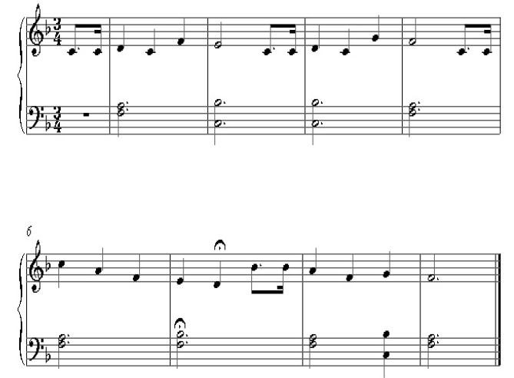
Music Normalization
Music piece X = { (p_{i}, d_{i}), i = 1,...,|X| }
Query Q = { (p_{j}, d_{j}), j = 1,...,|Q| }
Pitch → Relative Pitch(RP)
Duration → Duration Ratio(DR)
X
Q

Slide 7
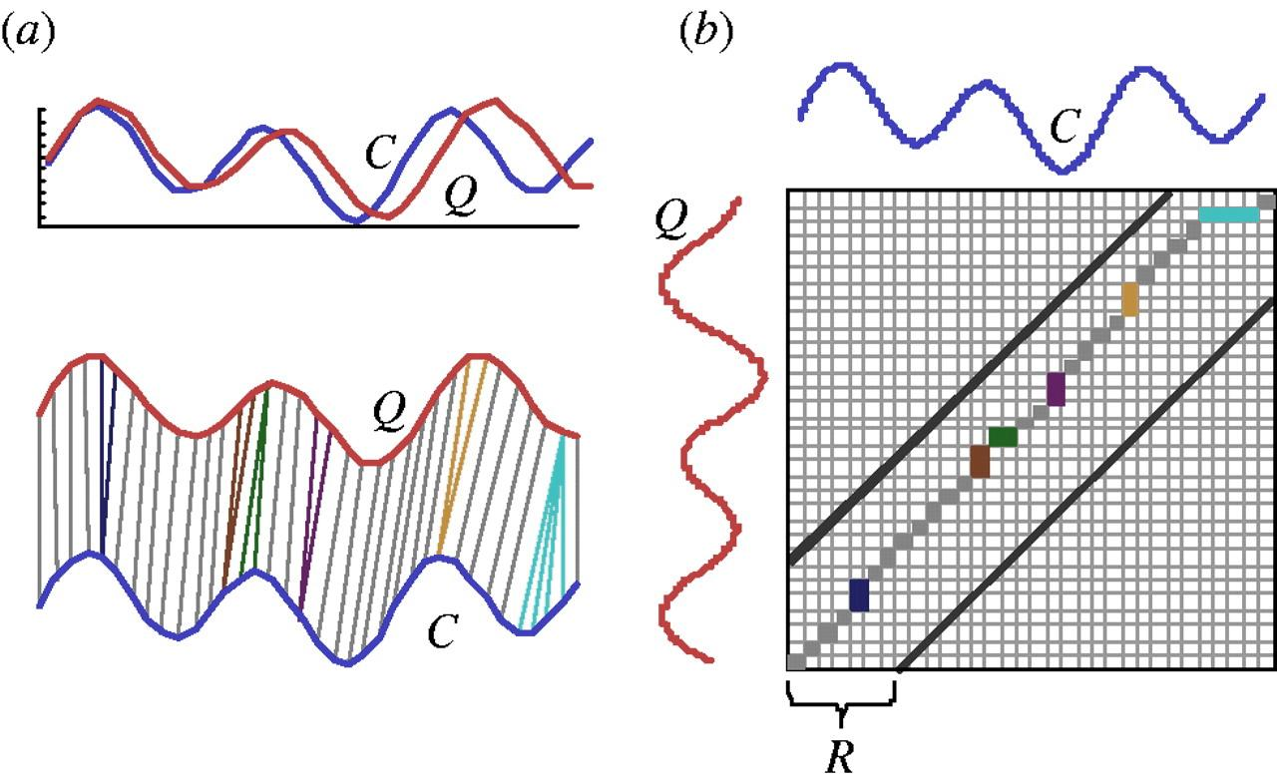
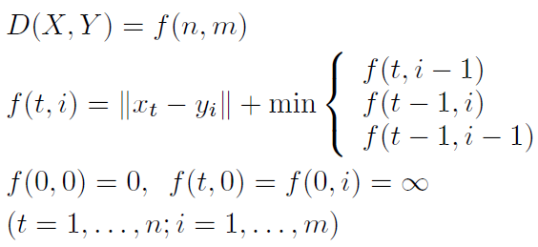
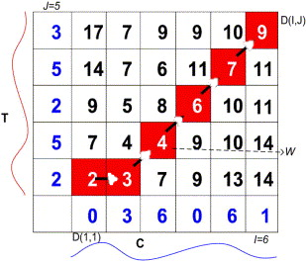
Dynamic Time Warping (DTW)
DTW is computed by dynamic programming
Stretch sequences along the time axis to minimize the distance
Warping path: set of grid cells in the time warping matrix
Time complexity: O(mn)
Optimal warping path(the best alignment)

Slide 8

Constrained Dynamic Time Warping (cDTW)
is obtained from DTW simply by placing an additional constraint to prevent pathological warpings which defined as:
Sakoe-Chiba band

Slide 9
Problem Definition
Subsequence matching for data streams
(Fixed-length) query sequence Y=(y₁ , y₂ ,…, y_{m})
Sequence (data stream) X=(x₁ , x₂ ,…, x_{n})
Find all subsequences X[t_{s},t_{e}] such that

Slide 10

Naïve Solution
Super-Naïve consider all possible subsequences

Slide 11
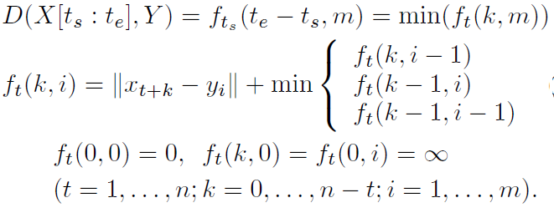
Naïve Solution
Naïve
Y
x₁
x_{ts}
x_{te}
X

Slide 12
Subsequence Matching
y₁
y_{m}
Y
x₁
x_{ts}
x_{te}
x_{n}
X
Redundant, useless subsequences
Other similar subsequences

Slide 13
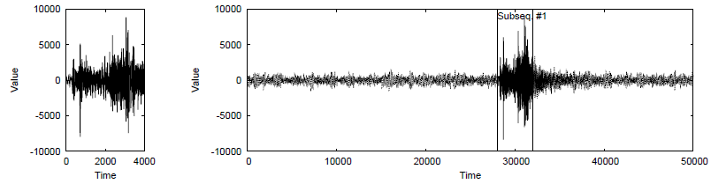
Sliding Window
Both methods are designed for full sequence matching.
Using a sliding window (length = |Q|) over each database sequence to compute a matching score for each database subsequence.

Slide 14
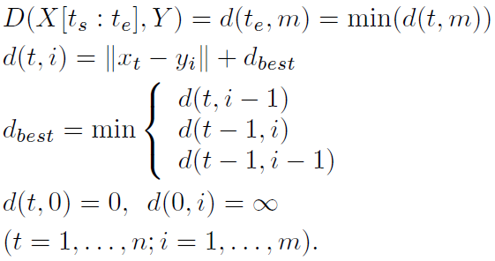

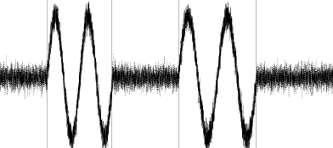
SPRING
Second
subsequence
Report X[t_{s}:t_{e}]
t=1
t=t_{s}
t=t_{e}
X

Slide 15
SPRING
distance (upper number), starting position (number in parentheses)
X=(5,12,6,10,6,5,13), Y=(11,6,9,4), ε = 20
y₄ = 4 | 54 (1) | 110 (2) | 14 (2) | 38 (2) | 6 (2) | 7 (2) | 88 (2)
y₃ = 9 | 53 (1) | 46 (2) | 10 (2) | 2 (2) | 10 (4) | 17 (4) | 18 (4)
y₂ = 6 | 37 (1) | 37 (2) | 1 (2) | 17 (4) | 1 (4) | 2 (4) | 51 (4)
y₁ = 11 | 36 (1) | 1 (2) | 25 (3) | 1 (4) | 25 (5) | 36 (6) | 4 (7)
x_{t} | 5 | 12 | 6 | 10 | 6 | 5 | 13
t | 1 | 2 | 3 | 4 | 5 | 6 | 7

Slide 16
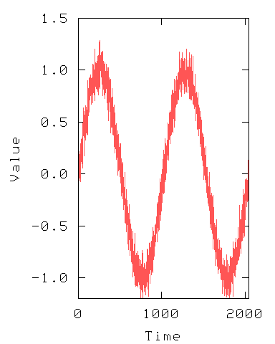
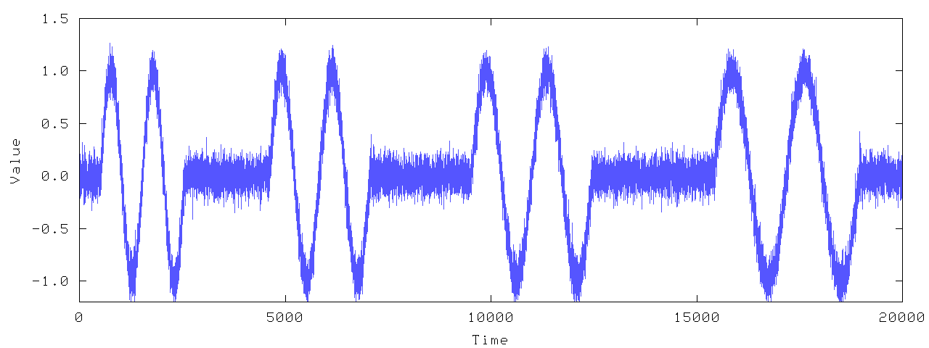
Pattern Discovery
MaskedChirp
Query sequence
Data stream

Slide 17
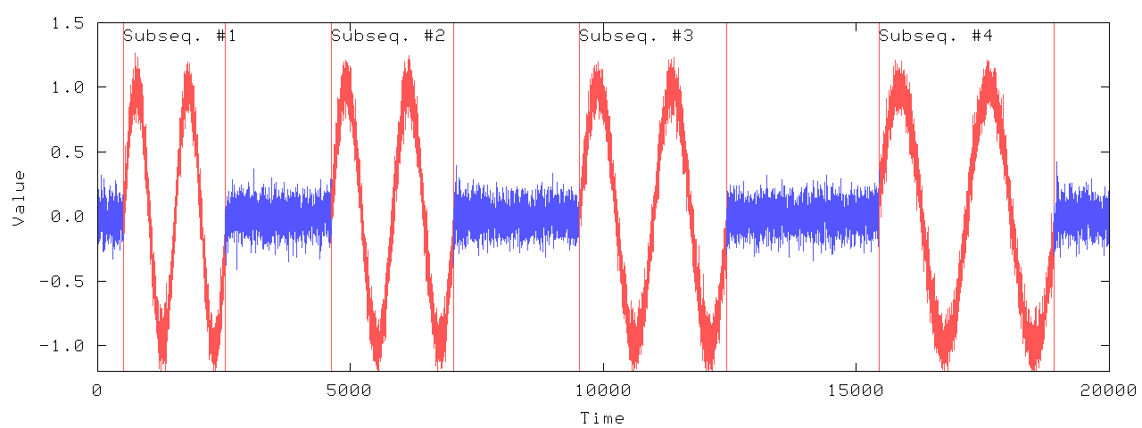
Pattern Discovery
MaskedChirp
SPRING identifies all sound parts with varying time periods
Query sequence
The output time of each captured subsequence is very close to its end position
Data stream

Slide 18
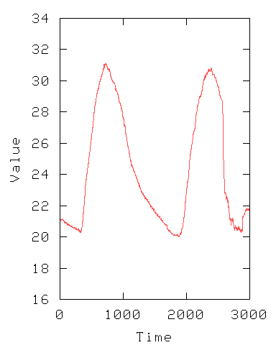
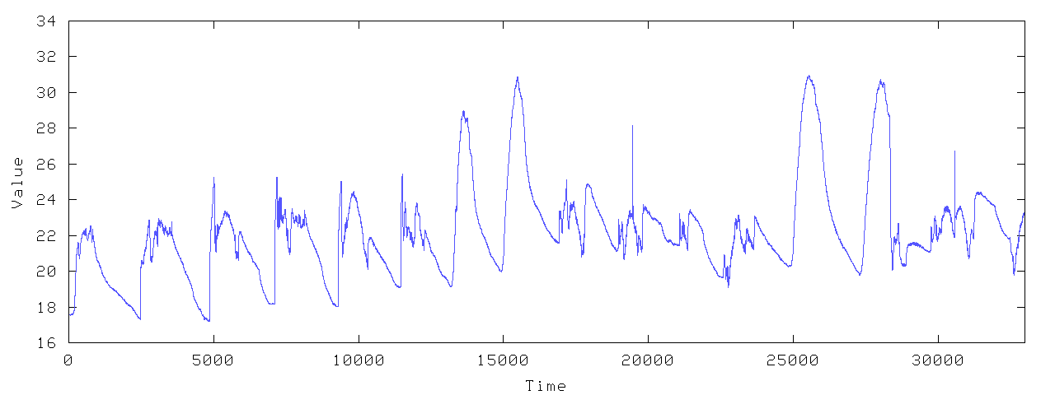
Pattern Discovery
Temperature
Query sequence
Data stream

Slide 19
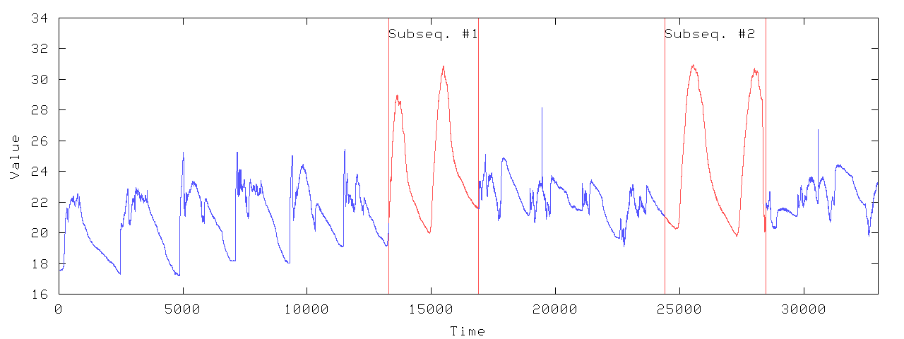
Pattern Discovery
Temperature
SPRING finds the days when the temperature fluctuates from cool to hot
Query sequence
Data stream

Slide 20
Experimental Evaluation
We created a database of 5,641 MIDI files covering many music genres.
Extracted for all channels (a MIDI file consists of at
most 16 channels) the highest pitch at every time click.
resulted in a music database consisting of a total of 10,749 time series with length at least 200.
Selected 200 random subsequences in the database as queries and added noise by replace 5, 10, 15, 20, 25, 30% of signal.

Slide 21
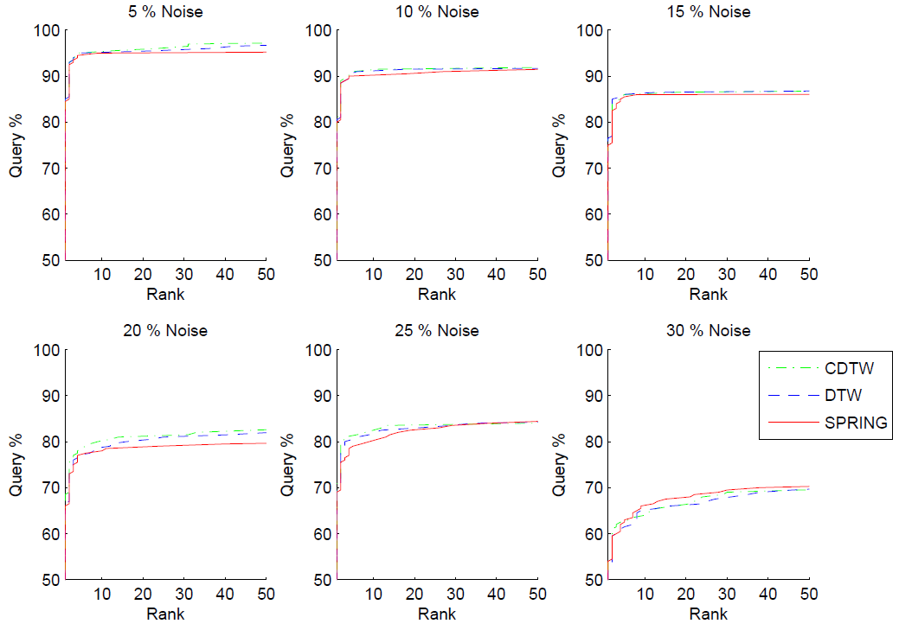
Experimental Evaluation

Slide 22
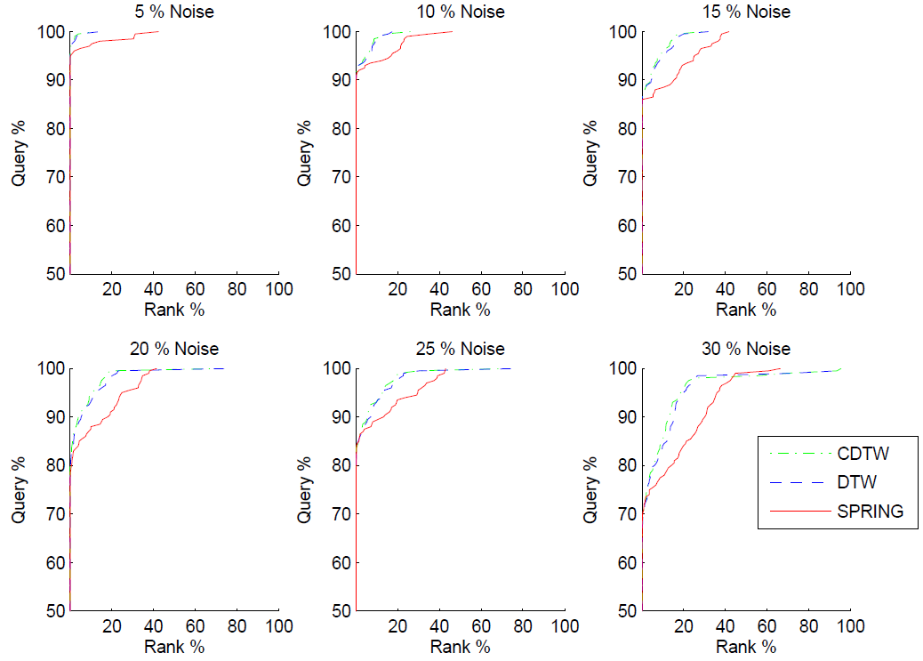
Experimental Evaluation

Slide 23
Conclusions & Future Works
In terms of retrieval runtime, SPRING is in turn faster than cDTW over a sliding window.
For noise such as relatively higher or durations with respect to the target sequence are still a bottle-neck for this paper.
Significant speed-ups could be achieved by using LB Keogh and Embedding-based subsequence matching (EBSM) for cDTW and SPRING respectively.

