Slide 1
An efﬁcient multiple-kernel learning for pattern classiﬁcation
Chi-Yuan Yeh, Wen-Pin Su, Shie-Jue Lee
Department of Electrical Engineering, National Sun Yat-Sen University, Kaohsiung 804, Taiwan, ROC
Expert Systems with Applications 40 (2013) 3491–3499
Presenter: 方鈞毅
Date: Mar. 18, 2013

Slide 2
abstract
Support vector machines (SVMs) have been broadly applied to classiﬁcation problems. However, a successful application of SVMs depends heavily on the determination of the right type and suitable hyperparameter settings of kernel functions. Recently, multiple-kernel learning (MKL) algorithms have been developed to deal with these issues by combining different kernels together. The weight with each kernel in the combination is obtained through learning.
Lanckriet et al. proposed a way of deriving the weights by transforming the learning into a semideﬁnite programming (SDP) problem with a transduction setting.However, the amount of time and space required by this method is demanding.

Slide 3
abstract
In this paper, we reformulate the SDP problem with an induction setting and incorporate two strategies to reduce the search complexity of the learning process, based on the comments discussed in the Lanckriet et al. paper.
The primal and dual forms of SDP are derived. A discussion on computation complexity is given. Experimental results obtained from synthetic and benchmark datasets show that the proposed method runs efﬁciently in multiple-kernel learning.

Slide 4
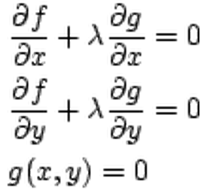
Lagrange Multiplier Method
Lagrange multiplier method，是一個求極值的方法。
f(x,y):目標函式
g(x,y)=0 :限制函式
λ:為一待求的數值
Lagrange 提出以 f(x,y) + λg(x,y) 對 x 和 y 的偏導數為 0，來代替，作為在 g(x,y)=0 上面尋找 f(x,y) 極值的條件。

Slide 5
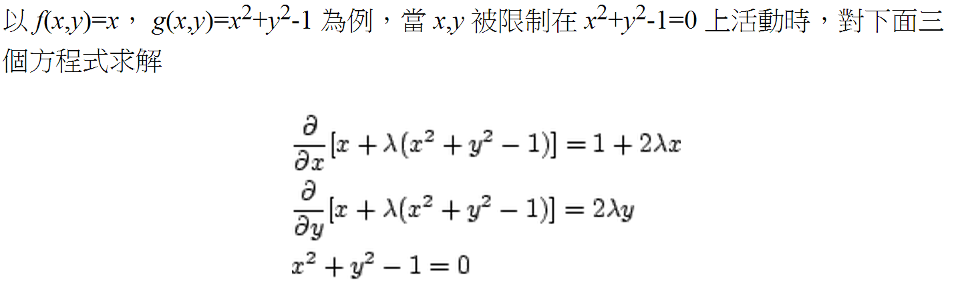
Lagrange Multiplier Method

Slide 6
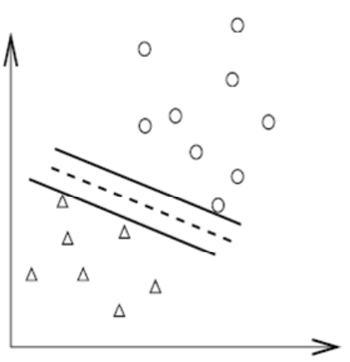
SVM 的概念
SVM對於一群在 R^{d} 空間中的資料，我們希望能夠在該空間之中找出一Hyper-plan，並且，希望此Hyper-plan可以將這群資料切成兩群(ie:群組 A、群組 B)。
而屬於群組 A 的資料均位於 Hyper-plan 的同側，而群組 B 的資料均位於 Hyper-plan的另一側，如下圖：

Slide 7
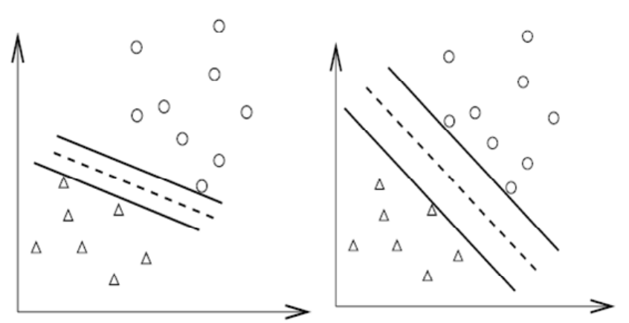
比較下圖左以及右，我們可以發現左圖所找出的 Hyper-plan(虛線)，其兩平行且與兩組資料點相切的 Hyper-plan(實線)之間距離較近，而右圖則具有較大的 Margin。
而由於我們希望可以找出將兩群資料點分的較開的 Hyper-plan，因次我們認為右圖所找出的是比較好的 Hyper-plan。

Slide 8
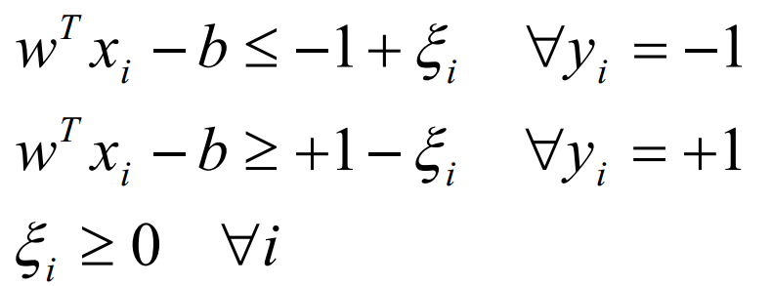
Soft margin SVM
To make the method more ﬂexible and robust,
all the patterns need not be correctly classiﬁed by the hyperplane.
The misclassiﬁed patterns are penalized, and slack variables ξ are introduced to account for such misclassiﬁcations.

Slide 9
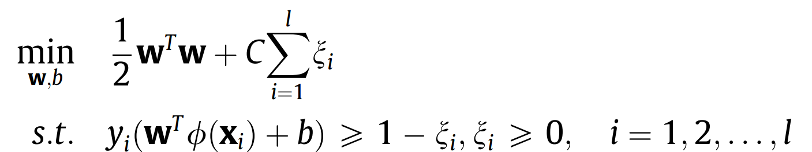
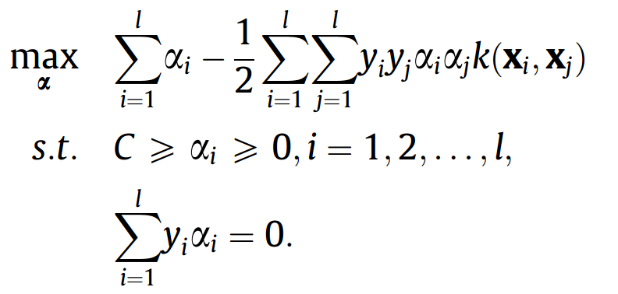
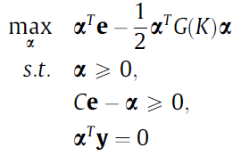
我們希望誤差項 ξ的範圍愈小愈好，所以給有誤差的資料多一點成本(cost)。
C是我們決定要給多少懲罰的權重。
則目標函式與限制函式可寫成:
再使用Lagrange Multiplier求解

Slide 10
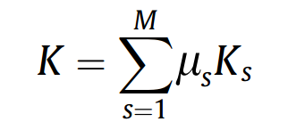
Multiple-kernel learning
The performance of a single-kernel method depends heavily on the choice of the kernel
Kernel fusion has been proposed to deal with this problem
where μ_{s} are weights. we’d like μ_{s} to be optimal.

Slide 11

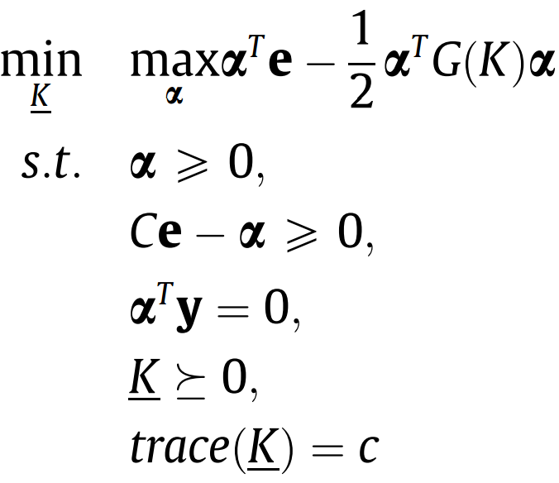
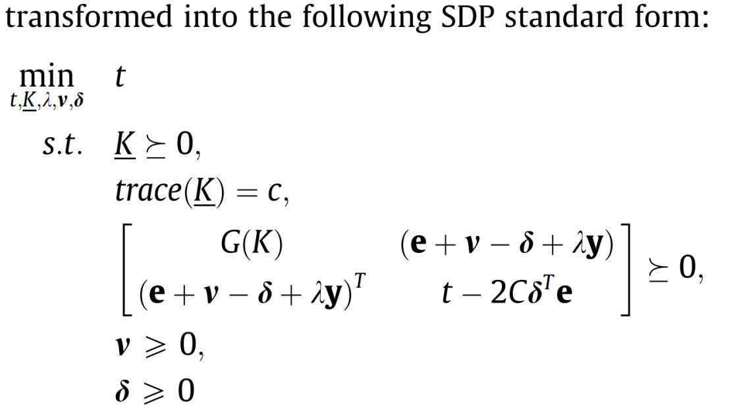
The generalized performance measure is minimized with respect to the combined kernel matrix K, where is obtained from both the training and testing patterns, and l is the total number of patterns. The objective function and constraints of the underlying problem are formulated as

Slide 12
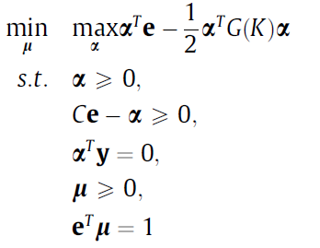
Proposed Method
Two strategies are incorporated
kernel weights to be non-negative
the sum of the weights to be one
Therefore, the multiplekernel optimization problem for SVMs becomes:

Slide 13
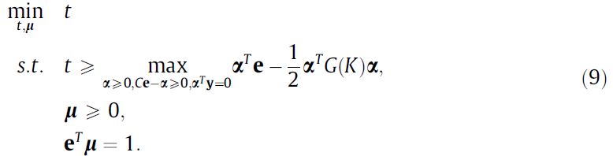


引入變數t當作此目標函式的upper bound 則上式可改寫為:
By using Lagrange Multiplier Method, and Schur complement lemma we can derive

Slide 14

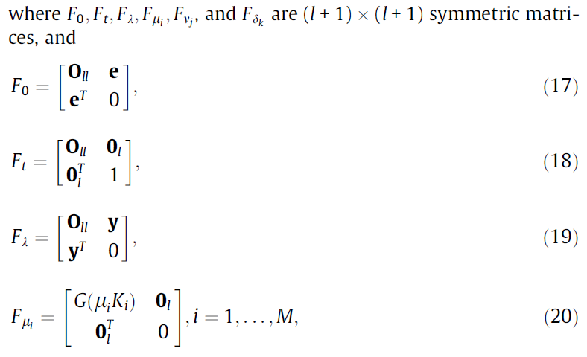
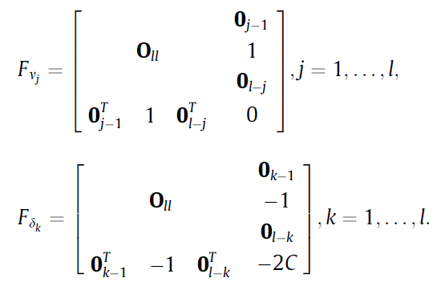
Than P can imply as

Slide 15
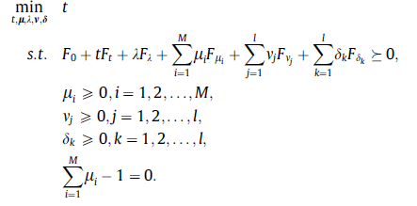
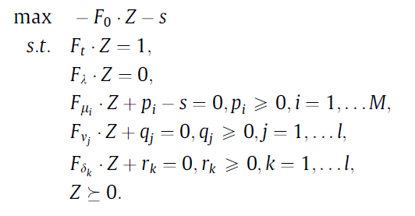
Then Eq. (15) can be rewritten as follows:
By applying the Lagrangian, we have
最後使用primal–dual interior point method求解

Slide 16
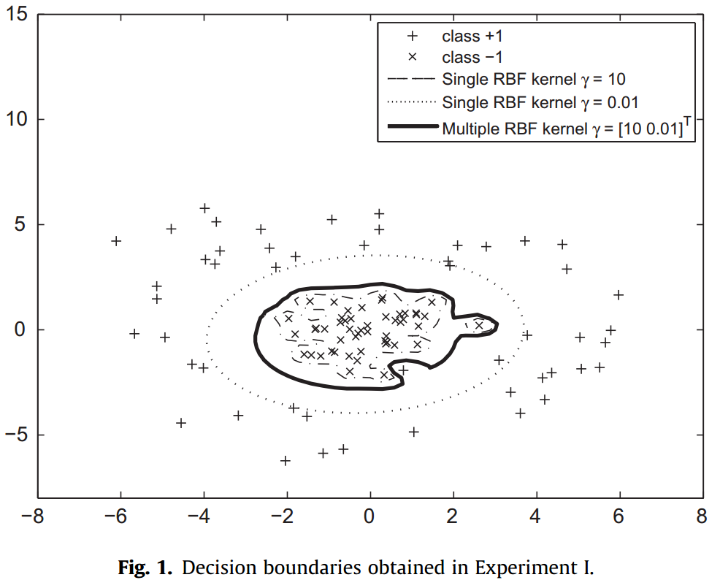
Experimental results
SDPI use two-kernel learning is adopted for this case, i.e., K = μ₁ *K₁+ μ₂ *K₂, where K₁ and K₂ are RBFs with γ₁ = 10 and γ₂ = 0.01, respectively. The optimal weights μ₁ and μ₂ obtained by our SDPI are 0.726 and 0.274.

Slide 17
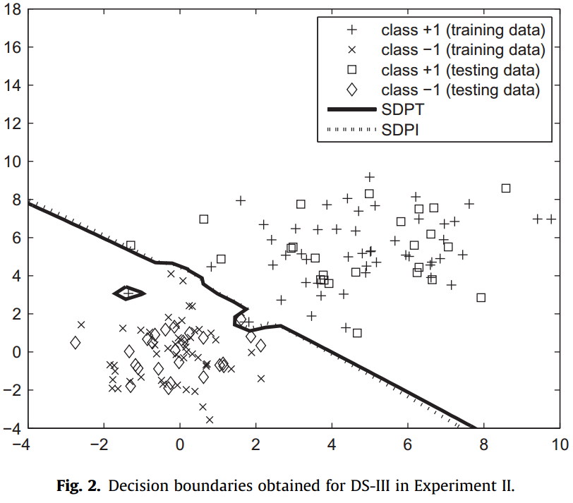
SDPI and SDPT both adopt two-kernel learning like above Experimental1 , i.e., K = μ₁ *K₁+ μ₂ *K₂, where K₁ and K₂ are RBFs with γ₁ = 10 and γ₂ = 0.01, respectively.

Slide 18
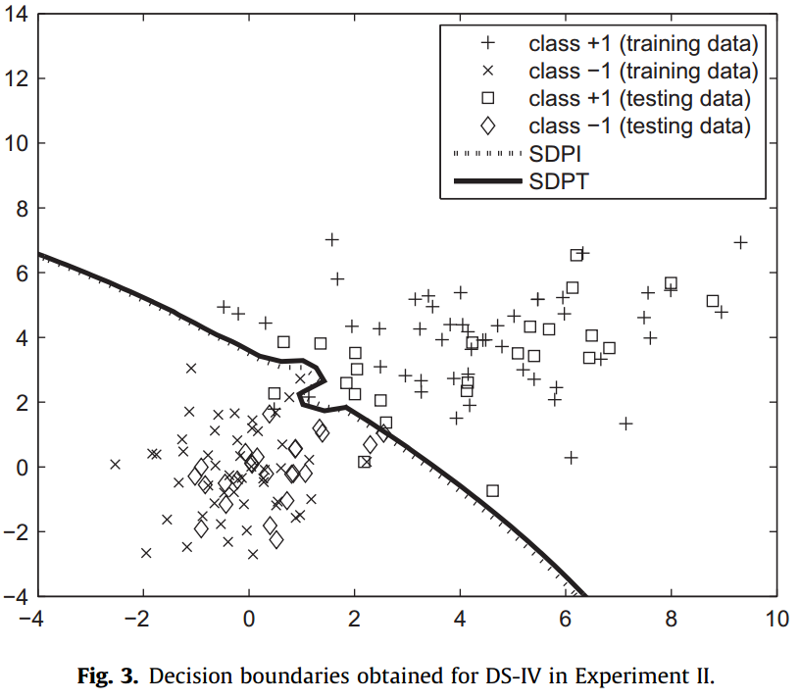

Slide 19
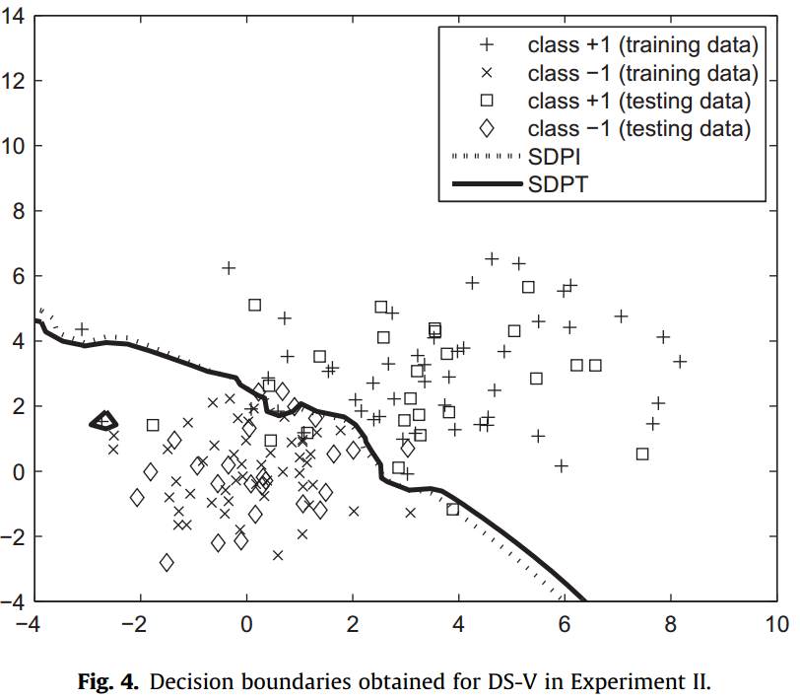

Slide 20
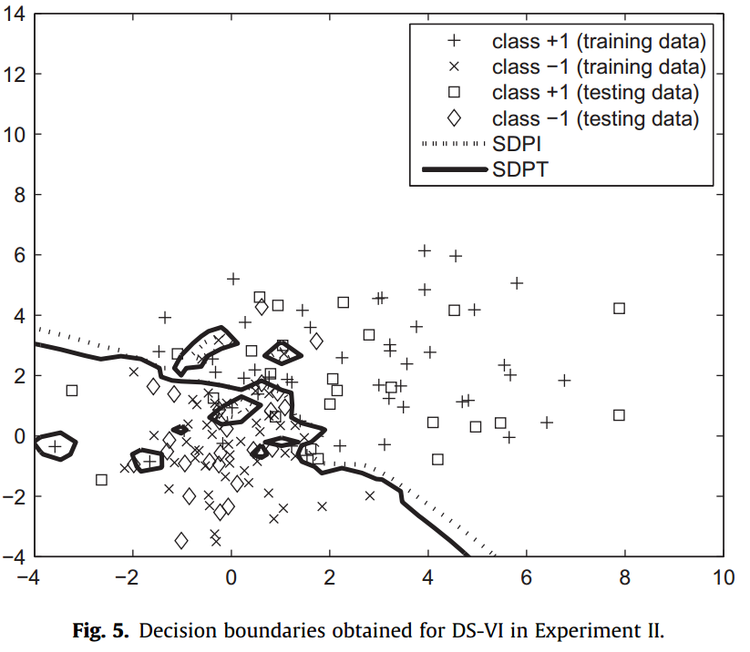

Slide 21
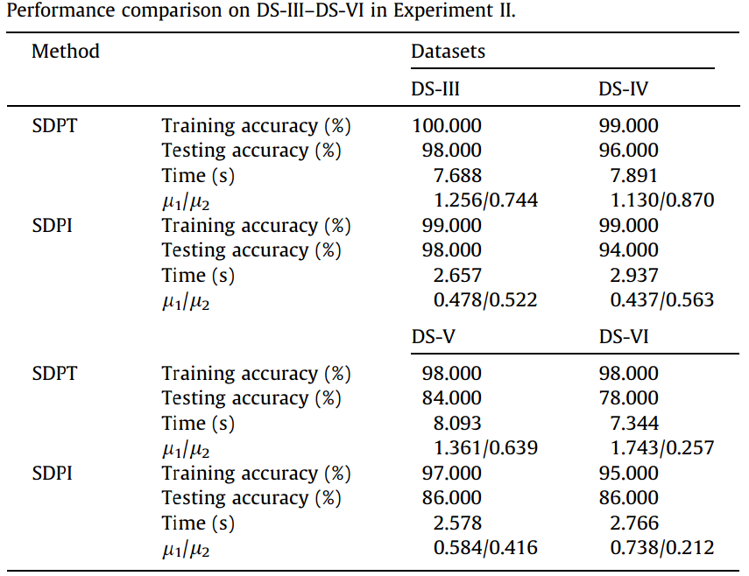

Slide 22
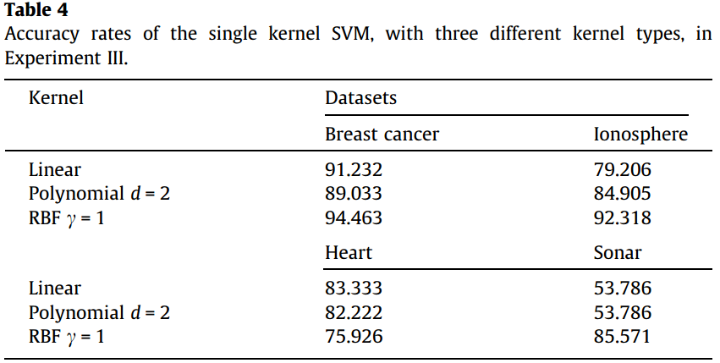
Single kernel SVM, SDPI, and SDPT, on some real datasets.
Three datasets,‘breast cancer’, ‘ionosphere’, and ‘sonar’, are taken from the UCI, and one dataset, ‘heart’, is taken from the Statlog collection

Slide 23
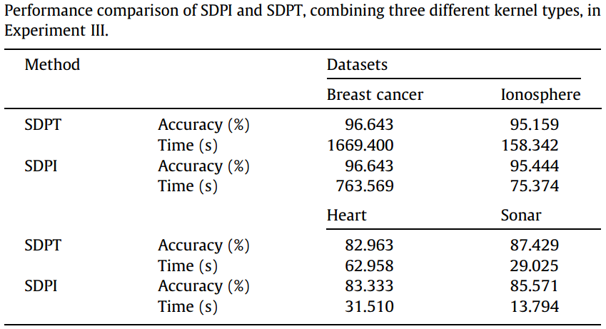

Slide 24
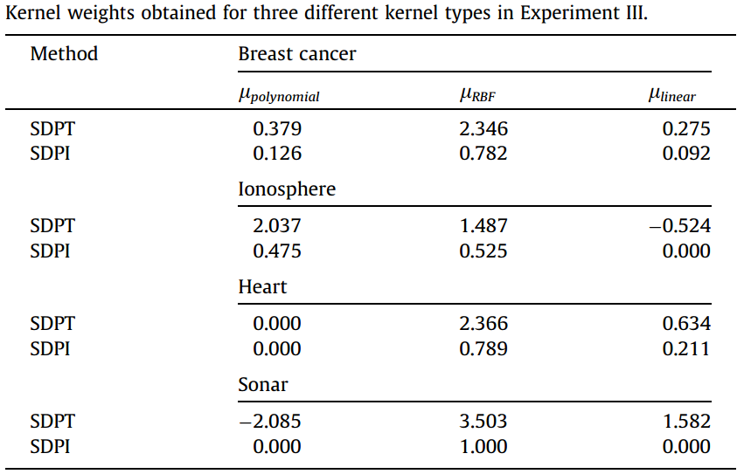

Slide 25
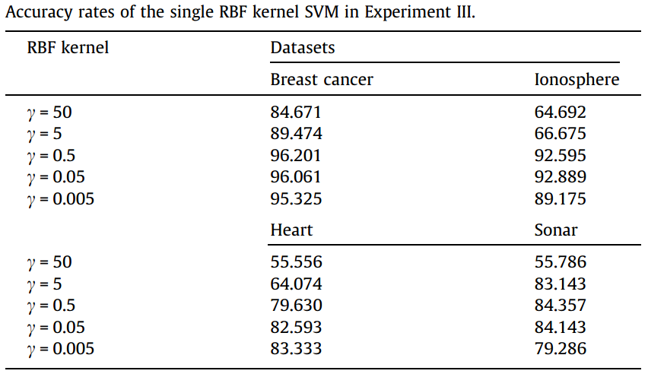

Slide 26
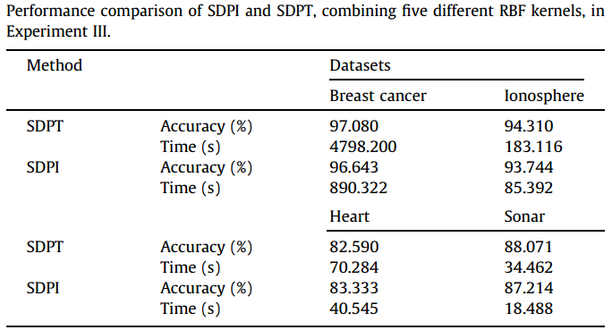

Slide 27
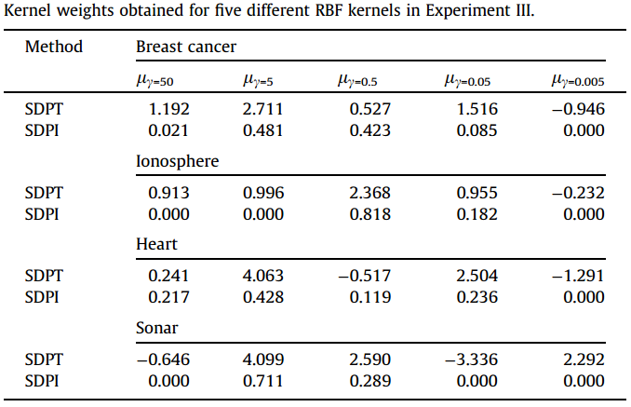

Slide 28
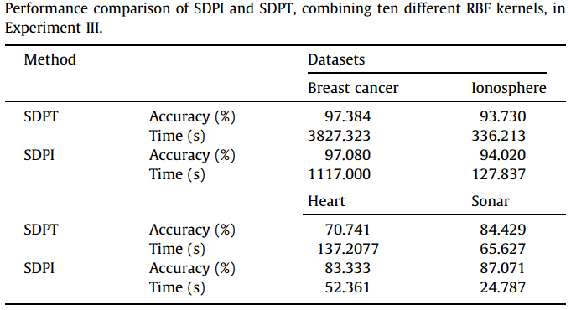

Slide 29
