Slide 1
All Common Subsequences
Hui Wang (王暉) School of Computing and Mathematics University of Ulster, Northern Ireland, UK Proceedings of the 20th international joint conference, 2007
Presenter: Guo Yi-Pu 2013-03-18

Slide 2
Abstract (1/2)
Time series data abounds in real world problems. Measuring the similarity of time series is a key to solving these problems. One state of the art measure is the longest common subsequence. This measure advocates using the length of the longest common subsequence as an indication of similarity between sequences, but ignores information contained in the second, third, ..., longest subsequences.
In order to capture the common information in sequences maximally we propose a novel measure of sequence similarity – the number of all common subsequences. We show that this measure satisfies the common properties of similarity functions. Calculating this measure is not trivial as a brute force

Slide 3
Abstract (2/2)
approach is exponential in time. We present a novel dynamic programming algorithm to calculate this number in polynomial time. We also suggest a different way of extending a class of such measures to multidimensional, real-valued time series, in the spirit of probabilistic metric spaces.
We conducted an experimental study on the new similarity measure and the extension method for classification. It was found that both the new similarity and the extension method are consistently competitive.

Slide 4
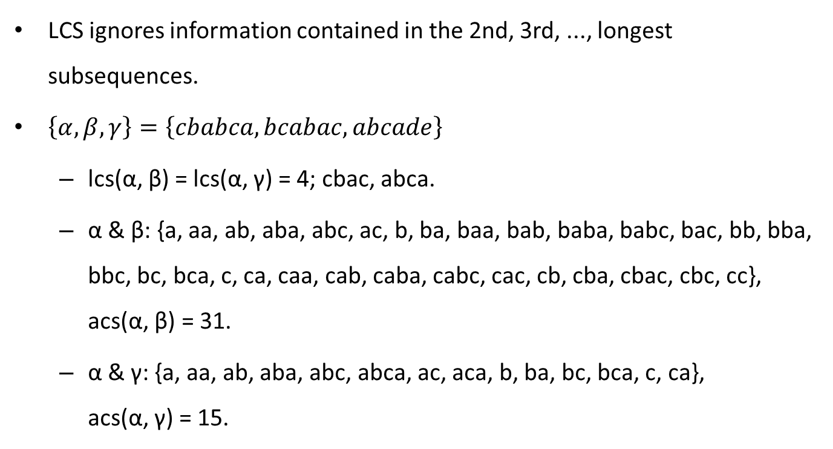
All Common Subsequences (ACS)
LCS ignores information contained in the 2nd, 3rd, ..., longest subsequences.
$\left\{α,β,γ\right\}=\left\{cbabca,bcabac,abcade\right\}$
lcs(α, β) = lcs(α, γ) = 4; cbac, abca.
α & β: {a, aa, ab, aba, abc, ac, b, ba, baa, bab, baba, babc, bac, bb, bba, bbc, bc, bca, c, ca, caa, cab, caba, cabc, cac, cb, cba, cbac, cbc, cc}, acs(α, β) = 31.
α & γ: {a, aa, ab, aba, abc, abca, ac, aca, b, ba, bc, bca, c, ca}, acs(α, γ) = 15.

Slide 5

For Discrete Symbols
$$N\left(i,j\right)=\left\{\begin{aligned}&N\left(i−1,j−1\right)×2,&if A_{i}=B_{j} \\ &N\left(i−1,j\right)+N\left(i,j−1\right)−N\left(i−1,j−1\right),&if A_{i}≠B_{j}\end{aligned}\right.$$
$A_{i}=B_{j}$
$S\left(i,j\right)=S\left(i−1,j−1\right)∪S\left(i−1,j−1\right)A_{i}$
$A_{i}≠B_{j}$
$S\left(i,j\right)=S\left(i−1,j\right)∪S\left(i,j−1\right)$

Slide 6
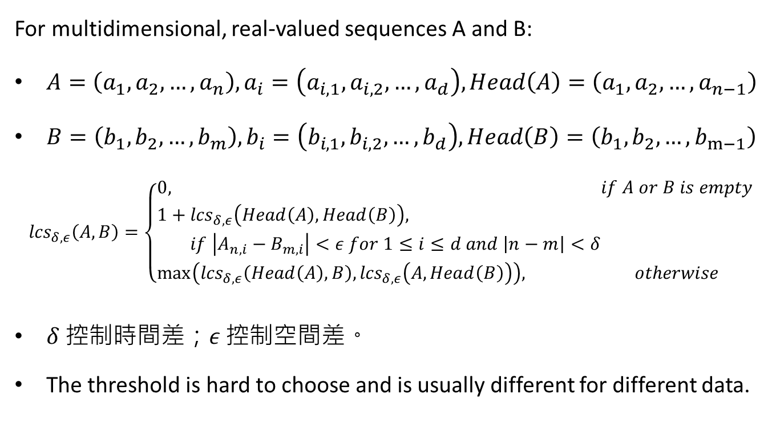
LCS Extended [Vlac03]
For multidimensional, real-valued sequences A and B:
$A=\left(a_{1},a_{2},…,a_{n}\right),a_{i}=\left(a_{i,1},a_{i,2},…,a_{d}\right),Head\left(A\right)=\left(a_{1},a_{2},…,a_{n−1}\right)$
$B=\left(b_{1},b_{2},…,b_{m}\right),b_{i}=\left(b_{i,1},b_{i,2},…,b_{d}\right),Head\left(B\right)=\left(b_{1},b_{2},…,b_{m−1}\right)$
$${lcs}_{δ,ε}\left(A,B\right)=\left\{\begin{aligned}&0,&if A or B is empty \\ &1+{lcs}_{δ,ε}\left(Head\left(A\right),Head\left(B\right)\right), \\ & if \left|A_{n,i}−B_{m,i}\right|<ε for 1≤i≤d and \left|n−m\right|<δ \\ &\max\left({lcs}_{δ,ε}\left(Head\left(A\right),B\right),{lcs}_{δ,ε}\left(A,Head\left(B\right)\right)\right),&otherwise\end{aligned}\right.$$
$δ$ 控制時間差；$ε$ 控制空間差。
The threshold is hard to choose and is usually different for different data.

Slide 7
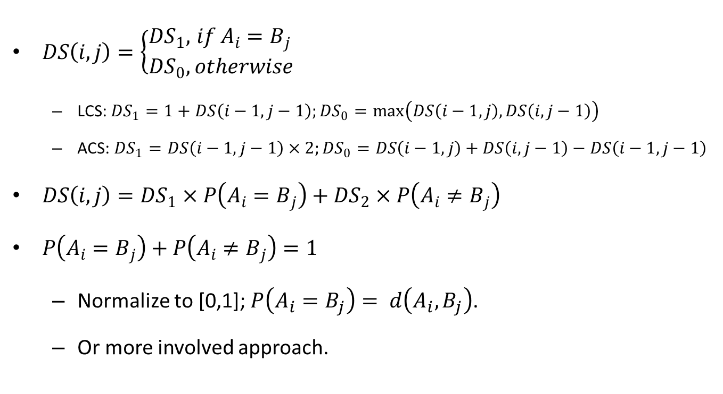
Extended: Probabilistic Metric Spaces
$DS\left(i,j\right)=\left\{\begin{aligned}&{DS}_{1},&if A_{i}=B_{j} \\ &{DS}_{0},&otherwise\end{aligned}\right.$
LCS: ${DS}_{1}=1+DS\left(i−1,j−1\right);{DS}_{0}=\max\left(DS\left(i−1,j\right),DS\left(i,j−1\right)\right)$
ACS: ${DS}_{1}=DS\left(i−1,j−1\right)×2;{DS}_{0}=DS\left(i−1,j\right)+DS\left(i,j−1\right)−DS\left(i−1,j−1\right)$
$DS\left(i,j\right)={DS}_{1}×P\left(A_{i}=B_{j}\right)+{DS}_{2}×P\left(A_{i}≠B_{j}\right)$
$P\left(A_{i}=B_{j}\right)+P\left(A_{i}≠B_{j}\right)=1$
Normalize to [0,1]; $P\left(A_{i}=B_{j}\right)= d\left(A_{i},B_{j}\right)$.
Or more involved approach.

Slide 8
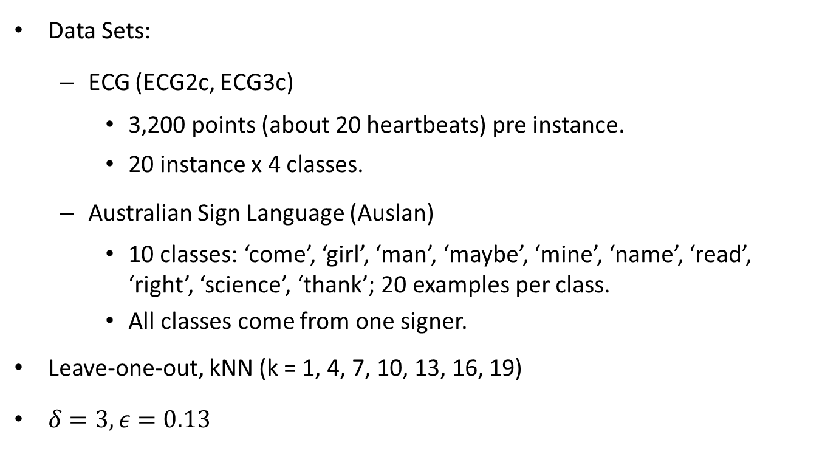
Experiment (1/2)
Data Sets:
ECG (ECG2c, ECG3c)
3,200 points (about 20 heartbeats) pre instance.
20 instance x 4 classes.
Australian Sign Language (Auslan)
10 classes: ‘come’, ‘girl’, ‘man’, ‘maybe’, ‘mine’, ‘name’, ‘read’, ‘right’, ‘science’, ‘thank’; 20 examples per class.
All classes come from one signer.
Leave-one-out, kNN (k = 1, 4, 7, 10, 13, 16, 19)
$δ=3,ε=0.13$

Slide 9
Experiment (2/2)
lcs_vhgk: the extended LCS presented in [Vlac03].
acs_vhgk: ACS extended in a way similar to lcs_vhgk.
lcs_w_euc: LCS extended with normalized Euclidean distance.
acs_w_euc: ACS extended with normalized Euclidean distance.
lcs_w_ncm: LCS extended with normalized NCM.
acs_w_ncm: ACS extended with normalized NCM.
The NCM similarity: H. Wang and W. Dubitzky. A flexible and robust similarity measure based on contextual probability.

Slide 10
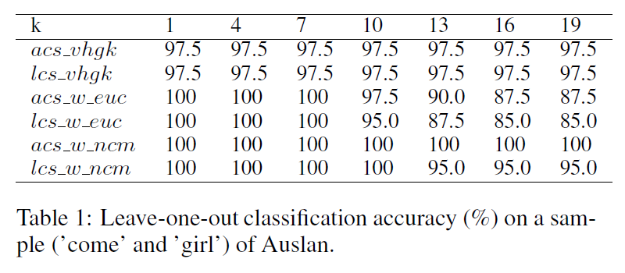
Auslan (Sampled)

Slide 11
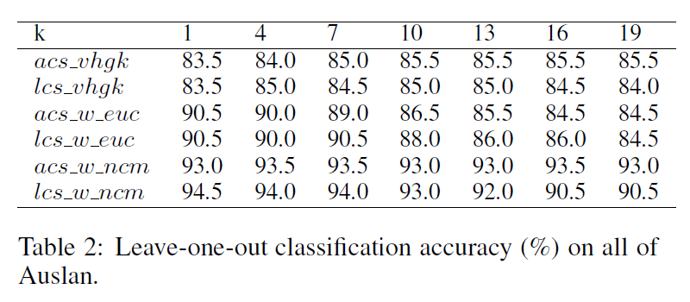
Auslan (All)

Slide 12
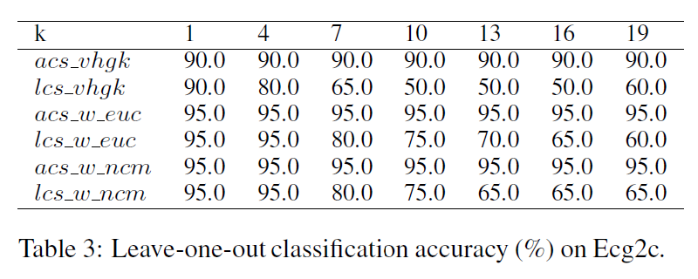
ECG2c

Slide 13
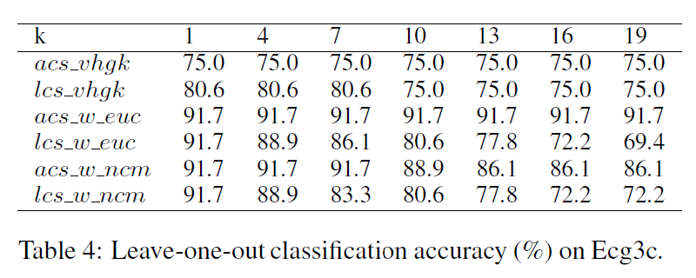
ECG3c

