Slide 1
Partitions based computational method for high-order fuzzy time series forecasting
Sukhdev Singh Gangwar, Sanjay Kumar
Expert Systems with Applications 39 (2012) 12158–12164
Presenter: Che-Jui Hsu(許哲睿)
Date: 2013/3/17

Slide 2
Abstract
In this paper, we present a computational method of forecasting based on multiple partitioning and higher order fuzzy time series. The developed computational method provides a better approach to enhance the accuracy in forecasted values. The objective of the present study is to establish the fuzzy logical relations of different order for each forecast. Robustness of the proposed method is also examined in case of external perturbation that causes the fluctuations in time series data. The general suitability of the developed model has been tested by implementing it in forecasting of student enrollments at University of Alabama. Further it has also been implemented in the forecasting the market price of share of State Bank of India (SBI) at Bombay Stock Exchange (BSE), India. In order to show the superiority of the proposed model over few existing models, the results obtained have been compared in terms of mean square and average forecasting errors.

Slide 3
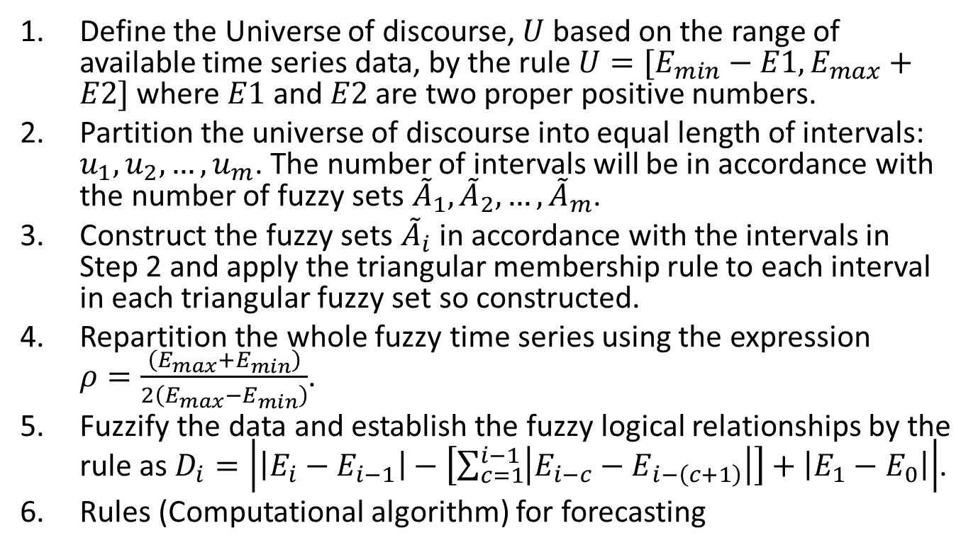
Proposed algorithm
Define the Universe of discourse, $U$ based on the range of available time series data, by the rule $U=[E_{min}−E1, E_{max}+E2]$where $E1$ and $E2$ are two proper positive numbers.
Partition the universe of discourse into equal length of intervals: $u_{1},u_{2}, …,u_{m}$. The number of intervals will be in accordance with the number of fuzzy sets ${\tilde{A}}_{1},{\tilde{A}}_{2},…,{\tilde{A}}_{m}$.
Construct the fuzzy sets ${\tilde{A}}_{i}$ in accordance with the intervals in Step 2 and apply the triangular membership rule to each interval in each triangular fuzzy set so constructed.
Repartition the whole fuzzy time series using the expression $ρ=\frac{\left(E_{max}+E_{min}\right)}{2\left(E_{max}−E_{min}\right)}$.
Fuzzify the data and establish the fuzzy logical relationships by the rule as $D_{i}=\left|\left|E_{i}−E_{i−1}\right|−\left[\sum_{c=1}^{i−1}{\left|E_{i−c}−E_{i−\left(c+1\right)}\right|}\right]+\left|E_{1}−E_{0}\right|\right|$.
Rules (Computational algorithm) for forecasting

Slide 4
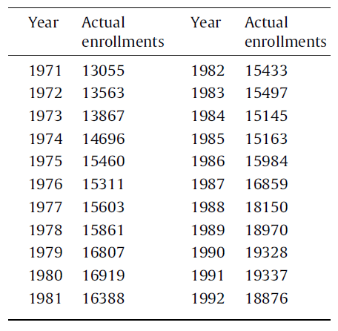
Forecasting enrollments with proposed method (1/8)

Slide 5
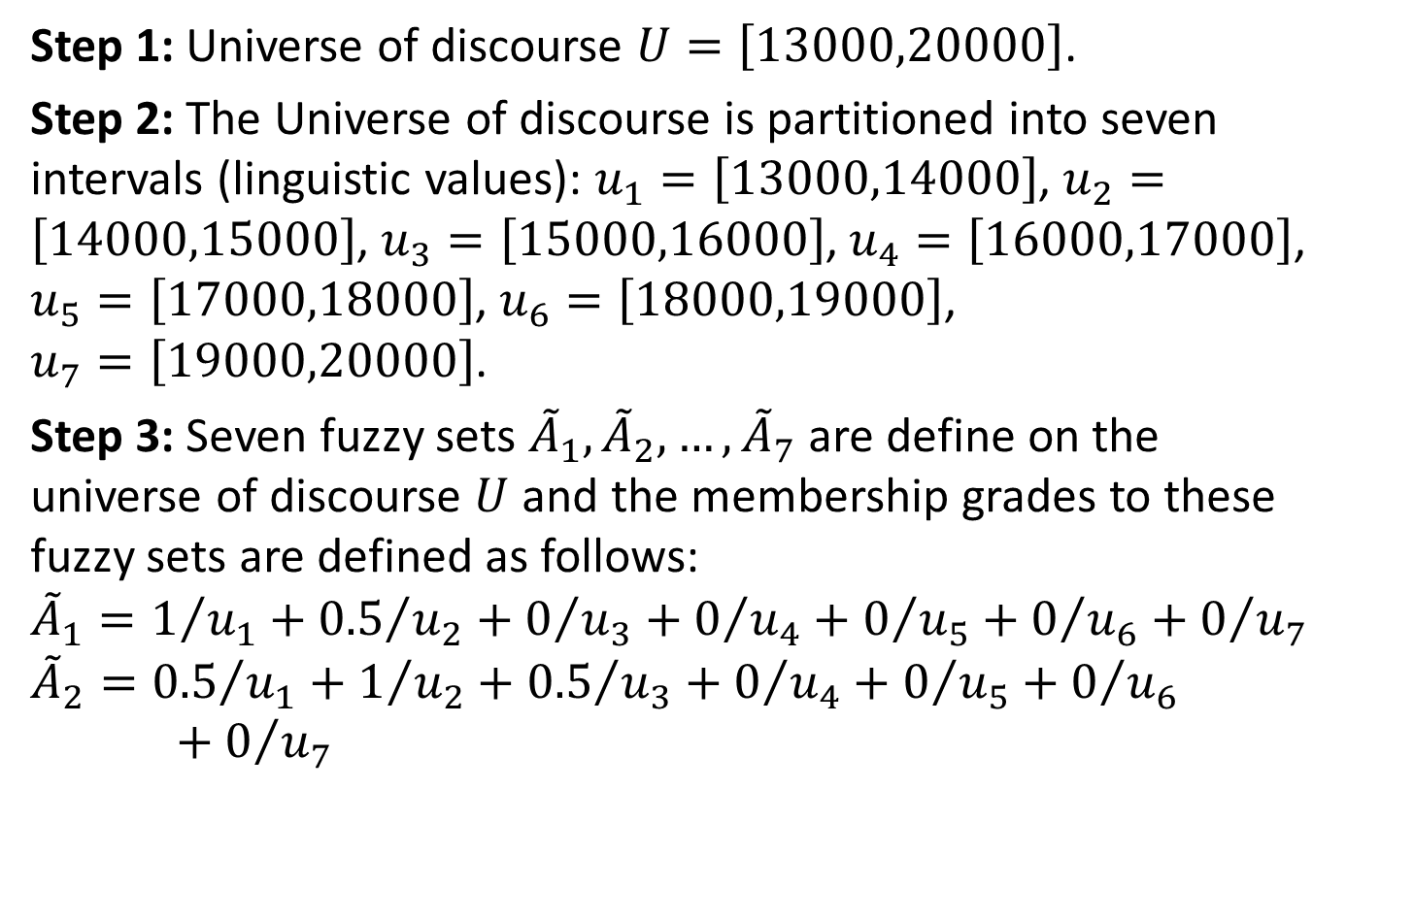
Forecasting enrollments with proposed method (2/8)
Step 1: Universe of discourse $U=\left[13000,20000\right]$.
Step 2: The Universe of discourse is partitioned into seven intervals (linguistic values): $u_{1}=\left[13000,14000\right]$, $u_{2}=\left[14000,15000\right]$, $u_{3}=\left[15000,16000\right]$, $u_{4}=\left[16000,17000\right]$, $u_{5}=\left[17000,18000\right]$, $u_{6}=\left[18000,19000\right]$, $u_{7}=\left[19000,20000\right]$.
Step 3: Seven fuzzy sets ${\tilde{A}}_{1},{\tilde{A}}_{2},…,{\tilde{A}}_{7}$ are define on the universe of discourse $U$ and the membership grades to these fuzzy sets are defined as follows:
$${\tilde{A}}_{1}=1/{u_{1}}+{0.5}/{u_{2}}+0/{u_{3}}+0/{u_{4}}+0/{u_{5}}+0/{u_{6}}+0/{u_{7}}$$
$${\tilde{A}}_{2}={0.5}/{u_{1}}+1/{u_{2}}+{0.5}/{u_{3}}+0/{u_{4}}+0/{u_{5}}+0/{u_{6}}+0/{u_{7}}$$

Slide 6
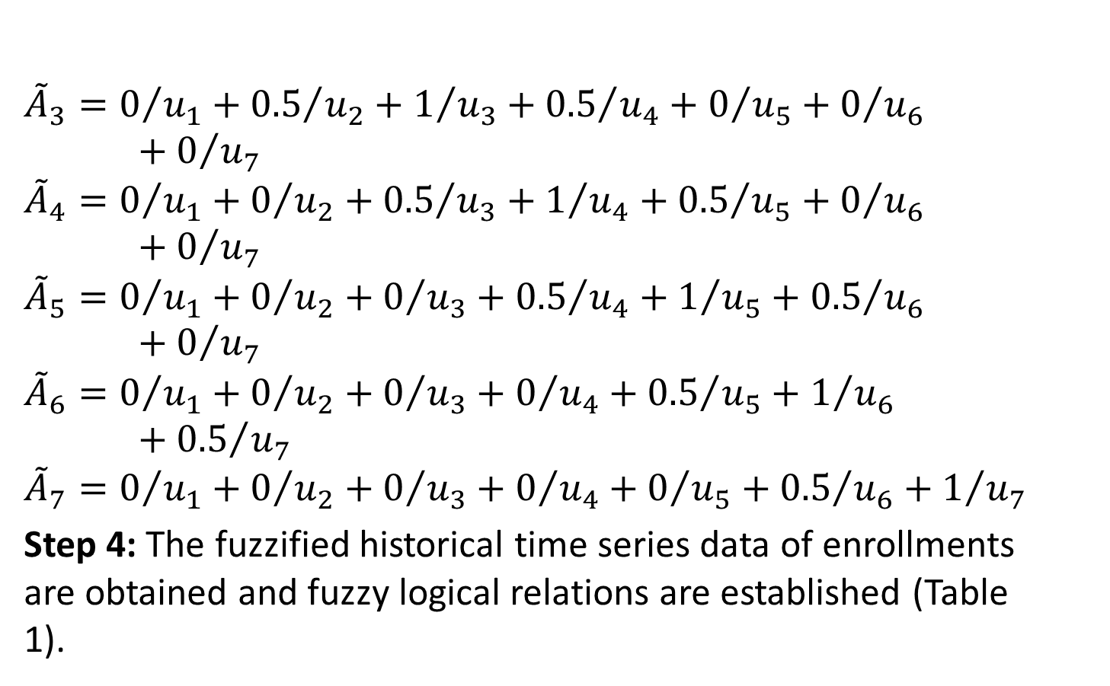
Forecasting enrollments with proposed method (3/8)
$${\tilde{A}}_{3}=0/{u_{1}}+{0.5}/{u_{2}}+1/{u_{3}}+{0.5}/{u_{4}}+0/{u_{5}}+0/{u_{6}}+0/{u_{7}}$$
$${\tilde{A}}_{4}=0/{u_{1}}+0/{u_{2}}+{0.5}/{u_{3}}+1/{u_{4}}+{0.5}/{u_{5}}+0/{u_{6}}+0/{u_{7}}$$
$${\tilde{A}}_{5}=0/{u_{1}}+0/{u_{2}}+0/{u_{3}}+{0.5}/{u_{4}}+1/{u_{5}}+{0.5}/{u_{6}}+0/{u_{7}}$$
$${\tilde{A}}_{6}=0/{u_{1}}+0/{u_{2}}+0/{u_{3}}+0/{u_{4}}+{0.5}/{u_{5}}+1/{u_{6}}+{0.5}/{u_{7}}$$
$${\tilde{A}}_{7}=0/{u_{1}}+0/{u_{2}}+0/{u_{3}}+0/{u_{4}}+0/{u_{5}}+{0.5}/{u_{6}}+1/{u_{7}}$$
Step 4: The fuzzified historical time series data of enrollments are obtained and fuzzy logical relations are established (Table 1).

Slide 7
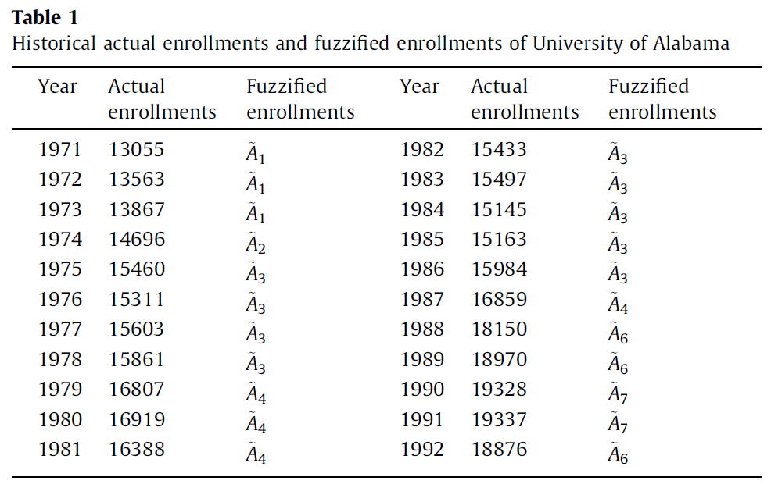
Forecasting enrollments with proposed method (4/8)

Slide 8
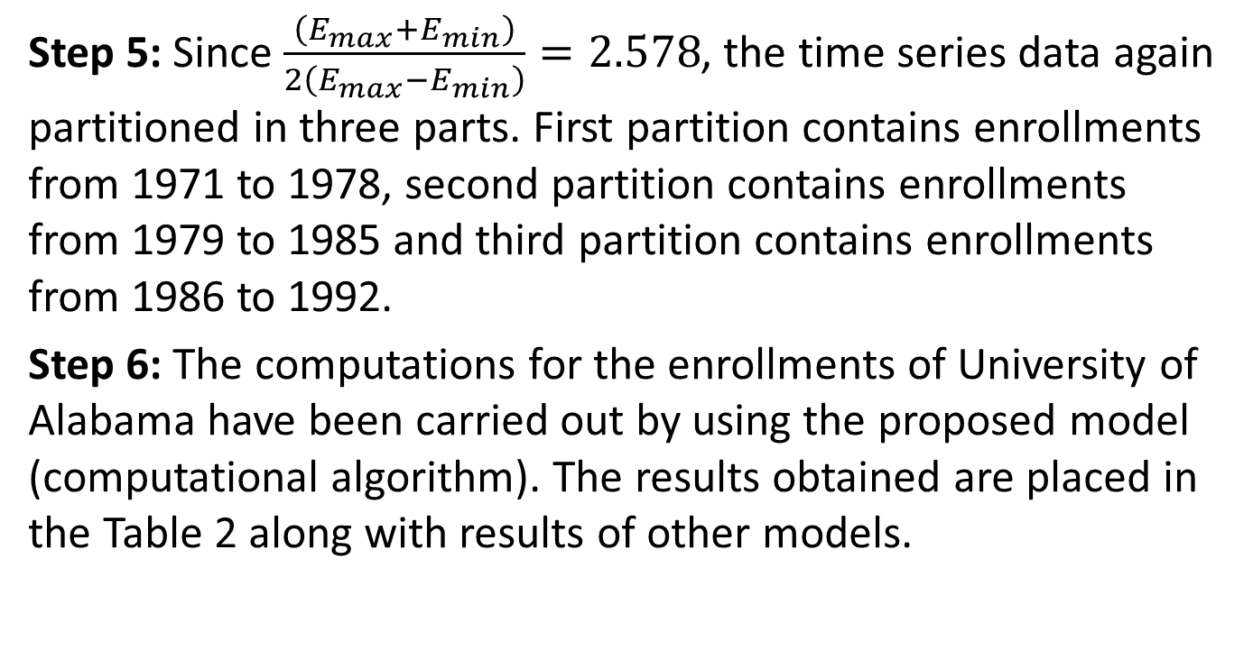
Forecasting enrollments with proposed method (5/8)
Step 5: Since $\frac{\left(E_{max}+E_{min}\right)}{2\left(E_{max}−E_{min}\right)}=2.578$, the time series data again partitioned in three parts. First partition contains enrollments from 1971 to 1978, second partition contains enrollments from 1979 to 1985 and third partition contains enrollments from 1986 to 1992.
Step 6: The computations for the enrollments of University of Alabama have been carried out by using the proposed model (computational algorithm). The results obtained are placed in the Table 2 along with results of other models.

Slide 9
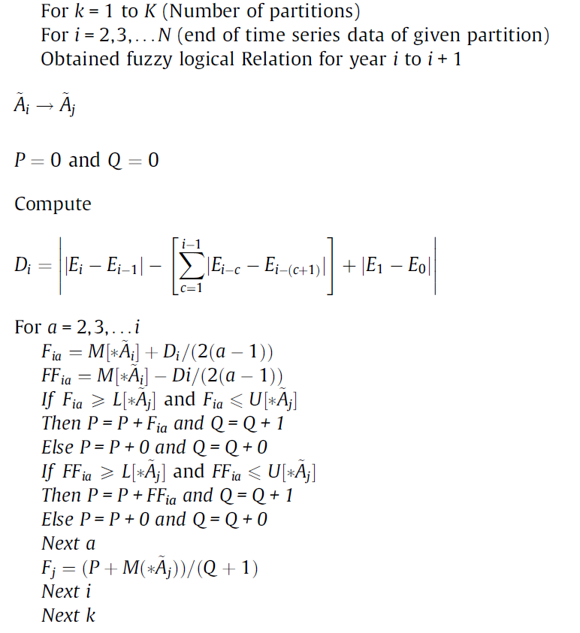
Computational algorithm (1/2)

Slide 10
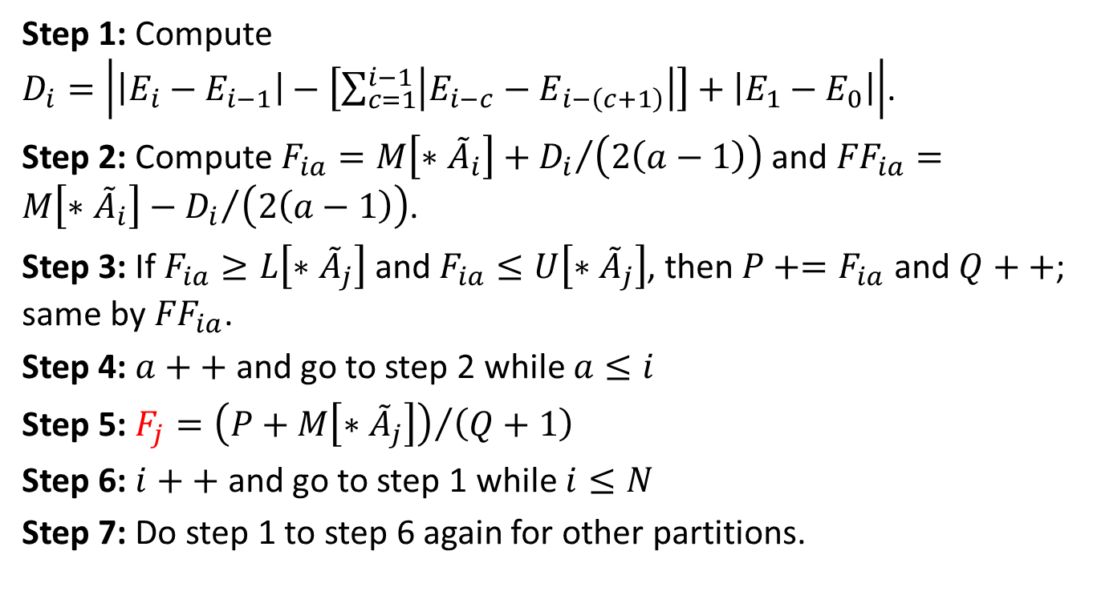
Computational algorithm (2/2)
Step 1: Compute $D_{i}=\left|\left|E_{i}−E_{i−1}\right|−\left[\sum_{c=1}^{i−1}{\left|E_{i−c}−E_{i−\left(c+1\right)}\right|}\right]+\left|E_{1}−E_{0}\right|\right|$.
Step 2: Compute $F_{ia}=M\left[∗{\tilde{A}}_{i}\right]+{D_{i}}/{\left(2\left(a−1\right)\right)}$ and ${FF}_{ia}=M\left[∗{\tilde{A}}_{i}\right]−{D_{i}}/{\left(2\left(a−1\right)\right)}$.
Step 3: If $F_{ia}≥L\left[∗{\tilde{A}}_{j}\right]$ and $F_{ia}≤U\left[∗{\tilde{A}}_{j}\right]$, then $P+=F_{ia}$ and $Q++$; same by ${FF}_{ia}$.
Step 4: $a++$ and go to step 2 while $a≤i$
Step 5: $F_{j}={\left(P+M\left[∗{\tilde{A}}_{j}\right]\right)}/{\left(Q+1\right)}$
Step 6: $i++$ and go to step 1 while $i≤N$
Step 7: Do step 1 to step 6 again for other partitions.

Slide 11
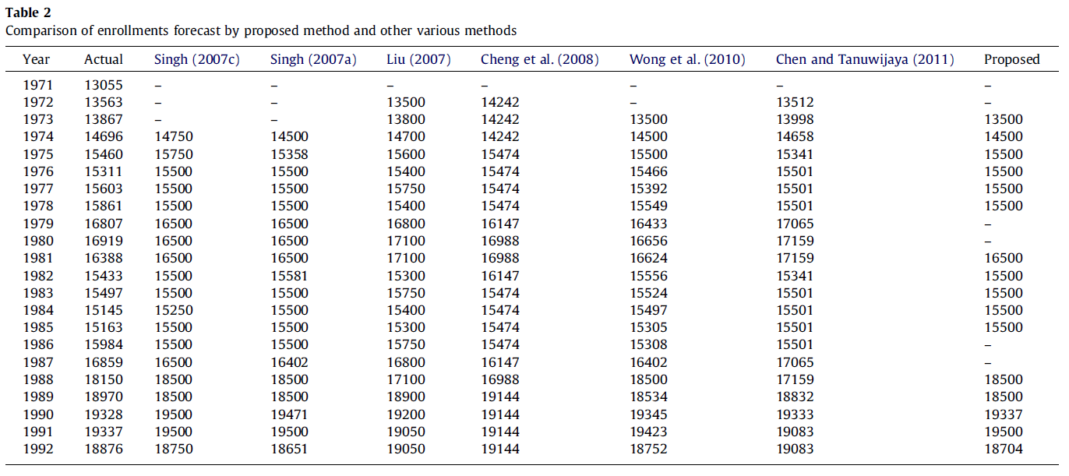
Forecasting enrollments with proposed method (6/8)

Slide 12
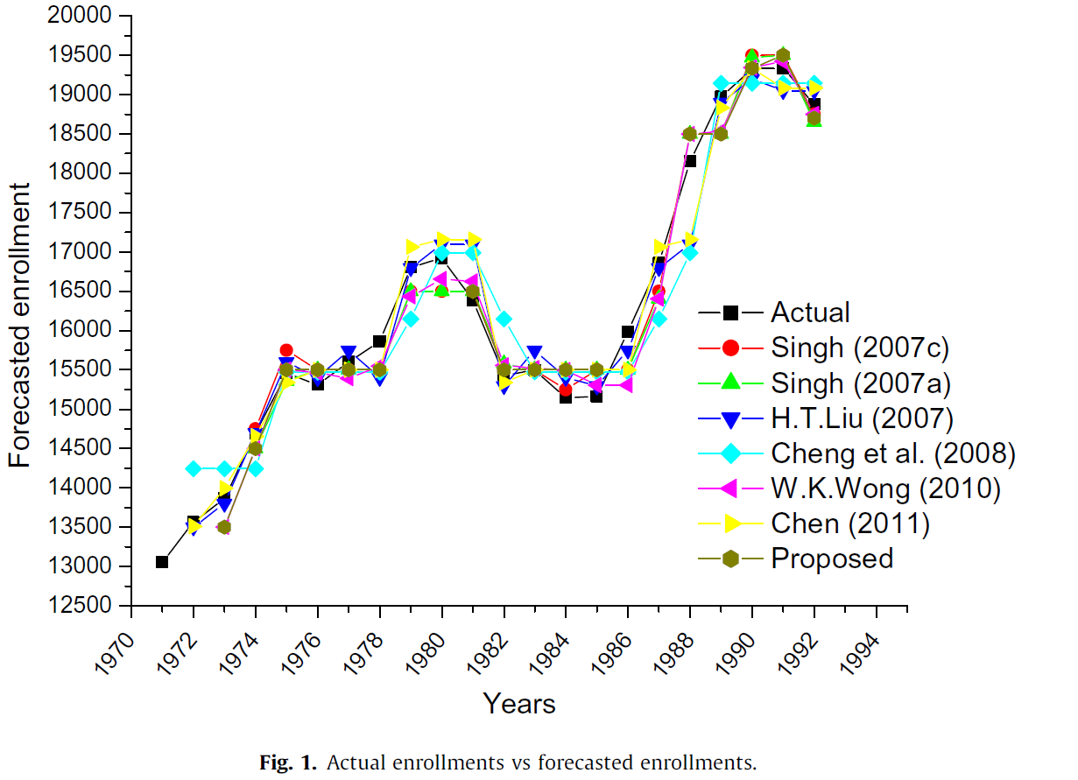
Forecasting enrollments with proposed method (7/8)

Slide 13
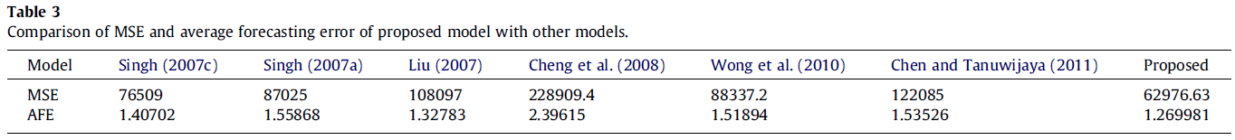
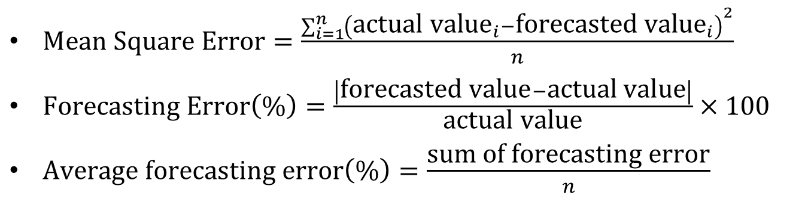
Forecasting enrollments with proposed method (8/8)
$\text{Mean} \text{Square} \text{Error}=\frac{\sum_{i=1}^{n}{{\left({\text{actual} \text{value}}_{i}−{\text{forecasted} \text{value}}_{i}\right)}^{2}}}{n}$
$\text{Forecasting} \text{Error}\left(\text{\%}\right)=\frac{\left|\text{forecasted} \text{value}−\text{actual} \text{value}\right|}{\text{actual} \text{value}}×100$
$\text{Average} \text{forecasting} \text{error}\left(\text{\%}\right)=\frac{\text{sum} \text{of} \text{forecasting} \text{error}}{n}$

Slide 14
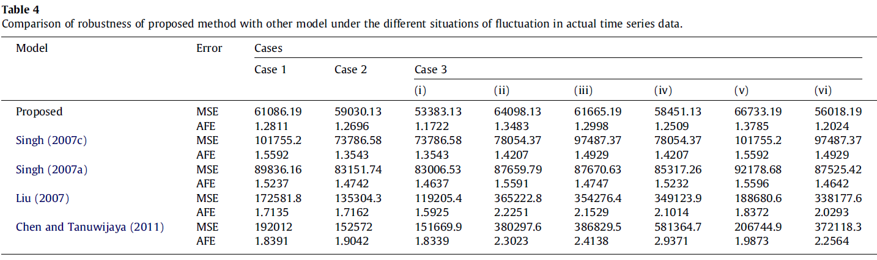
Robustness of the proposed method
Select year: 1973, 1981, 1988
↑↑↑
↓↓↓
↑↓↓
↓↑↓
↓↓↑
↑↑↓
↓↑↑
↑↓↑

Slide 15
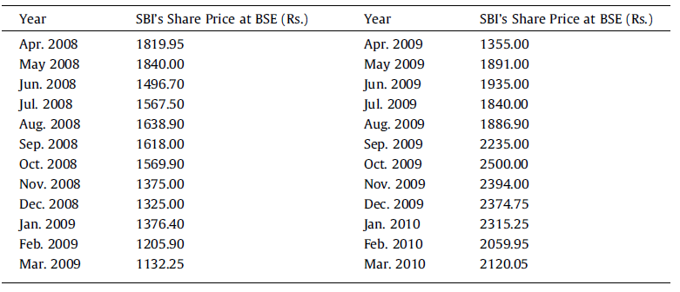
Forecasting market price of SBI’s share at Bombay Stock Exchange (BSE) (1/7)

Slide 16
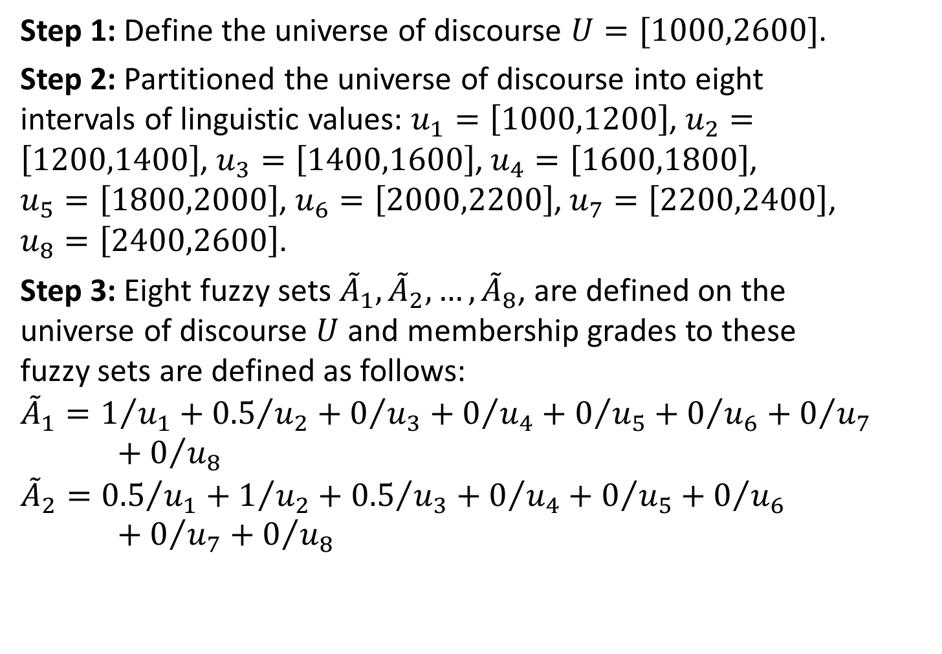
Forecasting market price of SBI’s share at Bombay Stock Exchange (BSE) (2/7)
Step 1: Define the universe of discourse $U=[1000,2600]$.
Step 2: Partitioned the universe of discourse into eight intervals of linguistic values: $u_{1}=\left[1000,1200\right]$, $u_{2}=\left[1200,1400\right]$, $u_{3}=\left[1400,1600\right]$, $u_{4}=\left[1600,1800\right]$, $u_{5}=\left[1800,2000\right]$, $u_{6}=\left[2000,2200\right]$, $u_{7}=\left[2200,2400\right]$, $u_{8}=\left[2400,2600\right]$.
Step 3: Eight fuzzy sets ${\tilde{A}}_{1},{\tilde{A}}_{2},…,{\tilde{A}}_{8}$, are defined on the universe of discourse $U$ and membership grades to these fuzzy sets are defined as follows:
$${\tilde{A}}_{1}=1/{u_{1}}+{0.5}/{u_{2}}+0/{u_{3}}+0/{u_{4}}+0/{u_{5}}+0/{u_{6}}+0/{u_{7}}+0/{u_{8}}$$
$${\tilde{A}}_{2}={0.5}/{u_{1}}+1/{u_{2}}+{0.5}/{u_{3}}+0/{u_{4}}+0/{u_{5}}+0/{u_{6}}+0/{u_{7}}+0/{u_{8}}$$

Slide 17
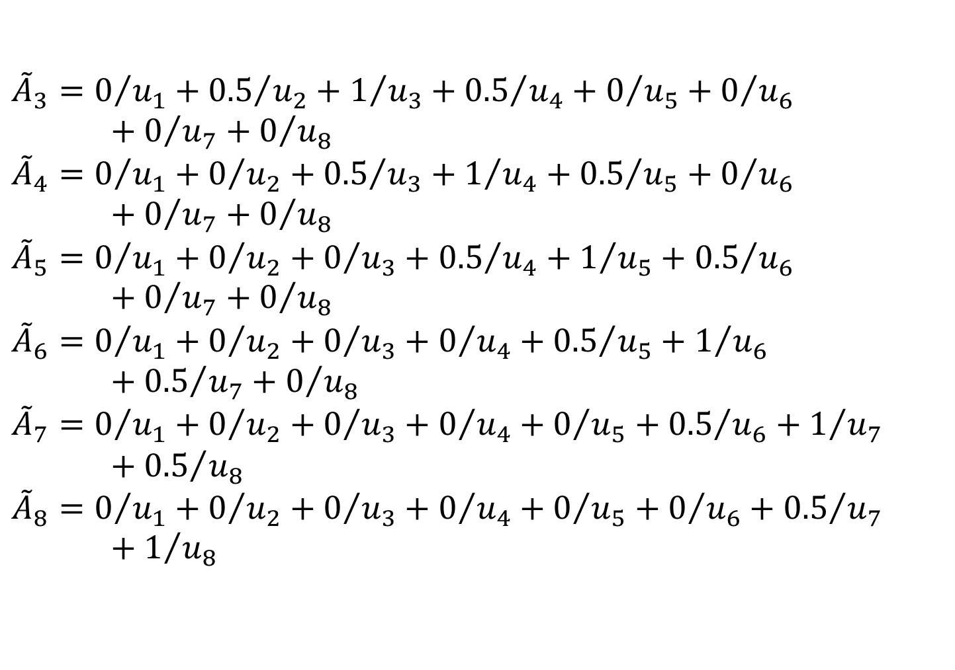
Forecasting market price of SBI’s share at Bombay Stock Exchange (BSE) (3/7)
$${\tilde{A}}_{3}=0/{u_{1}}+{0.5}/{u_{2}}+1/{u_{3}}+{0.5}/{u_{4}}+0/{u_{5}}+0/{u_{6}}+0/{u_{7}}+0/{u_{8}}$$
$${\tilde{A}}_{4}=0/{u_{1}}+0/{u_{2}}+{0.5}/{u_{3}}+1/{u_{4}}+{0.5}/{u_{5}}+0/{u_{6}}+0/{u_{7}}+0/{u_{8}}$$
$${\tilde{A}}_{5}=0/{u_{1}}+0/{u_{2}}+0/{u_{3}}+{0.5}/{u_{4}}+1/{u_{5}}+{0.5}/{u_{6}}+0/{u_{7}}+0/{u_{8}}$$
$${\tilde{A}}_{6}=0/{u_{1}}+0/{u_{2}}+0/{u_{3}}+0/{u_{4}}+{0.5}/{u_{5}}+1/{u_{6}}+{0.5}/{u_{7}}+0/{u_{8}}$$
$${\tilde{A}}_{7}=0/{u_{1}}+0/{u_{2}}+0/{u_{3}}+0/{u_{4}}+0/{u_{5}}+{0.5}/{u_{6}}+1/{u_{7}}+{0.5}/{u_{8}}$$
$${\tilde{A}}_{8}=0/{u_{1}}+0/{u_{2}}+0/{u_{3}}+0/{u_{4}}+0/{u_{5}}+0/{u_{6}}+{0.5}/{u_{7}}+1/{u_{8}}$$

Slide 18
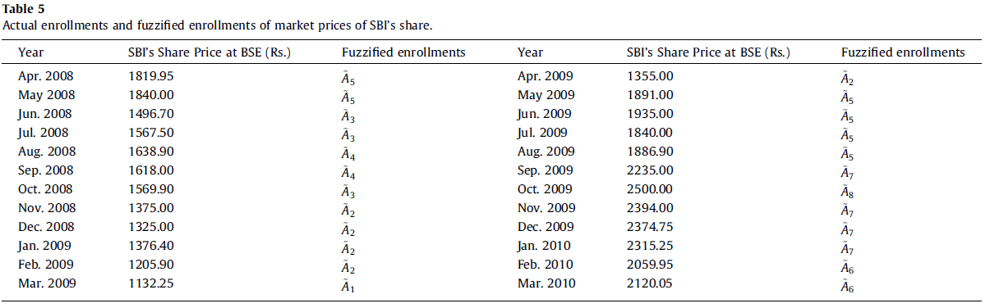
Forecasting market price of SBI’s share at Bombay Stock Exchange (BSE) (4/7)
Step 4: The market prices of SBI’s share at BSE are fuzzified with triangular membership function and are placed in Table 5.

Slide 19
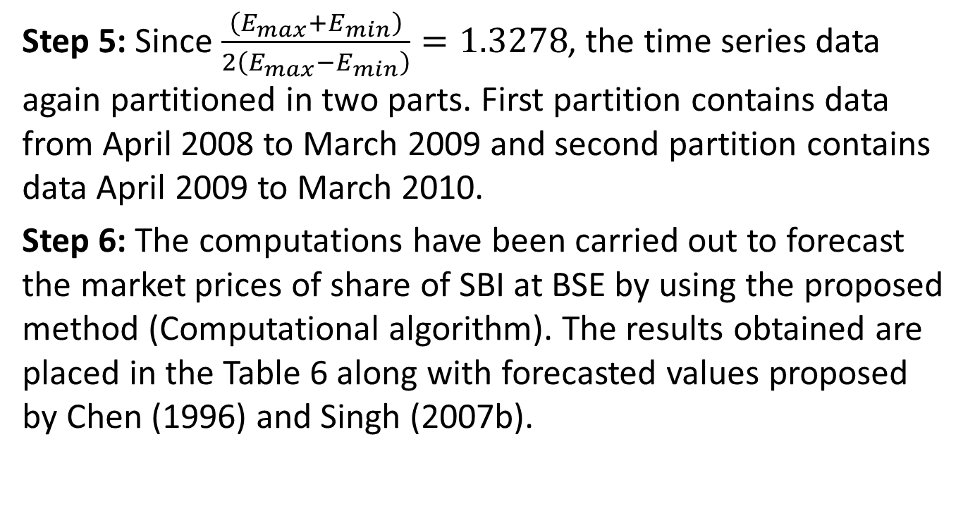
Forecasting market price of SBI’s share at Bombay Stock Exchange (BSE) (5/7)
Step 5: Since $\frac{\left(E_{max}+E_{min}\right)}{2\left(E_{max}−E_{min}\right)}=1.3278$, the time series data again partitioned in two parts. First partition contains data from April 2008 to March 2009 and second partition contains data April 2009 to March 2010.
Step 6: The computations have been carried out to forecast the market prices of share of SBI at BSE by using the proposed method (Computational algorithm). The results obtained are placed in the Table 6 along with forecasted values proposed by Chen (1996) and Singh (2007b).

Slide 20
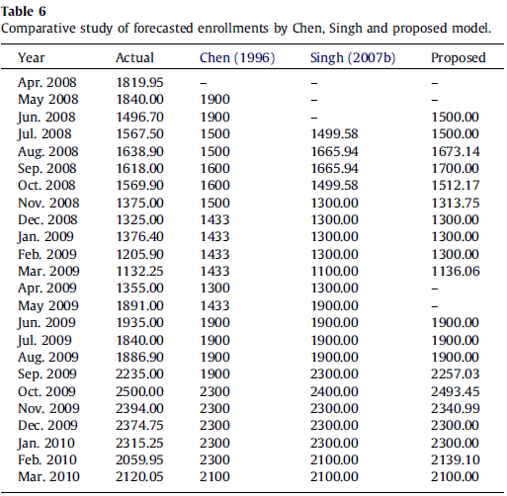
Forecasting market price of SBI’s share at Bombay Stock Exchange (BSE) (6/7)

Slide 21
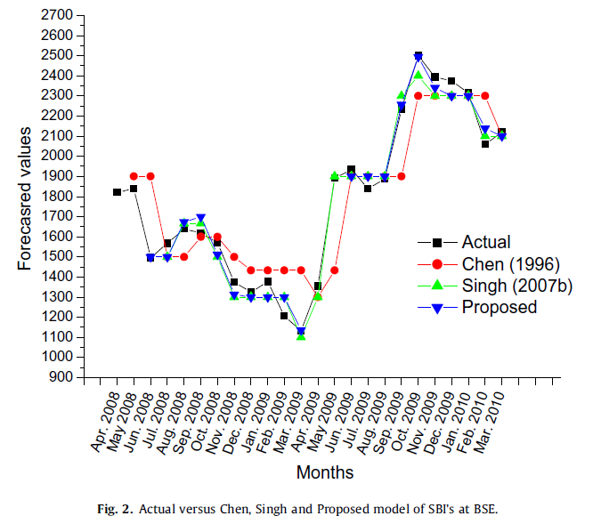
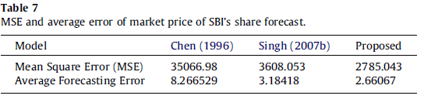
Forecasting market price of SBI’s share at Bombay Stock Exchange (BSE) (7/7)

